Slide 1
B - The Outliers
Software Engineering Project
Context-aware AAC board
Veronika, Jiahui and Thibaut
01
Notes:
Timing: 30 seconds. Introduce B - The Outliers and our selected topic: a context-aware augmentative and alternative communication (AAC) board. Presentation plan: approximately 9 minutes plus 1 minute for questions.

Slide 2
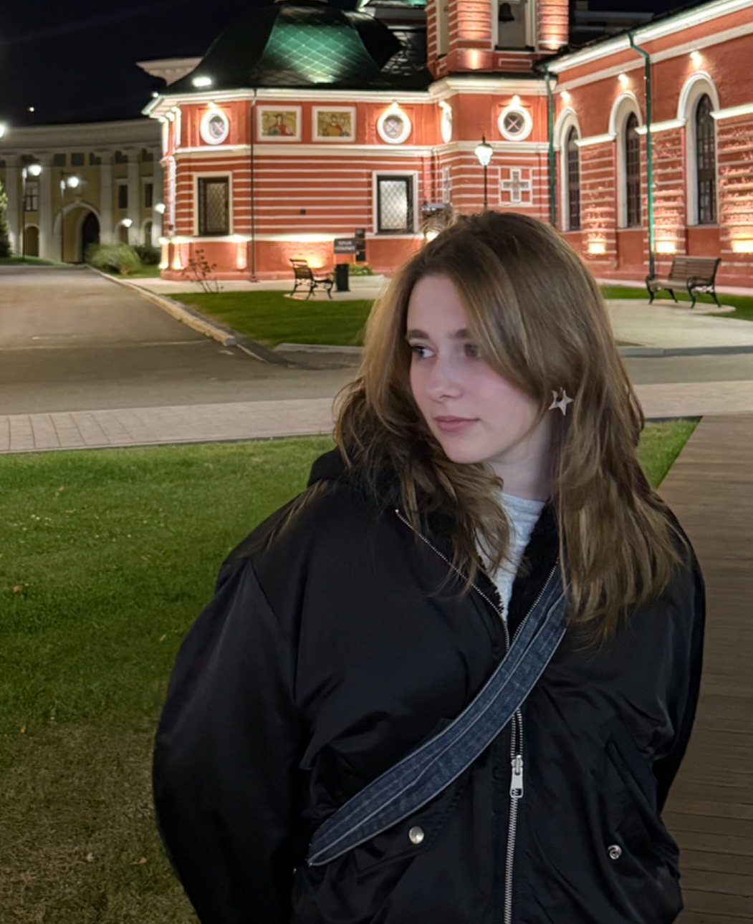
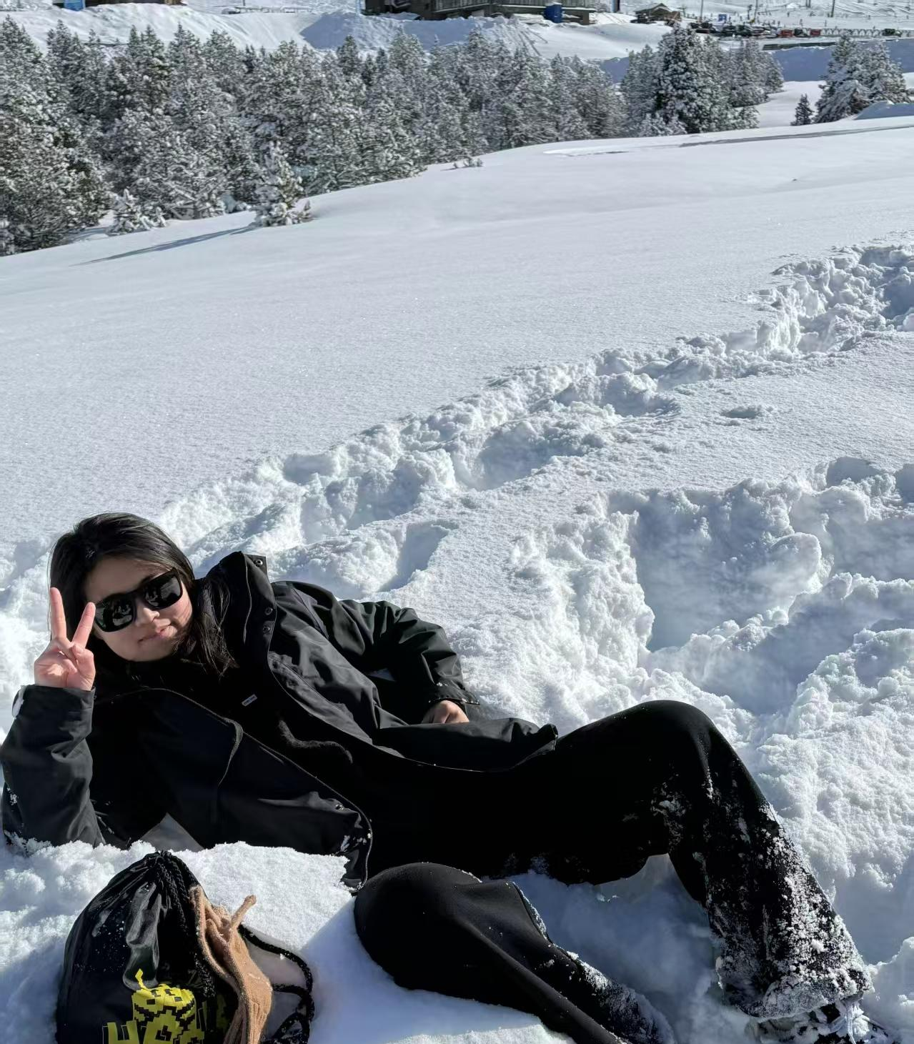
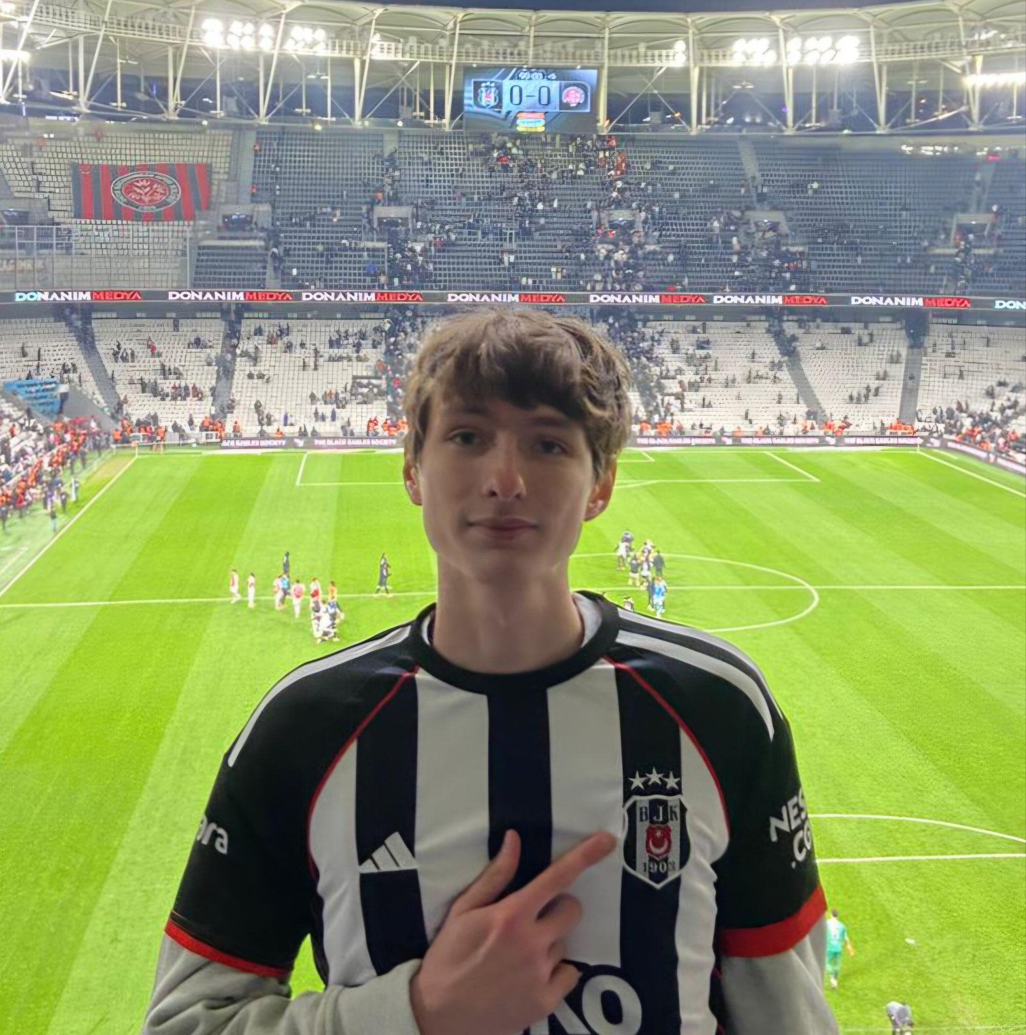
Team composition
Veronika Surianinova
Jiahui Chen
Thibaut de Robien
Artificial Intelligence Engineer
Aerospace Engineering
Mathematical Support and Administration of Information Systems
02

Slide 3
Veronika
EDUCATION & MAJOR
EXPERIENCE & SELECTED WORK
BSc, Information Systems and Technologies
SPbPU
MSc student, Mathematical Support and Administration of Information Systems
SPbPU
Exchange: Computer Science and Engineering, Beihang
Low-code Developer & CRM Administrator
Business workflows, document generation, SQL reports, user permissions and troubleshooting
Selected work: overtime request submission and approval workflow
Professional: C#, Razor, Groovy, PostgreSQL Coursework: Java, Python, Oracle, Flutter/Dart
03
Notes:
Timing: 1 minute. Introduce your education, relevant experience and selected work.
SPbPU: Peter the Great St. Petersburg Polytechnic University. Professional technologies: C#, Razor, Groovy, SQL (PostgreSQL). University coursework: Java, Python, Oracle, Flutter (Dart).

Slide 4
Jiahui
EDUCATION & EXPERIENCE
TECHNOLOGIES & SELECTED WORK
BSc, Artificial Intelligence
FIB, Universitat Politècnica de Catalunya (UPC)
Research Assistant, BSC-CNS
Computational Social Sciences and Humanities
Languages: Catalan, Spanish, English, Chinese
Python, TensorFlow / PyTorch, SQL, C++, MATLAB
VLMs / OCR, vLLM, SLURM, Linux, Docker, Nginx, Git/GitLab
Selected work: OCR / VLM benchmark for Spanish legal documents on MareNostrum 5
04
Notes:
Timing: 1 minute. Introduce your education, relevant experience and selected work.
Curricular internship at Barcelona Supercomputing Center (BSC-CNS). Benchmarked DeepSeek-OCR, GOT-OCR2, Nougat and Qwen2.5-VL-based models on BOE and DOUE legal document transcription. Ran batch inference using SLURM and vLLM on MareNostrum 5. Used OmniDocBench NED and BLEU metrics, statistical analysis and visualizations. Deployed INCEpTION and Argilla with Docker behind Nginx with TLS. Additional technologies: Docker Compose, ROS 1 / Gazebo, LaTeX, RDF, SPARQL, GraphDB.

Slide 5
Thibaut
EDUCATION & EXPERIENCE
TECHNOLOGIES & SELECTED WORK
Master’s student, IPSA Paris
Aerospace Propulsion specialty
Exchange: School of Aeronautics, Beihang
Two-month internship at LATMOS, Paris: BepiColombo / PHEBUS observation analysis
Python (VS Code, Spyder), SQL / MySQL
MATLAB / Simulink, Star-CCM+, FlexPDE, CATIA
Selected work: group design of a 1:10 McLaren MP4/8 Formula 1 model in CATIA
05
Notes:
Timing: 1 minute. Introduce your education, relevant experience and selected work.
LATMOS internship: studied anomalies affecting the EUV and FUV ultraviolet observations on BepiColombo using WebMust and Excel. Compared observations regarding PHEBUS using Notepad++. Prepared a bibliography on gain sag.

Slide 6
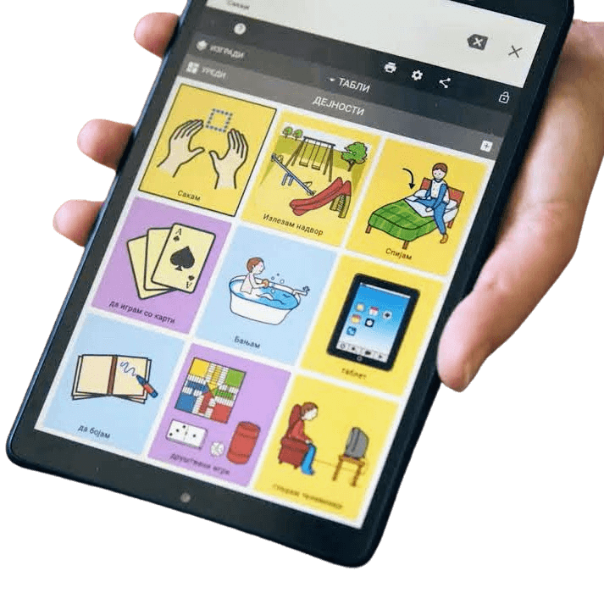
Our project: context-aware AAC
Everyday communication
Extend Cboard with AI to suggest complete English sentences from a scene photo and the user’s selected symbols or text.
WHO IT HELPS
WHY THIS PROJECT
People with speech or language impairments
Non-profit project aiming to reduce the effort of composing everyday requests.
06
Notes:
Timing: 1 minute 15 seconds. AAC means augmentative and alternative communication. We will extend the open-source Cboard communication board. Our goal is to help users compose context-relevant English sentences with fewer selections. This is a benefit we plan to evaluate, not an achieved result. Initial situations include a café, bus travel or a doctor’s visit. Source: https://github.com/cboard-org/cboard

Slide 7
How the application will work
English interface, sentence suggestions and speech output
01 Add context
02 Generate
03 Choose & speak
Photo of the scene
Symbols or text to express the user’s intent.
AI uses the scene and intent to suggest complete English sentences.
Accept a sentence and confirm speech.
Reject to generate new options.
Example: at a café, requesting water: “Could I have a glass of water, please?”
07
Notes:
Timing: 1 minute 15 seconds. Example: the user adds a café photo and selects water. A vision-language model provides scene context, and a language model proposes a complete request. The user confirms the intended message before the app speaks. The photo alone cannot reliably reveal intent. Rejection triggers another generation. The example is illustrative.

Slide 8
Possible technology stack
Layer | Proposed technology | Main responsibility
Frontend | React / JavaScript | Thibaut
Backend + data | Python / FastAPI PostgreSQL, cache | Veronika
AI | VLM / LLM API PyTorch if hosted locally | Jiahui
Deployment | Docker Compose Hosting to be selected | All
Shared tools: GitHub and Google Drive. Model and hosting choices remain open.
08
Notes:
Timing: 1 minute 15 seconds. This is the proposed stack for extending Cboard. React/JavaScript is the existing frontend stack. FastAPI keeps backend and AI integration in Python. PostgreSQL stores user data, accepted phrases and feedback. We will assess whether caching benefits repeated requests. A hosted model API or local inference is still to be selected. pgvector is optional if semantic caching proves useful. Sources: https://github.com/cboard-org/cboard and https://github.com/cboard-org/cboard/blob/master/package.json

Slide 9
Who does what, and why?
Member / role | Main tasks | Relevant background
A / Thibaut Frontend | Design, prototyping and deploying UI interface | Engineering and CATIA: design and prototyping. Python basics.
B / Jiahui AI | Model selection and prompts Sentence quality and evaluation | AI degree and BSC experience with VLMs and benchmarking.
C / Veronika Backend | API, database and deployment | Information systems studies, SQL and CRM workflow development.
All members contribute to requirements, testing and integration.
09
Notes:
Timing: 1 minute. Jiahui has the most direct model and evaluation experience, so those tasks stay together. Veronika’s information systems education, PostgreSQL and CRM work fit data, permissions and backend logic. Experience translating requirements into workflows supports project coordination, without implying prior formal PM expertise. Thibaut’s engineering and CATIA experience support structured design and prototyping. React/Cboard is a learning area, supported by team code review. Jiahui supports Docker and deployment. Veronika supports user flows. All members develop software and contribute to integration and testing.

Slide 10
What we plan to deliver
CORE PRODUCT
FIRST DEVELOPMENT STEPS
A working web application in English
Scene-based sentence suggestions
User confirmation before speech
Mobile version: optional extension
Set up Cboard locally
Connect one complete café scenario
Evaluate sentence quality and response time
Expand to more everyday situations
10
Notes:
Timing: 45 seconds, then approximately 1 minute for questions. Deliver a working web application, source code and project documentation. Focus first on a single end-to-end scenario. Mobile packaging remains optional and depends on feasibility and available time.

Slide 11

THANK YOU FOR YOUR
ATTENTION!
Veronika, Jiahui and Thibaut
01
Notes:
Timing: 30 seconds. Introduce B - The Outliers and our selected topic: a context-aware augmentative and alternative communication (AAC) board. Presentation plan: approximately 9 minutes plus 1 minute for questions.

