Slide 1
B - The Outliers
Software Engineering Project · Weekly Progress Report W06
Context-aware AAC board
Veronika, Jiahui, Thibaut and Abid
01
Notes:
Timing: 15 seconds. Weekly progress report for week 3: technical progress, deliverables (Assignment 1, the SRS) and team management. Total about 10 minutes.

Slide 2
Progress report outline
01
02
03
Technical progress
Experimental progress
Project progress
System development
Deliverables
Team collaboration and management
Requirements, existing foundation and the AI provider: hardware limits and model research
First Gemini probes, completed SRS content and the remaining Assignment 1 work
Roles, responsibilities and the allocation of experimental tasks
≈ 4.5 min
≈ 2.5 min
≈ 2 min
02
Notes:
Timing: 20 seconds. We follow the three-part structure: technical progress, deliverables, and team collaboration and management.

Slide 3
System requirements overview
01 Technical progress · what the system must do
ARCHITECTURE (SRS 2.1)
PRODUCT FUNCTIONS (SRS 2.2)
01
Add context
symbols / intent text, scene hint, optional photo
User
AAC user
Frontend
React, browser
HTTP/JSON
Backend API
FastAPI
02
Generate
up to three complete English sentences
03
Choose & speak
spoken only after explicit confirmation
04
Reject & regenerate
new options, no repeats
Speech output
English voice
Sentence provider
mock now; VLM/LLM later
Database
SQLite / PostgreSQL
05
Keep records
requests, suggestions, feedback
06
Operate
health / readiness, configuration
English only · web first, mobile optional · AI behind one interface
03
Notes:
Timing: 50 seconds. The Context-aware AAC Board is a new standalone web application; Cboard is only inspiration. The user adds context, the backend asks a replaceable sentence provider for up to three complete English sentences, and nothing is spoken until the user confirms. Requests, suggestions and feedback are stored for evaluation.

Slide 4
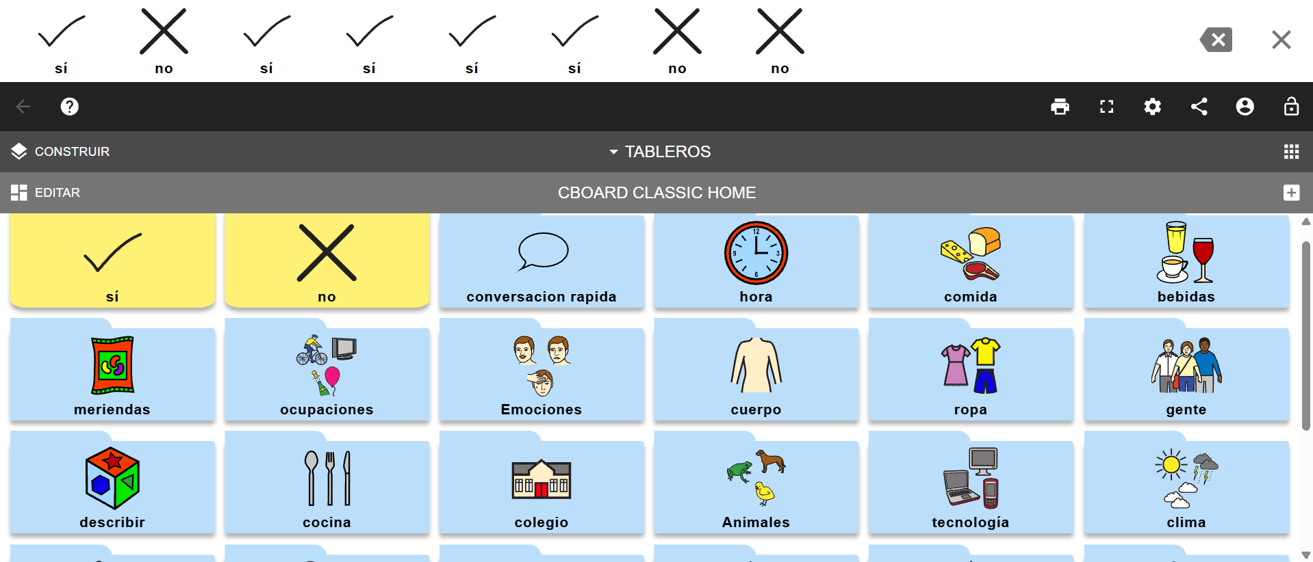
CBOARD: Source of inspiration
Notes:
Timing: 50 seconds. The Context-aware AAC Board is a new standalone web application; Cboard is only inspiration. The user adds context, the backend asks a replaceable sentence provider for up to three complete English sentences, and nothing is spoken until the user confirms. Requests, suggestions and feedback are stored for evaluation.

Slide 5
Existing foundation: backend starter v0.1
01 Technical progress · what already runs
6
26
19 / 45
API endpoints (API v0.1)
automated test cases passed
requirements passed (5 partly)
WHAT WORKS
NOT YET DONE
✓ Input validation: symbols, intent, scene hint
✓ Photo check, resize and metadata removal
✓ Mock suggestions, accept / reject, no repeats
✓ Persistence with Alembic migrations (SQLite)
✓ /health and /ready checks; CI on every push
○ Real AI provider (mock only, not AI)
○ Team web frontend (only a demo test page)
○ Authentication and user ownership
○ Docker Compose deployment and hosting
○ Live PostgreSQL and Windows verification
04
Notes:
Timing: 1 minute 15 seconds. The backend starter v0.1 is the foundation. It already validates input and photos, generates suggestions with a mock provider (fixed water/coffee templates, not AI), records feedback and survives restarts. 26 pytest cases, Ruff and the migration check passed on Linux with SQLite. Not verified yet: live PostgreSQL, Windows, real speech audio and browser click-through. Missing on purpose: real AI, our own frontend, authentication and deployment.

Slide 6
45 requirements in six areas
01 Technical progress · classification and current status (SRS 3 and 4)
19
passed
8
in progress
6
manual check not run
12
not started
Source: SRS 4, Verification table
05
Notes:
Timing: 1 minute 15 seconds. The SRS has 45 requirements with IDs REQ-AREA-NNN, grouped in the six IEEE areas. 19 pass their tests, 5 of them only partly (mock or backend only). 8 are in progress, 6 are implemented in the demo page but the manual check has not been run, and 12 are not started. Most of the open work is in quality of service, design and implementation, and AI/ML.

Slide 7
Assignment 1: SRS completed so far
02 Experimental progress · docs/requirements/SRS.md (IEEE template)
SECTIONS DRAFTED
VERSION HISTORY
✓
1. Introduction
purpose, scope, glossary, references
v0.1
2026-10-13
Initial draft from the proposal slides and backend starter
✓
2. Product overview
context diagram, 9 constraints, 6 assumptions, apportioning
3. Requirements
45 IDs: interfaces, functional, QoS, compliance, design, AI/ML
v0.2
2026-10-13
✓
Standalone product; Cboard only inspiration
✓
4. Verification
method, test link and status for each requirement
Next
by Week 7
✓
5. Appendixes
example scenario, 10 open issues, data model
Close TBDs, peer review, submit SRS
Companion documents: docs/API.md (API v0.1) · docs/VERIFICATION.md · docs/TEAM_NEXT_STEPS.md
06
Notes:
Timing: 1 minute 15 seconds. The SRS follows the IEEE-based template. Version 0.1 was drafted from the proposal and the backend starter; version 0.2 redefined the product as standalone, with Cboard only as inspiration. All five sections are drafted: 45 requirements, each with a verification method and status. Course milestones are recorded in 3.5.8 and the context diagram is in Mermaid so GitHub renders it. Ten decisions are still TBD.

Slide 8
Requirements still to develop
01 Technical progress · grouped by increment (SRS 2.6)
INCREMENT 1
Café scenario
BEFORE PUBLIC TRIAL
Deploy and protect
BEFORE REAL USERS
Consent and licence
INCREMENT 2
More situations
REQ-FUNC-010
web frontend flow
REQ-INT-006
symbol board mapping
REQ-ML-001…006
real provider
REQ-SEC-004
safe display
REQ-SEC-005
authentication
REQ-SEC-006
rate / cost limits
REQ-SEC-003
secrets
REQ-SEC-007
consent, retention
REQ-COMP-001
licences
REQ-FUNC-011
bus, doctor, …
Thibaut · Veronika · Jiahui
Abid Ali
All
All · Thibaut
Also open: 10 TBD decisions in SRS Appendix B (targets, model, hosting, auth method, limits, …)
07
Notes:
Timing: 1 minute 15 seconds. The remaining requirements are grouped by when they are needed. Increment 1 is the cafe scenario in our own frontend with the real AI provider. Security and deployment requirements must be done before any public trial; consent and licensing before real users. Increment 2 adds more everyday situations. The mobile version stays optional.

Slide 9
AI provider: hardware and budget limits
01 Technical progress · where the sentence model can run
7.3 GB
0.92 GB
WHAT THIS RULES OUT
✕
PyTorch / Transformers models
a 2B model in bf16 needs about 4–5 GB for weights
RAM in total
(Ryzen 5 5500U laptop)
RAM free with normal
apps open
✕
Local models of 4B or more
qwen3-vl:4b is 3.3 GB even when quantized
✕
Paid-only APIs
no budget for per-call costs
No CUDA
0 €
integrated Radeon GPU,
512 MB
API budget:
free tiers only
WHAT REMAINS
✓
Hosted vision model on a free tier
main option, nothing loads on the laptop
✓
qwen3-vl:2b (1.9 GB) via Ollama
offline backup only, off by default
Measured on the development laptop, 2026-10-20
08
Notes:
Timing: about 1 minute. Before choosing a model we measured the development laptop. It has 7.3 GB of RAM, but with normal apps open only 0.92 GB is free, and there is no NVIDIA GPU, only integrated Radeon graphics. The API budget is zero. This rules out PyTorch models, which need 4 to 5 GB just for the weights of a 2B model, and any local model of 4B parameters or more. What remains is a hosted vision model on a free tier as the main option, and a very small quantized local model only as an offline backup, switched off by default.

Slide 10
Model research: candidates compared
01 Technical progress · docs/design/AI_Model_Plan.md
Option | Runs on | Free access | Decision
Gemini Flash (Google) | hosted | free tier, rate-limited | Primary · tested this week
GLM-4.6V-Flash (Z.ai) | hosted | free | Backup · reachable from China
qwen3-vl:2b via Ollama | this laptop | free, 1.9 GB | Offline backup, off by default
Groq · Mistral · Alibaba | hosted | unclear or temporary | Reserve only
OpenRouter free models | hosted | 50 requests / day | Rejected: too few requests
GitHub Models | — | retired 2026-07-30 | Rejected: no longer exists
PyTorch local, 4B or more | this laptop | free | Rejected: does not fit in RAM
Design: one call per request · photo at low resolution · lowest thinking level → about 450 tokens per request
09
Notes:
Timing: about 1 minute 15 seconds. We compared the options that accept images and have a free path, using the providers' official pages. Gemini Flash is the main choice: free tier, photo and text in one call, nothing to load locally. GLM-4.6V-Flash from Z.ai is the backup because Gemini is not available from mainland China. The 2B local model stays as an offline backup. Groq, Mistral and Alibaba have unclear or temporary free access, so they are reserve options. OpenRouter allows only 50 free requests a day, GitHub Models was retired in July, and PyTorch or larger local models do not fit in memory. Each request is one call with the photo at low resolution and the lowest thinking level, about 450 tokens in total.

Slide 11
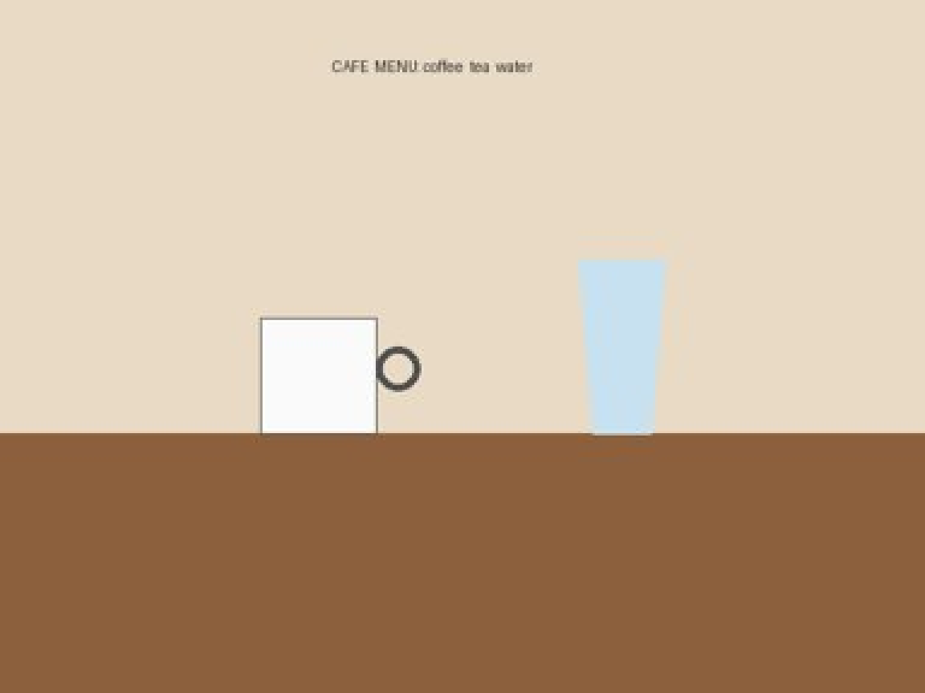
Example request: café photo + “water”
02 Experimental progress · first real call to Gemini 3.5 Flash, 2026-10-21
USER REQUEST
Symbol “water”
+ photo · scene hint “A café”
GEMINI 3.5 FLASH SUGGESTS
1
Water, please.
2
Could I have some water?
3
I would like water.
Drawn café scene (synthetic): the exact 384 × 288 JPEG sent
10.1 s · 412 input tokens (266 image) · 36 output · 0 thinking
10
Notes:
Timing: about 1 minute. This is the first real call to Gemini. The user is in a café, selects the water symbol and adds a photo. For the test we used a drawn, synthetic café scene, never a real photo, because free-tier inputs may be used by Google. The image on the left is exactly what was sent: 384 by 288 pixels. Gemini 3.5 Flash returned three short requests for water. The call took about 10 seconds and used 412 input tokens, 266 of them for the photo, 36 output tokens and no thinking tokens. Nothing is spoken until the user picks one and confirms.

Slide 12
Two more requests and their results
02 Experimental progress · same model and prompt, text only and a negation
REQUEST 1 · TEXT ONLY
REQUEST 2 · NEGATION
“water”
scene hint “A café” · no photo
“coffee” + “I do not want sugar”
scene hint “A café” · same café photo
SUGGESTIONS
SUGGESTIONS
✓ negation kept in all three
1
Water, please.
1
No sugar in my coffee, please.
2
Can I have some water?
2
I would like coffee with no sugar.
3
I would like some water.
3
Please make my coffee without sugar.
15.2 s · 146 input tokens · 37 output · 0 thinking
19.1 s · 418 input tokens (266 image) · 44 output
11
Notes:
Timing: about 1 minute. Two more cases from the same run. Without a photo, the water symbol still gives three polite requests, using 146 input tokens. The negation case matters most for our users: coffee plus the sentence I do not want sugar. All three suggestions keep the negation, so the model did not turn it into a request for sugar. This is the guardrail from REQ-ML-003. These three cases are the first entries of the evaluation set; the full set will add wrong scene hints, ambiguous photos, prompt injection and regeneration.

Slide 13
Gemini probes: what we measured
02 Experimental progress · src/ai/gemini_rate_limit.py, free-tier key, 2026-10-21
404
5 / min
20 / day
NEXT STEPS
1
Check the Flash-Lite quota
20 a day is too few for the evaluation
gemini-2.5-flash is closed to new API keys
free-tier requests per minute
free-tier requests per day: the real bottleneck
2
Add GLM-4.6V-Flash
second free provider, works from China
266
1.4–26 s
1 in 10
3
Connect to the backend
real SentenceProvider, timeouts, daily cap
tokens per photo at low resolution (≈1,120 default)
time per request through our network
requests hit a temporary 503 overload
4
Build the evaluation set
negation, wrong scene, injection, retries
Limits read from the quota names in Google's own 429 answers
12
Notes:
Timing: about 1 minute 15 seconds. We wrote two scripts: one for the example calls and one that measures the rate limits. Google does not send rate-limit headers, so the script sends tiny requests and reads the limits from Google's own 429 answers. Findings: Gemini 2.5 Flash is closed to new keys, so we moved to 3.5 Flash. The free tier allows 5 requests per minute and only 20 per day. A photo costs 266 tokens at low resolution instead of about 1,120. Calls took between 1.4 and 26 seconds through our network, and one request in ten hit a temporary overload. Twenty requests a day is too few for a 30 to 40 case evaluation, so the next step is to check the Flash-Lite quota and add the GLM backup, then connect the provider to the backend.

Slide 14
Remaining Assignment 1 work
02 Experimental progress · SRS due Week 7, split by SRS ownership
Owner | Area | SRS items to close
Thibaut | Frontend | UI design, accessibility standard (REQ-INT-001); symbol mapping (REQ-INT-006)
Veronika | Backend + data | Response-time target (REQ-PERF-001); provider timeout (REQ-REL-002); PostgreSQL check (REQ-PORT-001)
Jiahui | AI | Model choice; evaluation set and quality thresholds (REQ-ML-001…006)
Abid Ali | Deployment | Hosting, authentication method, rate and spending limits, availability target
All | Shared | Consent and retention; repository licence; increment dates; final review
W6 SRS v0.2 drafted
Next Owners close TBDs
Then Cross-team peer review
W7 SRS submitted
13
Notes:
Timing: 1 minute 15 seconds. The remaining SRS work is split by the ownership in SRS 2.6: each owner closes the TBD values and open issues of their own area, and shared items are done by everyone. Before submission in Week 7 we run the cross-team peer review through GitHub Issues. Dates for the individual steps are still to be agreed (open issue 10).

Slide 15
Collaboration and task allocation
03 Project progress · how we work and the first experimental tasks
HOW WE WORK
FIRST EXPERIMENTAL TASKS
1
GitHub
bhsei/26B, work on main
Owner | Task | Done when
Thibaut | Build the symbol board; send the selected tile to the API | "water" tile shows suggestions
Veronika | Connect frontend calls; provider tests for timeout and bad output | Team runs backend from README
Jiahui | Real provider behind SentenceProvider; synthetic café photo test | Photo + intent give evaluated options
Abid Ali | Docker Compose stack; migration on isolated PostgreSQL | Stack starts, /ready is ready
All | First usability scenario and small evaluation set | Agreed and documented
2
Online check ups
online calls to stay connected
3
Reviews
possibility to comment GitHub files
4
Meetings
irl meetings during the week
5
Files
shared Google Drive
14
Notes:
Timing: 1 minute. We work on main in bhsei/26B, one commit per document with the course message format, peer reviews as GitHub Issues, and CI on every push. The first experimental tasks come from TEAM_NEXT_STEPS and are adapted to the standalone frontend: each owner has one small, checkable task, and all of us define the first usability scenario and evaluation set.

Slide 16

THANK YOU FOR YOUR
ATTENTION!
Veronika, Jiahui, Thibaut and Abid
Notes:
Timing: 15 seconds. Thank the audience and take questions.

