Slide 1
B - The Outliers
Software Engineering Project · Weekly Progress Report W07
Context-aware AAC board
Veronika, Jiahui, Thibaut and Abid
01
Notes:
Week 7 progress report of Team B, The Outliers. This week is the SRS peer-review week.

Slide 2
Progress report outline
01
02
03
Technical progress
Experimental progress
Project progress
System development
Deliverables
Team collaboration and management
SRS v0.3 for peer review, backup AI models and reuse of accepted sentences
Rate limits of every Gemini model, live checks of the backup chain and the new frontend pages
Interest-discovery proposal, plan for week 8 and time management
≈ 4.5 min
≈ 3 min
≈ 1.5 min
02
Notes:
Three parts as every week: technical progress with the final SRS, experimental results, and project management.

Slide 3
This week: SRS ready for review, AI backups working
01 Technical progress · what moved forward in week 7
BACKEND
Veronika
FRONTEND
Thibaut
SRS
Abid
AI PROVIDER
Jiahui
Reuse endpoint
Three separate pages
v0.3 review draft
Backups and reuse
•
POST /api/suggestions/reuse
•
Login page
•
48 pages, written in Word
•
Fallback over Gemini models
•
Returns up to 3 accepted sentences
•
Context: place, tiles, photo
•
Owner and status per requirement
•
Reuse of accepted sentences
•
Exact match on symbols, text, scene
•
Suggestions: confirm, reject, stop
•
Diagrams and screenshots
•
Rate limits of 20 models
On her branch · not merged
Local · not pushed
Ready for peer review
57 tests pass · src/ai
03
Notes:
One card per member. The SRS and the AI work are on GitHub or ready; the frontend is still local and the backend reuse endpoint is on Veronika's branch.

Slide 4
SRS v0.3: the version for peer review
01 Technical progress · review draft by Abid, 27 October, based on v0.2
45
48
EVERY REQUIREMENT STATES
✓
Statement what the system shall do
requirements in 16 families, same IDs as v0.2
pages: 5 chapters and appendixes A to G
✓
Acceptance criteria the check that decides pass or fail
✓
Verification method test, demonstration, inspection or analysis
✓
Evidence / status what has been shown so far
7
60
✓
Owner who answers for it (new in v0.3)
figures: WBS, use case, activity, architecture and 3 screenshots
tables, 45 of them one per requirement
STRUCTURE
1 Introduction 2 Product overview 3 Requirements
4 Verification 5 Appendixes: scenario, open decisions, screenshots, architecture, contributions, literature
04
Notes:
Abid turned the Markdown v0.2 into a 48-page Word document following the professor's IEEE template. Same 45 requirement IDs, now with an owner and a status line each, four UML-style diagrams and the frontend screenshots.

Slide 5
SRS v0.3: 45 requirements, who owns them
01 Technical progress · counted from the requirement tables of v0.3
REQUIREMENTS PER FAMILY
OWNER
VERIFIED BY
FUNC
Functional
11
14
Veronika
14
Test
8
Abid and Veronika
11
Demonstration
SEC
Security
7
8
Thibaut (4 with the team)
7
Test + inspection
INT
Interfaces
6
7
Jiahui
6
Inspection
4
Abid
6
Analysis + demo
ML
AI / ML
6
4
All / team
1
Analysis
REL
Reliability
3
Owners split as in SRS 2.6
Thibaut: frontend and symbols · Veronika: backend and data · Jiahui: AI provider and evaluation · Abid: CI, deployment and security · All: reviews, consent, licences
COMP
Compliance
2
10 more
1 requirement each
10
PERF, AVAIL, OBS, INST, BUILD, DIST, MAINT, PORT, POC, CM
05
Notes:
Functional requirements are the largest family. Each requirement has one owner or a shared owner; Veronika owns most because the backend carries most of the tested behaviour.

Slide 6
SRS v0.3: the rules that shape the product
01 Technical progress · six requirements every part of the system follows
1
REQ-ML-003
2
REQ-FUNC-007
3
REQ-FUNC-006
Explicit intent
Confirmed speech
Reject and regenerate
Sentences follow the user's symbols or text, never the photo alone.
Nothing is spoken before the user selects and confirms; speech can be stopped.
New suggestions never repeat earlier ones in the same chain.
4
REQ-SEC-001
5
REQ-ML-004
6
REQ-SEC-005
Photo minimisation
No deception
Ownership
Resized to 1024 px, re-encoded without EXIF, raw photo never stored.
Mock mode and the image-analysed flag are shown truthfully.
Before any public trial, each user sees only their own records.
06
Notes:
These six requirements protect the user: the person decides what is said, nothing is spoken without confirmation, photos are minimised and the app never pretends to understand more than it does.

Slide 7
SRS v0.3: verification status and open decisions
01 Technical progress · SRS chapter 4 and appendix B
19
8
OPEN DECISIONS (APPENDIX B)
1
Accessibility target, keyboard and touch
passed (5 of them partly)
in progress
2
Symbol and icon licence
3
Real AI provider and evaluation set
4
Latency and timeout thresholds
6
12
5
Hosting and availability target
6
Login: authentication and ownership
demonstrations not yet run
not started
7
Rate and cost budgets
8
Consent, retention and deletion
9
Speech on browsers and devices
Of 45 requirements · week 6 snapshot in chapter 4, not a new test run
10
Scenario milestones and owners
07
Notes:
The counts are the week 6 snapshot written into chapter 4, not a new test run. Appendix B lists ten decisions the team still has to close; peer reviewers will probably ask about them.

Slide 8
SRS: what changed from v0.2 to v0.3
01 Technical progress · Abid's draft compared with docs/requirements/SRS.md
ADDED IN v0.3
TO RECONCILE AFTER THE REVIEW
✓
Owner and status for every requirement
!
Exact limits 20 symbols, 500 characters, 5 MiB and status codes became general wording
✓
Four diagrams WBS, use case, activity, architecture
!
REQ-FUNC-004 "no suggestions" case replaced by request identity
✓
Frontend screenshots login, context and suggestion pages
!
REQ-ML-003 negation rule no longer in the statement
✓
Team contributions evidence per member (appendix E)
!
REQ-ML-004 prompt-injection rule replaced by non-deception
✓
Research basis 4 papers on AAC and AI (appendix F)
!
Traceability per-test table of v0.2 now per family only
✓
Reuse endpoint documented in appendix E.3
!
Rationale same sentence on all 45 requirements
08
Notes:
Left: what v0.3 adds. Right: points where v0.3 is less precise than v0.2; we will fix them together with the peer-review comments, so the final version keeps both.

Slide 9
AI provider: backups when a quota runs out
01 Technical progress · src/ai/chain.py and providers.py, 57 offline tests
Request symbols · intention · scene · optional photo
RULES
↓
1
Daily cap
16 calls per model, 80 % of the measured 20
Reuse accepted before? → shown with no AI call
↓
2
429 answer
no retry: wait Google's delay or the next quota day, use the next model at once
1
gemini-3.5-flash-lite
own quota
2
gemini-3.1-flash-lite
own quota
3
3 failures in a row
model paused for 5 minutes
3
gemini-3.5-flash
5 / min · 20 / day
4
gemini-3.8-flash
20 / day
4
Shared counts
ai_data/usage.json, so separate runs agree
5
ollama · qwen3-vl:2b
local · next week
5
Prompt fix
"up to three" gave 1 sentence on Flash-Lite; now asks for three
↓
All failed → 503 "try again later", never a mock answer
09
Notes:
A request first checks whether the same request was accepted before. If not, the chain tries the providers in order. Each Gemini model has its own free quota, so four models on one key give several times the 20 calls a day. Ollama is the offline backup and comes next week.

Slide 10
Reuse and RAG: accepted sentences first
01 Technical progress · src/ai/retrieval.py, word overlap, no embeddings
HOW A PAST SENTENCE IS SCORED
LIVE CHECK, 28 OCTOBER
Field | Weight | Comparison
Symbols | 0.5 | same set, any order or case
Words | 0.3 | overlap of symbol and intention words
Scene | 0.2 | overlap of scene-hint words
1
Café + water + photo
Gemini 3.5 Flash-Lite, 4.3 s → sentence accepted
2
Same request, text only
reused from the store: 0 AI calls
3
Bus + water
score 0.8: not reused, sent as an example; 1.7 s, 182 tokens
≥ 0.9
≥ 0.4
reuse: shown with no AI call (text-only requests)
up to 3 sentences sent as examples in the prompt
4
Ollama first (not running)
"cannot connect" → 3.1 Flash-Lite answered in 6.2 s
Negation: "no sugar" never matches "sugar"
Next: move this scoring into the backend reuse service
10
Notes:
Before calling a model we score the request against sentences the person accepted before. A near-identical request is answered without any AI call; similar ones give the model up to three examples of the person's wording. Veronika's endpoint only finds exact matches; next we move this scoring into her service.

Slide 11
Rate limits of every Gemini model we can call
02 Experimental progress · survey of 20 models, free-tier key, 28 October
Model | What happened | Limit in Google's 429 | Quota counted as
gemini-3.5-flash-lite | 15 of 15 OK · 1.0 s median | none reached | —
gemini-3.1-flash-lite (+ preview) | 15 of 15 OK · 3.7–4.0 s | none reached | —
gemini-flash-lite-latest | 15 of 15 OK · 0.9 s | none reached | —
gemma-4-26b-a4b-it | 15 OK · 1.1 s, then 429 | 30 / min | gemma-4-26b
gemini-3.5-flash, 3.6-flash | 429 per minute | 5 / min · 20 / day | gemini-3.6-flash
gemini-3.8-flash, 3.7-flash, flash-latest | 503 and timeouts, then 429 | 20 / day | gemini-3.8-flash
gemini-3-flash-preview | 429 per minute | 5 / min | gemini-3-flash
gemma-4-31b-it | HTTP 500 internal error | — | —
Pro, Omni and gemini-4-argon | 429 at the first call, retry in 22.8 h | no free quota | —
gemini-2.5 (flash, flash-lite, pro) | 404: closed to new keys | — | —
Highlighted: usable in the chain. Limits are read from the quota names in Google's 429 answers. Tool: src/ai/gemini_rate_limit.py survey
11
Notes:
We sent a burst of up to 15 tiny requests to each model, 35 for Gemma, and read the limit from Google's 429 answer. Highlighted rows are usable for the chain. A second copy of the survey ran at the same time by mistake, so request counts are higher than one run; the limits come from Google's answers and are not affected.

Slide 12
Gemini survey: what it changes for the chain
02 Experimental progress · src/ai/README.md, survey of 28 October
≥15/min
30/min
3 → 1
NEXT STEPS
1
Flash-Lite models first
drop names that share a quota (3.6, 3.7, latest)
Flash-Lite models: no 429 in a 15-call burst
Gemma 4 26B, the highest limit we saw
names share one quota: 3.7, 3.8 Flash and flash-latest
2
Try Gemma 4 26B
30 per minute; check photo support first
0
404
0.9–1.1 s
3
Find the Flash-Lite daily limit
paced run over one day
free calls on Pro, Omni and gemini-4-argon
all 2.5 models are closed to new keys
median latency of the fastest models
4
Ollama offline backup
install and measure next week
12
Notes:
Flash-Lite models never returned a 429 in the burst, so they go first. Several model names share one quota, so listing them twice gains nothing. Gemma 4 26B allows 30 calls a minute and is the next candidate. Pro models have no free quota at all.

Slide 13
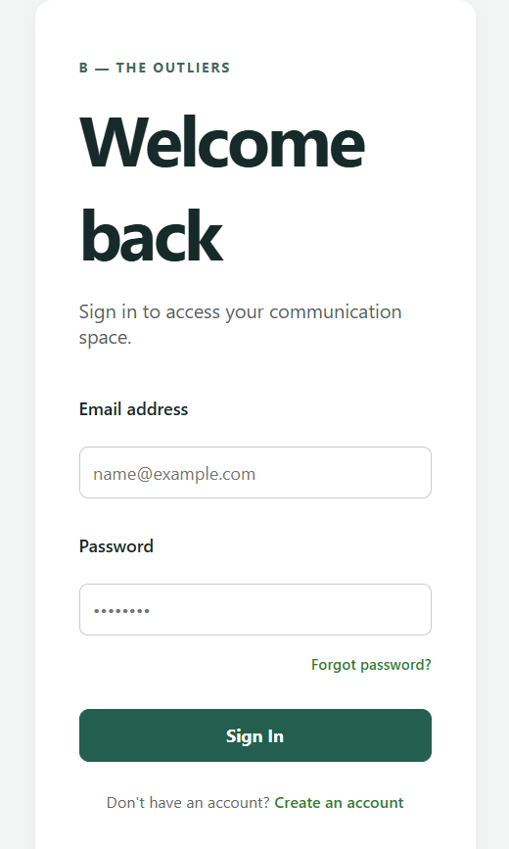
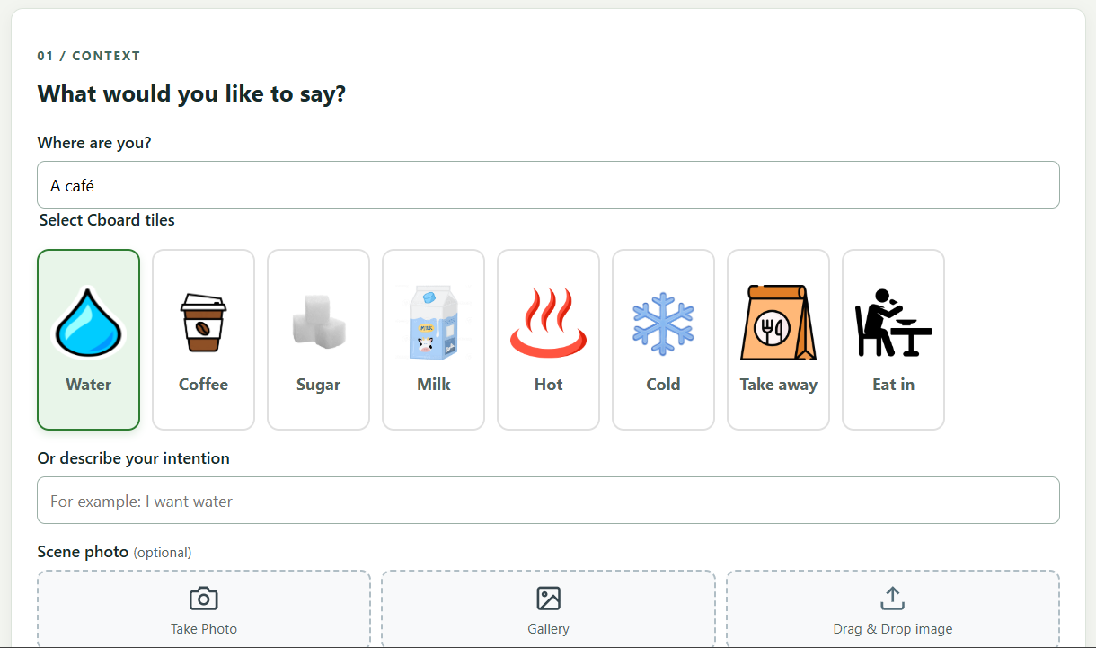
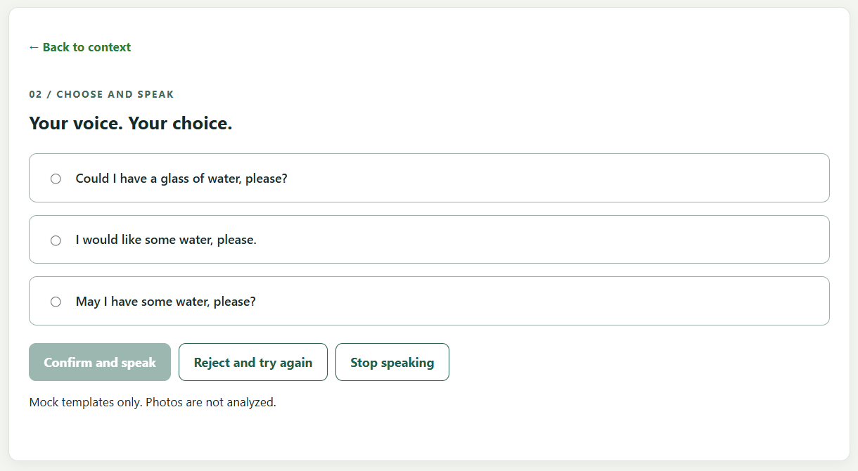
Interface: login, context and suggestions
02 Experimental progress · Thibaut, local version, not on GitHub yet
Context page
place, café tiles, intention text, photo by camera, gallery or drag and drop
Suggestions page
three choices, confirm and speak, reject and try again, stop speaking
Login page
email and password, create account
13
Notes:
Thibaut split the flow into separate pages. The login page is interface only: real authentication is still REQ-SEC-005. The suggestion page shows the mock notice, as REQ-ML-004 asks.

Slide 14
Proposal: discover what the user likes
03 Project progress · docs/design/Interest_Discovery_Proposal.md, for team decision
OPEN CHOICE
photo, no wish given
ALTERNATIVE
clear wish given
PREFERENCE PROFILE
learned from picks
•
3–4 options from the scene: Water? Juice?
•
Faithful sentences first
•
Liked items move up next time
•
Options are buttons, not sentences
•
At most one, labelled "Something else?"
•
One slot always for something new
•
The pick becomes the intention
•
Never after a negation or allergy
•
Needs user accounts and consent
Safer first step
Off by default
Later: REQ-SEC-005/007
Decision needed: do we add it, and if so only open choice or also alternatives? It changes REQ-ML-003 in the SRS.
14
Notes:
Idea: an empty cup in a café; the user wanted water but the app also offers juice and the user likes it. This conflicts with REQ-ML-003, so it needs a team decision. The safe first step is open choice: options, not sentences, and nothing is spoken until the user picks.

Slide 15
Next week: plan
03 Project progress · week 8, owners as in the README
Task | Owner | Goal
Peer review of the SRS | All | One Issue per document, one comment per finding; answer every comment
SRS v0.3.1 | Abid | Apply the review comments and restore the exact limits of v0.2
Merge the backend refactor | Veronika | Fix the review findings, merge to main, similarity in the reuse service
Local backup model | Jiahui | Install Ollama, smallest model that fits in RAM, measure it
AI chain in the backend | Jiahui | SentenceProvider with the backup chain, after the merge
Push and connect the frontend | Thibaut | Pages on GitHub, calls to the real API
Interest-discovery decision | All | Yes or no, and which mode first
Why the merge matters: the AI chain and the frontend both need the new backend structure
15
Notes:
Peer review first: answer the comments on our SRS and review the other team's. Then the integration work: merge the backend refactor, connect the AI chain and the frontend.

Slide 16
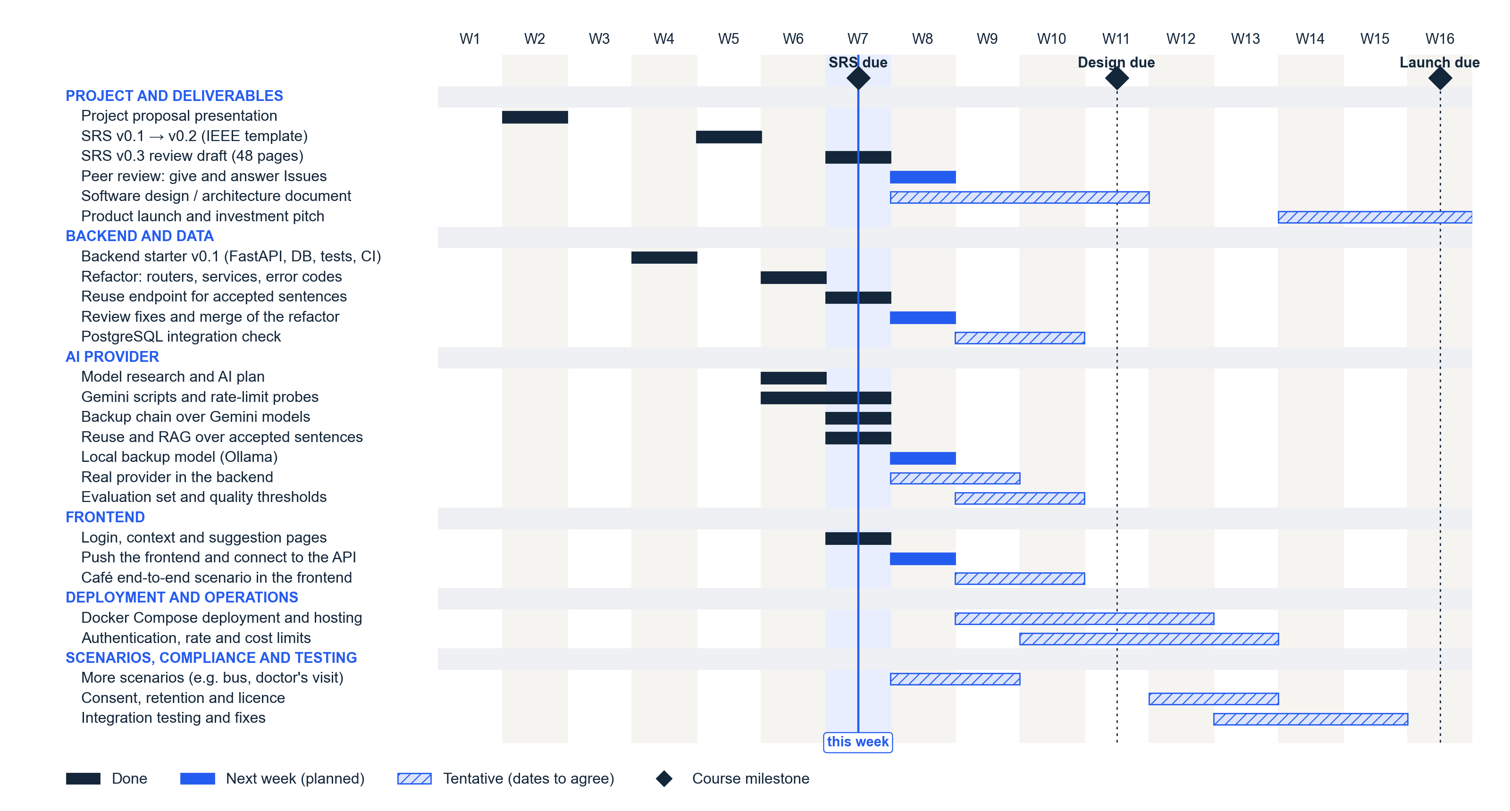
Time management
Notes:
Dark bars are done, blue bars are next week, hatched bars are tentative. The SRS milestone is this week; the design document starts next week.

Slide 17

THANK YOU FOR YOUR
ATTENTION!
Veronika, Jiahui, Thibaut and Abid
Notes:
Thank you. Questions?

