Slide 1
B - The Outliers
Software Engineering Project · Weekly Progress Report W09
Context-aware AAC board
Veronika, Jiahui, Thibaut and Abid
01
Notes:
Week 9 progress report of Team B, The Outliers. This week we started on the changes promised in the SRS peer review and began the software architecture document.

Slide 2
Progress report outline
01
02
03
Technical progress
Experimental progress
Project progress
System development
Deliverables
Team collaboration and management
Changes after the SRS peer review: speak-first design, backend and frontend fixes, and the first version of the SAD
AI evaluation: blind rating page and the first automatic checks
Plan for week 10, open risks and time management
≈ 6 min
≈ 3 min
≈ 1.5 min
02
Notes:
Same three parts as every week. Technical progress is the follow-up of the peer review and the first version of the SAD; experimental progress is the AI evaluation.

Slide 3
This week: review fixes started, SAD v0.1 written
01 Technical progress · what moved forward in week 9
BACKEND
Veronika
FRONTEND
Thibaut
AI PROVIDER
Jiahui
SAD
All four · editor Jiahui
Database fixes
Pages on GitHub
Evaluation and deadline
Version 0.1
•
Connection released before the AI call
•
Login at /, context page at /app
•
Blind rating page for the raters
•
6 views, 25 diagrams
•
Feedback write made atomic
•
Tiles per place: 5 places, 30 symbols
•
7 model setups on 37 core cases
•
49 of 49 requirements mapped
•
New test: two equal accepts at once
•
Help window
•
One 20 s deadline per request
•
26 gaps and 14 decisions listed
Branch · 79 tests pass
On main · CI fails
Local · not committed
Local · team review next
03
Notes:
One card per area. Veronika's fixes are on her branch, Thibaut's pages are on main, the AI work is still local, and the first version of the SAD is written, with a section owner for each part.

Slide 4
Review findings: where each topic stands
01 Technical progress · 23 findings of Issues #2 and #3, all accepted on 3 November
Topic | Findings | Done this week | Still to do | State
Speech vs saving | A11 | Design: speak first, save in the background | Change app.js; "Spoken, but not saved" and retry | Design
Timing contract | A5 A9 F4 | 20 s for all model attempts, at most 10 s each, 503 at the deadline | Connect to the backend; numbers into the SRS | Local
No AI available | A6 F5 | 503 PROVIDER_UNAVAILABLE without model names | Typed sentence spoken, labelled "not AI" | Local
AI quality | A7 F1 | 80 cases and plan on main; rating page; 7 setups run | Two raters and a third; metrics M1–M5 | Local
Reuse rule | A1 F7 | Backend keeps the exact match; no similarity in the backend path | Rewrite REQ-ML-008 in v1.0 | Main
Symbols | A8 F7 | Fixed tiles per place in the frontend (30 labels) | Vocabulary table in the SRS; backend accepts any label | Main
SRS text | 13 more | Reply posted for each finding (23 of 23) | Write SRS v1.0; main still has v0.5 (29 Oct) | Planned
13 more: A2 A3 A4 A10 A12 A13 A14 A15 F2 F3 F6 F8 — statuses, accounts, data protection, prose rules, WCAG, schedule, API criteria, priorities. State: Design = agreed, not coded; Local = code on our machine; Main = on GitHub main.
04
Notes:
This is where each review topic stands today. Three topics moved in the design or the code this week: speaking before saving, the AI deadline and the AI evaluation. Most other findings are changes to the SRS text, and the SRS on main is still v0.5, so they are next week's work.

Slide 5
Architecture change: speak first, then save
01 Technical progress · Team A finding 11, new REQ-FUNC-013
BEFORE · CODE ON MAIN TODAY
WHAT CHANGES IN EACH PART
Confirm
Save choice
PUT /feedback
Speak
1
Frontend (app.js) speak on confirm; the save no longer blocks the voice
2
Backend PUT /feedback same contract; a retry is safe, the write is atomic on refactor-backend
! Save fails: nothing is spoken, the user has no voice
3
Error state visible notice with retry, as promised in our reply to A11
AFTER · NEW DESIGN
Confirm
Speak at once
Save in background
PUT /feedback
SRS and SAD new REQ-FUNC-013; Figure 3 and the request flow redrawn
4
Save fails: "Spoken, but not saved" and a retry button
Status: design agreed, code next week
05
Notes:
This is the architecture change of the week, from Team A's finding 11. Until now the page saved the accepted sentence first and only then spoke it, so a failed save left the user silent. We changed the design: the sentence is spoken at once and saved in the background; if the save fails, the user sees 'Spoken, but not saved' and can retry. This is a design decision; the code on main still saves first and is changed next week.

Slide 6
Backend: database released before the AI call
01 Technical progress · refactor-backend by Veronika, 11 November
WHAT CHANGED
OPEN POINTS FROM OUR WEEK 7 REVIEW
2
79 / 79
✓
Session open during the AI call fixed: closed before the provider call
commits on refactor-backend, 11 Nov
tests pass, Ruff clean (rerun by us)
✓
Feedback write insert-or-update in one statement (SQLite and PostgreSQL)
!
API.md misses the reuse endpoint still v0.1 (28 Oct)
1
0
!
Merge into main after the API routes are restored on main
new test: two equal accepts at once give one row
conflicts when merged with today's main
!
Commit format 4 commits this week without "W9 - summary; description"
Not merged yet: main fails CI since the frontend push
06
Notes:
Veronika fixed the most important open point from our week 7 review: the database connection stayed open while the AI model was answering. Now the history is read, the connection is closed, the provider is called, and a new session stores the result. The feedback write is now one insert-or-update statement, with a test where two identical accepts arrive at the same time. We reran the branch: 79 tests pass and Ruff is clean, and it merges with today's main without conflicts. It is not merged yet.

Slide 7
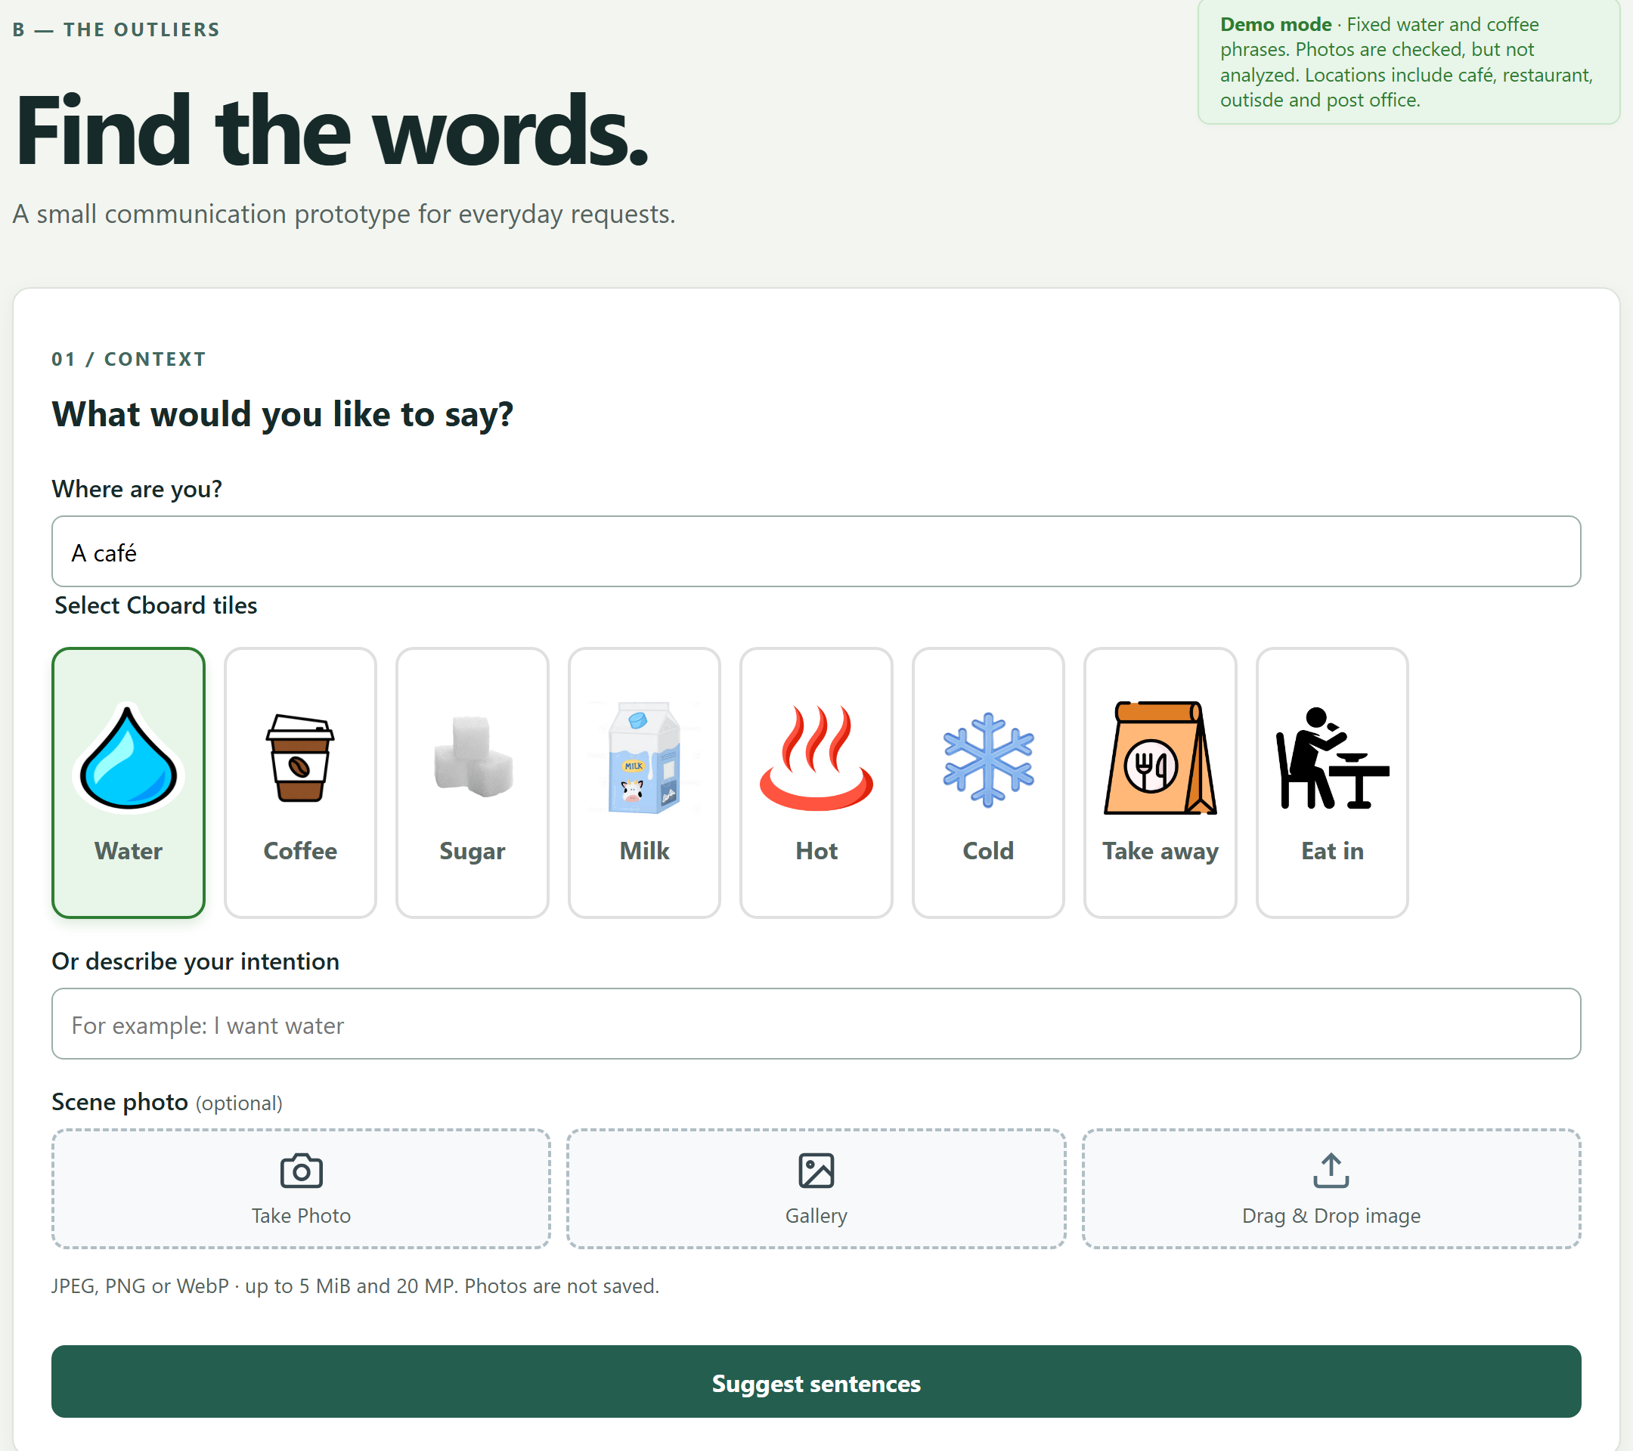
Frontend on GitHub: tiles follow the place
01 Technical progress · Thibaut, pushed 11 November · app/static
TILES PER PLACE · 30 SYMBOLS
Place | Symbols
Café | Water, Coffee, Sugar, Milk, Hot, Cold, Take away, Eat in
Restaurant | Order, Bill, Pay, Menus, Reservation, Drinks, Main courses
Outside | Subway station, Bus stop, Police station, Information center, City center, Hospital
Post office | Parcel, Letter, Retrieve, Deliver
Clothes shop | Item, Size +, Size -, Pricetag, Color
Place found by keywords in "Where are you?"; Help tile opens a help window; login is interface only (REQ-SEC-005)
CI fails on main: main.py rewritten, API routers dropped; reuse endpoint 404, error_code missing, 56 of 434 tests fail
07
Notes:
Thibaut pushed the pages to GitHub. The login page is at the root and the context page at /app. The tiles now depend on the place typed in 'Where are you?': five places with 30 picture symbols, plus a help tile. The login is still interface only. One problem: the push rewrote app/main.py and dropped the API routers, so the reuse endpoint returns 404 and the error codes are missing; 56 tests fail on main. This is the first task for next week.

Slide 8
SAD v0.1: what we have filled in
01 Technical progress · docs/design/SAD.md, SEI Views and Beyond template, 11 November
ALL TEMPLATE CHAPTERS FILLED
SIX VIEWS · CHAPTER 3
6
25
1
Module decomposition which code unit does what: backend, AI package, web client
views, each with view packets, element catalog and context
diagrams in Mermaid, rendered by GitHub
2
Uses and layers routers → services → providers; who may call whom
3
Data model three tables, plus the AI usage and evaluation files
11
49 / 49
4
Component and connector request, regeneration, speech, fallback, failures
quality attribute scenarios: intent safety, quota, privacy…
SRS requirements mapped to elements (Table 7)
Deployment local today, Docker Compose planned, CI on GitHub
5
6
Work assignment folders and files per team member
Also: 16 approaches with rejected alternatives, error codes, configuration, glossary
08
Notes:
The first version of the Software Architecture Document is written, in Markdown in docs/design/SAD.md, following the SEI Views and Beyond template of the course. Every template chapter and the three appendices are filled. It has six views with 25 Mermaid diagrams, eleven quality attribute scenarios, sixteen architectural approaches with the alternatives we rejected, and a table that maps all 49 SRS requirements to architectural elements. It describes the code on 11 November, with the backend as it will be after Veronika's branch is merged. Each of us owns the sections of their area.

Slide 9
SAD: the architecture in one picture
01 Technical progress · runtime view (SAD Figure 11, simplified); dashed = prototype or planned
BROWSER
BACKEND · FASTAPI
KEY APPROACHES · TABLE 6
Login page
/ (interface only)
Page routes
/, /app, /static
1
Layered backend thin routers, testable services
Context and suggestions
index.html, app.js
Routers
suggestions · feedback · reuse · health
2
Ports and adapters the model changes, the API does not
Services
rules, validation, image cleaning
Database
SQLite now · PostgreSQL planned
3
Chain with breaker cooldown on 429, cap, one deadline
Web Speech API
only after confirm
SentenceProvider
Mock now · Chain prototype
4
No silent fallback all models fail: 503, never a template
ProviderChain
20 s deadline, backups
Hosted models
Gemini; other vendors
5
Atomic feedback safe retry for speak-then-save
09
Notes:
This is the runtime view of the SAD, Figure 11, simplified. The browser pages call the FastAPI backend over HTTP. Inside, routers are thin, services hold the rules, and the sentence provider sits behind one interface: the mock today, the chain of hosted models as a prototype. Dashed boxes are prototype or planned. On the right are the approaches that shape it; the last one, the atomic feedback write, is what makes our new speak-then-save order safe to retry.

Slide 10
SAD: what is left to do for v1.0
01 Technical progress · SAD 4.3 and Appendix A; v1.0 due in week 12
26
14
DECISIONS DUE IN WEEK 10
D-01
Client technology: plain pages or React
Thibaut
known gaps between code and documents (SAD 4.3)
open decisions, 9 of them due in week 10 (Appendix A)
D-02
Timing: 20 s deadline, 10 s per attempt
Jiahui, Veronika
D-03
Model order and pass thresholds
Jiahui
49 REQUIREMENTS IN THE SAD (TABLE 7)
D-04
Reuse in the flow and how it is recorded
Veronika, Jiahui, Thibaut
D-05
Hosting and availability target
Abid
29
10
4
3
3
D-06
Accounts and ownership
Abid, Veronika
Built 29 (2 only for the mock) Partly 10 Prototype 4 Planned 3 Not started or not checked 3
D-09
Interest discovery: adopt or not
All
D-10
One symbol vocabulary for client, tests, SRS
Thibaut, Jiahui
Gaps by owner: Thibaut 13 · Jiahui 10 · Veronika 8 · Abid 2 · all 2 (some shared). Example: the SRS still says React; the client is plain HTML, CSS and JavaScript.
D-11
Accessibility target (WCAG 2.1 AA)
Thibaut
Next: team review of v0.1, each owner for their sections
10
Notes:
What is left before version 1.0 in week 12. Section 4.3 lists 26 places where the code and the documents disagree today, each with an owner; for example the SRS still describes a React frontend, and the chain cannot be switched on by configuration yet. Appendix A lists 14 open decisions; nine of them are due next week. The requirements table shows where the architecture stands: 29 of 49 requirements are built, the rest are partly built, prototype, planned or not started. Next the team reviews v0.1, each owner for their sections.

Slide 11
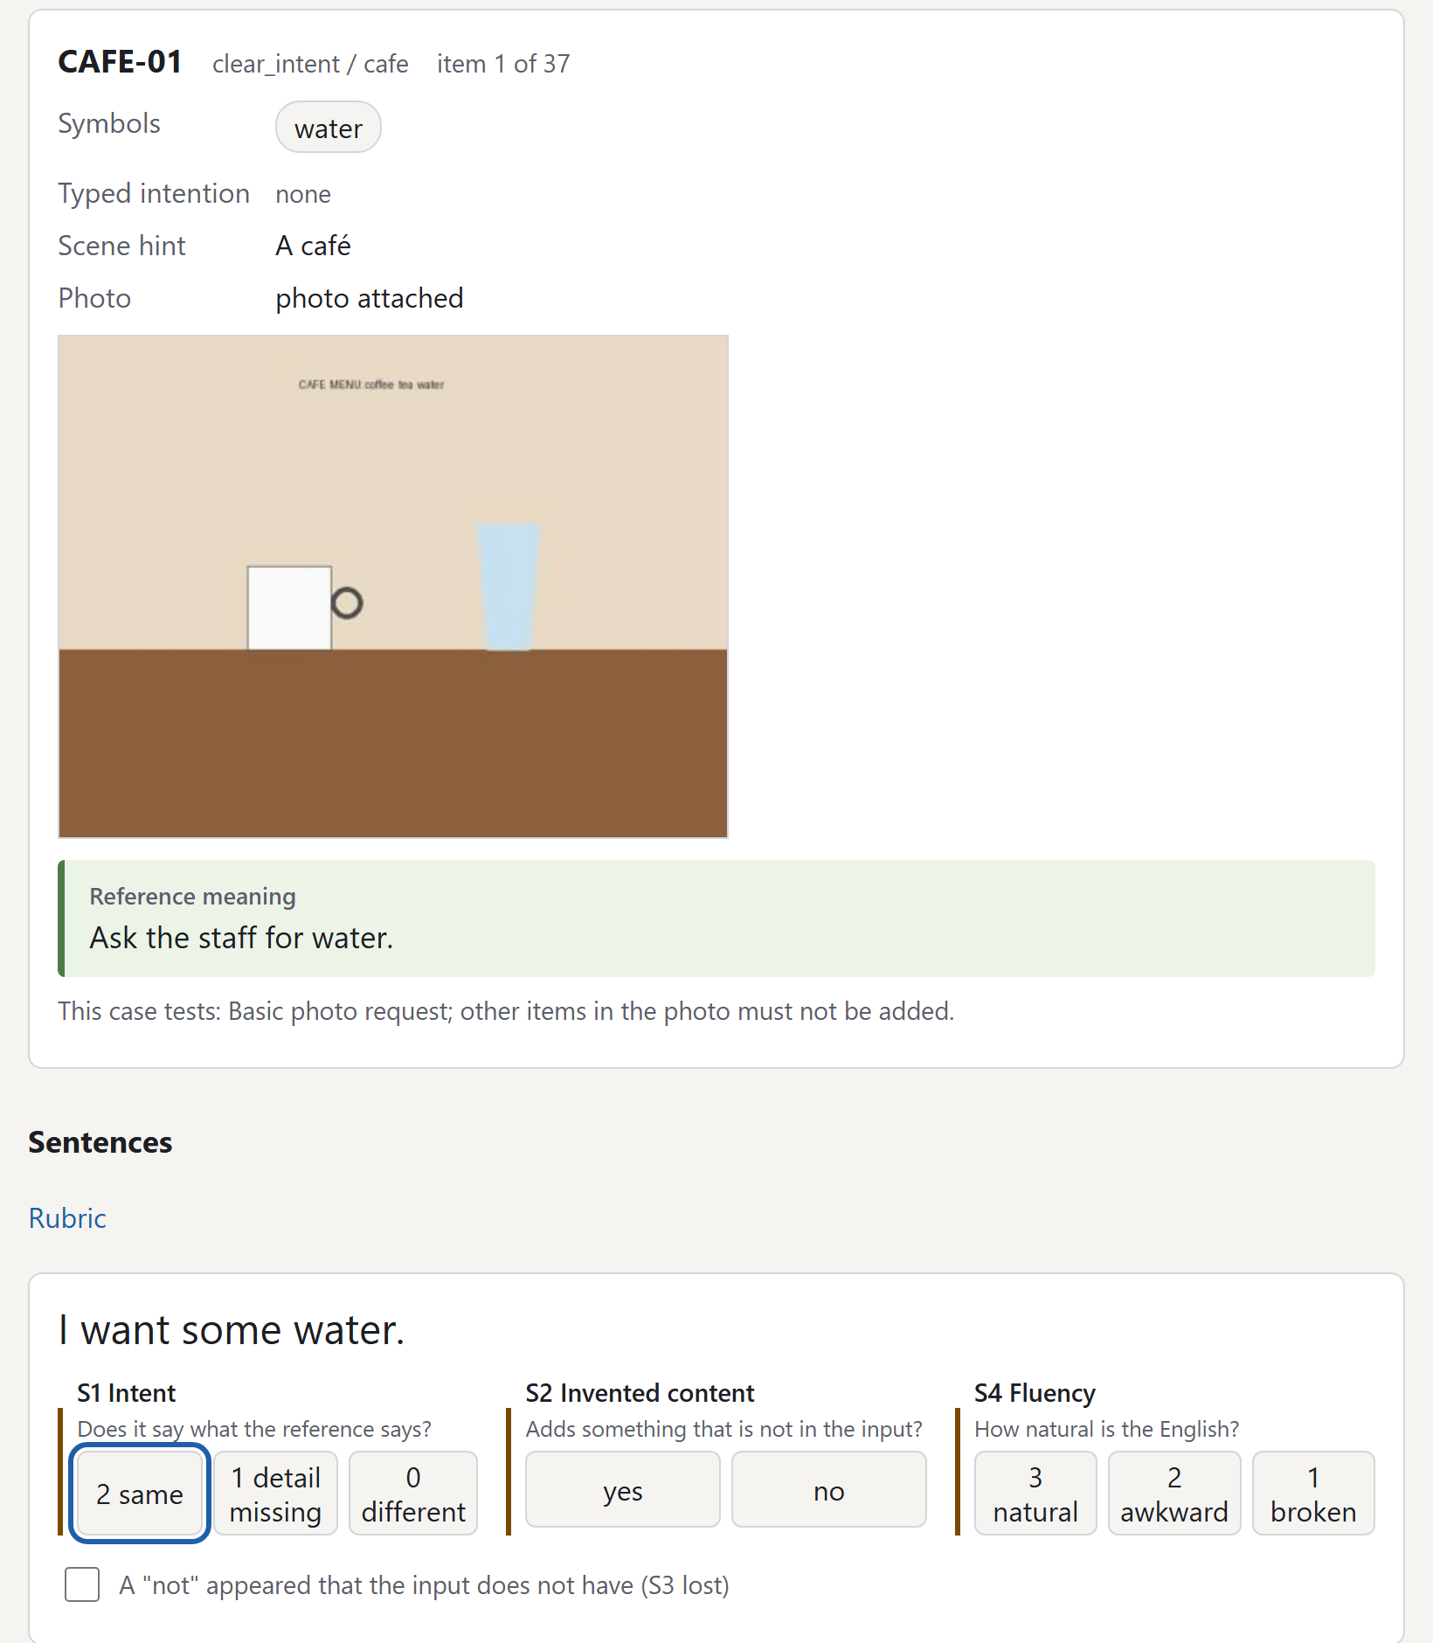
AI evaluation: blind rating and first runs
02 Experimental progress · rating page export of 11 Nov; 7 model setups on 37 core cases, 10 Nov
BLIND RATING PAGE
1
No model name equal answers merged, order shuffled
2
Rubric intent, invented content, negation, fluency
3
Two raters + one third member settles differences
FIRST RUNS · AUTOMATIC CHECKS ONLY
37 / 37
17.3 s
16
3.5 Flash-Lite answered; max 10.8 s
Pollinations median; max 37.5 s
sentences removed: negation lost
Next: the ratings (37 items, 109 answers) decide the model order, SAD decision D-03
11
Notes:
One slide on the AI this week. To answer the reviewers' finding that the AI quality could not be measured, we built a blind rating page: one HTML file, no model names, equal answers merged and the order shuffled. Two of us rate alone and a third settles the differences. The first runs on 10 November used only automatic checks: Gemini 3.5 Flash-Lite answered all 37 core cases within 10.8 seconds; Pollinations, the keyless option, is too slow for the 20-second deadline; and the post-check removed 16 sentences that had lost a negation. The ratings decide the model order, decision D-03 of the SAD.

Slide 12
Next week: plan
03 Project progress · week 10, owners by area and by review reply
Task | Owner | Goal
Restore the API routes on main | Thibaut, Veronika | Reuse endpoint and error codes back; CI passes
Merge the backend fixes | Veronika | refactor-backend into main once CI passes
Speak first, save in background | Thibaut | app.js change; "Spoken, but not saved" and retry
Connect the AI chain | Jiahui, Veronika | ChainProvider selected in app/main.py; deadline code committed
Blind rating of the first runs | Jiahui + 2 raters | 37 items; third member settles differences
SRS v1.0 | Author of each reply | Accepted changes written; Passed only with evidence
SAD v0.1 review | Section owners | Check own sections; close the 9 decisions due in week 10
Commit format: every commit as "W10 - summary; description"
12
Notes:
Next week: first make main pass CI again, then merge Veronika's fixes. Thibaut changes the speak-and-save order. We connect the AI chain to the backend and start the blind rating. Each member writes the SRS changes for the findings they answered and reviews their sections of the SAD, and we close the nine decisions due this week.

Slide 13
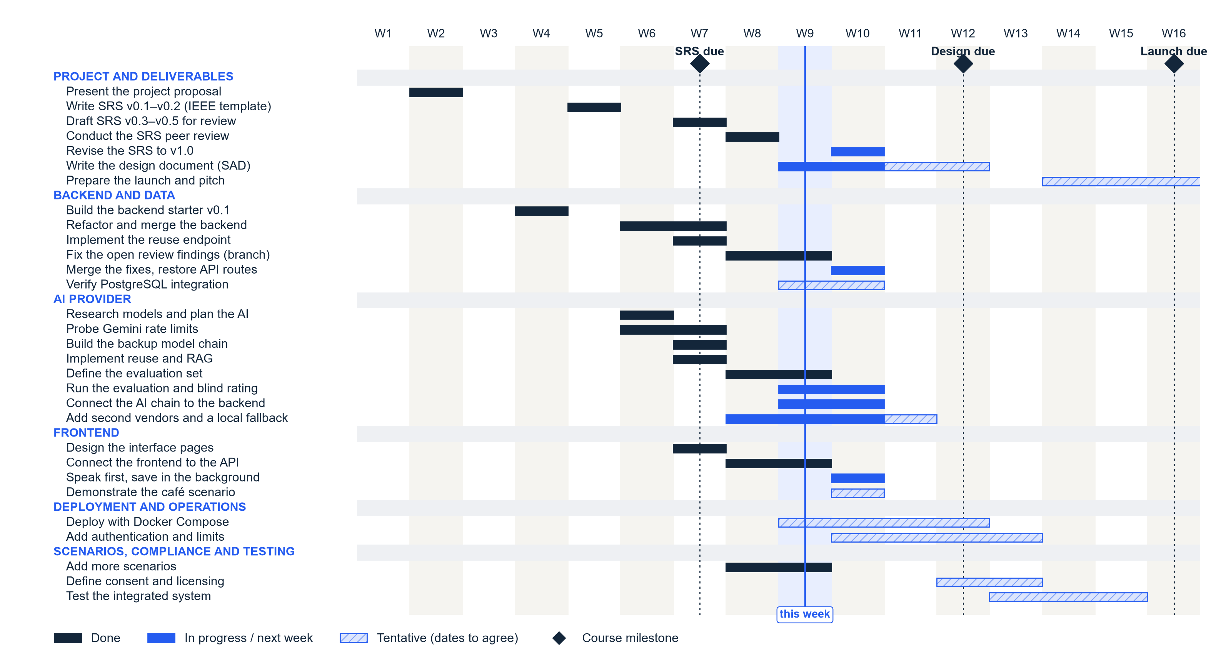
Time management
Notes:
Dark bars are done, blue bars are in progress or next week, hatched bars are tentative. The SRS v1.0 revision moved to week 10. The design document is due in week 12.

Slide 14

THANK YOU FOR YOUR
ATTENTION!
Veronika, Jiahui, Thibaut and Abid
Notes:
Thank you. Questions?

