Slide 1
NewEra POS — Progress Report
Weekly Report W06 · Increment 1 – Requirements: UC1 Process Sale end to end
Response to the W05 feedback: we went deep on one use case — from the scenario to requirements, rules, interfaces and traceability.
Team D · Software Engineering · Beihang University (BUAA) · github.com/bhsei/26D
Notes:
Agenda (max 10 min): 1) Technical progress – system development; 2) Experimental progress – deliverables; 3) Team collaboration and management (max 2 min). After the W05 feedback we decided to go deep on one use case, Process Sale, instead of describing everything at a high level.

Slide 2
1 · TECHNICAL PROGRESS — SYSTEM DEVELOPMENT
System requirements: use case model
NewEra POS
«actor»
Payment Service
UC1 Process Sale
UC2 Handle Returns
«actor»
Tax Calculator
UC3 Process Rental
«actor»
Accounting System
Cashier
UC4 Start Up
Customer = stakeholder (acts through the Cashier)
NEW
«actor»
HR System
UC5 Return Rental
Process models
SRS
Design
Launch
Course timeline
W1
W2
W3
W4
W5
W6 · now
W7
W8
W9
W10
W11
W12
W13
W14
W15
W16
Notes:
One primary actor, four supporting actors (external systems), five use cases. UC5 Return Rental is new: the analysis showed that returning rented equipment was not covered. Same links as the SRS §3.1.3 and Borja's diagram v0.2 (assets/use_case_diagram.puml): UC1, UC2, UC3 and UC5 use the Payment Service, Tax Calculator and Accounting System; UC4 uses the HR System and the Accounting System.

Slide 3
1 · TECHNICAL PROGRESS — SYSTEM DEVELOPMENT
What the analysis changed in our scope
1
2
3
Customer is a stakeholder, not an actor
Three payment methods
New use case UC5 Return Rental
Actors interact directly with the system. The customer only interacts through the cashier (as in the NextGen POS case).
Cash, credit card and check. Check is authorized by the Payment Service and has priority Could.
Returning rented equipment is a different visit, goal and set of rules: condition check, late fee, deposit refund.
W01 said 2 actors → 1 primary + 4 supporting
Proposal said 3 but named only 2
Scope: 4 → 5 use cases
Process models
SRS
Design
Launch
Course timeline
W1
W2
W3
W4
W5
W6 · now
W7
W8
W9
W10
W11
W12
W13
W14
W15
W16
Notes:
These were open questions in the W06 documents (use case model, glossary). We decided them as a team and applied them in the SRS v0.1. This is the kind of correction requirements analysis should produce.

Slide 4
1 · TECHNICAL PROGRESS — SYSTEM DEVELOPMENT
UC1 Process Sale: main success scenario
Cashier
NewEra POS
1
Cashier starts a new sale
→
System creates the sale in the cashier session
2
Cashier enters each item identifier
→
System adds a sale line item: description, price, subtotal
3
Cashier ends the sale
→
System gets the tax (Tax Calculator) and shows the total
4
Customer pays (cash · card · check)
→
System handles the payment (Payment Service for card)
5
No cashier action (done automatically)
→
System saves the sale, updates stock, reports to Accounting
6
Customer leaves with the receipt
→
System prints the receipt
Process models
SRS
Design
Launch
Course timeline
W1
W2
W3
W4
W5
W6 · now
W7
W8
W9
W10
W11
W12
W13
W14
W15
W16
Notes:
Fully dressed use case in the SRS §3.2.1: stakeholders and interests, precondition (open cashier session, UC4), success and failure guarantees, 13 steps in two columns, 13 extensions, special requirements and open issues.

Slide 5
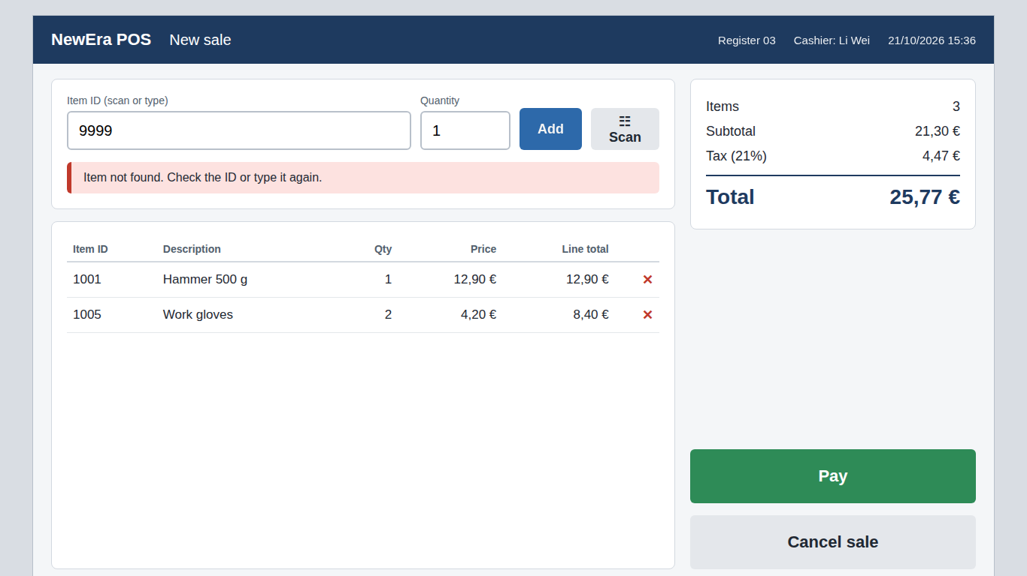
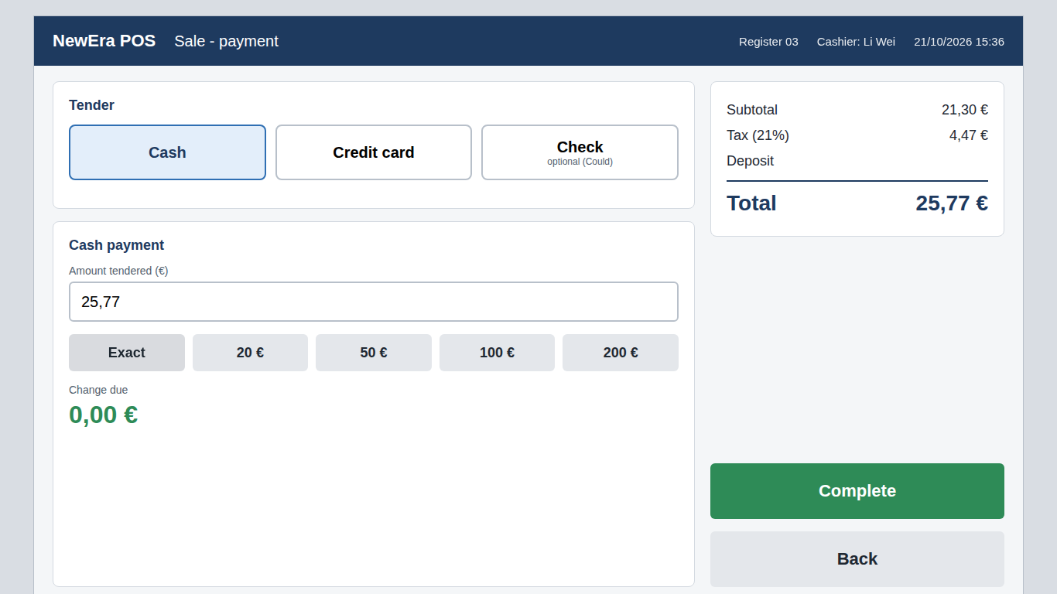
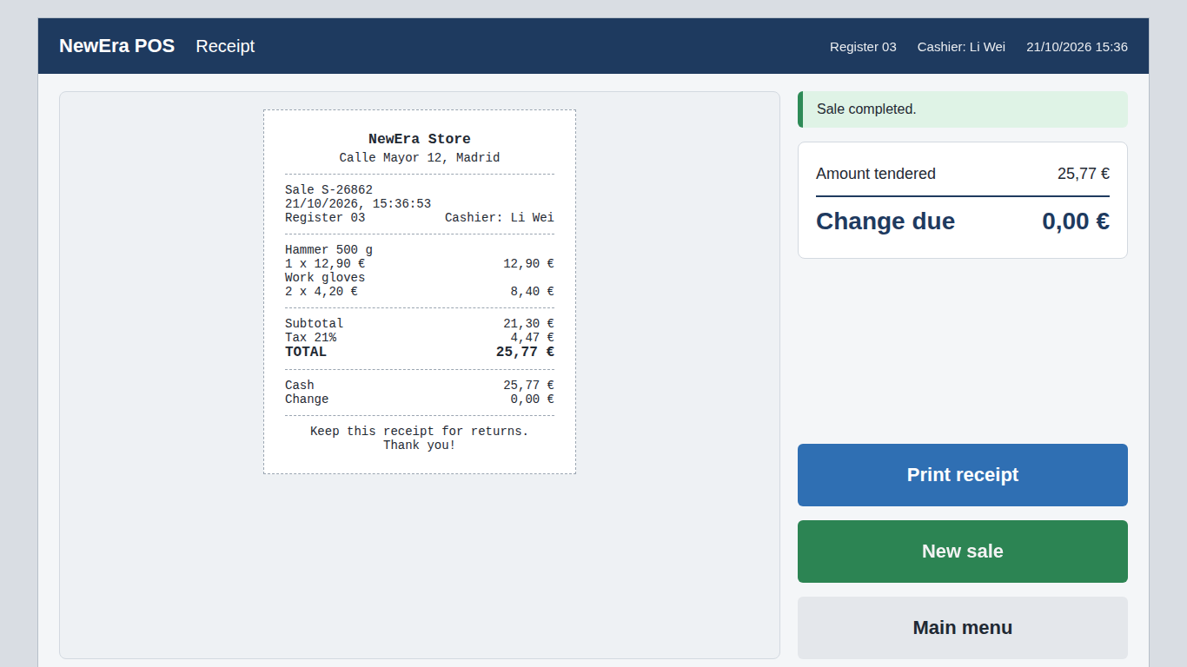
1 · TECHNICAL PROGRESS — SYSTEM DEVELOPMENT
UC1 in the UI prototype
›
›
1 · Sale
2 · Payment
3 · Receipt
Scan or type the item (FR-02); unknown code rejected (FR-03, ext. 4a)
Cash, card or check; change due (FR-09, BR-06)
Sale saved and receipt printed (FR-13, FR-16)
Clickable HTML prototype (docs/design/prototype/): start up and login, main menu, sale, payment, receipt, return, rental and return rental. External failures can be simulated (Tax Calculator, HR System, card declined, Payment Service down).
Process models
SRS
Design
Launch
Course timeline
W1
W2
W3
W4
W5
W6 · now
W7
W8
W9
W10
W11
W12
W13
W14
W15
W16
Notes:
Throw-away prototype, as decided in the process model: it validates the cashier's screens and the use case flows, it is not production code. Demo live if there is time: index.html → New sale → scan 1001 → Pay → Exact → Complete. Built by Haifa and Yasmine.

Slide 6
1 · TECHNICAL PROGRESS — SYSTEM DEVELOPMENT
UC1: extensions — where the real rules live
Cashier input
4a invalid identifier · 4b quantity · 4c remove line · 4d price override (BR-04) · cancel sale
Example in full · 9b. Credit card payment
1. The Customer gives the card; the card reader reads it.
2. The System requests authorization from the Payment Service (BR-05, IR-01).
3. The System records the payment with the authorization code.
9b2a. Declined: the System shows the reason; the Cashier asks for another tender; back to step 9.
9b2b. No answer: the System shows "Card payment not available", logs the failure (IR-10) and keeps the sale open; the Cashier asks for cash (IR-02).
Failure guarantee: no card payment is ever completed without authorization.
Payment
9a cash (BR-06) · 9b credit card (BR-05) · 9c check (Could)
External failures
7a Tax Calculator down (BR-02) · 9b2b Payment Service down · 11a Accounting down (IR-07)
Other
*a register crash · 11b stock < 10 → reorder list (BR-09) · 12a printer fails
Process models
SRS
Design
Launch
Course timeline
W1
W2
W3
W4
W5
W6 · now
W7
W8
W9
W10
W11
W12
W13
W14
W15
W16
Notes:
13 extensions in total (SRS §3.2.1). Each one is a condition the system can detect plus the response, and each is linked to a business rule (glossary) or an interface requirement (external interfaces). Main principle: an external failure never loses a sale or a payment, and never breaks a store rule.

Slide 7
1 · TECHNICAL PROGRESS — SYSTEM DEVELOPMENT
Requirements: classification and structure
FR
17
NFR
10
BR
14
IR
10
Functional
FR-01…17 from UC1
Non-functional
ISO 25010: performance, reliability, usability, security…
Business rules
tax, price, payment, return, rental, staff
Interface reqs.
4 external systems + logging
Conventions: unique IDs, MoSCoW priority, every requirement unambiguous and verifiable, every FR traced to its use case step and to the BR/IR it implements.
Still to develop (W07): FRs of UC2–UC5, usability and UI requirements, data requirements, verification method for each requirement.
Process models
SRS
Design
Launch
Course timeline
W1
W2
W3
W4
W5
W6 · now
W7
W8
W9
W10
W11
W12
W13
W14
W15
W16
Notes:
Documents: SRS §3.2.6 (FR), nfrs.md (NFR), glossary.md (BR), external_interfaces.md (IR), requirements_conventions.md (IDs, MoSCoW, writing rules).

Slide 8
1 · TECHNICAL PROGRESS — SYSTEM DEVELOPMENT
Requirements as written: examples
ID | Requirement | Priority / status | Traced to
FR-02 | The system shall record a sale line item when the cashier enters a valid item identifier, and shall show the product description, price, quantity and running subtotal. | Must | UC1 steps 4–5, BR-03
FR-10 | For a credit card payment, the system shall complete the payment only after the Payment Service approves it, and shall record the authorization code. | Must | UC1 ext. 9b, BR-05, IR-01
IR-02 | When the Payment Service does not answer or returns an error, the POS shall inform the cashier and keep the transaction open so that another tender can be used. | Must | UC1 ext. 9b2b, BR-05
NFR-01 | A sale line item must be registered in less than 1 second. | Performance (ISO 25010) | FR-02, UC1 special requirements
BR-06 | For cash payments, the amount tendered must be at least the total; the change due is the amount tendered minus the total. | Proposed | FR-09, UC1 ext. 9a
Every requirement: one ID, one "shall", one testable condition, a priority and a source. No "fast", "easy" or "user-friendly" without a number.
Process models
SRS
Design
Launch
Course timeline
W1
W2
W3
W4
W5
W6 · now
W7
W8
W9
W10
W11
W12
W13
W14
W15
W16
Notes:
Texts are copied from the SRS (FR), the external interfaces inventory (IR), nfrs.md (NFR) and the glossary (BR). BR-06 is still Proposed until we confirm the rules against the full case.

Slide 9
1 · TECHNICAL PROGRESS — SYSTEM DEVELOPMENT
Traceability: one requirement, end to end
Use case
Business rule
Requirement
Interface
Quality
Test
UC1 ext. 9b
BR-05
FR-10
IR-01 / IR-02
NFR-08
TC-10
Card payment
›
Card payment must be authorized first
›
Complete card payment only if approved
›
Request authorization; fallback to cash
›
Payment data encrypted
›
Mock approval; auth code saved
The traceability matrix (requirements_conventions.md) already covers FR-01 to FR-17 with a planned test case for each; the design column will be completed in increment 2.
Process models
SRS
Design
Launch
Course timeline
W1
W2
W3
W4
W5
W6 · now
W7
W8
W9
W10
W11
W12
W13
W14
W15
W16
Notes:
This is the chain we want for every requirement: why it exists (use case and business rule), what the system must do (FR), which external system is involved (IR), which quality constraint applies (NFR) and how we will test it (TC). Test case TC-10 is from Josué's traceability matrix (requirements_conventions.md).

Slide 10
2 · EXPERIMENTAL PROGRESS — DELIVERABLES
Assignment 1 – SRS (ISO/IEC/IEEE 29148): status
SRS section | Source document | Owner | Status
1 Introduction · 2 References | SRS.md (v0.3, review #19 fixed) | Alfonso | Done
Stakeholders, user characteristics | stakeholders.md, elicitation_plan.md | Yasmine | In review
Use case model (diagram + briefs) | use_case_model.md (v0.2, review #16 fixed) | Borja | Done
3.1.3 Software interfaces (IR-01…10) | external_interfaces.md | Haifa | In review
3.2.1 UC1 fully dressed + FR-01…17 | SRS.md | Alfonso | Draft
3.4/3.8 Quality attributes (NFR-01…10) | nfrs.md, quality_goals.md | Josué | Draft
3.10 Business rules (BR-01…14) + glossary | glossary.md | Avni | In review
UI prototype (5 use cases) | docs/design/prototype/ | Haifa, Yasmine | Draft
3.2.2–3.2.5 UC2–UC5, 3.5 data, 4 verification | — | Team (W07) | To do
Process models
SRS
Design
Launch
Course timeline
W1
W2
W3
W4
W5
W6 · now
W7
W8
W9
W10
W11
W12
W13
W14
W15
W16
Notes:
Review status: #14 Josué → Haifa (external interfaces), #16 Alfonso → Borja (use case model, fixed in v0.2), #17 Haifa → Avni (glossary), #19 Avni → Alfonso (SRS, 6 findings, fixed in v0.2 and v0.3), #20 and #21 Borja → Yasmine (stakeholders, elicitation plan). Still missing: Yasmine → Josué. Update this column before presenting.

Slide 11
2 · EXPERIMENTAL PROGRESS — DELIVERABLES
Remaining work for Assignment 1 (SRS v1.0, W07)
Alfonso
UC5 Return Rental; integrate all parts into SRS v1.0
Borja
System sequence diagram for UC1; first domain model
Josué
Verification method per requirement; traceability for UC2–UC5
Yasmine
UC2 Handle Returns fully dressed; usability requirements
Haifa
Prototype fixes after review; hardware interfaces and design constraints
Avni
UC3 Process Rental and UC4 Start Up; acceptance criteria for UC1
Flow: draft → review in a GitHub Issue → fix → new SRS version → SRS v1.0 at the W07 milestone
Process models
SRS
Design
Launch
Course timeline
W1
W2
W3
W4
W5
W6 · now
W7
W8
W9
W10
W11
W12
W13
W14
W15
W16
Notes:
Each fully dressed use case adds its own FRs (FR-18 onwards) to the SRS.

Slide 12
3 · PROJECT PROGRESS — TEAM COLLABORATION AND MANAGEMENT
Roles, reviews and way of working
Alfonso
Project lead · Requirements
reviews Borja
Borja
UML modeler · Docs
reviews Yasmine
Josué
Quality · Traceability
reviews Haifa
AP
BN
JR
Yasmine
UI/UX · Front-end
reviews Josué
Haifa
Integration · Full-stack
reviews Avni
Avni
Developer · Testing
reviews Alfonso
YC
HC
AO
GitHub: one document per commit (W<week> - summary; description), git pull --rebase, linear history; peer review with one Issue per document version and one comment per finding.
Process models
SRS
Design
Launch
Course timeline
W1
W2
W3
W4
W5
W6 · now
W7
W8
W9
W10
W11
W12
W13
W14
W15
W16
Notes:
Keep to 2 minutes. Reviews form a cycle so nobody reviews their own work.

Slide 13
Conclusion
1
2
3
Requirements specified
SRS v0.3 with UC1 fully dressed and 51 identified requirements.
Scope corrected
Analysis found 3 gaps: actors, payment methods and UC5.
Traceable
Every FR linked to its use case, business rules and interfaces.
Next week (W07): UC2–UC5 fully dressed, UI prototype, sequence diagram and domain model → SRS v1.0.
Thank you · Questions?

