Slide 1



New York
Chicago
Passenger Name:
Flight Price Predictor
Professor Navarro
Flight Number:
ADSP31006
Seat:
IP02
Gate:
UChicago
Aida Sarinzhipova, Bradley Stoller, Devi Mahajan, Cassandra Maldonado, Kirthi Rao, & Kyler Rosen
Date:
March 12, 2025
1

Slide 2
New York
Chicago
Agenda
Business Case & Problem Statement
Modeling Approach & Methodology
Data Understanding
Exploratory Data Analysis (EDA)
Preprocessing & Feature Engineering
Modeling Results & Analysis
Recommendations & Future Work
2

Slide 3
New York
Chicago
Business Case & Problem Statement
3

Slide 4
New York
Chicago
Business Case & Problem Statement
Travelers often struggle with knowing when to book flights to secure the lowest prices. Airline pricing algorithms are complex, and last-minute purchases often result in higher costs.
By using time series forecasting techniques and machine learning models, we aim to:
Identify price trends over time
Predict future ticket prices based on historical data
Provide insights for consumers to make cost-effective purchasing decisions
Integration into Commercial Platforms:
The predictive model can be integrated with travel booking websites, airline pricing tools, and consumer apps to help users make cost-effective flight purchases.
It can serve as a dynamic price alert system, notifying travelers when fares are likely to rise or fall.
4

Slide 5
New York
Chicago
Modeling Approach &
Methodology
5

Slide 6
New York
Chicago
Modeling Hypothesis & Assumptions
Modeling Hypothesis:
Airline ticket prices tend to increase as the departure date approaches
Fluctuation patterns are influenced by the time remaining until departure
Historical price data analysis helps identify these patterns
Predictive models can be developed to forecast future price trends
Key Assumptions:
Non-Stationarity: Means and variances change over time
Seasonality: Holidays, weekends, and major events affect prices
Correlation: Price is influenced by multiple factors (e.g. travel duration, distance, seats remaining, etc.)
External factors: Some demand fluctuations not in the data
6

Slide 7
New York
Chicago
Proposed Models
Traditional Time Series Models:
ARIMA
SARIMA
Prophet
Machine Learning Models:
Decision Tree
Random Forest
XGBoost
Deep Learning Models:
RNN
LSTM
7

Slide 8
New York
Chicago
Data
Understanding
8

Slide 9
New York
Chicago
Data Description & Properties
Dataset: Flight Price Dataset from Kaggle
82 million flight itineraries with 46 features related to the flight itineraries
Each row is a purchasable ticket on Expedia between April 16 and October 5 of 2022
Flights were to/from the following airports: ATL, DFW, DEN, ORD, LAX, CLT, MIA, JFK, EWR, SFO, DTW, BOS, PHL, LGA, IAD, OAK
Key Variables | Description
totalFare | Total fare of ticket at time of search date.
searchDate | Date price is being checked.
flightDate | Date of departure.
startingAirport | Flight origin airport.
destinationAirport | Flight destination airport.
totalTravelDistance | Distance from origin to destination airport.
9

Slide 10
New York
Chicago
Exploratory Data
Analysis (EDA)
10

Slide 11
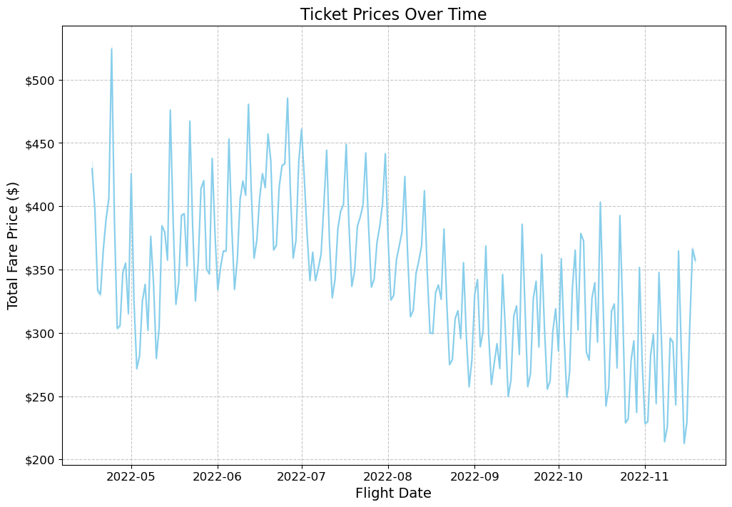
New York
Chicago
Fare Changes
Prices exhibit fluctuations, with a slight downward trend leading up to flight dates
The variability suggests potential seasonal or demand-driven changes in fare pricing
Useful for predicting how fares change over time
11

Slide 12
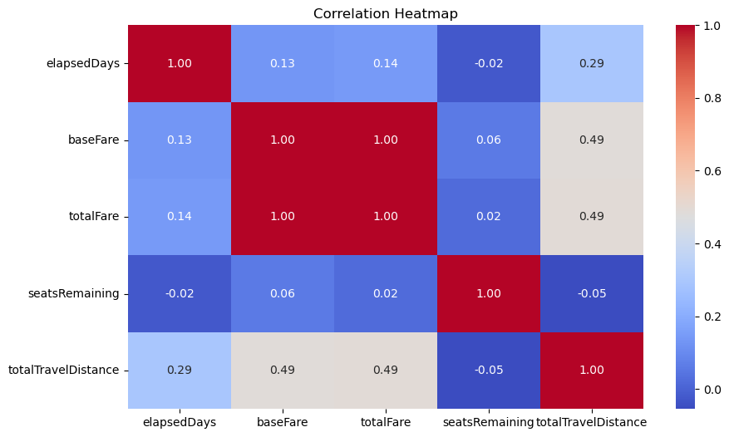
New York
Chicago
Correlations
Total fare is strongly correlated with base fare
Elapsed days has a weaker correlation, indicating last-minute bookings may not be as influential
Pricing strategies are largely independent of remaining seats, meaning last-minute sales do not heavily affect cost
12

Slide 13
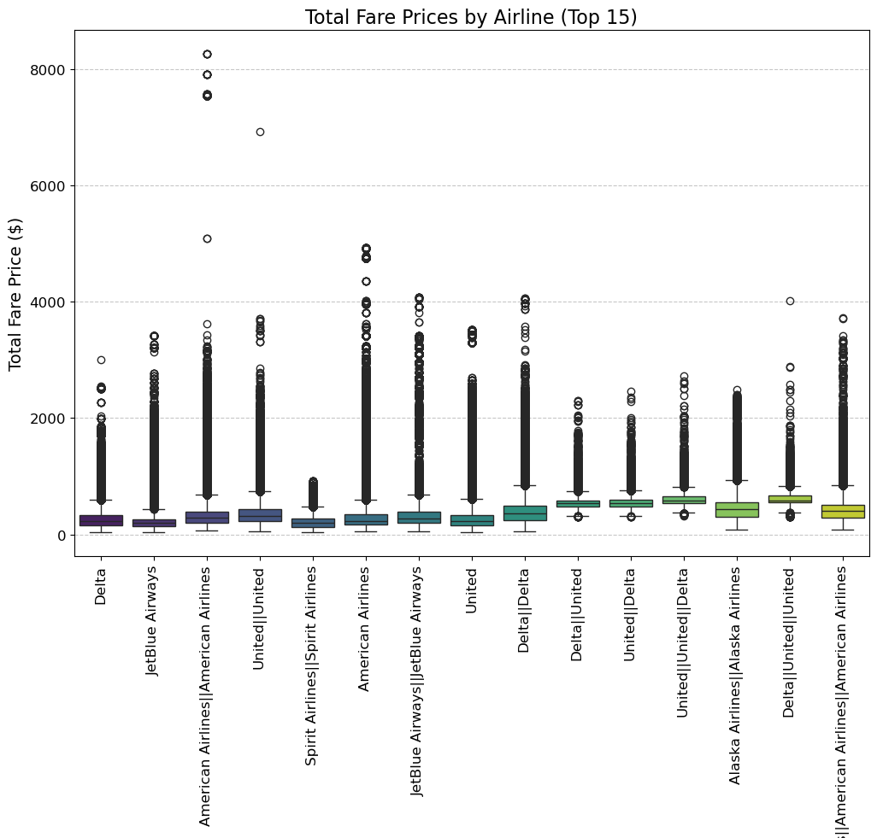
New York
Chicago
Boxplot of Ticket Prices
Ticket prices show significant variation across airlines, but airline-specific pricing strategies are less predictive than originally assumed.
Premium airlines tend to have higher price volatility, while budget airlines maintain a narrower price range.
Feature engineering excluded airline code due to its limited impact on model performance, shifting focus to more predictive variables like travel distance and departure time.
13

Slide 14
New York
Chicago
Preprocessing & Feature Engineering
14

Slide 15
New York
Chicago
Preprocessing & Feature Engineering
Derived Features:
• daysToDeparture (difference of searchDate and flightDate)
• Binned seatsRemaining into categories (low, medium, high availability)
• Extracted temporal features (e.g., month, weekday, hour of departure)
• Created a holiday indicator → Flights near holidays flagged for price impact.
Missing Data Handling:
• Imputation of missing totalTravelDistance values
3. Sequence-Based Additions:
• Lag prices from T-1 through T-7 were added to each row
15

Slide 16
New York
Chicago
Modeling Results & Analysis
16

Slide 17

New York
Chicago
Model Comparison
Model | MAE | RMSE | MAPE | R²
SARIMA | $143 | 210 | 44% | -0.48
Prophet | $121 | 168 | 34% | -0.31
Decision Tree | $64 | 114 | 23% | 0.65
Random Forest | $58 | 105 | 20% | 0.70
XGBoost | $56 | 104 | 19% | 0.71
RNN | $110 | 190 | 39% | 0.25
LSTM | $91 | 163 | 31% | 0.44
XGBoost performed best in all four of the error metrics
RNN & LSTM struggled due to high price variance
17

Slide 18
New York
Chicago
Performance & Evaluation
XGBoost Feature Importance
Hyperparameter tuning applied with GridSearchCV (288 fits)
Best parameters found:
colsample_bytree: 1.0
gamma: 0
learning_rate: 0.05
max_depth: 12
min_child_weight: 3
n_estimators: 200
Cross-validation RMSE: 60.81
XGBoost
MAE | 56.86
RMSE | 104.65
MAPE | 19.73 %
R² | 0.71
18

Slide 19
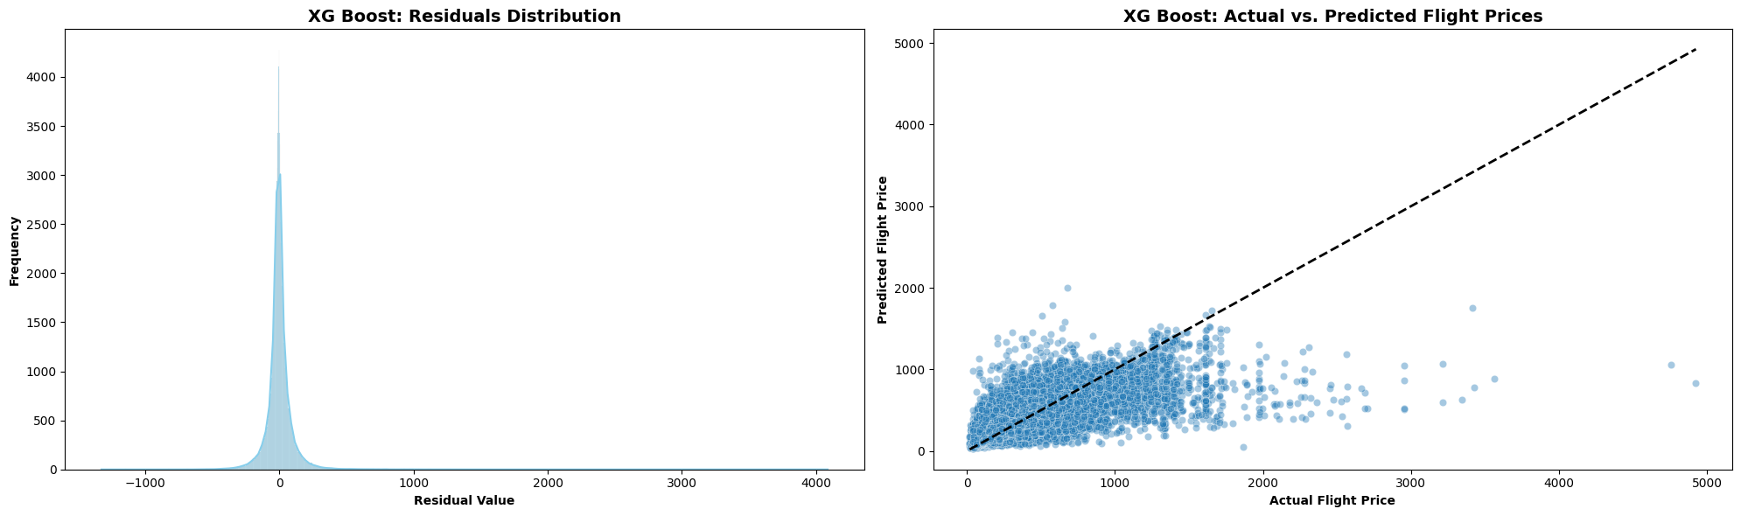
New York
Chicago
Residual Error Analysis
Residual distribution is largely normal (Gaussian) with a mean of 0
Some extreme outliers caused by last-minute flight fluctuations
19

Slide 20
New York
Chicago
Actual vs. Predicted Value Analysis
XGBoost captures the most variation in price, but struggles as fares increase
Residual variation suggests exogenous factors are uncaptured by the model
21

Slide 21
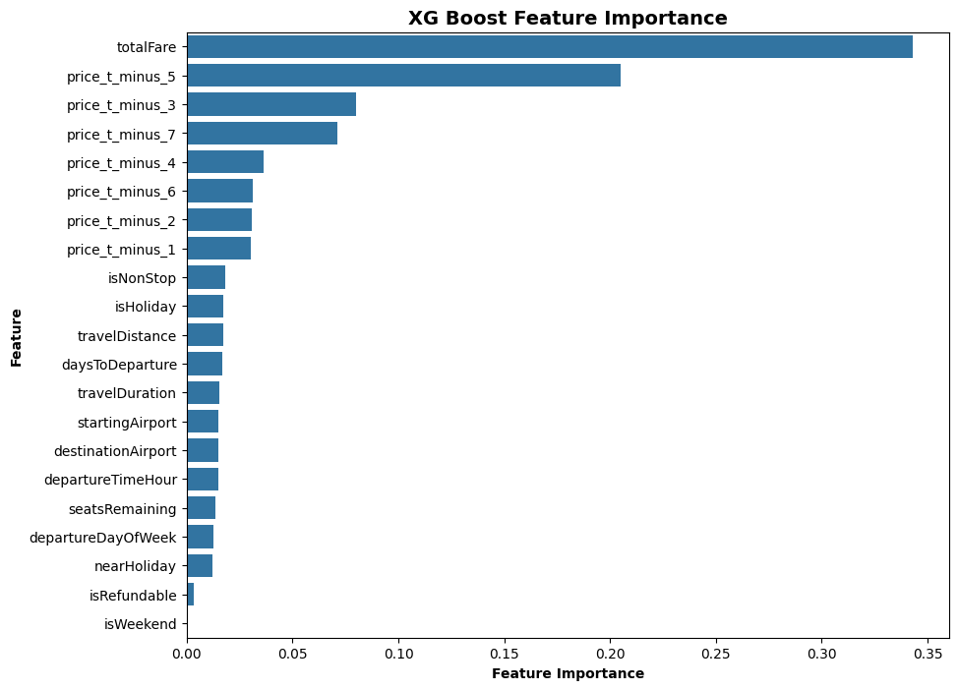
New York
Chicago
Feature Importances
Total Fare (today’s price) is the #1 predictor of tomorrow’s price
Lagged prices beat out all other features/predictors
22
Notes:
Historical price trends are the strongest predictors, meaning airline pricing behavior follows structured patterns.
Days to departure & holidays still matter, but less than past prices.
Seat availability has minimal influence, confirming earlier correlation findings.

Slide 22

New York
Chicago
To the demo!
23
Notes:
Historical price trends are the strongest predictors, meaning airline pricing behavior follows structured patterns.
Days to departure & holidays still matter, but less than past prices.
Seat availability has minimal influence, confirming earlier correlation findings.

Slide 23
New York
Chicago
Recommendations & Future Work
24

Slide 24
New York
Chicago
Recommendations & Future Work
Real-time Prediction System: Deploy a model API that continuously updates with new flight data
External Data Sources: Incorporate weather conditions, real-time seat availability, and airline promotions to improve accuracy
Hyperparameter Tuning: Further refine model parameters for even lower error rates
Transformer-based Models: Consider using Time Series Transformers to improve price forecasting
Integration: Future work should integrate real-time airline promotions & seat availability for better accuracy
25

Slide 25
New York
Chicago
Thank you!
26

Slide 26
New York
Chicago
Appendix
27

Slide 27
New York
Chicago
Data Properties
Data Challenges
Total travel distance was imputed using median-based techniques.
Categorical variables (e.g., airport codes, airlines) → Encoded using one-hot encoding.
Non-stationary trends in ticket prices → Feature transformations were applied.
Key Data Insights
Flight prices increase closer to departure, but the rate varies based on seasonality.
Some airlines exhibit more volatile pricing trends than others.
The number of available seats influences price, lower availability leads to higher fares.
8

Slide 28
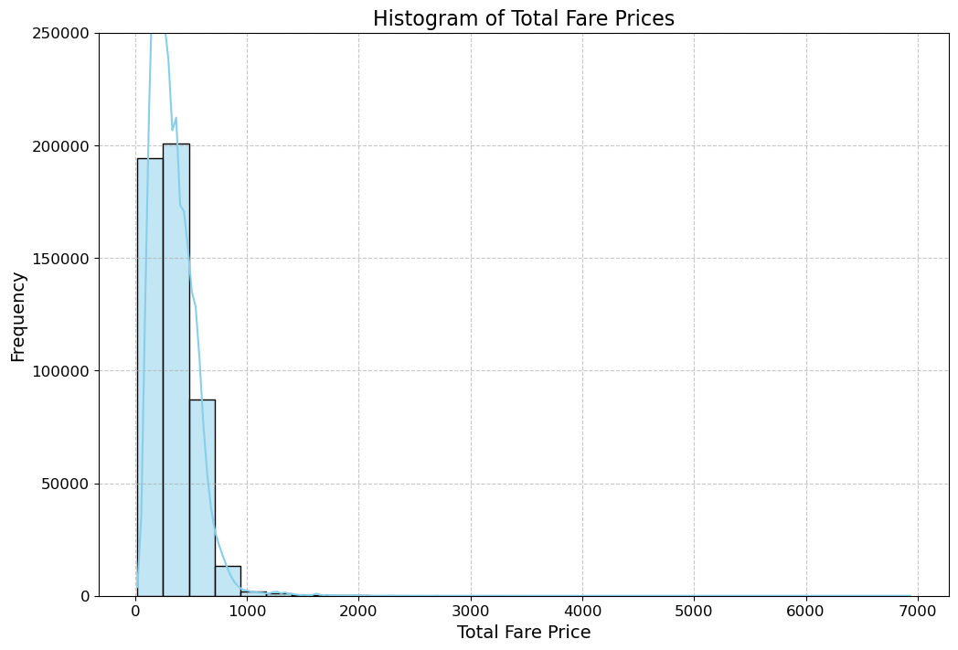
New York
Chicago
EDA
Histogram of Total Fare Prices
Most fares are concentrated below $1,000, with a steep drop-off afterward
There are a few outliers with significantly higher prices (premium/business class tickets)
This highlights the skewed nature of flight pricing, suggesting the need for transformations in modeling
11

Slide 29
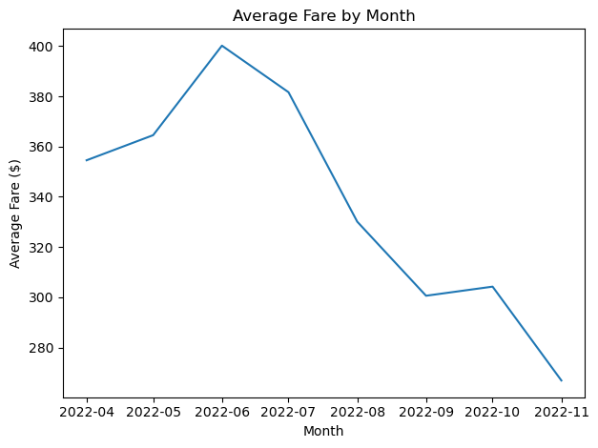
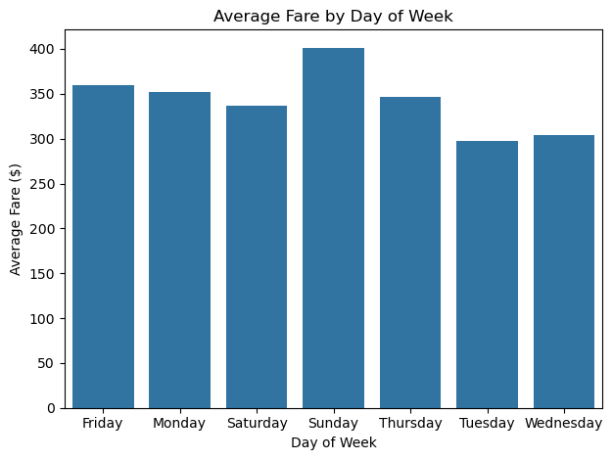
New York
Chicago
EDA
12

Slide 30
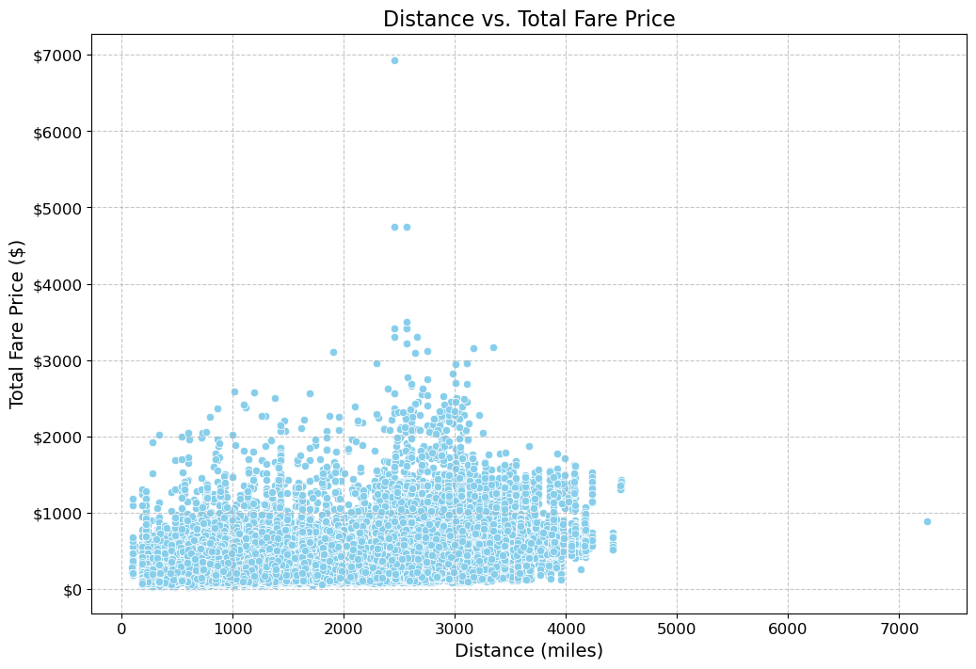
New York
Chicago
EDA
Scatter Plot of Distance vs. Price
Longer flights generally cost more, but with high variability
Some short-distance flights have very high fares, likely due to premium flights or last-minute bookings
Highlights the non-linear relationship between fare and distance, suggesting other factors influence pricing
14

Slide 31
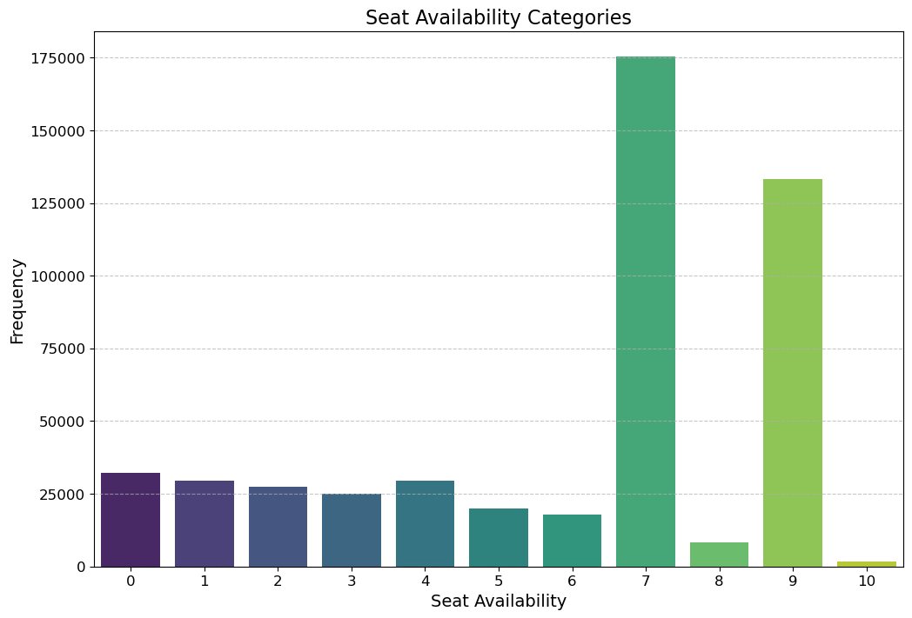
New York
Chicago
EDA
Bar Chart of Seat Availability Categories
The dataset shows that most flights have either low availability (0-5 seats) or high availability (7 and 9 seats)
Understanding seat availability helps in predicting pricing trends, as fewer seats often lead to higher fares
16

Slide 32
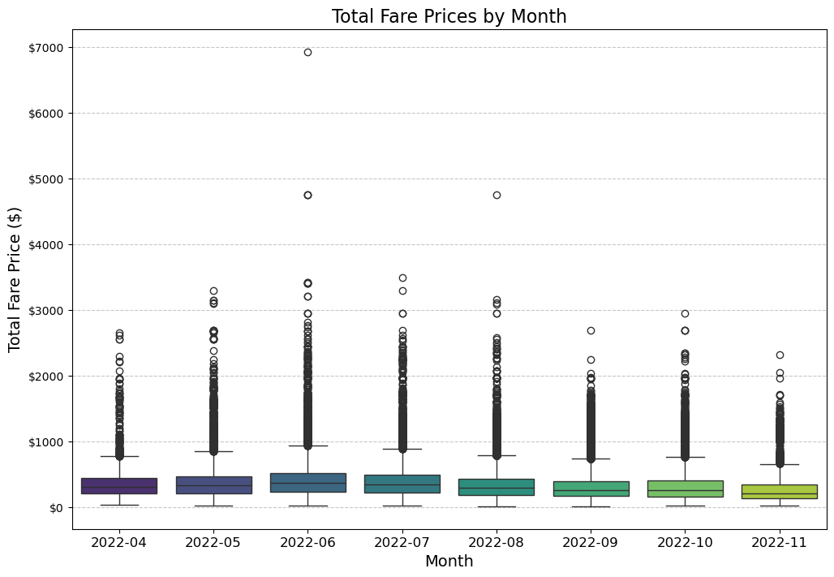
New York
Chicago
Feature Engineering
Boxplot of Prices by Month
Prices show similar distributions across all months with significant outliers (more in summer months)
Most likely associated with the high travel season during summer that raises average fares
19

Slide 33
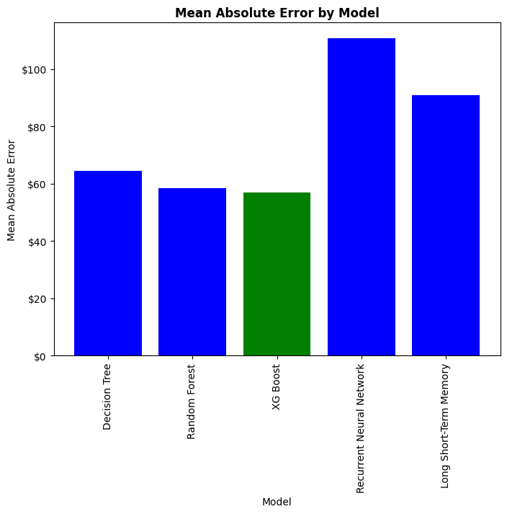
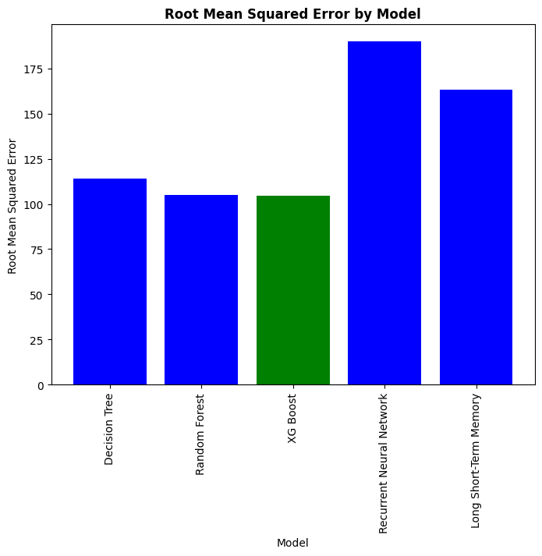
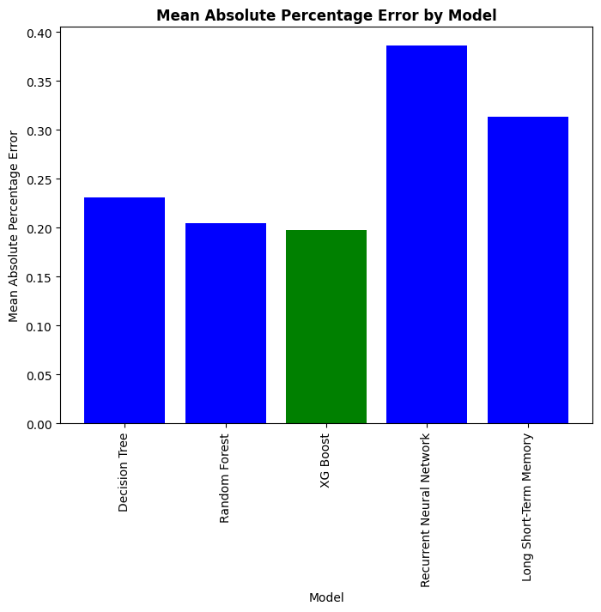
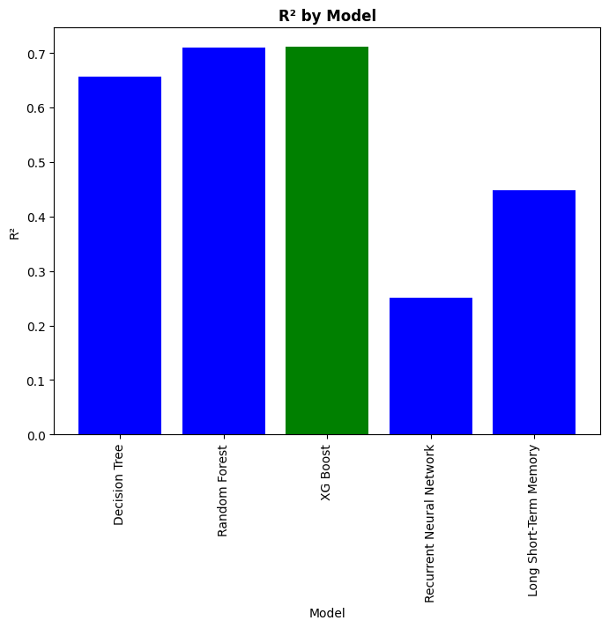
New York
Chicago
Models Tradeoff Discussion
Mean Absolute Error
Root Mean Squared Error
Mean Absolute Percent Error
R²
23

Slide 34
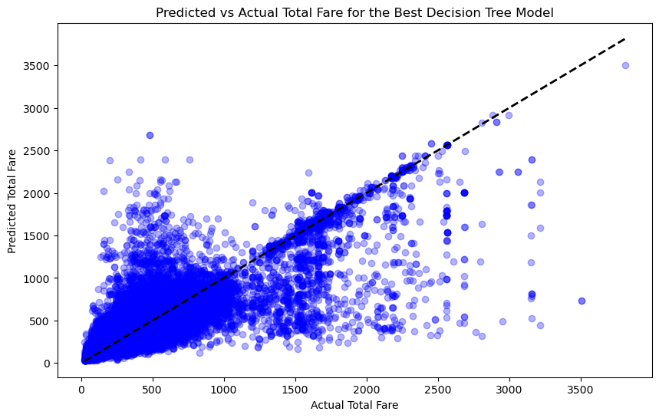
New York
Chicago
Key Insights
Tree-based models (Random Forest, XGBoost) outperform deep learning models for flight price prediction
Feature engineering significantly improved model accuracy, particularly holiday effects and seat availability binning
Flight prices are highly non-stationary, requiring advanced modeling techniques
31

Slide 35
New York
Chicago
Future Research Directions
Expanding the dataset
include international flights and budget airline fares.
Exploring ensemble methods
The ones that combine Random Forest and XGBoost for improved predictions.
Investigating reinforcement learning
In order to reach dynamic pricing recommendations.
33

