Slide 1

Fighting Fraud, Protecting Policyholders
Using machine learning to detect Medicare fraud and strengthen targeted prevention strategies
Group 4 | March 11th, 2025
Notes:
Insert any pre-title text in the text box at the top (ie. “Presented by…”)
Insert the presentation title in the second text box with the largest text
Insert the speaker’s name and/or the month, day and year of the presentation.
Delete any text boxes you didn’t use.
You are welcome to use the image that is already included. For instructions on how to change the image, view slide 6. In order to keep the transparent look, change the picture’s transparency to 75% in the ”Picture format” pane that should pop up on the right side of the screen.

Slide 2
Agenda
Problem Definition & Objective
Overview of the business problem and primary goal guiding the analysis
1
Approach & Methodology
Discussion of the data processing, feature engineering, and model selection
2
Modeling Results
Summary of the key findings and performance of the tested models
3
Analysis & Limitations
Analysis of the business implications and potential areas of enhancement
4

Slide 3
Agenda
Problem Definition & Objective
Overview of the business problem and primary goal guiding the analysis
1
Approach & Methodology
Discussion of the data processing, feature engineering, and model selection
2
Modeling Results
Summary of the key findings and performance of the tested models
3
Analysis & Limitations
Analysis of the business implications and potential areas of enhancement
4

Slide 4
Problem Definition and Objective: Using machine learning to identify fraudulent claims
Problem:
Medicare fraud, including false claims, overbilling, and service misrepresentation, led to $2 billion in taxpayer losses in 2024 and increased policyholder premiums by $25–$50. These fraudulent activities strain healthcare resources, inflate costs and undermine the integrity of the system.
Objective (What Machine Learning Can Do):
We will develop a machine learning model to identify fraudulent claims given high-dimensional insurance data. Specifically, by leveraging anomaly detection and classification models, we can enable Medicare and the Department of Health and Human Services to engage in targeted prevention efforts against fraud.

Slide 5
Agenda
Problem Definition & Objective
Overview of the business problem and primary goal guiding the analysis
1
Approach & Methodology
Discussion of the data processing, feature engineering, and model selection
2
Modeling Results
Summary of the key findings and performance of the tested models
3
Analysis & Limitations
Analysis of the business implications and potential areas of enhancement
4

Slide 6
From Kaggle, we collected inpatient, outpatient, and beneficiary data to understand Medicare fraud
To detect fraudulent healthcare providers, we collect and analyze Medicare claims data from inpatient (hospitals stays), outpatient (non-hospitals stays), and beneficiary records. This data includes hospital stays, medical procedures, billing details, and patient demographics.
Patient Outpatient
Data
Patient Beneficiary
Data
Patient Inpatient
Data
Merged Final Dataset

Slide 7
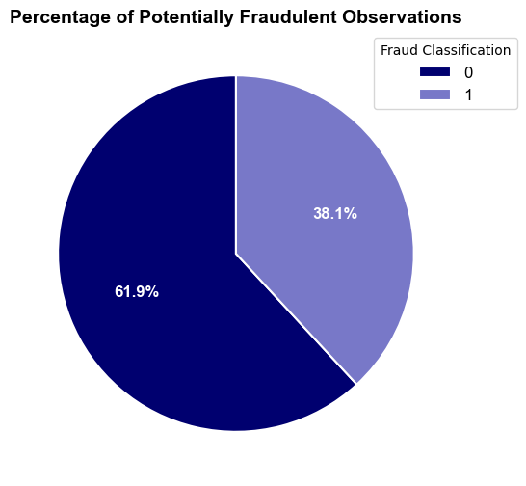

The balanced fraud distribution does not match real-world fraud frequency, raising generalization oncerns
The balanced fraud distribution does not match real-world fraud frequency, raising generalization concerns
But, only about 5-7% of Medicare claims were found to be actually fraudulent in 2024

Slide 8

Data Preparation and Feature Engineering: High-Level Overview & Approach
Data Preparation
Feature Engineering
Handle Missing Values (simple imputation)
Extract date features to remove datetime types
Handle outliers (use scaling/transformation)
Discretize age into bins
Encode categorical columns (e.g. claim codes)
Log transform skewed distributions
Apply Feature Scaling for Use in Modeling

Slide 9




We used a 4-pronged approach, shortlisting a comprehensive range of modeling options
Linear-Based Models
Logistic Regression
Tree-Based Models
Random Forest
XG Boost
Probabilistic Models
Gaussian Naïve Bayes
Bernoulli Naïve Bayes
Ensemble Methods
Voting Model (LR, RF, GNB)
Stacked Model (LR, SVM)

Slide 10
Agenda
Problem Definition & Objective
Overview of the business problem and primary goal guiding the analysis
1
Approach & Methodology
Discussion of the data processing, feature engineering, and model selection
2
Modeling Results
Summary of the key findings and performance of the tested models
3
Analysis & Limitations
Analysis of the business implications and potential areas of enhancement
4

Slide 11
Ultimately, XGBoost performed the best among the tested models in 3/5 metric categories
Model | Accuracy | Precision | Recall | F1 Score | ROC AUC
Logistic Regression | 81.07% | 78.35% | 69.63% | 73.73% | 86.30%
Random Forest | 93.17% | 99.02% | 82.92% | 90.25% | 98.42%
Gaussian Naïve Bayes | 80.11% | 81.98% | 61.39% | 70.21% | 80.43%
Bernoulli Naïve Bayes | 62.83% | 56.48% | 11.30% | 18.83% | 53.17%
Voting Model | 94.76% | 99.73% | 86.51% | 92.65% | -
Logistic Regression Stacked | 97.64% | 99.82% | 93.58% | 96.81% | 97.31%
SVM Stacked | 97.65% | 99.79% | 94.03% | 96.82% | -
XGBoost | 97.54% | 99.86% | 93.68% | 96.67% | 99.82%

Slide 12



While the XGBoost model performed best overall, precision and recall were not equally balanced
True Label
Modeling Performance Metrics
Not Fraud
Fraud
Predicted Label
Not Fraud
69,184
2,701
97.5% Overall Accuracy
99.9% Weighted Average Precision
Fraud
57
40,034
93.7% Weighted Average Recall

Slide 13
Agenda
Problem Definition & Objective
Overview of the business problem and primary goal guiding the analysis
1
Approach & Methodology
Discussion of the data processing, feature engineering, and model selection
2
Modeling Results
Summary of the key findings and performance of the tested models
3
Analysis & Limitations
Analysis of the business implications and potential areas of enhancement
4

Slide 14
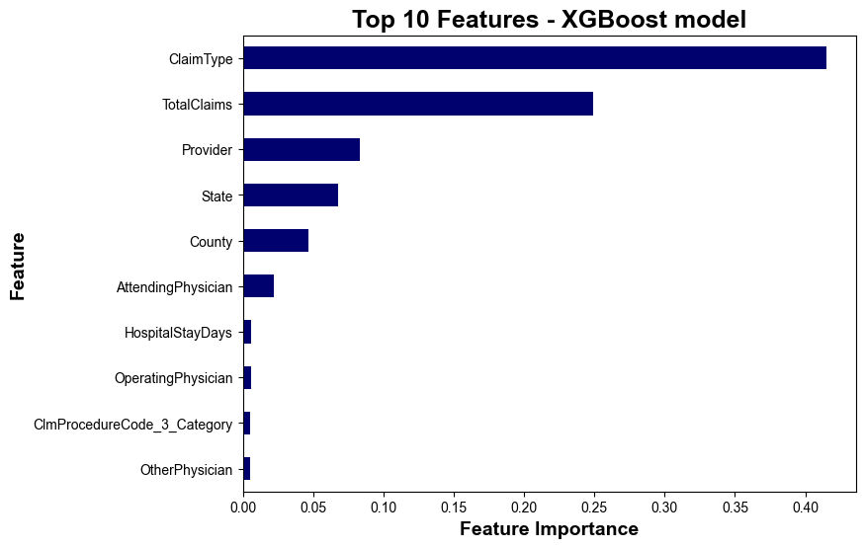
Claim type, total claims, and the provider should be prioritized most in future fraud investigations
Claim type is the #1 predictor of fraud
The top 3 predictors describe 75% of fraud

Slide 15


Optimizing Fraud Detection: Examining the trade-off between precision and recall
Fine tuning was a balance between the cost of investigating fraud and the benefits of identifying it
PRECISION
RECALL
Of the cases predicted to be fraudulent, 99% were actually fraudulent
Our model accurately
predicts 94% of fraud cases

Slide 16
Model deployment could lead to the recovery of approximately 16+% of taxpayer funding
$2B of taxpayer funding (2024)
$348M of predictable fraud
$326M (94%) of captured fraud
16% of funding returned

Slide 17
More information about the data and business priorities will further enhance the model’s value
Data Validation & Clarification
1
How is the data sourced and validated?
What is the exact definition of ‘PotentialFraud’?
Business Objective Refinement
2
What is the cost of fraud investigations?
Should the model prioritize recall or precision to maximize impact?

Slide 18
Questions?

Slide 19
Appendix

Slide 20
Key Takeaways from our Exploratory Data Analysis of the datasets:
Fraudulent claims have a higher reimbursement amount
Several columns have missing values, but many can be attributed to a sparse structure
There are some outliers in all datasets, but this is not unexpected given the variation in the cost of medical services and needs
Many categorical features require pre-processing to be used meaningfully in modeling – particularly the diagnosis and claims codes
The fraud distribution is balanced, raising generalizability concerns

Slide 21
Specific Data Preparation and Feature Engineering Processing Steps:
Stage | Step | Detail | Original Data Example | Processed Data Example
Data Cleaning | Dataset Merging | Joined the inpatient, outpatient, beneficiary, and provider datasets | - | -
 | Missing Value Handling | Kept all rows to avoid data loss but replaced NaN with 0 values | ClmProcedureCode_2: NaN | ClmProcedureCode_2: 0
 | Outlier Handling / Transformation | Retained all outliers and instead applied log-transformation to claim and deductible columns | InscClaimAmtReimburse: 11000 InscClaimAmtReimburse: 3000 | InscClaimAmtReimburse: 4.04 InscClaimAmtReimburse: 3.48
 | Categorical Encoding | Categorically encoded extracted diagnosis form claim and procedure codes | ClmProcedureCode_2: 41071 | Acute Myocardial Infarction (AMI) [Diagnosis Family] Subendocardial Infarction [Diagnosis Subtype Column]
Feature Engineering | Discretization | Binned age and claim features to for use in non-learn models | DOB: 1943-01-01 | Age: 82 Age_Bin: 80-85
 | Feature Creation | Created new features and made feature interactions | - | Avg_Claim_Provider Age_Diagnosis_Family

Slide 22
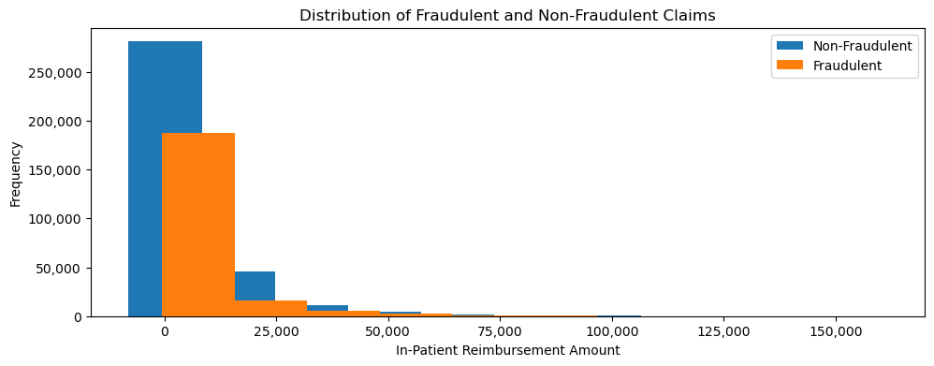
Fraudulent claims have a higher reimbursement amounts on average, but both are highly skewed distributions

Slide 23
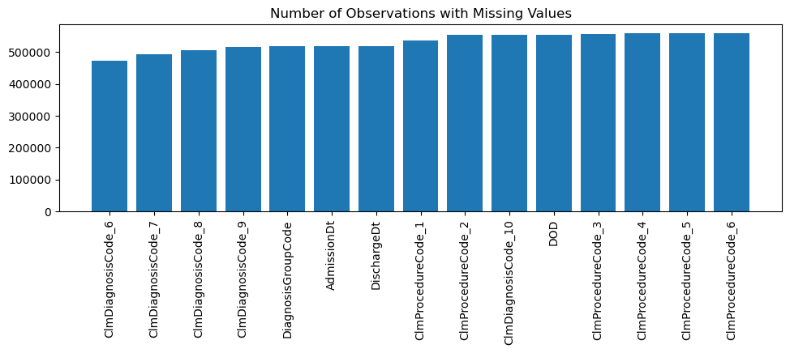
Several columns have missing values, but this can be attributed to collection structure, not quality issues

Slide 24
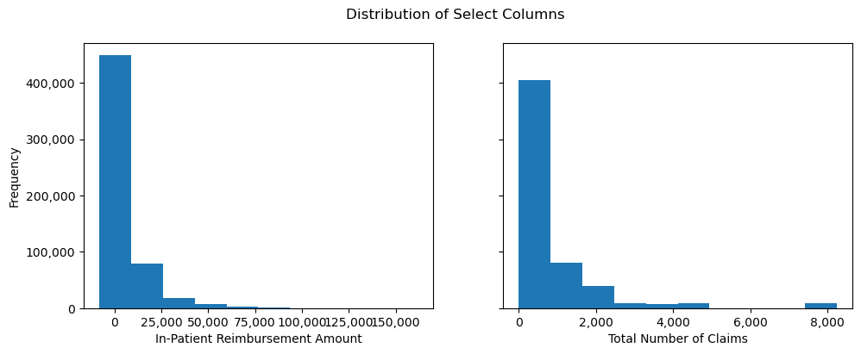
There are outliers, but this is not unexpected given the variation in the cost of medical services and needs

