Slide 1

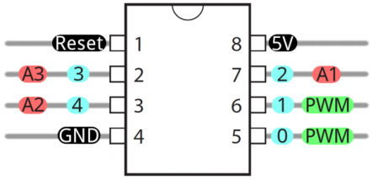
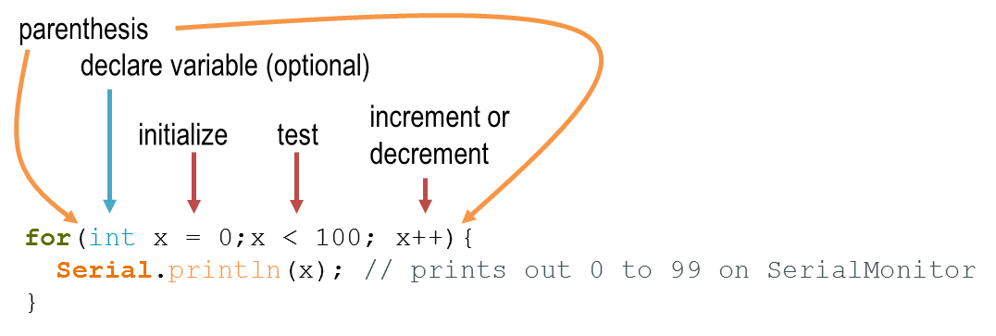
Sparkfun Electronics ATtiny85 Arduino Quick Reference Sheet
ATtiny85
Structure
/* Each Arduino sketch must contain the following two functions. */
void setup()
{ // this code runs once at the
// beginning of the code execution.
}
void loop()
{ // this code runs repeatedly over
// and over as long as the board is
// powered.
}
Comments
// this is a single line comment
/* this is
a multiline
comment */
Setup
pinMode(pinNum, INPUT/OUTPUT/INPUT_PULLUP);
/* Sets the mode of the digital I/O pin.
All pins are general I/O on the board. You must define what the pin will be used for at the beginning of your code in setup() */
Control Structures
if(condition)
{ // if condition is true, do something here
}
else
{ // otherwise, do this
}
for(init; condition; increment)
{
// do this, increment, and
// repeat while condition is true.
}
Digital I/O
digitalWrite(pin, val);
/* val = HIGH or LOW write a HIGH or a LOW
value to a digital pin. */
buttonVal = digitalRead(pin);
/* Reads the value from a specified digital
pin, either HIGH or LOW. */
Analog I/O
analogWrite(pin, val);
/* Writes an analog voltage (using PWM) to a pin. val = integer value from 0 to 255 */
sensorVal = analogRead(pin);
/* Reads the voltage from the specified
analog pin. 0V returns 0; Vcc returns 1023*/
Time
delay(time_ms);
/* Pauses the program for the amount of time (in milliseconds). */
millis();
/* Returns the number of milliseconds since the board began running the current program. max: 4,294,967,295 */
ATtiny85 Pins
Pins 0 – 4 : general purpose I/O pins (GPIO).
Both digitalWrite() and digitalRead() can be used with any of these pins.
Pins 0 & 1 : setup for PWM output using analogWrite().
Pins A1, A2, A3 : setup for reading sensor input with analogRead().
Data Types
void // nothing is returned
boolean // 0, 1, false, true
char // 8 bits: -128 to 127
byte // 8 bits: 0 to 255
int // 16 bits: -32,768 to 32,767
unsigned int // 16 bits (unsigned)
long /* 32 bits: -2,147,483,648
to 2,147,483,647 */
unsigned long // 32 bits (unsigned)
float // 32 bits, signed decimal
Serial Communication
A separate USB to serial adapter like FTDI is needed for Serial communication with the ATtiny. And. the ATtiny must be flashed to run at 8 MHz instead of 1 MHz.
The ATtiny does not support Serial natively. You need to use the SoftwareSerial library to enable this function.
#include <SoftwareSerial.h> // include library
SoftwareSerial tinySerial(3, 4);
/* Put above setup() and loop() – declares tinySerial using 3 & 4 for Transmit (tx) and Receive (rx) */
tinySerial.begin(9600); /* begin Serial at 9600 baud. Put this line in setup() */
tinySerial.print(“”); /* sends data on TX line – to your receiving computer. */
tinySerial.println(“”); /* sends data to Serial Monitor with CRLF. */
inChar = tinySerial.read();

Slide 2

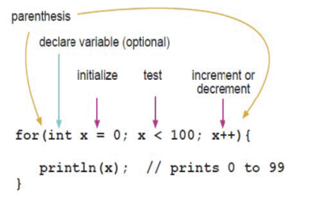

SparkFun Electronics ATtiny85 Arduino Quick Reference Sheet
ATtiny85
Structure
/* Each Arduino sketch must contain the following two functions. */
void setup()
{ // this code runs once at the
// beginning of the code execution.
}
void loop()
{ // this code runs repeatedly over
// and over as long as the board is
// powered.
}
Comments
// this is a single line comment
/* this is
a multiline
comment */
Setup
pinMode(pinNum, INPUT/OUTPUT/INPUT_PULLUP);
/* Sets the mode of the digital I/O pin.
All pins are general I/O on the board. You must define what the pin will be used for at the beginning of your code in setup() */
Control Structures
if(condition)
{ // if condition is true, do
//something here
}
else
{ // otherwise, do this
}
for(init; condition; increment)
{
// do this
}
Digital I/O
digitalWrite(pin, val);
/* val = HIGH or LOW write a HIGH or a LOW
value to a digital pin. */
buttonVal = digitalRead(pin);
/* Reads the value from a specified digital
pin, either HIGH or LOW. */
Analog I/O
analogWrite(pin, val);
/* Writes an analog value to a pin.
val = integer value from 0 to 255 */
sensorVal = analogRead(pin);
/* Reads the value from the specified
analog pin. */
Time
delay(time_ms);
/* Pauses the program for the amount of time (in milliseconds). */
delayMicroseconds(time_us);
/* Pauses the program for the amount of time (in microseconds). */
millis();
/* Returns the number of milliseconds since the board began running the current program. max: 4,294,967,295 */
micros();
/* Returns the number of microseconds since the board began running the current program. max: 4,294,967,295 */
ATtiny85 Pins
Pins 0 – 4 are all general purpose I/O pins (GPIO).
Both digitalWrite() and digitalRead() can be used with any of these pins.
Pins 0 & 1 are setup for PWM output using analogWrite().
Pins A1, A2, A3 are setup for reading sensor input with analogRead().
Data Types
void // nothing is returned
boolean // 0, 1, false, true
char // 8 bits: ASCII character
byte // 8 bits: 0 to 255
int // 16 bits: -32,768 to 32,767
unsigned int // 16 bits (unsigned)
long /* 32 bits: -2,147,483,648
to 2,147,483,647 */
unsigned long // 32 bits (unsigned)
float // 32 bits, signed decimal
Constants
HIGH \ LOW
INPUT \ OUTPUT \ INPUT_PULLUP
true \ false
/* The ‘for’ statement is used to repeat
a block of statements enclosed in curly
braces. An increment counter is usually
used to increment and terminate the loop.
*/
v2

Slide 3


Arduino ATtiny85 Quick Reference Sheet
analogWrite(pin, value);
pinMode(pin, [INPUT/OUTPUT/INPUT_PULLLUP);
analogWrite([0/1], value);
digitalWrite([0-4], [HIGH\LOW]);
analogRead([A1/A2/A3);
digitalRead([0-4]);
delay(time_ms);
Arduino colors:
dark green: 94, 109, 3
orange: 233, 115, 0
blue: 0, 150, 189
grey: 67, 79, 84

Slide 4
parenthesis
declare variable (optional)
initialize
test
increment or decrement
for(int x = 0;x < 100; x++){
Serial.println(x); // prints out 0 to 99 on SerialMonitor
}

