Slide 1

Intrusion detection system in the Smart Distribution Network: A smart feature engineering-based PI-LightGBM approach Master of Computer Application(MCA)
Submitted by :- Under the Guidance of
Bhubanesh Maharana Mr. J. Chandrakanta Badajena
Regd. No. :-23240002 School Of Computer Sciences, OUTR

Slide 2
Contents
Introduction
Problem Statement
Objective
Algorithm Used
Proposed Model
Results and Experimental Analysis
Conclusion

Slide 3
The Network Intrusion Detection System (NIDS) is used to protect networks from unauthorized access, targeted to network and computing resources.
In a short interval of time NIDS classify the network data into normal traffic data and intrusion data .
In NIDS , we used various methods of like feature selection based pattern matching, including several machine learning algorithms with big data technologies.
With the help of this algorithms we can classify and find the intrusion data and this data can be further classify into DDOS(Distributed denial of service), Probing, R2L (Remote to Local) and U2R (User to Root).
Introduction

Slide 4
Real-Time Detection: Optimize ML models for fast and efficient intrusion detection. Ensure they can handle high data loads and use resources effectively.
False Positives and False Negatives: Minimize false alarms and missed threats by fine-tuning model sensitivity. Reduce the operational burden of false alerts
Adaptability and Scalability: Regularly update models to handle evolving threats and diverse network traffic. Ensure the IDS can scale with network growth.
Problem Statement

Slide 5
Aims to build up an efficient network IDS , which takes appropriate decision about the data is normal data or anomaly data type in the network traffic.
To conduct both numeric and symbolic data representation in the network traffic.
To recognize the attack type of anomaly data.
Objective

Slide 6
In my proposed framework I used two algorithms mainly for feature selection and classification.
For feature selection I used permutation importance score to listed top important features.
Where for classification I used a gradient boosting decision tree (GBDT) algorithm LightGBM.
Algorithms Used

Slide 7
Permutation Improtance based feature selection agent
Permutation importance is a method for feature importance calculation in machine learning. It measures the decrease in model performance when the values of a feature are randomly permuted, while holding all other features constant.
The feature importance score is then calculated as the difference between the original performance and the performance with permuted features. This score represents the contribution of the feature to the model's accuracy. By setting a PI-threshold value we can obtain a list of important features .

Slide 8
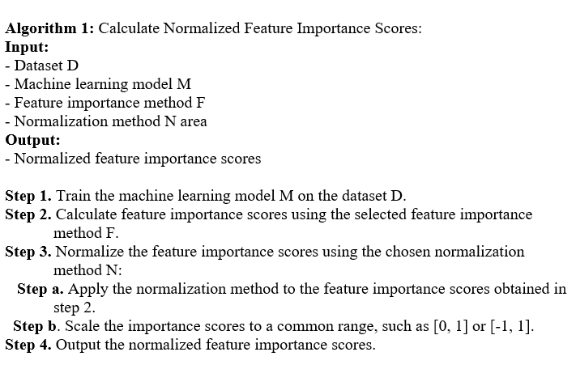
To compute permutation importance score .

Slide 9
Model Training with LightGBM:
The Gradient Boosting Decision Tree (GBDT) algorithm has been enhanced with the introduction of LightGBM.
Integrating several "weak" learners into one "strong" learner is the key principle of LightGBM.
This concept serves as the foundation for two types of machine learning algorithms. Initially, "weak" learners are simple to pick up. Second, the generalization performance of a group of learners is usually higher than that of a single student.

Slide 10
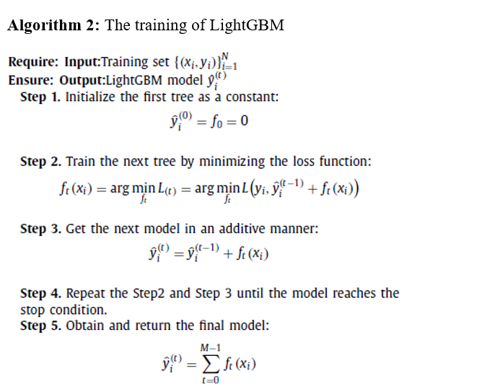
LightGBM Algorithm

Slide 11
My proposed methodology comprises three components: Data preprocessing, a Feature selection agent, and a classification module.
Preparing data for analysis and consistency is crucial in machine learning. This involves cleaning, transforming, and standardizing data.
The Permutation importance measures feature importance by evaluating the decrease in model performance when a feature's values are randomly permuted.
The LightGBM (Light Gradient Boosting Machine) is an advanced gradient boosting framework designed for speed and efficiency, ideal for large datasets and high-dimensional data.
Proposed Model

Slide 12
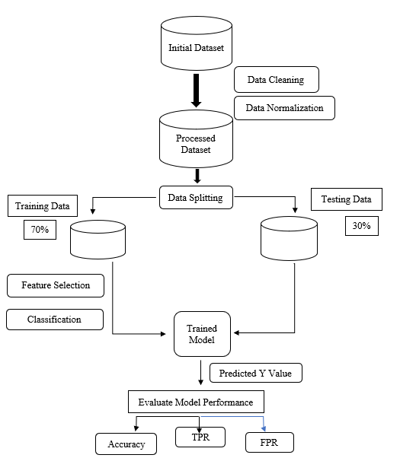
Proposed Model
[ Figure : describing the flow of procedure ]

Slide 13
Result and Experimental Analysis
The experiment is done with the KDD99 and NSL-KDD dataset for intrusion detection evaluation.
The original KDD99 dataset consists of 5,000,000 labeled records with 41 attributes. Traffic belongs to either the "Normal" class or an "Attack" class.
The "Attack" class is further divided into four categories: DDOS (Distributed denial of service), Probing, R2L (Remote to Local), and U2R (User to Root) . Within the data set exists 4 different classes of attacks: Denial of Service (DoS), Probe, User to Root(U2R), and Remote to Local (R2L).

Slide 15
Analysis
The detection performance is assessed in this work using a variety of metrics, including accuracy, false positive rate, F-measure, and true positive rate (also known as detection rate).
This review highlights the framework's efficiency in producing accurate predictions for detecting threats in network security and analyzes the challenges encountered as well as possible areas for growth.

Slide 16
Confusion Matrix
My framework yields the best results, as can be drawn from confusion matrix ,
with 99.89% TPR, 0.10% FPR, and 99.63% accuracy.

Slide 17
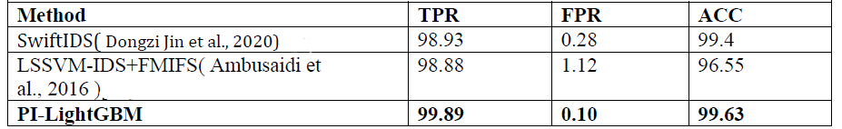
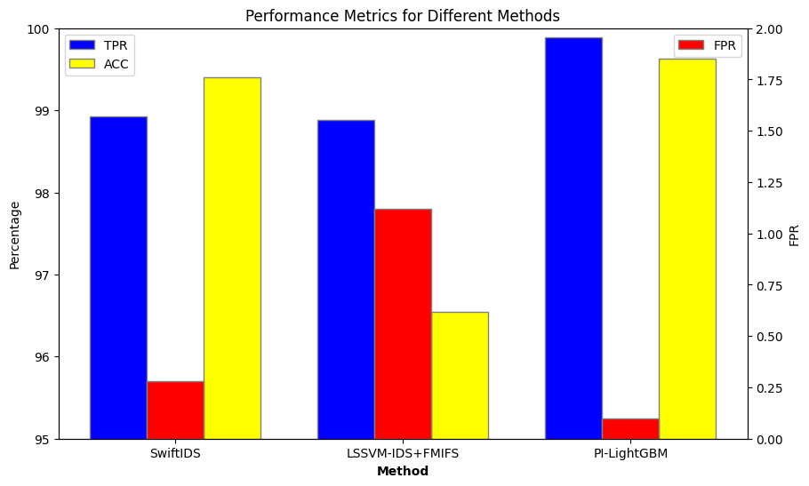
Compare to other Frameworks
[ Tabular and graph representation of comparison of model with other framework ]

Slide 18
Conclusion
To sum up, the main objective of intrusion detection systems (IDS) is to detect and stop attacks before they have a substantial negative impact. The growing amount of traffic data in high-speed networks presents serious difficulties for IDS solutions now in use.
For real-time intrusion detection systems (IDSs) to function well in real-time settings and retain high detection performance, several issues must be resolved.
The use of PI-LightGBM is suggested in this study to improve the accuracy and speed of traffic analysis. This method seeks to greatly enhance the real-time capabilities of IDS by combining Intelligent Feature Selection with the LightGBM algorithm, guaranteeing strong and effective network protection against dynamic cyber threats.

Slide 19
THANK YOU

