Slide 1

An intelligent, efficient and low cost Parking Solution
Submitted in partial fulfilment of M. Tech. Software Systems Degree programme
By
Bhuban Mohan Mishra
Id No. 2013HT13067

Slide 2
Problem statement
Parking of vehicles has always been a manual and time-consuming task. From large retails to corporates that maintain huge parking spaces for their customers and employees, find it very hard to provide necessary information to the commuters that would guide them to the available parking space. Commuters usually have to drive through to find the available parking space that is time consuming, costly and tiring. Commuters often miss the nearby parking spot and park at a faraway place that adds to the frustration.

Slide 3
Objective of the study
Come up with an automated approach to finding free parking places at designated parking areas.
Find a Cost effective solution that can be implemented with minimum/existing infrastructure
Come up with a Prototype of a Smart Camera that can be taken forward for mass production.
Come up with a User dashboard to receive meaningful information from the system that will be helpful to the Community.

Slide 4
Methodology
Background Research: Identify the difficulties and issues with the existing Parking management and gather requirements for automating the same.
System Design: Design the architecture that will implement the intelligent solution and help in managing and displaying data.
Prototyping and Coding: Create a prototype of the smart camera and build the necessary modules.
Testing the Prototype: Test the prototype and the interaction of the device with various modules.
Implementation: Deploy the modules on cloud to make it available to desired stakeholders.

Slide 5
Existing system
The existing parking management system is more of a manual process where the only information available to commuters is the location of parking places. There is absolutely no information provided to the commuters about the availability of free parking places.
Disadvantages
Search is not optimal (Not the nearest)
Time Consuming
Frustration

Slide 6
Proposed System
An intelligent device that makes use of Image Processing from the images received from Cameras placed at designated Parking locations to derive the availability of parking spaces.
The cameras could send the information processed to a Central Server on Cloud.
This information could then be presented to End Users through various devices like:
Dashboards at designated entry locations
Mobile Devices
An administrator interface to manage the cameras and metadata.

Slide 7
Internet of Things
Due to the distributed nature of the application and involvement of smart devices / cameras, there is a need for connectivity between these devices. Based on this need, Internet of Things is one of the key ingredients of this solution that will help in bringing more automation, faster processing and real time availability of data to the end users.

Slide 8
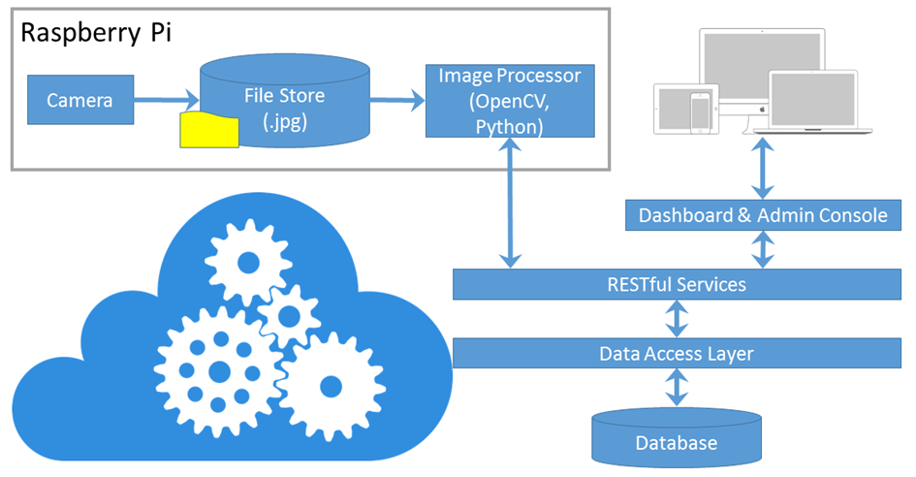
Solution Architecture
Various Components:
Database
RESTful Services
Admin Console
Dashboard
Image Processor

Slide 9







Development tools
Visual Studio 2015 Community Edition
Version Control (Git)
Database
SQLite
Programming Language (Web)
HTML5, CSS3, jQuery
Programming Language (Services)
ASP.NET Web API, Entity Framework
Image Processor
Python, OpenCV

Slide 10
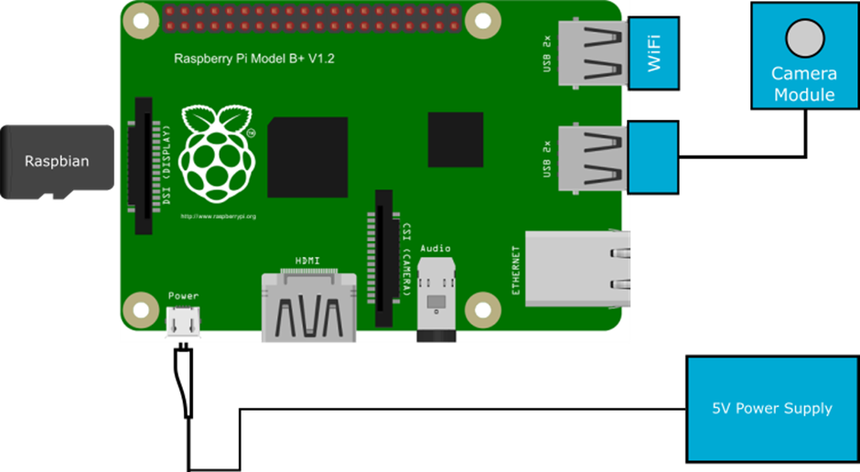
prototype

Slide 11
Image processor

Slide 12
Deployment architecture

Slide 13
Application and Code Walkthrough
Demonstration of the project
Python Code (Image Processing)
Service Layer
Admin Interfaces
Parking Management
Camera Management
User Dashboard

Slide 14
Summary
In this research, a solution for a common problem of Parking management is proposed that uses image processing techniques for object detection. The current manual system can be highly automated by use of this technique and thus help the common people with the use of technology.
Because of the use of Image Processing Technique used in the detection of Vehicles, this Solution is very Cost Effective and Efficient.
The use of Cameras can also help with multiple purpose and mainly for Security Purpose. Installation of cameras at various locations could help in monitoring even remote locations and can thus help in fighting crime.

Slide 15
Questions?
Thank You

