Slide 1
How to sign up to use Teachercom

Slide 2
What will I need?
A twilio account
A working phone number and the ability to answer it while signing up
A credit card
$20 Dollars to start
A teachercom account with twilio credentials

Slide 3
Step 1: Create Twilio account
Open a web browser
Navigate to www.twilio.com

Slide 4


Slide 5
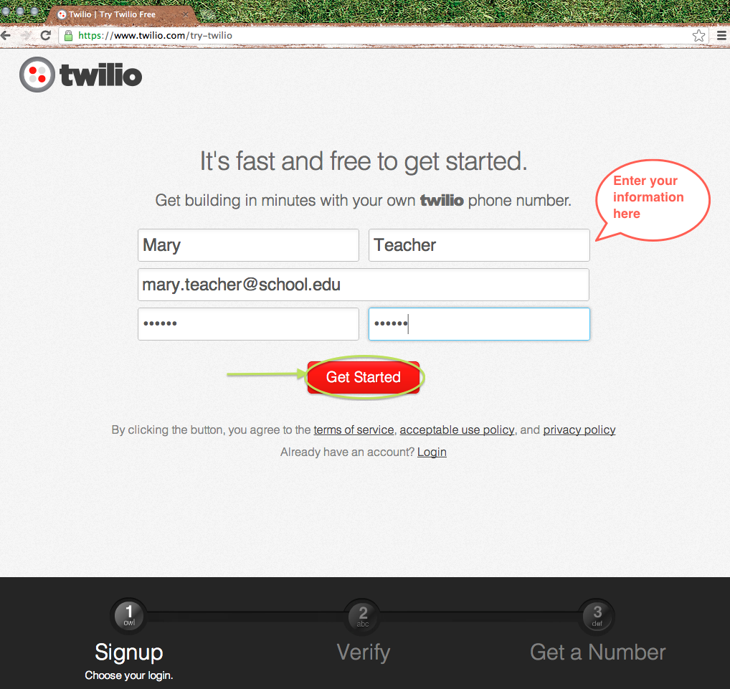

Slide 6
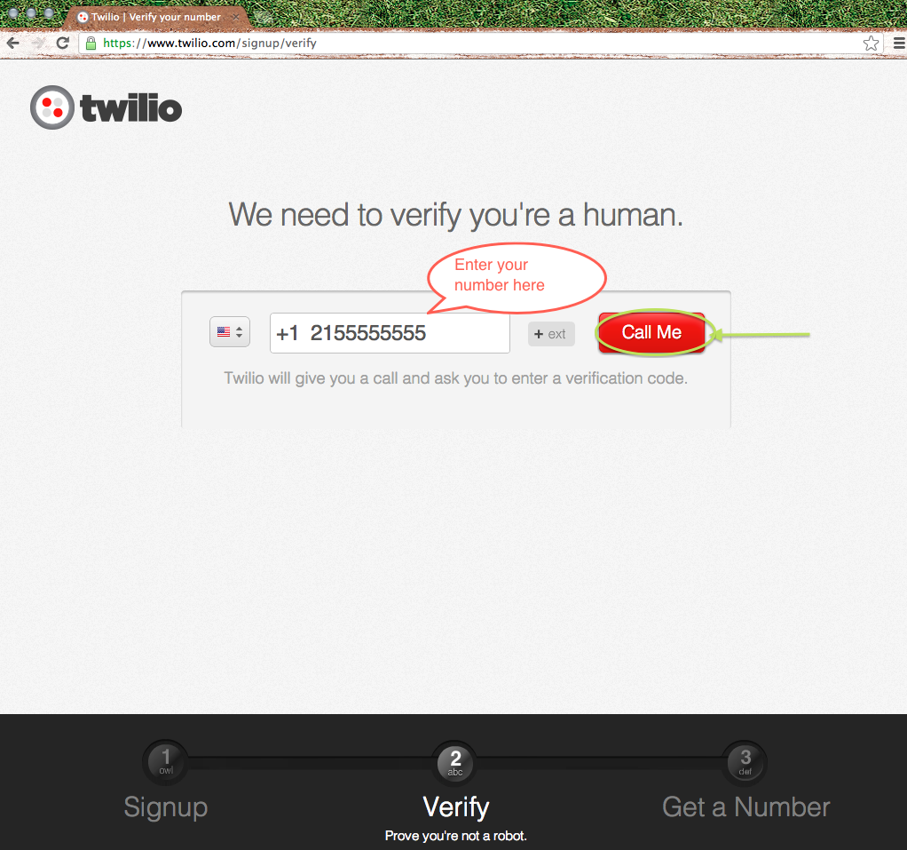

Slide 7
Twilio is calling, please answer your phone
Enter the verification code into keypad

Slide 8
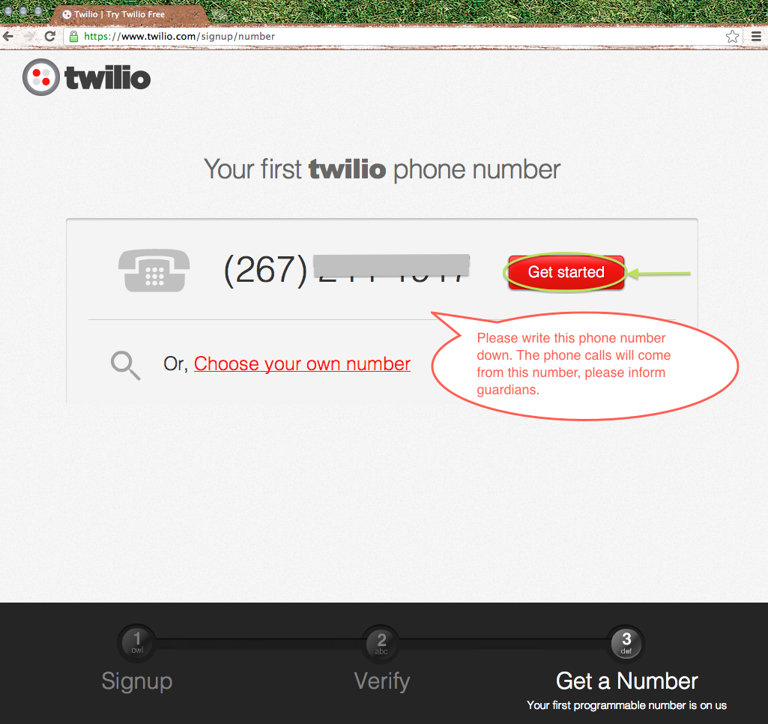

Slide 9
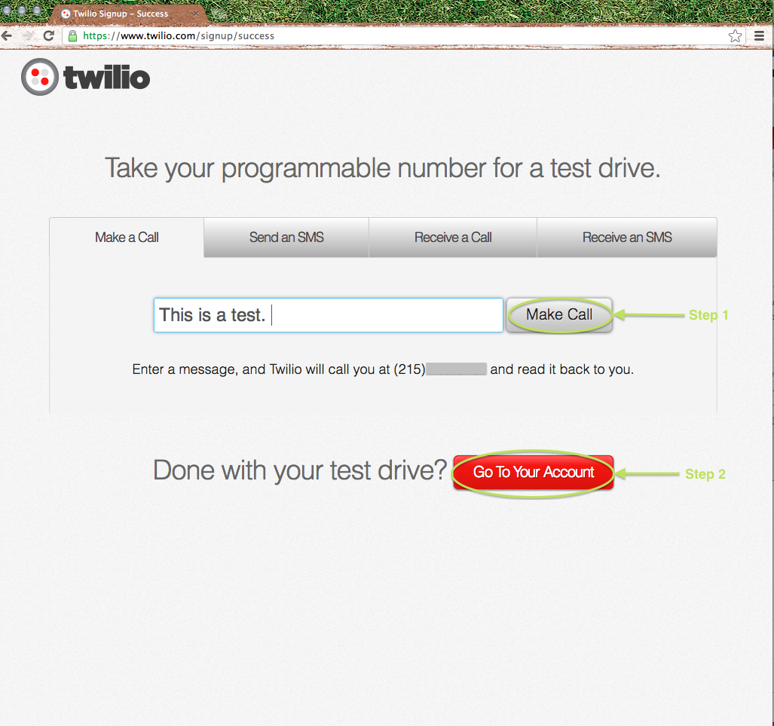

Slide 10
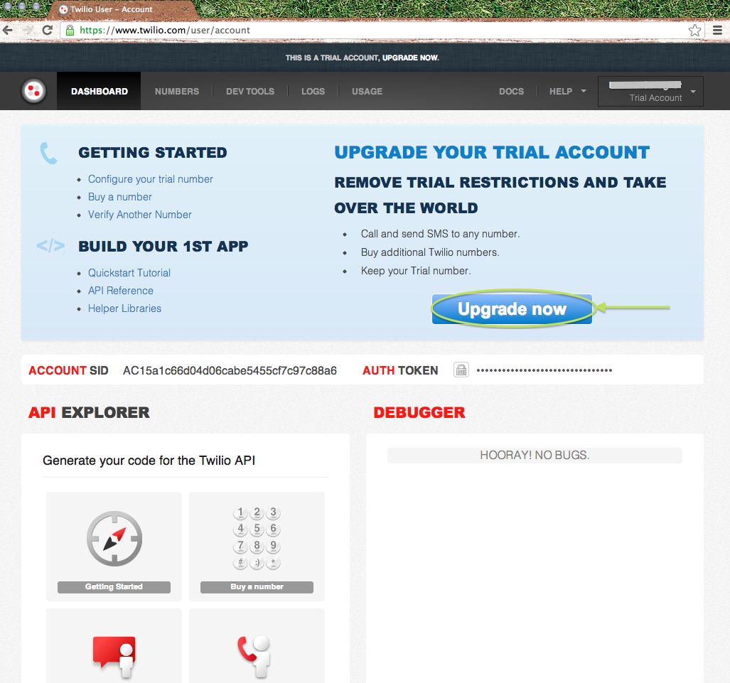

Slide 11
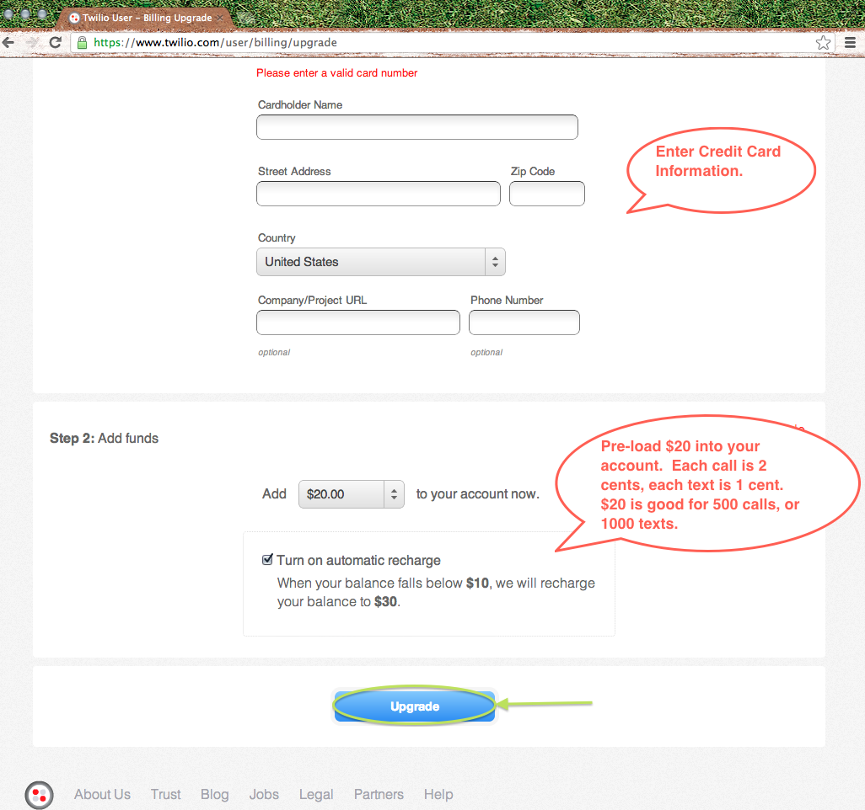

Slide 12
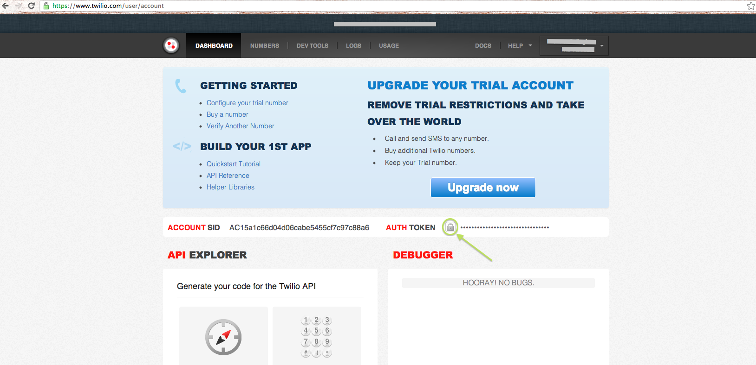

Slide 13
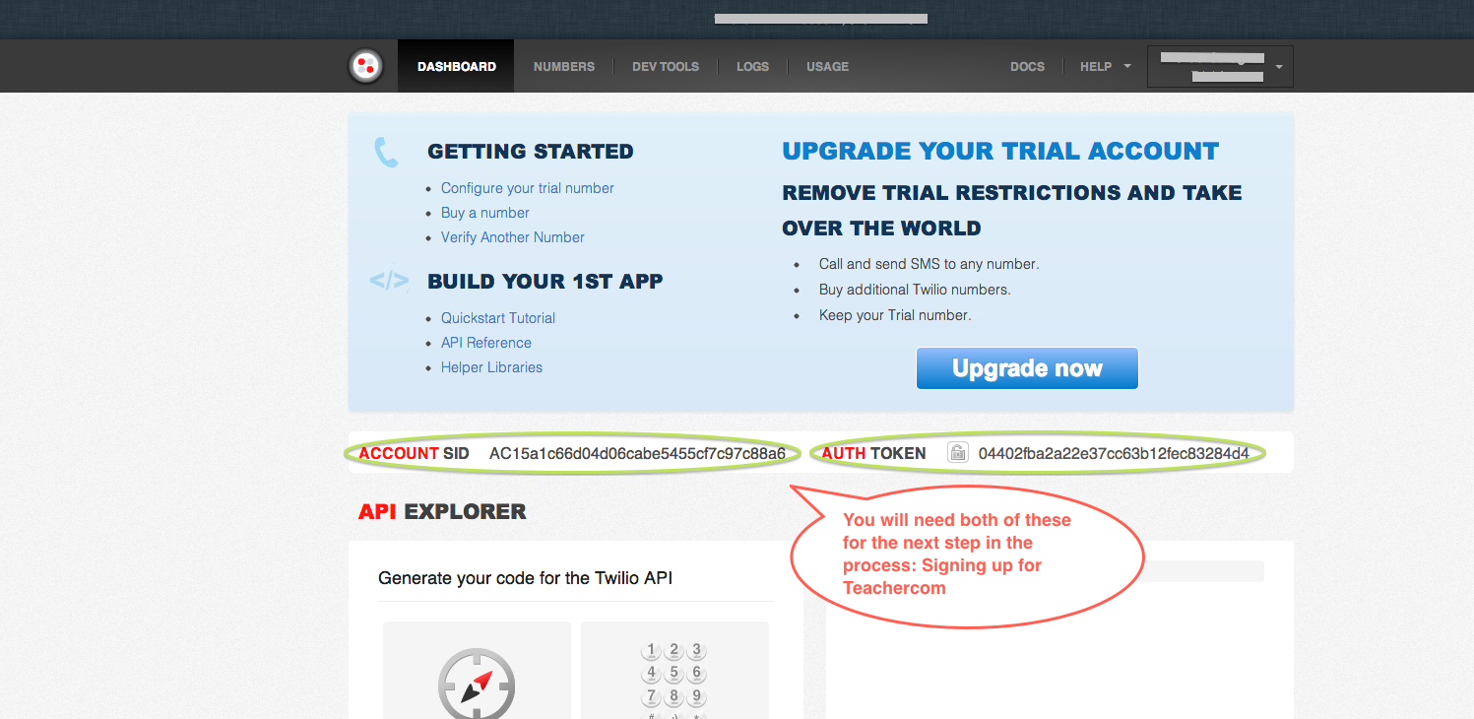

Slide 14
Now you are ready to use Teachercom

Slide 15
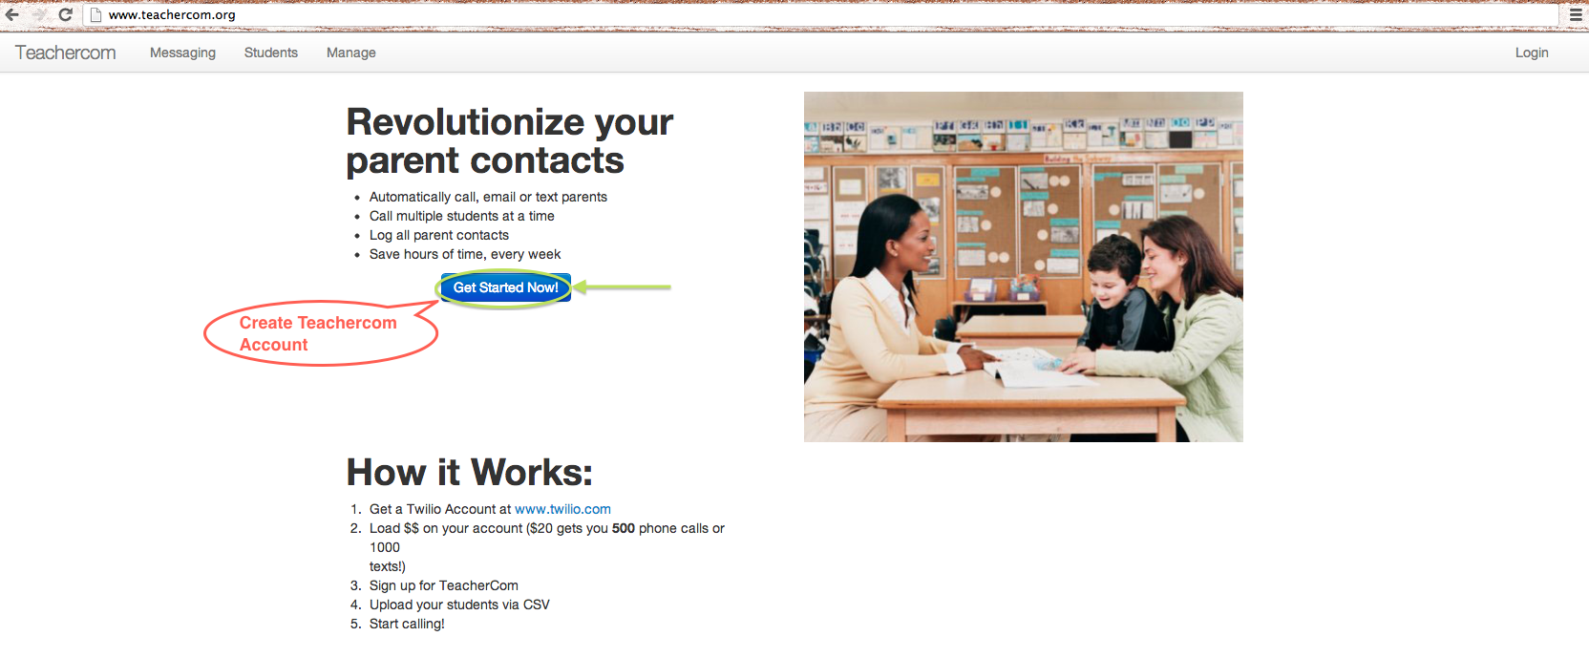

Slide 16
