Slide 1
How to upload students with a .csv file

Slide 2
Open Microsoft Excel
Add Students using the following columns, in order
Template Provided (www.teachercom.org/docs/template.csv)
Student id (If you don’t have this, just number them 1, 2, 3, etc…)
First name
Last name
Phone Number
Email
Sms preference – (True/False)
Call preference – (True/False)
Email preference – (True/False)

Slide 3
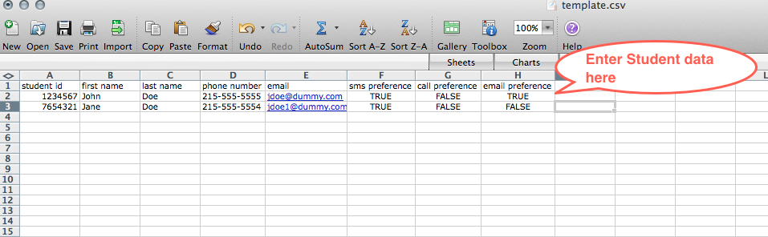

Slide 4
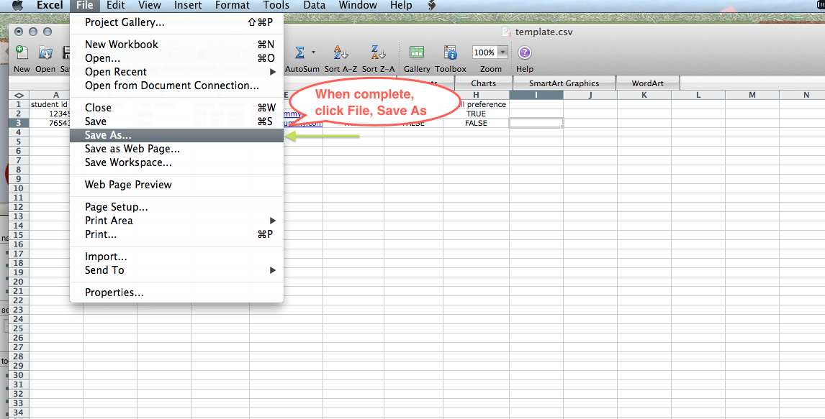

Slide 5
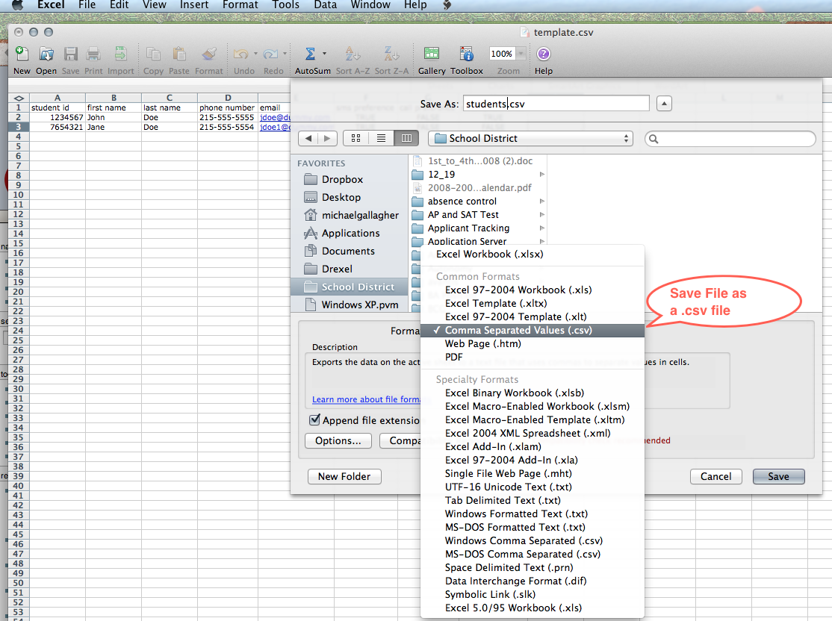

Slide 6
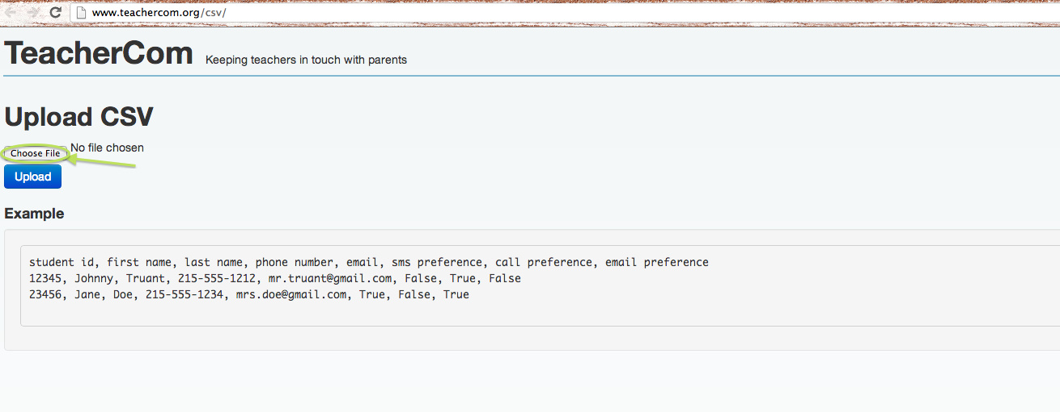

Slide 7
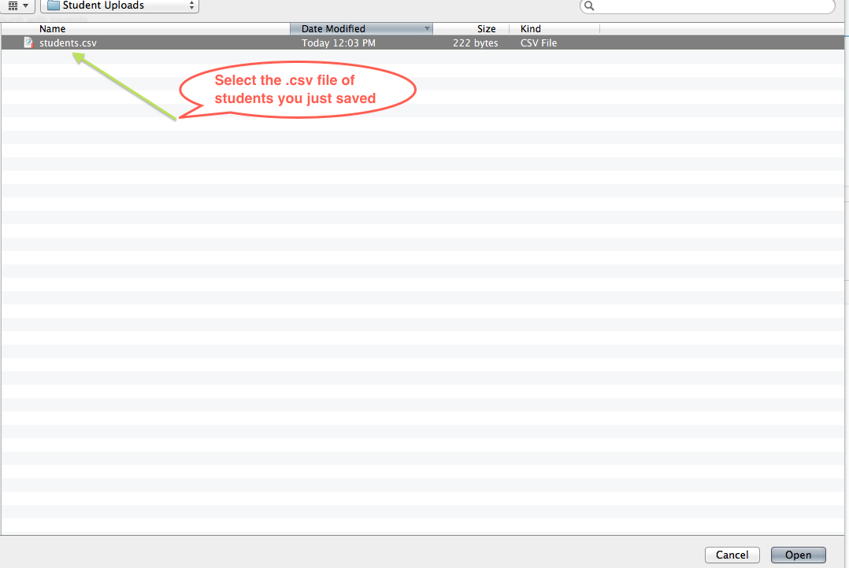

Slide 8
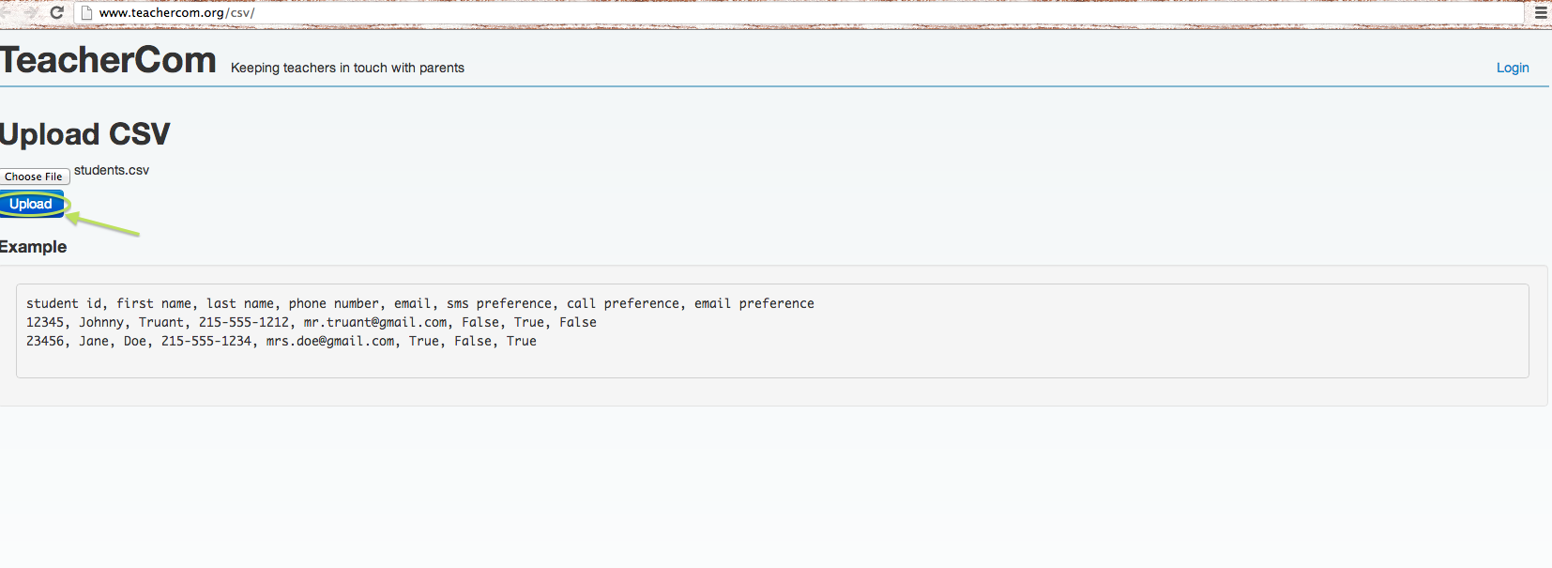

Slide 9
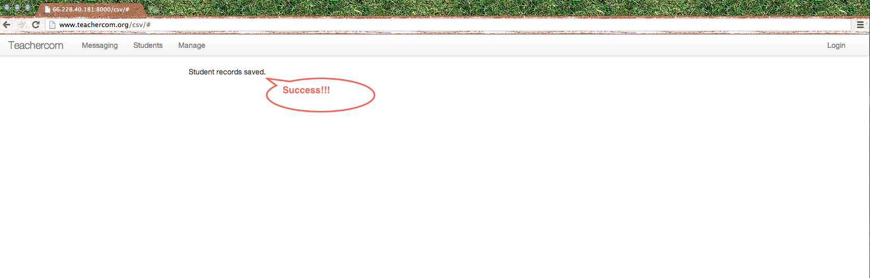

Slide 10
