Slide 1

USA Renewable Energy
Group 5: Artem Iliushin, Bhumi Bhusal, Rafael Tem Pahs, Ryan Callaghan, Ryan Cheng

Slide 2
Project Description
Our goal is to use past and current renewable and consumption data to predict which states, by 2035, will be running entirely on sustainable
Predict which states would not be producing the same amount of renewable energy compared to energy consumption by 2035

Slide 3







FlowChart
Data Sources
Data Clean & Linear Regression
Back End
Front End
U.S Energy Information Administration

Slide 4
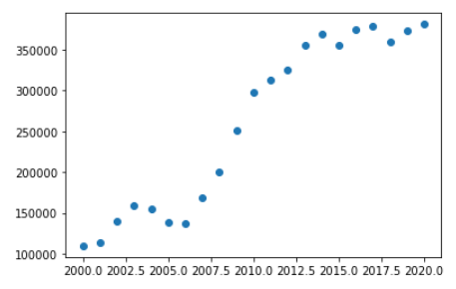
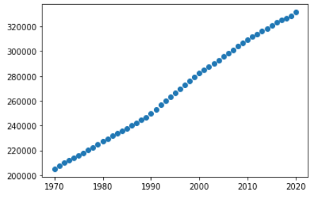
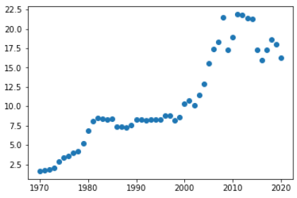
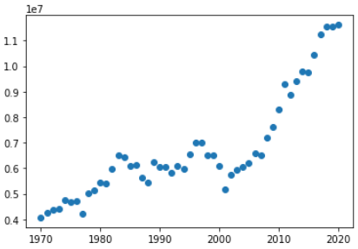
United States Renewable Energy Linear Regression
Data was mostly linear for the years 1970 to 2020 and the key features were increasing each year.
The features used were population, energy price and renewable production.
We calculated the renewable energy deficit by taking renewable energy production less the total energy consumption each year.
We used linear regression model to predict the above features future values for the next 15 years.
Then we used multiple-linear regression model to predict the renewable energy deficit for the next 15 years.
Consumption
Scatter
Population
Scatter
Price Scatter
Production
Scatter

Slide 5
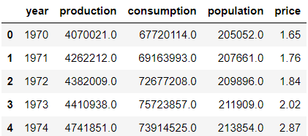
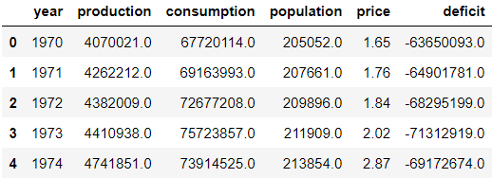
Time series analysis with lag features
Target Variable:
Deficit = Renewable energy production – Total consumption
?
?
?
???

Slide 6
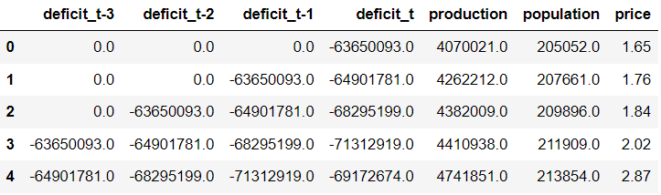
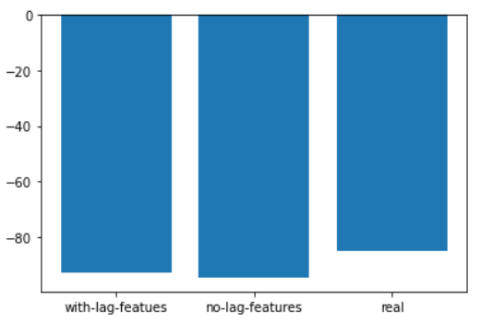
Time series analysis with lag features
Prediction for 2021
R2 = 0.93
R2 = 0.92
Energy Deficit (Bil BTU)

Slide 7
Web Visualizations

