Slide 1

MVC

Slide 2
Agenda
  What is MVC?

Slide 3
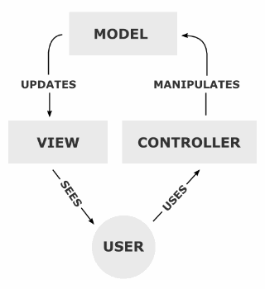
Understanding MVC

Slide 4
Model-View-Controller
The model is responsible to manage the data; it stores and retrieves entities used by an application, usually from a database, and contains the logic implemented by the application.
The view (presentation) is responsible to display the data provided by the model in a specific format. It has a similar usage with the template modules present in some popular web applications, like wordpress, joomla, …
The controller handles the model and view layers to work together. The controller receives a request from the client, invoke the model to perform the requested operations and send the data to the View. The view format the data to be presented to the user, in a web application as an html output.

Slide 5
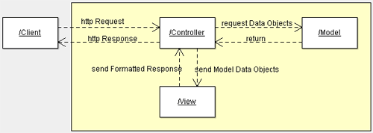
Model-View-Controller

Slide 6
Why use an MVC framework?
Avoid “reinventing the wheel”
Use proven, tested code
Automation Maintainability
“Plugin” functionality

Slide 7
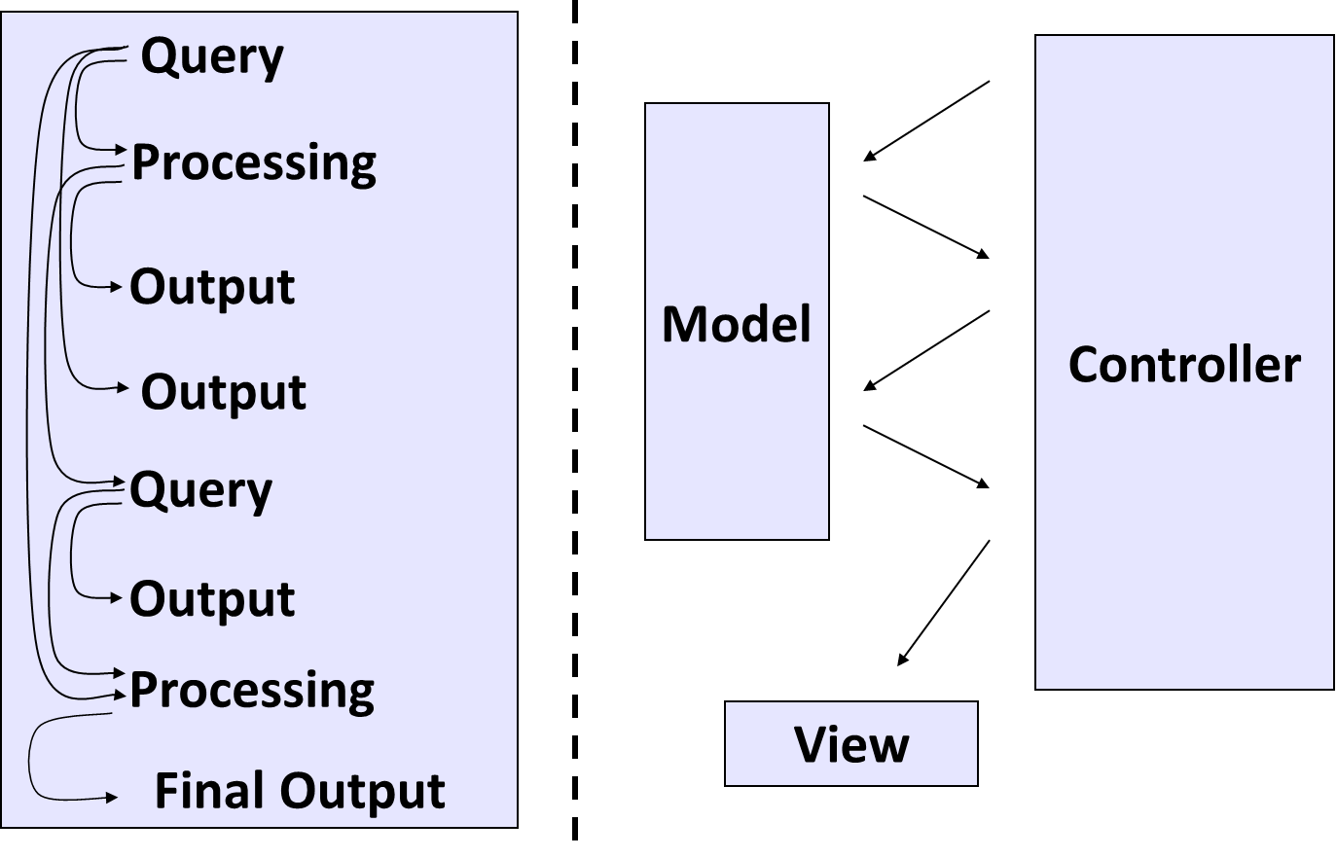

Flow: Traditional vs. MVC

Slide 8
Benefits of MVC framework
Clarity in design with efficient modules
Better support for building bigger applications
Separate components for user interface
Provision of highly interactive web development system
Better maintenance of different technologies
Multiple views via the same model
Creation of websites that can be easily maintained, upgraded and updated

Slide 9
Web Application Layers
Presentation Layer (View and Controller classes)
  Responsible for rendering UI
Business Layer Responsible for executing
    Validation Rules
    Manipulation Rules
Data Access Layer
  Responsible for interacting with database/web service/file system

Slide 10
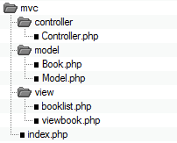
Example for MVC

Slide 11
Controller
The controller is the first thing which takes a request, parse it, initialize and invoke the model and takes the model response and send it to the presentation layer.
It communicates between the Model and the View.
In our example controller is controller.php .
The application entry point will be index.php.
The index.php file will delegate all the requests to the controller.

Slide 12
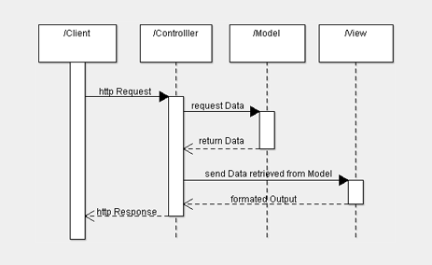
MVC Sequence Diagram

Slide 13
Model and Entity Classes
The Model represents the data and the logic of an application, what many calls business logic.
Usually, it’s responsible for:
storing, deleting, updating the application data.
Generally it includes the database operations, but implementing the same operations invoking external web services API.

Slide 14
View (Presentation)
The view(presentation layer)is responsible for formatting the data received from the model in a form accessible to the user.
The data can come in different formats from the model: simple objects( sometimes called Value Objects), xml structures, json, …

Slide 15
LARAVEL

Slide 16
Installation
Go to Wamp/Xampp www folder
Create Laravel folder
Open CMD
Navigate to Xampp/Wamp www folder
Run below command
  composer create-project laravel/laravel laravel "~5.0.0" --prefer-dist

Slide 17
Directory Structure
app - contains the core code of application.
bootstrap - contains a few files that bootstrap the framework and configure autoloading.
config - as the name implies, contains all of application's configuration files.
database - contains database migration and seeds.
public - contains the front controller and your assets (images, JavaScript, CSS, etc.).
resources - contains your views, raw assets and "language" files.
storage - contains compiled Blade templates, file based sessions, file caches, and other files generated by the framework.
tests - contains your automated tests.
vendor - contains your Composer dependencies.

Slide 18
App Directory
app directory ships with a variety of additional directories such as Console, Http, and Providers. The HTTP protocol and CLI are both mechanisms to interact with your application, but do not actually contain application logic. In other words, they are simply two ways of issuing commands to your application. The Console directory contains all of your Artisan commands, while the Http directory contains your controllers, filters, and requests.
Commands directory, houses the commands for your application. Commands represent jobs that can be queued by your application, as well as tasks that you can run synchronously within the current request lifecycle.
Events directory, houses event classes.
Handlers directory contains the handler classes for both commands and events. Handlers receive a command or event and perform logic in response to that command or event being fired.
Services directory contains various "helper" services your application needs to function. For example, the Registrar service included with Laravel is responsible for validating and creating new users of your application. Other examples might be services to interact with external APIs, metrics systems, or even services that aggregate data from your own application.
Exceptions directory contains your application's exception handler and is also a good place to stick any exceptions thrown by your application.

Slide 19
Create Controller
php artisan make:controller DemoController
Route::controller('demo', 'DemoController');
Add view with return view()

Slide 20
Model
php artisan make:migration create_demo_table
php artisan migrate
php artisan make:model User
protected $table = 'demo';
Add an entry from controller
Fetch an entry from controller
Show in view

Slide 21
view
Go to resources folder
Got to views
Create your folder
test

Slide 22
Any Questions?

