Slide 1


Slide 2
CSS3
CSS3 Overview
Slide <number>
Copyright © 2006. Cybage Software Pvt. Ltd. All Rights Reserved. Cybage Confidential.

Slide 3


Brief history… 1997-2001
Content: HTML 4.01
Presentation: CSS1
Slide <number>
Copyright © 2006. Cybage Software Pvt. Ltd. All Rights Reserved. Cybage Confidential.

Slide 4


Brief history… 2001-2006
Content: XHTML 1
Presentation: CSS2
Slide <number>
Copyright © 2006. Cybage Software Pvt. Ltd. All Rights Reserved. Cybage Confidential.

Slide 5



Brief history… 2007-present
Content: HTML5
Presentation: CSS3
Slide <number>
Copyright © 2006. Cybage Software Pvt. Ltd. All Rights Reserved. Cybage Confidential.

Slide 6
Vendor Prefixes
Some CSS rules won’t work without the vendor prefix.
  Mozilla Browsers (Firefox)
  -moz
  Webkit Browsers (Safari, Chrome)
  -webkit
  Opera
  -o
  Internet Explorer
  -ms
  <!--[if IE]> <![endif]-->
Not all CSS rules work with all browsers:
  http://www.caniuse.com/
  http://www.css3.info/selectors-test/
  http://quirksmode.org/css/contents.html
Slide <number>
Copyright © 2006. Cybage Software Pvt. Ltd. All Rights Reserved. Cybage Confidential.

Slide 7
CSS3 : Index
CSS3 Introduction
CSS3 Modules
Borders
Text Effects
User Interface
Multiple Columns
Backgrounds
Selectors
Media Queries
Understanding of div & span tags, float, display, clear, position, margin, padding properties
Slide <number>
Copyright © 2006. Cybage Software Pvt. Ltd. All Rights Reserved. Cybage Confidential.

Slide 8
CSS3 : Introduction
CSS3 offers a huge variety of new ways to create an impact with your designs, with quite a few important changes.
Modules
The development of CSS3 is going to be split up into ‘modules’. So it has been broken down into smaller pieces – with new ones also added. Some of these modules include.
Borders
Text Effects
User Interface
Multiple Columns
Backgrounds
Selectors
Media Queries
Slide <number>
Copyright © 2006. Cybage Software Pvt. Ltd. All Rights Reserved. Cybage Confidential.

Slide 9
CSS3 : Borders
We’ll be taking a look at borders. Everyone who uses CSS is familiar with the border property – it’s a great way to structure content, create effects around images and improve page layout.
CSS3 takes borders to a new level with the ability to use gradients, rounded corners, shadows and border images. We are going to look at each of these in a bit more detail, using examples where possible.
Slide <number>
Copyright © 2006. Cybage Software Pvt. Ltd. All Rights Reserved. Cybage Confidential.

Slide 10

CSS3 : Borders
Rounded Borders
Achieving rounded borders using current CSS coding can be tricky – there are numerous methods available, but none are extremely straight forward. Creating individual images for each border is often needed in addition. Using CSS3, creating a rounded border is incredibly easy. It can be applied to each corner or individual corners, and the width/colour are easily altered. The CSS code is
.border_rounded {
background-color: #ddccb5;
-webkit-border-radius: 10px;
-moz-border-radius: 10px;
border-radius: 10px;
border: 2px solid #897048;
padding: 10px;
width: 310px;
}
_{http://border-radius.com/}
Slide <number>
Copyright © 2006. Cybage Software Pvt. Ltd. All Rights Reserved. Cybage Confidential.

Slide 11

CSS3 : Borders
Gradients
Gradient borders can look effective if used correctly. This code is a little more complex, requiring you to define each colour of the gradient. The CSS code is:
.border_gradient {
border: 8px solid #000;
-moz-border-bottom-colors:#897048 #917953 #a18a66 #b6a488 #c5b59b #d4c5ae #e2d6c4 #eae1d2;
-moz-border-top-colors: #897048 #917953 #a18a66 #b6a488 #c5b59b #d4c5ae #e2d6c4 #eae1d2;
-moz-border-left-colors: #897048 #917953 #a18a66 #b6a488 #c5b59b #d4c5ae #e2d6c4 #eae1d2;
-moz-border-right-colors:#897048 #917953 #a18a66 #b6a488 #c5b59b #d4c5ae #e2d6c4 #eae1d2;
padding: 5px 5px 5px 15px;
width: 300px;
}
www.colorzilla.com/gradient-editor
Slide <number>
Copyright © 2006. Cybage Software Pvt. Ltd. All Rights Reserved. Cybage Confidential.

Slide 12
CSS3 : Borders
Gradients
background-color: #1a82f7;
background: url(images/linear_bg_2.png);
background-repeat: repeat-x;
/* Safari 4-5, Chrome 1-9 */
background: -webkit-gradient(linear, 0% 0%, 0% 100%, from(#1a82f7), to(#2F2727));
/* Safari 5.1, Chrome 10+ */
background: -webkit-linear-gradient(top, #2F2727, #1a82f7);
/* Firefox 3.6+ */
background: -moz-linear-gradient(top, #2F2727, #1a82f7);
/* IE 10 */
background: -ms-linear-gradient(top, #2F2727, #1a82f7);
/* Opera 11.10+ */
background: -o-linear-gradient(top, #2F2727, #1a82f7);
Ref: http://css-tricks.com/examples/CSS3Gradient/
Slide <number>
Copyright © 2006. Cybage Software Pvt. Ltd. All Rights Reserved. Cybage Confidential.

Slide 13

CSS3 : Borders
Box Shadows
Adding a shadow to an element is difficult at present – it is a good way to differentiate a certain area, but as with any effect, it should be used sparingly. The CSS code is:
.border_shadow {
-webkit-box-shadow: 10px 10px 5px #888;
padding: 5px 5px 5px 15px;
width: 300px;
}
box-shadow: none|h-shadow v-shadow blur spread color |inset|initial|inherit;
Ref - http://www.cssmatic.com/box-shadow
Slide <number>
Copyright © 2006. Cybage Software Pvt. Ltd. All Rights Reserved. Cybage Confidential.

Slide 14
CSS3 : Text Effects
Typography is, without any doubt, one of the most important aspects to get right when designing a layout. Type can draw the reader through a page, give a certain impression, provide impact, be subtle, or aid in separating content.
CSS is already reasonably versatile in the way in which text can be displayed, but still constricts design in quite a few areas. CSS3 goes some way towards removing those limitations.
Slide <number>
Copyright © 2006. Cybage Software Pvt. Ltd. All Rights Reserved. Cybage Confidential.

Slide 15

CSS3 : Text Effects
Text Shadow
Text shadows sound a little tacky, but it all depends how they are executed. When experimenting for this article I found some combinations to look terrible, and some to give an attractive, subtle effect. Shadows could definitely be put to good use in headings and titles:
.text_shadow {
color: #897048;
background-color: #fff;
text-shadow: 2px 2px 2px #ddccb5;
font-size: 15px;
}
text-shadow: x-pos y-pos blur color;
Slide <number>
Copyright © 2006. Cybage Software Pvt. Ltd. All Rights Reserved. Cybage Confidential.

Slide 16
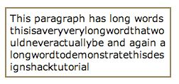
CSS3 : Text Effects
Word Wrapping
At present, if a word is too long to fit within one line of an area, it expands outside. This isn’t a very common occurrence, but does crop up from time to time. The new word wrapping ability allows you to force the text to wrap – even if it means splitting it mid-word. The code is incredibly straight forward:
.word-wrap {
color: #897048;
background-color: #fff;
word-wrap:break-word;
font-size: 15px;
}
Slide <number>
Copyright © 2006. Cybage Software Pvt. Ltd. All Rights Reserved. Cybage Confidential.

Slide 17

CSS3 : Text Effects
Web Fonts
A Web Font is simply a way to use any font in your page, being downloaded automatically by the browser. This will be a revolutionary change to web design, which previously has been limited to 10-15 widely supported fonts. However, this new feature brings copyright into debate as only properly licensed fonts should be used.
@font-face {
font-family: 'Name of the new font';
src: url('http://www.designshack.net/fonts/font.ttf');
}
Slide <number>
Copyright © 2006. Cybage Software Pvt. Ltd. All Rights Reserved. Cybage Confidential.

Slide 18
CSS3 : User Interface
CSS3 brings some great new properties relating to resizing elements, cursors, outlining, box layout and more. We’re focusing on three of the most significant user interface enhancements in this tutorial.
The examples shown below can be seen at our CSS3 examples page. Many, however, can only be appreciated in the latest builds of various browsers:
Slide <number>
Copyright © 2006. Cybage Software Pvt. Ltd. All Rights Reserved. Cybage Confidential.

Slide 19
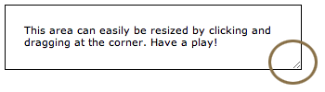
CSS3 : User Interface
Resizing
The latest version of Safari has a feature which allows resizable text areas. This is a great addition and one I find myself using daily. CSS3 allows you to easily apply this to any element, eventually to become cross-browser compatible. The code is the resize:both; line:
.ui_resizable {
padding: 20px;
border: 1px solid;
resize: both;
overflow: auto;
}
resize: none|both|horizontal|vertical|initial|inherit;
Slide <number>
Copyright © 2006. Cybage Software Pvt. Ltd. All Rights Reserved. Cybage Confidential.

Slide 20

CSS3 : User Interface
Box Sizing
The box-sizing property allows you to define certain elements to fit an area in a certain way:
Syntax
box-sizing: content-box|border-box|inherit:
Example:
.area {
width: 300px;
border: 10px solid #ddccb5;
height: 60px;
}
.boxes {
box-sizing: border-box;
-moz-box-sizing:border-box; /* Firefox */
width:50%;
height: 60px;
text-align: center;
border: 5px solid #897048;
padding: 2px;
float:left;
}
Slide <number>
Copyright © 2006. Cybage Software Pvt. Ltd. All Rights Reserved. Cybage Confidential.

Slide 21
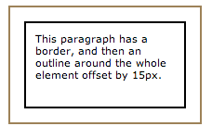
CSS3 : User Interface
Outline
Setting an element outline is already available in CSS2, but in CSS3 includes the facility to offset the outline away from the element – by a value you define. It differs from a border in two ways:
- Outlines do not take up space
- Outlines may be non-rectangular
Syntax
outline-offset: length|inherit:
Example:
.ui_outline {
width: 150px;
padding: 10px;
height: 70px;
border: 2px solid black;
outline: 2px solid #897048;
outline-offset: 15px;
}
Slide <number>
Copyright © 2006. Cybage Software Pvt. Ltd. All Rights Reserved. Cybage Confidential.

Slide 22
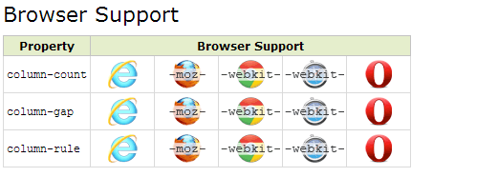
CSS3 : Multiple Columns
At present, this feature is available in Firefox and Safari 3.
There are four properties which relate to the multiple column layout in CSS3, allowing you to set the number of columns, width, gap between each column and a border between each:
- column-count
- column-width
- column-gap
- column-rule
Slide <number>
Copyright © 2006. Cybage Software Pvt. Ltd. All Rights Reserved. Cybage Confidential.

Slide 23
CSS3 : Multiple Columns
Create Multiple Columns : number|auto;
.multiple-columns {
-moz-column-count:3; /* Firefox */
-webkit-column-count:3; /* Safari and Chrome */
column-count:3;
}
Specify the Gap Between Columns : length|normal;
.multiple-columns-gap {
-moz-column-gap:40px; /* Firefox */
-webkit-column-gap:40px; /* Safari and Chrome */
column-gap:40px;
}
Column Rules : column-rule-width column-rule-style column-rule-color;
.multiple-columns-rules {
-moz-column-rule:3px outset #ff00ff; /* Firefox */
-webkit-column-rule:3px outset #ff00ff; /* Safari and Chrome */
column-rule:3px outset #ff00ff;
}
Slide <number>
Copyright © 2006. Cybage Software Pvt. Ltd. All Rights Reserved. Cybage Confidential.

Slide 24
CSS3 : Multiple Columns
Spanning columns : 1|all;
h2 {
column-span:all;
-webkit-column-span:all; /* Safari and Chrome */
}
Ref: http://www.quackit.com/css/css3/properties/css_column-span.cfm
Slide <number>
Copyright © 2006. Cybage Software Pvt. Ltd. All Rights Reserved. Cybage Confidential.

Slide 25
CSS3 : Backgrounds
Background Size : length|percentage|cover|contain;
div
{
background:url(img_flwr.gif);
background-size:80px 60px;
background-repeat:no-repeat;
}
background-origin Property: padding-box|border-box|content-box;
div
{
background-image:url('smiley.gif');
background-repeat:no-repeat;
background-position:left;
background-origin:content-box;
}
Slide <number>
Copyright © 2006. Cybage Software Pvt. Ltd. All Rights Reserved. Cybage Confidential.

Slide 26
CSS3 : Backgrounds
background-clip: border-box|padding-box|content-box;
div
{
background-color:yellow;
background-clip:content-box;
}
multiple background images :
div
{
background:
url(number.png) 600px 10px no-repeat, /* On top, like z-index: 4; */
url(thingy.png) 10px 10px no-repeat, /* like z-index: 3; */
url(Paper-4.png); /* On bottom, like z-index:1; */
}
Slide <number>
Copyright © 2006. Cybage Software Pvt. Ltd. All Rights Reserved. Cybage Confidential.

Slide 27
CSS3 : Selectors
In CSS, selectors are patterns used to select the element(s) you want to style.
Reference Websites -
http://www.w3schools.com/cssref/css_selectors.asp
http://net.tutsplus.com/tutorials/html-css-techniques/the-30-css-selectors-you-must-memorize/
http://css-tricks.com/attribute-selectors/
.class | .intro | Selects all elements with class="intro"
#id | #firstname | Selects the element with id="firstname"
 | * | Selects all elements
Element | p | Selects all <p> elements
element,element | div,p | Selects all <div> elements and all <p> elements
element element | div p | Selects all <p> elements inside <div> elements
Slide <number>
Copyright © 2006. Cybage Software Pvt. Ltd. All Rights Reserved. Cybage Confidential.

Slide 28
CSS3 : Selectors
element>element | div>p | Selects all <p> elements where the parent is a <div> element
element+element | div+p | Selects all <p> elements that are placed immediately after <div> elements
[attribute] | [target] | Selects all elements with a target attribute
[attribute=value] | [target=_blank] | Selects all elements with target="_blank"
[attribute~=value] | [title~=flower] | Selects all elements with a title attribute containing the word "flower"
[attribute|=value] | [lang|=en] | Selects all elements with a lang attribute value starting with "en"
:link | a:link | Selects all unvisited links
:visited | a:visited | Selects all visited links
:active | a:active | Selects the active link
:hover | a:hover | Selects links on mouse over
Slide <number>
Copyright © 2006. Cybage Software Pvt. Ltd. All Rights Reserved. Cybage Confidential.

Slide 29
New selectors!
element1~element2
Selects an element that is a general next sibling of another element.
  Example:
  http://www.quirksmode.org/css/selector_sibling.html
[attribute^=value]
Represents an element with the attribute whose value begins with the prefix value.
[attribute$=value]
Represents an element with the attribute whose value ends with the prefix value.
[attribute*=value]
Represents an element with the attribute whose value contains the prefix value.
  Example:
  http://www.quirksmode.org/css/selector_attributeAdvanced.html
Slide <number>
Copyright © 2006. Cybage Software Pvt. Ltd. All Rights Reserved. Cybage Confidential.

Slide 30
New pseudo elements/classes!
:first-of-type
:last-of-type
:only-of-type
  Select elements that are first, last, or only child of its type of its parent
  Example:
  http://www.quirksmode.org/css/type.html
:first-child
:only-child
:last-child
  Selects an element that is the first, only, or last child of its parent.
  Examples:
  http://www.quirksmode.org/css/firstchild.html
  http://www.quirksmode.org/css/onlychild.html
Slide <number>
Copyright © 2006. Cybage Software Pvt. Ltd. All Rights Reserved. Cybage Confidential.

Slide 31
More new pseudo elements/classes!
nth-child(n)
:nth-of-type(n)
  Allows you to select elements with a formula.
  Example:
  http://www.quirksmode.org/css/nthchild.html
:nth-last-child(n)
:nth-last-of-type(n)
  Work same as nth-child, except that they start counting at the last element instead of the first.
  Example:
    http://www.quirksmode.org/css/nthlastchild.html
:root
  Selects the root initial containing block (in HTML, this is the <html> tag)
  Example:
    http://www.quirksmode.org/css/root.html
:empty
  Selects elements with no content (“empty”).
  Example:
    http://www.quirksmode.org/css/empty.html
:target
  Selects a targeted element – one with an ID with the same value as the URL's hash.
  Example:
    http://www.quirksmode.org/css/target.html
    http://www.quirksmode.org/css/target.html#testHash
Slide <number>
Copyright © 2006. Cybage Software Pvt. Ltd. All Rights Reserved. Cybage Confidential.

Slide 32
Still more new pseudo elements/classes!
:enabled
:disabled
:checked
  Allows a designer to apply style to enabled, disabled, or checked form field elements.
  Example:
    http://www.quirksmode.org/css/enabled.html
:not(selector)
  Negates a selector.
  Example:
    http://www.quirksmode.org/css/not.html
::selection
  Defines style for text that a user selects.
  Example:
    http://www.quirksmode.org/css/selection.html
Slide <number>
Copyright © 2006. Cybage Software Pvt. Ltd. All Rights Reserved. Cybage Confidential.

Slide 33
CSS3 : Media Queries
Media Type
Some CSS properties are only designed for a certain media. For example, the "font-size" property can be used for both screen and print media, but perhaps with different values. A document usually needs a larger font-size on a screen than on paper, and sans-serif fonts are easier to read on the screen, while serif fonts are easier to read on paper.
@media screen {
p.test {font-family:verdana,sans-serif;font-size:14px;}
}
@media print {
p.test {font-family:times,serif;font-size:10px;}
}
@media screen,print {
p.test {font-weight:bold;}
}
Slide <number>
Copyright © 2006. Cybage Software Pvt. Ltd. All Rights Reserved. Cybage Confidential.

Slide 34
CSS3 : Media Queries
A media query consists of a media type and at least one expression that limits the style sheets' scope by using media features,
<!-- CSS media query on a link element -->
<link rel="stylesheet" media="(max-width: 800px)" href="example.css" />
<!-- CSS media query within a style sheet -->
<style>
@media (max-width: 600px) {
.facet_sidebar {
display: none;
}
}
</style>
Slide <number>
Copyright © 2006. Cybage Software Pvt. Ltd. All Rights Reserved. Cybage Confidential.

Slide 35
CSS3 : Media Queries
Max Width
The following CSS will apply if the viewing area is smaller than 600px.
@media screen and (max-width: 600px) {
.class {
background: #ccc;
}
}
/////////////////////////
Min Width
The following CSS will apply if the viewing area is greater than 900px.
@media screen and (min-width: 900px) {
.class {
background: #666;
}
}
Slide <number>
Copyright © 2006. Cybage Software Pvt. Ltd. All Rights Reserved. Cybage Confidential.

Slide 36
CSS3 : Media Queries
Multiple Media Queries
You can combine multiple media queries. The following code will apply if the viewing area is between 600px and 900px.
@media screen and (min-width: 600px) and (max-width: 900px) {
.class {
background: #333;
}
}
@media screen and (orientation: portrait) {
_{.product-info {}
_{clear: both;}
}
}
@media screen and (orientation: landscape) {
_{.main-container {}
_{float: right;}
}
}
Slide <number>
Copyright © 2006. Cybage Software Pvt. Ltd. All Rights Reserved. Cybage Confidential.

Slide 37
CSS3 : Media Queries
Device Width
The following code will apply if the max-device-width is 480px (eg. iPhone display). Note: max-device-width means the actual resolution of the device and max-width means the viewing area resolution.
@media screen and (max-device-width: 480px) {
.class {
background: #000;
}
}
Slide <number>
Copyright © 2006. Cybage Software Pvt. Ltd. All Rights Reserved. Cybage Confidential.

Slide 38
Reset CSS
CSS rules that resets the styling of all HTML elements to a consistent baseline
every browser has its own default ‘user agent’ stylesheet, that it uses to make unstyled websites appear more legible
Obviously this creates a certain amount of headaches for CSS authors, who can’t work out how to make their websites look the same in every browse
Using a CSS Reset, CSS authors can force every browser to have all its styles reset to null, thus avoiding cross-browser differences as much as possible.
Slide <number>
Copyright © 2006. Cybage Software Pvt. Ltd. All Rights Reserved. Cybage Confidential.

Slide 39
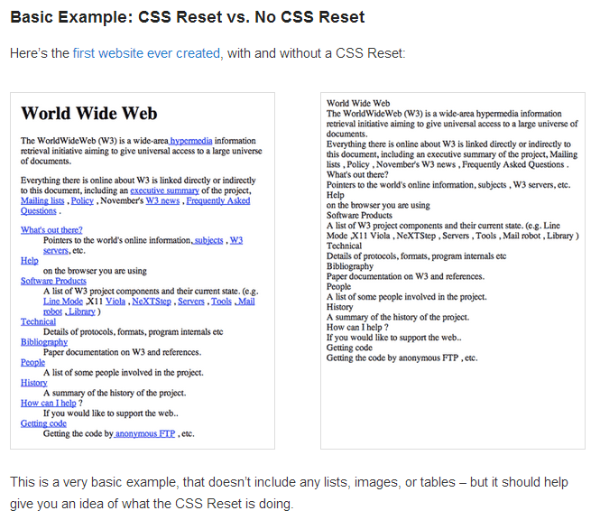
Slide <number>
Copyright © 2006. Cybage Software Pvt. Ltd. All Rights Reserved. Cybage Confidential.

Slide 40
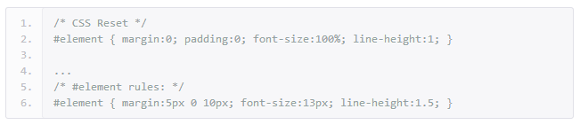
CSS Reset Issues
In many ways, they’re right – it duplicates effort and processing time, when a single declaration would have sufficed
many developers and designers feel that this violates the ‘DRY’ (Don’t Repeat Yourself) principle.
Slide <number>
Copyright © 2006. Cybage Software Pvt. Ltd. All Rights Reserved. Cybage Confidential.

Slide 41
normalize.css
Normalize.css preserves useful defaults rather than "unstyling" everything. For example, elements like sup or sub "just work" after including normalize.css (and are actually made more robust) whereas they are visually indistinguishable from normal text after including reset.css. So, normalize.css does not impose a visual starting point (homogeny) upon you. This may not be to everyone's taste. The best thing to do is experiment with both and see which gels with your preferences.
Normalize.css corrects some common bugs that are out of scope for reset.css. It has a wider scope than reset.css, and also provides bug fixes for common problems like: display settings for HTML5 elements, the lack of font inheritance by form elements, correcting font-sizerendering for pre, SVG overflow in IE9, and the button styling bug in iOS.
Slide <number>
Copyright © 2006. Cybage Software Pvt. Ltd. All Rights Reserved. Cybage Confidential.

Slide 42
Normalize.css doesn't clutter your dev tools. A common irritation when using reset.css is the large inheritance chain that is displayed in browser CSS debugging tools. This is not such an issue with normalize.css because of the targeted stylings.
Normalize.css is more modular. The project is broken down into relatively independent sections, making it easy for you to potentially remove sections (like the form normalizations) if you know they will never be needed by your website.
Normalize.css has better documentation. The normalize.css code is documented inline as well as more comprehensively in the GitHub Wiki. This means you can find out what each line of code is doing, why it was included, what the differences are between browsers, and more easily run your own tests. The project aims to help educate people on how browsers render elements by default, and make it easier for them to be involved in submitting improvements.
Slide <number>
Copyright © 2006. Cybage Software Pvt. Ltd. All Rights Reserved. Cybage Confidential.

Slide 43
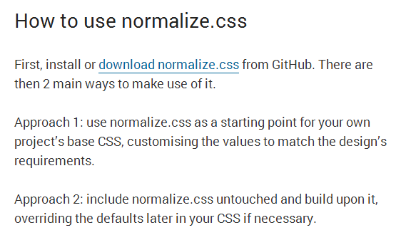
http://nicolasgallagher.com/about-normalize-css/
Slide <number>
Copyright © 2006. Cybage Software Pvt. Ltd. All Rights Reserved. Cybage Confidential.

Slide 44
Principles of writing consistent, idiomatic CSS
1. General principles
  Don't try to prematurely optimize your code; keep it readable and understandable.
  All code in any code-base should look like a single person typed it, even when many people are contributing to it.
  Strictly enforce the agreed-upon style.
  If in doubt when deciding upon a style use existing, common patterns.
2. Whitespace
  Never mix spaces and tabs for indentation.
  Choose between soft indents (spaces) or real tabs. Stick to your choice without fail. (Preference: spaces)
  If using spaces, choose the number of characters used per indentation level. (Preference: 4 spaces)
Slide <number>
Copyright © 2006. Cybage Software Pvt. Ltd. All Rights Reserved. Cybage Confidential.

Slide 45
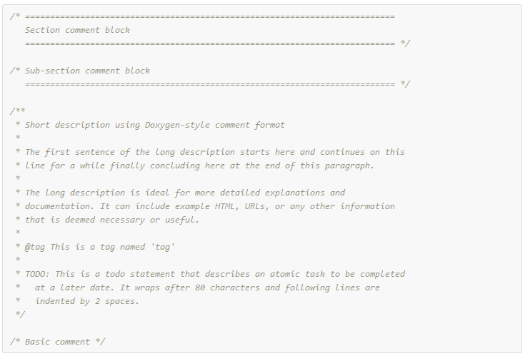
3. Comments
  Place comments on a new line above their subject.
  Keep line-length to a sensible maximum, e.g., 80 columns.
  Make liberal use of comments to break CSS code into discrete sections.
  Use "sentence case" comments and consistent text indentation.
Slide <number>
Copyright © 2006. Cybage Software Pvt. Ltd. All Rights Reserved. Cybage Confidential.

Slide 46
4. Format
Use one discrete selector per line in multi-selector rulesets.
Include a single space before the opening brace of a ruleset.
Include one declaration per line in a declaration block.
Use one level of indentation for each declaration.
Include a single space after the colon of a declaration.
Use lowercase and shorthand hex values, e.g., #aaa.
Use single or double quotes consistently. Preference is for double quotes, e.g., content: "".
Quote attribute values in selectors, e.g., input[type="checkbox"].
Where allowed, avoid specifying units for zero-values, e.g., margin: 0.
Slide <number>
Copyright © 2006. Cybage Software Pvt. Ltd. All Rights Reserved. Cybage Confidential.

Slide 47
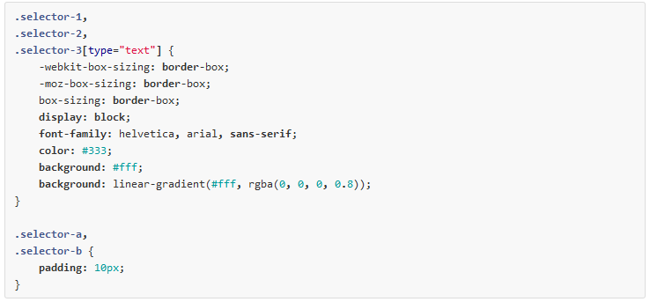
Include a space after each comma in comma-separated property or function values.
Include a semi-colon at the end of the last declaration in a declaration block.
Place the closing brace of a ruleset in the same column as the first character of the ruleset.
Separate each ruleset by a blank line.
Slide <number>
Copyright © 2006. Cybage Software Pvt. Ltd. All Rights Reserved. Cybage Confidential.

Slide 48
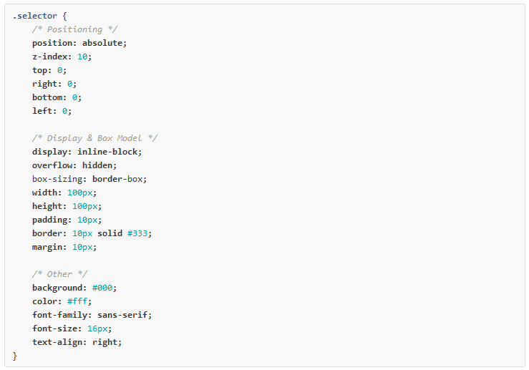

Declaration order
Slide <number>
Copyright © 2006. Cybage Software Pvt. Ltd. All Rights Reserved. Cybage Confidential.

Slide 49
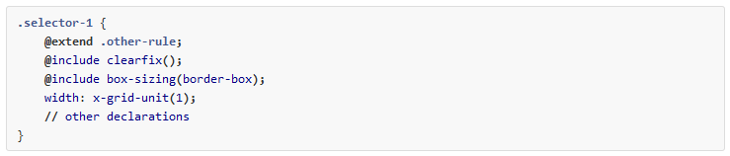
Preprocessors: additional format considerations
Limit nesting to 1 level deep. Reassess any nesting more than 2 levels deep. This prevents overly-specific CSS selectors.
Avoid large numbers of nested rules. Break them up when readability starts to be affected. Preference to avoid nesting that spreads over more than 20 lines.
Always place @extend statements on the first lines of a declaration block.
Where possible, group @include statements at the top of a declaration block, after any @extend statements.
Consider prefixing custom functions with x- or another namespace. This helps to avoid any potential to confuse your function with a native CSS function, or to clash with functions from libraries.
Slide <number>
Copyright © 2006. Cybage Software Pvt. Ltd. All Rights Reserved. Cybage Confidential.

Slide 50
Assignments
Create a Simple Responsive web page using media query and div structure
Create a web page to show Text and Gradient effects
Slide <number>
Copyright © 2006. Cybage Software Pvt. Ltd. All Rights Reserved. Cybage Confidential.

Slide 51
Thank You
Slide <number>
Copyright © 2006. Cybage Software Pvt. Ltd. All Rights Reserved. Cybage Confidential.

