Slide 1
ORM – Object Relation Mapping
Authored by : Shritesh Avlani Presented by : Shritesh Avlani

Slide 2
Agenda
What is OOP, how to define a class?
How we store Data in DB?
What is ORM?
Use of ORM.
Pros and Cons of ORM.

Slide 3
What is OOP, how to define a class?
Definition : A class is a template definition of the methods and variables in a particular kind of object that reflects an real world entity.
Entity can be: Student, School, Employee.
Class Employee
{
Properties: Name, ID, Department, Project, Ext, keyno.
Methods: Add, Delete, Save, Copy, Modify
}

Slide 4
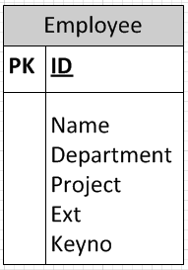
How we store Data in DB? Table Structure

Slide 5
How we store Data in DB? Code
<?php
//connect to the database
mysql_connect ("host_name_or_IP_Address","username","password") or die ('Cannot connect to MySQL: ' . mysql_error());
mysql_select_db ("database_name") or die ('Cannot connect to the database: ' . mysql_error());
$query = mysql_query(“insert into employee values (‘1’, ’Test’, ’Eng’, ’3333’, ’4444’)”);

Slide 6
What is ORM?
WikiPedia: Object-relational mapping (ORM) in computer software is a programming technique for converting data between incompatible type systems in relational databases and object-oriented programming languages.
Simple: Map class properties with DB fields and provide methods to manipulate data.

Slide 7
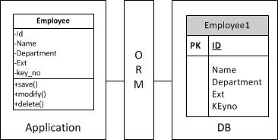
What is ORM? - Diagram

Slide 8
What is ORM? Pros
Simpler for developers
Supports many database platforms
Supports many different languages
The impedance mismatch is handled for us
Developer can focus on the code, not the database

Slide 9
What is ORM? Cons
Can be cumbersome to set up.
Joins and complex queries can be difficult.
Hard to read performance metrics.
Another layer between the database and the application.

Slide 10
Any Questions?

Slide 11
Thank you!

