Slide 1

EMPLOYEE DATA REPORT
PRESENTED BY
VAISHNAVI BHUJBAL.

Slide 2
AGENDA OF REPORT
INTRODUCTION
OBJECTIVE
ANALYSIS OF VISUAL
KEY BUSINESS QUESTIONS ANSWERED
INSIGHTS
CONCLUSION

Slide 3
Introduction
The two dashboards provide a comprehensive analysis of employee data, focusing on key aspects such as workforce distribution, retention, compensation, job roles, education, and performance. Together, they offer actionable insights into organizational dynamics to help HR teams optimize resource allocation, improve retention, promote diversity, and ensure equitable compensation.
The first dashboard primarily examines high-level workforce trends, including attrition, travel patterns, gender diversity, department distribution, and education fields. It highlights factors influencing job satisfaction, such as ratings by education and compensation benchmarks.
The second dashboard delves deeper into employee tenure, working experience, and compensation trends by job role and department. It further evaluates gender representation, workforce distribution, and pay equity across roles, providing a detailed breakdown of organizational dynamics.

Slide 4
Objective
understand employee retention: identify factors contributing to employee attrition, such as overtime, tenure, and job roles, to implement strategies for improving retention.
Assess Workforce Distribution: Examine department-wise and role-wise distribution of employees to ensure optimal allocation of resources and identify gaps in staffing.
Evaluate Diversity and Inclusion: Analyze gender and education representation across departments and roles to promote diversity and equality within the organization.
Analyze Compensation Trends: Assess salary distribution, work rates, and pay equity across roles and departments to maintain competitive and fair compensation structures.
Measure Employee Satisfaction: Use ratings related to job performance, satisfaction, and work environment to identify areas for improvement in employee engagement.
Provide Data-Driven Insights: Equip HR and management teams with actionable insights to develop strategies that enhance productivity, employee well-being, and organizational efficiency

Slide 5
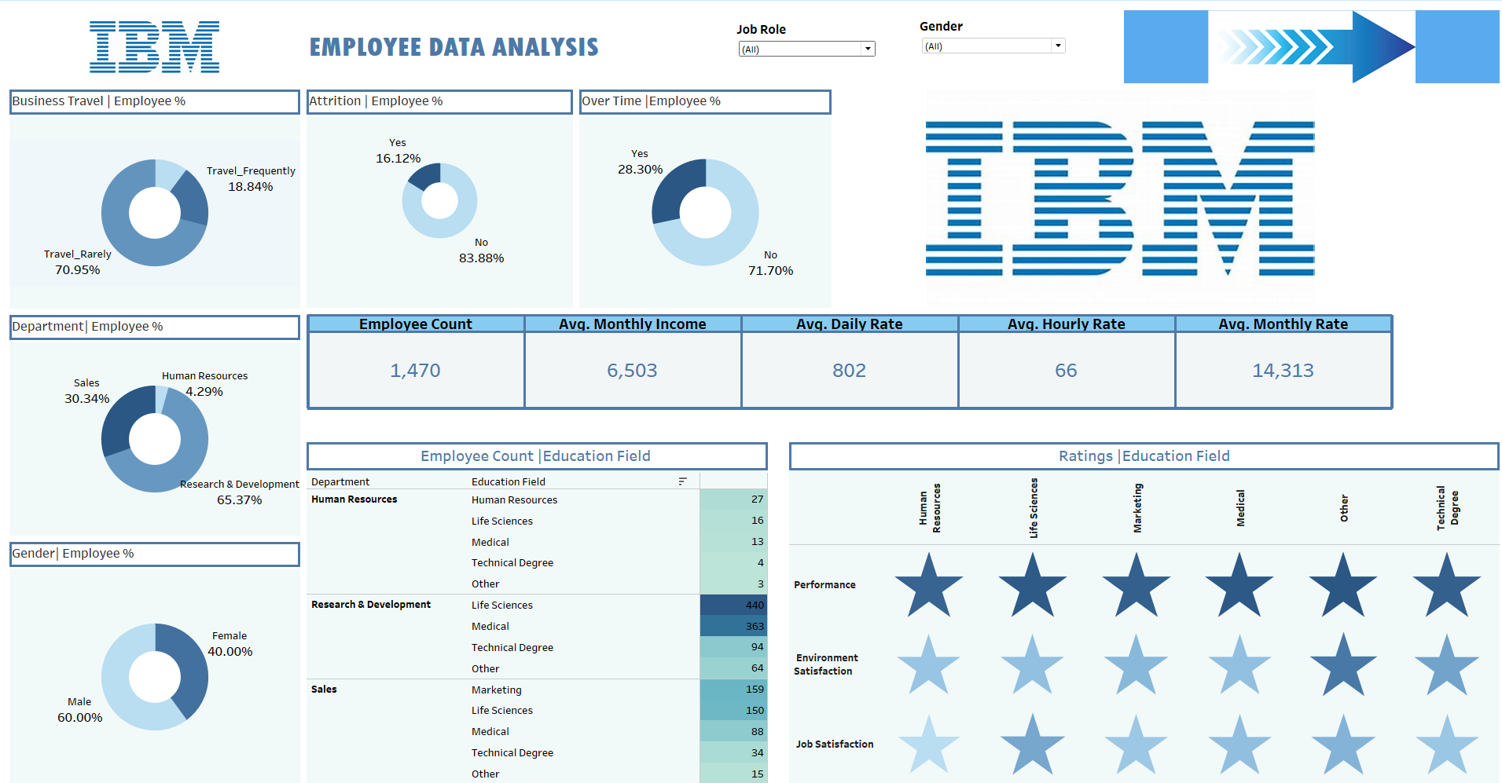
COMPLETE DASHBOARD
IBM EMPLOYEE ANALYSIS -1

Slide 6
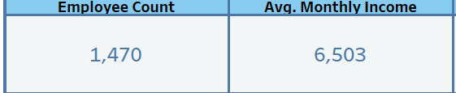
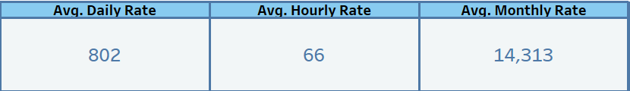
Key matrix Analysis
Employee Count: 1,470 employees.
Average Monthly Income: $6,503.
Average Daily Rate: $802.
Average Hourly Rate: $66.
Average Monthly Rate: $14,313.
Purpose: Provides a snapshot of overall employee compensation and workforce size.
Questions Answered:
What is the average cost per employee?
Are compensation levels competitive across roles
and departments?

Slide 7
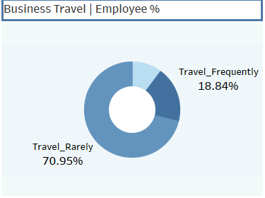
Business Travel & Employee %
Shows: Travel frequency among employees (e.g., 70.95% travel rarely).
Purpose: Understands travel demands and their potential impact on work-life balance.
Key Insight: Most employees travel rarely, reducing the likelihood of travel-related burnout.

Slide 8
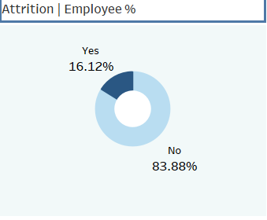
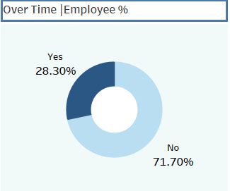
ATTRITION & OVER-TIME %
Shows: Attrition (16.12%) and employees working overtime (28.3%).
Purpose: Links overtime and attrition trends.
Key Insight: High overtime percentages could contribute to attrition

Slide 9
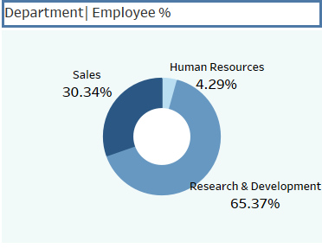
DEPARTMENT DISTRIBUTION
Shows: Employee percentage by department (e.g., R&D: 65.37%).
Purpose: Evaluates workforce distribution across departments.
Key Insight: R&D dominates the workforce; HR has the lowest representation.

Slide 10
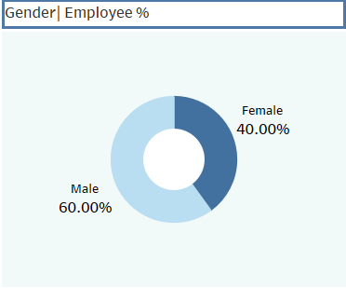
GENDER DISTRIBUTION
Shows: Workforce divided by gender (e.g., 60% male, 40% female).
Purpose: Assesses gender diversity.
Key Insight: Moderate gender disparity exists.

Slide 11
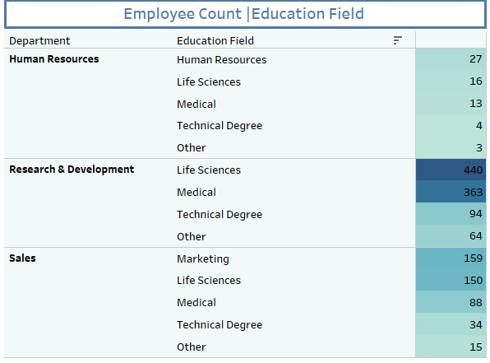
EDUCATION FIELD | EMPLOYEE COUNT
Shows: Distribution of employees by department and educational background (e.g., 440 R&D employees have Life Sciences degrees).
Purpose: Identifies how education fields align with department requirements.
Why Heat Map:
Highlights patterns and clusters in large datasets.
4. Questions Answered:
Are the right educational backgrounds allocated to the right
departments?
Is there diversity in educational qualifications within
departments?

Slide 12
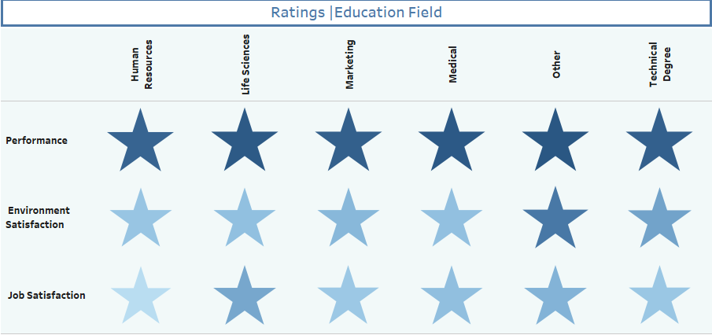
RATINGD | EDUCATION FIELDS
Shows: Employee ratings (e.g., performance, satisfaction) grouped by education field.
Purpose: Highlights variations in satisfaction and performance by educational background.
Why Star Chart:
Efficiently compares multiple attributes across
categories.
Questions Answered:
Which education fields yield higher satisfaction or
performance?
Are there disparities in satisfaction among different
education backgrounds?

Slide 13
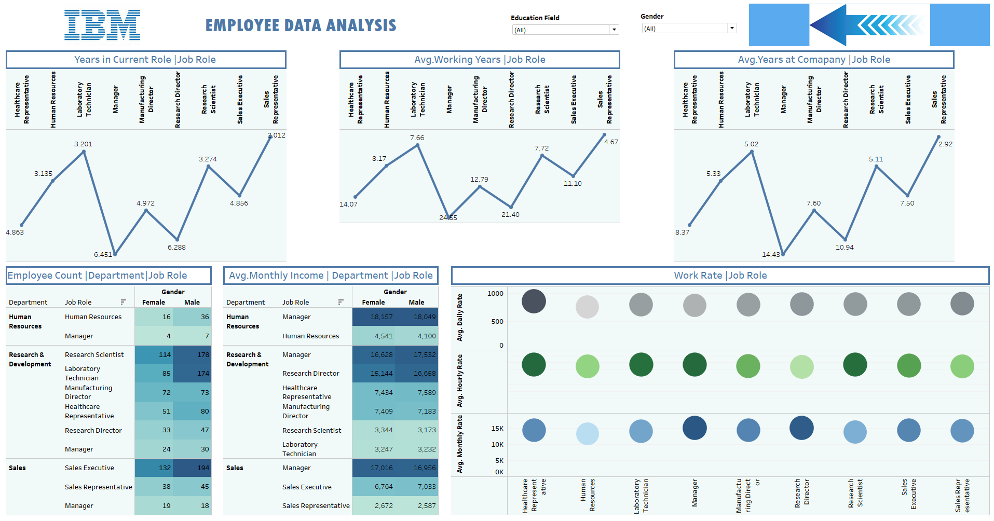
COMPLETE DASHBOARD
IBM EMPLOYEE ANALYSIS -2

Slide 14
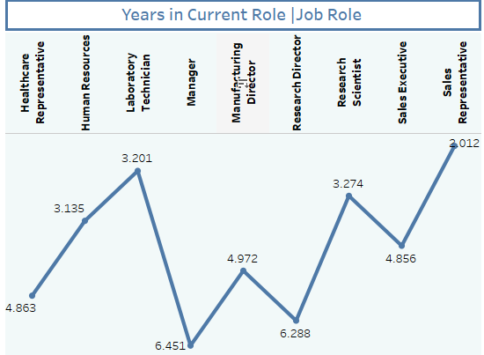
YEARS IN CURRENT ROLE | JOB ROLE
Shows: Average tenure of employees in their current roles (e.g., Laboratory Technicians: 6.45 years, Sales Executives: 3.01 years).
Purpose: Highlights retention and potential stagnation in specific roles.
Why Line Chart:
Ideal for comparing trends across job roles.
4. Questions Answered:
Are employees staying in roles too long without
promotions?
Which roles experience the shortest retention periods?

Slide 15
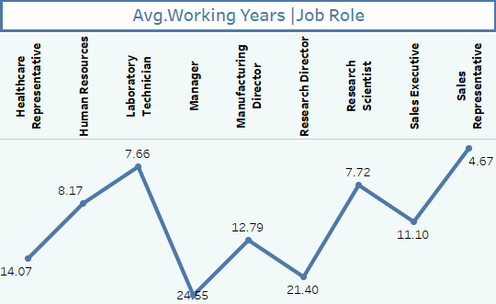
AVG. WORKING YEARS | JOB ROLE
Shows: Average total working experience of employees in various roles (e.g., Manufacturing Directors: 21.4 years).
Purpose: Reveals the level of experience in each job role.
Why Line Chart:
Effectively illustrates variation in experience across
job categories.
4. Questions Answered:
Are experienced employees concentrated in
leadership roles?
Is there a lack of seasoned talent in any roles?

Slide 16
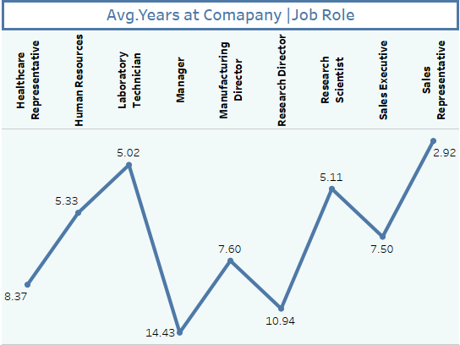
AVG. YEARS AT COMAPNY
Shows: Average tenure at the company by job role (e.g., Managers: 7.6 years, Laboratory Technicians: 14.4 years).
Purpose: Identifies roles with high loyalty or high turnover.
Why Line Chart:
Clearly compares tenure trends across roles.
4. Questions Answered:
Which roles foster the longest employee loyalty?
Are certain roles prone to early attrition?

Slide 17
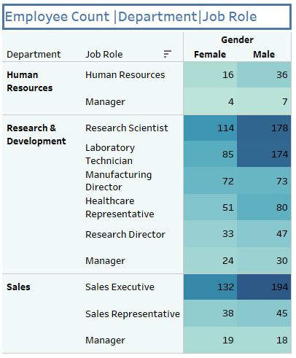
DEPARTMENT | EMPLOYEE COUNT
Shows: Workforce distribution across departments and genders.
Purpose: Evaluates diversity and staffing.
Key Insight: R&D has a gender disparity, with males dominating technical roles.

Slide 18
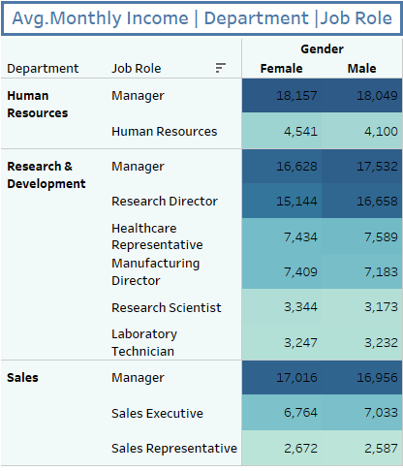
DEPARTMENT | AVG. MONTHLY INCOME
Shows: Income trends across roles (e.g., Research Directors are highest paid).
Purpose: Assesses pay equity.
Key Insight: Significant salary variations exist between roles.

Slide 19
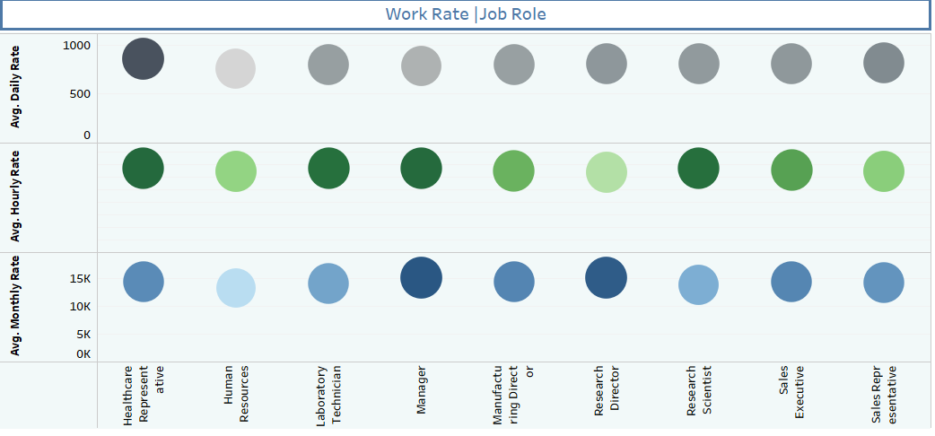
WORK RATE BY ROLE
Shows: Daily, hourly, and monthly rates for each job role, represented as bubbles of varying sizes.
Purpose: Provides a comparative view of pay rates by job role, helping assess the value of roles within the organization.
Why Bubble Chart:
Allows simultaneous comparison of multiple metrics (e.g.,
daily, hourly, and monthly rates) for different job roles.
4. Business Questions Solved:
Which roles contribute the most value in terms of pay rates?
Are pay rates proportional to experience or job demands?

Slide 20
INSIGHTS
Retention Patterns:
Roles like Laboratory Technicians and Research Scientists exhibit longer retention, suggesting satisfaction or limited career progression.
Lower tenure for roles like Sales Representatives may indicate high turnover rates.
Workforce Allocation:
R&D dominates the workforce with a significant gender disparity in technical roles.
Sales Executives show a balanced gender distribution but face shorter tenure on average.
Compensation Trends:
High-paying roles like Research Directors and Manufacturing Directors align with their high experience levels.
Pay disparities could be addressed in roles with similar requirements but lower compensation.
Diversity:
Gender imbalance exists in leadership roles, with fewer females occupying managerial positions.
Departments like Sales show better gender parity compared to R&D.
Experience Levels:
Roles requiring high expertise, like Research Directors, attract experienced professionals with longer working years.

Slide 21
THANK YOU

