Slide 1

DREAM CONNECT
DREAM CONNECT
PRESENTED BY TEAM: BUG BREAKERS

Slide 2
PROBLEM STATEMENT :
Entrepreneurs face difficulties finding investors, co-founders, and team members
Investors struggle to discover startups that fit their interests
Existing platforms are fragmented, focusing only on funding or networking
Lack of a unified collaborative environment

Slide 3
OUR SOLUTION: DREAM CONNECT
Dream Connect offers an integrated platform
Connects investors, entrepreneurs, and team members
Promotes collaboration, idea exchange, and efficient team formation
TARGET AUDIENCE :
INVESTORS
ENTREPRENEURS
TEAM COLLOBORATORS

Slide 4
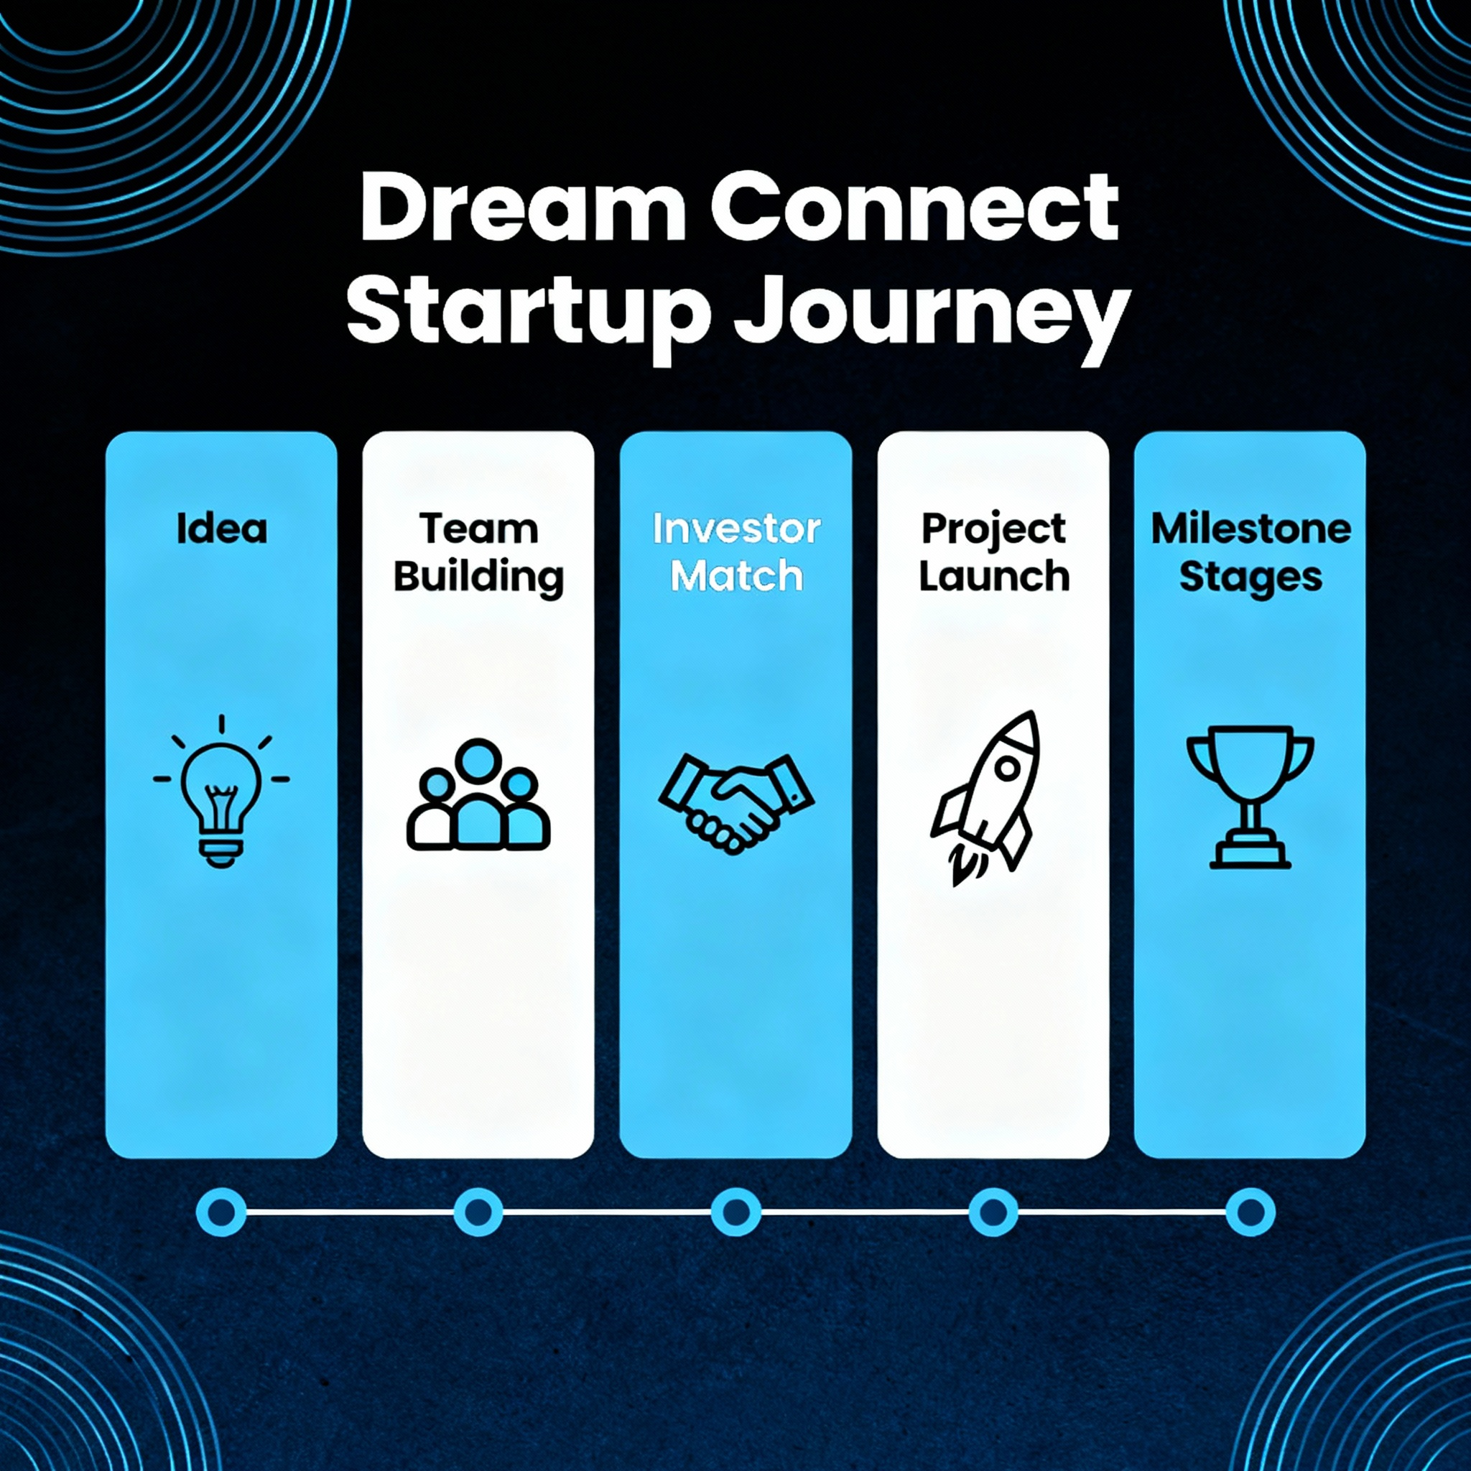
OBJECTIVE AND VISION:
To build a unified platform connecting entrepreneurs, investors, and talented team members.
Foster an ecosystem where ideas, funding, and skills come together seamlessly.
Empower startups to grow faster and investors to find the best early-stage opportunities

Slide 5
PLATFORM FEATURES:
AI-powered matching for projects, investors, and teammates.
Interactive project boards for collaboration and progress tracking.
Secure messaging system for confidential discussions.
Role-specific dashboards for entrepreneurs, investors, and team members.
Real-time notifications to keep everyone updated.
Multilingual platform.
AI assistant and whatsapp chat facilities .

Slide 6
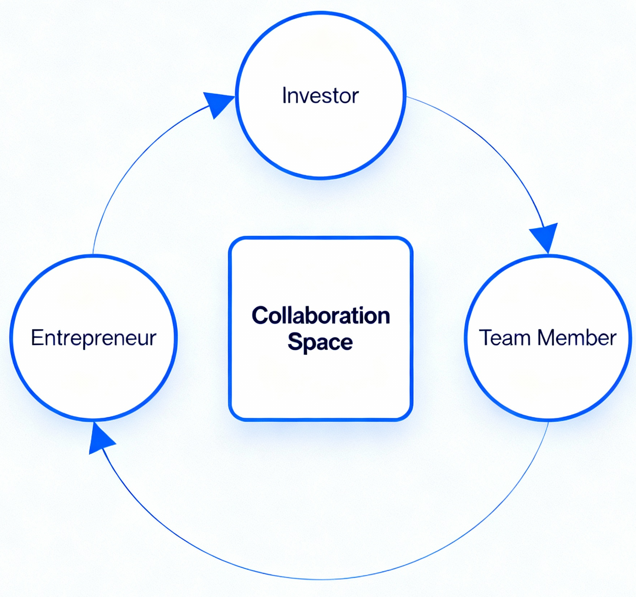
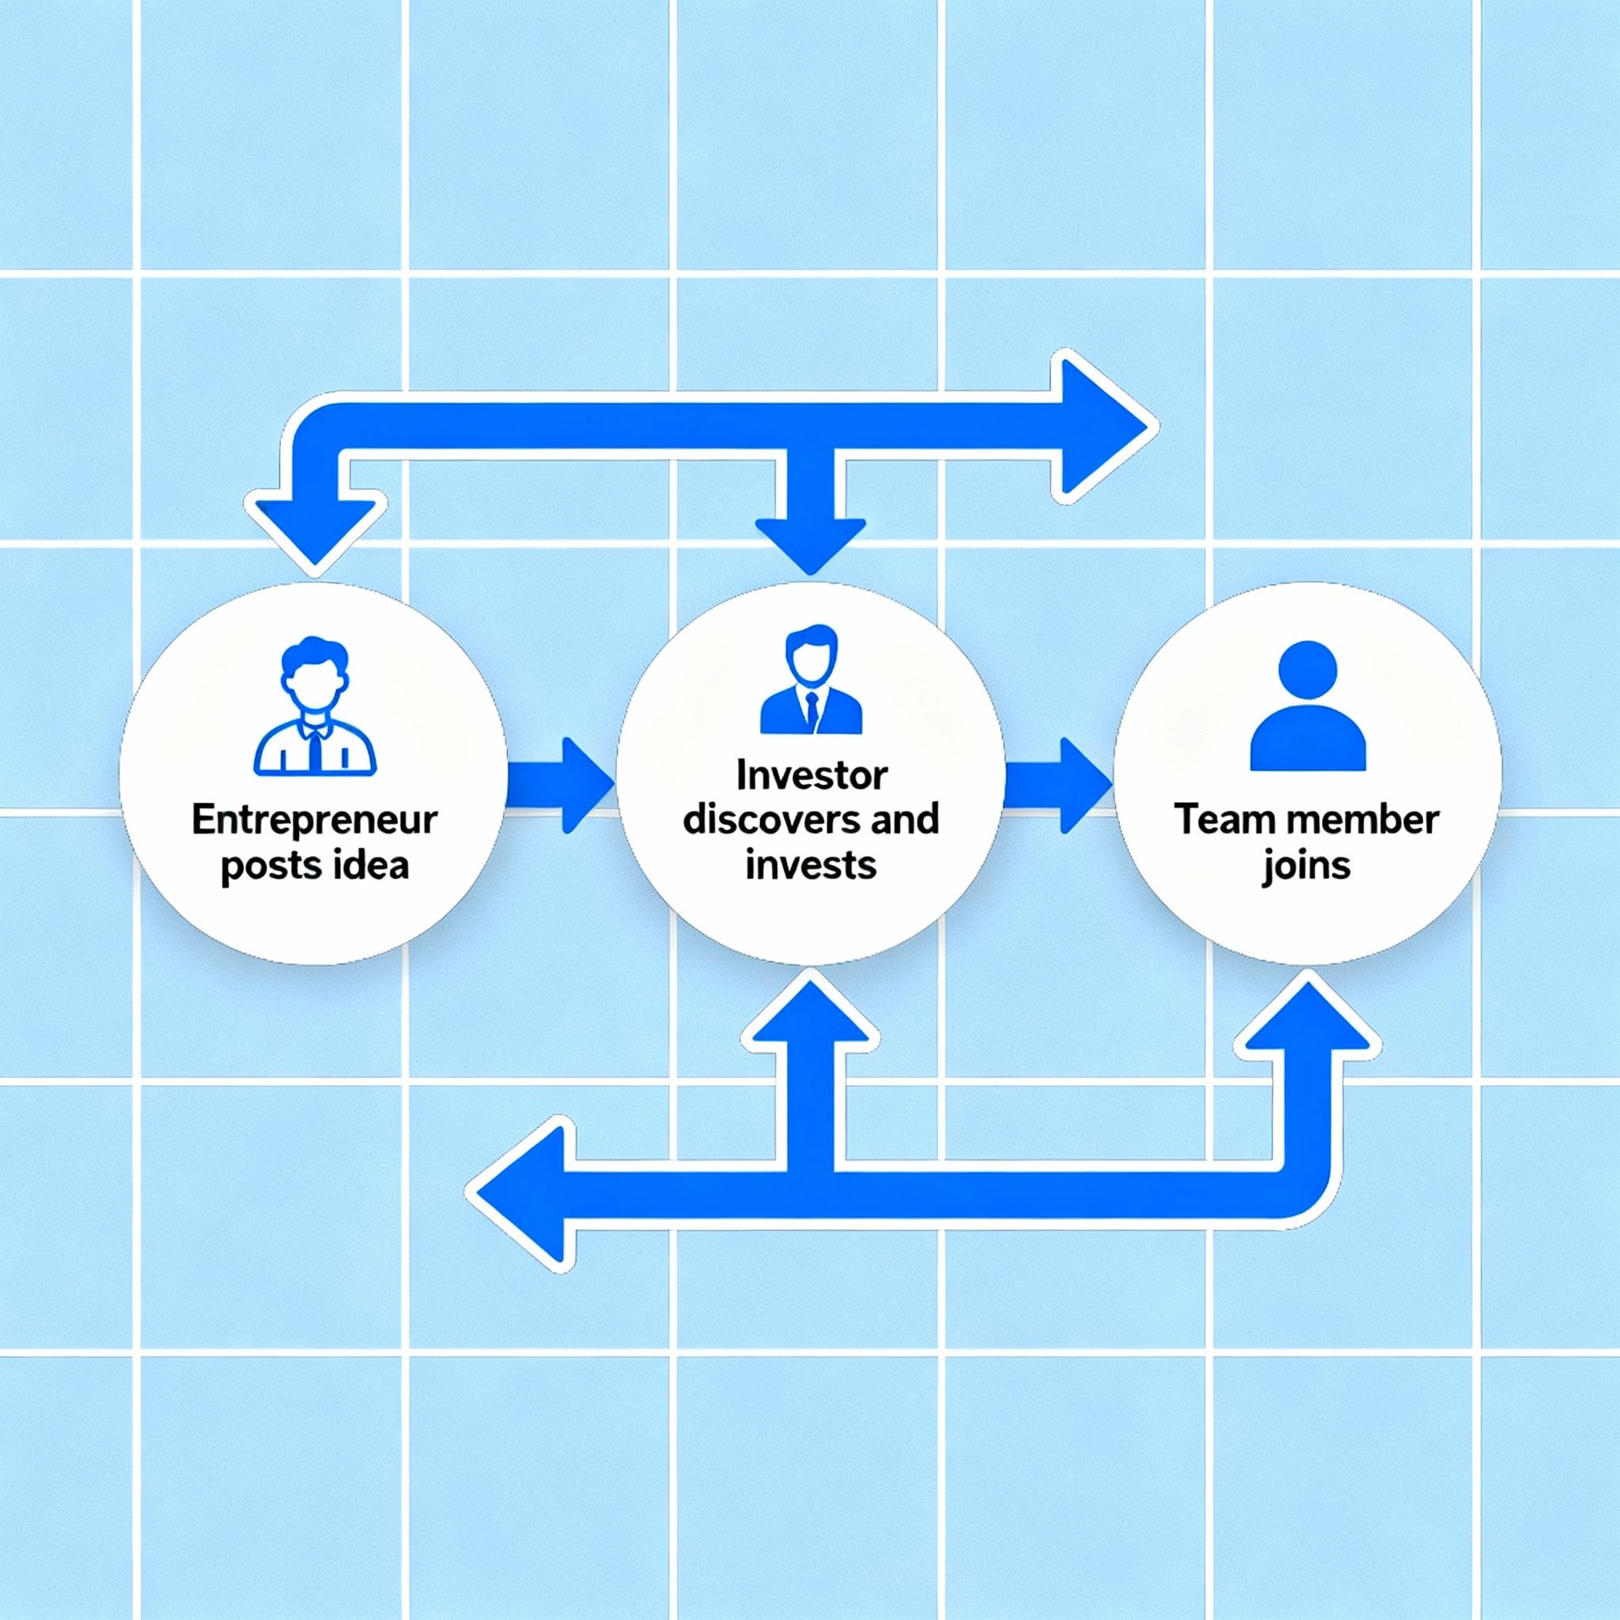
WORK FLOW:
All users interact in dedicated workspaces to build projects together.

Slide 7
TECHNOLOGIES USED:
Front-end: React.js or Angular for a dynamic user interface.
Back-end: Node.js or Django for scalable server logic.
Database: MySQL or MongoDB for reliable, secure data storage.
Cloud Hosting: AWS or Firebase for high performance and security.

Slide 8
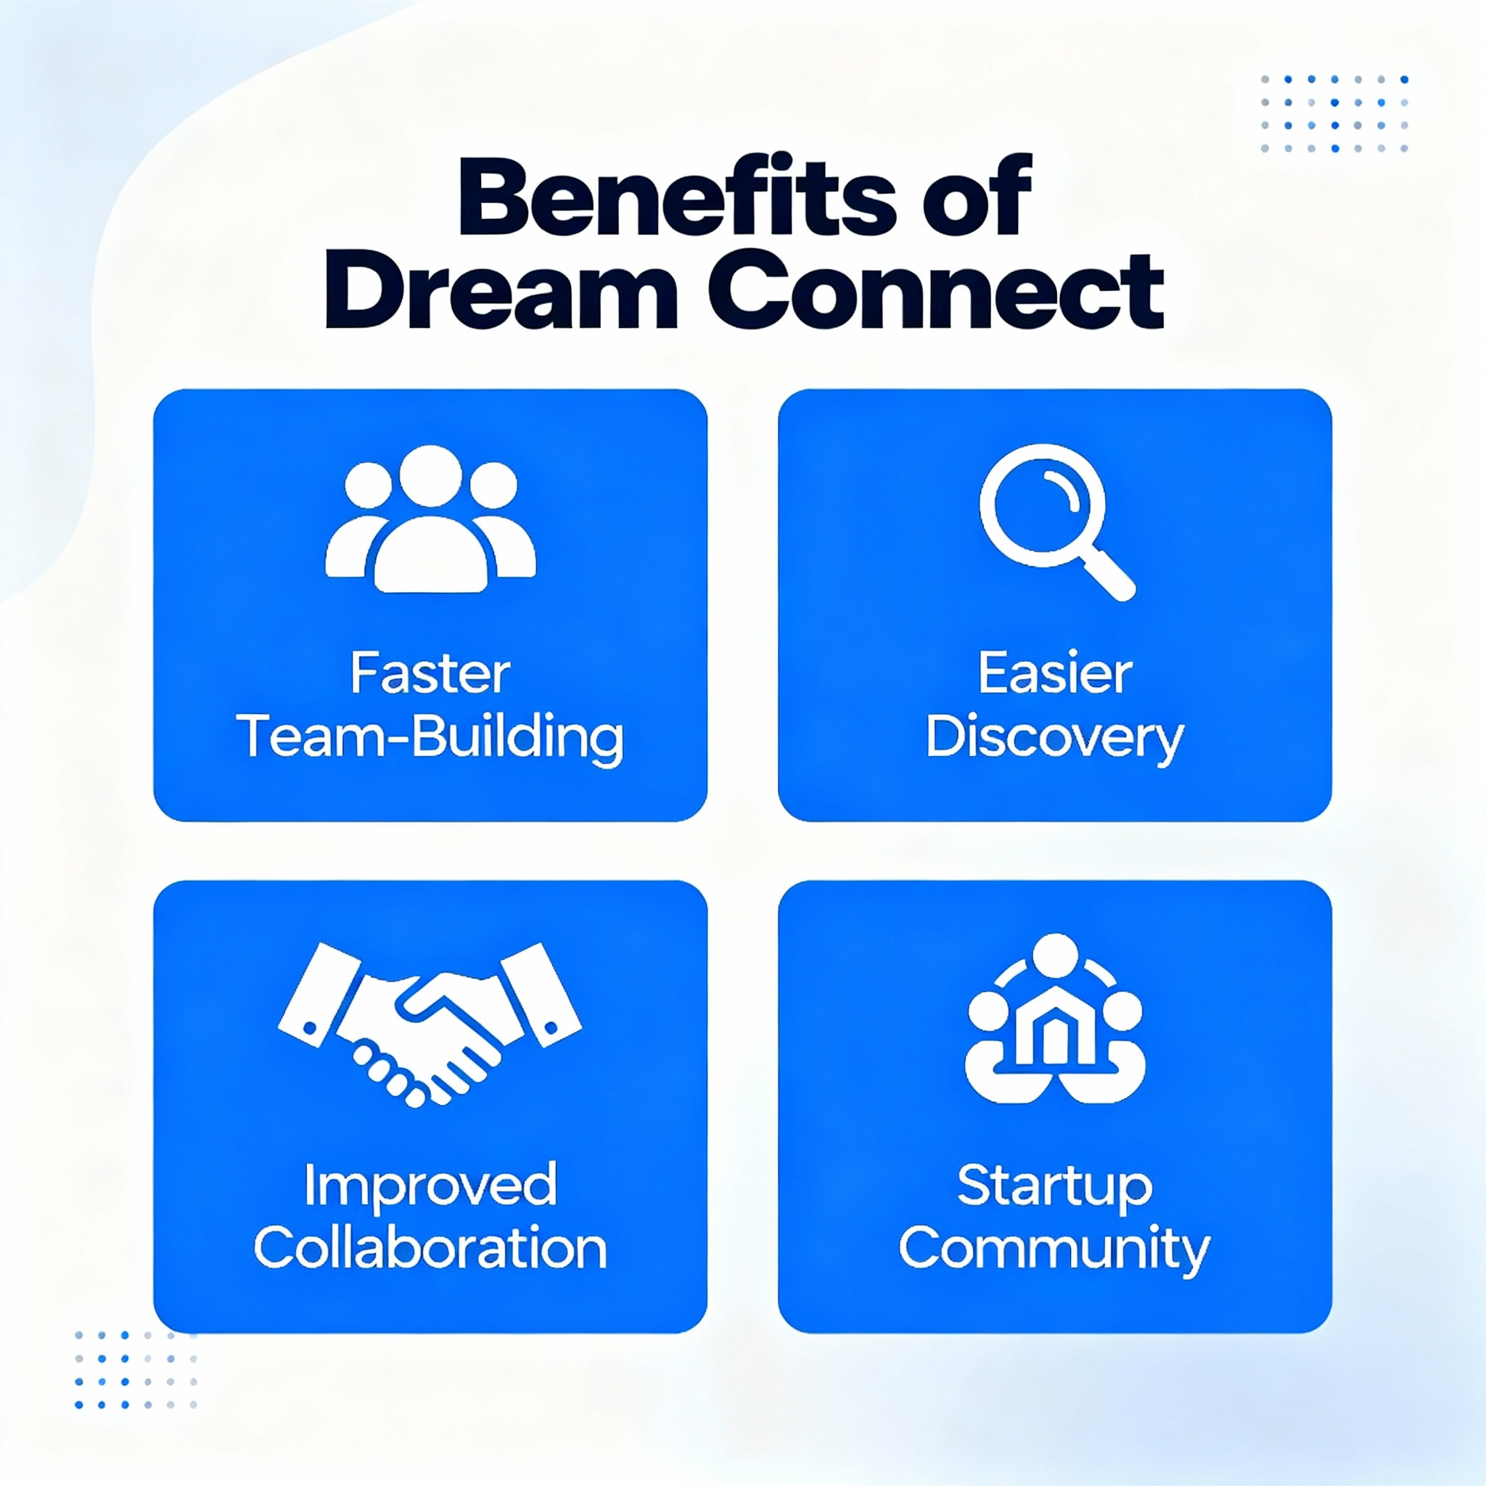
BENEFITS & VALUE PREPOSITION:
Faster team and startup formation
Easier discovery for investors and founders
Improved collaboration, communication, and success rates
Builds a thriving startup network

Slide 9
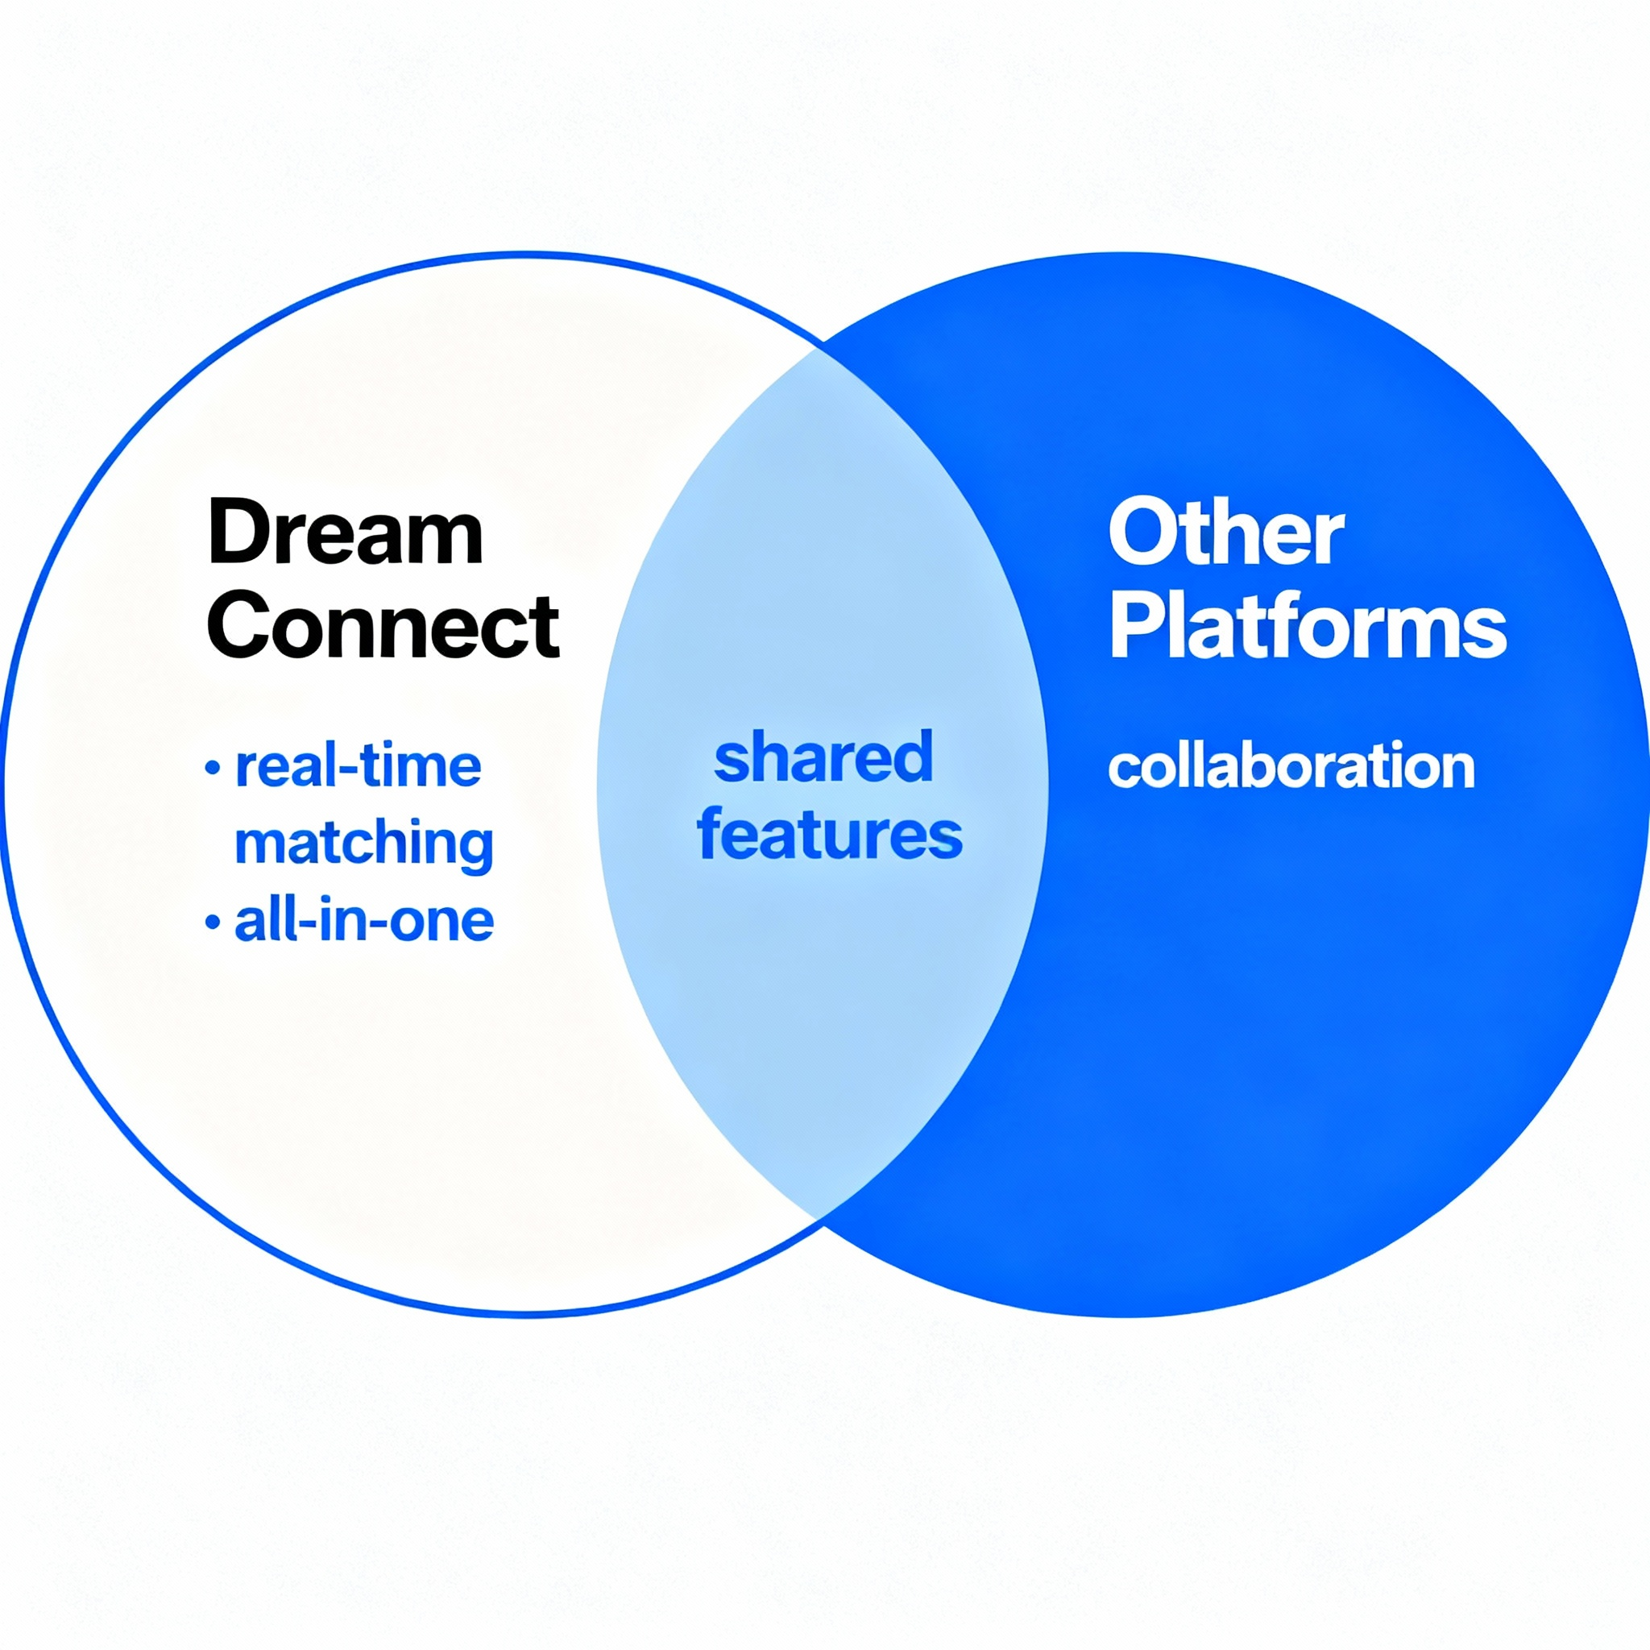
Why DREAM CONNECT Is Unique ?
All-in-one platform for funding, team-building, and idea sharing
Real-time collaboration among all stakeholders
AI-powered matching for entrepreneurs, investors, and team members
Builds lasting startup communities, unlike fragmented competitors
Also involves AI assistant and whats app chat .

Slide 10
CONCLUSION:
DREAM CONNECT bridges crucial gaps in startup collaboration, funding, and team formation.
By uniting entrepreneurs, investors, and team members, it creates new opportunities for growth and innovation.
Our platform simplifies connections and empowers users to turn ideas into successful ventures.
Join us to build the future of entrepreneurship together!

Slide 11
THANK YOU
TEAM MEMBERS:
U BHULAKSHMI
S MAHATHI SIRI
Y NARENDRA

