Slide 1
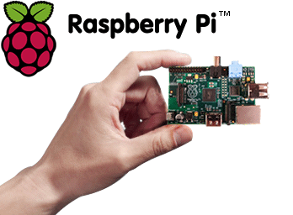
Internet of Things Meets CIS By Team of Steel
Gurbir Singh
Ronald Bhuleskar
Sankara Bhogi
Shivaraju Gowda
Venkat Iyer

Slide 2


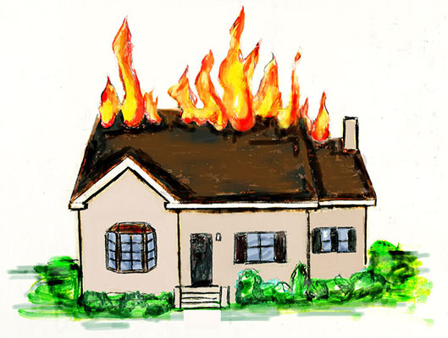
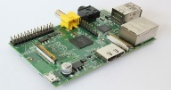




What?

Slide 3
Why?
To create a DIY solution which improves day to day life
And of course, to win the first prize !!!!!!
To create a solution that is extendible
To showcase another CIS use case

Slide 4
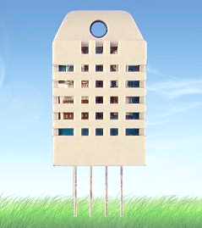
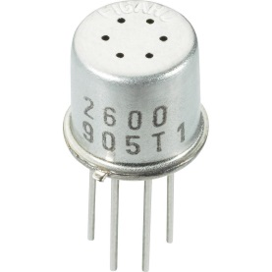
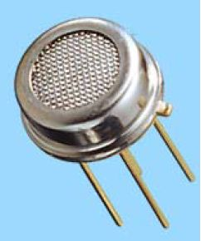
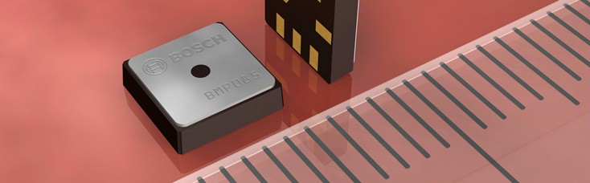
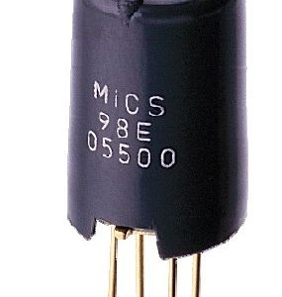

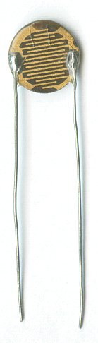


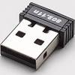

System Components

Slide 5
How?
WWW
Raspberry Pi
(eeml and Webservices)
CIS
(Webservices)
Triggers/Persistence
Xively/Sense (Webservices)
User
(Email)
Visualization

Slide 6


Data Controller
Raspberry Pi
eeml over webservice
eeml over webservice
Rest Endpoint
Rest Endpoint
Triggers
Xively
Persistence
Sen.se
Rule engine
alerts
Data Visualization
Rule
DB
When to send?

Slide 7
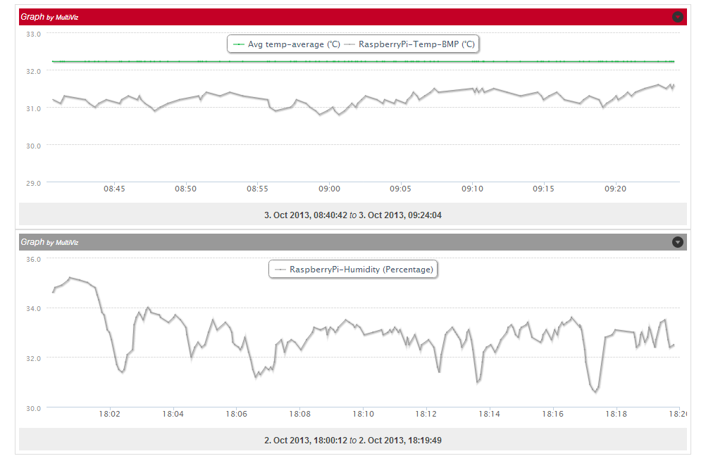
Visualization

Slide 8
Alternates Considered…
iRobot, Pi integration to map and gather data in a data center/office location
Wrestling of two Pi Self Controlling Robots
Face recognition based solution to open Composite main door ( no more forgotten keys for Gurbir)

Slide 9
Demo

