Slide 1
Farmer Buddy
By The Alpha Team
Under guidance of:
Deepak Gangadharan
Adarsh Dharmadevan

Slide 2
What is the project about?
Ans. The goal of the project is to help farmers by giving them data to keep track of in their farms.

Slide 3
Apparatus
Sensors
DHT 11 Sensor.
Water Level Sensor
Ultrasonic sensor
Barometer Sensor

Slide 4
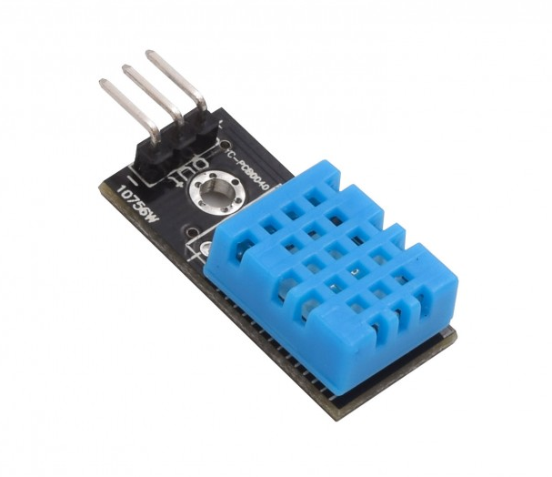
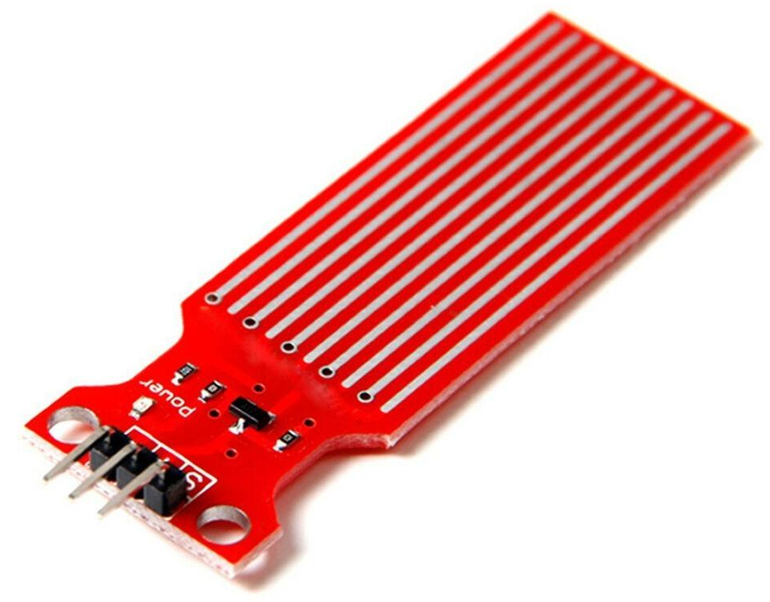
Procedure
We build a circuit which measures the water level and humidity in the farm, using the appropriate sensors.
The data from circuit is uploaded to thingspeak cloud.
Now the data collected from the circuit is also uploaded to onem2m server.
The data uploaded on the onem2m server can be used to analyse the conditions of the field and compare it relevant datas.

Slide 5
What we intend the device to do?

Slide 6
With the help of the device, we think that the farmer would make better choices, and hence yield more crop.

Slide 7
More about the Device
The Device needs a very basic internet and power connection to function correctly. The device has to be planted in a farm in a place, where it is safe. The DHT 11 sensor, must be left in a place where we wish to measure the data. The water sensor must be put along the wall of a pit which is dug in the farm, to check the water level. The other sensors, must be left in any but harsh conditions.
What does the device do, actually?
It shall upload the data to a cloud (Thingspeak or onem2m cloud in this case.)
With the help of the data in the cloud the farmer can make the right choices.
Aside from farmers, botanists can also use the device and download data from the cloud.

Slide 8
Credits
Poorvaja(2020101096) - Report + PPT
Lokesh (2020111017) - Hardware + ngrok + graphs.
Shubh(2020101009) - Coding + Report analysis
Siddik (2020101089) - PPT + Presentation

Slide 9
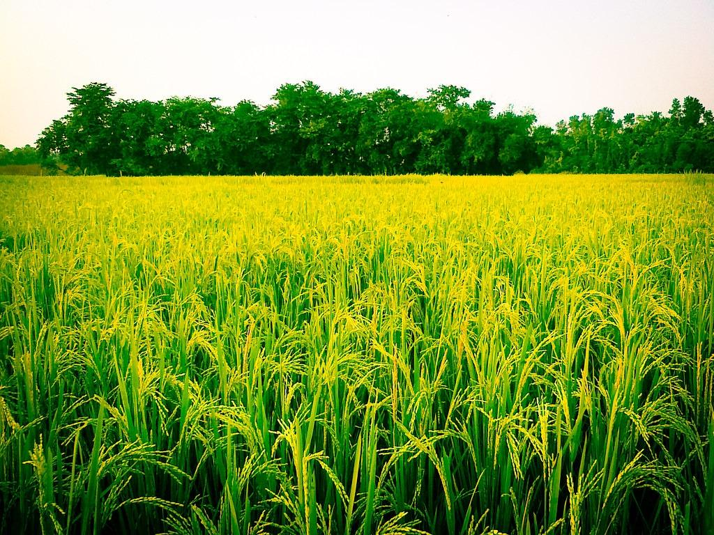
Thank You !!!

