Slide 1
HED Challenge Team 2: The Opioid Crisis in Eastern Tennessee
Josh Williams
Brandon Hulse
11.15.2024

Slide 2
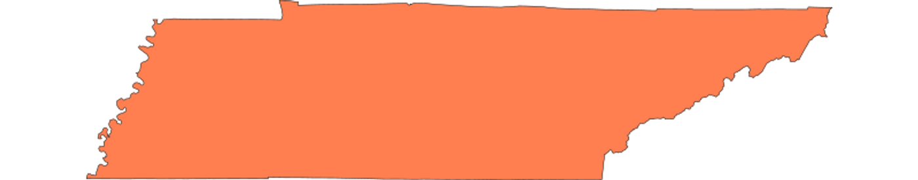
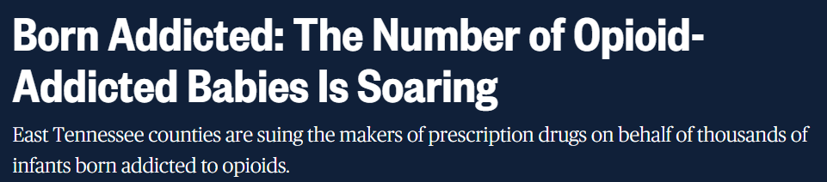
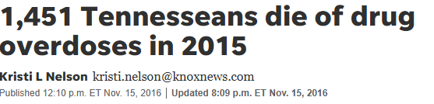
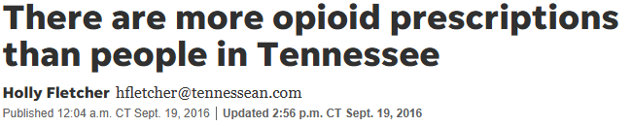
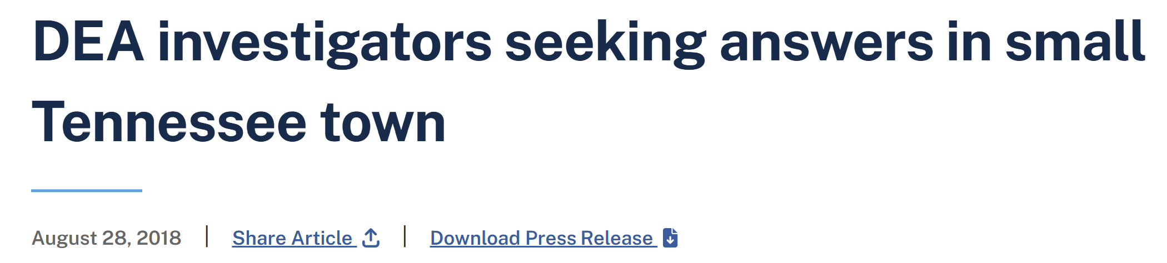
Tennessee is at the center of the opioid crisis
#3 nationally in opioid prescribing
#4 nationally for overdose deaths
Sources: BlueCross BlueShield of Tennessee
‹#›

Slide 3
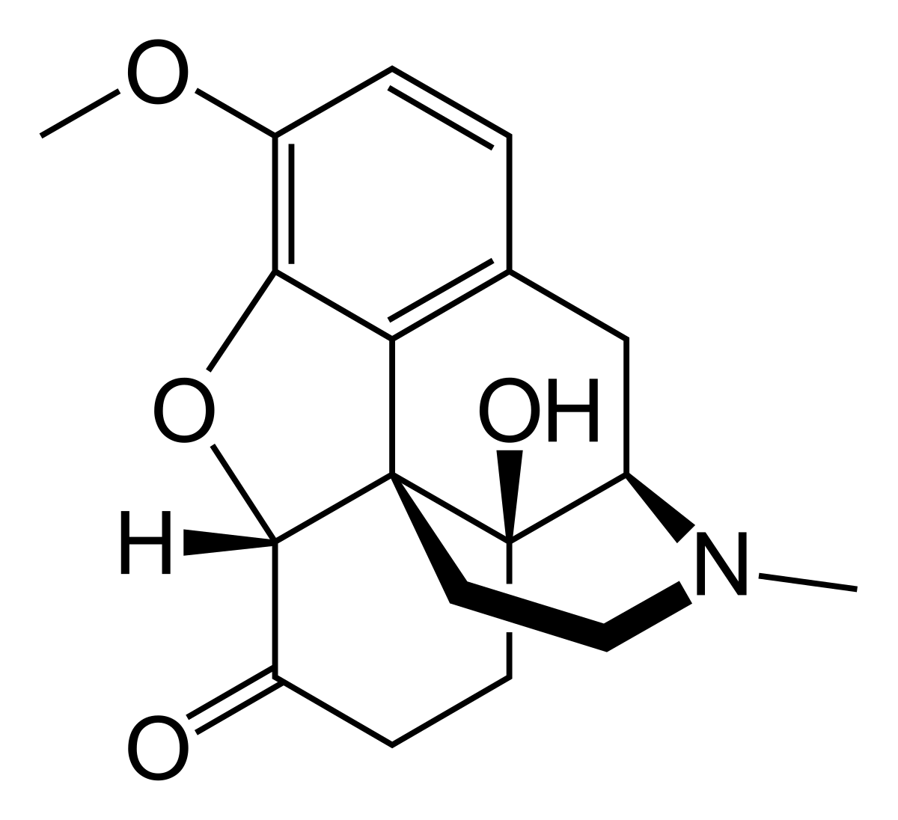

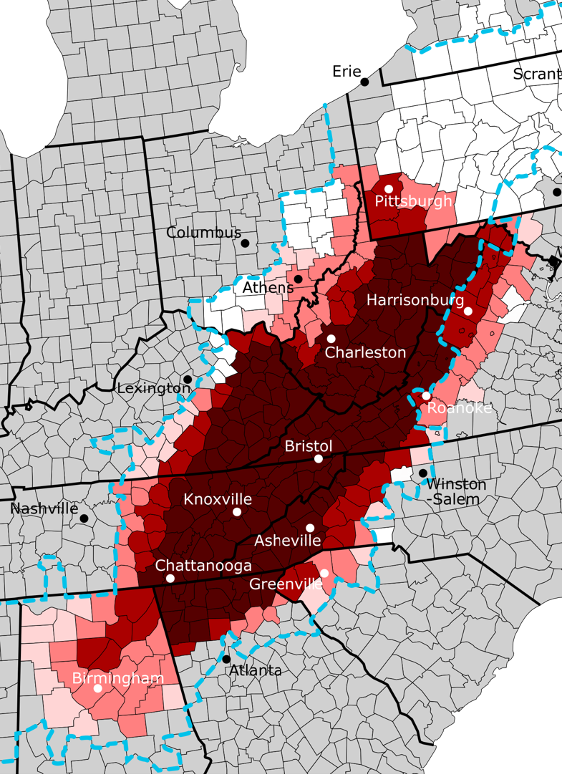
Context: Understanding the Opioid Crisis in Tennessee
Opioid Molecules
Opioid Policy in Tennessee
Oxycodone: prescription opioid for pain management; popular in early stages of epidemic with brand names like OxyContin
Tennessee has passed a variety of laws to help tackle substance use disorders in the state.
In this presentation, we will focus on the Tennessee Prescription Safety Act of 2012.
Tennessee Prescription Safety Act of 2012 (TN-PSA)
Purpose: aimed at addressing the opioid crisis in Tennessee by regulating the prescribing of controlled substances, especially prescription opioids
How it Worked
Pill Mills: facilities that prescribe large amounts of opioids with minimal medical oversight or justification
Established a statewide prescription drug monitoring program to track the dispensing of controlled substances such as prescription opioids
Called the Controlled Substance Monitoring Database (CSMD)
All pharmacies and prescribers were required to report opioid prescriptions in the CSMD
Physicians were required to check the CSMD regularly to ensure prescriptions were given appropriately
Regional Disparities
Appalachian region – rural, higher poverty rates and opioid use
Overdose-related mortality rates are ~72% higher in Appalachia
Eastern TN is in Appalachia
Intended Effect: crack down on “pill mills” and overprescriptions
Sources: Harvard School of Public Health, US DOJ, Appalachian Regional Commission, TN Gov, Vanderbilt Medical Center
‹#›

Slide 4
Our Research Question:
How effective was the Tennessee Prescription Safety Act of 2012? Were there differences in efficacy across various groups or regions?

Slide 5

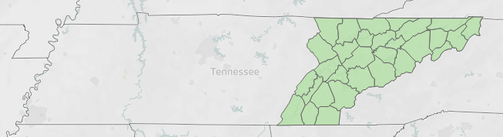



Data Sets and Analysis
Data Sets
Analysis
ARCOS Data: national database where manufacturers and distributors report transactions of controlled substances
Immediate Effect and Sustained Effect
Filters applied
Interrupted Time Series
Evaluation of Bias and Error
Molecule: Oxycodone
Buyers: Hospitals, Retail Pharmacies, Chain Pharmacies, & Practitioners
Location: Eastern TN Counties
Common prescription opioid
Identify transactions where substance use disorders more prominent
Center of opioid crisis in TN; urban and rural
Rural vs. Urban
Map Oxycodone Purchases
Geospatial Analysis
Account for Population Density
TN Data: Population, Area (sq mi) by County
TN Data: Income by County
Idenitfy High Risk Areas
Sources: ARCOS Data Portal, Census, NIH
‹#›

Slide 6
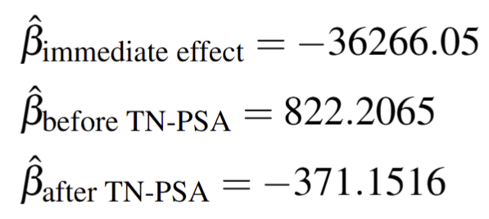
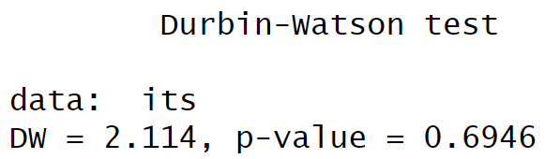
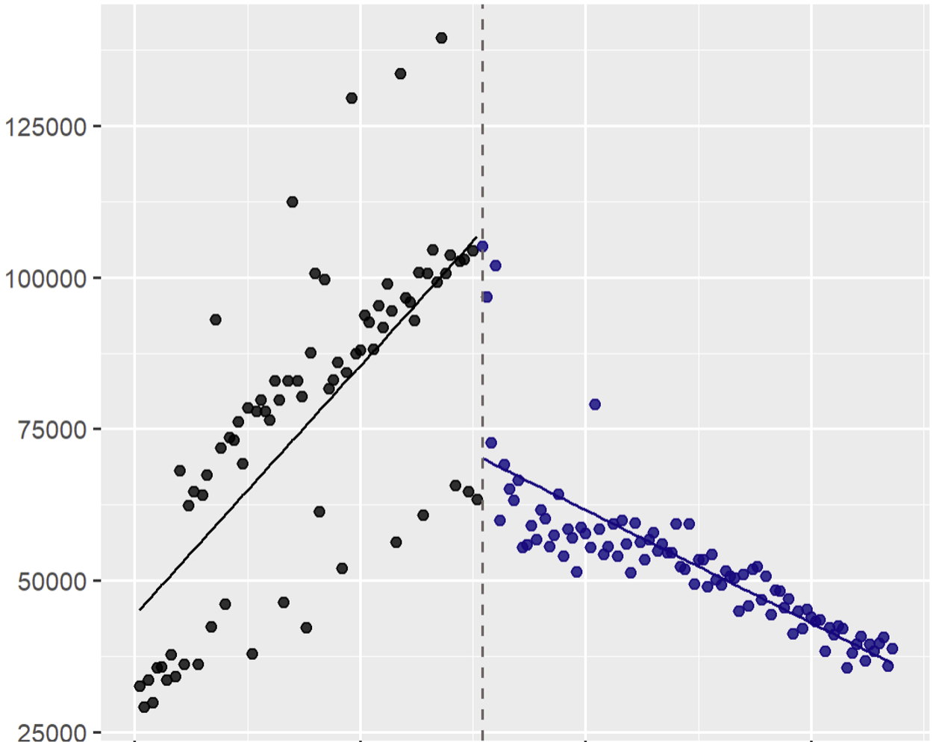
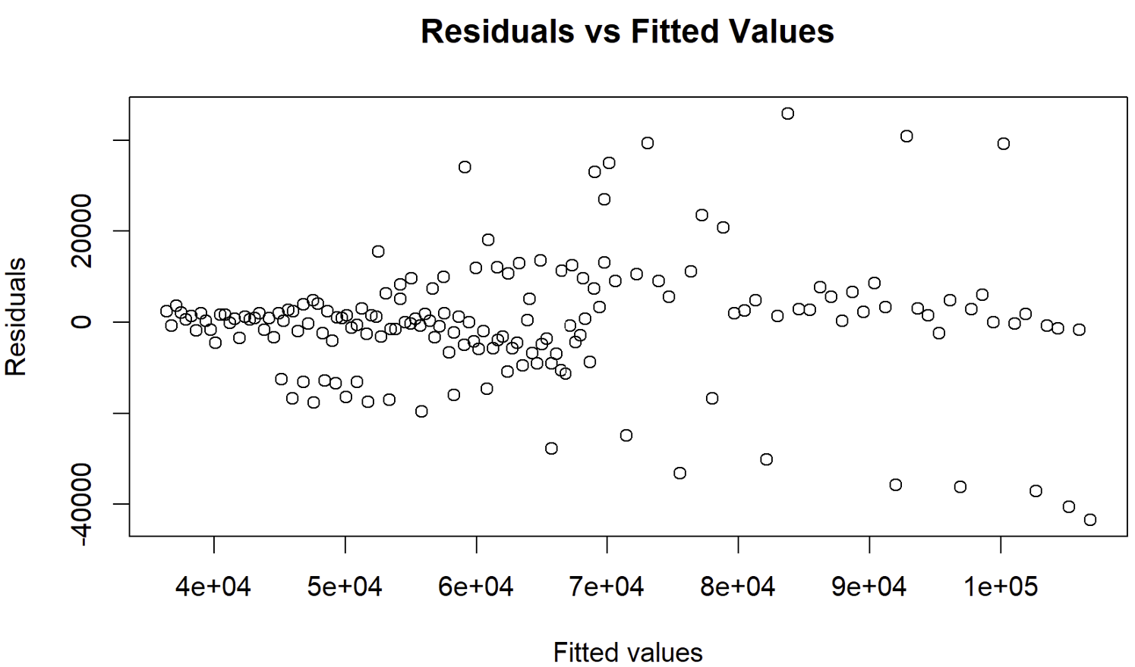
Interrupted Time Series Results
Interrupted Time Series
Evaluation of Bias and Error
We considered autocorrelation and heteroscedasticity in our evaluation of error
Interrupted Time Series of the Tennessee Prescription Safety Act of 2012
No statistically significant evidence of autocorrelation
Quantity of Oxycodone Purchased in East Tennessee
All variables were statistically significant with (***) significance codes
Heteroscedasticity possible
Jan 06’
Feb 10’
Apr 14’
Jun 18’
Conclusion: The TN-PSA of 2012 led to a significant immediate and sustained decline in the quantity of oxycodone purchased in East TN.
Sources: Data Science for Public Service, SAS
‹#›

Slide 7
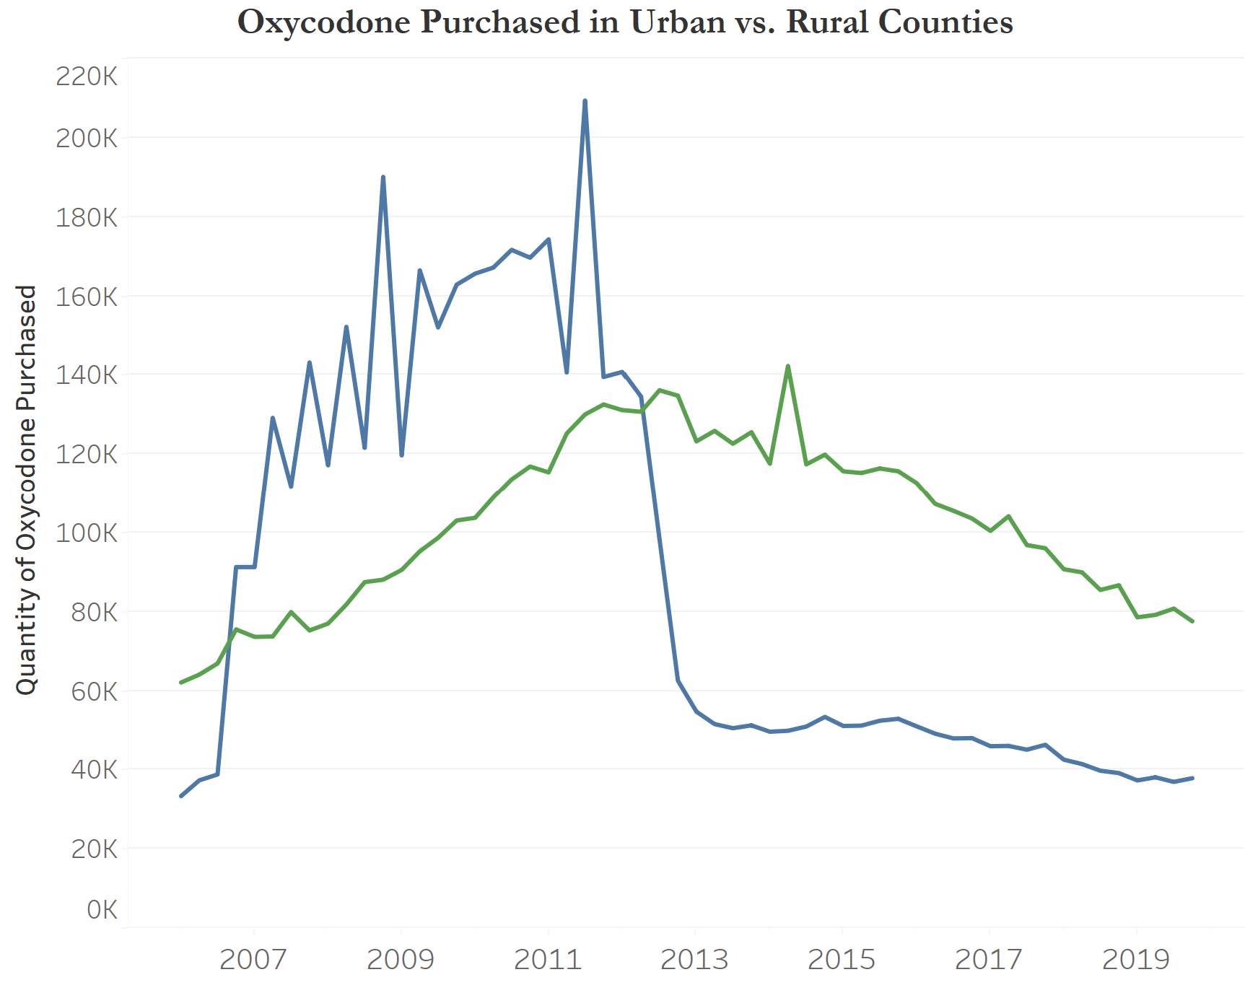
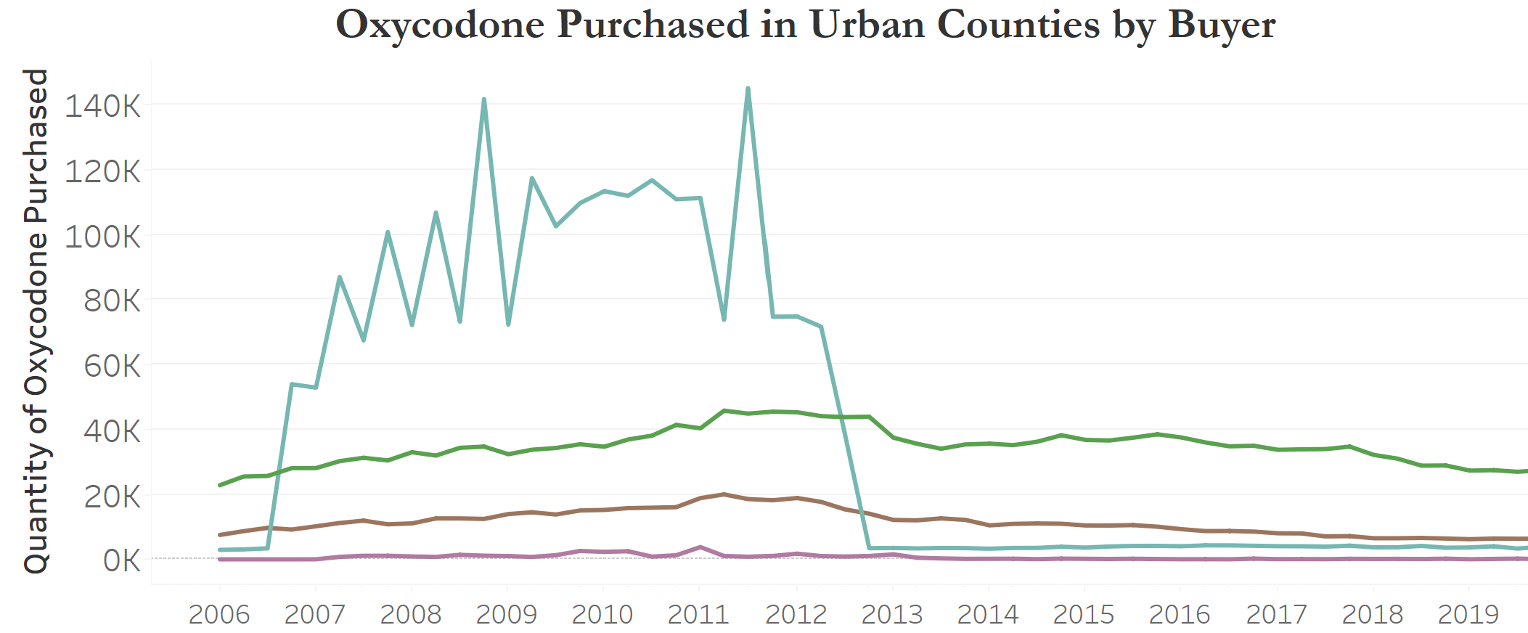
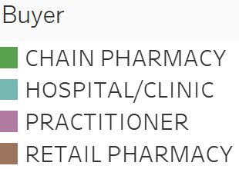

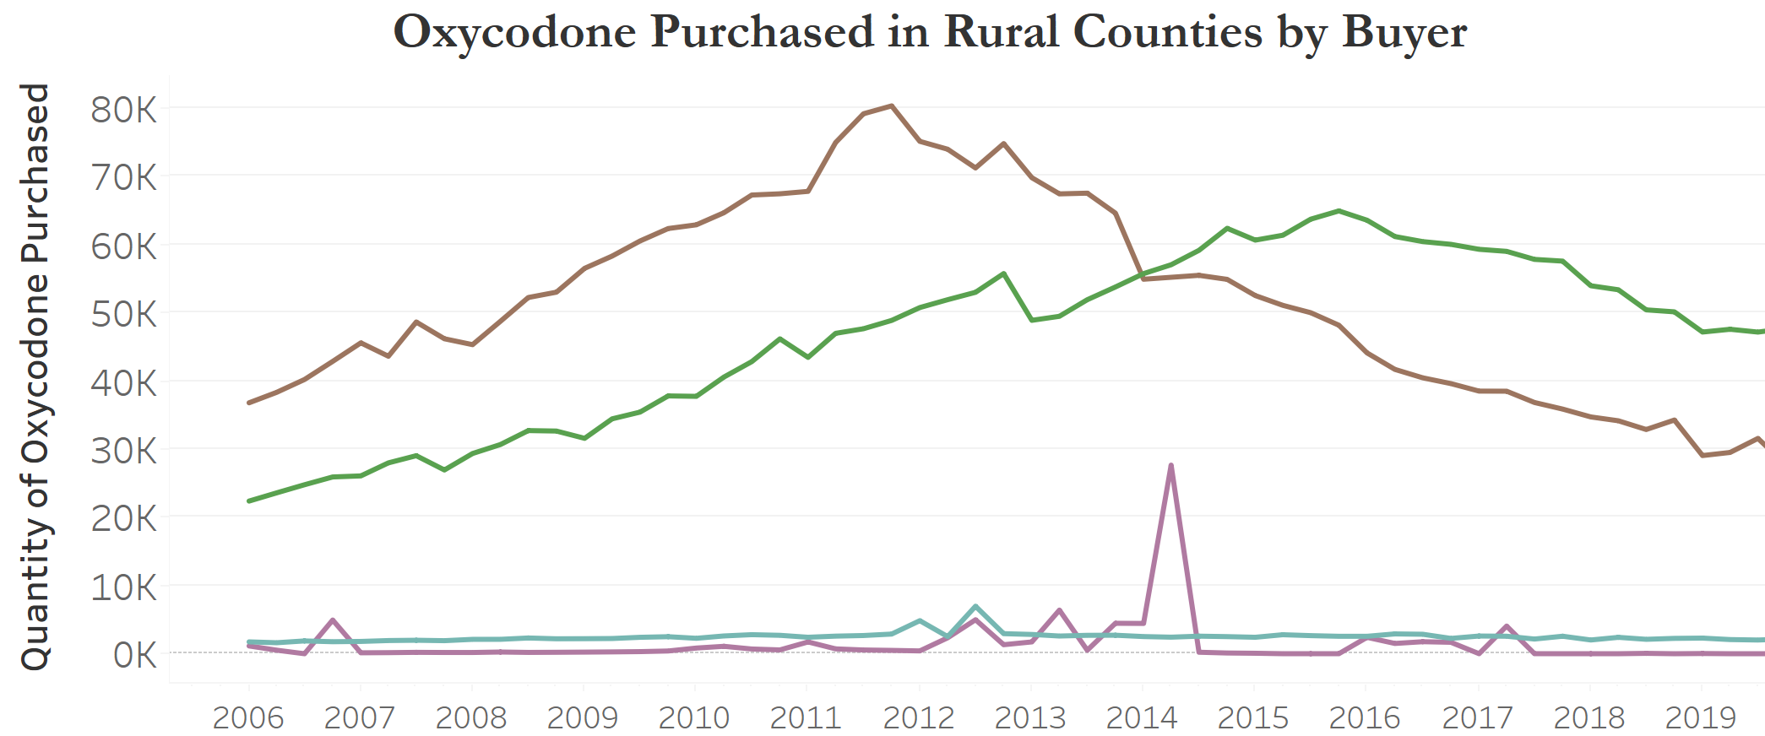
Effect of TN-PSA: Rural vs. Urban Communities
Definition: The two most populous East TN counties, Knox (Knoxville) and Hamilton (Chattanooga) are “Urban.” All others are “Rural.”
Sources:
‹#›

Slide 8
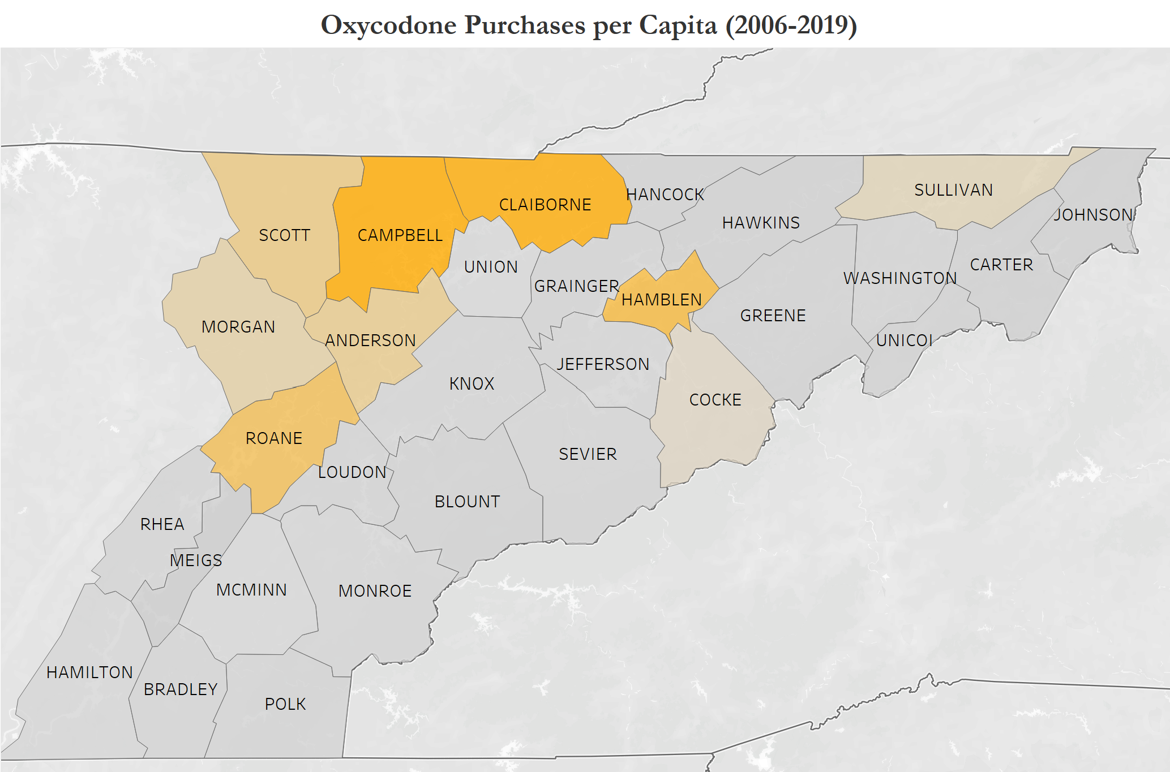
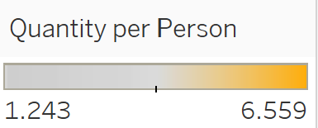
Which Rural Areas were at the Highest Risk?
Opioid purchases distributed unevenly across counties in Eastern Tennessee
Most intense purchases in top left of map: Scott County, Campbell County, Claiborne County, etc.
Note: considering purchases by chain pharmacies, retail pharmacies, and practitioners only
Sources:
‹#›

Slide 9
Conclusion
Policy Recommendations
For Further Analysis
The Tennessee Prescription Safety Act of 2012 led to a significant immediate and sustained decline in the quantity of oxycodone purchased in Eastern Tennessee.
However, efficacy of the policy varied, especially for certain rural counties.
Learning from the TN-PSA, we have the following recommendations to guide future policy.
Ensure adequate medical oversight across all types of healthcare providers
Use data analysis to employ targeted support and resources to the areas and counties that need it most
Age
Black Market
Income
Next Steps
Draw Area
Gender
Patient Data
Sources:
‹#›

Slide 10
Thank You

