Slide 1
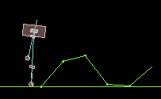
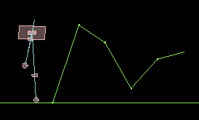
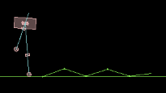
Increasing difficulty

Slide 2
Increasing difficulty

Slide 3
Increasing difficulty

Slide 4
Increasing difficulty

