Slide 1
School of Computer Science, Carnegie Mellon University; bhumbers@cs.cmu.edu
Department of Civil and Environmental Engineering, University of Pittsburgh; felher.c@gmail.com

Slide 2
Introduction
Weather forecasts are useful for a wide range of applications, from everyday personal decisions, to large-scale industrial activities. However, many physical phenomena are involved in the evolution of the state of the atmosphere, and some of these are still largely misunderstood. Moreover, physically-based models require large amounts of data that can only be indirectly estimated in most cases. Therefore, many researchers have turned their attention towards machine learning methods to create simplified models based on available observations. The purpose of this project is to apply variants of a Vector Auto-Regression (VAR) model to the forecasting of meteorological variables using satellite-based observations.

Slide 3
Dataset
As opposed to measurements from weather stations, satellite observations offer total spatial coverage at the cost of reduced precision. Figure 1 shows samples from the North America Data Assimilation System (NLDAS) satellite-based observations available from the GES-DISC at NASA: values for the different meteorological variables are provided hourly for each cell within a regular grid.

Slide 4
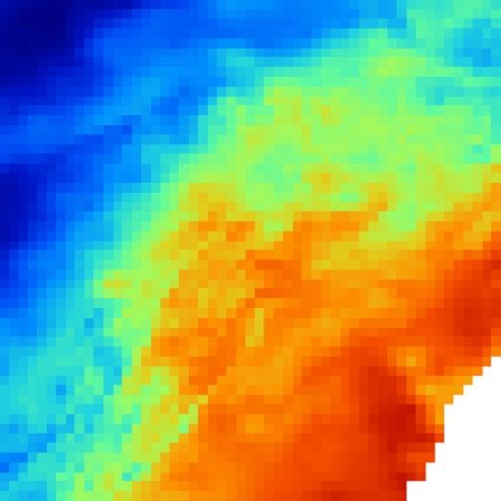
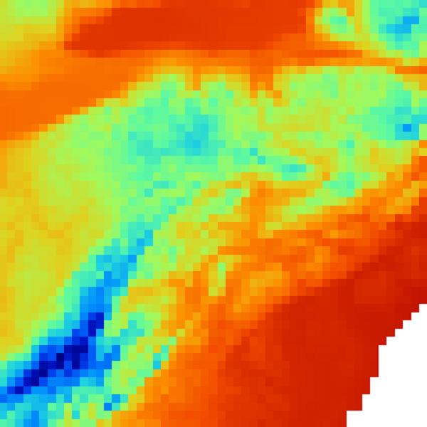
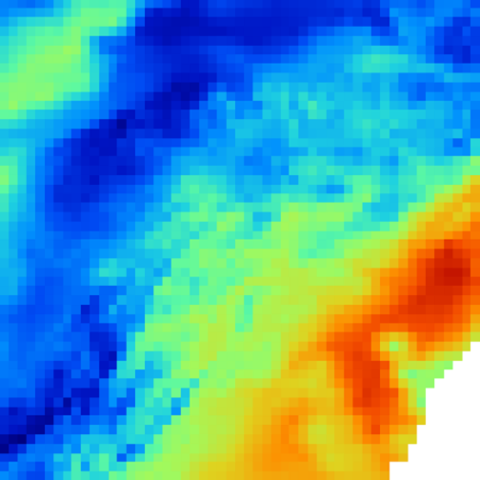
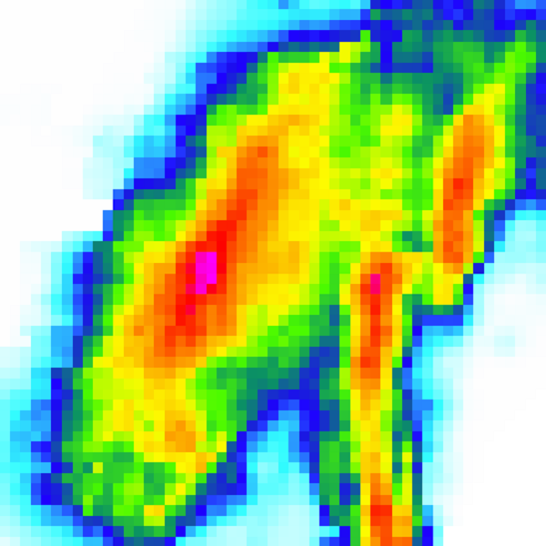
…
Humidity
Pressure
Temperature
Precipitation
Figure 1. Gridded values for the weather variables are available every hour from NLDAS

Slide 5
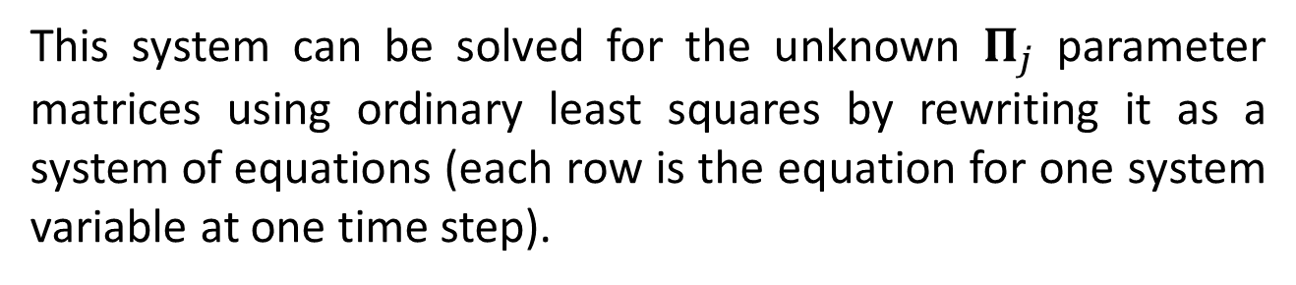

Method
Our work uses a vector autoregressive (VAR) model in order to simulate and predict the evolution of the meteorological system over time. The model describes the system values X at time t as a linear combination of some number of prior system states p:
$$X_{t}=c+Π_{1}X_{t−1}+…+Π_{p}X_{t−p}+ε_{t}$$
This system can be solved for the unknown $Π_{j}$ parameter matrices using ordinary least squares by rewriting it as a system of equations (each row is the equation for one system variable at one time step).

Slide 6
Three aspects for the setup of the model were considered:
Using the past values of the same variable vs. using the past values of all the variables
The number of previous states to consider (p)
Whether or not to include the values on neighboring cells (neighborhood radius r)
Figure 2 illustrates two possible the setups for the VAR model, with varying lag p and neighborhood radius r.

Slide 7
a.
Cell = (x - r … x + r, y - r … y + r)
X₁
X₂
X₃
…
X_{n}
Time = t - p … t - 1
X₁
X₂
X₃
…
X_{n}
Time = t
Cell = (x, y)
b.
Cell = (x - r … x + r, y - r … y + r)
X₁
X₂
X₃
…
X_{n}
Time = t - p … t - 1
X_{i}
Time = t
Cell = (x, y)
Figure 2. Variables used for estimating values X at time t at cell (x, y); a. Single-variable model; b. Multivariate model

Slide 8
a.
X₁
X₂
X₃
…
X_{n}
Time = t - p … t - 1
Cell = (x, y)
X₁
X₂
X₃
…
X_{n}
Time = t
Cell = (x, y)
Cell = (x - r … x + r, y - r … y + r)
b.
X₁
X₂
X₃
…
X_{n}
Time = t - p … t - 1
X₁
X₂
X₃
…
X_{n}
Time = t
Cell = (x, y)

Slide 9
a.
Time = t - p … t - 1
X₁
X₂
X₃
…
X_{V}
Cell = (i, j)
X_{v}
Time = t
Cell = (i, j)
b.
Cell = (1 … s_{x} , 1 … s_{y})
X₁
X₂
X₃
…
X_{V}
Time = t - p … t - 1
X_{v}
Time = t
Cell = (i, j)

