Slide 1
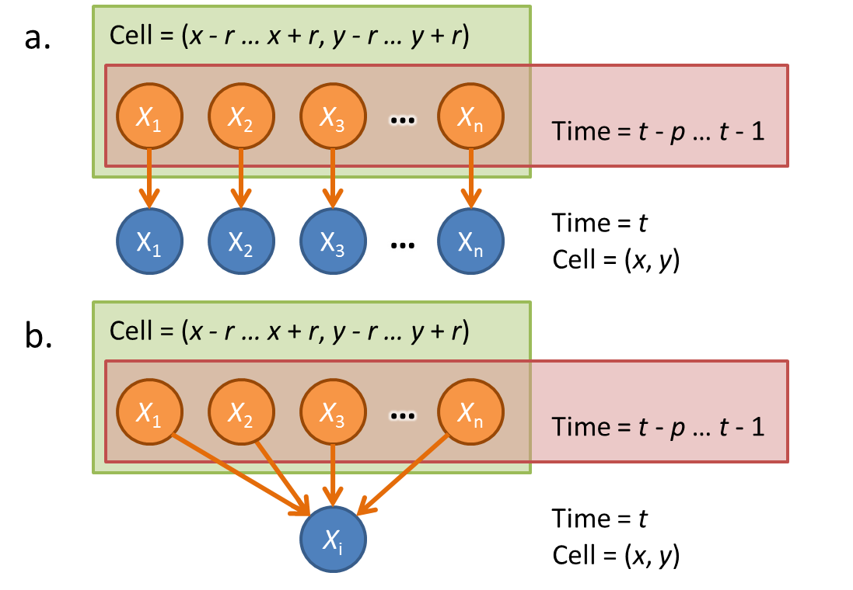
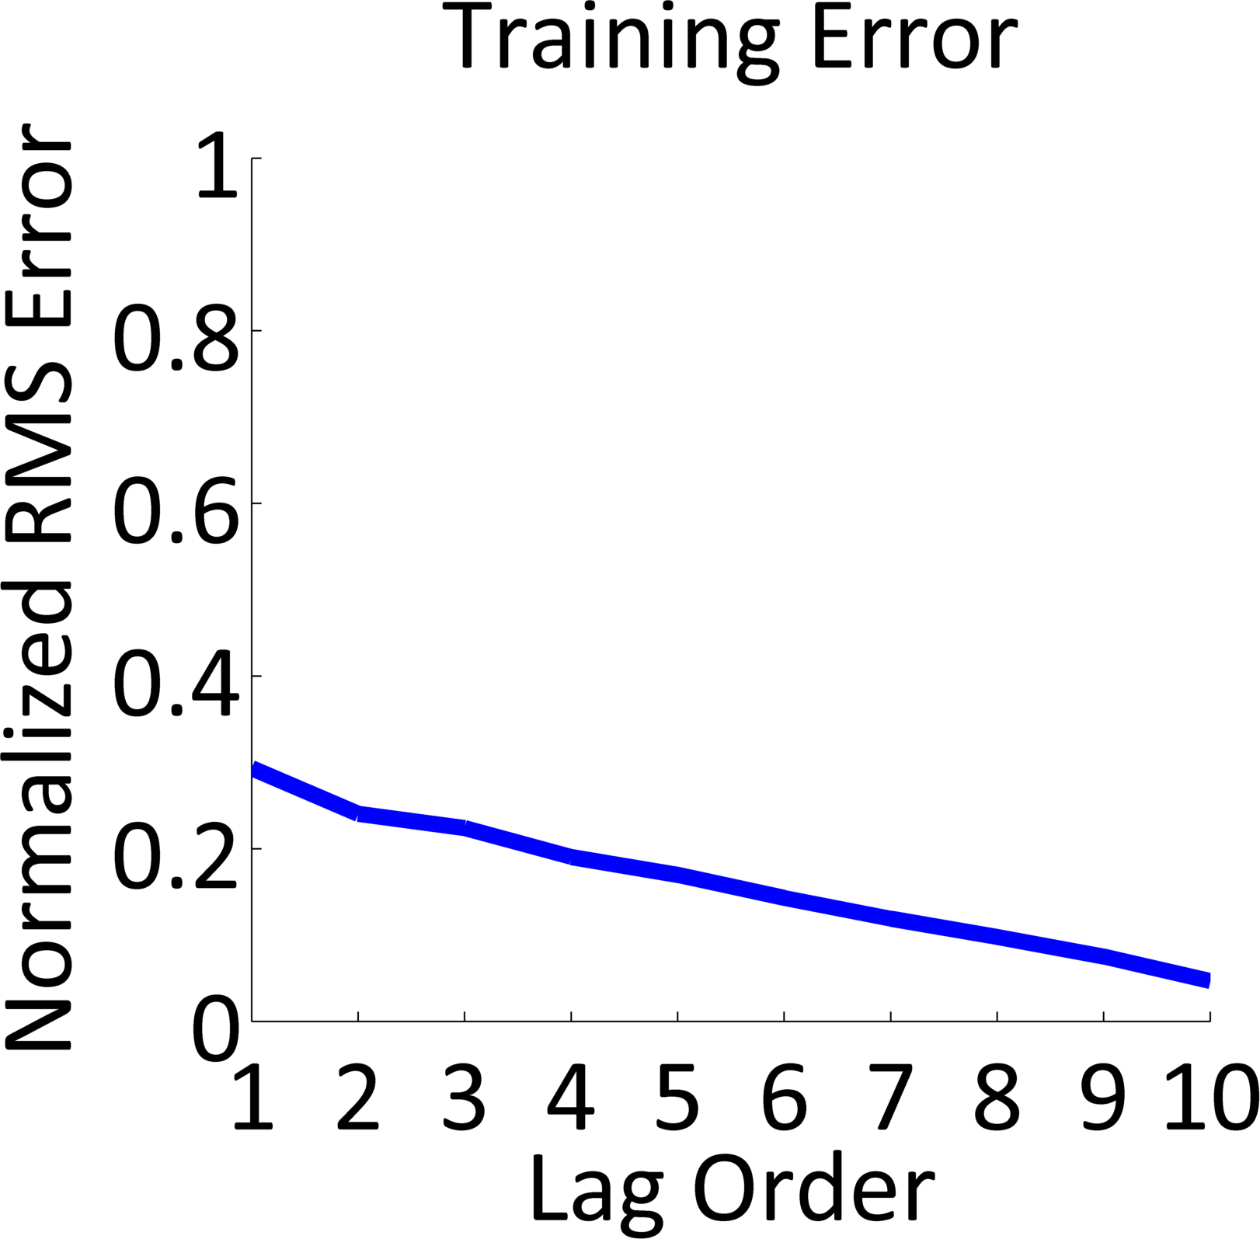
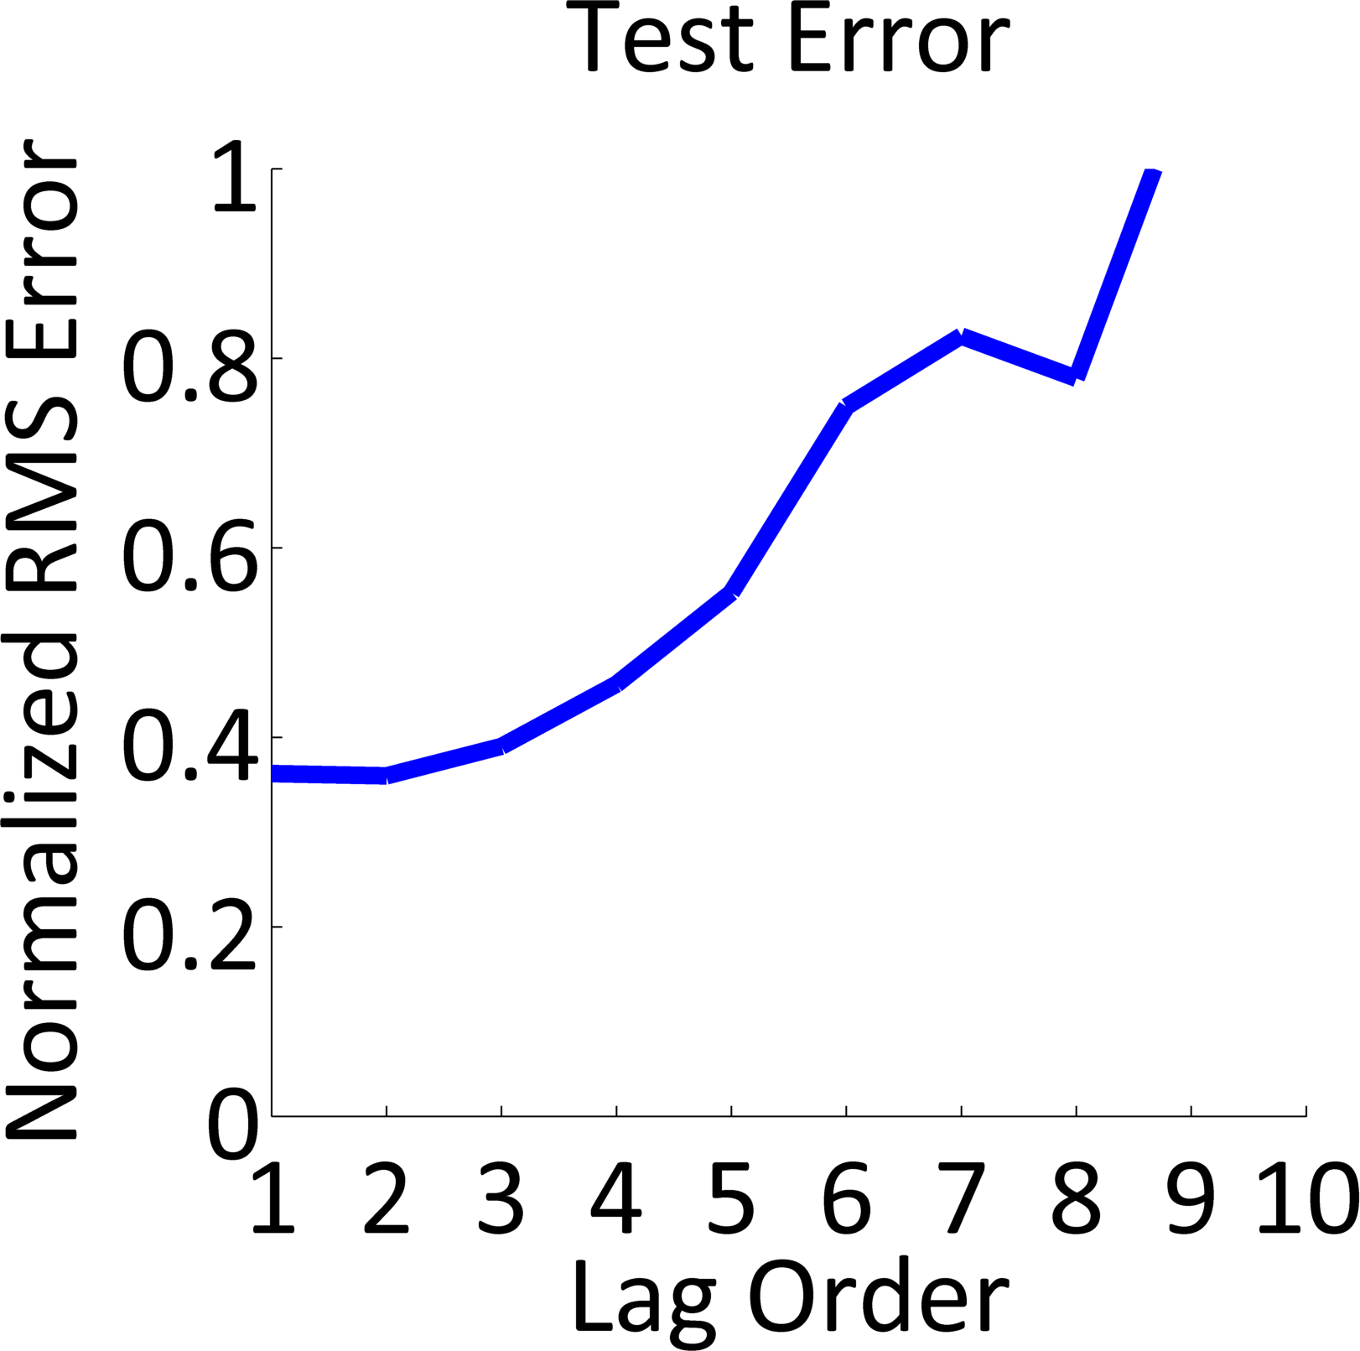
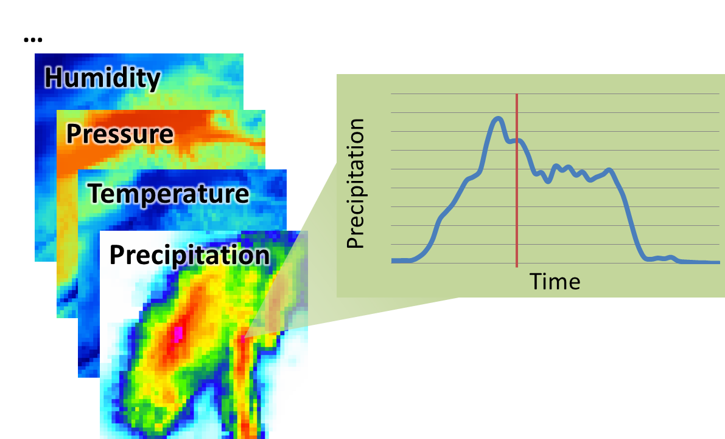
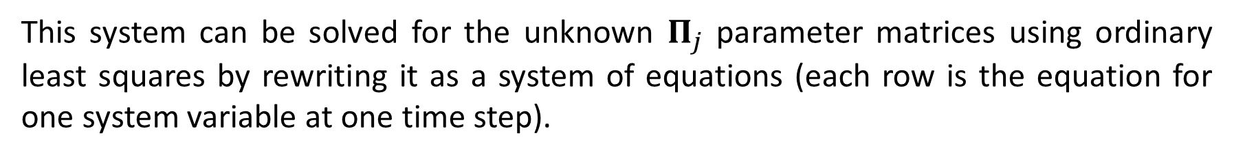

Predicting Meteorological Values on a Spatial Grid using the North American Land Data Assimilation System
Ben Humberston¹ and Felipe Hernández²
Introduction
Figure 2 illustrates two possible the setups for the VAR model, with varying lag p and neighborhood radius r.
Weather forecasts are useful for a wide range of applications, from everyday personal decisions, to large-scale industrial activities. However, many physical phenomena are involved in the evolution of the state of the atmosphere, and some of these are still largely misunderstood. Moreover, physically-based models require large amounts of data that can only be indirectly estimated in most cases. Therefore, many researchers have turned their attention towards machine learning methods to create simplified models based on available observations ([1] and [2]). The purpose of this project is to apply variants of a Vector Auto-Regression (VAR) model to the forecasting of meteorological variables using satellite-based observations.
Figure 4. RMS Error when using independent variable model vs. interdependent variables model
Dataset
As opposed to measurements from weather stations, satellite observations offer total spatial coverage at the cost of reduced precision. Figure 1 shows samples from the North America Data Assimilation System (NLDAS) satellite-based observations available from the GES-DISC at NASA [3]: values for the different meteorological variables are provided hourly for each cell within a regular grid.
Figure 2. Variables used for estimating values X at time t at cell (x, y); a. Independent variable model; b. Model with interdependencies between variables
Results
Figure 5. Training and Test RMS Error as a function of VAR model lag order p for multivariable model
Results
Conclusions
Overfitting for higher order lags; need regularization (lasso & fused lasso)
Some variables easy to predict (temperature & pressure); some hard due to sparsity (precipitation)
Adding neighboring cells or adding other variables to the model doesn't significantly improve accuracy
IE: we get the same performance using a very simple lag order of 1 or 2 and just looking at values for same variable at same cell
Problem might be too easy… just linearly extrapolating works well
Harder problem would be to forecast many steps into the future
Have preliminary results for this if possible (5 or so steps into the future, how does the model fare?)
References to figures 3, 4, and 5
Figure 1. Gridded values for the weather variables are available every hour from NLDAS
Method
Our work uses a vector autoregressive (VAR) model in order to simulate and predict the evolution of the meteorological system over time (see [4], [5] for details on the VAR approach). The model describes the system values X at time t as a linear combination of some number of prior system states p:
References
$$X_{t}=c+Π_{1}X_{t−1}+…+Π_{p}X_{t−p}+ε_{t}$$
[1] Maier, H. and Dandy, G, (2000), “Neural networks for the predictions and forecasting of water resources variables: review of modeling issues and applications”, Environmental Modelling and Software 15, 101–124.
[2] Applequist, S., Garhs, G., and Pfeffer, R., (2002), “Comparisons of methodologies for probabilistic quantitative precipitation forecasting”, Weather and Forecasting 17 (4), 783–799.
[3] National Aeronautics and Space Administration, “Land Data Assimilation Systems (LDAS)”, available online at http://ldas.gsfc.nasa.gov/index.php.
[4] Lutkepohl, H. (1991), Introduction to Multiple Time Series Analysis. Springer-Verlag, Berlin.
[5] Zivot, E. and Wang, J. (2006), Vector autoregressive models for multivariate time series”, in Modeling Financial Time Series with S-PLUS, pages 385–429. Springer New York.
This system can be solved for the unknown $Π_{j}$ parameter matrices using ordinary least squares by rewriting it as a system of equations (each row is the equation for one system variable at one time step).
Figure 3. RMS Error when using single cell model or model that includes neighboring cells as input
Three aspects of the input data for the model were considered:
Whether or not to use values on neighboring cells (neighborhood radius r)
Whether to predict different variables independently or to measure interdependencies between variables
The number of previous states to include in the model (VAR lag order p)
School of Computer Science, Carnegie Mellon University; bhumbers@cs.cmu.edu
Department of Civil and Environmental Engineering, University of Pittsburgh; felher.c@gmail.com

