Slide 1
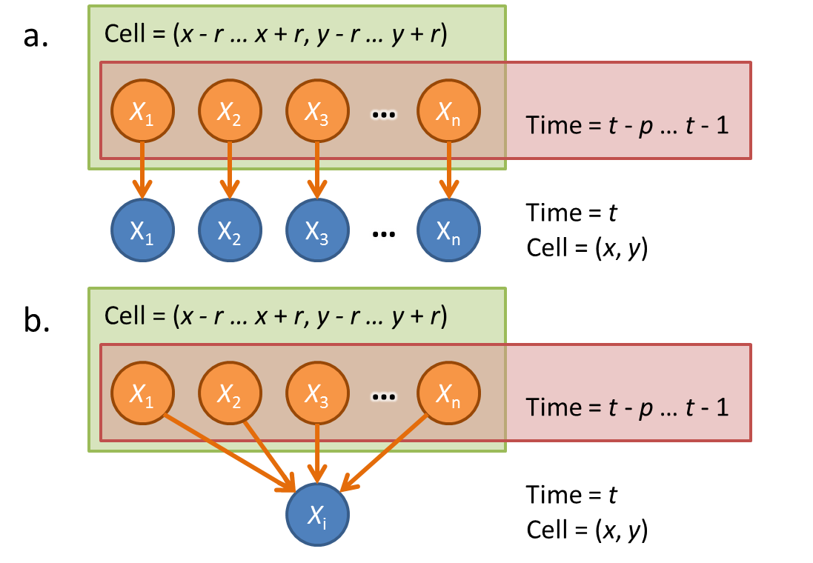
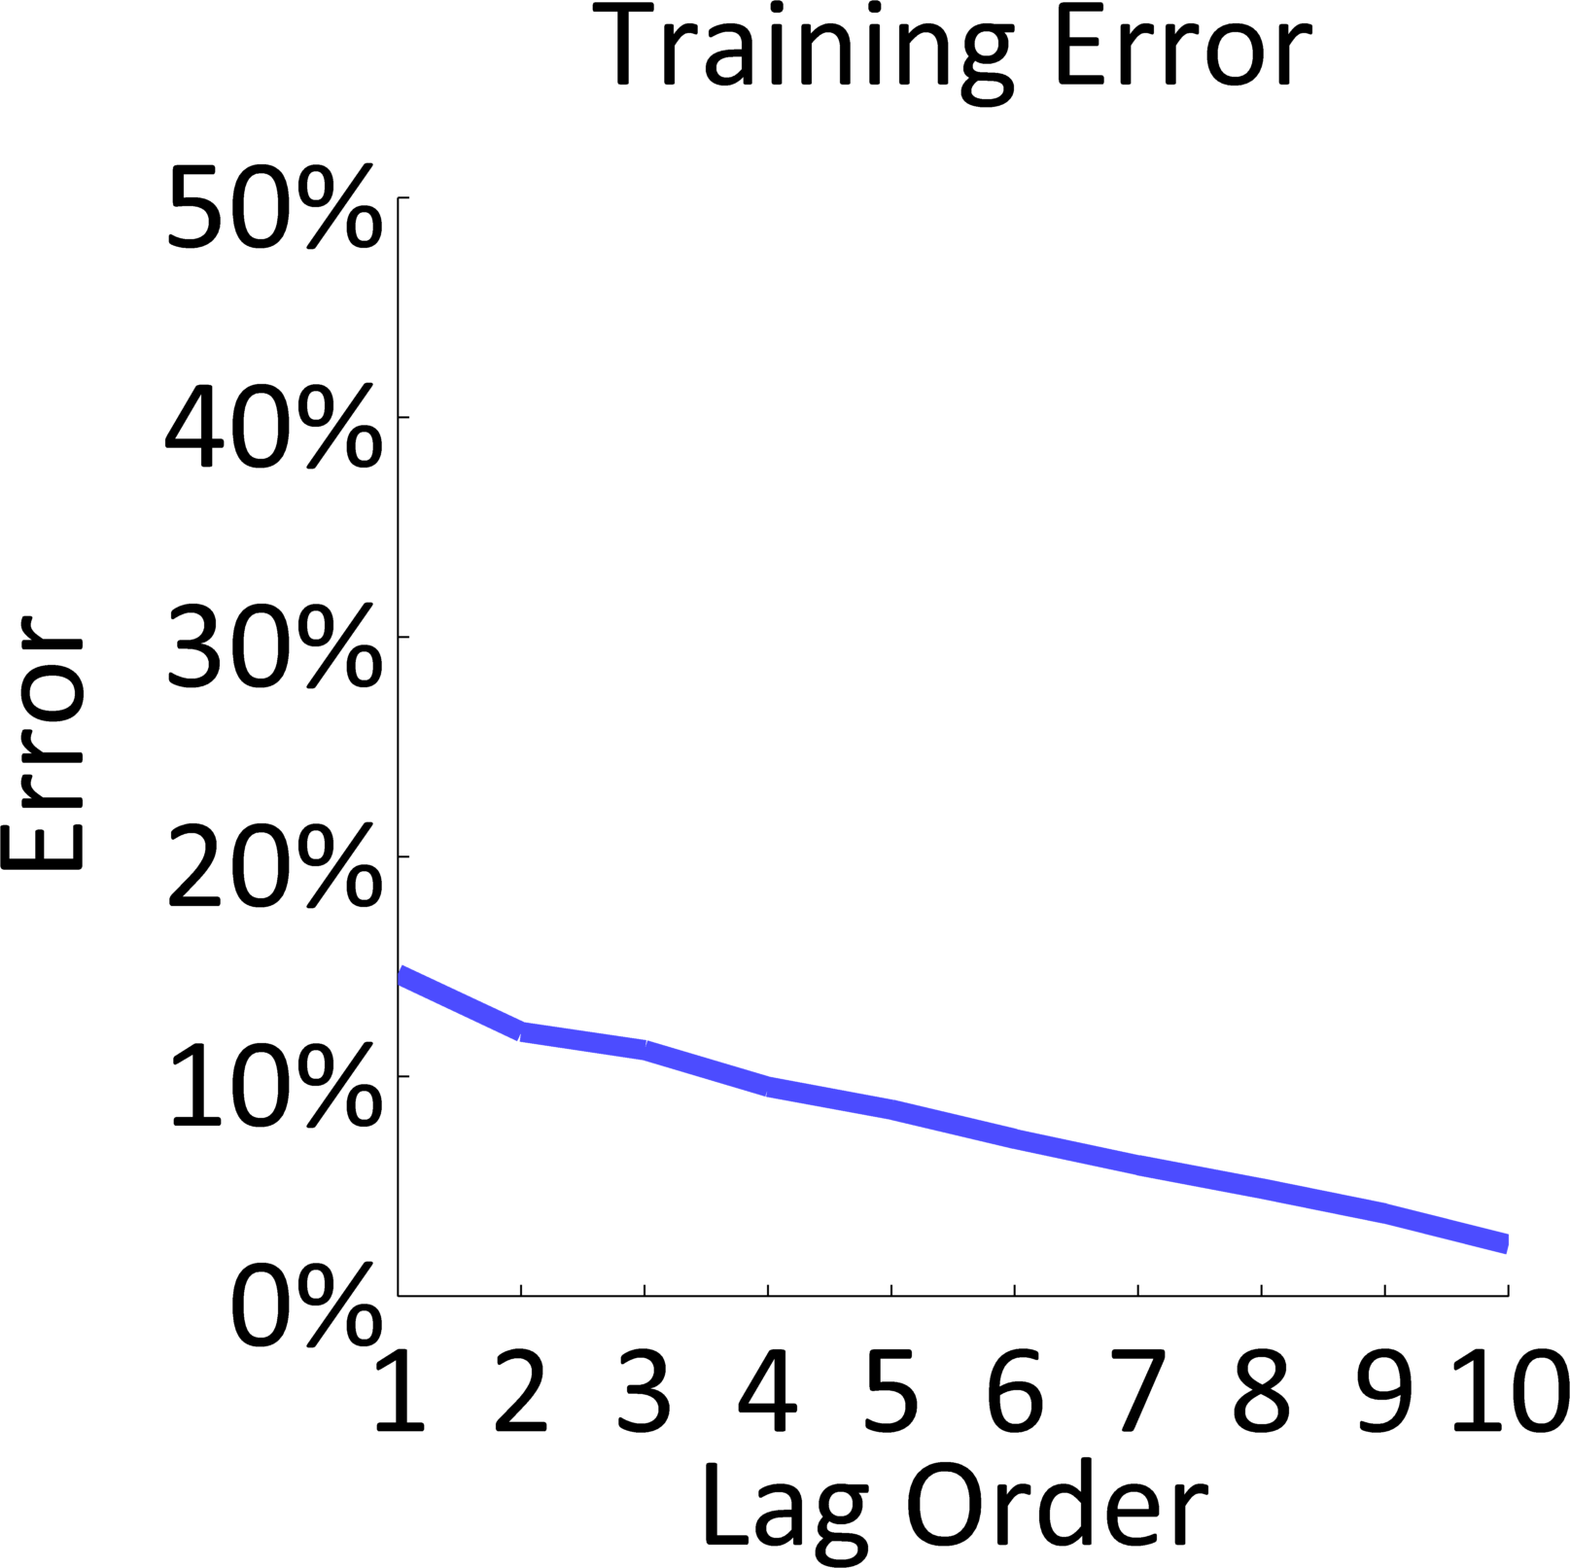
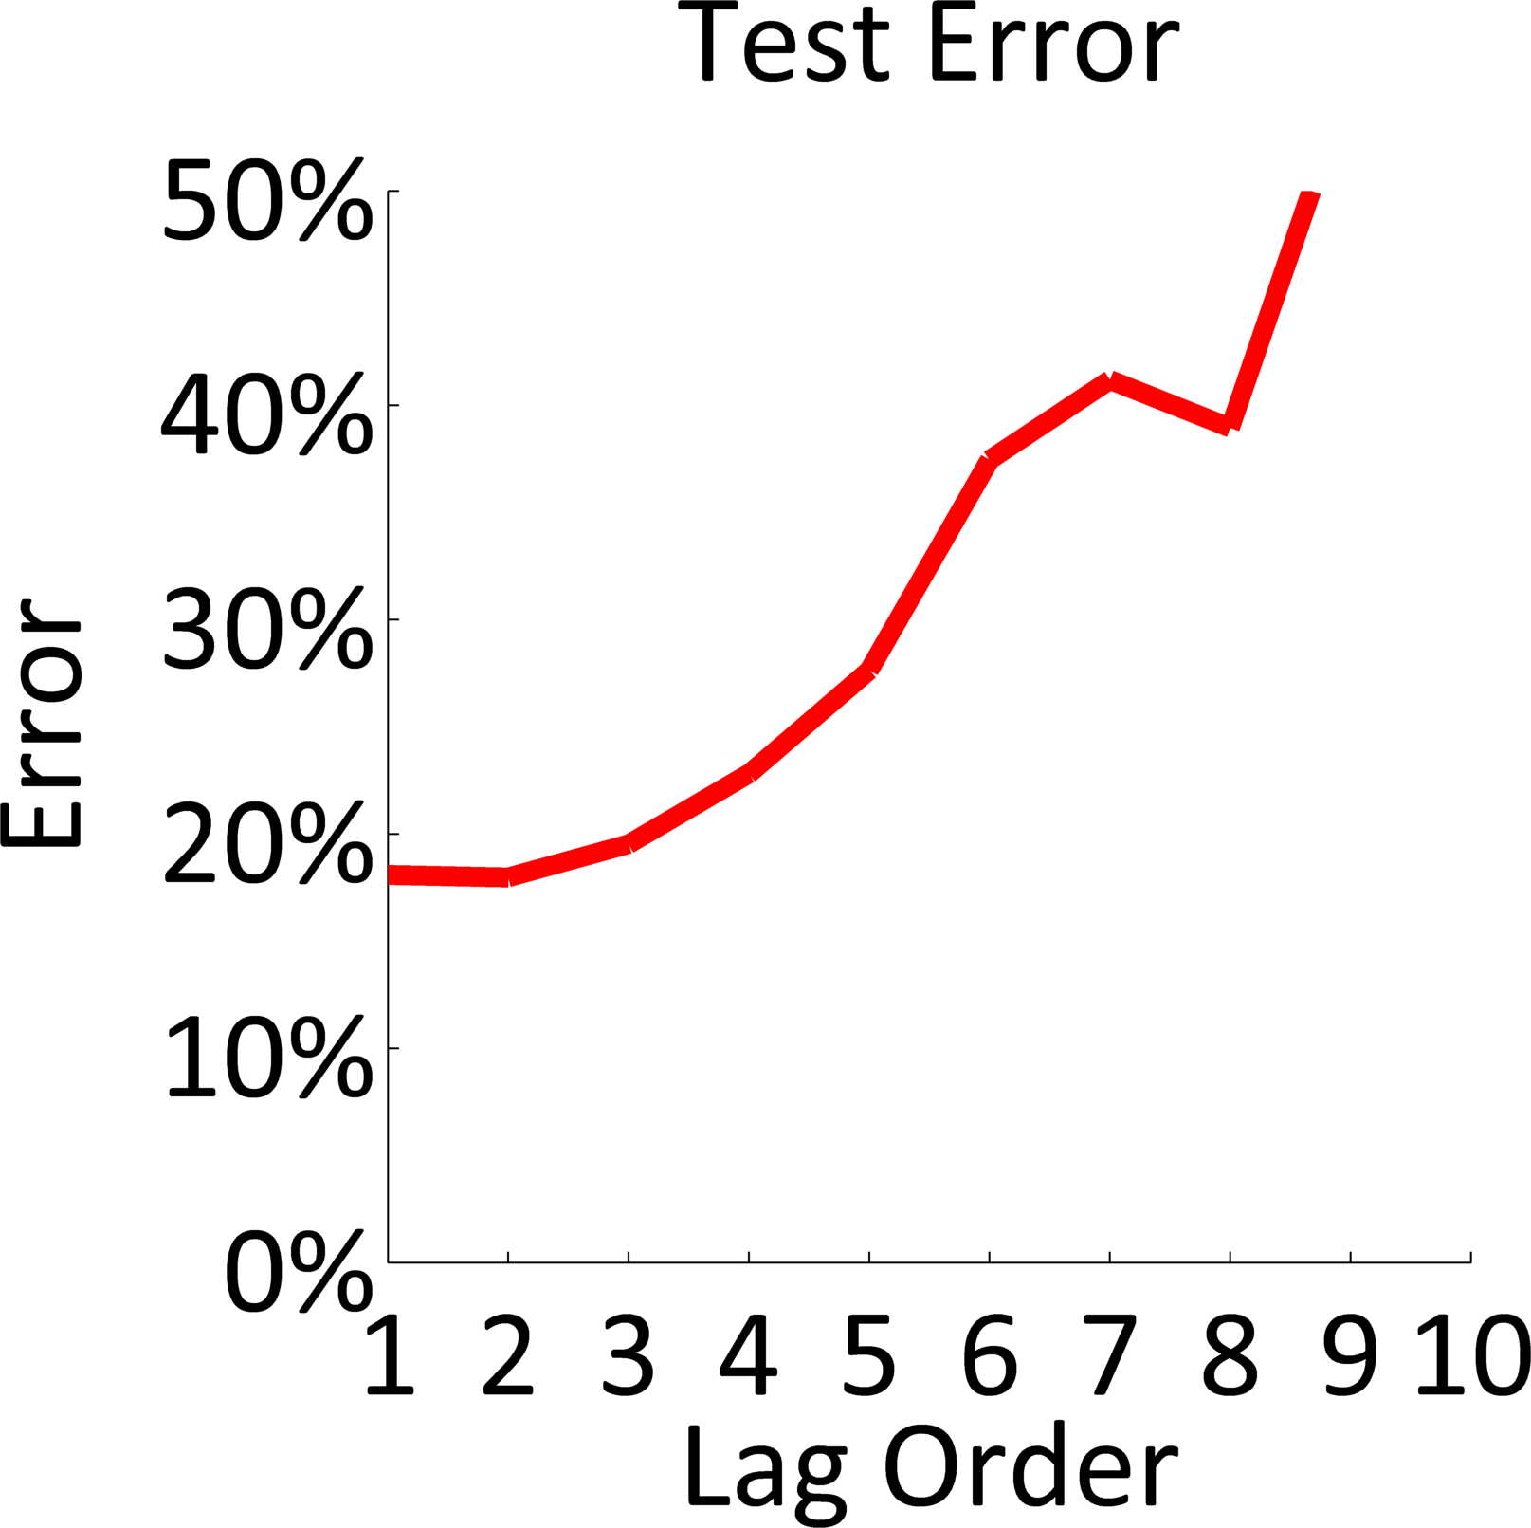
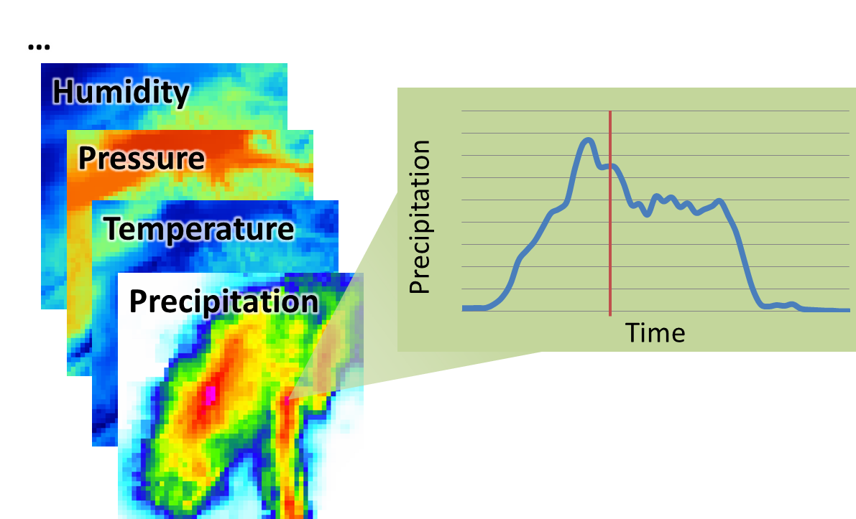
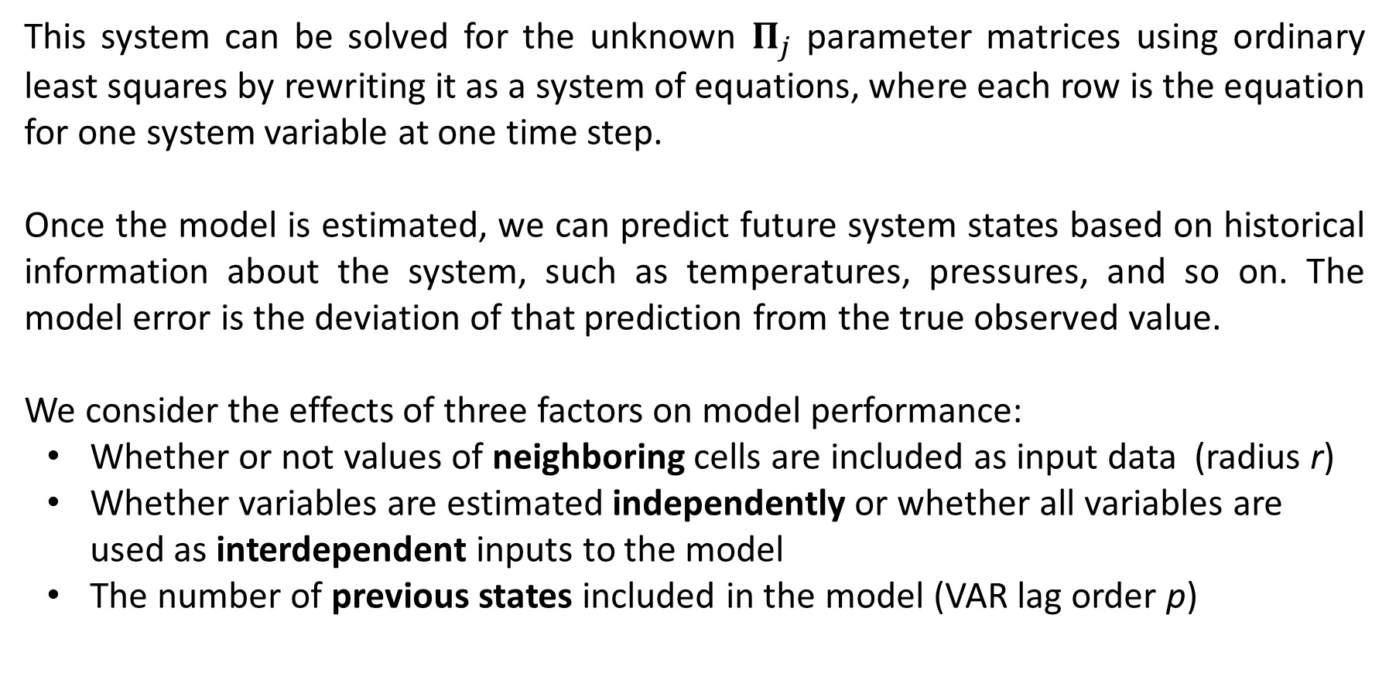

ID# 29
Predicting Meteorological Values on a Spatial Grid using the North American Land Data Assimilation System
Ben Humberston¹ and Felipe Hernández²
Introduction
Figure 2 illustrates two of the possible the setups for the VAR model, with varying lag p and neighborhood radius r.
Finally, we observe the performance of the VAR model for increasing lag order p. The greater the lag order, the more complex the model becomes. Figure 5 shows the training and test error as a function of the lag order of the model. Training error decreases nearly uniformly as the lag order increases, but test set performance balloons upward beyond p = 2.
Weather forecasts are useful for a wide range of applications, from everyday personal decisions, to large-scale industrial activities. However, many physical phenomena are involved in the evolution of the state of the atmosphere, and some of these are still largely misunderstood. Moreover, physically-based models require large amounts of data that can only be indirectly estimated in most cases. Therefore, many researchers have turned their attention towards machine learning methods to create simplified models based on available observations ([1] and [2]). The purpose of this project is to apply variants of a Vector Auto-Regression (VAR) model to the forecasting of meteorological variables using satellite-based observations.
Dataset
As opposed to measurements from weather stations, satellite observations offer total spatial coverage at the cost of reduced precision. Figure 1 shows samples from the North America Data Assimilation System (NLDAS) satellite-based observations available from the GES-DISC at NASA [3]: values for the different meteorological variables are provided hourly for each cell within a regular grid.
Figure 2. Variables used for estimating values X at time t at cell (x, y); a. Independent variable model; b. Model with interdependencies between variables
Figure 5. RMS errors as a function of VAR model lag order p
Conclusions
Our model’s complexity increases when using large grid cell neighborhoods or all variables as input as well as when using a large number of prior states. While we expect some amount of complexity is needed in order to capture the dynamics of weather over time, our results show that the model is overfit for highly complex versions, particularly when cell neighborhoods and high lag orders are used. We plan to combat this overfitting by using lasso regularization, which imposes feature selection on the model by encouraging sparsity of the estimated parameters.
An additional finding was that predicting variables such as temperature or air pressure is well-served by our linear model, but other variables like precipitation show poor performance regardless of model complexity. Critically, the former variables exhibit dense, periodic trends, while the latter class includes sporadic phenomena with no clear periodicity. This suggests that, using our approach, effective weather forecasting is possible for phenomena which already show some degree of predictability, but other aspects may require physically-based modeling.
Results
Selecting a single variable of interest, air temperature, and a lag order p = 1, we observe the performance when either using only a single grid cell as input to the model or including a number of neighboring grid cells. The average, normalized RMSE for training and test data sets across all outputs is shown for both of these models in Figure 3. Models that include the neighbor cells as input show a modest decrease in training error compared to single cell models, but this advantage is lost when considering test set performance.
We also compare a model that estimates variables independently with one that introduces interdependencies by using all variables as inputs. In this case, both training and test performance improves for the latter, more complex model (see Figure 4).
Figure 1. Gridded values for the weather variables are available every hour from NLDAS
Method
References
Our work uses a vector autoregressive (VAR) model in order to simulate and predict the evolution of the meteorological system over time (see [4], [5] for details on the VAR approach). The model describes the system values X at time t as a linear combination of some number p of prior system states:
[1] Maier, H. and Dandy, G, (2000), “Neural networks for the predictions and forecasting of water resources variables: review of modeling issues and applications”, Environmental Modelling and Software 15, 101–124.
[2] Applequist, S., Garhs, G., and Pfeffer, R., (2002), “Comparisons of methodologies for probabilistic quantitative precipitation forecasting”, Weather and Forecasting 17 (4), 783–799.
[3] National Aeronautics and Space Administration, “Land Data Assimilation Systems (LDAS)”, available online at http://ldas.gsfc.nasa.gov/index.php.
[4] Lutkepohl, H. (1991), Introduction to Multiple Time Series Analysis. Springer-Verlag, Berlin.
[5] Zivot, E. and Wang, J. (2006), Vector autoregressive models for multivariate time series”, in Modeling Financial Time Series with S-PLUS, pages 385–429. Springer New York.
$$X_{t}=c+Π_{1}X_{t−1}+…+Π_{p}X_{t−p}+ε_{t}$$
This system can be solved for the unknown $Π_{j}$ parameter matrices using ordinary least squares by rewriting it as a system of equations, where each row is the equation for one system variable at one time step.
Once the model is estimated, we can predict future system states based on historical information about the system, such as temperatures, pressures, and so on. The model error is the deviation of that prediction from the true observed value.
We consider the effects of three factors on model performance:
Whether or not values of neighboring cells are included as input data (radius r)
Whether variables are estimated independently or whether all variables are used as interdependent inputs to the model
The number of previous states included in the model (VAR lag order p)
Figure 3. RMS errors using single cell vs. neighboring cell input models
School of Computer Science, Carnegie Mellon University; bhumbers@cs.cmu.edu
Department of Civil and Environmental Engineering, University of Pittsburgh; felher.c@gmail.com
Figure 4. RMS errors using independent vs. interdependent variables model

