Slide 1
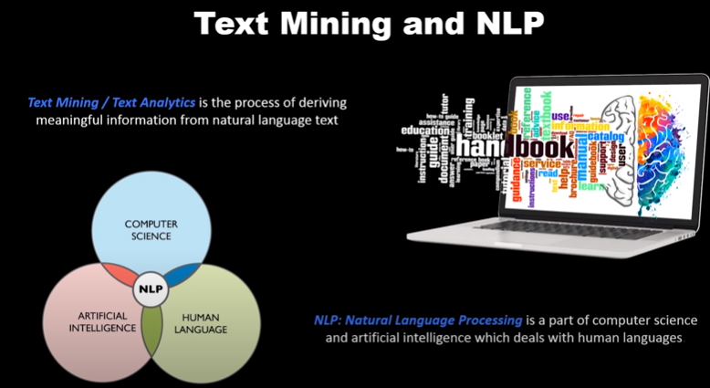
NLP

Slide 2
The field of study that focuses on the interactions between human language and computers is called Natural Language Processing, or NLP for short. It sits at the intersection of computer science, artificial intelligence, and computational linguistics. NLP is a way for computers to analyze, understand, and derive meaning from human language in a smart and useful way. By utilizing NLP, developers can organize and structure knowledge to perform tasks such as automatic summarization, translation, named entity recognition, relationship extraction, sentiment analysis, speech recognition, and topic segmentation.

Slide 3
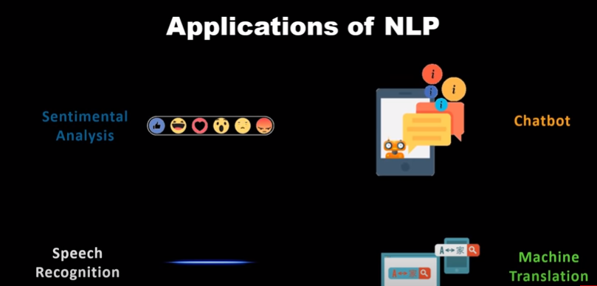
Applications of NLP

Slide 4
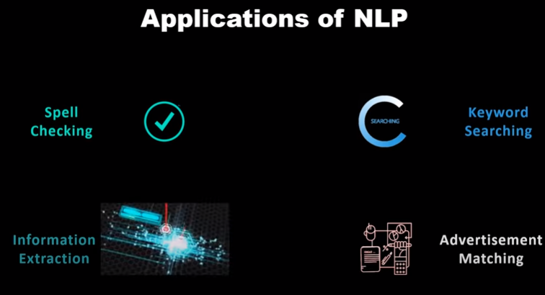
Applications of NLP

Slide 5
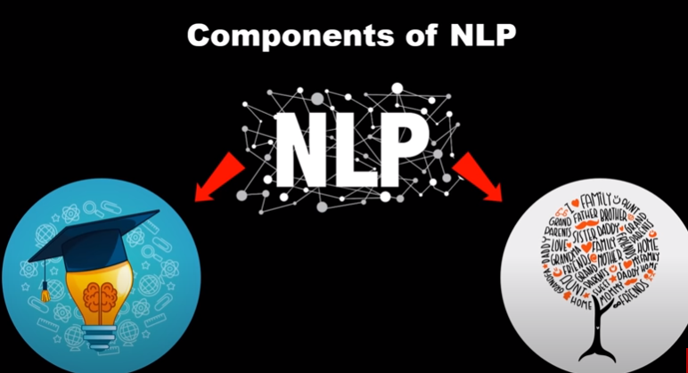

Slide 6
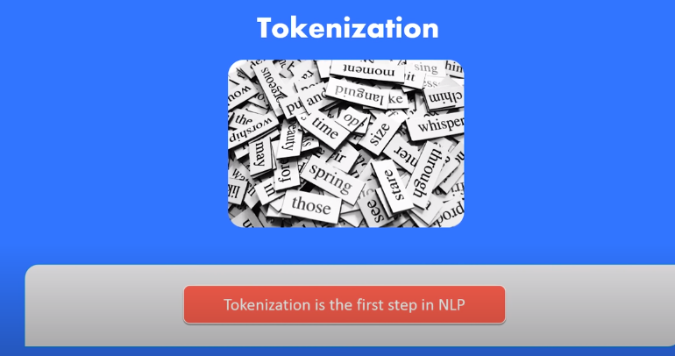
Tokenization is just the term used to describe the process of converting the normal text strings into a list of tokens i.e words that we actually want. Sentence tokenizer can be used to find the list of sentences and Word tokenizer can be used to find the list of words in strings.

Slide 7
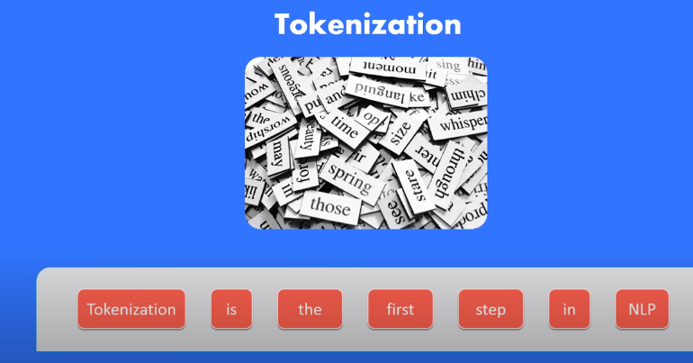

Slide 8
The NLTK data package includes a pre-trained Punkt tokenizer for English.
Removing Noise i.e everything that isn’t in a standard number or letter.
Removing Stop words. Sometimes, some extremely common words which would appear to be of little value in helping select documents matching a user need are excluded from the vocabulary entirely. These words are called stop words

Slide 9
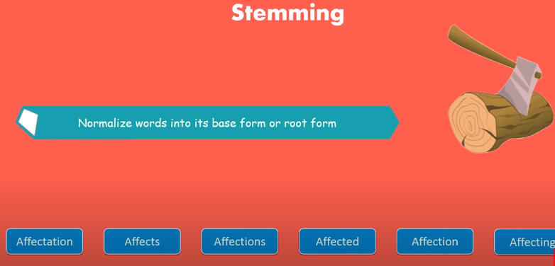
Stemming is the process of reducing inflected (or sometimes derived) words to their stem, base or root form — generally a written word form. Example if we were to stem the following words: “Stems”, “Stemming”, “Stemmed”, “and Stemtization”, the result would be a single word “stem”.

Slide 10
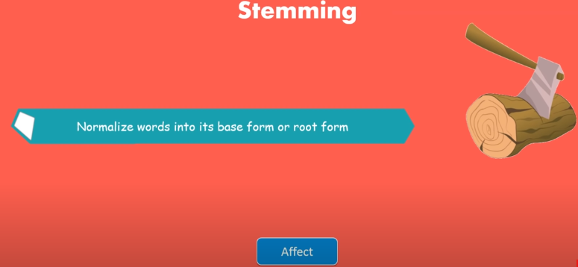

Slide 11
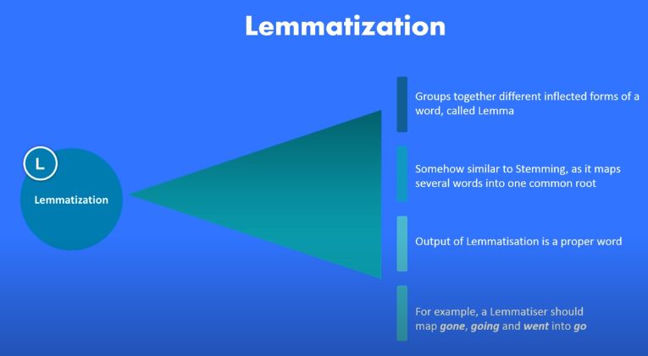
A slight variant of stemming is lemmatization. The major difference between these is, that, stemming can often create non-existent words, whereas lemmas are actual words. So, your root stem, meaning the word you end up with, is not something you can just look up in a dictionary, but you can look up a lemma. Examples of Lemmatization are that “run” is a base form for words like “running” or “ran” or that the word “better” and “good” are in the same lemma so they are considered the same.

Slide 12
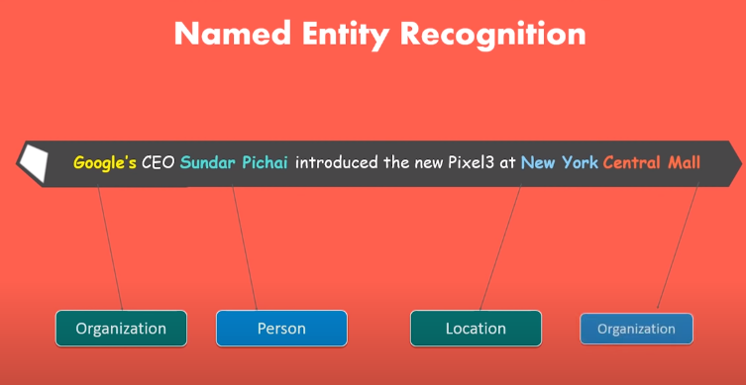

Slide 13
