Slide 1
PRODUCT & UX CASE STUDY
Redesigning the Donation Funnel
A UX audit and product plan for InAmigos Foundation's website
Bhumika Nathawat
Product & UX Intern — InAmigos Foundation

Slide 2
CONTEXT
Who this is for, and my role
About the organization
My role
InAmigos Foundation is a Section 8 registered non-profit (est. 2020, Chhattisgarh) running six initiatives — food & clothing relief, child education, animal welfare, women's empowerment, environmental work, and employability training.
Its website is the primary channel for donations and volunteer sign-ups — making UX quality directly tied to funding and impact.
As Product & UX Intern, I independently audited the live site, identified UX gaps affecting the donation funnel, and produced this case study — followed by a redesigned demo of the highest-impact pages.
Scope: heuristic evaluation, funnel mapping, prioritization, annotated screenshots, wireframes, and a working prototype.
02

Slide 3
THE PROBLEM
Where the donation funnel breaks
Homepage
Causes
Cause Detail
Donate
“Understand what this org does”
“Find a cause I care about”
“Learn enough to trust it”
“Give money in <60 sec”
→
→
→
Weak
Broken
Missing
Untested
Framing: each step of the funnel maps to a job the visitor is trying to do. A broken step isn't just “ugly” — it's a 100% drop-off point.
03

Slide 4
PROCESS
Methods used in the audit
01
Heuristic Evaluation
02
Funnel Mapping
Assessed every page against Nielsen's usability heuristics — visibility of system status, error prevention, consistency, aesthetic-minimalist design.
Traced the donor journey end-to-end (Home → Causes → Detail → Donate) to locate the exact step where users would drop off.
03
Jobs-to-be-Done
04
Impact vs. Effort Prioritization
Reframed each page around the visitor's actual goal, not just its visual polish — surfaces functional gaps, not just cosmetic ones.
Scored every finding on impact and build effort (a lightweight RICE-style pass) to produce an action-ordered backlog.
04

Slide 5
FINDINGS — PART 1
Homepage & global elements
URGENT
Spam links injected above the header
Signals a likely security compromise; risks search-engine penalties.
HIGH
Logo lacks visual presence
Small, icon-only mark weakens brand recall, especially on mobile.
HIGH
Broken social links
Twitter, Google, Pinterest icons point to generic homepages, not real profiles.
MEDIUM
Dense, uninterrupted homepage copy
Six projects and all certifications run into one paragraph with no visual break.
05

Slide 6
FINDINGS — PART 2
Causes & Events pages
URGENT
Causes page renders with no content
Core funnel step is a dead end — header, breadcrumb, footer, and nothing else.
HIGH
No per-cause donate path
Once populated, each cause needs its own description, image, and direct donate action.
MEDIUM
Events listing looks inactive
Only 3 events shown, all from early 2025 — no recent or upcoming activity visible.
Bottom line: the site's single most valuable page for conversion (Causes) is the one page with zero content.
06

Slide 7
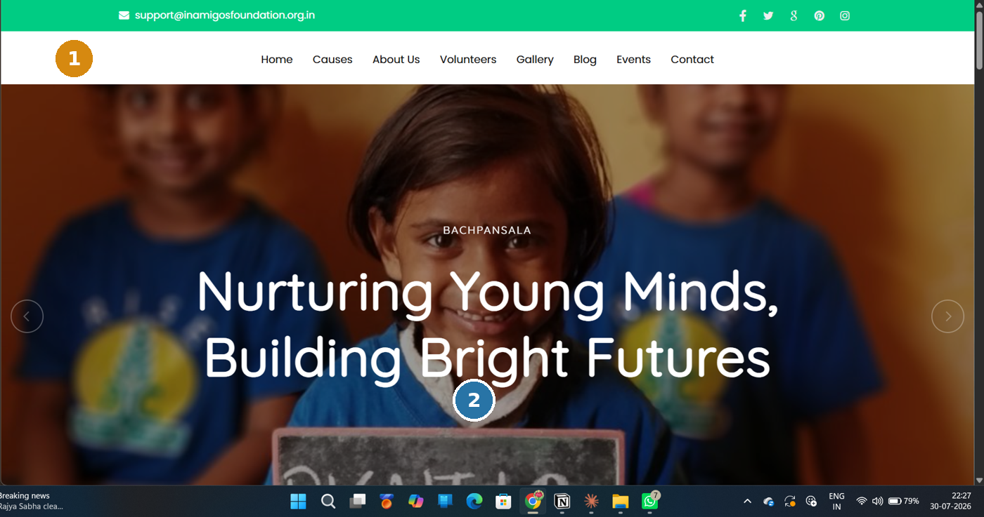
FINDINGS — VISUAL EVIDENCE
Homepage & header (annotated)
1
Logo lacks presence
Small icon-only mark sits inside a tall white nav bar with room to spare — easy to miss, especially on mobile.
2
Hero has no call-to-action
A strong headline but no visible “Donate Now” / “See our causes” button in the hero itself — visitors must hunt for the next step.
07

Slide 8
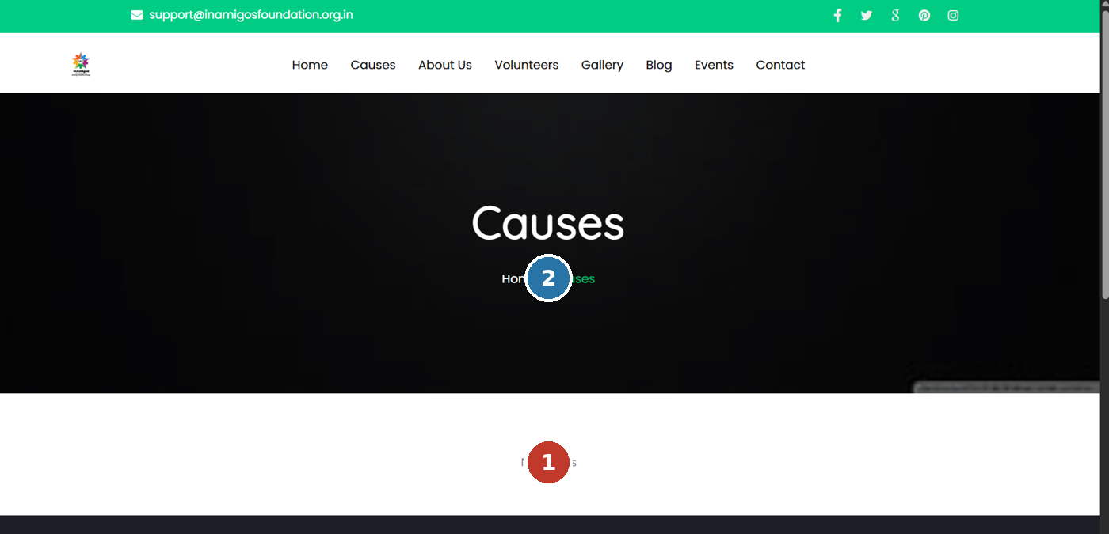
FINDINGS — VISUAL EVIDENCE
Causes page (annotated)
1
“No Results” — core page is empty
This is the literal donor-facing message on the site's most important conversion page.
2
Oversized hero, minimal payoff
A large black banner + breadcrumb precedes the empty content area — a lot of scroll for zero information.
08

Slide 9
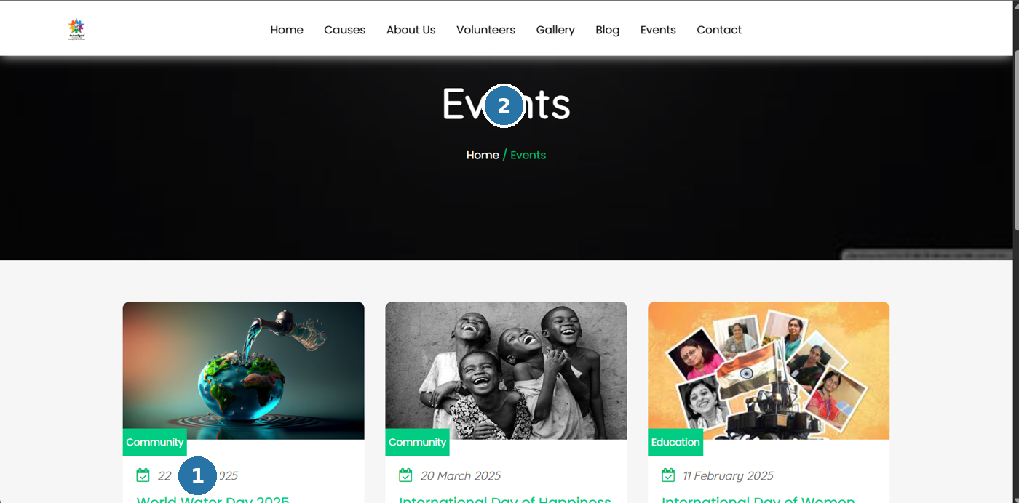
FINDINGS — VISUAL EVIDENCE
Events page (annotated)
1
Listing looks stale
All visible events date to early 2025 — with today well past that, the org reads as inactive to a new visitor.
2
No filter or search
Category tags (Community, Education) exist but aren't clickable filters — no way to browse by interest as the list grows.
09

Slide 10
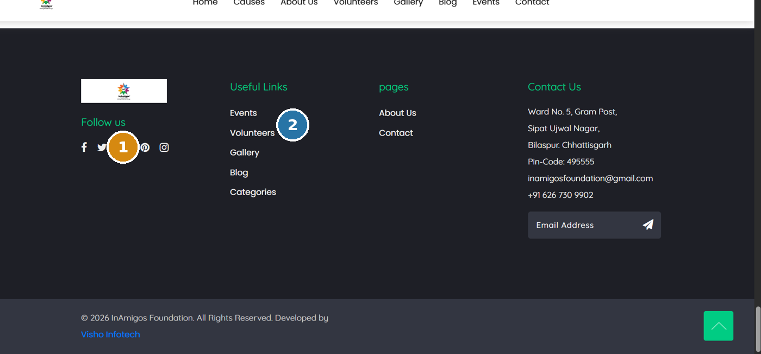
FINDINGS — VISUAL EVIDENCE
Footer (annotated)
1
Dead-platform social icon
The Google+ icon points to a platform Google shut down years ago — an easy broken-link fix once spotted.
2
Flat, low-warmth visual treatment
Plain dark background with no accent color, pattern, or mission reminder — a missed chance to end the page on an emotional note.
10

Slide 11
FROM FINDINGS TO FIXES
Proposed Redesign & Wireframes
Low-fidelity structural fixes for the two highest-impact pages, followed by a note on visual (UI) upgrades.

Slide 12
PROPOSED REDESIGN
Homepage — fixed structure (wireframe)
LOGO
Headline: “Nurturing Young Minds, Building Bright Futures”
Donate Now →
Volunteers
States
Beneficiaries
Projects
6 project cards, one line each — not one paragraph
12

Slide 13
PROPOSED REDESIGN
Causes page — fixed structure (wireframe)
Causes
Home / Causes
All
Education
Women
Environment
Animal Welfare
Donate →
Donate →
Donate →
Donate →
Donate →
Donate →
13

Slide 14
BEYOND STRUCTURE
The UI itself can be elevated, too
Fixing broken pages is necessary but not sufficient. The visual language — color, type, imagery — can do more to communicate hope and empathy, which matters for an NGO donation site.
CURRENT
PROPOSED
Bright green + black/white — functional, but reads more “corporate template” than “warm and human.”
Teal + warm terracotta accent, softer neutrals — trustworthy and hopeful without losing energy.
Also worth doing: warmer real photography over stock-feeling crops, a consistent heading typeface (currently mixed), and softer card shadows instead of hard borders — small details that add up to “premium and human” rather than “default template.”
14

Slide 15
PRIORITIZATION
Impact vs. effort
HIGH IMPACT
Fix spam links
Build Causes page
Do first: Urgent + High-impact/low-effort. “Build Causes page” costs more effort but unlocks the whole funnel — next priority after the quick fixes.
Fix social links
Per-cause donate CTA
Enlarge logo
Break up homepage copy
Refresh events + filters
Icons on stat block
Warmer color palette
LOW IMPACT
LOW EFFORT
HIGH EFFORT
15

Slide 16
RECOMMENDATIONS
Action-ordered summary
URGENT
HIGH
MEDIUM
Remove spam injection (security)
Build out the Causes page with real content
Fix broken social links (incl. dead Google+ icon)
Enlarge / strengthen the logo
Add per-cause donate CTAs
Break up dense homepage copy
Add icons to impact stats
Warm up the color palette + typography
Refresh & filter events listing
Polish the footer
16

Slide 17
WHAT'S NEXT
From audit to a working demo
This case study is Chapter 1. Chapter 2 is a redesigned, functional demo of the Homepage and Causes page — built to show, not just tell, how these fixes come together.
1
Fix urgent security/content gaps
2
Redesign Homepage + Causes (demo)
3
Share with InAmigos for feedback
Bhumika Nathawat • linkedin.com/in/bhumikanathawat1910 • github.com/bhumi-git

