Slide 1


SMART INDIA HACKATHON 2025
TITLE PAGE
Problem Statement ID – 25050
Problem Statement Title- Smart Traffic Management System for Urban Congestion
Theme- Transportation & Logistics
PS Category- Software + (Hardware)
Team ID-
Team Name- ALPHA

Slide 2
SMART TRAFFIC CONTROL SIGNALS
Alpha
Smart Traffic Controls Signals using AI that:
🚑 Detect ambulance sirens → create green corridor.
🚗 Monitor car density → adjust signals to reduce jams.
ADDRESSING PROBLEM BY : Developing software to control traffic signals for emergency vehicles, congestion, and pedestrians, with a demo model using Arduino Uno hardware for real-life world example.".
Innovation and uniqueness
Prioritizes emergency vehicles in real-time.
Dynamically adjusts traffic signals based on flow.
Detects vehicle and pedestrian density for smarter control.
Demonstrated with Arduino for real-world implementation.
Handles congestion, pedestrians, and emergencies simultaneously.
Scalable and AI-driven for continuous optimization.

Slide 3
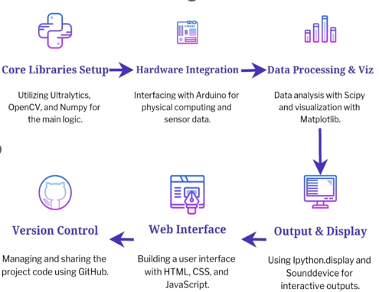






TECHNICAL APPROACH
Alpha
METHODOLOGY (FLOWCHART)
TECHNOLOGY USED:
HARDWARE CIRCUIT DIAGRAM
LIBRARY USED (BACKEND+AI)
ULTRALYTICS
OPENCV-PYTHON
IPYTHON.DISPLAY
NUMPY
SOUNDDEVICE
MATPLOTLIB.PYPLOT
SCOOTY.FFTPACK
TIME
SERIAL
PYTHON
Frontend ( software)
HTML
CSS
JS
For Hardware
Arduino ide ( in C++)

Slide 4
FEASIBILITY AND VIABILITY
Alpha
Feasibility Analysis
Technical: Detects traffic and emergency vehicles; demo uses webcam, real-world uses advanced sensors.
Operational: Improves traffic flow, emergency response, and safety.
Economics: Reduces accidents and fuel use; lowers costs long-term through better traffic management.
Potential Challenges & Risks
Limited coverage and weather effects on detection.
High traffic may slow processing.
Integration issues with traffic lights.
False alerts for emergencies.
Privacy concerns.
Strategies to Overcome all Challenges
Use multiple or high-res sensors.
Train AI for all conditions like weather effects etc.
Local processing for speed.
Backup manual control.
Reduce false alerts and protect privacy.

Slide 5
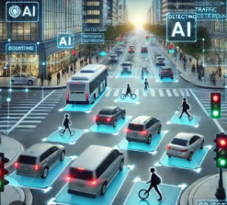
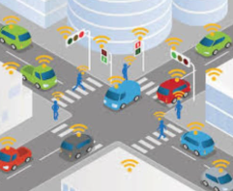
IMPACT AND BENEFITS
Alpha
Potential Impact on Target Audience
Benefits of the Solution
Faster emergency response and reduced accident risks.
Improved pedestrian safety and smoother traffic flow.
Less stress and better commuting experience.
Economic: Saves fuel, lowers medical and operational costs, cost-effective long-term.
Environmental: Reduces congestion and pollution.
Social: Enhances public safety and overall urban mobility.

Slide 6

RESEARCH AND REFERENCES
Alpha
Shingate, K., Jagdale, K., Dias, Y., “Adaptive Traffic Control System using Reinforcement Learning.” IJERT, 2020.
Elsagheer, S. A. M., AlShalfan, K. A., “Intelligent Traffic Management System Based on the Internet of Vehicles (IoV).” Journal of Advanced Transportation, 2021.
IoT Based Emergency Vehicle Detection using YOLOv8 (Syed Suhana et al., India)
Density Based Traffic Management Using Deep Learning and Computer Vision (Ramakrishna et al.)
Intelligent Traffic Light Control using Arduino (ResearchGate)
Road Accidents India – 2022 (ReportTitle: 1.68 lakh people died in 4.61 lakh road accidents in 2022: Road ministry report by the Ministry of Road Transport & Highways (MoRTH), India.)
Ahmedabad Adaptive Signals & Wait TimeTitle: Adaptive signals to reduce waiting time at 400 junctions (Ahmedabad) — The Times of India article.
YOUTUBE https://youtu.be/RkFp7xHUhkg?feature=shared
YOUTUBE https://youtu.be/OssY5pzOyo0?si=R0GvwojPDvpsawNf

