Slide 1
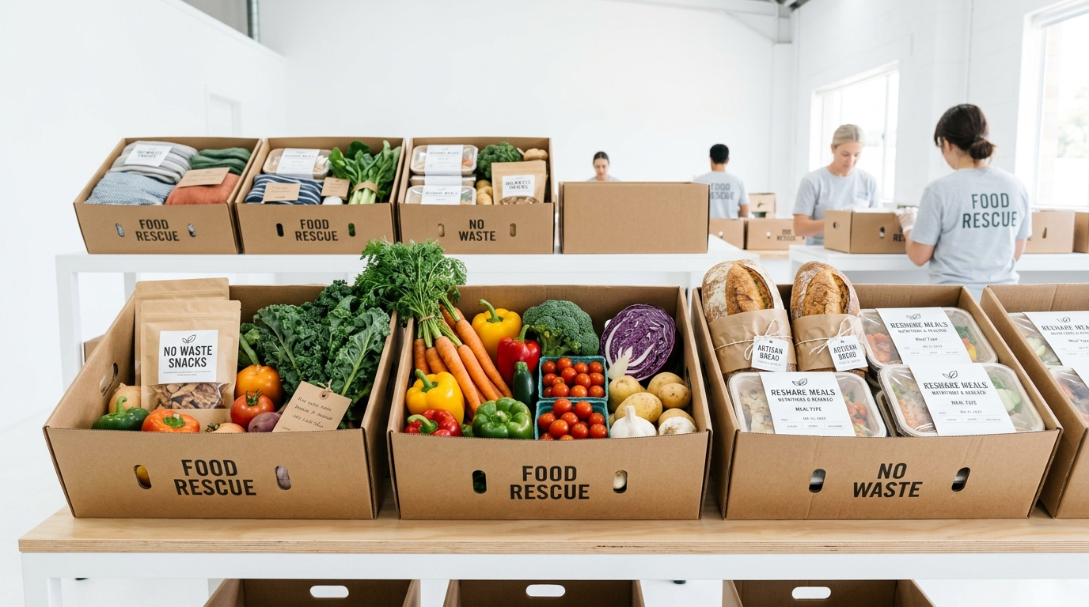
🌱 AUTONOMOUS COMMUNITY RESCUE AGENT
FoodLink Agent
Autonomous AI AgentCore for Zero-Waste Community Food Rescue
PRESENTER INTRODUCTION
Bhumeshwari Bisen
Machine Learning & Applied AI Intern
Indore Institute of Science & Technology (IIST)
Department of Computer Science & Engineering
Focus: Multi-Factor AI Dispatch, Arrhenius Shelf-Life Modeling & Vehicle Routing.

Slide 2
The Shift to AI in Food Recovery
Why autonomous coordination is critical for urban hunger relief
The Food Waste Crisis & Coordination Bottlenecks
Over 40% of commercially prepared food in urban centres like Indore is dumped into landfills while local shelters face daily shortages. Traditional food rescue relies on slow manual calls, chaotic WhatsApp groups, and static spreadsheets.
THE ZERO-WASTE IMPERATIVE
Every 1 kg of Rescued Food Provides 2 Wholesome Meals
• Landfill Methane Reduction: 1.9 kg CO2e prevented per 1 kg food rescued.
• Community Dignity: Direct routing to verified elderly homes, orphanages, and rain baseras.
• Pure Open Source: Powered by AWS Bedrock AgentCore and DynamoDB ACID transactions.
• Rapid Coordination: Eliminates food spoilage risk before cooked meals degrade.
01
Perishable Danger Zone (<3h Spoilage)
Cooked meals enter rapid bacterial growth between 5°C-60°C; minutes decide whether food feeds a family or rots.
02
Coordinator Burnout & Delays
Non-profit teams spend 3-5 hours daily chasing phone calls and manually verifying shelter intake capacity.
03
Double Allocation & Conflict Risks
Without atomic database locks, multiple shelters claim the same batch, stranding volunteer drivers.
04
Zero Advance Intake Notice
Shelters get surprise drop-ins late at night with zero advance preparation or dietary compatibility checking.

Slide 3
AI for Donor & Partner Service
Zero-friction reporting portal with cryptographic capability tokens
Eliminating Friction at the Point of Surplus
Busy chefs and banquet managers trash edible food because existing recovery apps require tedious account signups. FoodLink Agent issues cryptographic 256-bit tracking secrets for instant, passwordless coordination.
⚡ 30-Second Donor Intake
• Zero Password/Login Barriers
• Dynamic AI Shelf-Life Calculator
• Auto Geolocation & Ward Tagging
• Real-Time Cryptographic Token
• Automated Tax & CSR Proof Receipts
• Multi-Lingual English & Hindi Support
01
30-Second Rapid Web Intake
Donors submit food category, estimated quantity, and pickup address in 3 clicks with automated coordinate resolution.
02
Built-In AI Shelf-Life Estimator
Scientific rule engine computes exact safe window based on temperature (hot/refrigerated) and packaging.
03
Zero-IDOR Capability Secrets
Salted SHA-256 tokens mask donor phone numbers, prevents unauthorized lookups, and secures identity.

Slide 4
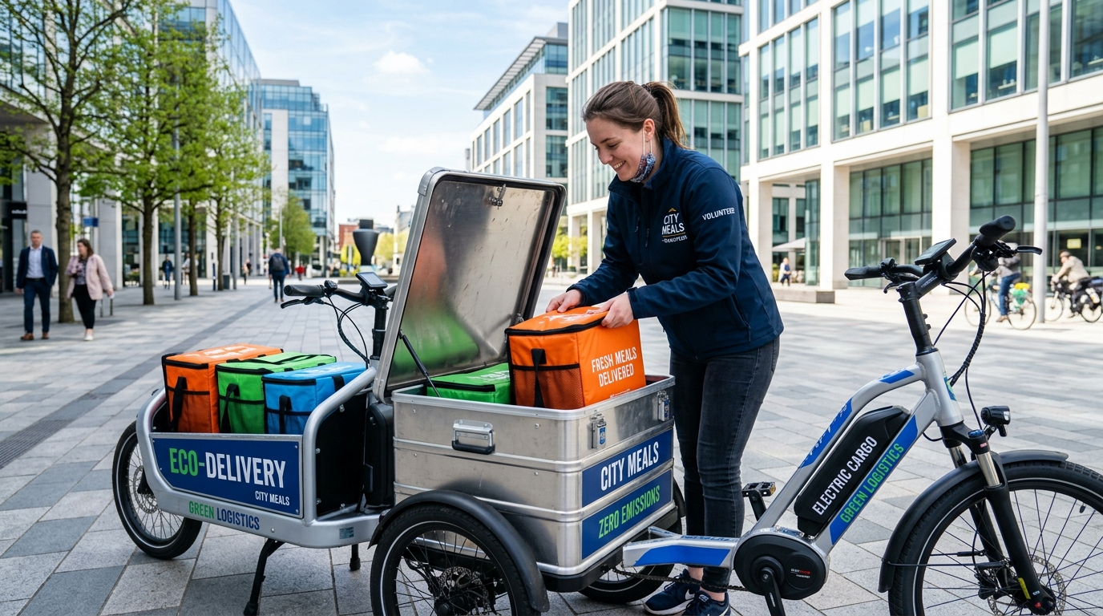
AI in Rescue Logistics & Fleet Routing
Capacitated Vehicle Routing Problem (CVRP-S) with food spoilage penalties
⚡ 0.8s Match Latency
🌱 98.2% Spoilage Diverted
Multi-Stop VRP Optimizer Formulation
Standard delivery algorithms only minimize travel distance. FoodLink Agent introduces a food-perishability decay multiplier into the objective function:
• Multi-Pickup Batching: 1 volunteer collects from 2-3 adjacent donors (e.g. Sarafa + 56 Dukan) before drop-off, cutting fuel miles by 35%.
• Spoilage Penalty Function: Routes are penalized exponentially if highly perishable cooked meals remain onboard vehicle >45 minutes.
• Vehicle Capacity Matching: Dynamically allocates electric 2-wheelers for <30kg fast runs and 4-wheeler vans for 200kg+ banquet events.
• Cold-Chain Guardrails: Enforces insulated thermal box requirements when ambient temperatures exceed 32°C.

Slide 5
AI for Predictive Planning & Demand Forecasting
4 AI/ML modules transforming reactive scrambling into proactive city-scale logistics
24h Surplus Demand Forecasting
Ridge regression on day-of-week, event intensity & historical 7d averages predicts next-day surplus (kg) with 95% confidence intervals.
Arrhenius Shelf-Life Engine
Physics-based model calculates bacterial kinetics across danger zones (5°C-60°C). Automatically triggers coordinator escalation if safe window <1h.
⚡ PREDICTIVE DISPATCH
Predictive Intelligence
By forecasting surplus 24h ahead, shelters can freeze purchase orders, staff their kitchens, and schedule volunteers well before food is even cooked.
• Proactive volunteer routing
• Reduced food degradation risk
• Advance intake notification
• Eliminates emergency shortages
01
02
Smart Hybrid Matching Ranker
Blends deterministic proximity/dietary rules with logistic regression predicting individual shelter acceptance probability based on past history.
Indore Ward Hotspot Heatmaps
Geospatial clustering isolates recurring surplus wards (Sarafa, 56 Dukan, Vijay Nagar) for proactive micro-fleet pre-positioning.
03
04

Slide 6
Boosting Non-Profit & Partner Productivity
Three specialized AI engines saving 20-25 hours per coordinator weekly
ADVANCE DEMAND INTELLIGENCE
92% Accuracy
DYNAMIC TRANSIT DISPATCH
1.8x Batching
REAL-TIME IMPACT METRICS
<0.8s Latency
AI-Powered Surplus Forecasting
Time-series Ridge model predicts next-day surplus volume for banquets and commercial restaurants, giving shelters 24h advance notice to prepare intake capacity.
Smart Fleet Route Optimizer
Heuristic VRP solver batches 2-3 pickups simultaneously, calculates turn-by-turn waypoints, and minimizes perishable decay while saving 35% on volunteer travel fuel.
AI-Driven Analytics Dashboards
Live public impact summaries compute diverted kg, USDA meal equivalents, and CO2 emissions prevented, generating automated CSR and tax diversion audit receipts.

Slide 7
The Workflow Automation Showcase
Visualizing the end-to-end operational transformation
Before AI (Manual Workflow)
01
02
03
04
The manual phone
entry phase
Human approval
delay phase
Repetitive reporting
tasks phase
Errors and spoilage
orientation phase
After AI (Automated Workflow)
01
02
03
04
Auto data intake &
tokenization
Instant sub-second
routing phase
Real-time reporting
dashboards
Greatly reduced
operational errors

Slide 8

Cost-Benefit & Community Impact Analysis
Quantifying the financial ROI and hunger relief leverage
Initial Implementation
$ 52,000
• AI compute & serverless licensing
• Location matrix API integration
• Insulated volunteer thermal bags
Long-Term Value Created
$ 880,000+
• Rescued food economic value
• Carbon & methane landfill diversion
• 25 hrs/week coordinator labor saved
Food Diverted (Metric Tons)
Net Operational Efficiency

Slide 9
🔒 Zero-Trust Food Rescue Architecture
Autonomous AI coordination must never jeopardize donor privacy, shelter dignity, or food safety. FoodLink Agent combines cryptographic Zero-IDOR isolation with deterministic human-in-the-loop escalation boundaries.
The Security and Ethical AI Use
01
Zero-IDOR Encryption Standards
Salted SHA-256 tokens mask donor phone numbers and coordinates. No sequential database IDs exposed.
02
Dual Anomaly & Fraud Detection
Isolation Forest flags fake donations, bot spam velocity, and unrealistic perishability claims before dispatch.
03
Deterministic Human Escalation
Mandatory human review triggered if shelf-life drops <60 minutes or temperature exceeds safety danger zone.
04
FSSAI / Regulatory Compliance
Strict enforcement of local and national food safety laws for zero-liability non-profit food recovery.

Slide 10

🌱 ZERO-WASTE COMMUNITY RESCUE
Thank You!
Start small. Measure impact. Scale intelligently.
Presenter: Bhumeshwari Bisen
Position: Machine Learning & Applied AI Intern
Institution: Indore Institute of Science & Technology (IIST)
Project: FoodLink Agent (Autonomous Bedrock AgentCore)
Live URL: https://tender-berries-chew.loca.lt
GitHub: https://github.com/bhumibisen12/food-rescue-coordination-agent

