Slide 1
SmartStock AI
Complete Project Analysis Report
Flask • PostgreSQL • Odoo • HTML/CSS/JavaScript
Internship / Academic Documentation • October 2026

Slide 2
Agenda
01
Project Overview & Architecture
02
Technology Stack & Project Files
03
Modules: Auth, Products, Inventory
04
Purchases, Sales, Reviews, Reports
05
Odoo Integration & Database Tables
06
Data Flow Diagrams (Context + Level 1)
07
Strengths, Limitations & Conclusion
SmartStock AI | Complete Project Analysis
2 / 16

Slide 3
1. Project Overview
SmartStock AI is a Flask-based inventory management system connected to an existing Odoo PostgreSQL database.
Authentication
Products
Inventory
Signup, Login, Sessions, Password Hash
CRUD with Odoo tables integration
Stock-in / Stock-out, validation
Purchases & Sales
Reviews
Reports & Export
Orders with automatic stock update
1–5 star ratings and comments
CSV, Excel, PDF + Audit history
SmartStock AI | Complete Project Analysis
3 / 16

Slide 4
2. High-Level Architecture
User Browser
HTML / CSS / JavaScript + Bootstrap 5
Flask Application
Auth • Products • Inventory • Purchases • Sales • Reviews • Reports
PostgreSQL Database
Odoo Tables (product_template, product_product, stock_quant) + SmartStock Tables
Outputs
Dashboard • JSON APIs • CSV • Excel (.xlsx) • PDF Reports
SmartStock AI | Complete Project Analysis
4 / 16

Slide 5
3. Technology Stack
1
2
3
4
5
Python
Flask
PostgreSQL
Odoo Tables
psycopg2
Backend logic
Web framework & APIs
Data storage
Products & stock
DB connector
6
7
8
9
10
Bootstrap 5
JavaScript
Werkzeug
ReportLab
openpyxl
Responsive UI
Frontend logic
Password hashing
PDF export
Excel export
SmartStock AI | Complete Project Analysis
5 / 16

Slide 6
4. Application Modules
Auth
Products
Inventory
Signup, Login, Logout
Sessions, Password Hash
Forgot Password, Roles
CRUD Operations
Odoo Table Writes
Search & Pagination
Stock In / Stock Out
Negative Stock Prevent
Transaction History
Orders
Reviews
Reports
Purchase Orders
Sales Orders
Auto Stock Update
1–5 Star Rating
Comments & Avg
Product Details Page
Metrics & Charts
CSV / Excel / PDF
Audit Export
SmartStock AI | Complete Project Analysis
6 / 16

Slide 7
5. Authentication & Product Management
Authentication
Product Management
Signup Flow
POST /api/auth/signup → Validate → Hash → Save user → Session
Login Flow
POST /api/auth/login → Find user → Verify hash → Session → Dashboard
Security
• Werkzeug password hashing
• Roles: admin / user
• Reset tokens with expiry
• Session-based auth
Features
• Create, View, Update, Delete
• Search & Pagination
• Product details + Reviews
Odoo Writes
• product_template
• product_product
• stock_quant
APIs: GET/POST/PUT/DELETE /api/products
SmartStock AI | Complete Project Analysis
7 / 16

Slide 8
6. Inventory, Purchases & Sales
Stock In / Out
Purchase Order
Sales Order
1
Select product
1
Select product
1
Select product
2
Choose In or Out
2
Enter qty & price
2
Enter qty & price
3
Enter quantity
3
Create PO record
3
Check available stock
4
Validate (no negative)
4
Increase stock
4
Decrease stock
5
Update stock_quant
5
Save to purchase_orders
5
Save to sales_orders
6
Log transaction
SmartStock AI | Complete Project Analysis
8 / 16

Slide 9
7. Odoo Integration & Database Tables
Odoo Tables
SmartStock Tables
product_template
Template, name, list price
users / roles
sales_orders
product_product
Variants, standard price
categories
inventory_history
stock_quant
Current stock quantity
suppliers / customers
product_reviews
stock_transactions
password_reset_tokens
purchase_orders
SmartStock AI | Complete Project Analysis
9 / 16

Slide 10
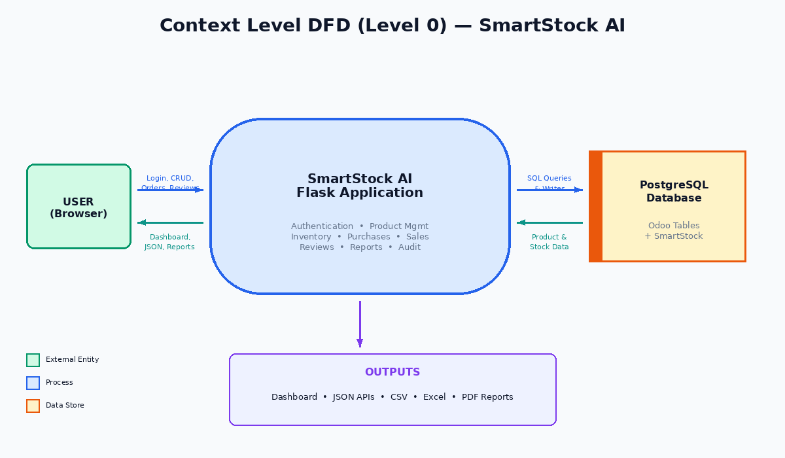
8. Context Level DFD (Level 0)
SmartStock AI | Complete Project Analysis
10 / 16

Slide 11
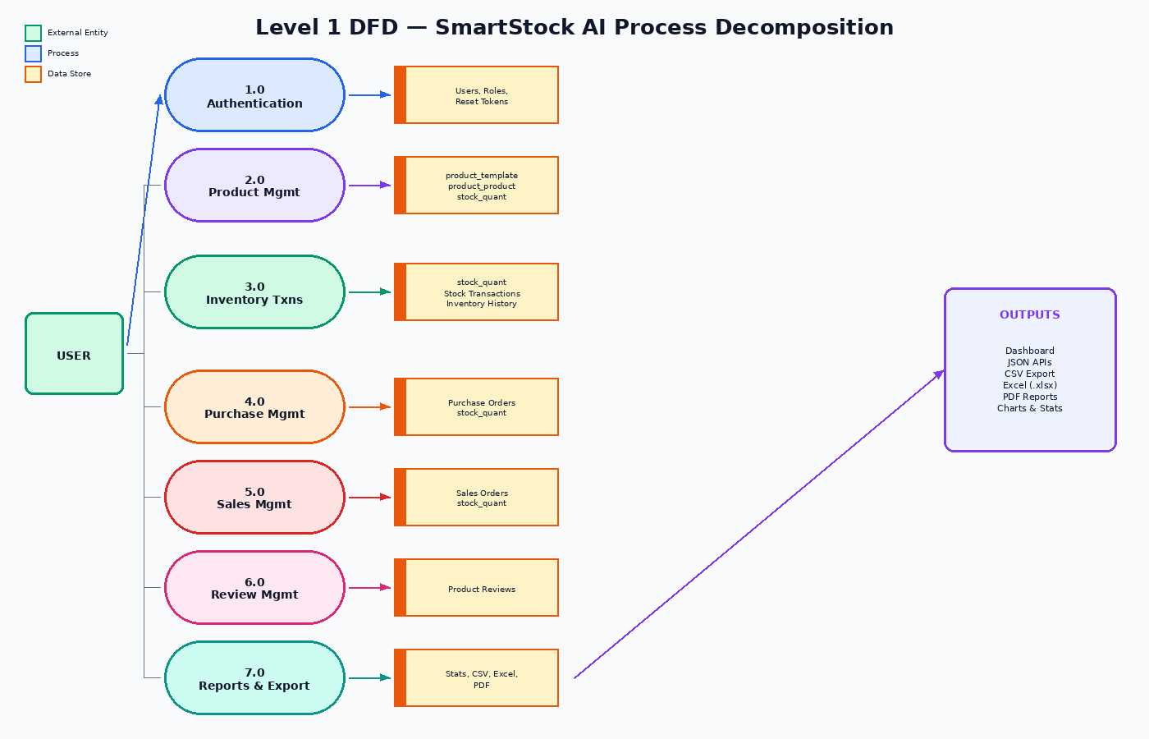
9. Level 1 DFD — Process Decomposition
SmartStock AI | Complete Project Analysis
11 / 16

Slide 12
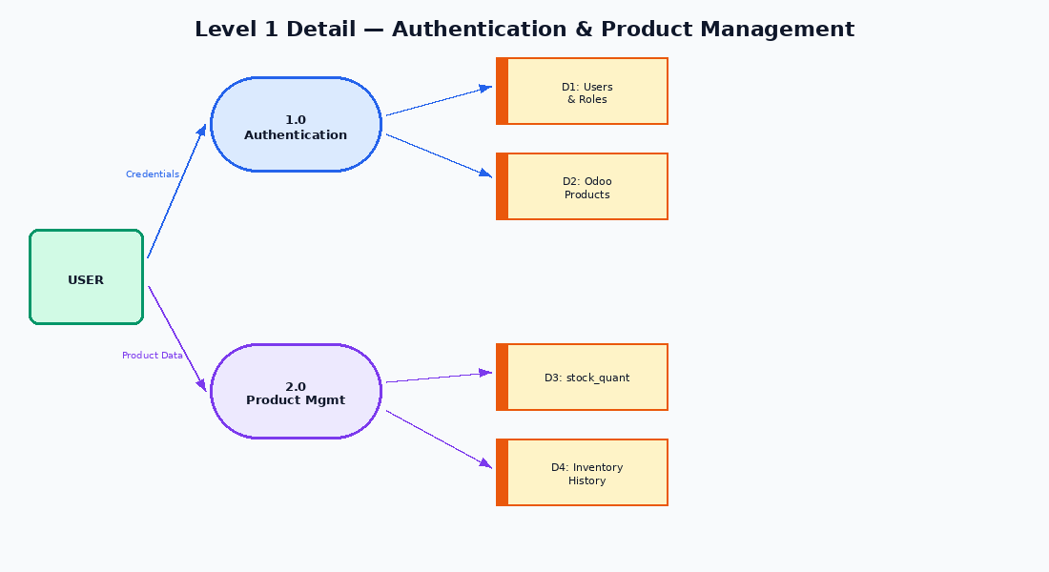
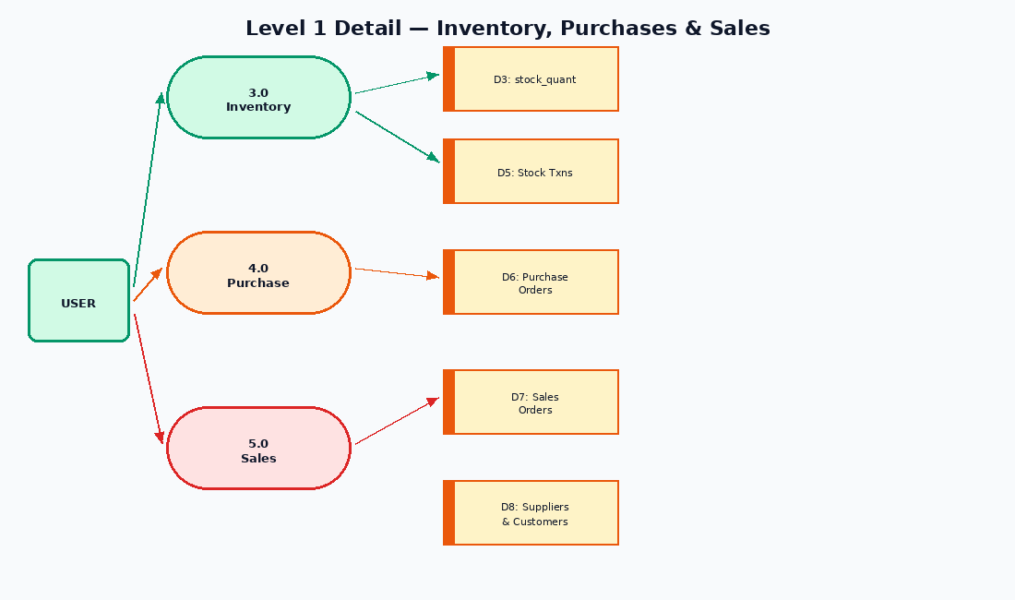
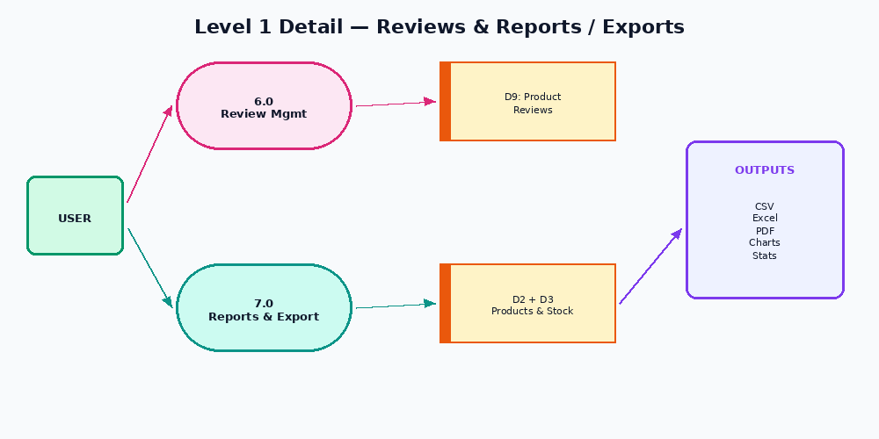
10. Level 1 Detail — Auth, Product, Inventory
SmartStock AI | Complete Project Analysis
12 / 16

Slide 13
11. Project Strengths
✓
Complete Business Flow
Products → Inventory → Purchases → Sales → Reviews
✓
Odoo Integration
Direct read/write of product_template, product_product, stock_quant
✓
Authentication & Roles
Signup, login, sessions, hashing, admin/user roles
✓
Inventory Validation
Prevents negative stock; transaction logging
✓
Multi-format Export
CSV, Excel (openpyxl), PDF (ReportLab) + Audit
✓
Modular Structure
Separated backend, database, config, frontend
SmartStock AI | Complete Project Analysis
13 / 16

Slide 14
12. Limitations & Future Improvements
Security
Odoo Integration
• Strong FLASK_SECRET_KEY
• CSRF protection & rate limiting
• Email-based password reset
• Secure cookies + HTTPS
• Replace direct SQL with
custom Odoo module
• Use Odoo ORM + XML views
• Access rights & security rules
Functional Improvements
• Update/Delete for categories, suppliers, customers
• Customer selection in sales • Supplier selection in purchases
• Database-level pagination • Advanced report filters • Chart library
• Automated tests • Database migrations
SmartStock AI | Complete Project Analysis
14 / 16

Slide 15
13. Internship Discussion Points
Python
Functions, decorators, context managers, exceptions, transactions, hashing
Flask
App factory, blueprints, routes, JSON APIs, sessions, auth decorators
PostgreSQL
Tables, keys, joins, aggregations, transactions, constraints
Odoo
product_template, product_product, stock_quant, SQL vs ORM
Frontend
HTML forms, CSS, fetch/JSON, dynamic tables, Bootstrap
SmartStock AI | Complete Project Analysis
15 / 16

Slide 16
Conclusion
SmartStock AI demonstrates a complete inventory management system with:
▸ Authentication, roles, and secure sessions
▸ Product CRUD with Odoo PostgreSQL integration
▸ Stock movements, purchases, sales with validation
▸ Reviews, reports, audit, and multi-format export
▸ Clear DFDs and modular architecture
Key production step: Replace direct Odoo SQL with a custom Odoo module (ORM + security).
Python + Flask + PostgreSQL + Odoo | Ready for Internship Discussion

