Slide 1

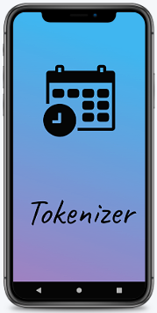
TOKENIZER
ITM VOCTIONAL UNIVERSITY
DEPARTMENT OF COMPUTER SCIENCE & ENGINEERING
Created By:
Labdhi Shah
Bhumi Prajapati
Guide Name: Mr. Harun Mohammed

Slide 2
Problem
Crowd management is a very tough task.
Queue is a quick solution to this problem but it has its own drawbacks. People need to stand for hours waiting for their turn.
Whereas, if there is unavailability of resources, people don't get the service and there is loss of their time and energy.
But after the introduction of novel corona virus, intensity of this issue rose drastically.
People have to follow norms of social distancing which is frustrating the crowd more.

Slide 3
Solution
To solve this issue of crowd management in public places we have proposed an online appointment booking system (Tokenizer) which helps to book appointment online in just few steps.
This application reduce the crowd in public places as people have to book appointment before visiting place so this will also save time and save money.

Slide 4

How We Build It?

Slide 5
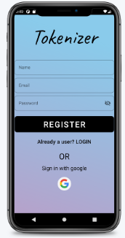

User Registration
User can easily register just by
providing required details.
Option of ‘sign in with google’ is also available

Slide 6
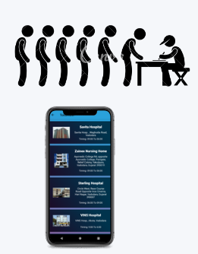
AVOID LONG QUEUES
People can book online appointments to stop long queues and maintain social distance.

Slide 7
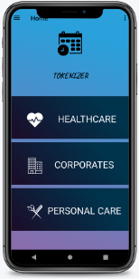



HealthCare
Select category according to requirements
Corporates
Personal Care

Slide 8
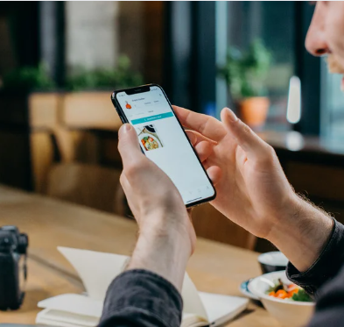

You will get notification 10 minutes prior to your booking.

Slide 9
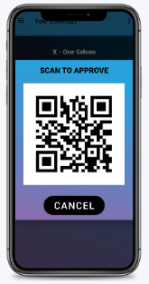
SEE BOOKING’S QR CODE
User has to show QR code from your bookings section to client.
Verify your booking easily from QR Code.

Slide 10
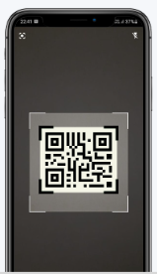
SCAN QR CODE
Scan QR Code from business app to verify user's appointment.
Business App user has to scan QR Code from user to verify details.

