Slide 1
Game Playing (Tic-Tac-Toe)
By
Jiya, Serra, Bhumika Singh

Slide 2
Outline of the Talk
Game Playing
Tic-Tac-Toe
Minimax Algorithm
Alpha Beta Prunning
AndOr graph and AO* Algorithm
References

Slide 3
Games vs Search Problems
"Unpredictable" opponent : specifying a move for every possible opponent reply
Time limits : unlikely to find goal, must approximate

Slide 4
Game Playing Strategy
Maximize winning possibility assuming that opponent will try to minimize (Minimax Algorithm)
Ignore the unwanted portion of the search tree (Alpha Beta Pruning)
Evaluation(Utility) Function
  A measure of winning possibility of the player

Slide 5
Tic-Tac-Toe
X | O
e(p) = 6 - 5 = 1
Initial State: Board position of 3x3 matrix with 0 and X.
Operators: Putting 0’s or X’s in vacant positions alternatively
Terminal test: Which determines game is over
Utility function:
e(p) = (No. of complete rows, columns or diagonals are still open for player ) – (No. of complete rows, columns or diagonals are still open for opponent )

Slide 6
Minimax Algorithm
Generate the game tree
Apply the utility function to each terminal state to get its value
Use these values to determine the utility of the nodes one level higher up in the search tree
  From bottom to top
  For a max level, select the maximum value of its successors
  For a min level, select the minimum value of its successors
From root node select the move which leads to highest value

Slide 7

Game tree for Tic-Tac-Toe
Courtesy : Artificial Intelligence and Soft Computing. Behavioural and Cognitive Modelling of the Human Brain

Slide 8
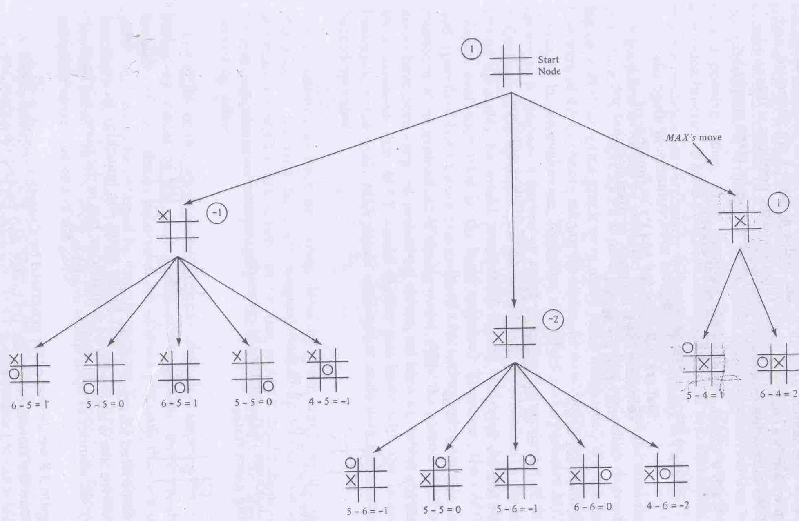
Courtesy : Principles of Artificial Intelligence , Nilsson

Slide 9
Properties of Minimax
Complete : Yes (if tree is finite)
Time complexity : O(b^{d})
Space complexity : O(bd) (depth-first exploration)

Slide 10
Observation
Minimax algorithm, presented above, requires expanding the entire state-space.
Severe limitation, especially for problems with a large state-space.
Some nodes in the search can be proven to be irrelevant to the outcome of the search

Slide 11
Alpha-Beta Strategy
Maintain two bounds:
Alpha (α): a lower bound on best that the
player to move can achieve
Beta (β): an upper bound on what the
opponent can achieve
Search, maintaining α and β
Whenever α ≥ βhigher, or β ≤ αhigher further search at this node is irrelevant

Slide 12
How to Prune the Unnecessary Path
If beta value of any MIN node below a MAX node is less than or equal to its alpha value, then prune the path below the MIN node.
If alpha value of any MAX node below a MIN node exceeds the beta value of the MIN node, then prune the nodes below the MAX node.

Slide 13
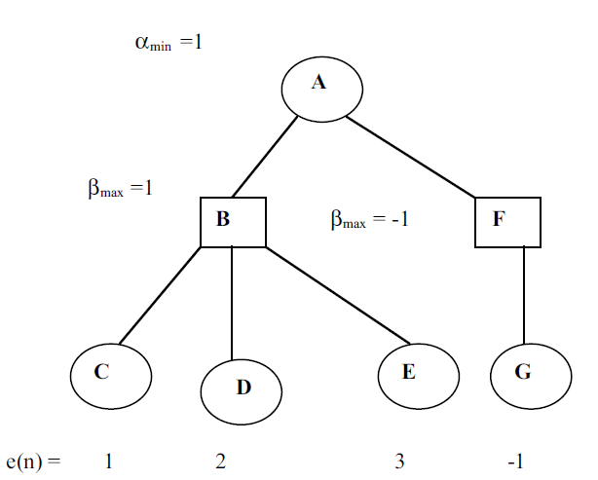
Example

Slide 14
Tic-Tac-Toe
X : MAX player
0 : MIN player
e(p) = (rows + cols + diagonals open to ‘X’) – (Same to ‘0’)
(MAX) Start
e(p) = 0
X
X
X
X’s Turn
e = 8 – 4 = 4
e = 8 – 6 = 2
e = 8 – 5 = 3
X
X
0’s Turn
0
0
e = 5 – 4 = 1
e = 5 – 3 = 2
Courtesy : CS621-Artificial Intelligence , 2007, Prof. Pushpak Bhatacharya

Slide 15
Alpha-Beta Search Algorithm
If the MAXIMIZER nodes already possess αmin values, then their current αmin value = Max (αmin value, α’min); on the other hand, if the MINIMIZER nodes already possess βmax values, then their current
βmax value = Min (βmax value, β’max).
If the estimated βmax value of a MINIMIZER node N is less than the
αmin value of its parent MAXIMIZER node N’ then there is no need
to search below the node MINIMIZER node N. Similarly, if the
αmin value of a MAXIMIZER node N is more than the βmax value of
its parent node N’ then there is no need to search below node N.

Slide 16
Alpha-Beta Analysis
Pruning does not affect the final result.
Assume a fixed branching factor and a fixed depth
Best case: b^{d/2} + b^{(d/2)-1}
Approximate as b^{d/2}
Impact ?
Minmax: 10⁹ = 1,000,000,000
Alpha-beta: 10⁵+ 10⁴ = 110,000
But best-case analysis depends on choosing the best move first at cut nodes (not always possible)
The worst case : No cut-offs, and Alpha-Beta degrades to Minmax

Slide 17
AND OR GRAPH

Slide 18
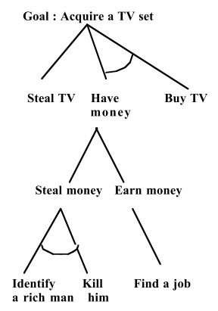
AND OR Graph
OR graphs : generally used for data driven approach
AND OR graphs: used for Goal driven approach
  Problems solvable by decomposing into sub problems some of which is to be solved.
Graph consisting of OR arcs and AND arcs
  OR : the node has to be solved.
  AND : all the nodes in the arc has to be solved
Courtesy : Artificial Intelligence and Soft Computing. Behavioural and Cognitive Modelling of the Human Brain

Slide 19
How to explore
Expand nodes
Propagate values to ancestors
Futility
  If the estimated cost of a solution becomes greater than futility then abandon the search
  A threshold such that any solution with higher cost is too expensive to be practical

Slide 20

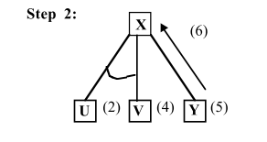
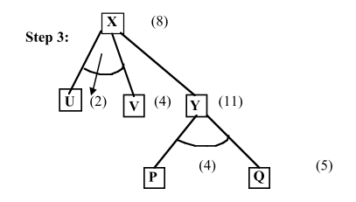
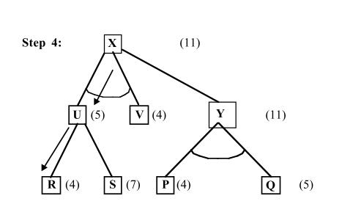
AO* illustration
Courtesy : Artificial Intelligence and Soft Computing. Behavioural and Cognitive Modelling of the Human Brain

Slide 21
References
D. E. Knuth and R. W. Moore. An analysis of alpha-beta pruning. Artificial Intelligence, 6:293–326, 1975
Rich, E. and Knight, K., Artificial Intelligence, McGraw-Hill, New York, 1991.
Nilson, J. N., Principles of Artificial Intelligence, Morgan-Kaufmann,
San Mateo, CA, pp. 112-126,1980.
Russel, S. and Norvig, P., Artificial Intelligence: A Modern Approach,
Prentice-Hall, Englewood Cliffs, NJ, 1995.
Amit Konar , Artificial Intelligence and Soft Computing Behavioral and Cognitive Modeling of the Human Brain, CRC Press 2000.

