Slide 1

ET623 Course Project
LMS Log data analysis for the early prediction of student performance
Presented by
Bhumika Khetan(22M0754) Tanvi Keluskar(22M0782)
19 April 2024

Slide 2
Motivation : Key Points
Course Agnostic Data.
Single-course models perform well but lack generalizability.
Previous studies report a 9% to 28% accuracy drop when applying single-course models to other courses within the same degree.
Courses with similar LMS usage patterns can experience a 22% to 25% loss in accuracy when using course-specific models.
Moodle logs from University of Oviedo.
Early Prediction of student performance at-risk, excellent and pass/fail students.
The moments of prediction used were 10%, 25%, 33% and 50% of the course duration.
Research suggests full models for early prediction may lack accuracy.
Identify key variables impacting student performance.
Discover student clusters based on LMS usage, independent of course attributes.
Investigate correlation between student clusters and performance outcomes.

Slide 3
Approach - Research Questions
Can student performance in LMS assignments be predicted by analyzing logs at 10%, 25%, 33%, and 50% course completion?
What LMS log-derived variables have the greatest influence on student performance?
Do student clusters based on LMS usage exist independently of course features?
Is there a correlation between student clusters and their performance?

Slide 4
Dataset Details
Variables related to students’ actions
Variables related to assignment tasks
CourseViewPct
CourseViewTime
ResourceViewPct
Accomplish Mandatory
Accomplish Optional
ResourceViewTime
ResourceViewTimePct
Accomplish Optional Grade
Accomplish Mandatory Grade
ResourceViewUniquePct
UrlViewPct
UrlViewTime
Accomplish Optional Pct Graded:
UrlViewUniquePct
Accomplish Optional Percentile Grade
UrlViewTimePct
AssignViewTime
QuizViewPct
Accomplish Mandatory Pct Graded
QuizViewTime
QuizViewTimePct
Accomplish Mandatory Percentile Grade
QuizAttemptTime
QuizCloseAttemptTime
…and many more
Detailed Variables Info : https://docs.google.com/document/d/1uZzmy91DC0AOpFuayQeBj9XzqduZEbFdmy9fsQZIROk/edit?usp=sharing

Slide 5
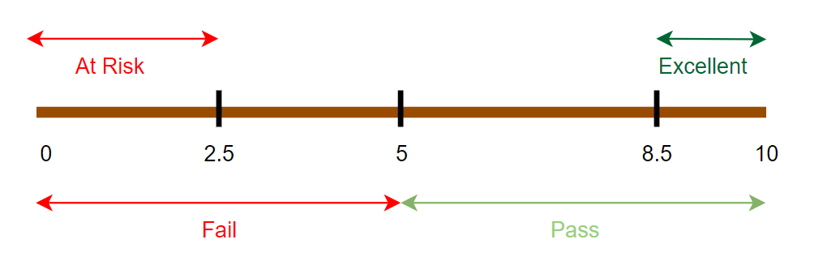
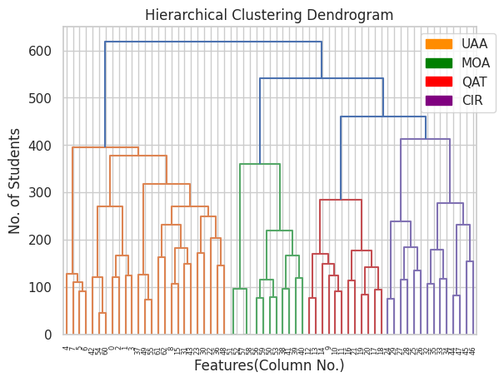
Dataset Details
Thresholds Definition: We establish a 0-10 marks scale where:
2.5 marks: At-risk threshold
5 marks: Pass/Fail threshold
8.5 marks: Excellent student threshold
2. Features Used : The 4 aggregated features are :
URL and assignment access (UAA)
Mandatory and optional assignment evaluation (MOA)
Quiz access time (QAT)
Course and resource view (CIR)

Slide 7
Research Question 1: Can student performance in LMS assignments be predicted by analyzing logs at 10%, 25%, 33%, and 50% course completion?
We use the following models for the prediction at different moments of time and different grade.
Logistic Regression
Support Vector Classifier (SVC)
Decision Tree
Neural Network
Naive Bayes
Random Forest
AdaBoost
Performed hyperparameter tuning using Randomized Search Cross-Validation to optimize model performance.
Evaluated model performance using accuracy and area under the Receiver Operating Characteristic (ROC) curve (AUC).
Identified trends in model performance based on accuracy and ROC curves.
Summarized key findings and highlighted the significance of early performance prediction for improving student outcomes in online courses.

Slide 8
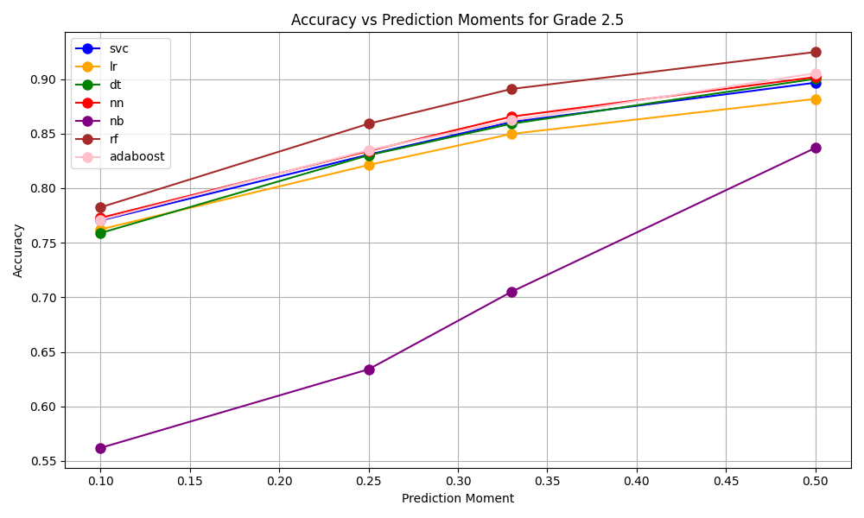
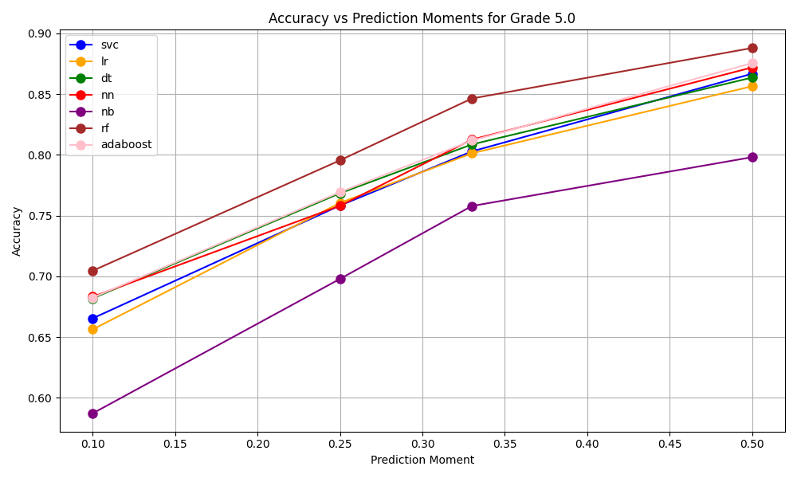
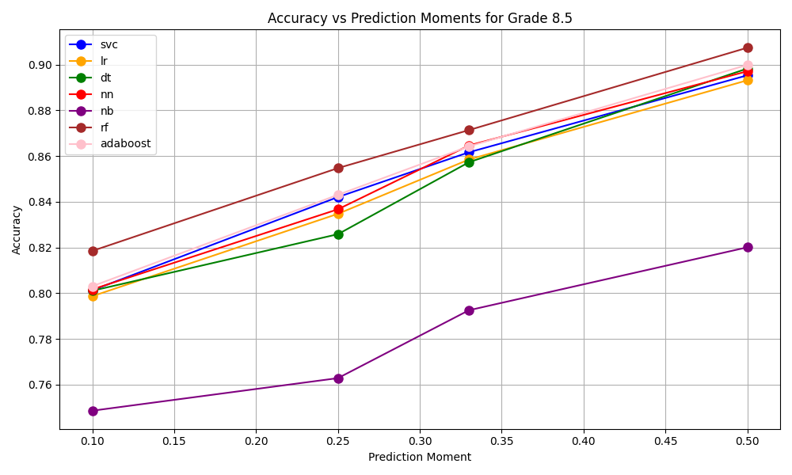
Accuracy of different models, at prediction moments

Slide 9
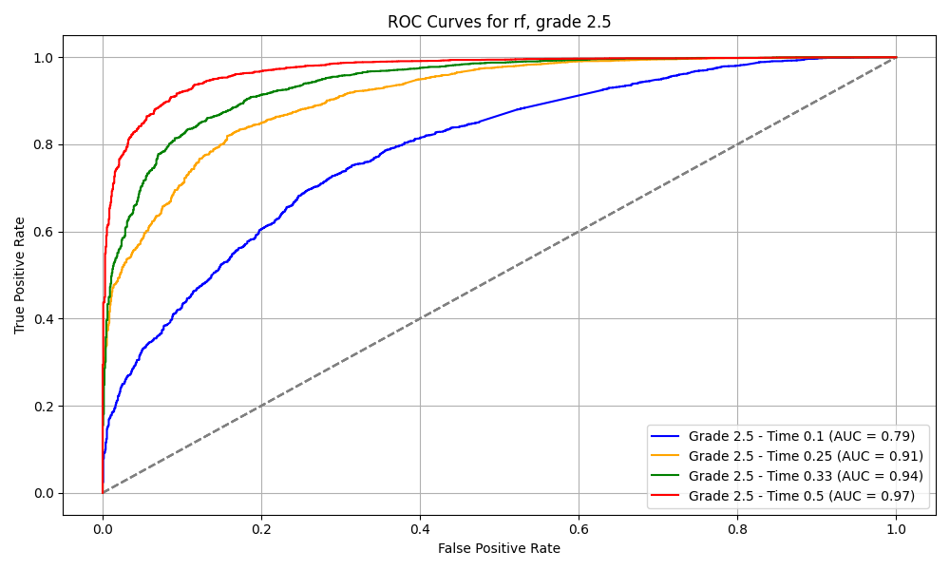
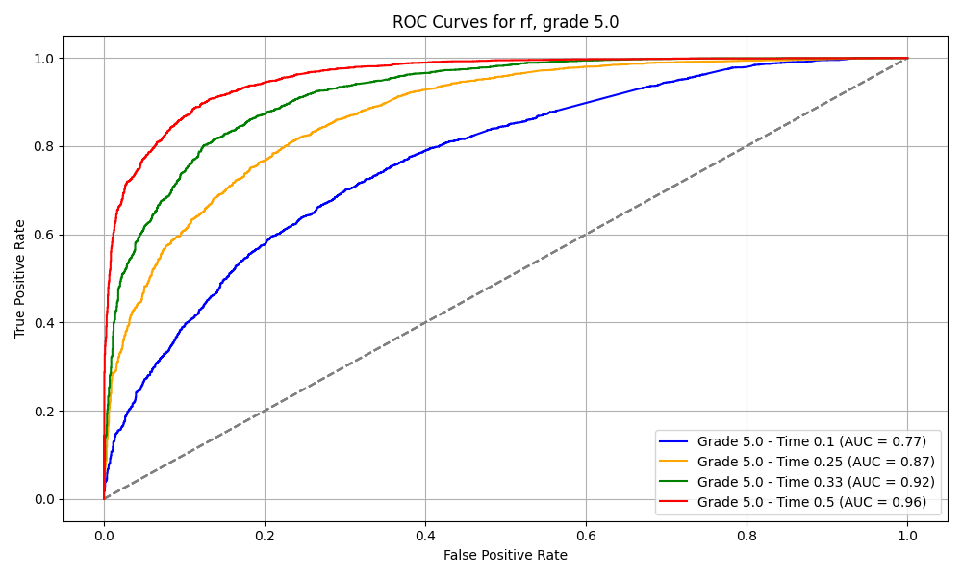
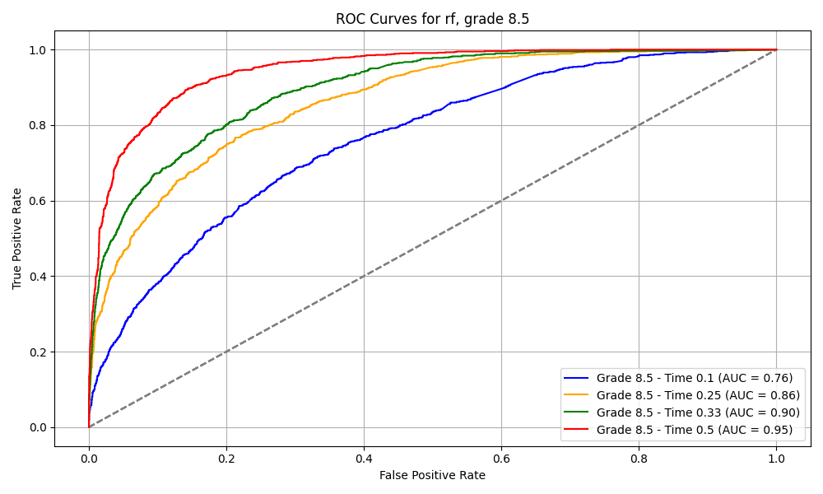
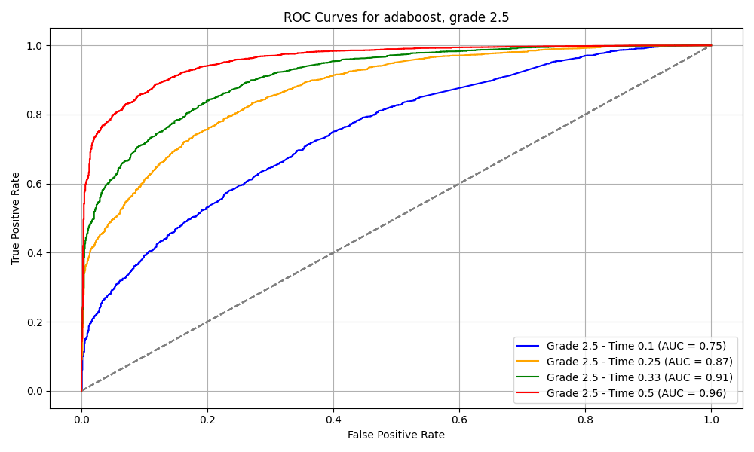
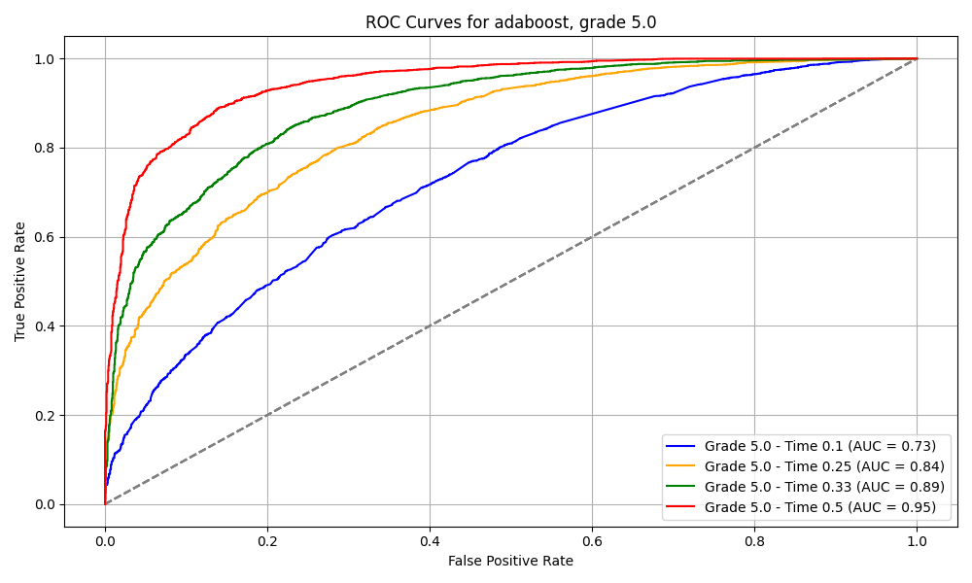
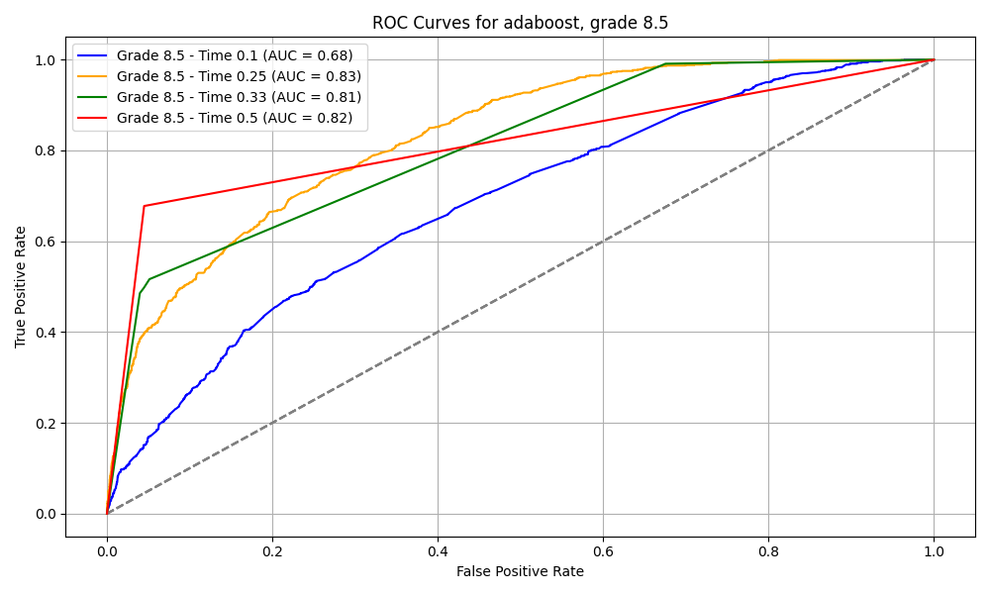
ROC Curve: Random Forest
ROC Curve: AdaBoost

Slide 10
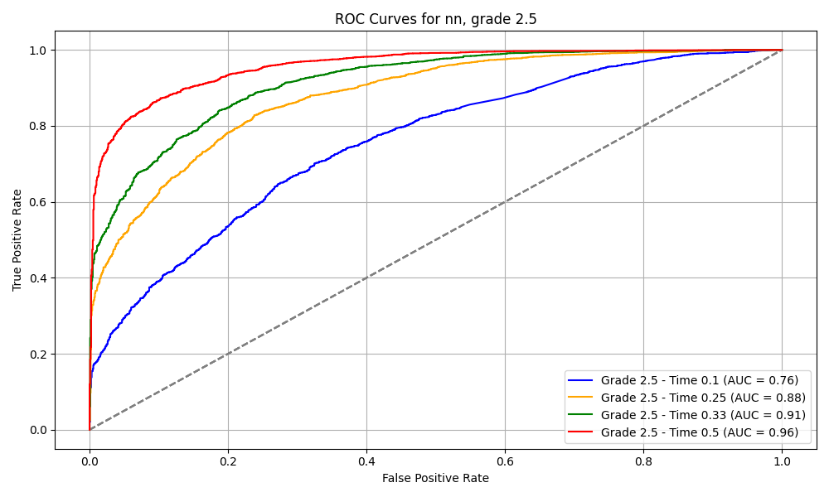
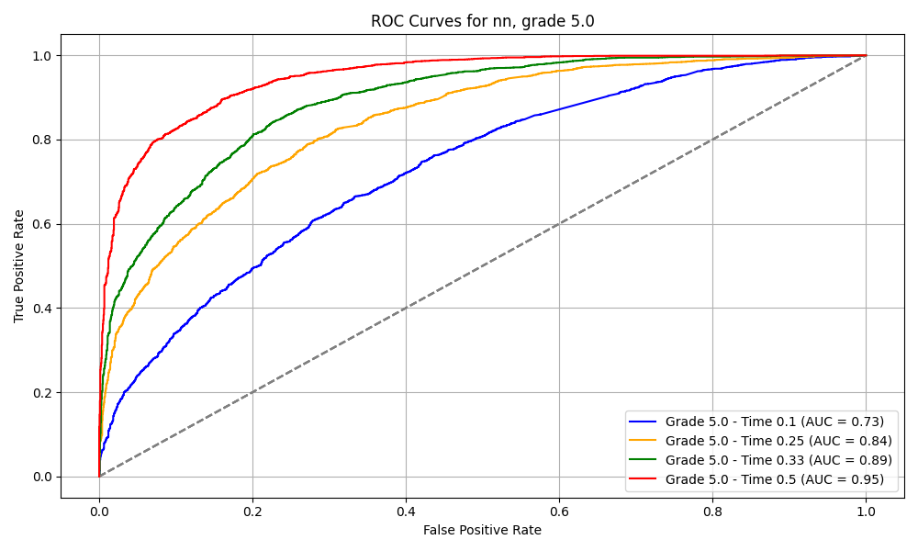
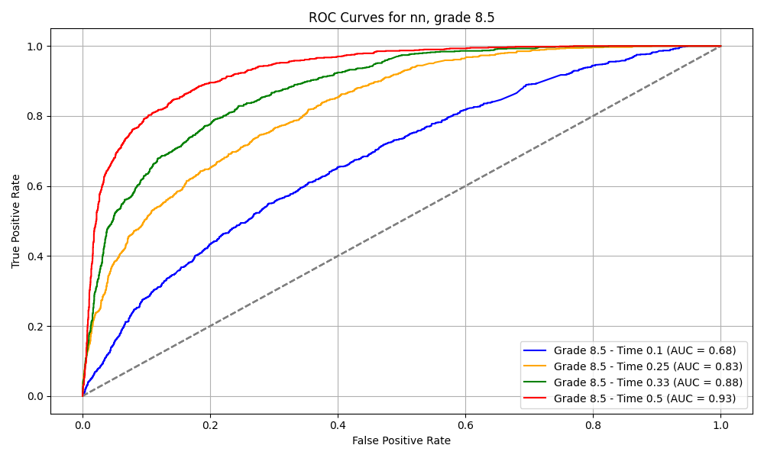
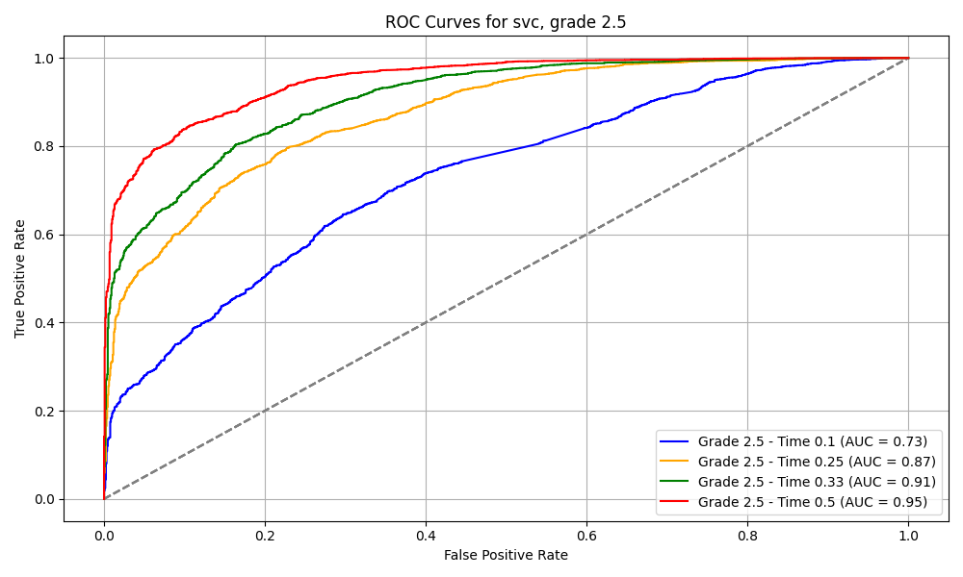

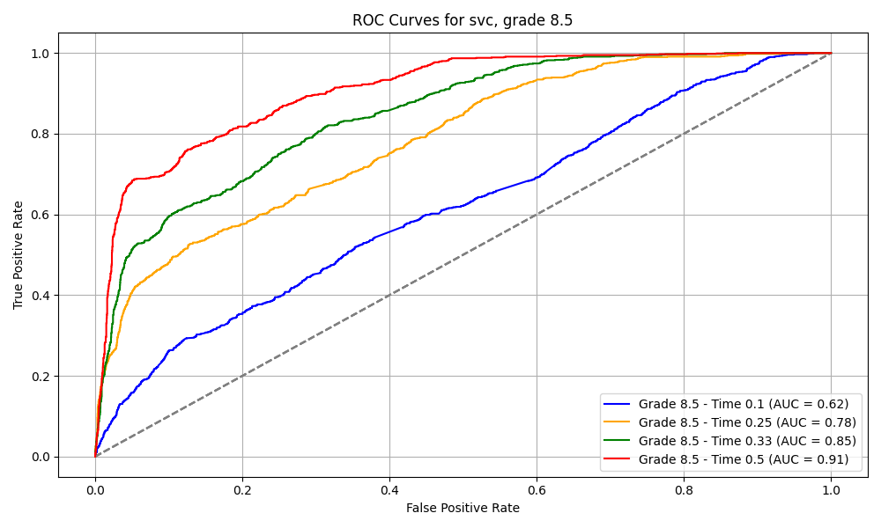
ROC Curve: Neural Network
ROC Curve: SVC

Slide 11
Model Details
Scenario for grade 2.5 and 5.0 Models :
Positives : People above the grade threshold
Objective: Prioritize high precision to reduce false positives, particularly for at-risk and fail students.
F0.5 Score: Weighs precision twice as much as recall. This emphasizes minimizing false positives over false negatives.
Scenario for Excellent Students (Grade ≥ 8.5):
Negatives: People below the grade threshold
Objective: Emphasize recall to reduce false negatives, particularly for excellent students.
F2 Score: Doubles the weight given to recall, prioritizing the detection of excellent students even if it increases false positives.

Slide 12
Moment of Prediction | Metric | Mark Threshold |  |  | Algorithm
 |  | 2.5 | 5 | 8.5
10% | Accuracy | 78% | 70% | 81% | RF
 | Precision | 79% | 71% | 82%
 | Recall | 96% | 84% | 98%
25% | Accuracy | 85% | 79% | 85% | RF
 | Precision | 87% | 79% | 87%
 | Recall | 95% | 90% | 97%
33% | Accuracy | 89% | 84% | 87% | RF
 | Precision | 90% | 76% | 89%
 | Recall | 96% | 91% | 96%
50% | Accuracy | 92% | 88% | 90% | RF
 | Precision | 93% | 89% | 93%
 | Recall | 97% | 93% | 96%

Slide 13
Research Question 2: What LMS log-derived variables have the greatest influence on student performance?
Active Course Engagement: Features like COURSE_VIEW_PCT and COURSE_VIEW_TIME_PCT consistently indicate high importance, suggesting that active participation in course materials is crucial for performance.
Mandatory Grade Completion: ACCOMPLISH_MANDATORY_GRADE is consistently influential, emphasizing the necessity of meeting mandatory grade requirements for higher grades.
Resource Utilization: RESOURCE_VIEW_PCT and RESOURCE_VIEW_UNIQUE_PCT highlight the importance of effectively using learning resources for better outcomes.
Assignment Submission Patterns: Features related to assignment submission, such as ASSIGN_SUBMIT_UNIQUE_PCT and ASSIGN_SUBMIT_PCT, indicate the significance of timely and complete submissions.
Consistent Predictive Factors: Certain features maintain importance across different grade levels and time intervals, suggesting their reliability in predicting student success.

Slide 14
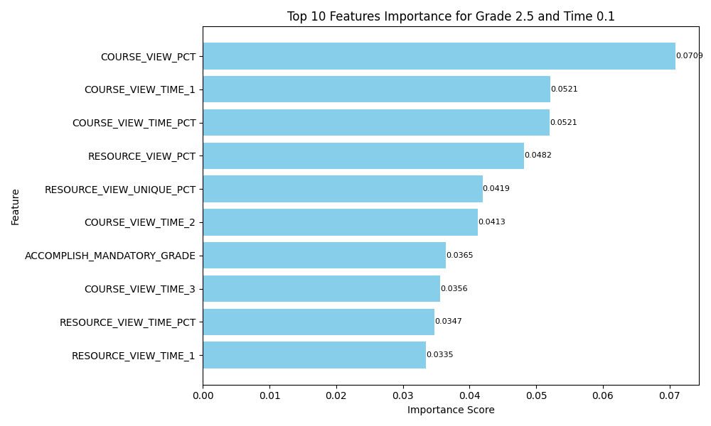
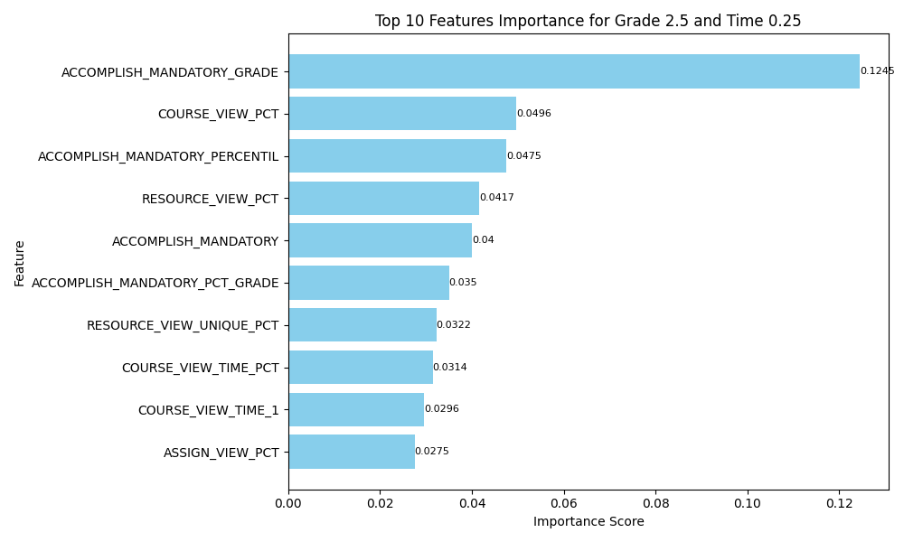
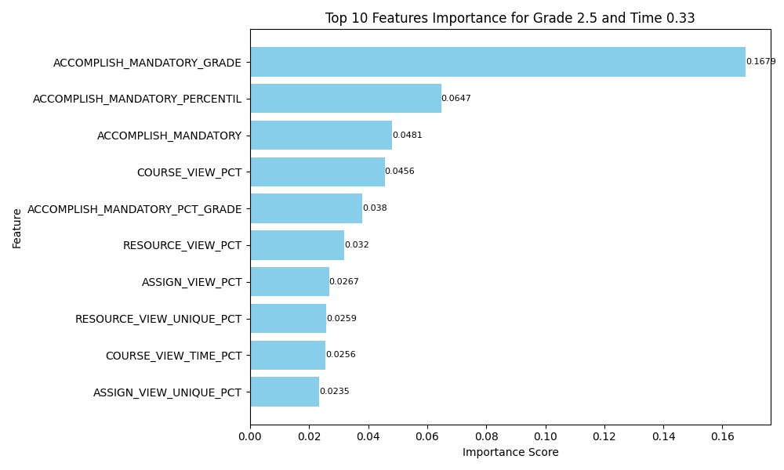
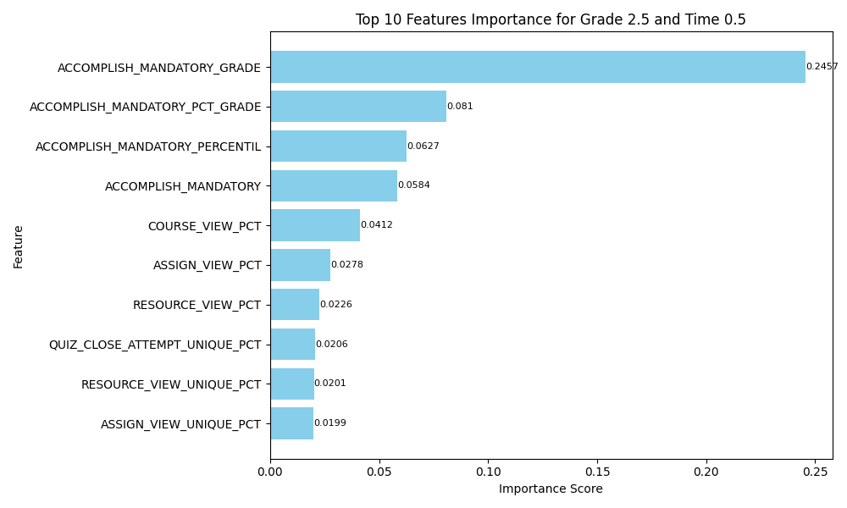
Grade 2.5

Slide 15
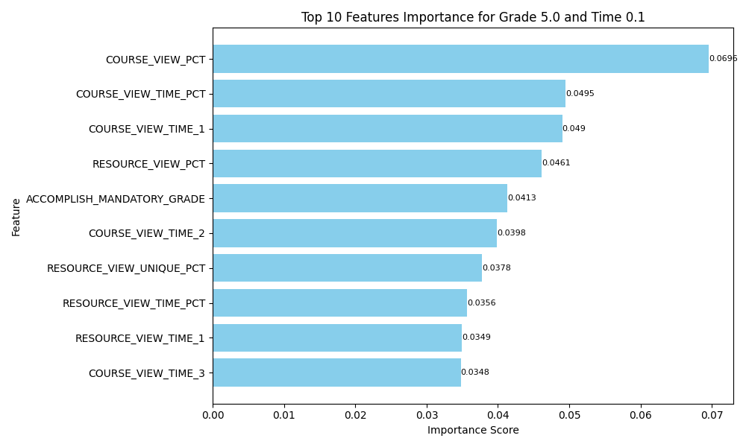
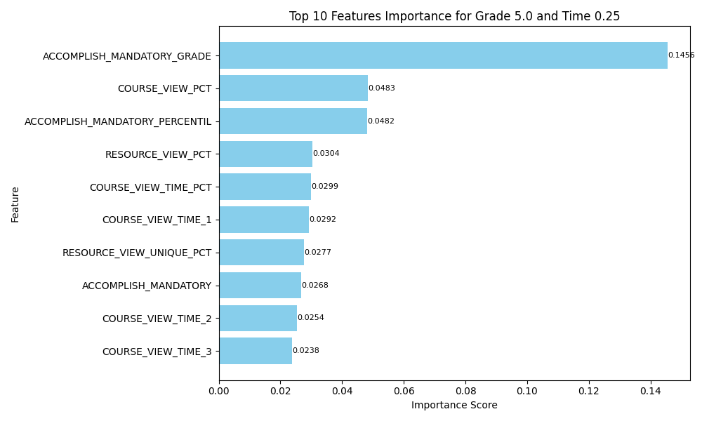
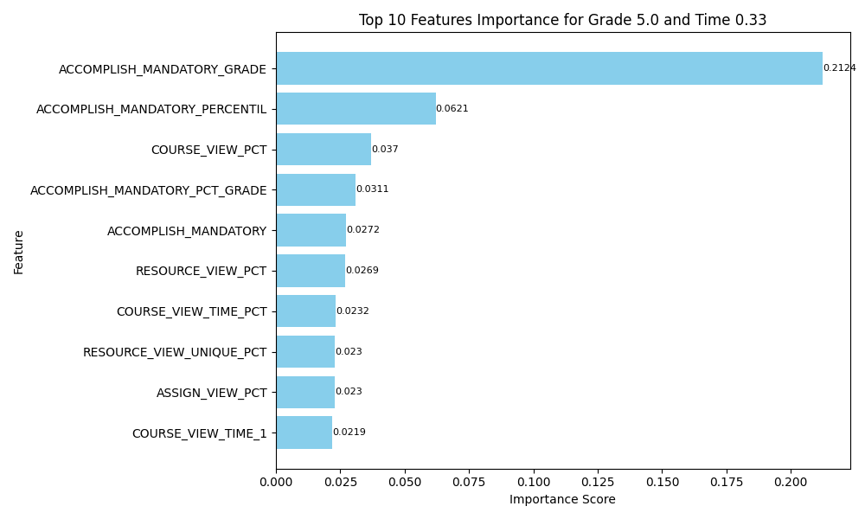
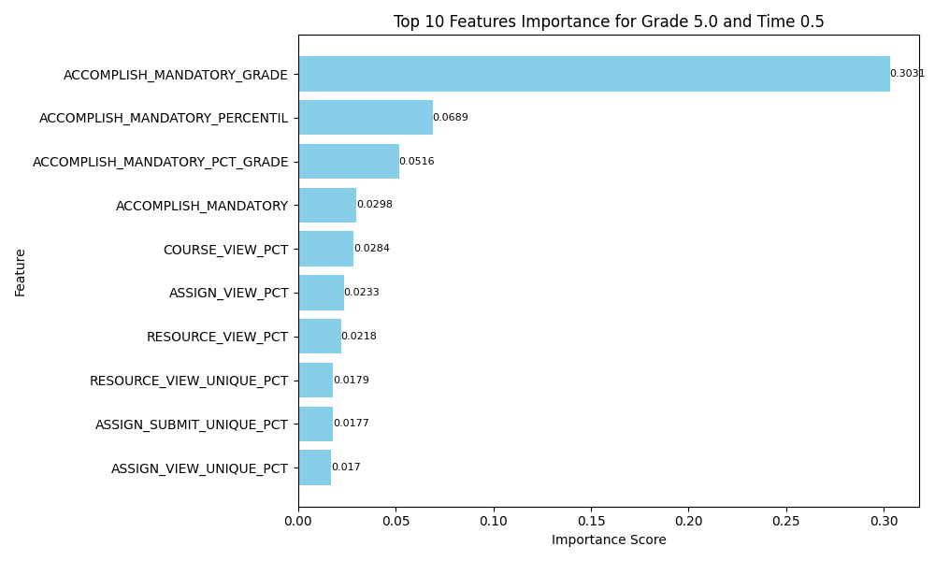
Grade 5

Slide 16
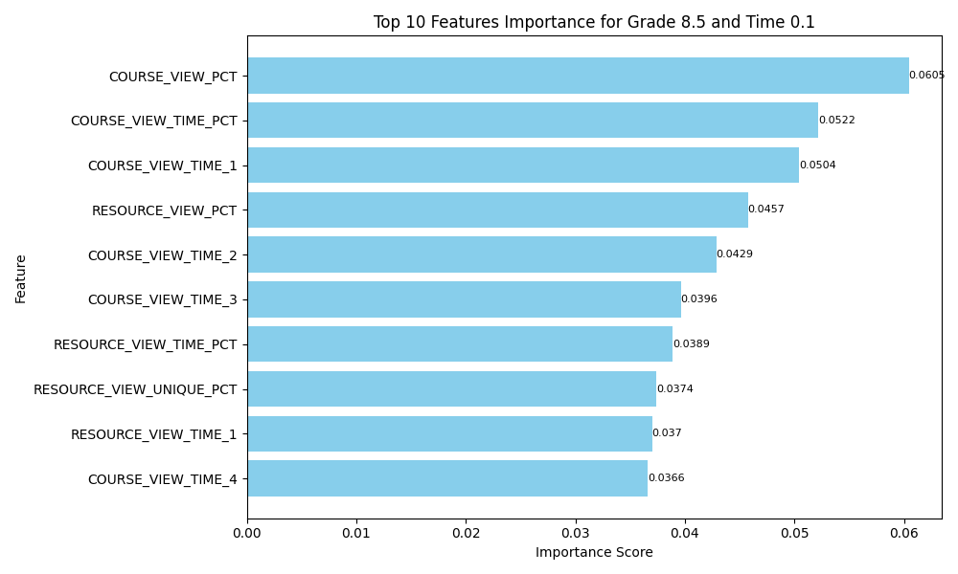
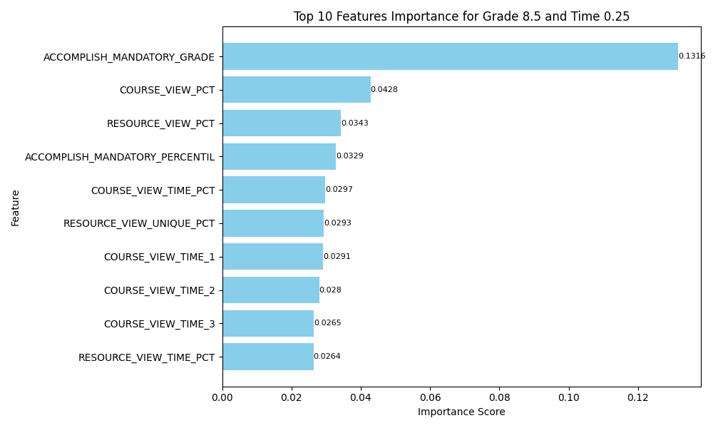
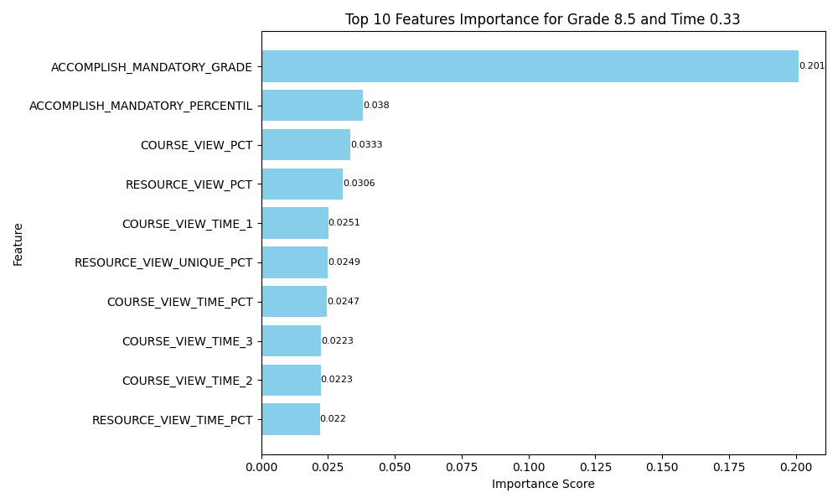
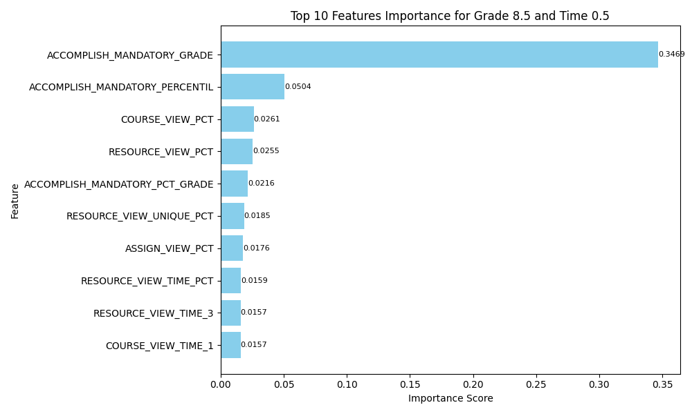
Grade 8.5

Slide 17
Research Question 3 : Do student clusters based on LMS usage exist independently of course features?
1 Data Preprocessing:
Missing values in the dataset are imputed using mean strategy.
Standard scaling is applied to the imputed data to normalize the features.
Feature agglomeration is performed to reduce dimensionality while preserving important information. So out of 66 total features following 4 features were us :
URL and assignment access (UAA) primarily combines the submission and viewing of URLs and assignments within the LMS.
Mandatory and optional assignment evaluation (MOA) primarily consolidates variables related to evaluating assignments.
Quiz access time (QAT) aggregates variables related to quiz actions.
Course and resource view (CIR) encompasses variables related to viewing course materials and resources.
2 Cluster Analysis:
K-means clustering was applied to the aggregated data.
Optimally 6 clusters were found out, which divide students into differentiable clusters
Detailed Feature agglomeration Info : https://docs.google.com/document/d/1uZzmy91DC0AOpFuayQeBj9XzqduZEbFdmy9fsQZIROk/edit?usp=sharing

Slide 18
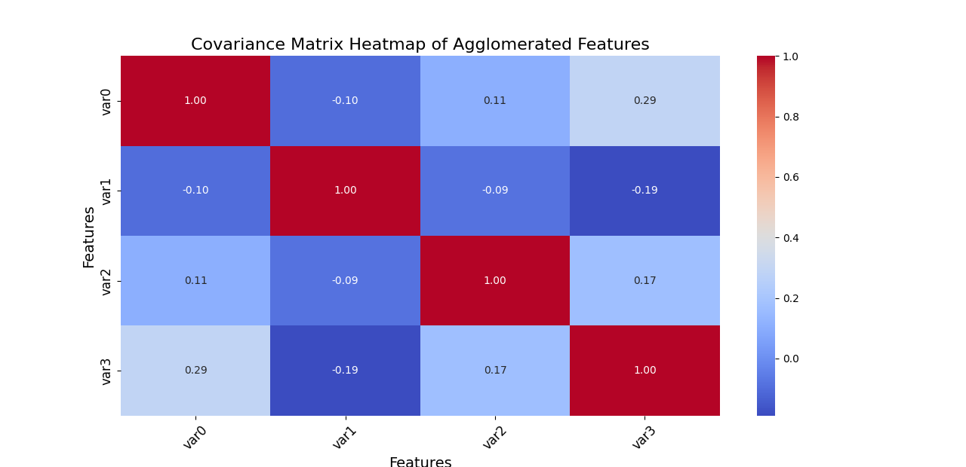
For 50% Moment of Prediction

Slide 19
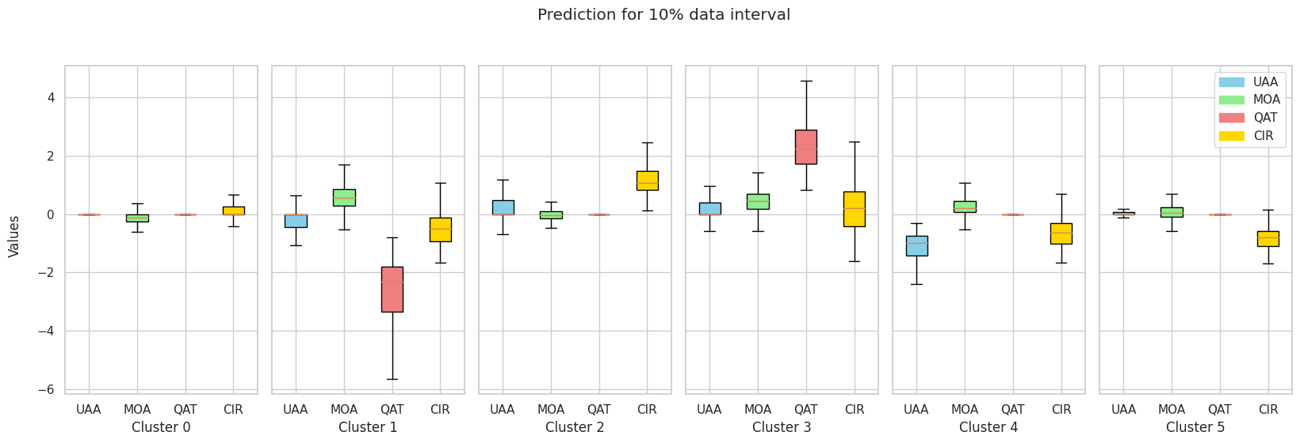
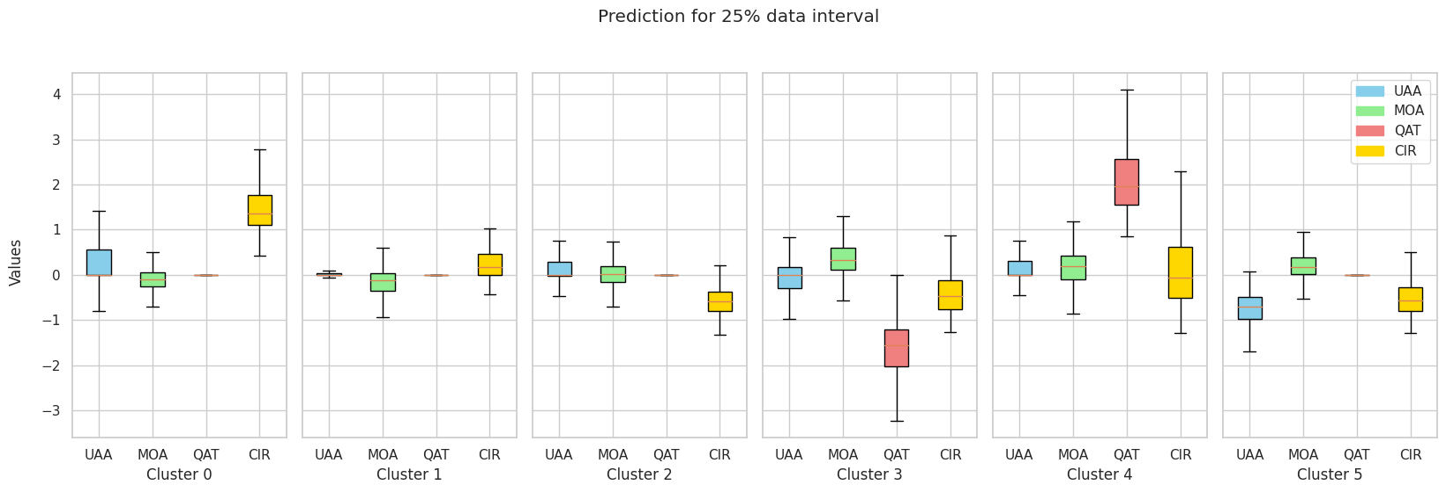
Feature Distribution for each cluster at different moments of prediction

Slide 20
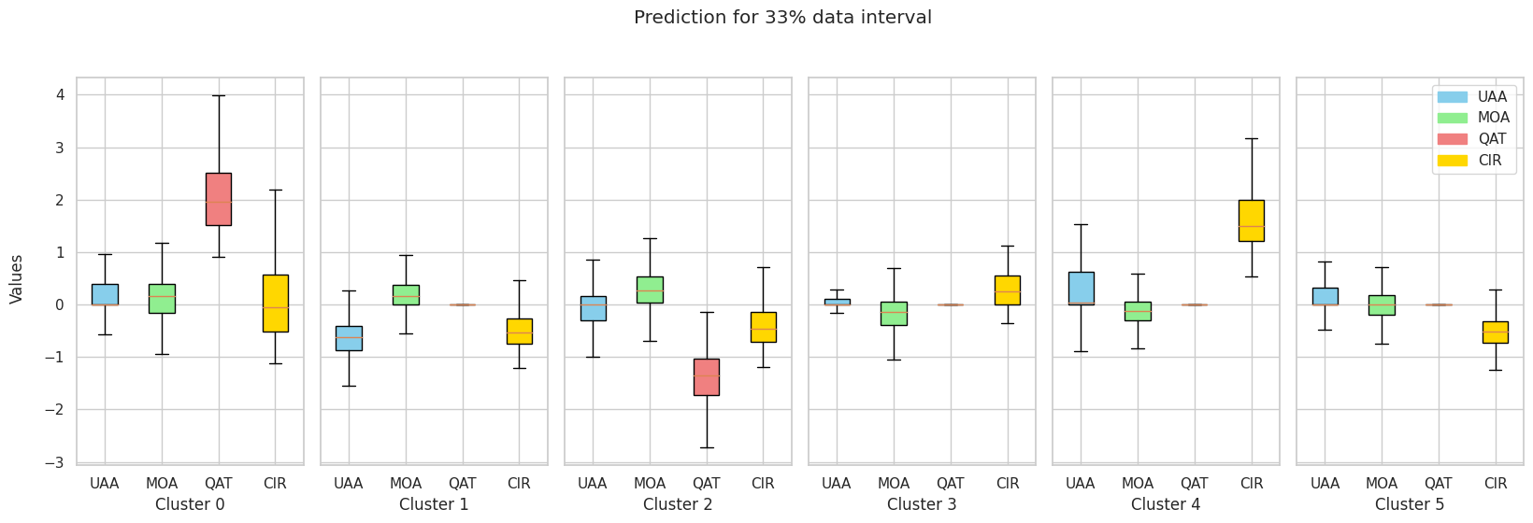
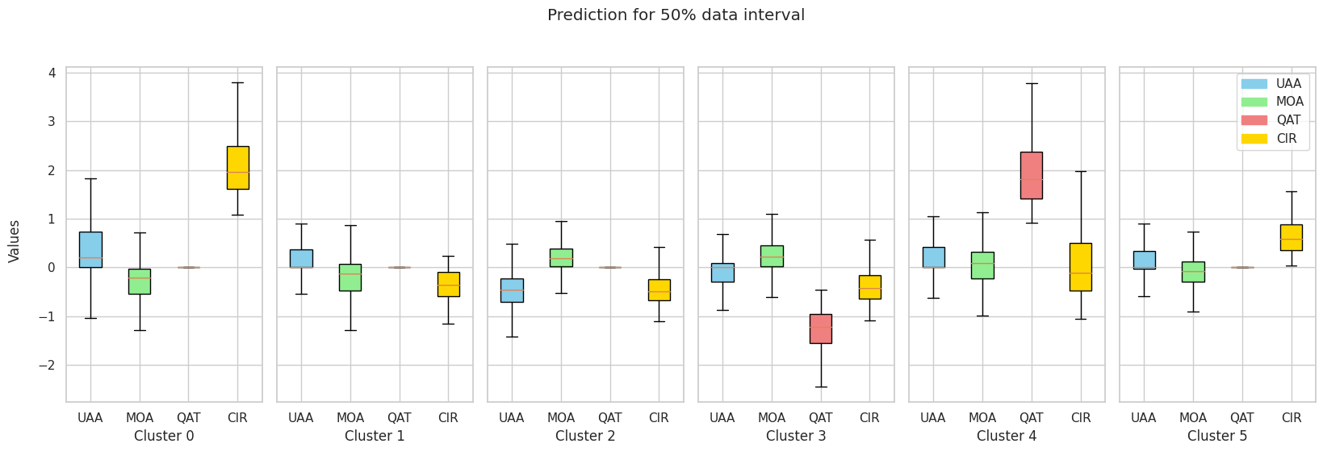
Feature Distribution for each cluster at different moments of prediction

Slide 21
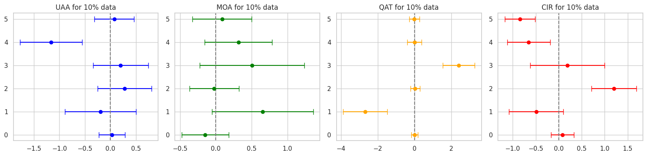
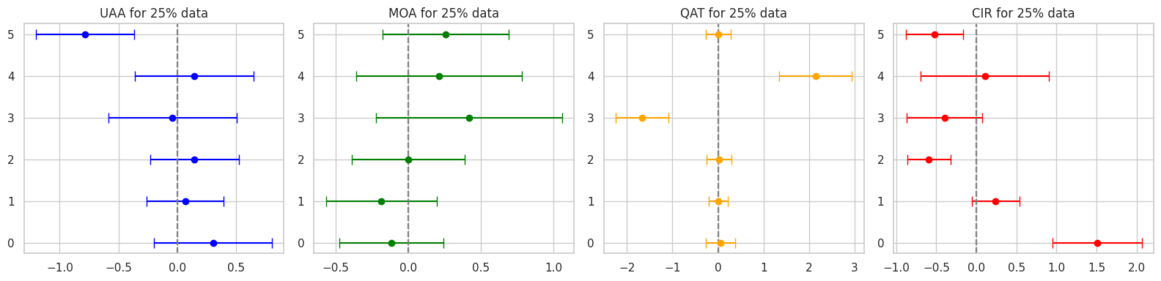

Slide 22
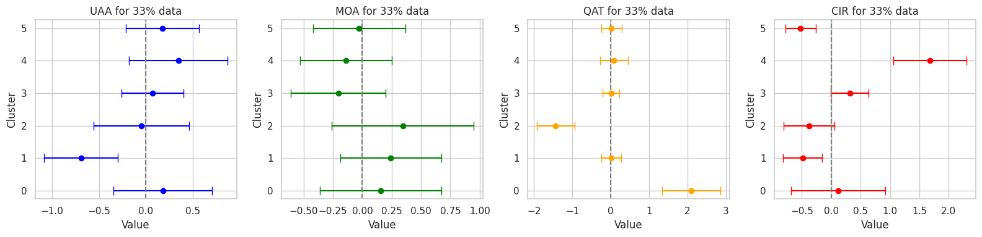
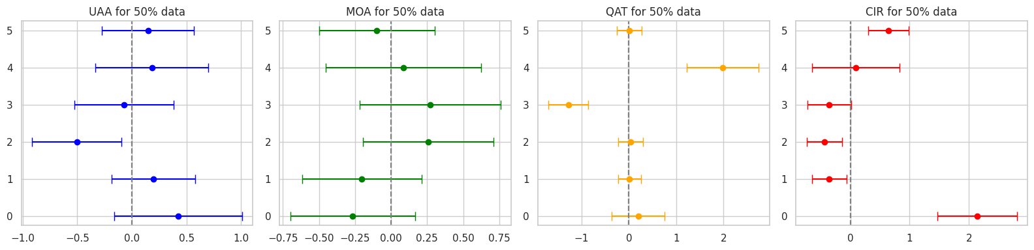

Slide 23
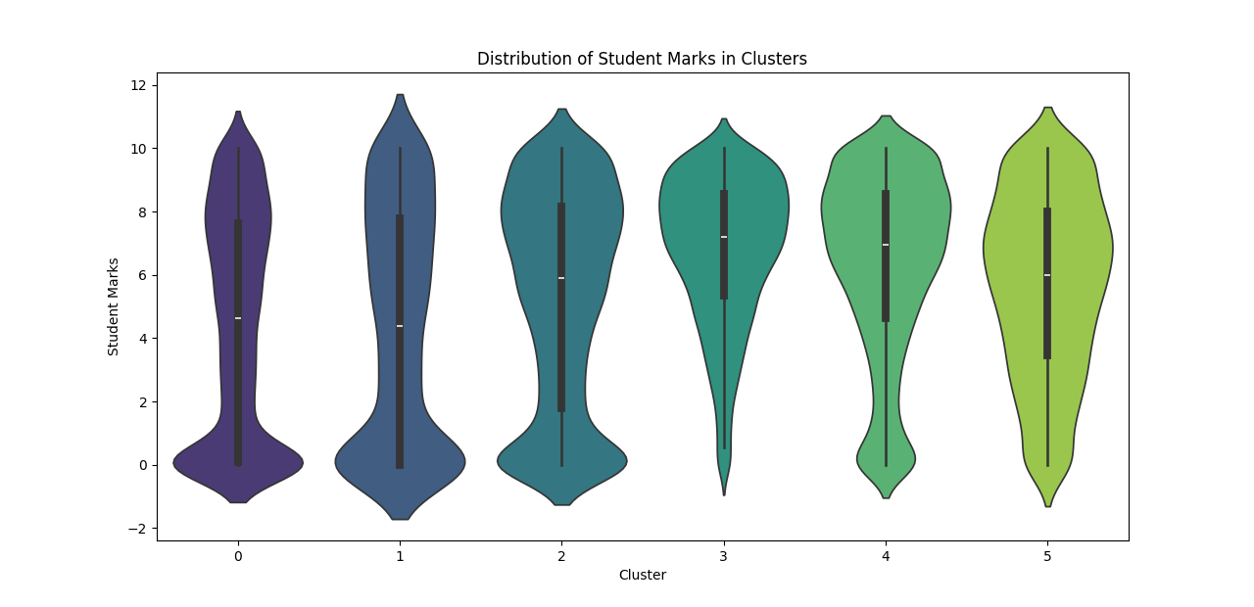

Slide 24
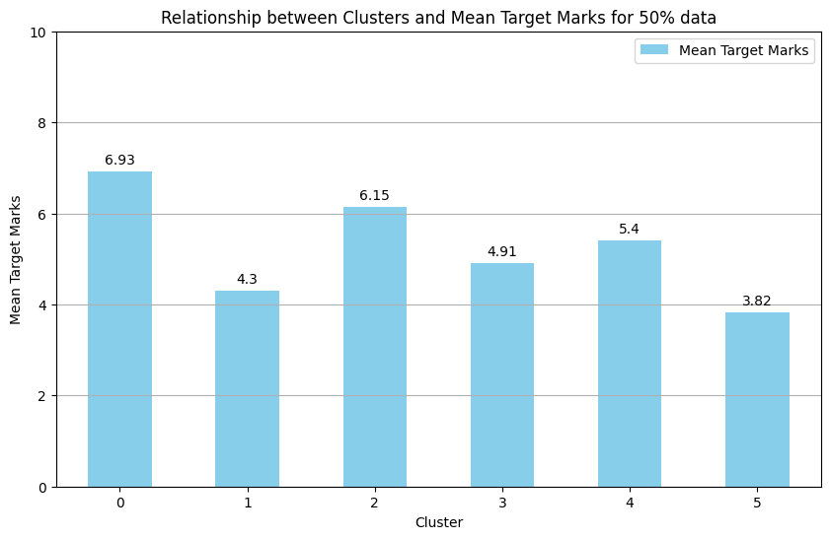
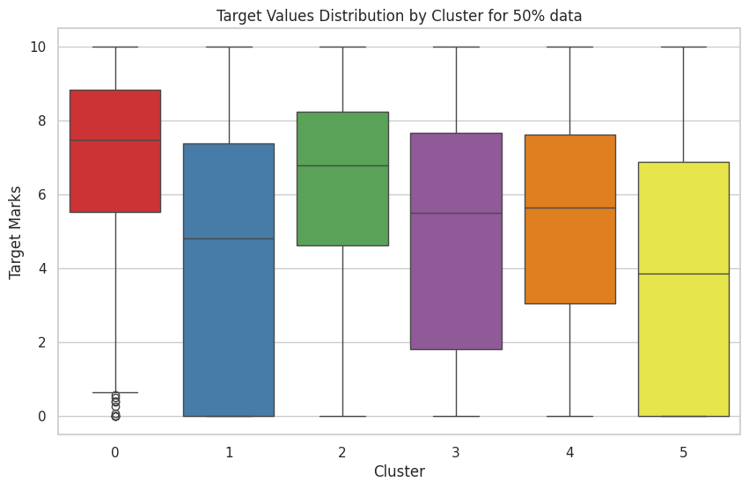
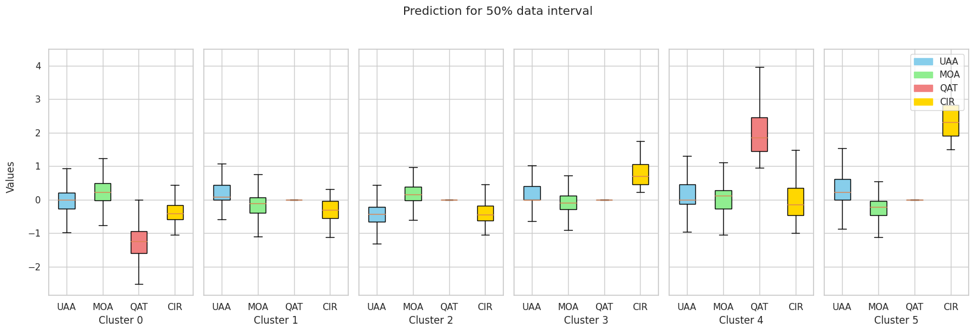
Research Question 4 : Is there a correlation between student clusters and their performance?

Slide 25
Inference
LMS logs analysis indicates potential for predicting student performance at various course completion percentages.
Certain LMS log-derived variables, like mandatory assessment grade, significantly influence student performance.
Student clusters based on LMS usage patterns exist irrespective of course features, suggesting distinct learner profiles.
Correlations between student clusters and performance levels suggest tailored interventions can improve student outcomes in online courses.

