Slide 1
DATA STRUCTURES AND APPLICATIONS
Module - 1

Slide 2
TextBooks
Textbook:
1. Ellis Horowitz, Sartaj Sahni and Susan Anderson-Freed, Fundamentals of Data Structures in C, 2nd Ed, Universities Press, 2014
Reference Books:
1. Seymour Lipschutz, Data Structures Schaum's Outlines, Revised 1st Ed, McGraw Hill,
2014.
2. Gilberg & Forouzan, Data Structures: A Pseudo-code approach with C, 2nd Ed, Cengage
Learning,2014.
3. Reema Thareja, Data Structures using C, 3rd Ed, Oxford press, 2012.
4. Jean-Paul Tremblay & Paul G. Sorenson, An Introduction to Data Structures with
Applications, 2nd Ed, McGraw Hill, 2013
5. A M Tenenbaum, Data Structures using C, PHI, 1989
6. Robert Kruse, Data Structures and Program Design in C, 2nd Ed, PHI, 1996.

Slide 3
TopICS
INTRODUCTION TO DATA STRUCTURES:
Data Structures
Classifications (Primitive & Non-Primitive)
Data structure Operations
Review of pointers and dynamic Memory Allocation
ARRAYS and STRUCTURES:
Arrays
Dynamic Allocated Arrays
Structures and Unions
Polynomials
Sparse Matrices
representation of Multidimensional Arrays
Strings
STACKS: Stacks
Stacks Using Dynamic Arrays
Evaluation and conversion of Expressions

Slide 4
Arrays
An array data structure, or simply an array, is a data structure consisting of a collection of (mainly of similar data types) elements (values or variables), each identified by at least one array index or key. An array is stored so that the position of each element can be computed from its index tuple by a mathematical formula.
ARRAYS IN C
➢ A one-dimensional array can be declared as follows:
int list[5]; //array of 5 integers
int *plist[5]; //array of 5 pointers to integers
Disadvantage: Not intelligent systems.

Slide 5
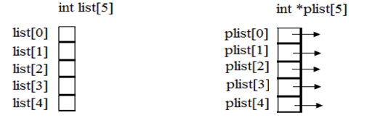
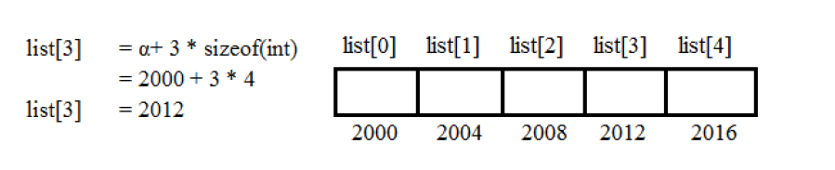
Array Placements
➢ Compiler allocates 5 consecutive memory-locations for each of the variables 'list' and 'plist'.
➢ Address of first element list [0] is called base-address.
➢ Memory-address of list[i] can be computed by compiler as
α + i * sizeof (int) where α =base address

Slide 6
Program to find sum of n numbers using array
#define MAX_SIZE 100
float sum(float [ ], int);
float input[MAX_SIZE], answer;
int i;
main ( )
{
for (i = 0; i < MAX_SIZE; i++)
input[i] = i;
answer = sum(input, MAX_SIZE);
printf("The sum is: %f\n", answer);
}
float sum(float list[ ], int n)
{
int i;
float tempsum = 0;
for (i = 0; i < n; i++)
tempsum += list[i];
return tempsum;
}

Slide 7
Code Breakdown
1. #define MAX_SIZE 100
This defines a constant named MAX_SIZE with a value of 100.
Used to set the size of the array.
2. float sum(float [ ], int);
This is a function prototype for sum, which takes:
An array of floats
An integer n (number of elements)
Returns a float (the total sum)
3. float input[MAX_SIZE], answer;
Declares:
input: an array of 100 floats
answer: a float to store the result
4. int i;
Declares a loop counter variable.

Slide 8
Code Breakdown
5. main()
The main function where execution starts.
Inside main():
for (i = 0; i < MAX_SIZE; i++) input[i] = i;
Fills the input array with values from 0 to 99.
answer = sum(input, MAX_SIZE);
Calls the sum function, passing the array and its size.
Stores the result in answer.
printf("The sum is: %f\n", answer);
Prints the result using %f for floating-point format.

Slide 9
Code Breakdown
float sum(float list[], int n)
{ int i;
float tempsum = 0;
for (i = 0; i < n; i++)
tempsum += list[i];
return tempsum; }
Loops through the array list of size n
Adds each element to tempsum
Returns the total sum
Since the array contains values from 0 to 99, the sum is:
\text{Sum} = 0 + 1 + 2…… 99 = 4950
So the output will be:
The sum is: 4950.000000

Slide 10
Arrays are generally used when we want to store large amount of similar type of data. But they have the following limitations:
➢ Arrays are of fixed size.
➢ Data elements are stored in contiguous memory locations which may not be always available.
➢ Insertion and deletion of elements can be problematic because of shifting of elements from their positions.

Slide 11
DYNAMICALLY ALLOCATED ARRAYS
ONE-DIMENSIONAL ARRAYS
• When writing programs, sometimes we cannot reliably determine how large an array must be.
• A good solution to this problem is to
➢ defer this decision to run-time &
➢ Allocate the array when we have a good estimate of required array-size.

Slide 12
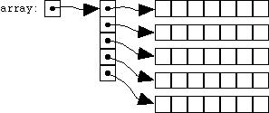
TWO DIMENSIONAL ARRAYS
• These are created by using the concept of array of arrays.
• A 2-dimensional array is represented as a 1-dimensional array in which each element has a pointer to a 1-dimensional array as shown below
int x[5][7]; //we create a 1-dimensional array x whose length is 5;
//each element of x is a 1-dimensional array whose length is 7.
• Address of x[i][j] = x[i]+j*sizeof(int)
}
Array-of-arrays representation

Slide 13
Create C program to create 2D array with 2 rows and 3 columns and Perform sum operation.
#include <stdio.h>
int main() {
int a[2][3], i, j, sum = 0;
printf("Enter the 2*3 array");
for (i = 0; i < 2; i++) {
for (j = 0; j < 3; j++) {
scanf("%d", &a[i][j]);
}
}
for (i = 0; i < 2; i++) {
for (j = 0; j < 3; j++) {
printf("%d \t", a[i][j]);
sum = sum + a[i][j];
}
printf("\n");
}
printf("Total sum : %d", sum);
}

Slide 14
STRUCTURES
In C, a way to group data that permits the data to vary in type. This mechanism is called the structure, for short struct.
A structure (a record) is a collection of data items, where each item is identified as to its type and name.
Generic Definition : A structure in C is like a custom box where you can store different types of data together under one name.
Ex:
Structure Student
Name (Text)
Age (Number)
Marks (Decimal)

Slide 15
Syntax:
struct
{
data_type member 1;
data_type member 2;
………………………
………………………
data_type member n;
} variable_name;
Ex: struct {
char name[10];
int age;
float salary;
} Person;

Slide 16
The above example creates a structure and variable name is Person and that has three fields:
name = a name that is a character array
age = an integer value representing the age of the person
salary = a float value representing the salary of the individual.
Assign values to fields :
To assign values to the fields, use . (dot) as the structure member operator. This operator is used to select a particular member of the structure
Ex: strcpy(Person.name,“james”);
Person.age = 10;
Person.salary = 35000;

Slide 17
Declare a variable of the structure :
struct Person p1;
strcpy(p1.name, "Amit");
p1.age = 20;
p1.marks = 88.5;
Access and Use the Data :
printf("Name: %s\n", p1.name);
printf("Age: %d\n", p1.age);
printf("Marks: %.2f\n", p1.marks);

Slide 18
Type-Defined Structure
The structure definition associated with keyword typedef is called Type-Defined Structure.
Syntax 1:
typedef struct
{
data_type member 1;
data_type member 2;
………………………
………………………
data_type member n;
}Type_name;
Note : A type-defined structure in C uses the keyword typedef to give a nickname to a structure. This makes your code shorter and cleaner.

Slide 19
➢ typedef is the keyword used at the beginning of the definition and by using typedef user defined data type can be obtained.
➢ struct is the keyword which tells structure is defined to the complier
➢ The members are declare with their data_type
➢ Type_name is not a variable, it is user defined data_type.

Slide 20
Syntax 2:
struct struct_name
{
data_type member 1;
data_type member 2;
………………………
………………………
data_type member n;
};
typedef struct struct_name Type_name;
Note : Every time you declare a variable, you have to write struct Student. That gets tiring!
So you use typedef to say:
"Hey C, from now on, just call this Student"

Slide 21
Ex:
typedef struct
{
char name[10];
int age;
float salary;
}humanBeing;
In above example, humanBeing is the name of the type and it is a user defined data type.
Declarations of structure variables:
humanBeing person1, person2;
This statement declares the variable person1 and person2 are of type humanBeing.

Slide 22
//Sample program to illustrate Typedef
#include <stdio.h>
typedef struct {
char name[50];
int age;
} Person;
int main() {
Person p1;
p1.age = 25;
strcpy(p1.name, "Amit");
printf("Name: %s, Age: %d\n", p1.name, p1.age);
return 0;
}

Slide 23
Structure Operation
The various operations can be performed on structures and structure members.
1. Structure Equality Check:
Here, the equality or inequality check of two structure variable of same type or dissimilar type is not allowed
typedef struct
{
char name[10];
int age;
float salary;
}humanBeing;
humanBeing person1, person2;
if (person1 = = person2) is invalid.
While structures cannot be directly checked for equality or inequality, we can write a function to do this.

Slide 24
The valid function is shown below:
#define FALSE 0
#define TRUE 1
//A typical function call might be:
if (humansEqual(person1,person2))
printf("The two human beings are the same\n");
else
printf("The two human beings are not the same\n");

Slide 25
//Function to check equality of structures
int humansEqual(humanBeing person1, humanBeing person2)
{
/* return TRUE if person1 and person2 are the same human being otherwise
return FALSE */
if (strcmp(person1.name, person2.name))
return FALSE;
if (person1.age != person2.age)
return FALSE;
if (person1.salary != person2.salary)
return FALSE;
return TRUE;

Slide 26
2. Assignment operation on Structure variables:
person1 = person2
The above statement means that the value of every field of the structure of person 2 is assigned as the value of the corresponding field of person 1, but this is invalid statement.
Valid Statements is given below:
strcpy(person1.name, person2.name);
person1.age = person2.age;
person1.salary = person2.salary;

Slide 27
Structure within a structure:
There is possibility to embed a structure within a structure. There are 2 ways to embed structure.
1. The structures are defined separately and a variable of structure type is declared inside the definition of another structure. The accessing of the variable of a structure type that are nested inside another structure in the same way as accessing other member of that structure

Slide 28
Example: The following example shows two structures, where both the structure are defined separately.
typedef struct
{
int month;
int day;
int year;
}date;
typedef struct
{
char name[10];
int age;
float salary;
date dob;
} humanBeing;
humanBeing person1;

Slide 29
A person born on February 11, 1944, would have the values for the date struct set as:
person1.dob.month = 2;
person1.dob.day = 11;
person1.dob.year = 1944;
2. The complete definition of a structure is placed inside the definition of another structure.
Example:
typedef struct
{ char name[10];
int age;
float salary;
struct
{ int month;
int day;
Int year;
} date;
} humanBeing;

Slide 30
SELF-REFERENTIAL STRUCTURES
➢ A self-referential structure is one in which one or more of its components is a pointer to itself.
➢ These require dynamic storage management routines (malloc & free) to explicitly obtain and release memory.
Note : It is a structure that contains a pointer to itself — meaning, it can point to another structure of the same type.
Think of it like a train :
Each coach (structure) has a hook (pointer) that connects it to the next coach (another structure of the same type).

Slide 31
Why Is It Useful?
Self-referential structures let you:
Link multiple elements together dynamically
Build flexible structures like:
Linked Lists (each node points to the next)
Trees (each node can point to children)
Graphs (nodes can point to multiple others)
Example
typedef struct
{
char data;
struct list *link; //list is a pointer to a list structure
}list;

Slide 32

➢ Consider three structures and values assigned to their respective fields:
list item1,item2,item3;
item1.data='a';
item2.data='b';
item3.data='c';
item1.link=item2.link=item3.link=NULL;
➢ We can attach these structures together as follows
item1.link=&item2;
tem2.link=&item3;

Slide 33
INTERNAL IMPLEMENTATION OF STRUCTURES
➢ The size of an object of a struct or union type is the amount of storage necessary to represent the largest component, including any padding that may be required.
➢ Structures must begin and end on the same type of memory boundary. For ex, an even byte boundary (2, 4, 6 or 8).

Slide 34
Union
A union is a special data type available in C that allows us to store different data types in the same memory location. You can define a union with many members, but only one member can contain a value at any given time. Unions provide an efficient way of using the same memory location for multiple-purpose.
#include <stdio.h>
#include <string.h>
union Data
{ int i;
float f;
char str[20]; };
int main( )
{ union Data data;
printf( "Memory size occupied by data : %d\n", sizeof(data));
return 0;
}

Slide 35
The memory occupied by a union will be large enough to hold the largest member of the union. For example, in the above example, Data type will occupy 20 bytes of memory space because this is the maximum space which can be occupied by a character string.

Slide 36

Polynomials
What is a polynomial?
“A polynomial is a sum of terms, where each term has ax^e, where x is the variable, a is the coefficient and e is the exponent.
Terms :
The largest (or leading) exponent of a polynomial is called its degree.
Coefficients that are zero are not displayed.
The term with exponent equal to zero does not show the variable since x raised to a power of zero is 1.

Slide 37
A Polynomial ADT abstracts the concept of polynomials, allowing us to:
1. Represent the polynomial
Each term can be represented as a combination of:
Coefficient (e.g., 4)
Exponent (e.g., 3 for x^3)
Variable (e.g. x)
2. Support operations like:
Create a polynomial
Add two polynomials
Subtract two polynomials
Multiply two polynomials
Evaluate a polynomial at a given value of xxx
Display the polynomial in human-readable form

Slide 38
Common Implementations
Polynomials can be implemented using Arrays :
Each index can represent the exponent, and the value at that index is the coefficient.
Example: P(x) = 4x^3 + 2x^2 - 5x + 7 you can use an array:
index: 0 1 2 3 → Exponent
coefficient: 7 -5 2 4

Slide 39
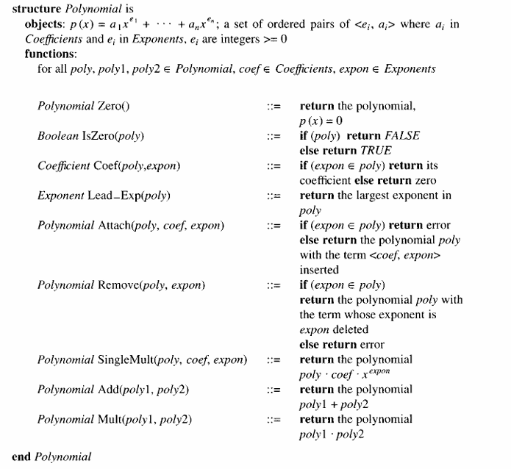

Slide 40
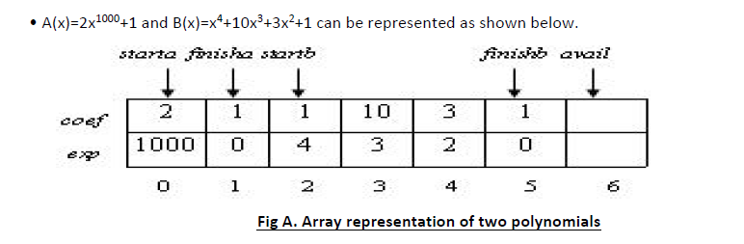
POLYNOMIAL REPRESENTATION:
#define MAX_TERMS 100
typedef struct
{ float coef;
int expon;
}polynomial;
polynomial terms[MAX_TERMS];
int avail=0;

Slide 41
• startA & startB give the index of first term of A and B respectively.
• finishA & finishB give the index of the last term of A & B respectively.
avail gives the index of next free location in the array.
• Any polynomial A that has ‘n’ non-zero terms has startA & finishA such that finishA=startA+n-1
• Advantage: This representation solves the problem of many 0 terms since A(x)-2x1000+1 uses only 6 units of storage (one for startA, one for finishA, 2 for the coefficients and 2 for the exponents)
• Disadvantage: However, when all the terms are non-zero, the current representation requires about twice as much space as the first one.

Slide 42
Function to add two polynomials
General Rule : We only add the coefficients of terms with equal exponents
If the exponents are different, we don’t add — we just copy the term to the result
A(x) = 5x⁴ + 3x² + 7
B(x) = 2x⁴ + 4x³ + 1
5x⁴ and 2x⁴ → same exponent → add coefficients → 7x⁴ - Can be added
3x² and 4x³ → different exponents → can't add
C function is written that adds two polynomials, A and B to obtain D =A + B.
To produce D (x), padd( ) is used to add A (x) and B (x) term by term. Starting at position avail, attach( ) which places the terms of D into the array, terms.
If there is not enough space in terms to accommodate D, an error message is printed to the standard error device & exits the program with an error condition

Slide 43
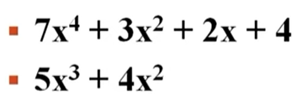
Function to add two polynomials
 | A(x)
0 | 7
 | 4
1 | 3
 | 2
2 | 2
 | 1
3 | 4
 | 0
4 | .
 | .
5 | .
 | .
 | B(x)
0 | 5
 | 3
1 | 4
 | 2
2 | -
 | -
3 | -
 | -
4 | -
 | -
5 | -
 | -
 | D(x)?
0
1
2
3
4
5

Slide 44
Function to add two polynomials
This is a function named padd, short for polynomial add. It adds two polynomials A(x) and B(x) and stores the result in polynomial D(x).
starta, finisha: Start and end indices of polynomial A in a global terms array.
startb, finishb: Start and end indices of polynomial B.
*startd, *finishd: Pointers to store the start and end indices of result polynomial D.
void padd (int starta, int finisha, int startb, int finishb,int * startd, int *finishd)
{
/* add A(x) and B(x) to obtain D(x) */
float coefficient;
Declares a temporary variable to hold the sum of coefficients when two terms have the same exponent.
*startd = avail;
avail is assumed to be a global index that tells where the next term should be inserted in the terms array.. We set the start of polynomial D (*startd) to the current value of avail.
while (starta <= finisha && startb <= finishb)
Loop runs while both A and B have terms left.
It compares terms of A and B (from the terms array), one-by-one.
{

Slide 45
switch (COMPARE(terms[starta].expon, terms[startb].expon))
COMPARE is a macro or function that compares the exponents of the current terms from A and B.
It returns:
-1 if A's exponent < B's exponent
0 if equal
1 if A's exponent > B's exponent
{
case -1: /* a expon < b expon */
attach(terms[startb].coef, terms[startb].expon);
startb++
break;
Go to the next term in polynomial B.
case 0: /* equal exponents */
coefficient = terms[starta].coef + terms[startb].coef;
if (coefficient)
attach (coefficient, terms[starta].expon);
starta++;
startb++;
break;
If exponents are equal, add coefficients.
If the result is not 0, add the term to D.
Move both A and B to next term.

Slide 46
Function to add two polynomials
case 1: /* a expon > b expon */
attach(terms[starta].coef, terms[starta].expon); starta++;
Move to next term in A.
}
}
/* add in remaining terms of A(x) */
for( ; starta <= finisha; starta++)
attach(terms[starta].coef, terms[starta].expon);
/* add in remaining terms of B(x) */
for( ; startb <= finishb; startb++)
attach(terms[startb].coef, terms[startb].expon);
*finishd =avail -1;
}
Add remaining terms of A and B.
Set the end index of polynomial D to the last inserted term.

Slide 47
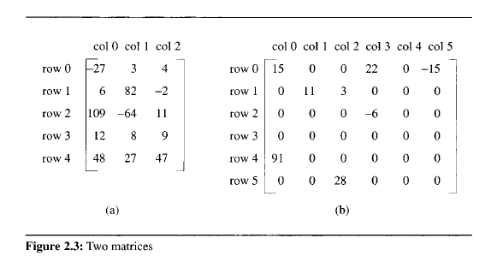
THE SPARSE MATRIX ABSTRACT DATA TYPE
The standard representation of a matrix in computer science is a two-dimensional array defined as a[MAX~ROWS][MAX-COLS]. With this representation, we can locate quickly any element by writing a[Z][y], where i is the row index and j is the column index. However, there are some problems with the standard representation. For instance, if you look at Figure 2.3(b), you notice that it contains many zero entries. We call this a sparse matrix. Although it is difficult to determine exactly whether a matrix is sparse or not, intuitively we can recognize a sparse matrix when we see one. In Figure 2.3(b), only 8 of 36 elements are nonzero and that certainly is sparse.

Slide 48
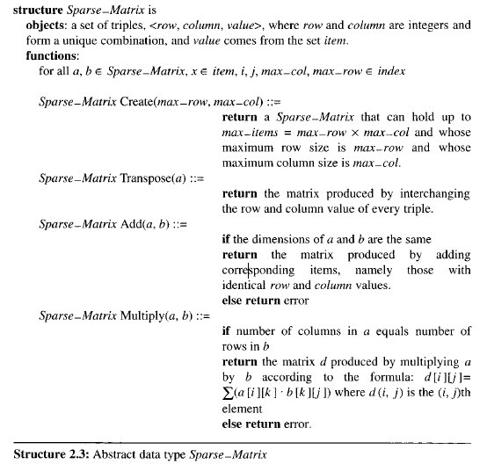
Before developing a particular representation, we first must consider the operations that we want to perform on these matrices. A minimal set of operations includes matrix creation, addition, multiplication, and transpose. Structure 2.3 contains our specification of the matrix ADT.

Slide 49
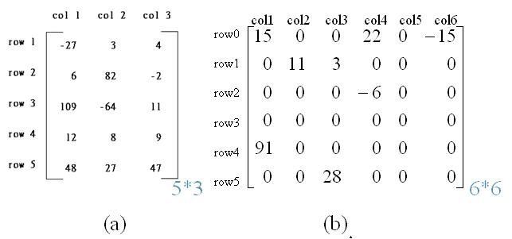
• Sparse matrix contains many zero entries.
• When a sparse matrix is represented as a 2-dimensional array, we waste space.
• For ex, if 100*100 matrixes contain only 100 entries then we waste 9900 out of 10000 memory spaces.
• Solution: Store only the non-zero elements.

Slide 50
SPARSE MATRIX REPRESENTATION
• We can classify uniquely any element within a matrix by using the triple <row,col,value>. Therefore, we can use an array of triples to represent a sparse matrix.
SpareMatrix Create(maxRow,maxCol) ::=
#define MAX_TERMS 101
typedef struct term
{
int col;
int row;
int value;
} term;
term a[MAX_TERMS];
Sparse matrix and its transpose stored as triples
triple
Thus, a [0].row contains the number of rows; a [0].col contains the number of columns; and a[0].value contains the total number of nonzero entries

Slide 51
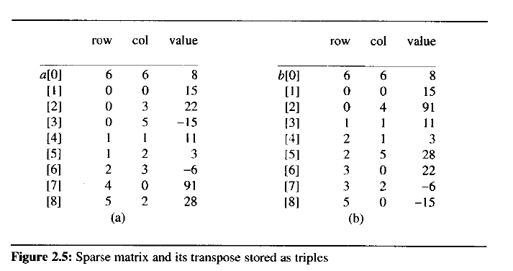
• a[0].row contains the number of rows; a[0].col contains number of columns and a[0].value contains the total number of nonzero entries.

Slide 52
TRANSPOSING A MATRIX
• To transpose a matrix, we must interchange the rows and columns.
• Each element a[i][j] in the original matrix becomes element b[j][i] in the transpose matrix.
• Algorithm To transpose a matrix:
for all elements in column j
place element <i,j,value>
in element <j,i,value>
Transpose analysis
Outer for loop is iterated a [0].col times
a [0].col holds the number of columns in the original matrix
In addition, one iteration of the inner for loop requires a [0].value time, where a [0].value holds the number of elements in the original matrix.
Total time for the nested for loops is columns • elements. Hence, the asymptotic time complexity is O(columns • elements).

Slide 53
TRANSPOSE OF A SPARSE MATRIX
void transpose (term a[], term b[])
{
/* b is set to the transpose of a */
int n, i, j, currentb;
n = a[0].value; /* total number of elements */ b[0].row = a[0].col; /* rows in b = columns in a */ b[0].col = a[0].row; /*columns in b = rows in a */ b[0].value = n;
if (n > 0)
{ /*non zero matrix */
currentb = 1;
for (i = 0; i < a[0].col; i++) /* transpose by columns in a */
for( j = 1; j <= n; j++) /* find elements from the current column */
if (a[j].col == i)
{ /* element is in current column, add it to b */
b[currentb].row = a[j].col;
b[currentb].col = a[j].row;
b[currentb].value = a[j].value;
currentb++
} } }

Slide 54
TRANSPOSE OF A SPARSE MATRIX
void transpose (term a[], term b[]) {
This function performs the transpose of a sparse matrix.
a[] is the input sparse matrix (represented as an array of term structs).
b[] will store the transposed matrix.
Each element (or "term") in the array represents a non-zero element of the matrix, with:
row: row index
col: column index
value: the actual value
/* b is set to the transpose of a */
int n, i, j, currentb;
These are local variables used in the function:
n: Number of non-zero elements in matrix a.
i, j: Loop counters.
currentb: Index in matrix b[] where the next transposed term will be inserted.
n = a[0].value;
The 0th index (i.e., a[0]) stores metadata about the matrix:
a[0].value → total number of non-zero elements in the matrix a.
b[0].row = a[0].col;
b[0].col = a[0].row;
b[0].value = n;
In a transpose: Rows and columns are swapped
b[0].row ← a[0].col
b[0].col ← a[0].row
b[0].value ← same number of non-zero elements n

Slide 55
if (n > 0)
If n == 0, the matrix is all zeros, nothing to transpose.
Only proceed if there are actual elements to work with.
{
currentb = 1;
currentb keeps track of the next empty spot in array b[] where a transposed element will be stored.
We start at 1 (since b[0] is metadata).
for (i = 0; i < a[0].col; i++) /* transpose by columns in a */
i represents a column number in matrix a.
We iterate over all columns of a.
for( j = 1; j <= n; j++) /* find elements from the current column */
j goes from 1 to n, scanning all non-zero elements in a.
Remember: elements start from index 1, not 0.
if (a[j].col == i)
Check if current term in a[j] is in the current column i.
If yes, we transpose this term.
{ /* element is in current column, add it to b */
b[currentb].row = a[j].col;
b[currentb].col = a[j].row;
b[currentb].value = a[j].value;
Swap the row and column for transpose:
row ← col
col ← row
Keep the value same.
currentb++; //Move to next empty slot in b[] to store the next transposed term.
} } }

Slide 56
What is Fast Transpose?
A sparse matrix is mostly zeros. Instead of storing all elements, we store only the non-zero terms in a compact format
typedef struct {
int row;
int col;
int value;
} term;
The transpose of a matrix flips rows and columns. Fast transpose does this efficiently by:
Counting non-zero elements per column.
Calculating where each transposed element should go.
Placing them directly without scanning repeatedly.

Slide 57
#include <stdio.h>
#define MAX_TERMS 100
#define MAX_COL 10
typedef struct
{ int row;
int col;
int value;} term;
void fast_transpose(term a[], term b[])
{
int row_terms[MAX_COL], starting_pos[MAX_COL];
int i, j;
int num_cols = a[0].col;
int num_terms = a[0].value;
//Set the Metadata
b[0].row = num_cols;
b[0].col = a[0].row;
b[0].value = num_terms;

Slide 58
if (num_terms > 0) {
for (i = 0; i < num_cols; i++)
row_terms[i] = 0;
for (i = 1; i <= num_terms; i++)
row_terms[a[i].col]++;
starting_pos[0] = 1;
for (i = 1; i < num_cols; i++)
starting_pos[i] = starting_pos[i - 1] + row_terms[i - 1];
for (i = 1; i <= num_terms; i++) {
j = starting_pos[a[i].col]++;
b[j].row = a[i].col;
b[j].col = a[i].row;
b[j].value = a[i].value;
}
}
}

Slide 59
void print_matrix(term m[]) {
printf("\nSparse Matrix Representation:\n");
printf("Index\tRow\tCol\tValue\n");
for (int i = 0; i <= m[0].value; i++)
{
printf("%d\t%d\t%d\t%d\n", i, m[i].row, m[i].col, m[i].value);
}
}
int main()
{
term a[MAX_TERMS] = {
{6, 6, 8}, // Metadata: 6x6 matrix with 8 non-zero terms
{0, 0, 15},
{0, 3, 22},
{0, 5, -15},
{1, 1, 11},
{1, 2, 3},
{2, 3, -6},
{4, 0, 91},
{5, 2, 28}
};

Slide 60
term b[MAX_TERMS]; // Transposed matrix
printf("Original Matrix:");
print_matrix(a);
fast_transpose(a, b);
printf("\nTransposed Matrix:");
print_matrix(b);
return 0;
}

Slide 61
for (i = 1; <= num_terms; i++) {
j = starting_pos [a[ i ]. col ]++;
b[j].row = a[i].col;
b[j].col = a[i].row;
b[j].value = a[i].value;
}
}
Breakdown:
For each term in a:
Use its column (a[i].col) to determine which row it will go to in b.
Use startingPos to find exact position in b array.
Swap row and column.
Copy the value.
After placing it, increment startingPos to point to the next empty slot for that row.

Slide 62
Pattern matching :
Consider two strings str and pat where,
pat is a pattern to be searched for in str.
The easiest way to find if the pat is in str is by using the built in function strstr.
Common Usage of Pattern Matching :
Text Editors and word processors : Find and Replace
Search Engines : When a user enters a query, search engines utilize sophisticated string-matching algorithms to find relevant web pages and documents
Spam Filters: Email services employ string matching to identify and filter out unwanted or malicious emails (spam).
Plagiarism Detection: Software designed to detect plagiarism uses string matching to compare a submitted document against a vast database of existing texts
Spell Checkers and Autocorrect: These tools use string matching to compare typed words against a dictionary of correctly spelled words.

Slide 63
Common pattern matching algos:
Brute force/Basic/Naïve - O(M*N)
KMP(Knuth Morris Pratt - O(M+N)
Boyer Moore
Rabin Karp
STRSTR – The built in function for pattern matching
Example: If we have a declaration as follows
Char pat[max_size], str[max_size], *t;
The pattern matching can be carried out as follows
if((t= strstr(str,pat))
Printf(“The pattern found in the string is %s”,t);
Else
Printf(“ The pattern was not found”);
The call (t = strstr(string,pat)) returns a null pointer if pat is not in string. If pat is in string, t holds a pointer to the start of pat in string. The entire string beginning at position t is printed out.

Slide 64
Although strstr seems ideally suited to pattern matching,
there are two reasons why we may want to develop our own pattern matching function:
The function strstr is new to ANSI C. Therefore, it may not be available with the compiler we are using.
There are several different methods for implementing a pattern matching function. The easiest but least efficient method sequentially examines each character of the string until it finds the pattern or it reaches the end of the string.
If pat is not in string, this method has a computing time of O(n ■ m)
n is the length of pat and
m is the length of string.

Slide 65
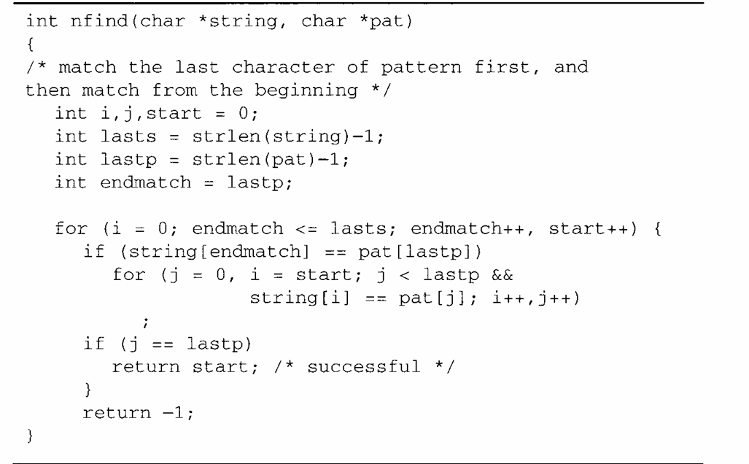
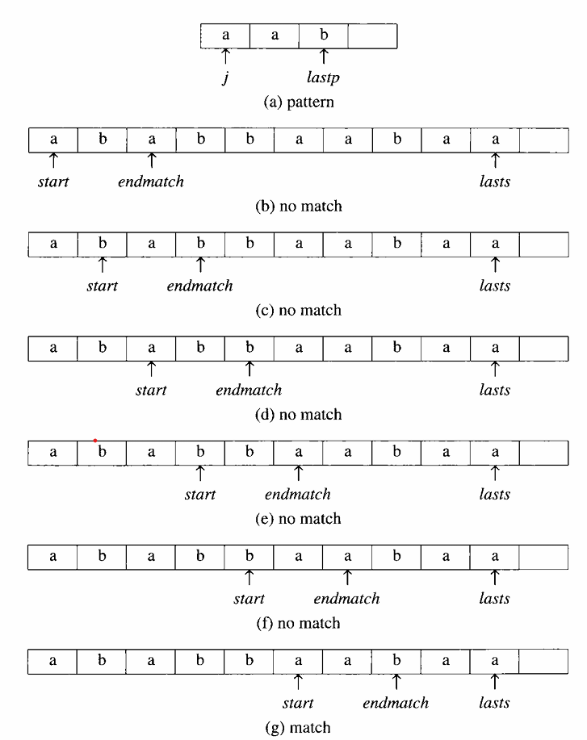

Slide 66
First nfind compares string [endmatch] and pat [lastp]. If they match, nfind uses i and j to move through the two strings until a mismatch occurs or until all of pat has been matched. The variable start is used to reset i if a mismatch occurs.
Analysis of nfind - If we apply nfind to string = "aa • • • a" and pat = "a • • • ab", then the computing time for these strings is linear in the length of the string O(m), which is certainly far better than the sequential method. Although the improvements we made over the sequential method speed up processing on the average, the worst-case computing time is still O(n• m).
Note : Why j==lastp – gives successful pattern matching,
The loop checks j<lastp, so it verifies all the characters except the last one.
String | A | B | C | D | A | B | C | A | B | C | D | F
Pattern | A | B | C | D | F

Slide 67
KMP Alogrithm
Effective algorithm that works in O(strlen (string) + strlen(pat)) time. This is optimal for this problem as in the worst case it is necessary to look at all characters in the pattern and string at least once. We want to search the string for the pattern without moving backwards in the string. That is, if a mismatch occurs, we want to use our knowledge of the characters in the pattern and the position in the pattern where the mismatch occurred to determine where we should continue the search. Knuth, Morris, and Pratt have developed a pattern matching algorithm that works in this way and has linear complexity.
pat = ‘a b c d a b c’
Prefix = a, ab, abc, abcd…
Suffix = c, bc, abc, dabc….

Slide 68
KMP Alogrithm
Pie table or LPS table(Longest prefix same as Suffix) or failure computation
Will find out if pattern is present in the string,x1 using KMP algorithm
Steps :
Identify the pattern and create a pie table or LPS table or failure computation
Start matching the pattern by assigning i to the start of the string
And assign j to the 0th position of the pattern
Compare i and j+1 characters and continue with the pattern matching
If character matched, i and j pointer increments.
If character not matching, backtrack of i should not happen in KMP algorithm instead keep i pointer intact(in same position) and move j to the value assigned to the current character pointed and continue comparing i and j+1 series.
When j cannot be further bracktracked to the value, then i will be incremented.
A | B | C | D | A | B | E | A | B | F
0 | 0 | 0 | 0 | 1 | 2 | 0 | 1 | 2 | 0

