Slide 1
DATA STRUCTURES AND APPLICATIONS
Module - 1

Slide 2
TextBooks
Textbook:
1. Ellis Horowitz, Sartaj Sahni and Susan Anderson-Freed, Fundamentals of Data Structures in C, 2nd Ed, Universities Press, 2014
Reference Books:
1. Seymour Lipschutz, Data Structures Schaum's Outlines, Revised 1st Ed, McGraw Hill,
2014.
2. Gilberg & Forouzan, Data Structures: A Pseudo-code approach with C, 2nd Ed, Cengage
Learning,2014.
3. Reema Thareja, Data Structures using C, 3rd Ed, Oxford press, 2012.
4. Jean-Paul Tremblay & Paul G. Sorenson, An Introduction to Data Structures with
Applications, 2nd Ed, McGraw Hill, 2013
5. A M Tenenbaum, Data Structures using C, PHI, 1989
6. Robert Kruse, Data Structures and Program Design in C, 2nd Ed, PHI, 1996.

Slide 3
TopICS
INTRODUCTION TO DATA STRUCTURES:
Data Structures
Classifications (Primitive & Non-Primitive)
Data structure Operations
Review of pointers and dynamic Memory Allocation
ARRAYS and STRUCTURES:
Arrays
Dynamic Allocated Arrays
Structures and Unions
Polynomials
Sparse Matrices
representation of Multidimensional Arrays
Strings
STACKS: Stacks
Stacks Using Dynamic Arrays
Evaluation and conversion of Expressions

Slide 4
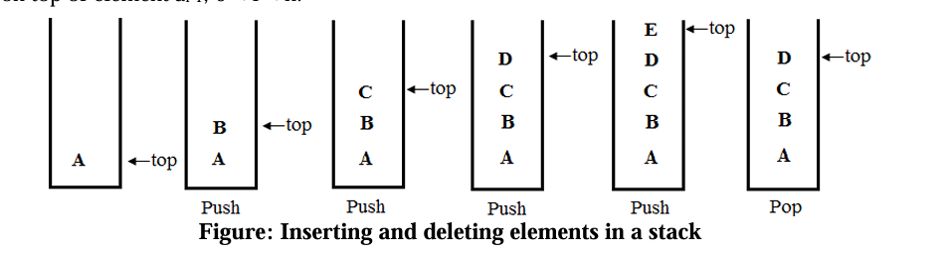
STACKS
“A stack is an ordered list in which insertions (pushes) and deletions (pops) are made at one end called the top.” Given a stack S= (a0, ... ,an-1), where a0 is the bottom element, an-1 is the top element, and ai is on top of element ai-1, 0 < i < n.
Since the last element inserted into a stack is the first element removed, a stack is also known as a Last-In-First-Out (LIFO) list.

Slide 5
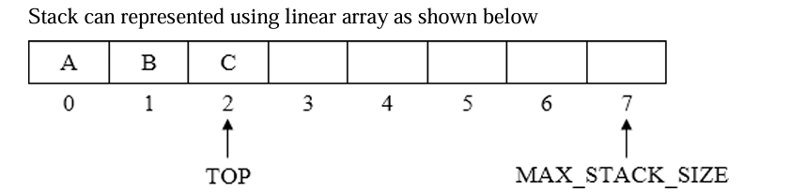
ARRAY REPRESENTATION OF STACKS
• Stacks may be represented in the computer in various ways such as one-way linked list (Singly linked list) or linear array.
• Stacks are maintained by the two variables such as TOP and MAX_STACK_ SIZE.
• TOP which contains the location of the top element in the stack. If TOP= -1, then it indicates stack is empty.
• MAX_STACK_SIZE which gives maximum number of elements that can be stored in stack.

Slide 6
STACK OPERATIONS
Implementation of the stack operations as follows.
Stack Create
Stack CreateS(maxStackSize )::=
#define MAX_STACK_ SIZE 100 /* maximum stack size*/ typedef struct { int key;
/* other fields */
} element;
element stack[MAX_STACK_SIZE]; int top = -1;
The element which is used to insert or delete is specified as a structure that consists of only a key field.
2. Boolean IsEmpty(Stack)::= top < 0;

Slide 7
3. Boolean IsFull(Stack)::= top >= MAX_STACK_SIZE-1; The IsEmpty and IsFull operations are simple, and is implemented directly in the program push and pop functions. Each of these functions assumes that the variables stack and top are global.
4. Push( ) Function push checks whether stack is full. If it is, it calls stackFull( ), which prints an error message and terminates execution. When the stack is not full, increment top and assign item to stack [top].
void push(element item)
{ /* add an item to the global stack */
if (top >= MAX_STACK_SIZE-1)
stackFull();
stack[++top] = item;
}

Slide 8
5. Pop( ) Deleting an element from the stack is called pop operation. The element is deleted only from the top of the stack and only one element is deleted at a time.
element pop ( )
{ /*delete and return the top element from the stack */
if (top == -1)
return stackEmpty(); /*returns an error key */
return stack[top--];
}
6. stackFull( ) The stackFull which prints an error message and terminates execution.
void stackFull() { fprintf(stderr, "Stack is full, cannot add element"); exit(EXIT_FAILURE); }

Slide 9
STACKS USING DYNAMIC ARRAYS
The array is used to implement stack, but the bound (MAX_STACK_ SIZE) should be known during compile time. The size of bound is impossible to alter during compilation hence this can be overcome by using dynamically allocated array for the elements and then increasing the size of array as needed. Stack Operations using dynamic array
Stack CreateS( )::=
typedef struct { int key; /* other fields */ }
element; element *stack;
MALLOC(stack, sizeof(*stack));
int capacity= 1;
int top= -1;

Slide 10
2. Boolean IsEmpty(Stack)::= top < 0;
3. Boolean IsFull(Stack)::= top >= capacity-1;
4. push()
Here the MAX_STACK_SIZE is replaced with capacity void push(element item) { /* add an item to the global stack */
if (top >= capacity-1)
stackFull();
stack[++top] = item; }
5. pop( ) In this function, no changes are made.
element pop ( )
{ /* delete and return the top element from the stack */
if (top == -1)
return stackEmpty(); /* returns an error key */
return stack[top--]; }

Slide 11
6. stackFull( ) The new code shown below, attempts to increase the capacity of the array stack so that new element can be added into the stack. Before increasing the capacity of an array, decide what the new capacity should be. In array doubling, array capacity is doubled whenever it becomes necessary to increase the capacity of an array. void stackFull()
{
REALLOC (stack, 2*capacity*sizeof(*stack));
capacity *= 2;
}

Slide 12
Stack full with array doubling
Analysis In the worst case, the realloc function needs to allocate 2*capacity*sizeof (*stack) bytes of memory and copy capacity *sizeof (*stack)) bytes of memory from the old array into the new one. Under the assumptions that memory may be allocated in O(1) time and that a stack element can be copied in O(1) time, the time required by array doubling is O(capacity). Initially, capacity is 1.
Suppose that, if all elements are pushed in stack and the capacity is 2k for some k, k>O, then the total time spent over all array doublings is O(∑ 𝒌 𝟐𝒊 𝒊=𝟏 ) = O(2k+l) = O(2k). Since the total number of pushes is more than 2k-1, the total time spend in array doubling is O(n), where n is the total number of pushes. Hence, even with the time spent on array doubling added in, the total run time of push over all n pushes is O(n).

Slide 13
STACK APPLICATIONS: POLISH NOTATION
Expressions: It is sequence of operators and operands that reduces to a single value after evaluation is called an expression.
Example Expression
X = a / b – c + d * e – a * c
Operators: +, –, /, *
Operands: a, b, c, d, e
Real-time application usage:
Compilers and Interpreters
Expression Evaluation in Calculators
Virtual Machines & Bytecode Execution
Syntax Parsing in Programming Languages

Slide 14
Expression Formats
Prefix (Polish) | Infix | Postfix (Reverse Polish)
The operator appears before its operands. Example: + A B | The binary operator is placed in-between the operands. Example: A + B | The operator appears after its operands. Example: A B +

Slide 15
The Problem of Precedence
The first problem with understanding the meaning of expressions and statements is finding out the order in which the operations are performed.
Example: X = a / b – c + d * e – a * c
Assume a=4, b=c=2, d=e=3. The result depends entirely on the evaluation order.
With Standard Precedence
((4/2)-2) + (3*3) - (4*2)
= 0 + 9 - 8
= 1
With Different Grouping
(4 / (2-2+3)) * (3-4) * 2
= (4/3) * -1 * 2 ≈ -2.67

Slide 16
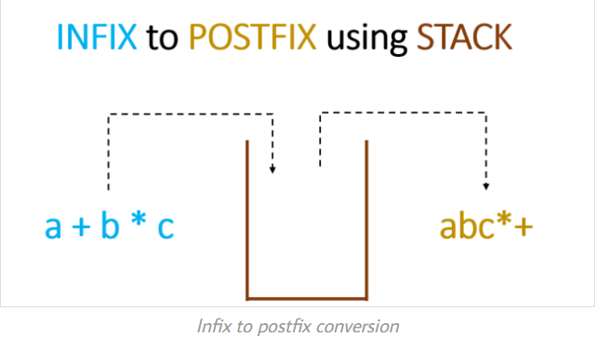
Infix to Postfix Conversion: A Simple Algorithm
Step 1: Fully parenthesize the expression based on precedence.
Step 2: Move all binary operators so that they replace their corresponding right parentheses.
Step 3: Delete all parentheses.
Example
Infix: a/b-c+d*e-a*c
Parenthesized: (((a/b)-c)+((d*e))-(a*c))
Postfix: ab/c-de*+ac*-

Slide 17
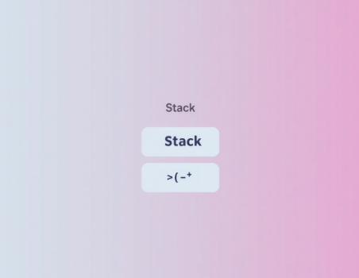
A More Robust Method: Stack-Based Conversion
A simple algorithm can be difficult. A more robust scheme uses a stack to handle operators and parentheses based on their precedence.
Scan the infix expression from left to right.
If an operand is found, add it to the postfix string.
If an operator is found, push it to the stack after handling precedence.
Parentheses have special handling rules.

Slide 18
In-Stack vs. Incoming Precedence
To correctly manage the operator stack, we differentiate between the precedence of an operator already on the stack versus one we are about to add.
In-Stack Precedence (isp) The precedence of an operator that is already on the stack. A left parenthesis on the stack has very low precedence, so it isn't popped by other operators. | Incoming Precedence (icp) The precedence of an operator from the input expression. An incoming left parenthesis has the highest precedence to ensure it's always pushed onto the stack.

Slide 19
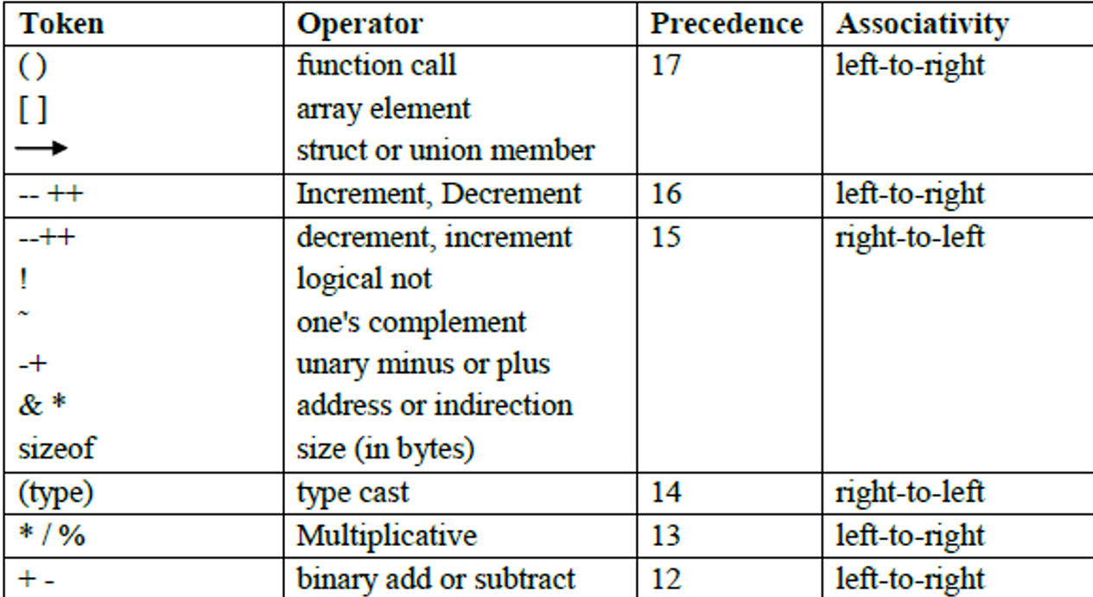
In-Stack vs. Incoming Precedence

Slide 20
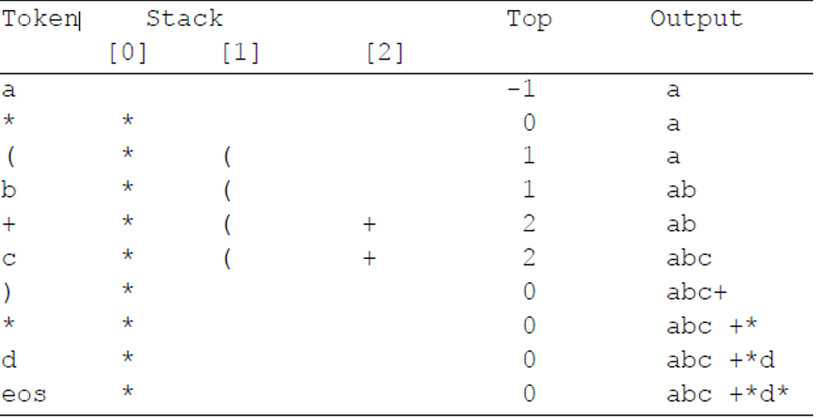
In-Stack vs. Incoming Precedence
Rule 1 : if opening parenthesis, can directly push operator to the stack
Rule 2 : if closing parenthesis, have to pop out all the operators one by one until we get opening parenthesis.

Slide 21
The Postfix Conversion Algorithm Logic
The algorithm processes each token from the infix expression:
If token is an operand: output it.
If token is a right parenthesis: pop from stack and output until a left parenthesis is found. Discard both parentheses.
If token is an operator: while the top of the stack has `isp >= icp` of the current token, pop and output. Then, push the current token onto the stack.
At the end of the expression: pop and output all remaining items from the stack.

Slide 22
Precendence getToken(char *symbol, int *n)
{/*get the next token, symbol is the character representation, which is returned, the token is represented by its enumerated value, which is returned in the function name*/
*symbol=expr[(*n)++];
switch(*symbol)
{ case ‘(‘: return lparen;
case ‘)‘: return rparen;
case ‘+‘: return lparen;
case ‘-‘: return minus;
case ‘/‘: return divide;
case ‘*‘: return times;
case ‘%‘: return mod;
case ‘ ‘: return eos;
default: return operand;
} }

Slide 23
The declarations that establish the precedence’s are: /* isp and icp arrays-index is value of precedence lparen rparen, plus, minus, times, divide, mod, eos */
int isp[] = {0,19,12,12,13,13,13,0};
int icp[] = {20,19,12,12,13,13,13,0};
isp: in-stack precedence — precedence of operators already on the stack.
icp: incoming precedence — precedence of the current token being read.
void postfix(void)
{
char symbol; precedence token;
int n = 0,top = 0; /* place eos on stack */
stack[0] = eos;
symbol: holds the current character from the expression.
token: holds the type of symbol (operand, operator, etc.).
n: index for reading the expression.
top: top of the stack.
stack[0] = eos: initialize stack with end-of-string marker.

Slide 24
for (token = getToken(&symbol, &n); token != eos; token = getToken(&symbol,& n))
//If token is operand(A,B,C,D..) then just print it
{if (token == operand)
printf("%c", symbol);
else if (token == rparen)
{ while (stack[top] != lparen)
printToken(pop( ));
pop( ); }
else {
while(isp[stack[top]] >= icp[token])
printToken(pop());
push(token);
} }
while((token = pop ())!= eos)
printToken(token);
printf("\n");
}

Slide 25
EVALUATION OF POSTFIX EXPRESSION
• The evaluation process of postfix expression is simpler than the evaluation of infix expressions because there are no parentheses to consider.
• To evaluate an expression, make a single left-to-right scan of it. Place the operands on a stack until an operator is found. Then remove from the stack, the correct number of operands for the operator, perform the operation, and place the result back on the stack and continue this fashion until the end of the expression. We then remove the answer from the top of the stack.

Slide 26
Symbol | Action | Stack
3 | Push 3 | 3
5 |  | 3,5
7 | Push 7 | 3,5,7
4 | Push 4 | 3,5,7,4
- | Pop 4 and 7
 | Push 7 – 4 | 3,5,3
2 | Push 2 | 3,5,3,2
^ | Push 2 and 3
 | Push 3 ^ 2 | 3,5,9
* | Pop 9 and 5
 | Push 5 * 9 | 3,45
+ | Push 45,3 | 48
int eval(void)
{ precedence token;
char symbol;
int opl,op2, n=0;
int top= -1;
token = getToken(&symbol, &n);
while(token! = eos) {
if (token == operand)
push(symbol-'0'); /* stack insert */
else
{ op2 = pop(); /* stack delete */
opl = pop();
switch(token) {
case plus: push(opl+op2); Ex : 3574-2^*+
break;
case minus: push(opl-op2); 3574-2^*+
break;
case times: push(opl*op2);
break;

Slide 27
case divide: push(opl/op2);
break;
case mod: push(opl%op2);
break;
} }
token = getToken(&symbol, &n); }
return pop(); /* return result */ }
Program: Function to get a token from the input string
precedence getToken(char *symbol, int *n)
{ *symbol = expr[(*n)++];
switch (*symbol)
{ case '(‘ : return lparen;
case ')’ : return rparen;
case '+’ : return plus;
case '-’ : return minus;
case '/’ : return divide;
case '*’ : return times;
case '%’ : return mod;
case ' ‘ : return eos;
default: return operand; } }

Slide 28
• The function eval ( ) contains the code to evaluate a postfix expression. Since an operand (symbol) is initially a character, convert it into a single digit integer.
• To convert use the statement, symbol-'0'. The statement takes the ASCII value of symbol and subtracts the ASCII value of '0', which is 48, from it. For example, suppose symbol = '1. The character '1' has an ASCII value of 49. Therefore, the statement symbol-'0' produces as result the number 1.
• The function getToken( ), obtain tokens from the expression string. If the token is an operand, convert it to a number and add it to the stack. Otherwise remove two operands from the stack, perform the specified operation, and place the result back on the stack. When the end of expression is reached, remove the result from the stack.
5 6 2 + * 12 4 / -
Ex : Symbol = 3 then 51-48 = 3
ASCII Values : 0 = 48, 1=49, 2=50…..

Slide 29
A recursive procedure Suppose P is a procedure containing either a Call statement to itself or a Call statement to a second procedure that may eventually result in a Call statement back to the original procedure P. Then P is called a recursive procedure. So that the program will not continue to run indefinitely, a recursive procedure must have the following two properties: 1. There must be certain criteria, called base criteria, for which the procedure does not call itself. 2. Each time the procedure does call itself (directly or indirectly), it must be closer to the base criteria.

