Slide 1
IBM University Engagement Project Submission
“Exploring the Power of Agentic AI with IBM Granite and IBM Bob”

Slide 2

Project Tile – AI-Powered Telecom Training Assistant
Domain of Project – Education
Student Name | Recent Passport Photo | Email ID | Mobile number [WhatsApp]
Bhumika More |  | bhumikamore556@gmail.com | 8197303974

Slide 3
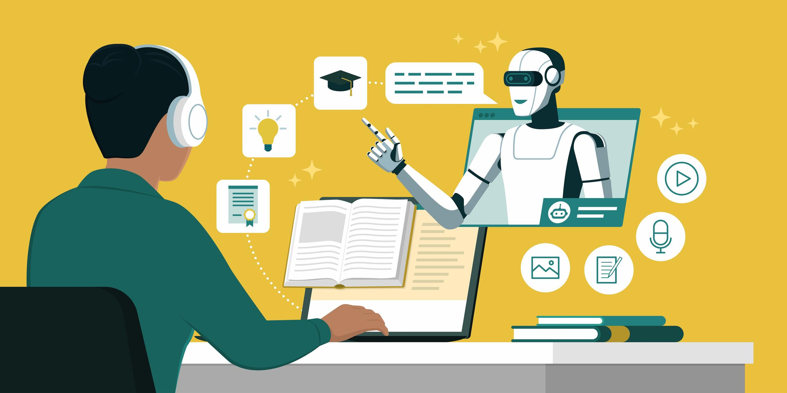
Problem Statement -
Problem Statement :
Students often struggle to understand complex telecommunication concepts through traditional learning resources. Existing materials such as textbooks and recorded lectures provide limited personalization and do not offer instant doubt resolution. An intelligent system is therefore required to provide interactive, document-based and personalized telecom learning.
The Challenge
Students often struggle to understand complex telecommunication concepts through traditional learning resources. Existing materials such as textbooks and recorded lectures provide limited personalization and do not offer instant doubt resolution. An intelligent system is therefore required to provide interactive, document-based and personalized telecom learning.
The Objective
Retrieve telecom knowledge using RAG
Provide instant answers using IBM Granite
Simplify complex telecom concepts
Generate AI-based quizzes
Provide interactive chatbot-based learning
Display relevant learning sources

Slide 4
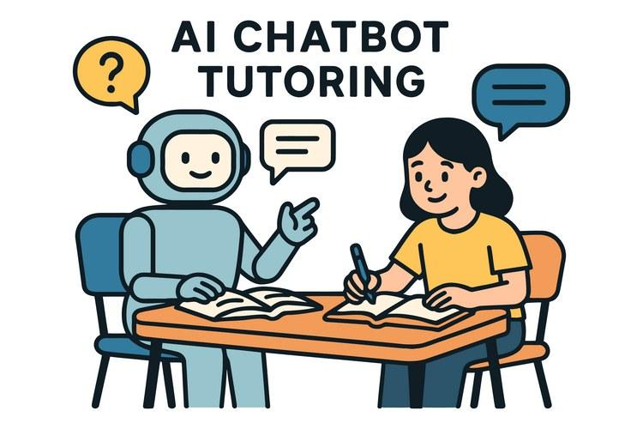
Proposed Solution -
Develop an AI-Powered Telecom Training Assistant using RAG and IBM Granite models.
Retrieve relevant information from uploaded telecom learning materials.
Provide simple and understandable explanations of complex telecom concepts.
Enable students to ask questions through an interactive chatbot and receive instant answers.
Generate topic-based quizzes to help students practice and assess their understanding.
Use Streamlit to provide an interactive and user-friendly learning interface.

Slide 5
Technology Used
Python – Core programming language for developing the application.
Streamlit – Used to build the interactive web interface and chatbot.
IBM Granite Models – Used for AI-based question answering, explanations, and quiz generation.
RAG (Retrieval-Augmented Generation) – Retrieves relevant information from telecom learning materials before generating answers.
Vector Database – Stores document embeddings and enables semantic retrieval of relevant content.
Embeddings – Converts telecom document content into vectors for similarity-based searching.
PDF Processing – Extracts text from uploaded telecom learning materials.
IBM Cloud Agentic Lab – Environment for working with IBM Granite models and AI capabilities.

Slide 6
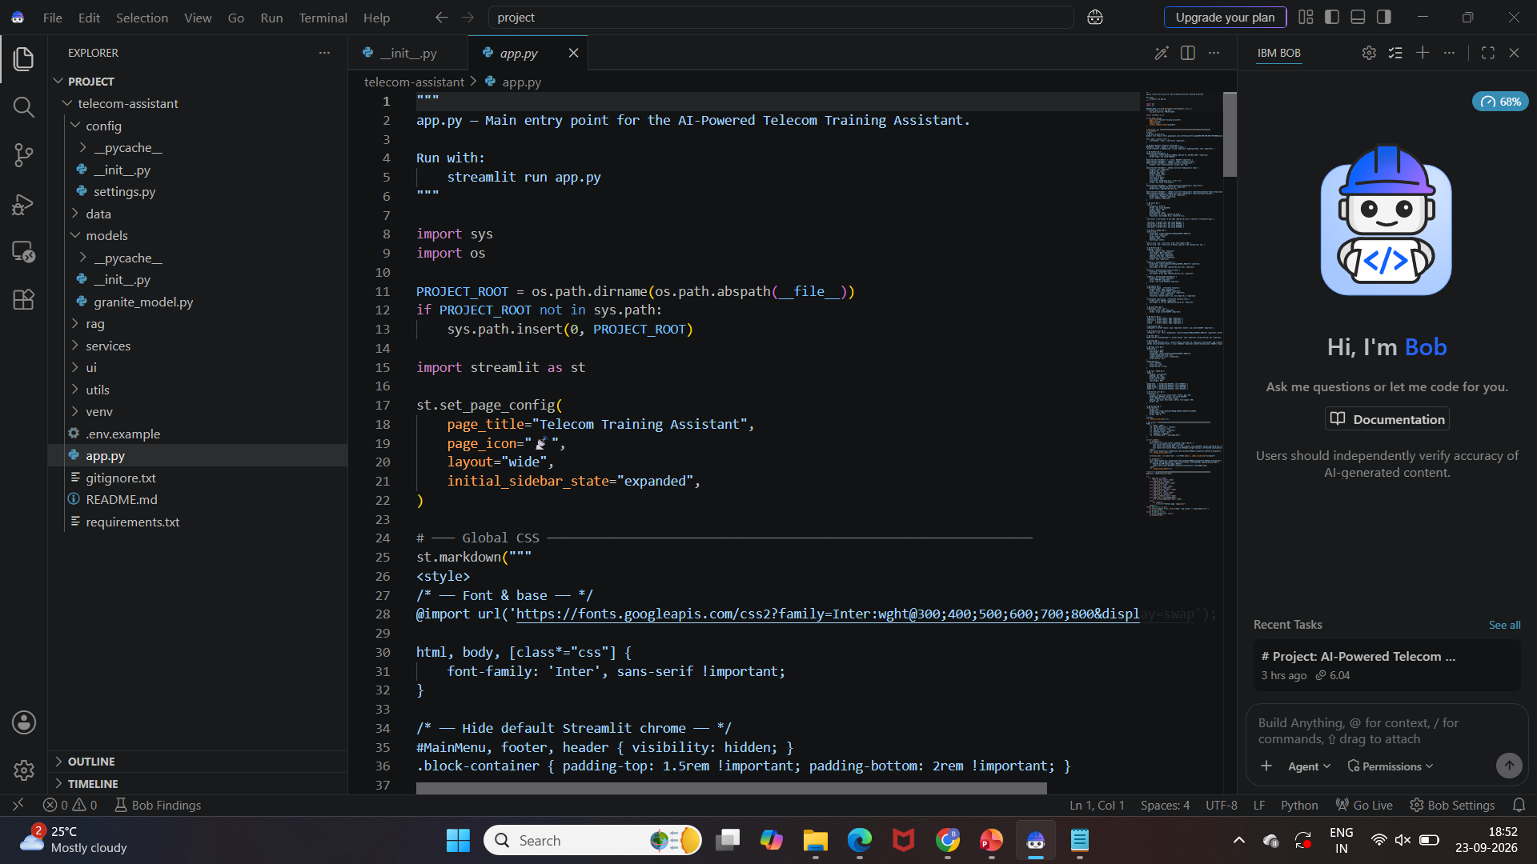
Required Files created using IBM bob -
App.py
Requirements.txt
.env etc

Slide 7
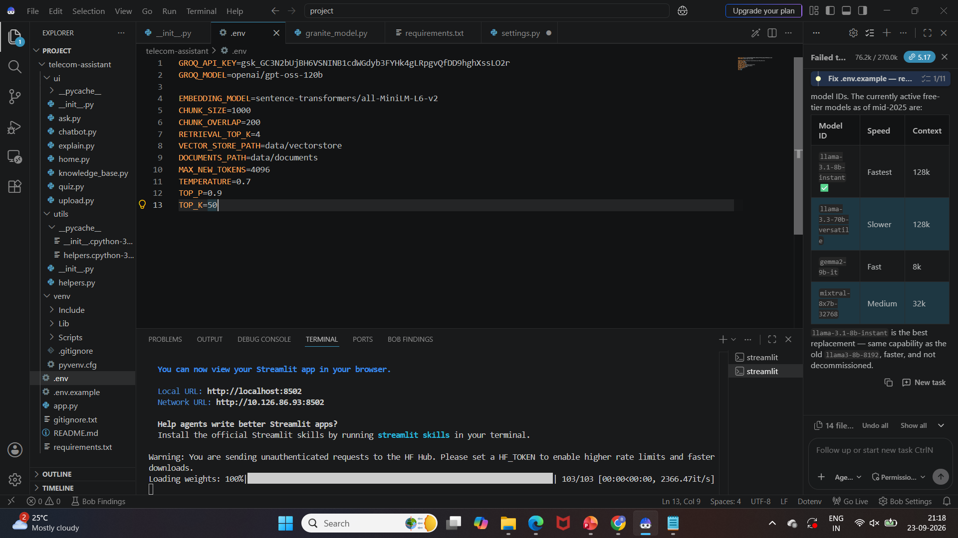
IBM Bob Screenshots:

Slide 8
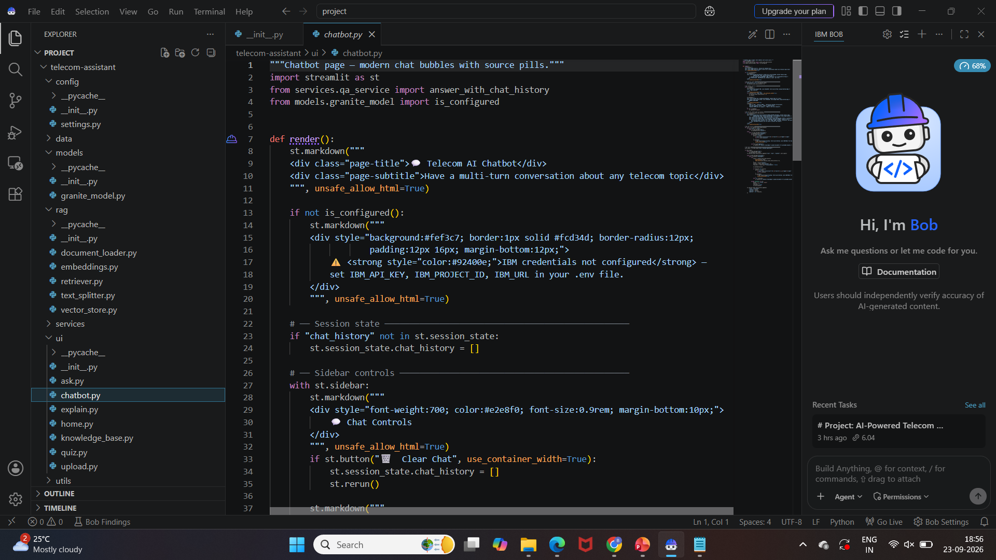

Slide 9
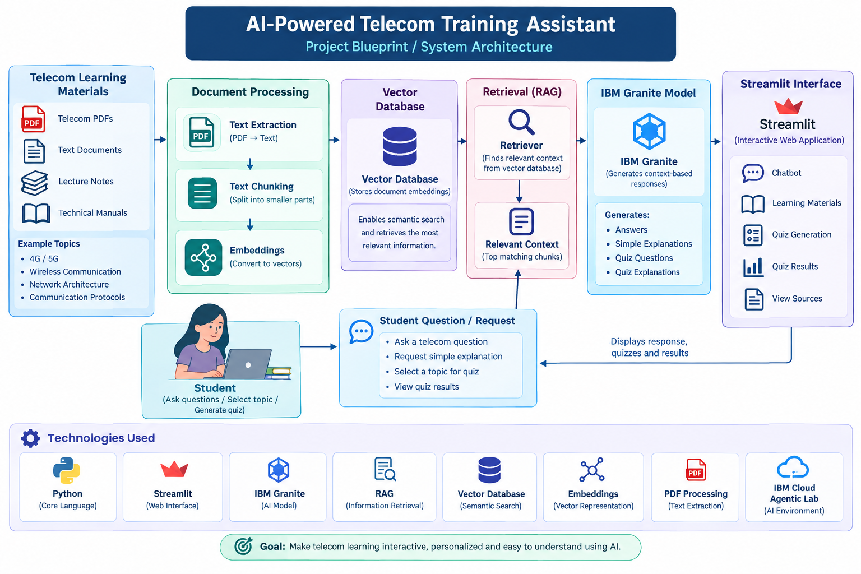
Blueprint-

Slide 10
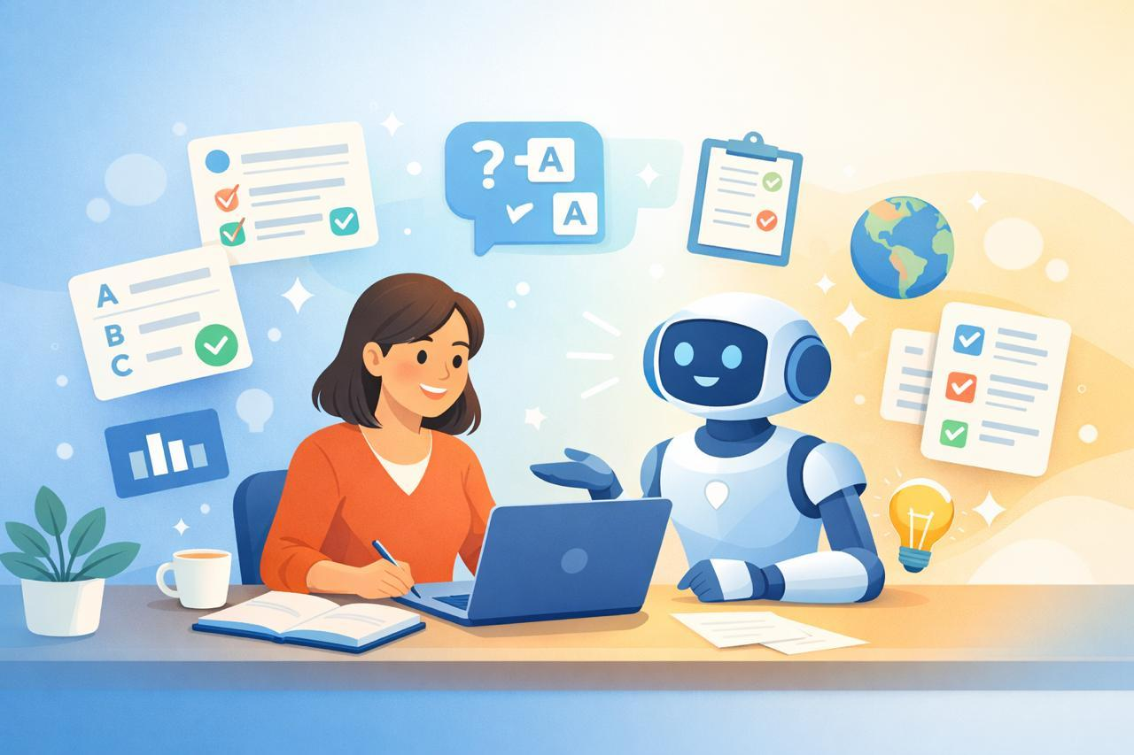
Role of Agentic AI in the solution
Understands Student Queries: Identifies what the student is asking about a telecom topic.
Retrieves Relevant Knowledge: Uses RAG to find relevant information from uploaded telecom learning materials.
Generates Answers: Uses IBM Granite to generate clear and context-based responses.
Simplifies Concepts: Converts complex telecom information into easy-to-understand explanations.
Generates Quizzes: Creates topic-based questions from the available learning materials.
Supports Interactive Learning: Allows students to continuously ask questions and learn through the chatbot.
Provides Source-Based Responses: Connects answers with the relevant retrieved learning material.

Slide 11
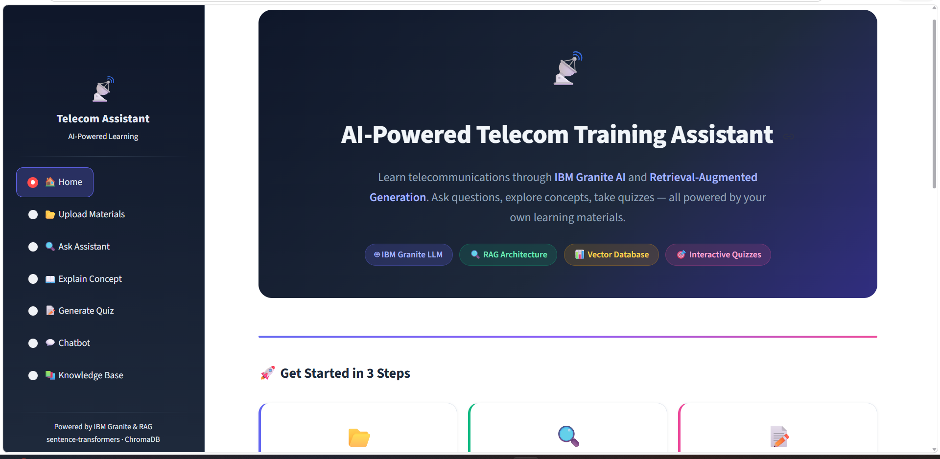
Project Output Screenshot
Please put IBM Bob output screenshots with 2-3 prompts.
You can take 2-3 more slides for each screenshot
·
·
·

Slide 12
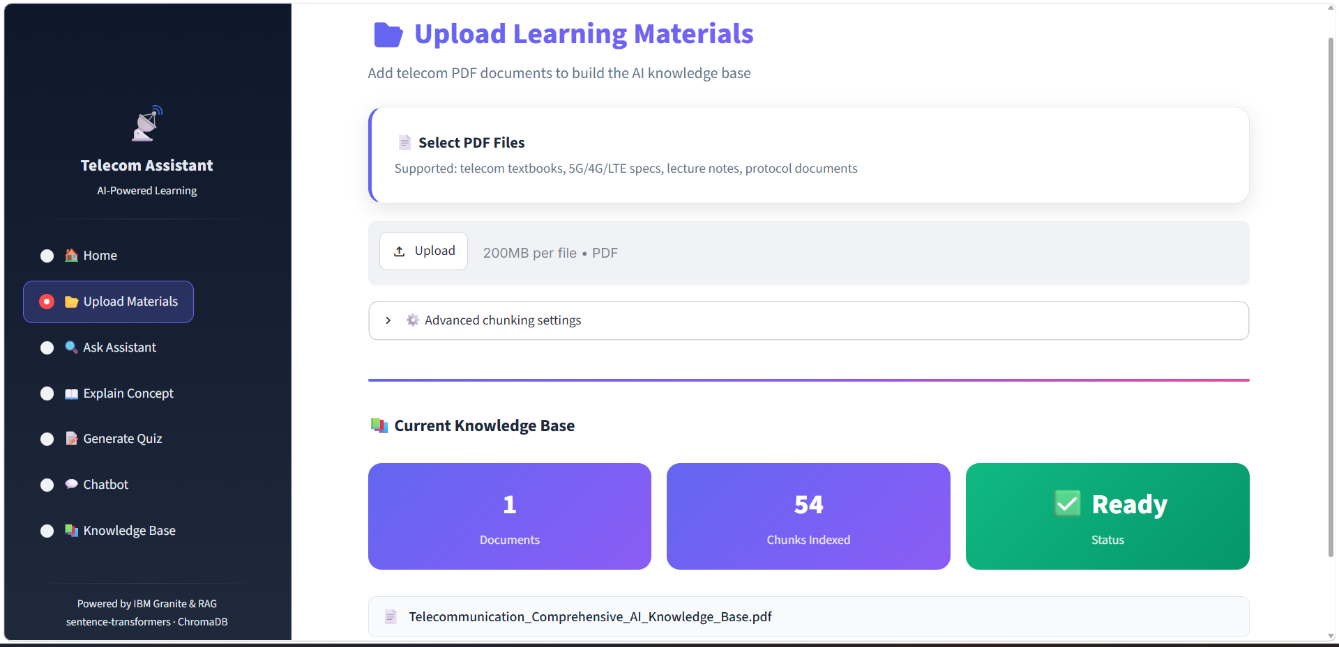

Slide 13
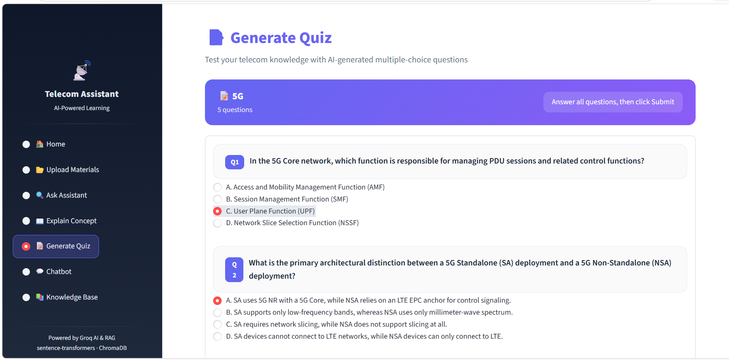
Please put IBM Bob output screenshots with 2-3 prompts.
You can take 2-3 more slides for each screenshot
·
·
·

Slide 14
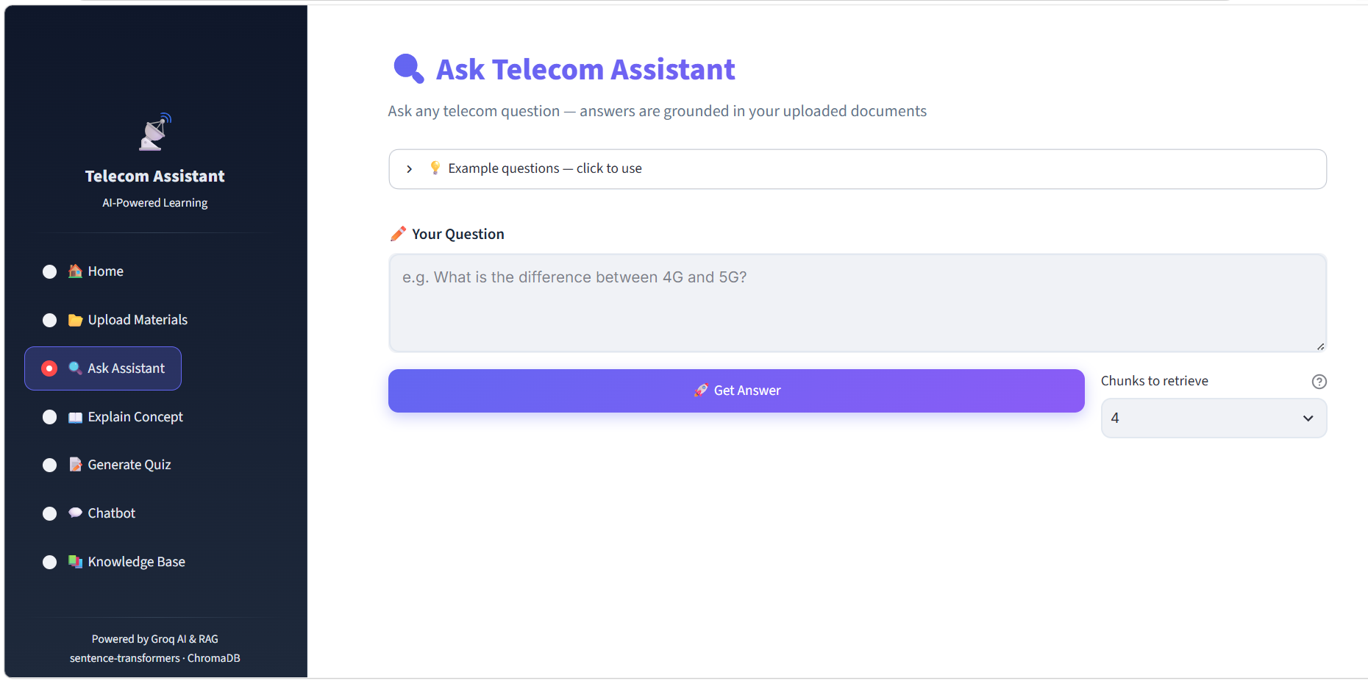

Slide 15
Novelty and Uniqueness
Telecom-Specific AI Assistant: Designed specifically for learning telecommunication concepts, rather than general-purpose question answering.
RAG-Based Learning: Retrieves information from uploaded telecom learning materials to provide context-based answers.
IBM Granite Integration: Uses IBM Granite models for explanations, question answering, and quiz generation.
Interactive Learning: Combines an AI chatbot with simplified explanations and quizzes in one platform.
Document-Based Knowledge: Allows students to learn directly from their own telecom PDFs and study materials.
Agentic Learning Approach: The AI can determine the relevant information needed to respond to different types of student learning requests.
Learning + Assessment: Integrates learning, doubt resolution, and self-assessment in a single system.

Slide 16
Git Hub Link
https://github.com/bhumikamore556/IBMBOB.git

Slide 17
Future Scope
Voice-Based Learning: Enable students to ask telecom questions using voice and receive spoken explanations.
Multilingual Support: Provide telecom explanations in regional languages for wider accessibility.
Personalized Learning Paths: Recommend topics and learning materials based on quiz performance.
Advanced 5G/6G Content: Extend the knowledge base to emerging 5G and 6G technologies.
Real-Time Telecom Data: Integrate live network information for advanced learning and analysis.
Adaptive Quizzes: Automatically adjust quiz difficulty according to the student's performance.
Mobile Application: Extend the assistant to Android and iOS for learning on the go.
Learning Analytics: Track student progress, frequently asked topics, quiz scores, and learning improvement.
·
·
·

Slide 18
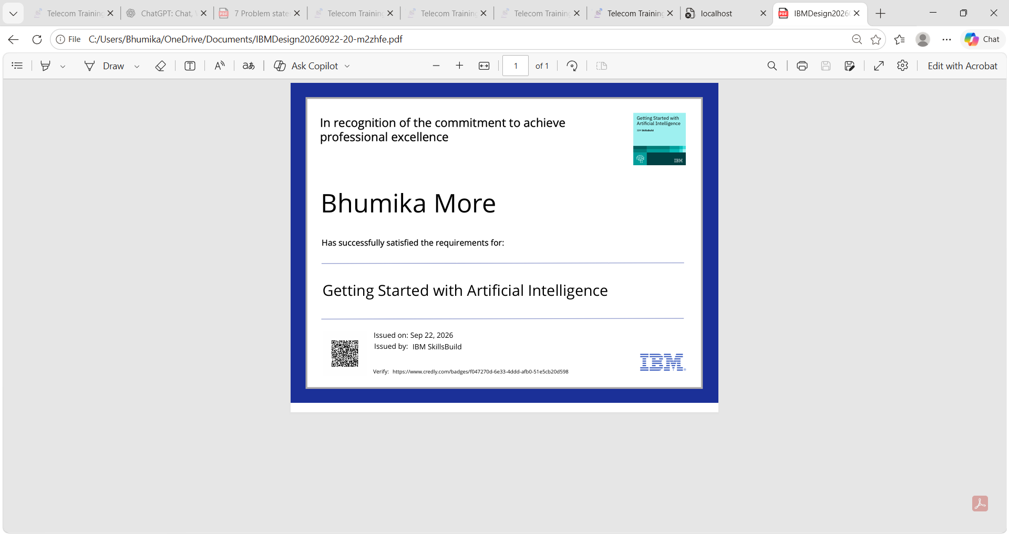
Certificates Earned:
Please add your credly certificate

Slide 19
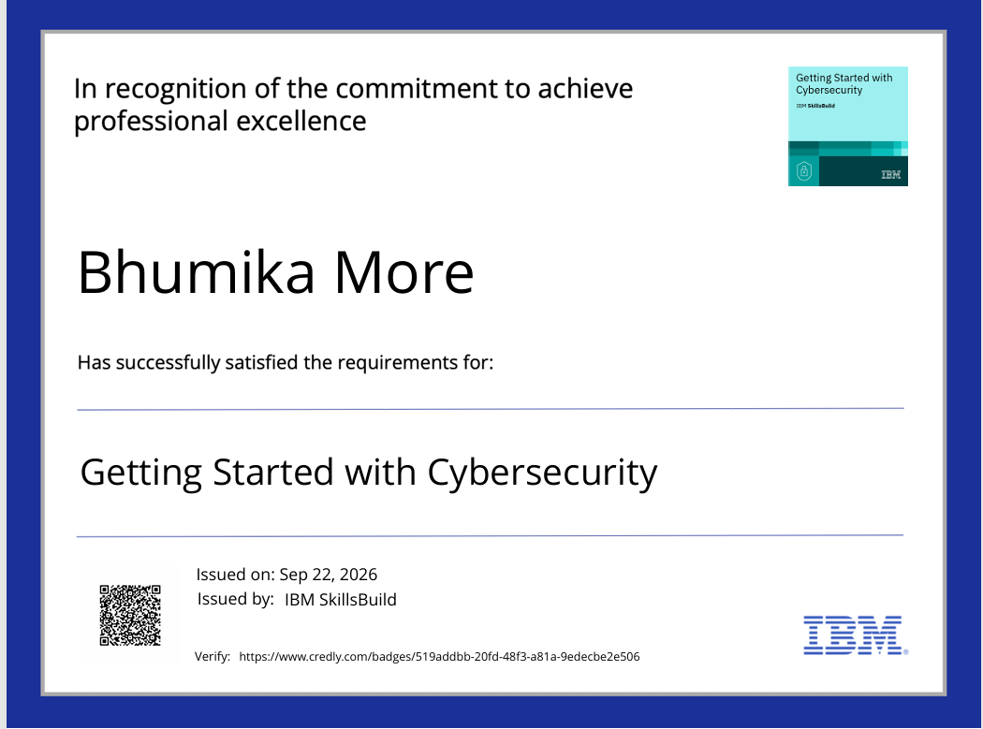

Slide 20
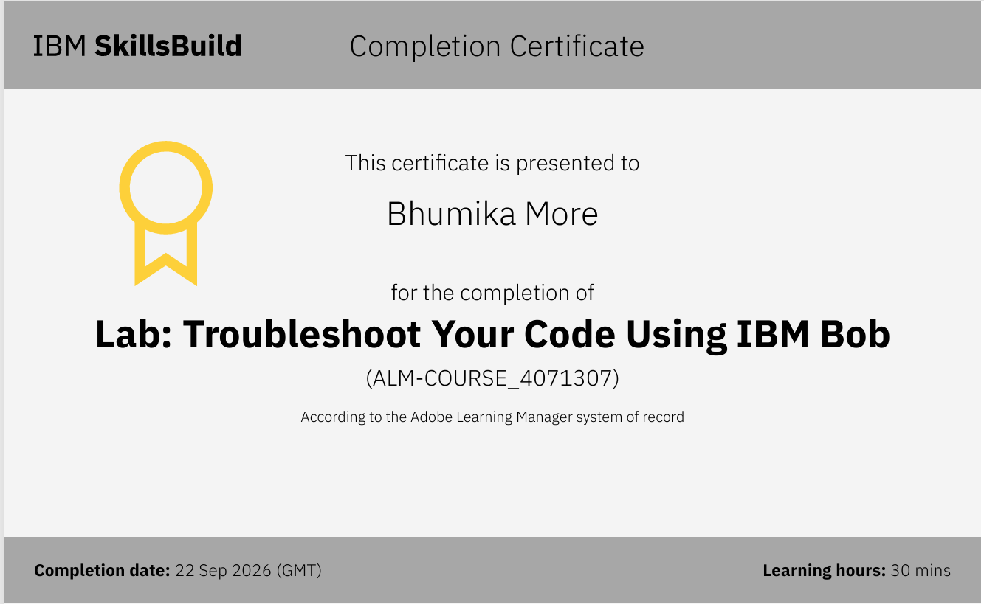
Certificates Earned:​
Add your IBM BOB Certificate

Slide 21


