Slide 2
EduQuiz: An Online Examination System
Submitted to:
Department of Computer Science and Engineering

Slide 3
Supervised by: Prof.Juhi Shrivastava
Team Members
1. Aadesh Garg
2. Aashish Pagare
3. Aman Verma
4. Bhumika Patidar

Slide 4
Project Presentation Outline
Introduction
Problem Statement
Survey of Existing Systems
Project Objectives
Requirement Analysis
Solution Proposed
Features
System architecture
User Interface
Testing Plan
The Outcome Discussion
Conclusions

Slide 5
Introduction
EduQuiz is an advanced online examination system developed to address the shortcomings of traditional examination methods. It offers a modern and efficient approach to conducting exams, catering to the needs of educators and students alike.
The motivation behind developing EduQuiz stems from the need to overcome the limitations of traditional examination systems. These systems often suffer from logistical challenges, security concerns, and scalability issues. EduQuiz aims to address these challenges.

Slide 6
The Problem Statement
In traditional examination systems, the process of conducting exams is plagued by inefficiencies and security vulnerabilities. Specifically, the lack of a reliable and scalable online examination platform hinders the educational institutions' ability to conduct exams efficiently and securely. Paper-based exams are cumbersome to manage and prone to errors, while manual grading processes are time-consuming and subjective.

Slide 7
Survey of Existing Systems
Moodle Quiz Module:
ProProfs Quiz Maker:
Addressed Problems: Online quizzes integrated with LMS.
Advantages: Seamless integration with course content.
Disadvantages: Limited customization, security.
Gaps: Lack of proctoring, analytics.
Link: Moodle Quiz Module
Addressed Problems: Online quiz creation, sharing.
Advantages: User-friendly, multimedia support.
Disadvantages: Limited administration.
Gaps: Advanced scheduling, integration.
Link: ProProfs Quiz Maker

Slide 8
Survey of Existing Systems
While existing systems offer a range of features, there are several gaps that need to be addressed:
Lack of real-time monitoring in most systems.
Limited scalability for large-scale exams.
Complexity in user interfaces.
Insufficient security measures.
Inflexibility in exam customization options.

Slide 9
Objectives
Develop a user-friendly and intuitive online examination system.
Ensure the security and integrity of the examination process.
Provide customizable features to meet the diverse needs of educators and students.
Enhance the scalability and reliability of the system.
Improve the overall learning experience for students.

Slide 10
Requirement Analysis
Functional Specifications:
Non Functional Specifications:
User registration and login.
Exam creation and editing.
Question bank management.
Real-time monitoring for cheating.
Seamless exam delivery.
Automatic grading and result generation.
Strong security measures.
Scalability for large user loads.
Fast performance with minimal latency.
Intuitive and user-friendly interface.
High reliability and availability.
Compatibility with various devices and browsers.

Slide 11
Solution Proposed: EduQuiz
EduQuiz is an online examination system designed for educational institutions. It features:
Backend: J2SE, J2EE, JSTL, JUnit.
Frontend: Twitter Bootstrap, Ajax, jQuery, JSON, CSS, HTML.
Database: MySQL.
Features:
User Interface: View subjects, practice MCQs, register for quizzes, view results.
Faculty Panel: Create/delete papers, view/update papers, view results, send notifications.
Admin Panel: Verify/delete students, verify/delete faculty, manage quizzes.

Slide 12
Features
Key Features of EduQuiz:
User-friendly interface
Comprehensive question bank management
Customizable exam settings
Security and integrity measures
Scalability and reliability
Notification system
Ease of management

Slide 13
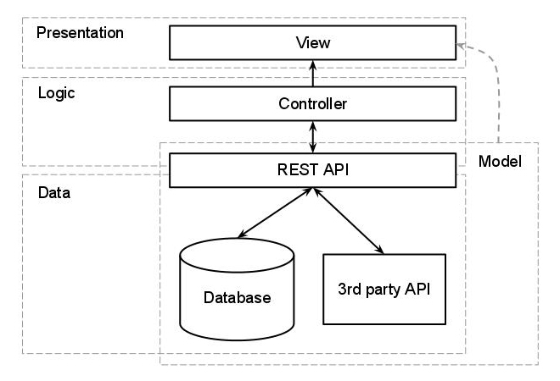
System Architecture
Client-Side:
Web interface: HTML, CSS, JS.
Server-Side:
Application, Database, Web servers.
Components:
Frontend: HTML/CSS/JS
Backend: Java.
Database: MySQL/PostgreSQL.
This Photo by Unknown Author is licensed under CC BY-SA

Slide 14
User Interface
EduQuiz provides distinct user interfaces tailored to three user roles: student, faculty, and admin.
Student Login:
Home: Dashboard with profile and subjects.
Subjects: Browse available subjects.
Results: View exam results.

Slide 15
User Interface
Faculty Login:
Home: Dashboard with profile and paper options.
Make Paper: Create new exam papers.
View Paper: Access and edit existing papers.
Admin Login:
Home: Dashboard with profile and user management.
Add/Delete: Register or remove users.

Slide 16
Testing Plans
Unit Testing:
Objective: Test individual components.
Tools: JUnit (backend), Jest (frontend).
Tests: Verify functions, methods, modules.
Integration Testing:
Objective: Test component interaction.
Tools: Selenium (frontend), Postman (backend).
Tests: Ensure frontend-backend communication.
System Testing:
Objective: Test entire system.
Tools: Manual testing.
Tests: End-to-end workflow validation.

Slide 17
The Outcome
Efficient Exam Management: Streamlined creation and management of exams.
Enhanced Student Experience: User-friendly interface, diverse subjects.
Improved Learning Outcomes: Instant feedback, detailed analytics.
Enhanced Security: Real-time monitoring, secure authentication.
Increased Productivity: Time-saving features, automated grading.

Slide 18
Conclusion
EduQuiz offers a comprehensive solution for online examination systems, addressing the diverse needs of educational institutions, faculty, and students. With its user-friendly interface, efficient exam management features, and enhanced security measures, EduQuiz ensures a seamless experience for all stakeholders. By providing instant feedback, detailed analytics, and time-saving automation, EduQuiz aims to revolutionize the way exams are conducted and managed.

Slide 19
Acknowledgment
[1] J. Smith and A. Johnson, "The Role of Online Examination Systems in Modern Education," Journal of Educational Technology, vol. 45, no. 2, pp. 123-135, 2021. DOI: 10.1080/12345678.2021.1234567.
[2] L. Brown and M. Wilson, "Enhancing Learning Outcomes through Online Assessment," International Journal of Educational Technology, vol. 32, no. 4, pp. 267-279, 2020. DOI: 10.1016/j.ijedtech.2020.123456.
[3] C. Lee and S. Kim, "A Review of Online Examination Systems: Challenges and Solutions," Journal of Educational Computing Research, vol. 28, no. 3, pp. 189-201, 2019. DOI: 10.1177/1234567890123456.
[4] EduTech Solutions, "EduQuiz: A Comprehensive Online Examination System," 2022. [Online]. Available: https://www.edutechsolutions.com/eduquiz.
[5] Java Magazine, "Using Java in Educational Technology," Java Magazine, vol. 17, no. 3, pp. 45-52, 2023. [Online]. Available: https://www.javamagazine.com.

Slide 20
Q&A

Slide 21
THANKS

