Slide 1


JSPM’s
Rajarshi Shahu College of Engineering, Tathawade, Pune
(An Autonomous Institute affiliated to Savitribai Phule Pune University)
Department of Computer Science and Business Systems
Academic Year: 2026-27
Project Title: Restaurant Management System
Students Name and PRN no: Bhumi (PRN: ________), Name 2 (PRN: ________)
Date: ____ / ____ / 2026
Course Name: Database Management System
Course Coordinator: Prof. Rutuja S. Bachhav

Slide 2
Index
Introduction
Problem Definition & Objectives
Literature Survey
Feasibility Study
System Design & Architecture
Database Design & ER Diagram
SQL Implementation & Results
Conclusion
References

Slide 3
Introduction / Background
Definition: A Restaurant Management System (RMS) is a database application that records orders, tables, customers, employees, vendors, raw materials, services, feedback and finances, and enforces dining operational rules.
Overview: Point-of-Sale (POS) order dispatch, dynamic bill calculation, stock inventory tracking, and financial ledgers are handled as database transactions, ensuring concurrency and ACID integrity.
Domain context: Food & Beverage (F&B) Hospitality & Retail – a fast-paced business where one wrong entry means billing leakage, kitchen delay, or ingredient stockout.
Evolution: Paper KOTs & physical registers → standalone spreadsheets → proprietary POS terminals → integrated relational database systems with active triggers and analytics.
Motivation: Apply Chen ER modelling, 3NF normalization, MySQL schema design, active billing triggers, and analytical views to a real-world dining problem, enforcing core rules directly inside the database engine.

Slide 4
Problem Definition
Manual paper slips (KOTs) and spreadsheets cause billing errors, delayed table service, untracked ingredient consumption, and lack of financial auditing.
Build a database-driven RMS that centralizes dining data, computes order bills automatically via active database triggers, enforces inventory thresholds, and provides real-time analytics.
Objectives
• ER model → relational schema in 3NF with primary, foreign, and CHECK constraints
• MySQL DDL/DML with complete schema and realistic seed data across 15 tables
• Business logic in DB: 2 views (v_low_stock, v_monthly_profit), 3 billing triggers
• 10 analytical SQL queries (JOIN, GROUP BY, HAVING, subqueries, NOT EXISTS)
• Streamlit web front end (10 interactive modules) with built-in SQL Lab for viva demo
Problem Definition
Manual paper slips (KOTs) and spreadsheets cause billing errors, delayed table service, untracked ingredient consumption, and lack of financial auditing.
Build a database-driven RMS that centralizes dining data, computes order bills automatically via active database triggers, enforces inventory thresholds, and provides real-time analytics.
Objectives
• ER model → relational schema in 3NF with primary, foreign, and CHECK constraints
• MySQL DDL/DML with complete schema and realistic seed data across 15 tables
• Business logic in DB: 2 views (v_low_stock, v_monthly_profit), 3 billing triggers
• 10 analytical SQL queries (JOIN, GROUP BY, HAVING, subqueries, NOT EXISTS)
• Streamlit web front end (10 interactive modules) with built-in SQL Lab for viva demo
Problem Definition
Manual paper slips (KOTs) and spreadsheets cause billing errors, delayed table service, untracked ingredient consumption, and lack of financial auditing.
Build a database-driven RMS that centralizes dining data, computes order bills automatically via active database triggers, enforces inventory thresholds, and provides real-time analytics.
Objectives
• ER model → relational schema in 3NF with primary, foreign, and CHECK constraints
• MySQL DDL/DML with complete schema and realistic seed data across 15 tables
• Business logic in DB: 2 views (v_low_stock, v_monthly_profit), 3 billing triggers
• 10 analytical SQL queries (JOIN, GROUP BY, HAVING, subqueries, NOT EXISTS)
• Streamlit web front end (10 interactive modules) with built-in SQL Lab for viva demo

Slide 5
Literature Survey
Approach | Strengths | Limitations / Gap
Paper registers & KOTs | Cheap, no training required | No search, arithmetic mistakes, easy to lose slips
Spreadsheets (Excel) | Sorting and totals | No constraints, weak multi-user safety, manual formulas
Commercial POS (Toast, Petpooja, eZee) | Full feature set | Costly, closed proprietary design, not suited for learning
Student RMS projects | Easy to build | Rules kept in app code; weak triggers, unnormalized schema
Proposed: MySQL 8.0 + Streamlit RMS | Rules inside DB (triggers & views); 3NF schema | Single restaurant prototype, expandable to multi-branch
Theory base: Codd's relational model (1970), Chen's ER model (1976), normalization (Elmasri & Navathe; Silberschatz et al.).
Gap addressed: enforce restaurant business rules and automated billing inside the database itself.

Slide 6
Feasibility Study
Presentation tier: Streamlit Web UI, 10 interactive screens (Dashboard, Orders, Customers, Employees, Menu, Inventory & Vendors, Services, Finance, Feedback, SQL Lab)
  Application tier: Python 3.13 Engine (app.py + mysql-connector-python + pandas), transaction helper tx(), dynamic query builder
Data tier: MySQL 8.0 (restaurant_db) = 15 tables in 3NF, 2 analytical views, 3 active billing triggers, ACID transactions
  Zero licence cost; eliminates paper KOT costs and cashier arithmetic leakage; schema easily scales to multi-branch restaurants via restaurant_id.
Operational Feasibility
  Simple 10-screen web interface for managers, waitstaff, and cashiers; database blocks invalid actions with clear SQL constraint messages, requiring minimal training.

Slide 7
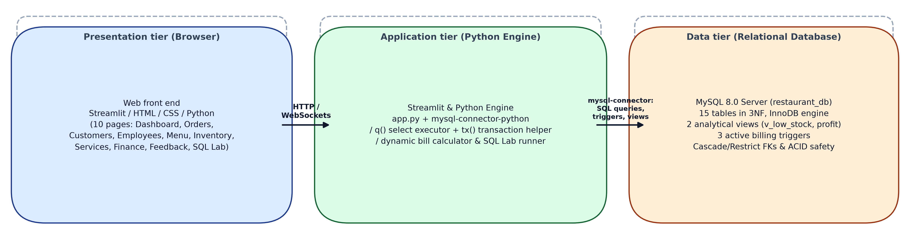
System Design & Architecture
Presentation tier: HTML/CSS/JS, 8 screens
Application tier: Express REST API, 9 route modules; calls stored procedures, then writes the audit log
Data tier: MySQL = transactional core with rules; MongoDB = flexible logs and feedback

Slide 8
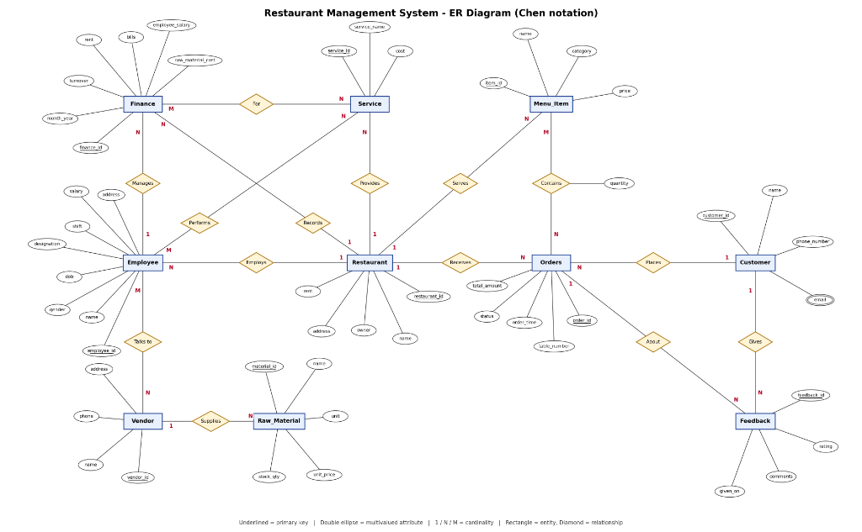
Database Design & ER Diagram
Entities (10): RESTAURANT, EMPLOYEE, VENDOR, RAW_MATERIAL, MENU_ITEM, CUSTOMER, ORDERS, SERVICE, FINANCE, FEEDBACK
Bridge tables: Order_Item (M:N Contains), Employee_Vendor (M:N Talks to), Employee_Service (M:N Performs), Finance_Service (M:N For)
Multivalued: email → Customer_Email table (customer_id, email)
Derived attribute: total_amount in Orders → calculated automatically by active trigger on Order_Item
Relationships: all 1 : N (employs, supplies, serves, places, receives, provides, records, manages, gives) and M : N bridge tables
Normal form: 3NF; 15 tables with cascade/restrict integrity rules

Slide 9
SQL Implementation & Results
Tables (15): Restaurant, Employee, Vendor, Employee_Vendor, Raw_Material, Menu_Item, Customer, Customer_Email, Orders, Order_Item, Service, Employee_Service, Finance, Finance_Service, Feedback
Views (2): v_low_stock (stock <= 15), v_monthly_profit (turnover - operating expenses)
Triggers (3): trg_after_order_item_insert, trg_after_order_item_update, trg_after_order_item_delete
Front End: Streamlit 10-screen responsive dashboard + interactive SQL Lab
Integrity: FOREIGN KEY ON DELETE RESTRICT (Customer), CASCADE (Order_Item), CHECK rating 1-5
MongoDB: activity_logs, feedback (indexed)
-- trg_after_order_item_insert (core automated billing logic)
CREATE TRIGGER trg_after_order_item_insert
AFTER INSERT ON Order_Item FOR EACH ROW
BEGIN
UPDATE Orders
SET total_amount = (
SELECT COALESCE(SUM(oi.quantity * m.price), 0.00)
FROM Order_Item oi
JOIN Menu_Item m ON m.item_id = oi.item_id
WHERE oi.order_id = NEW.order_id
)
WHERE order_id = NEW.order_id;
END;
'Cannot check out: Outstanding
balance unpaid.';
END IF;
UPDATE booking SET status='Checked-out'
WHERE booking_id = p_booking_id;
UPDATE room SET availability='Available'
WHERE hotel_id=v_hotel_id AND room_no=v_room_no;
COMMIT;

Slide 10
SQL Implementation & Results (contd.)
Best-selling items & Pricing (Menu_Item JOIN Order_Item)
Low Stock Alerts (view v_low_stock with Vendor Contact)
Menu Item | Category | Price
Butter Chicken | Main Course | Rs 340
Chicken Dum Biryani | Main Course | Rs 320
Paneer Butter Masala | Main Course | Rs 290
Paneer Tikka | Starter | Rs 240
Garlic Naan | Bread | Rs 55
Material | Stock | Unit | Vendor Phone
Fresh Milk | 6.00 | litre | 9876501234
Paneer | 8.50 | kg | 9876501234
Chicken | 12.00 | kg | 9811223344
Tomatoes | 25.00 | kg | 9876543210
Rules enforced by the database
Monthly Profit Analysis (view v_monthly_profit)
Check-out with dues -> ERROR 1644:
Cannot check out: Outstanding balance unpaid.
Overlapping dates -> ERROR 1644:
Room is already reserved or occupied.
4 guests in 2-guest room -> ERROR 1644:
Number of guests exceeds capacity.
Month | Turnover | Profit
2026-09 | 345,000 | 59,100
2026-08 | 320,000 | 29,200
Results from the seed data: 20 rooms, 10 customers, 12 bookings, 11 payments; 10 report queries run; all invalid operations rejected.

Slide 11
Conclusion
Built: a complete Restaurant Management System – Chen ER diagram → 3NF MySQL schema → Streamlit Web UI.
Rules live in the database: Constraints, 2 views, 3 active billing triggers, and cascade/restrict foreign keys.
3-Tier Design: Streamlit (Presentation) ↔ Python Engine (Logic) ↔ MySQL 8.0 InnoDB (Data).
Outcome: Zero billing discrepancies; live stock alerts; centralized staff, menu, vendor, and financial accounting.
Future scope: Table-side QR-code ordering, online payment gateway (Razorpay/Stripe), machine learning demand forecasting.

Slide 12
References
E. F. Codd, “A Relational Model of Data for Large Shared Data Banks,” CACM, 13(6), 1970.
P. P. Chen, “The Entity-Relationship Model,” ACM TODS, 1(1), 1976.
R. Elmasri & S. B. Navathe, Fundamentals of Database Systems, 7th ed., Pearson, 2016.
A. Silberschatz, H. F. Korth & S. Sudarshan, Database System Concepts, 7th ed., McGraw-Hill, 2019.
MySQL 8.0 Reference Manual – dev.mysql.com/doc/refman/8.0/en/
Streamlit Documentation – docs.streamlit.io
Pandas Library Documentation – pandas.pydata.org
Express.js – expressjs.com ; Node.js – nodejs.org

