Slide 1
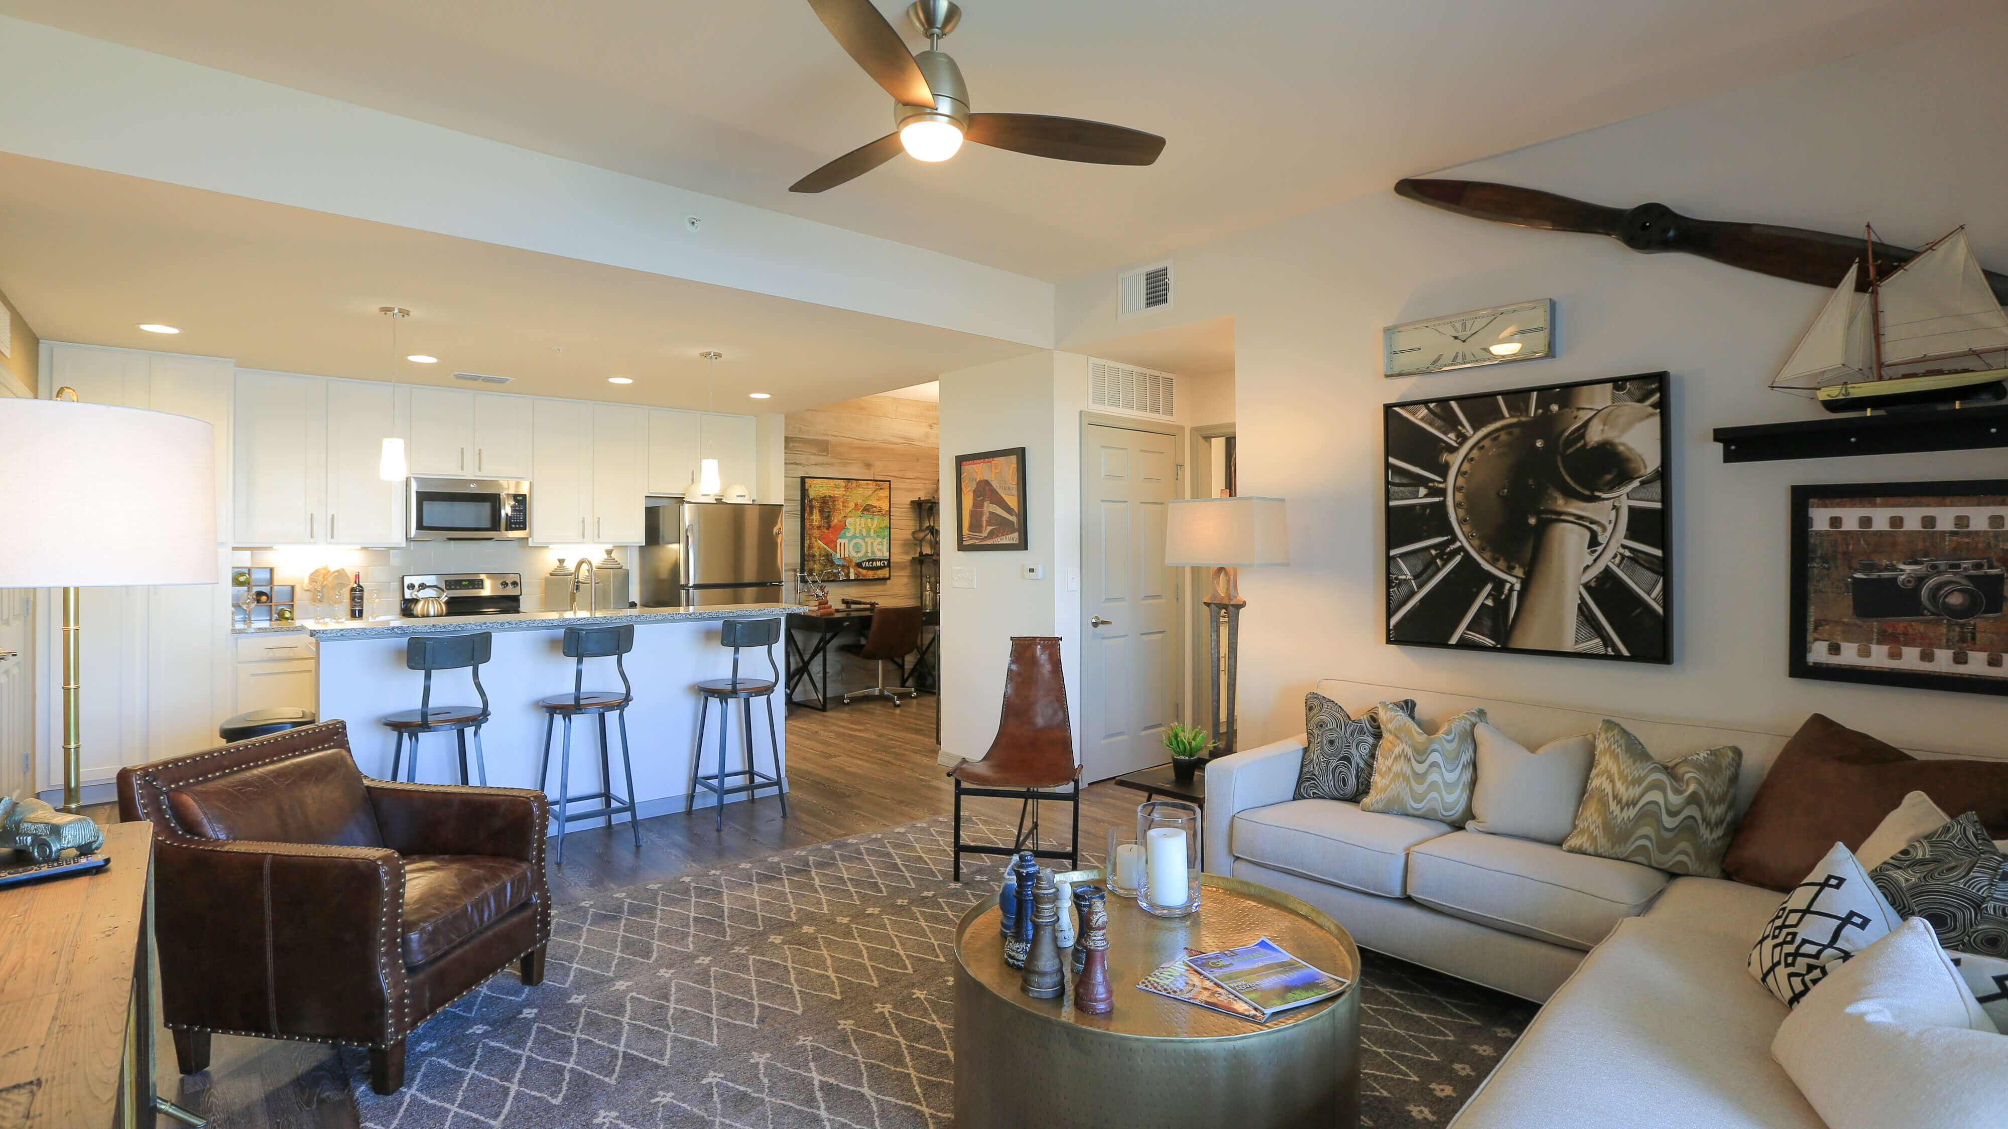
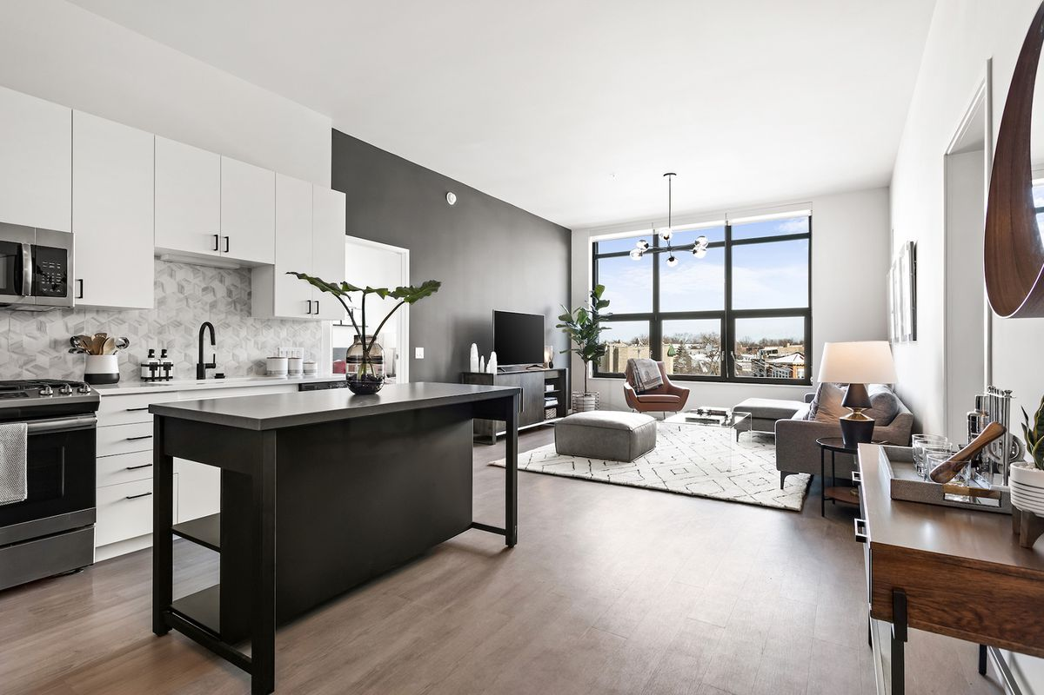
RENT-IT-OUT
INFO 6210 DATA MANAGEMENT AND DATABASE DESIGN
GROUP- DATA JUNKIES
BHUMIKA PUNJABI – 001061256
PRANATHA RAJPRASAD RAO – 001023759
ANISH NAIK – 001065785
YASH KHOKALE - 001054321

Slide 2
OBJECTIVES
To ease user’s task whenever they need to rent a unit.
To transform the manual process of renting a house to an online and computerized system.
To validate the house rental system using user feedback and testimonies
To produce the documentation such as Software Requirement specification, Software Design Description and Software Development References

Slide 3
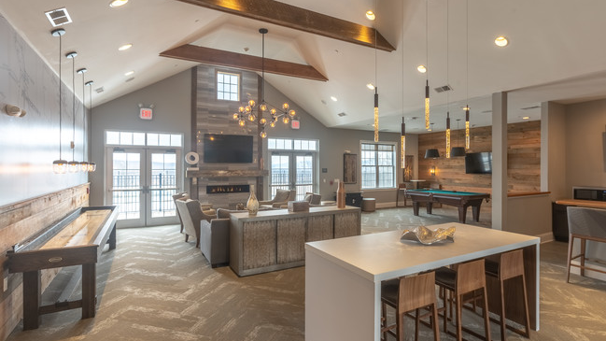
DESIGN APPROACH
User are client, agent or owner. Agents or owner can post the rent which can be viewed by the clients looking for the apartments.
Client lease out the Unit considering, the availability date, location, facilities available, rent of the unit etc. and can also request for maintenance after leasing out the unit whenever required.
Property contain all the features of the unit that the clients look for.
The unit entity contains the location details which is dependent on the property and further extends to show the features available in the unit.
Appointment schedule contains details such as time and date the client can come and visit the apartment.
Details like transportation services, stores in vicinity, crime rate near the area, has also been made available to the Client.

Slide 4
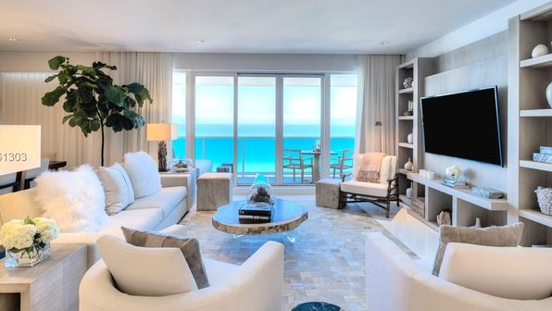
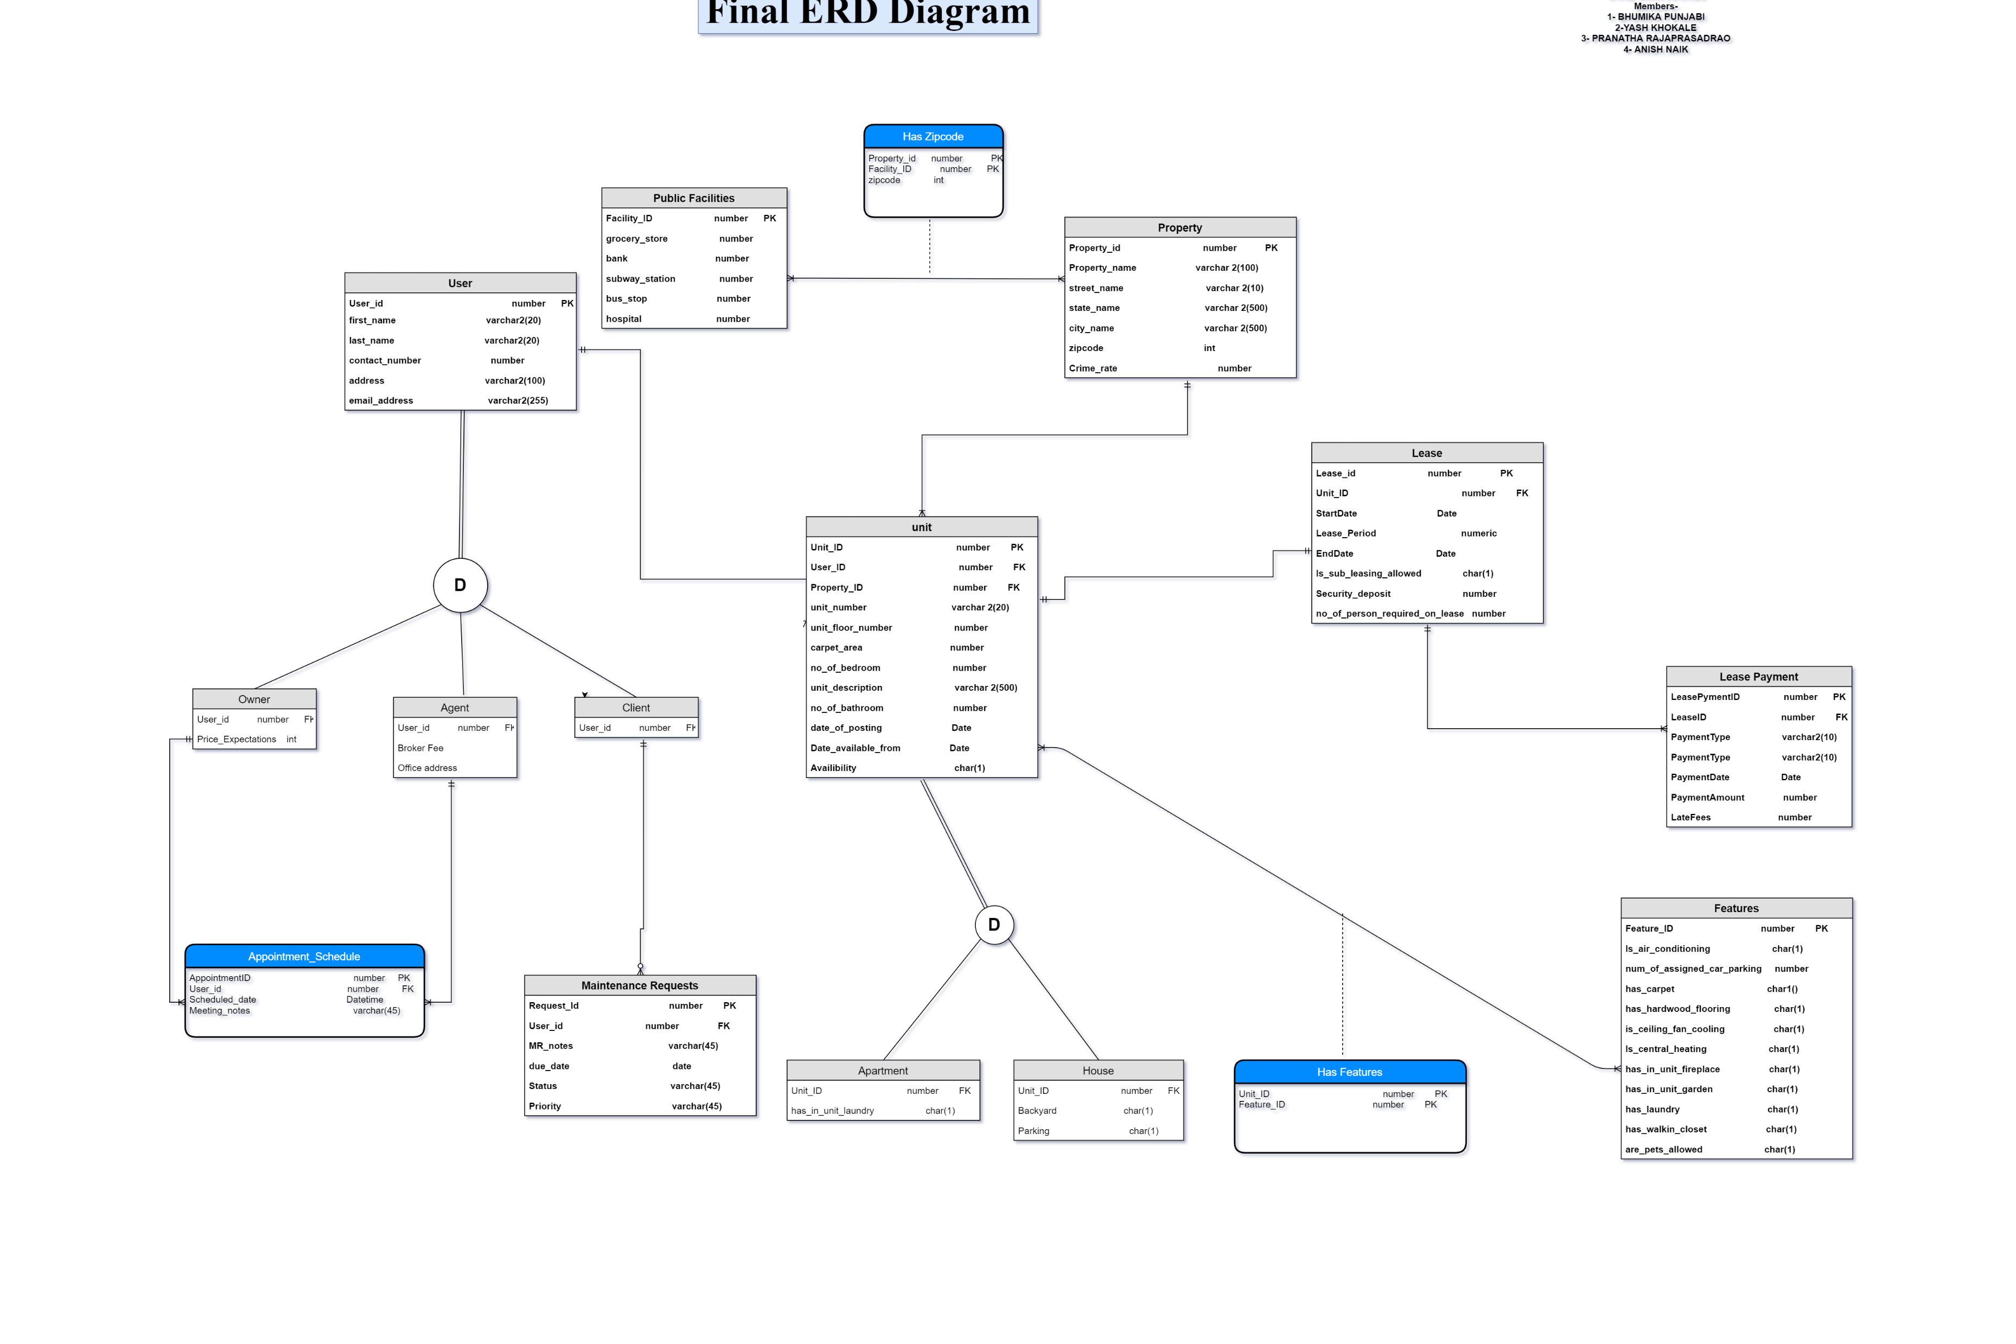
ERD Diagram

Slide 5
DDL & DML Statements
Some important entities like User ( Subtype and Supertype), Property, Unit and Lease required special attention.
Most of the relations are through these entities.
Property and Unit make up most of the relations whereas Lease is a crucial entity on its own

Slide 6
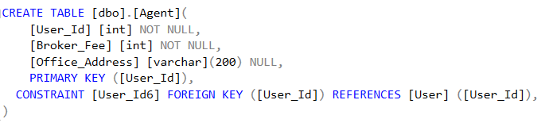

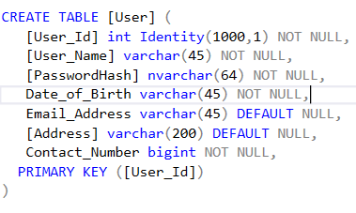
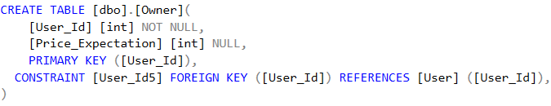
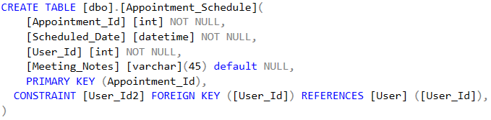
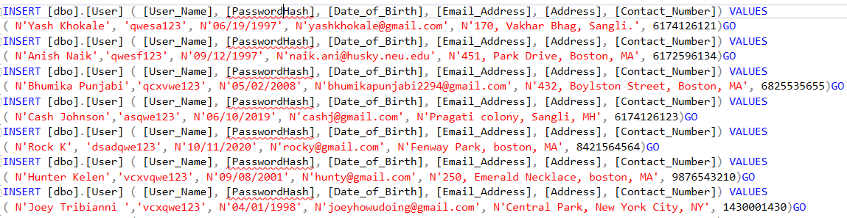
USER DETAILS

Slide 7
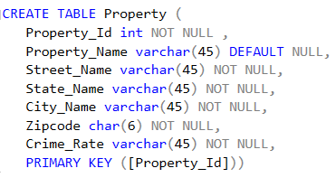
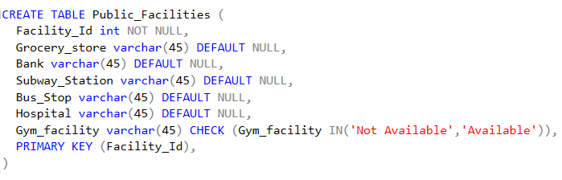
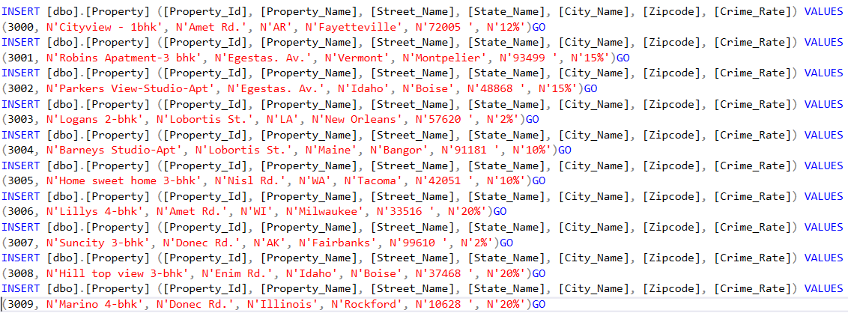
PROPERTY DETAILS

Slide 8
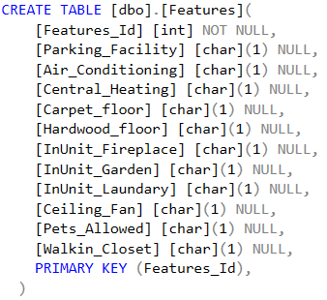
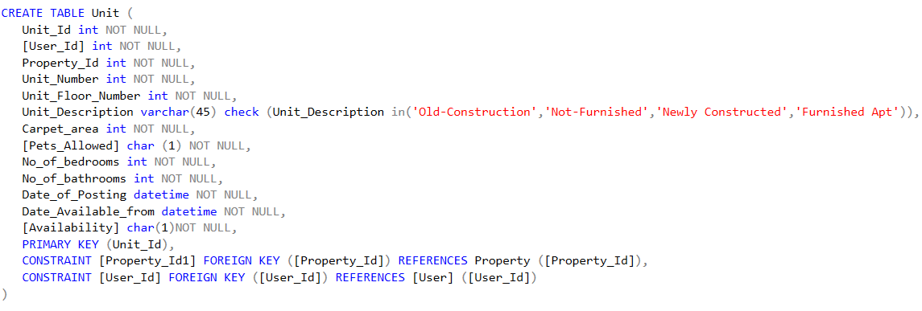
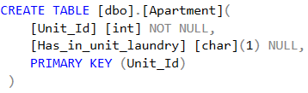
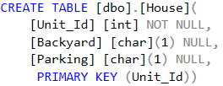
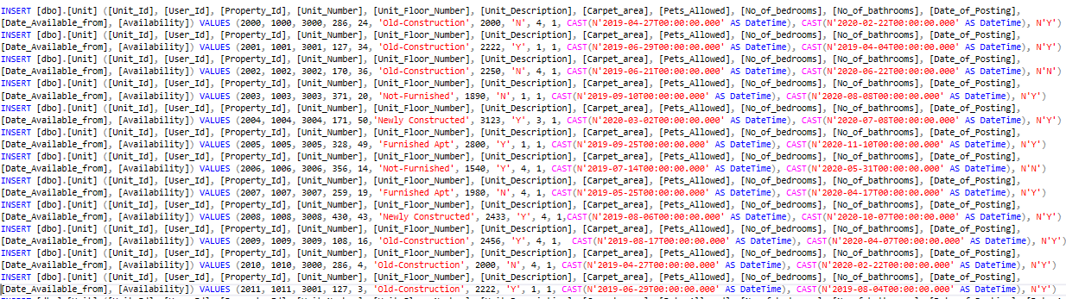
UNIT DETAILS

Slide 9
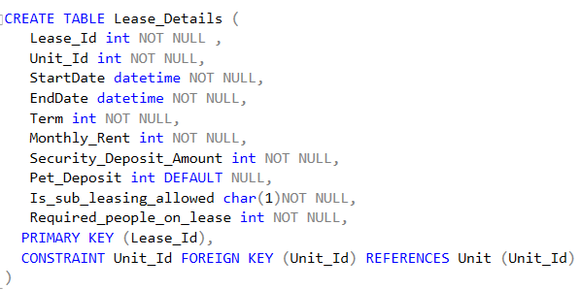
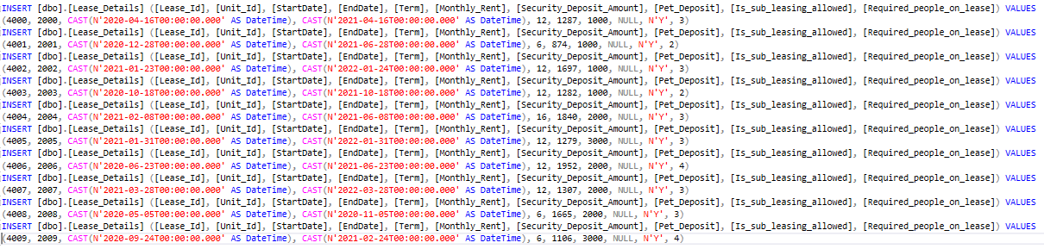
Lease DETAILS

Slide 10
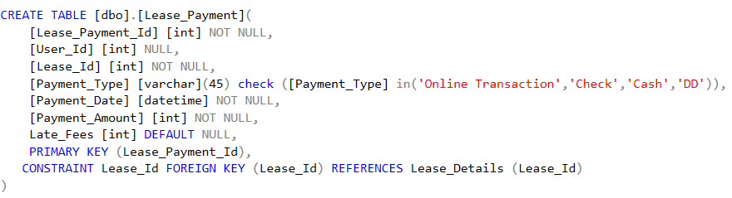
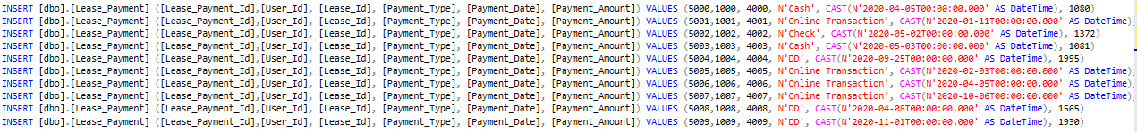
Lease PAYMENT

Slide 11
Database Objects
Implemented triggers, Stored procedures and views.
Triggers largely implemented to allow for ease of insertion and avoiding re-entering data to maintain data integrity.
Procedures implemented to easily insert additional attributes to employee information.
Views created to provide some important grouping of data.

Slide 12
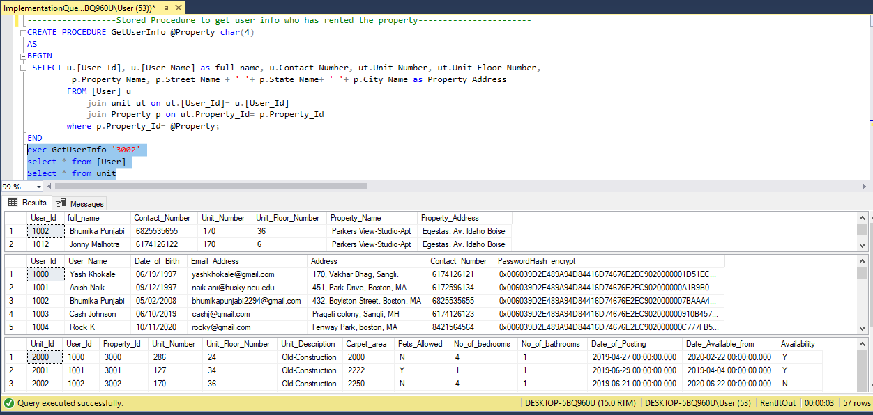
STORED PROCEDURE
GetUserInfo : TO GET USERS INFORMATION WHO HAS RENTED THE PROPERTY

Slide 13
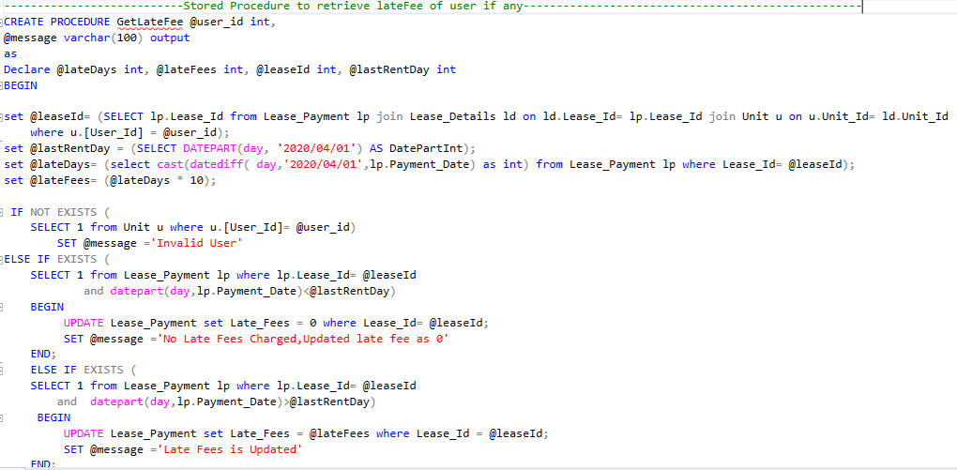
STORED PROCEDURE
LateFee: retrieves late fees of user if any

Slide 14
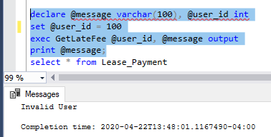
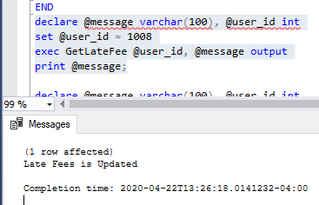
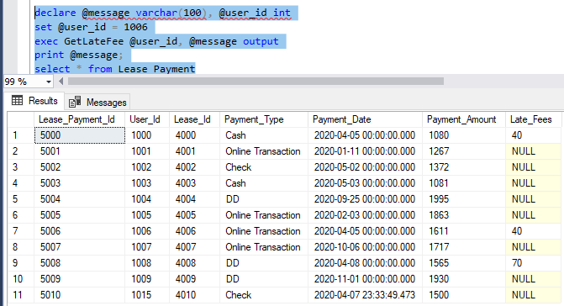
STORED PROCEDURE
Output-late Fee value updated in the Table

Slide 15
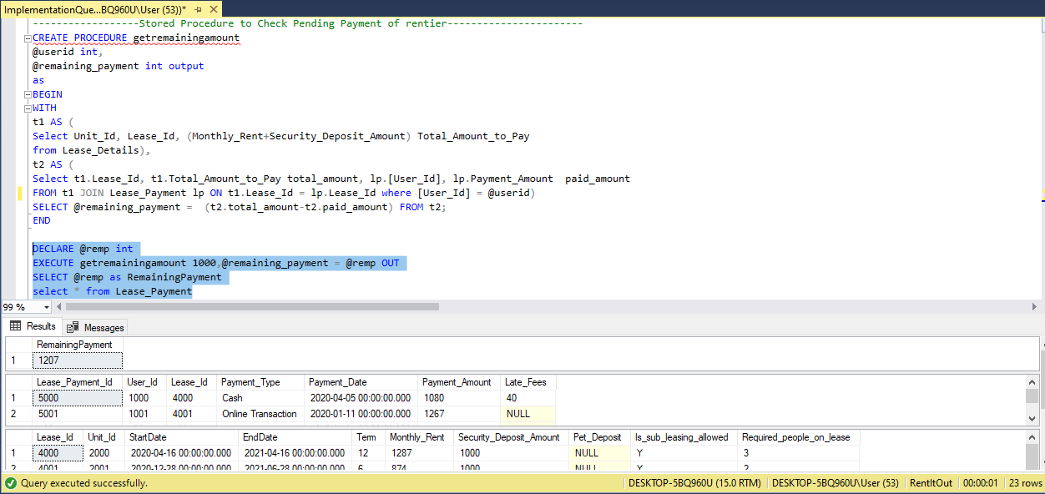
STORED PROCEDURE
GetRemainingAmount: Checks Pending Payment of user(rentier)

Slide 16
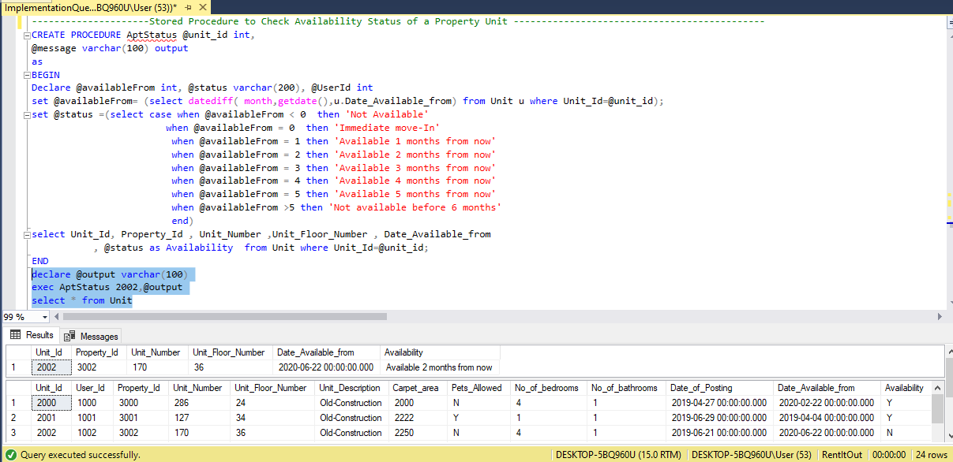
STORED PROCEDURE
PropertyAvaliability: Check Availability Status of a Property Unit

Slide 17
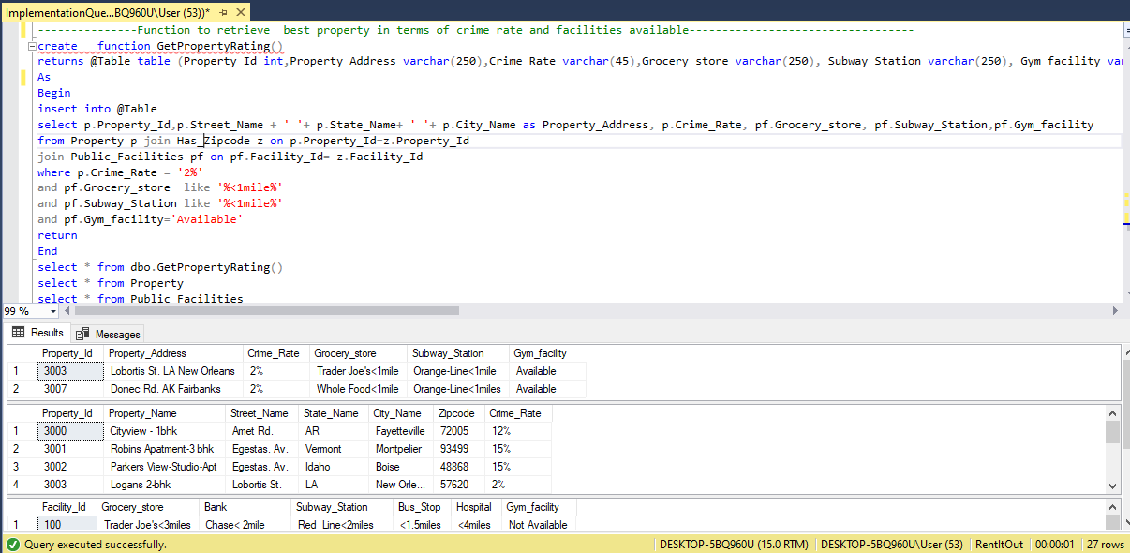
FUNCTIONS
To retrieve best property in terms of crime rate and facilities available

Slide 18
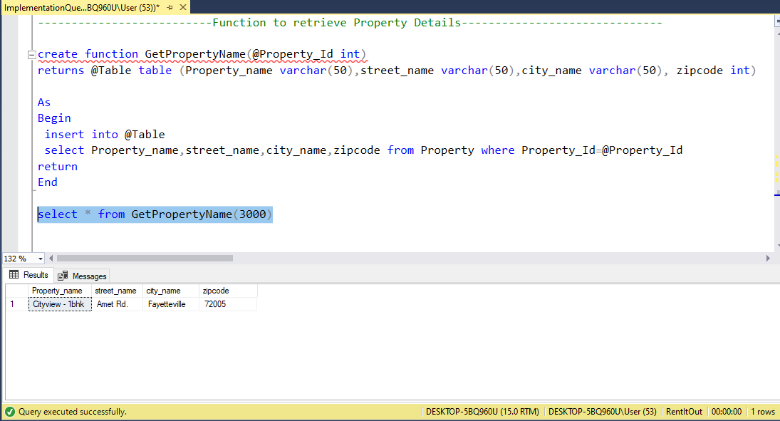
FUNCTIONS
Function to retrieve Property details

Slide 19
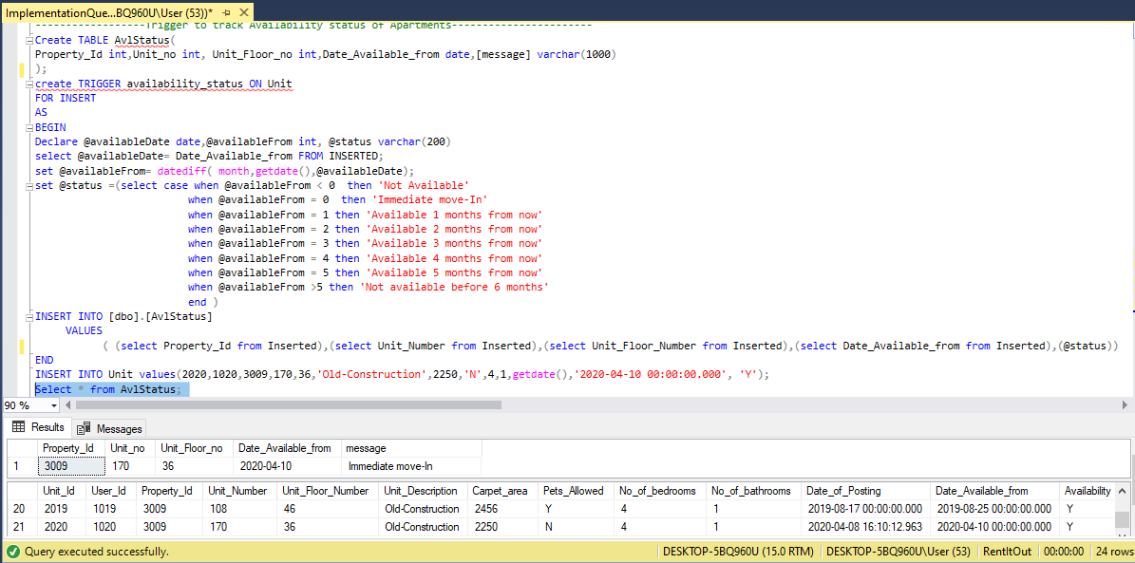
TRIGGERS
Trigger to track availability status of the apartment

Slide 20
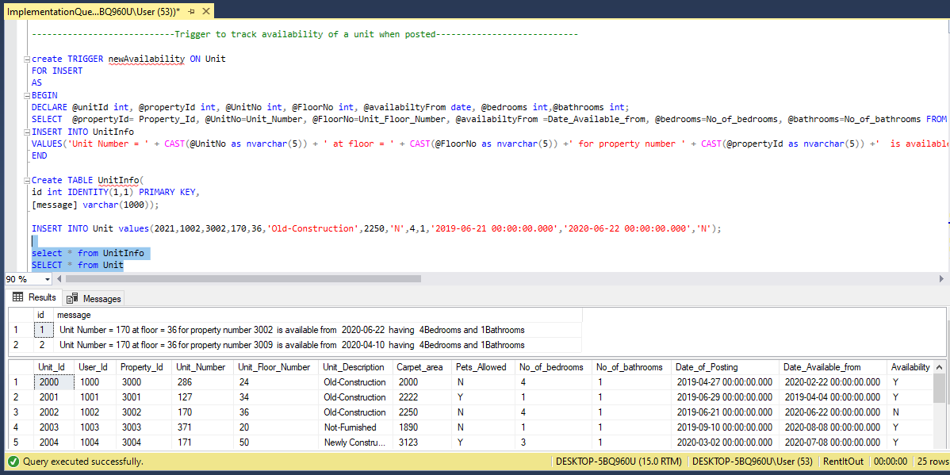
TRIGGERS
Trigger to track availability of Unit with its features when posted

Slide 21
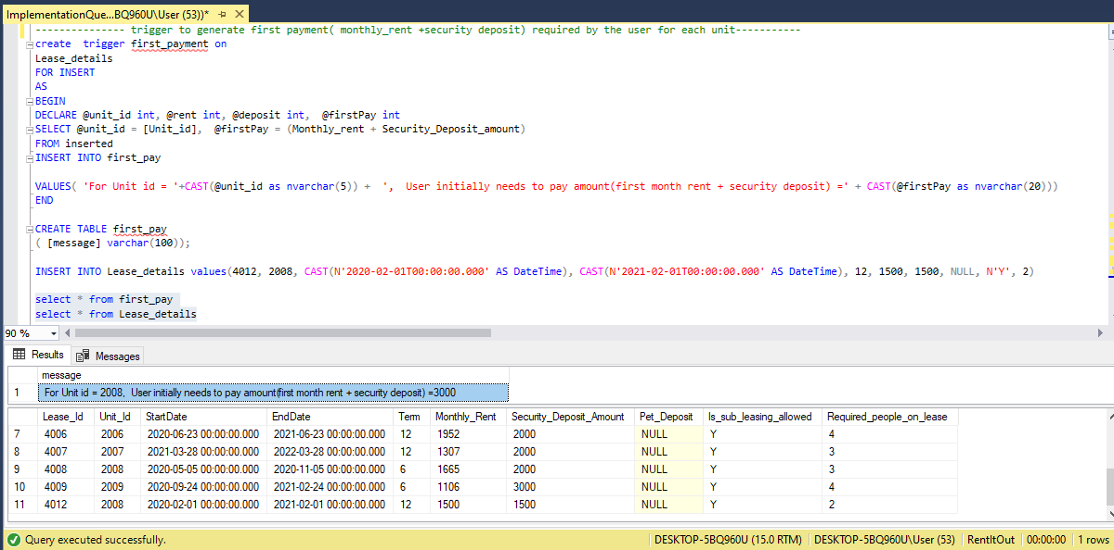
TRIGGERS
Trigger to generate first payment(monthlyrent +securitydeposit) required by the user for each unit

Slide 22
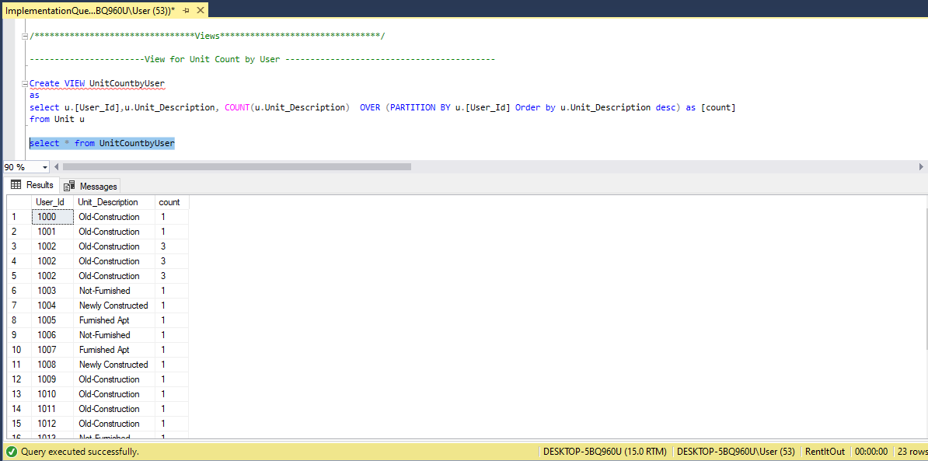
VIEWS
View for Unit Count by User

Slide 23
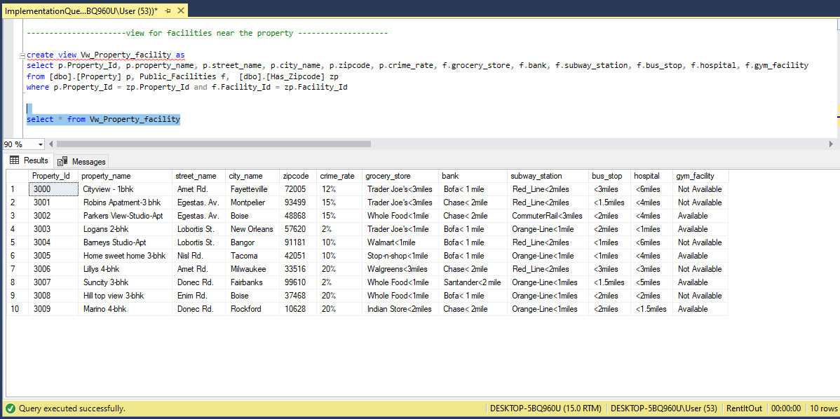
VIEWS
View showing Facilities Available near the Property

Slide 24
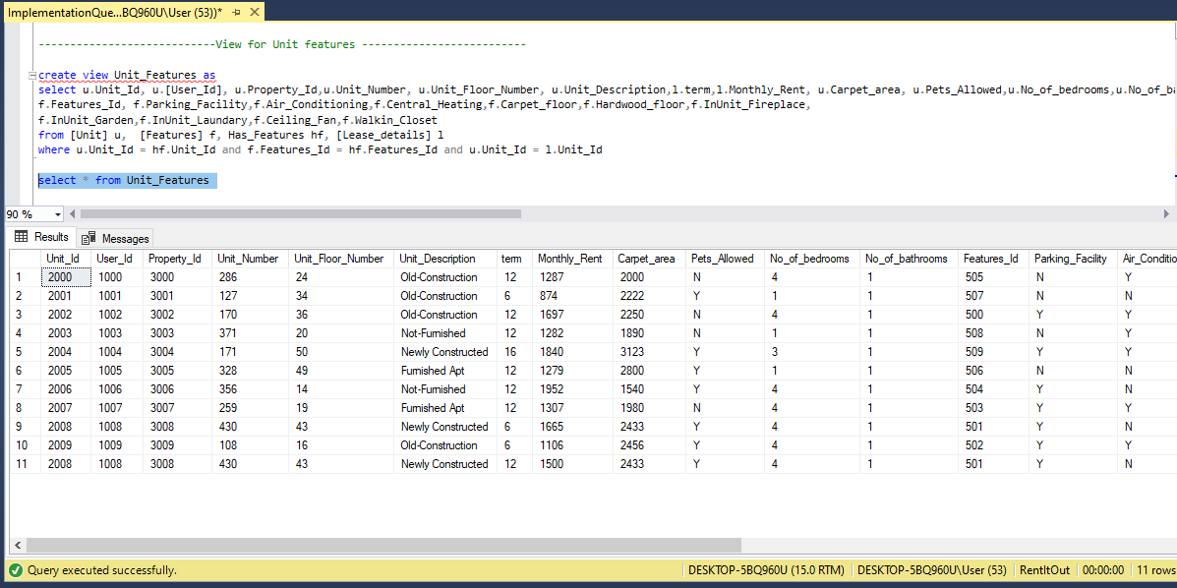
View showing Unit Features
VIEWS

Slide 25
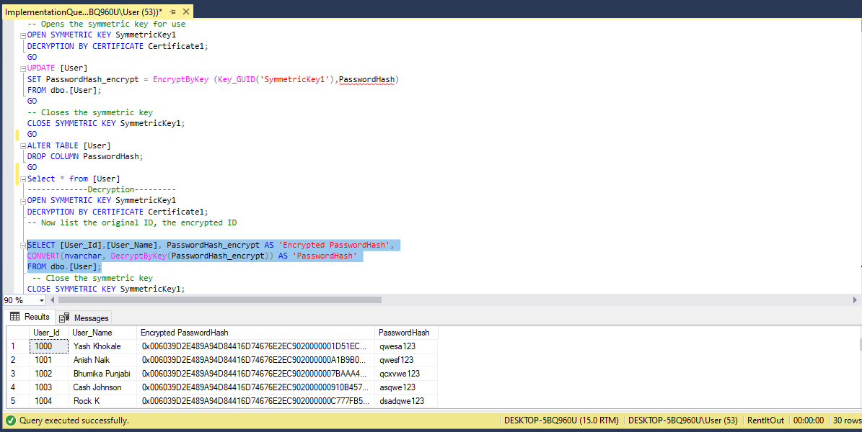
Column Data Encryption on User’s Password
COMPUTED DATA ENCRYPTION

Slide 26
Data Visualization for Rental-It-Out

Slide 27
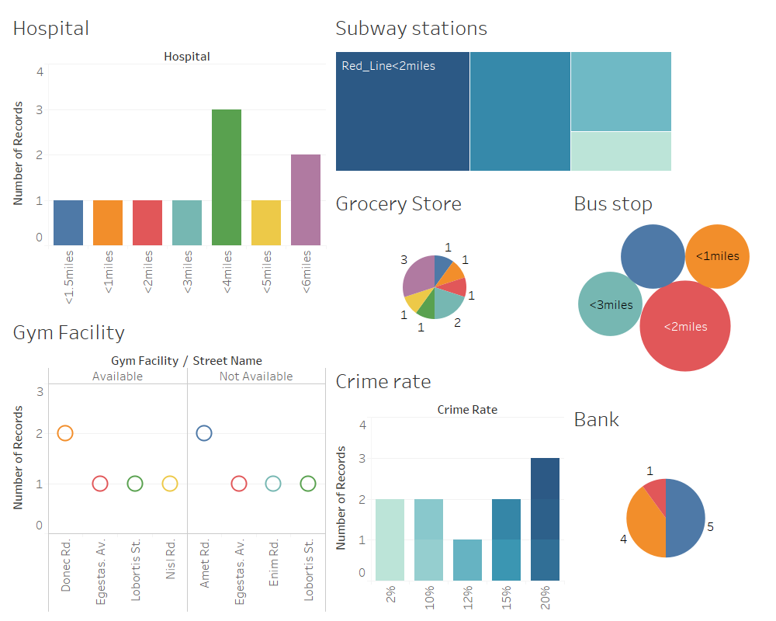
DASHBOARD FOR PROPERTY FACILITY

Slide 28
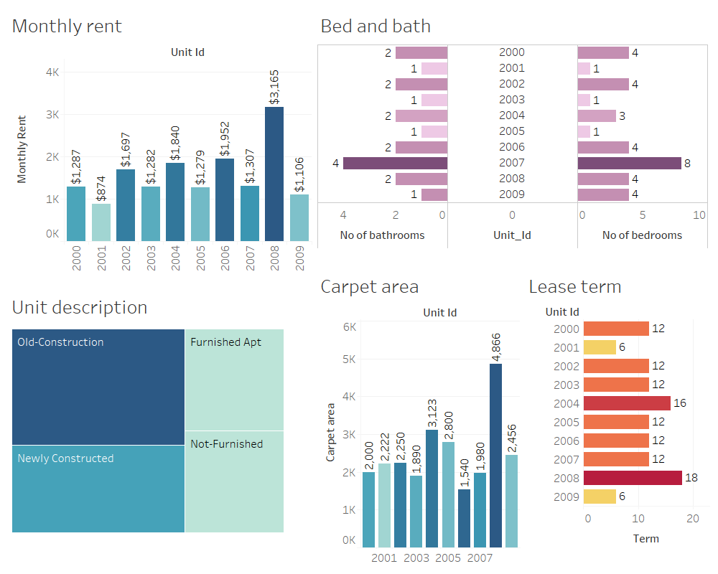
DASHBOARD FOR UNIT FEATURES

Slide 29
THANK YOU!!
By- Data Junkies

