Slide 1

Forage Simulation: PowerBI
PwC Switzerland
Submitted By:
Bhumi Mehta

Slide 2

Agenda
Task 1: Introduction
Task 2: Call Center Trends
Task 3: Customer Retention
Task 4: Diversity and Inclusion

Slide 3
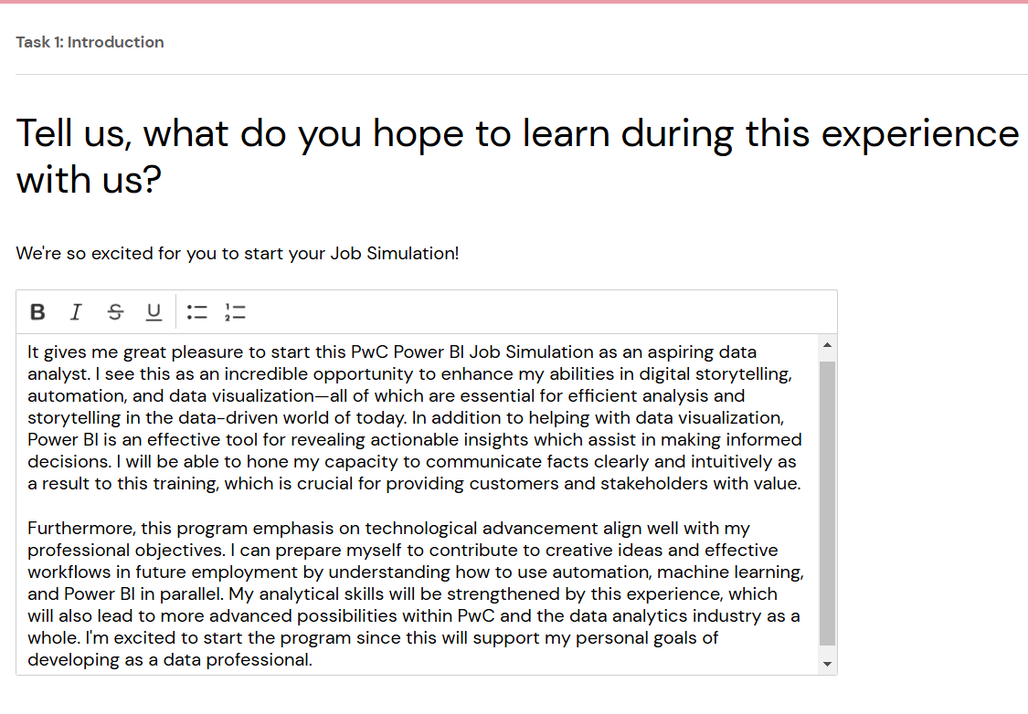
Task 1 Introduction

Slide 4
Task 2 – Call Center Trends

Slide 5
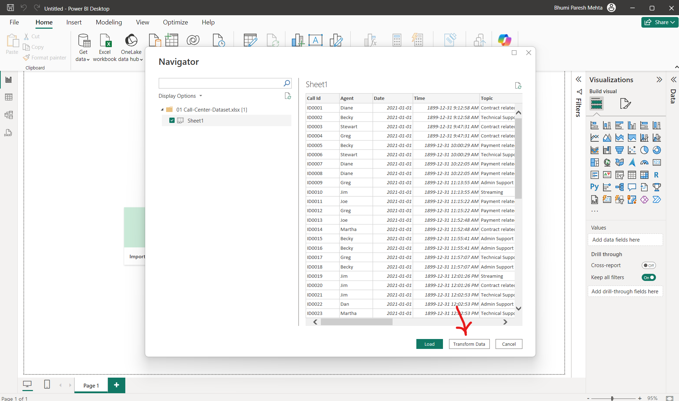
Steps Performed
Step 1: Importing and transforming ‘Call Center Dataset’.

Slide 6
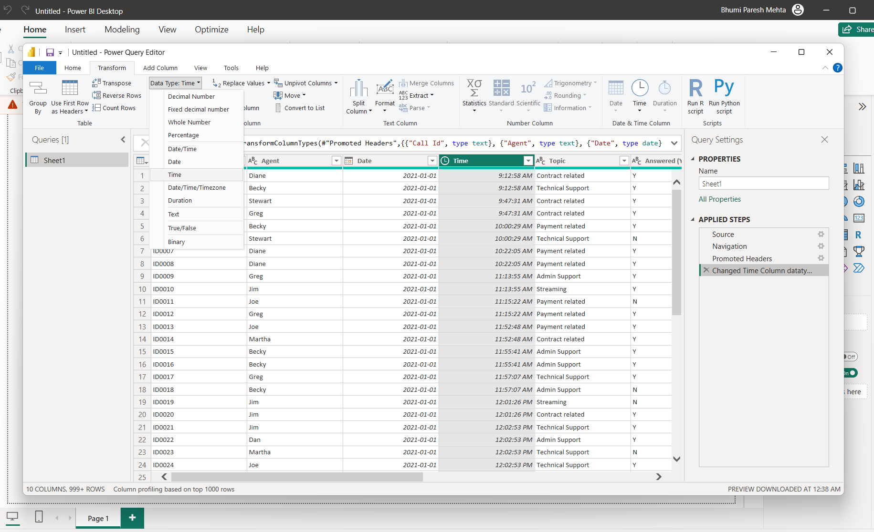
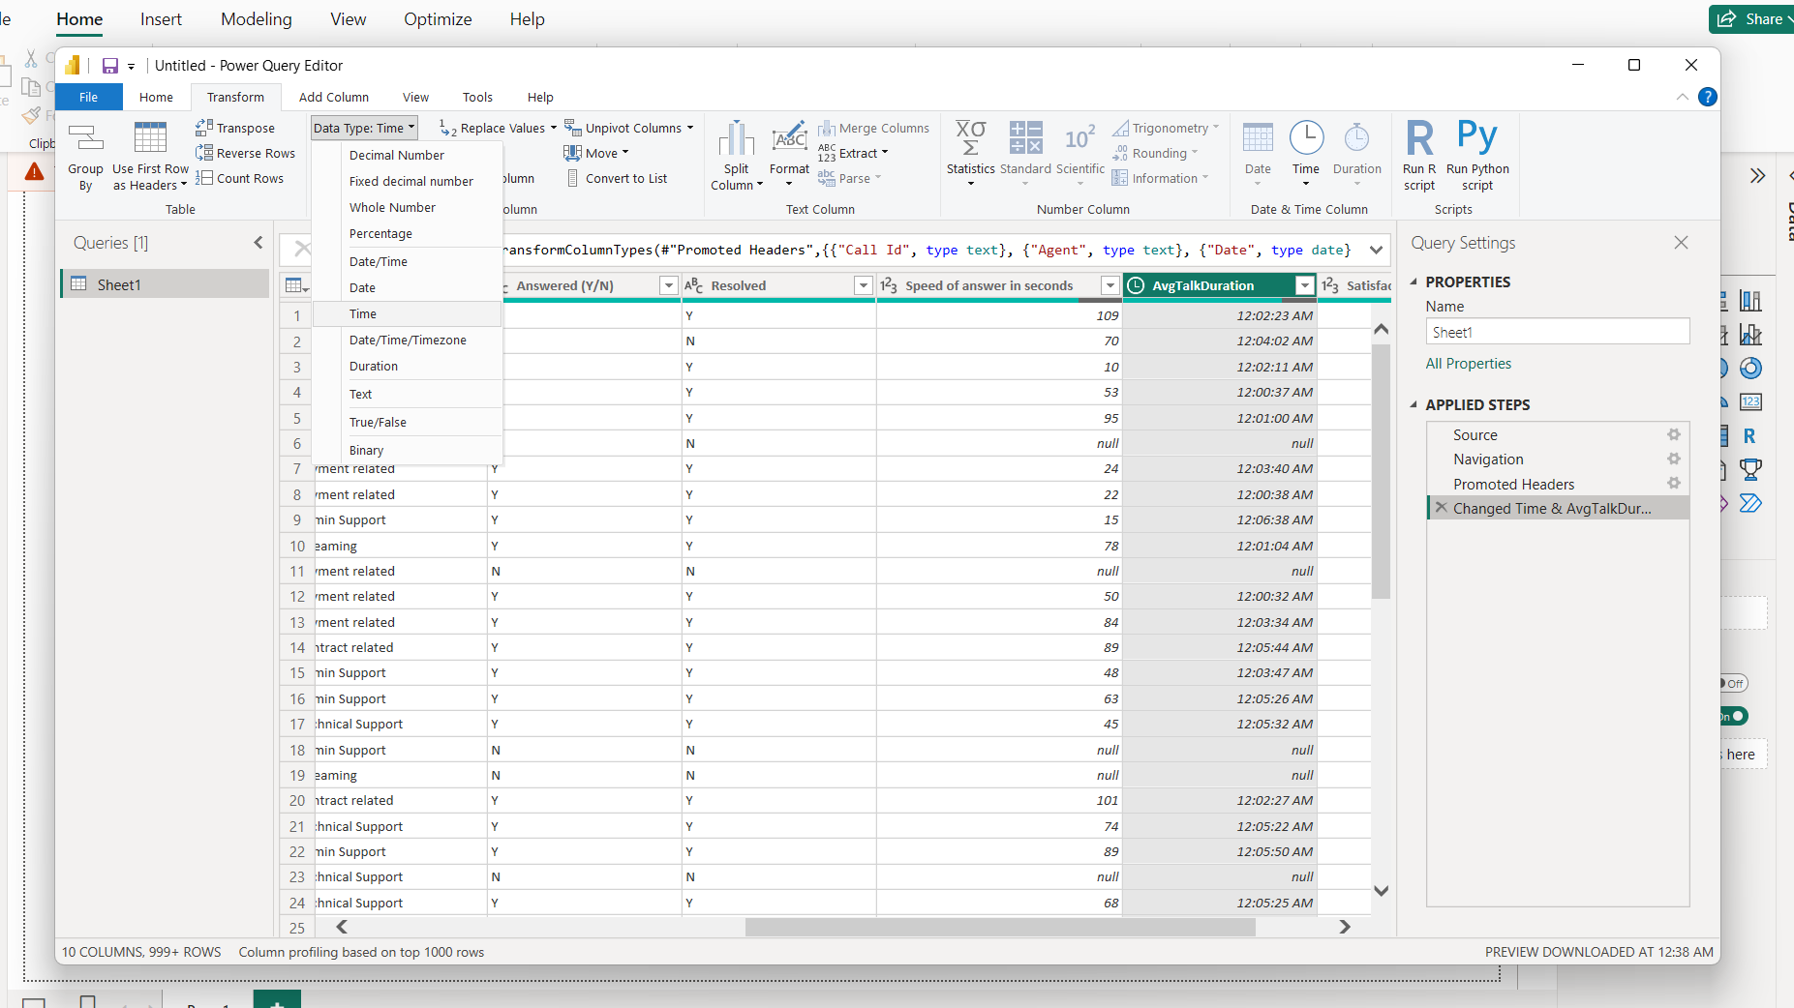
Changed the datatype of ‘Time’ and ‘AvgTalkDuration’ variables to Time type.
Step 2:

Slide 7
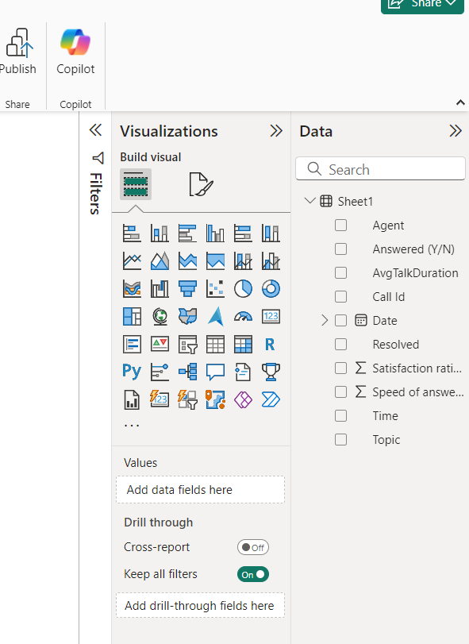
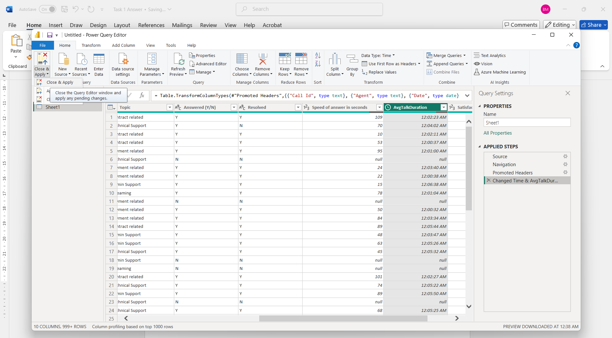
Close and Apply Changes. Once we close and apply changes, our dataset is successfully imported in PowerBI.
Step 3:

Slide 8
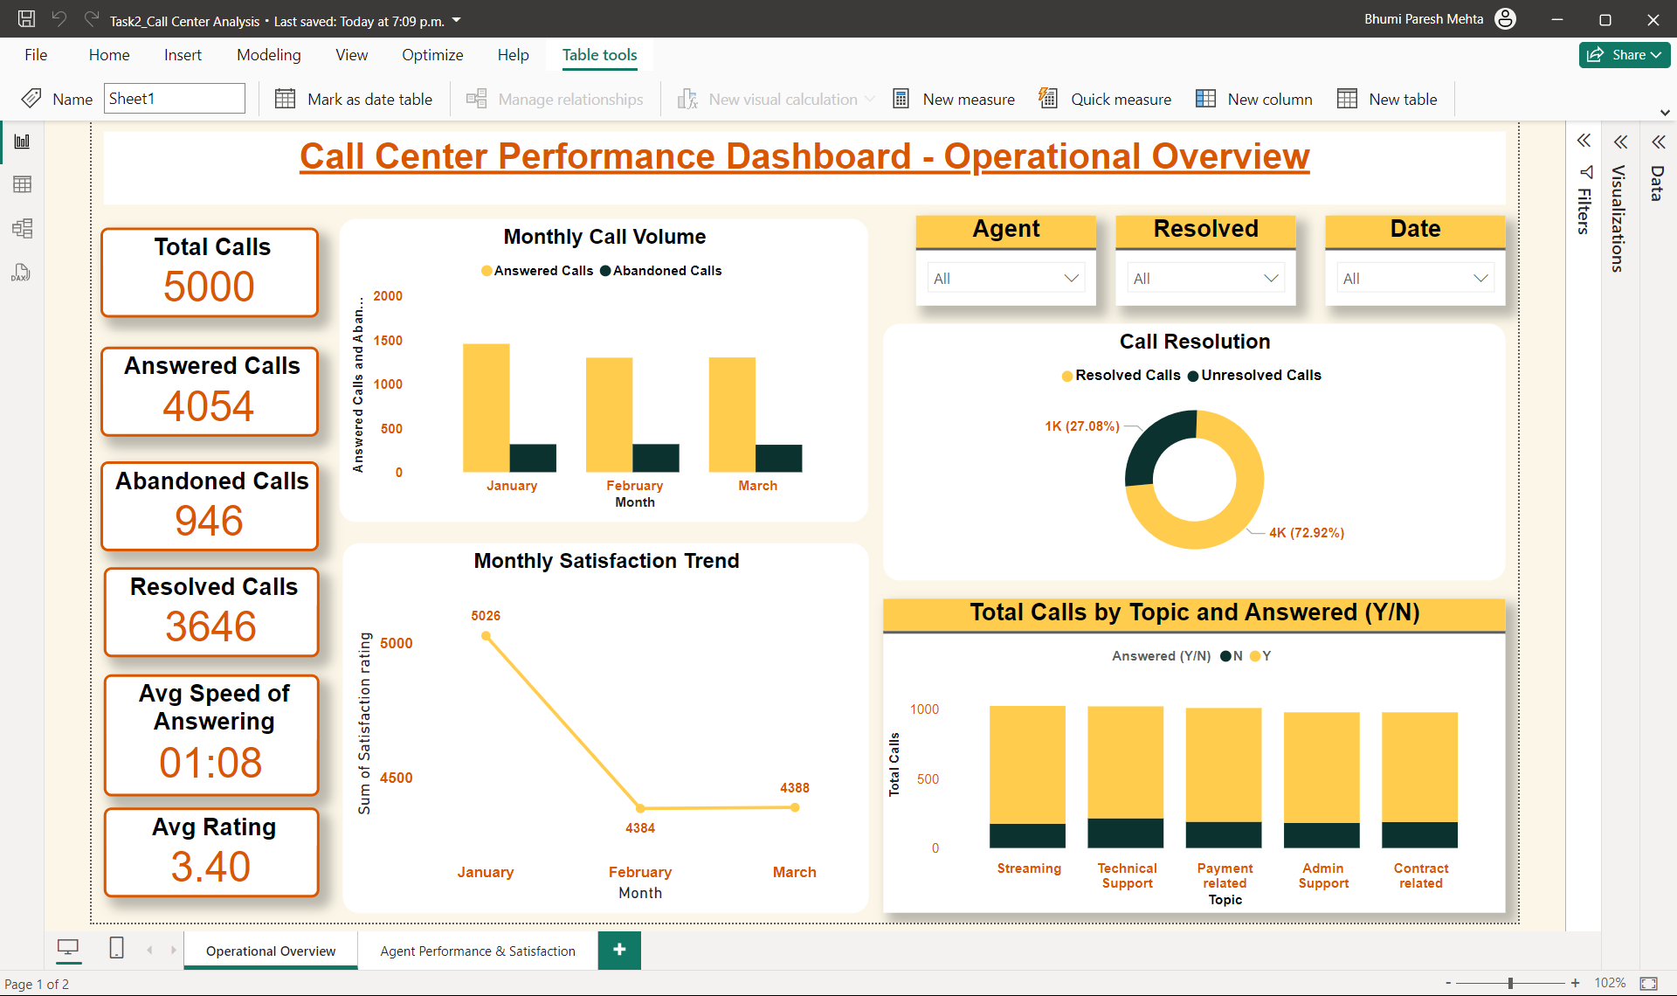
Operational Overview

Slide 9
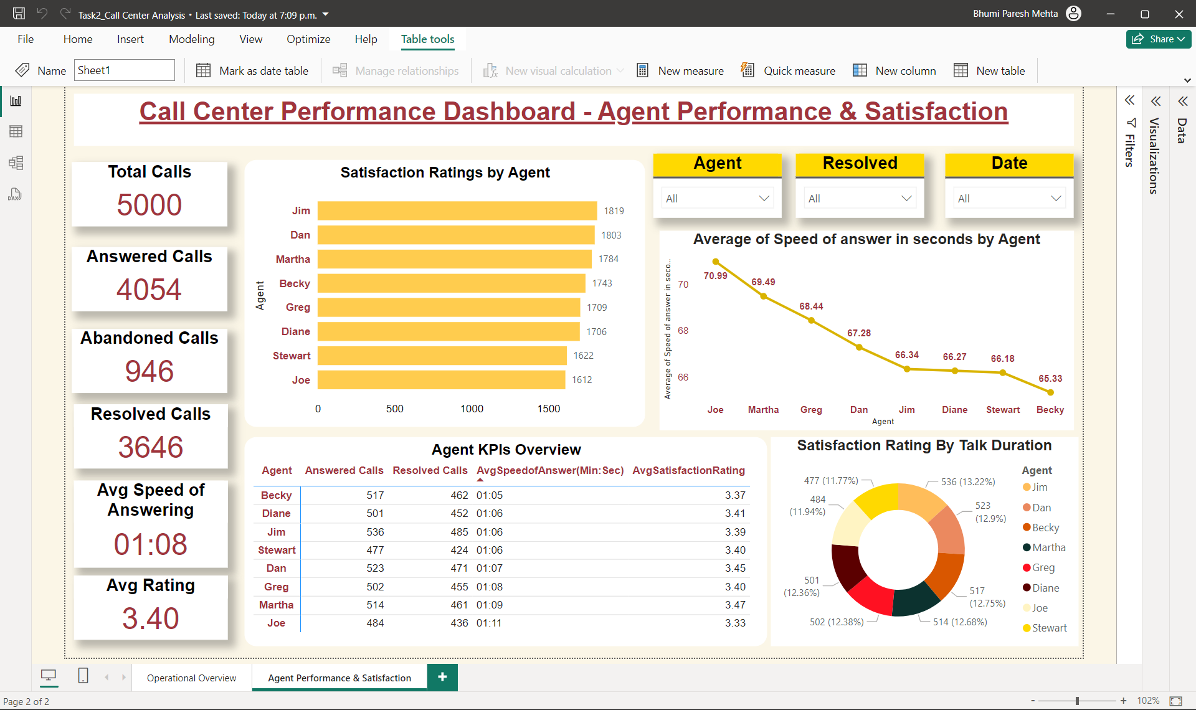
Agent Performance & Satisfaction

Slide 10
Task 3 – Customer Retention

Slide 11
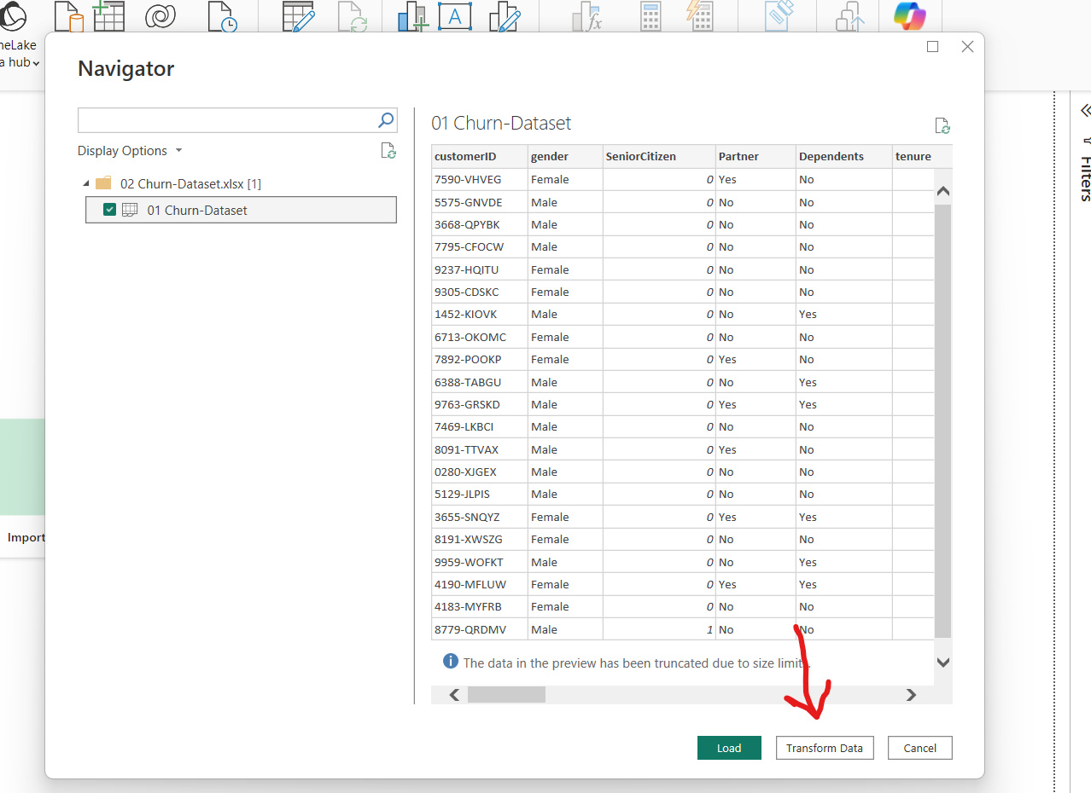
Steps Performed:
Import and transform the ‘Churn Dataset’. Check for datatypes and if any missing values.
Once checked, close and apply.

Slide 12
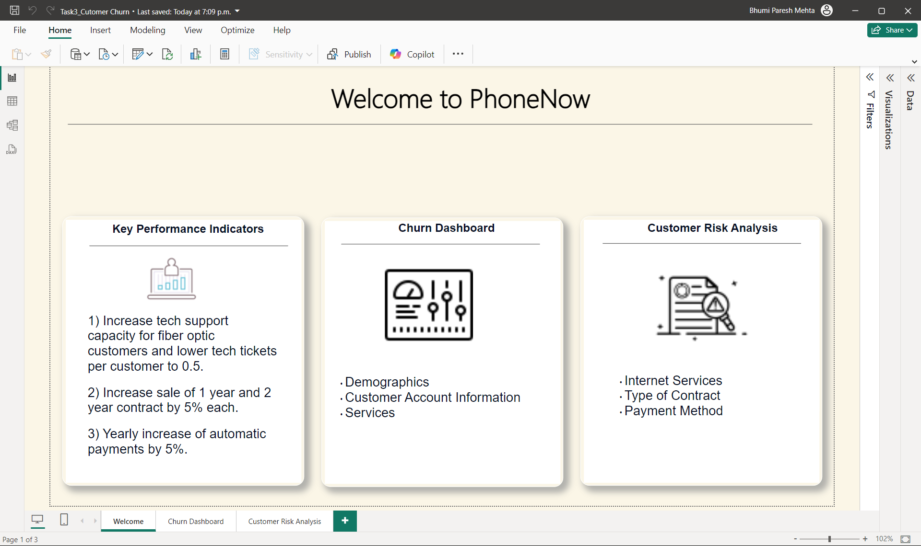
Welcome Page

Slide 13
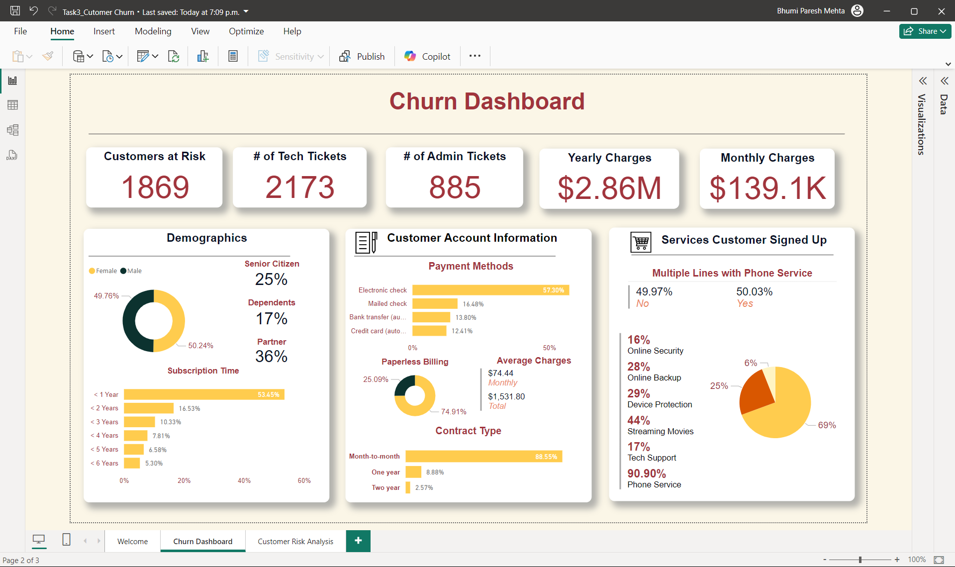
Churn Dashboard

Slide 14
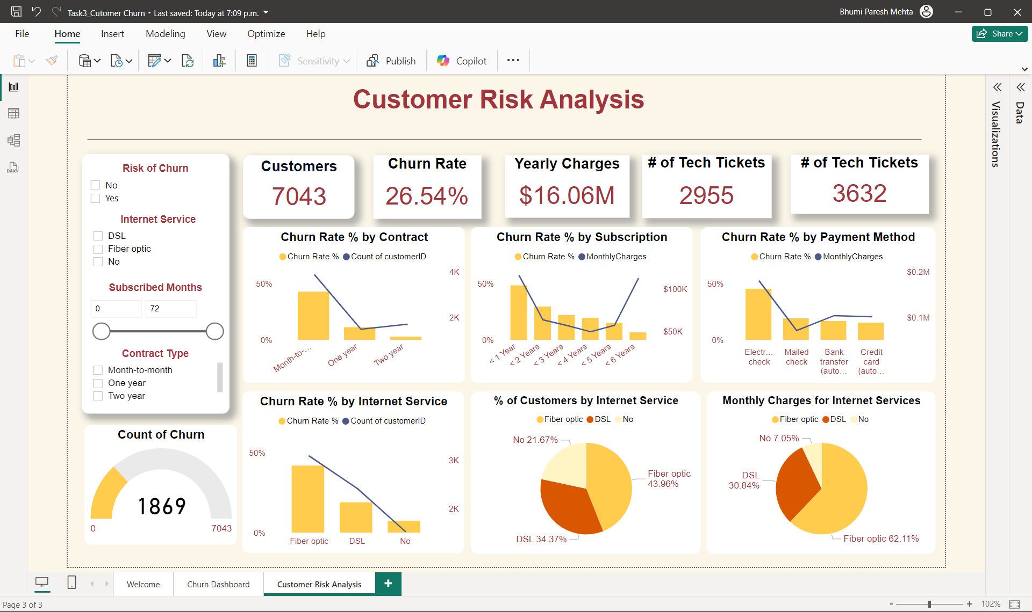
Customer Risk Analysis

Slide 15
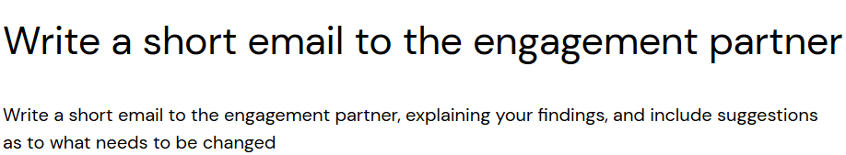
Email to the Engagement Partner
Subject: Analysis and Suggestions for Customer Retention Dear Janet, I hope this email finds you well. I'm sending this email to give you an overview of our most recent customer retention analysis and provide some suggestions for enhancing our approach. Key Findings:
Churn Rate: At 34.1%, our current churn rate shows that a sizable percentage of our customers are discontinuing their use of our service. Since this exceeds the industry standard, lowering turnover ought to be a primary concern.
Customer Lifetime Value (CLV): While the average CLV is encouraging, there is room to grow it by improving customer happiness and engagement.
Customer Acquisition Cost (CAC): Our CAC has been trending decrease, indicating that our acquisition techniques are becoming more efficient. However, total profitability may benefit from additional CAC optimization.
Monthly Recurring Revenue (MRR): While MRR trends remain consistent, churn might be decreased and MRR increased by adding more long-term contracts.
Net Promoter Score (NPS): At the moment, our NPS shows that consumer satisfaction is moderate. Improving the customer experience can increase the number of customers who become promoters, which lowers churn and draws in new clients through favorable word-of-mouth.
Customer Engagement: Rates of engagement vary, with periods of reduced engagement being noted. During these times, focused engagement efforts may increase retention rates overall.

Slide 16
Email Continuing..
Suggestions:
Targeted Retention Campaigns: Create customized retention strategies for high-risk clients according to their usage and engagement trends.
Improve consumer Experience: Put feedback systems in place to recognize and quickly fix consumer problem areas. To boost client happiness and loyalty, concentrate on enhancing the entire customer experience.
Encourage Long-Term Contracts: To lower the chance of customer attrition, provide discounts and incentives to clients who agree to longer-term agreements.
Increase Customer Engagement: To keep customers actively using our services, implement focused engagement campaigns during slow times. We can greatly increase our customer retention rates and promote long-term business success by putting these tactics into practice. Please feel free to reach out if you have any questions or would like to discuss these findings further. Kind regards, Bhumi Mehta.

Slide 17
Task 4 – Diversity & Inclusion

Slide 18
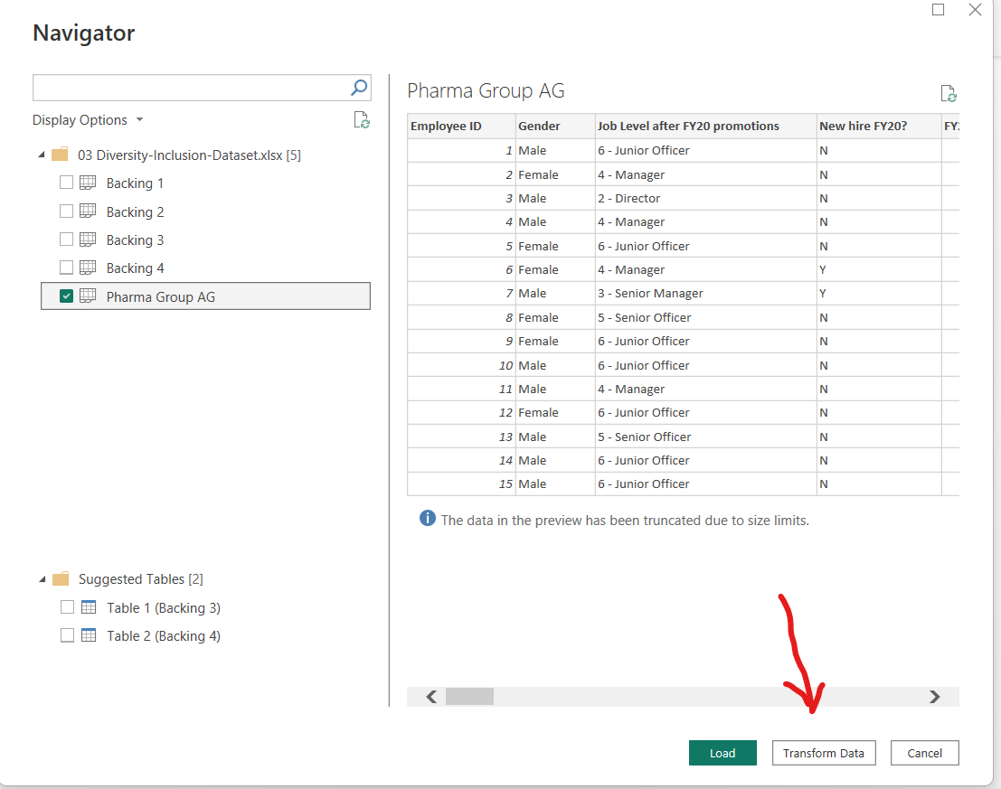
Step Performed
Import and transform the ‘Diversity-Inclusion Dataset’. Check for datatypes and if any missing values.
Once checked, close and apply.

Slide 19
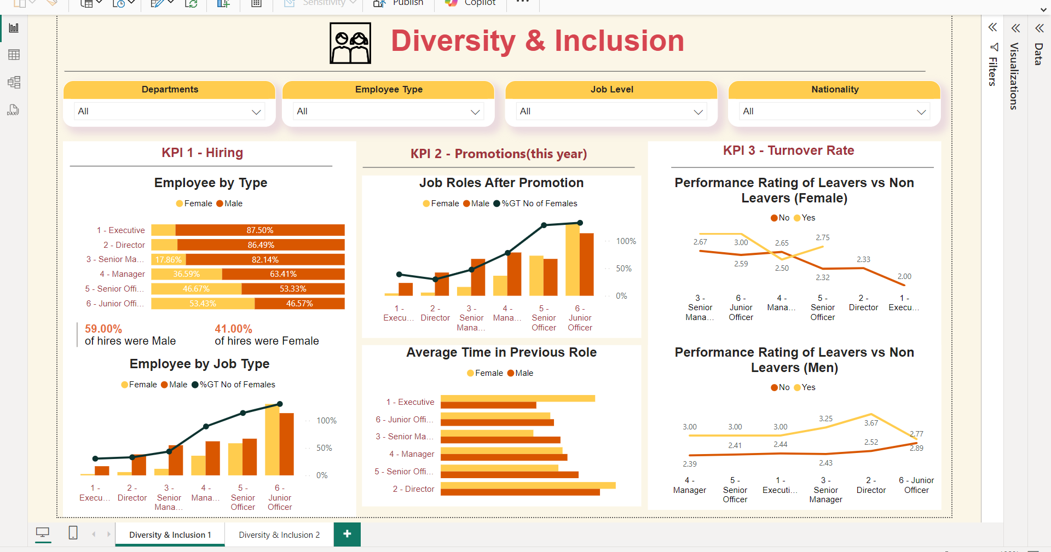

Slide 20
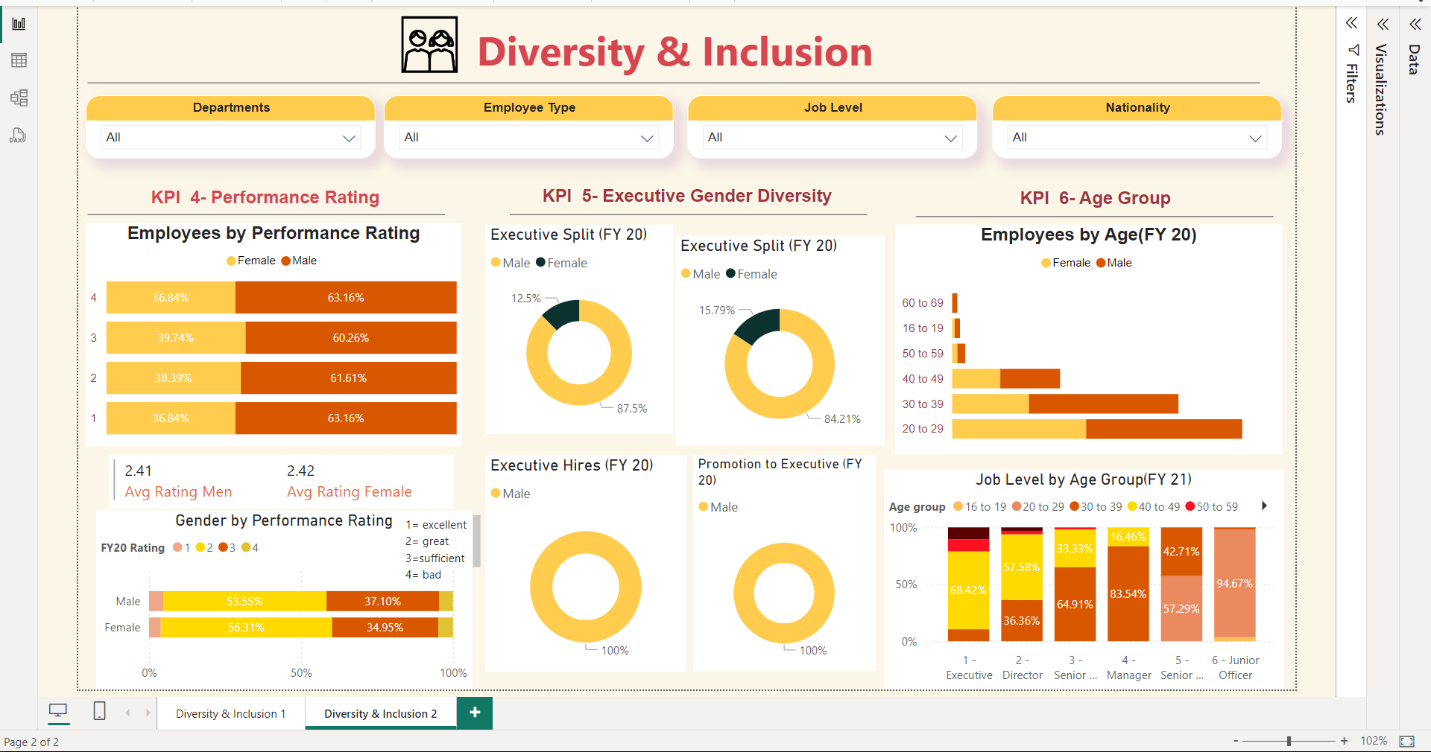

Slide 21
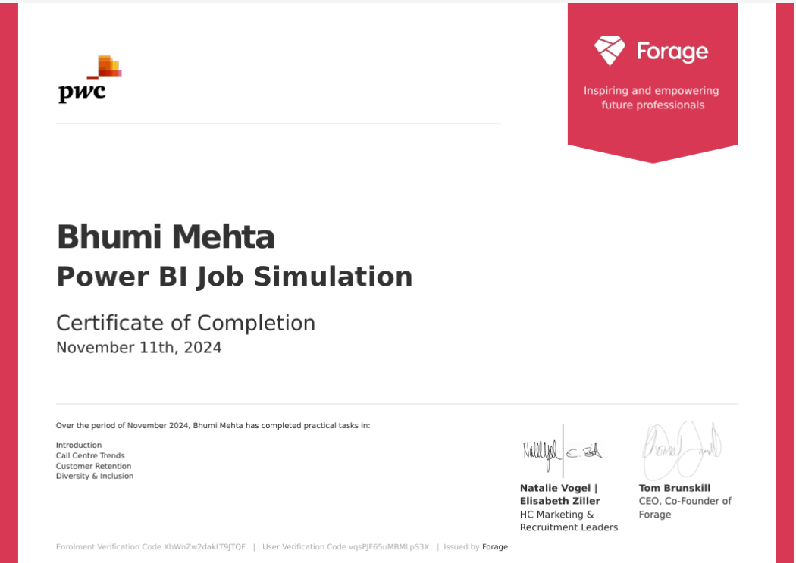
Certificate

Slide 22
Thank You!

