Slide 1

Stock Market Reactions of the Airline Industry During the First and Second Waves of COVID-19
A Study on 15 Global Airlines’ Stock Performance in 2020
Presented by: Group1

Slide 2
Why Study Airline Stocks?
COVID-19 caused a 60.2% drop in global passenger demand (IATA, 2021), making airlines a critical case for crisis response.
Governments imposed travel bans, grounding 66% of fleets (ICAO, 2020), triggering unprecedented stock volatility

Slide 3
Research Objective
Objective:
Analyze adjusted close prices and trading volumes across 15 airlines during Wave 1 (Jan- Jun) and Wave 2 (Jul- Dec).
Research Question:
RQ1: Relationship between stock volume and prices?
RQ2: Difference in prices/volumes between waves?

Slide 4
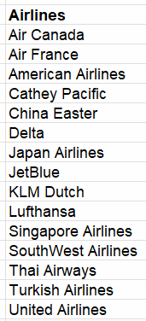
Methodology & Cleaning Process
Data Source: Yahoo Finance (15 airlines, 1/1/2020 – 12/31/2020)
Tool Used: Excel
Data Pre-Processing Steps:
Data Type Conversion: Fixing numeric, standard unit and text mismatches
Feature Engineering: Added new ‘Wave’(1 or 2) Column
Conditional Formatting

Slide 5
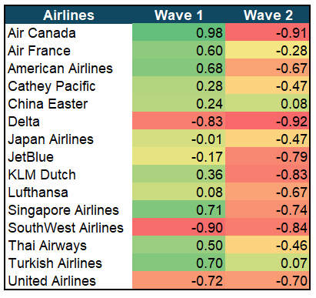
RQ1: Correlation Analysis
First Wave(Jan-Jun): Negative correlation: Delta: -0.83 Southwest: -0.90 Indicates panic selling when prices fell | Second Wave(Jul-Dec): 12/15 airlines showed negative correlations. Strongest: Delta(-0.92) , KLM(-0.83) Suggests profit-taking during price increases.
Relationship between stock volume and prices?

Slide 6
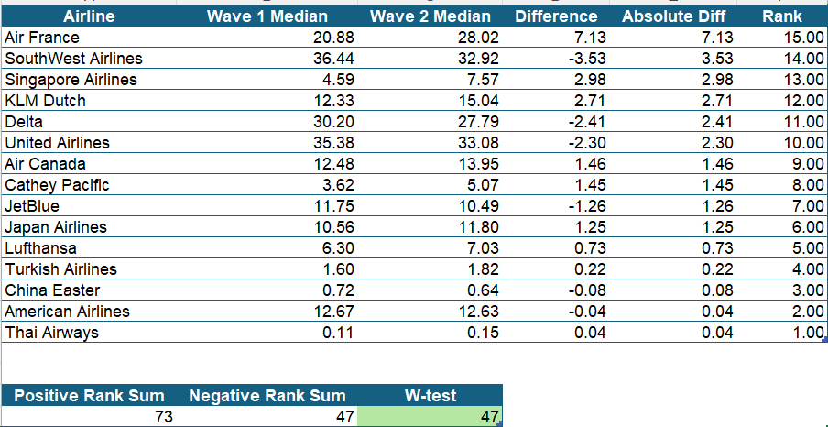
RQ2: Wilcoxon Test
Difference in prices between waves?
W-test(47) > Critical Value(25)
No Significant Recovery
Top Performers:
Air France
Singapore Airlines
KLM Dutch

Slide 7
RQ2: Trend Analysis
Trading Volume:
Trading volume depend on the airlines and the timeframe.
Majority airlines has lower trading volume in 1st wave compared to the 2^{nd.}
Stock Price Trends:
Prices declined from February to mid-2020.
Recovery observed in the following months, aligning with the 2nd wave rebound

Slide 8
Implications & Recommendations
Strategic Recommendations:
For Airlines:
Maintain emergency cash reserves, Develop crisis management plans
Develop cargo/diversification strategies
For Investors:
Monitor volume spikes as early warning signs
Adapt investment strategies.
Future research implications:
Explore other industries’ stock behavior during crises.
Study long-term post-pandemic stock performance for extended insights.
Incorporate social media sentiment analysis to understand investor psychology.

Slide 9
Conclusion
Key Findings from Analysis:
Wave 1: Panic-driven sell-offs (March-April 2020)
Wave 2: Cautious investor adaptation
Trading volumes stabilized faster than stock prices
Airline Industry Resilience & Challenges:
Stocks were hit hard but showed gradual recovery
Uneven adaptation among airlines shaped market rebound
Investor confidence returned slowly amid ongoing risks
Takeaway:
Long-term structural changes are crucial for industry stability.

Slide 10
Thank You!

