Slide 1

Data Structures and Algorithms
NAME: Bhumireddy Sudharshan Reddy
REG : 12210632

Slide 2
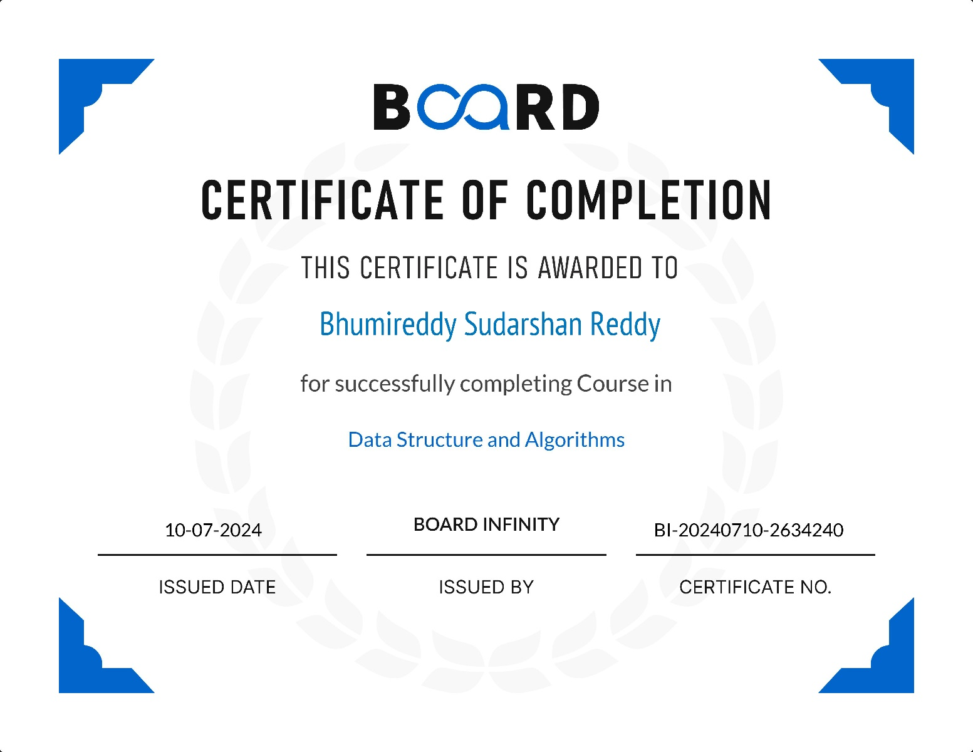

Slide 3
About Summer Training
In this summer training I were learned about the Data Structures and Algorithms using CPP in Board
Infinity.
This training covers the fundamentals of DSA and progresses to advanced topics.
This DSA program improved the ability to develop efficient, scalable code for real-world applications.
This Summer training advanced my coding skills, problem solving skills and also logical thinking.

Slide 4
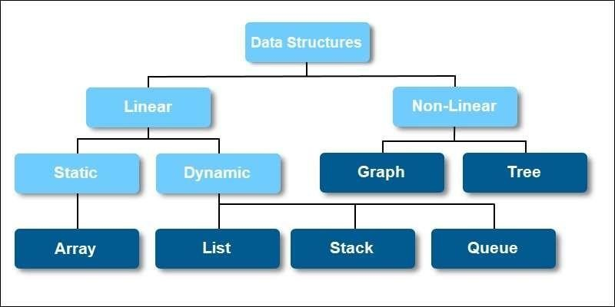
Data Structures and it’s types:

Slide 5
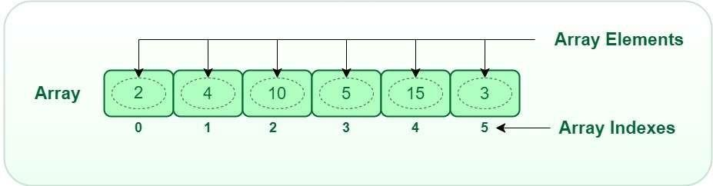
Arrays:
Array is a linear data structure where all elements are arranged sequentially.
It is a collection of elements of same data type stored at contiguous memory locations.
Operations in arrays: Traversing , Insertion , Deletion and Searching operation.

Slide 6
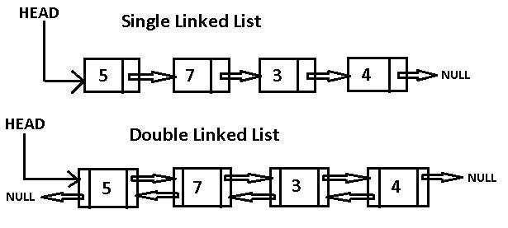
Linked List:
A linked list is a linear data structure where elements, known as nodes, are stored at different memory locations and are connected via pointers.
Each node contains data and a pointer/reference to the next node in the list.
Types: Single Linked List, Double Linked List, Circular Linked List.

Slide 7
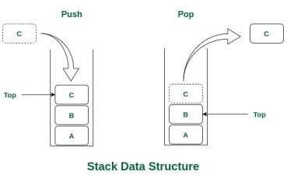
Stack:
A Stack is a linear data structure that follows a particular order in which the operations are performed.
The order may be LIFO(Last In First Out) or FILO(First In Last Out).
LIFO implies that the element that is inserted last, comes out first and FILO implies that the element that is inserted first, comes out last.
Operation in Stack: Push(), Pop(), peek(), isEmpty(), isFull()

Slide 8
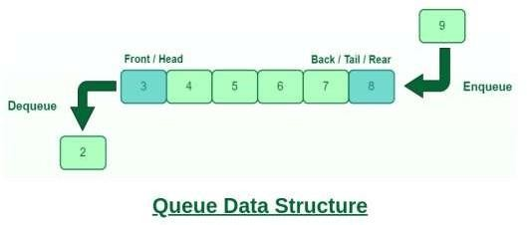
Queue:
A queue is a linear data structure that follows the First-In-First-Out (FIFO) principle.
This means that the first element added to the queue will be the first one to be removed, much like a line of people waiting at a ticket counter—those who arrive first are served first.
Queue Operations: Enqueue, Dequeue, Peek, isEmpty, isFull.

Slide 9
Trees:
Tree Data Structure is a non-linear data structure in which a collection of elements known as nodes are connected to each other via edges such that there exists exactly one path between any two nodes.
The topmost node of the tree is called the root, and the nodes below it are called the child nodes. Each node can have multiple child nodes, and these child nodes can also have their own child nodes called leaf nodes, forming a recursive structure.
Operations in Trees: Inorder (Left -> Root -> Right), Preorder ( Root -> Left -> Right), Postorder (Left -> Right -> Root)

Slide 10
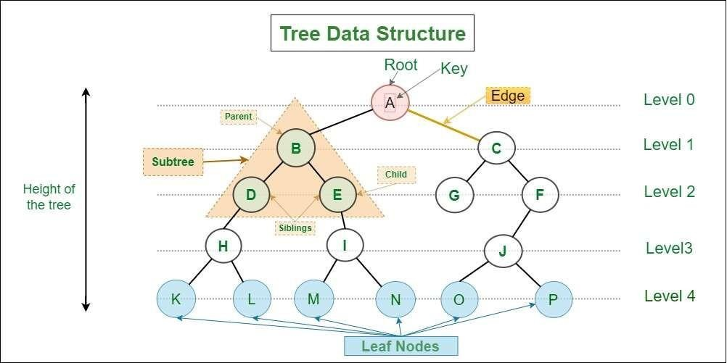

Slide 11
PROJECT: Library Management
System
The Library Management System (LMS) project is designed to develop a basic system for managing books within a library using C++.
This system is aimed at helping students apply their knowledge of data structures and algorithms to solve real- world problems.
The project encompasses the implementation of various features such as adding new books, searching for books, issuing and returning books, listing all books, and deleting books. Through this project, students will gain practical experience in managing data and implementing essential algorithms.

Slide 12
Arrays:
Use arrays for simple storage of book data. Arrays provide quick access by index but require resizing if the library expands.
Linked Lists:
Utilize linked lists for dynamic storage. This structure allows for efficient insertions and deletions but requires more memory due to pointers.
Stacks and Queues:
Employ stacks or queues to manage book issuance and returns. These structures help in maintaining the order of operations.
Search Algorithms:
Implement linear search for unsorted data and binary search for sorted data to locate books efficiently.
Sorting Algorithms:
Use quick sort or merge sort to arrange books in a sorted order. Sorting is essential for displaying books in a systematic manner.

Slide 13
Adding a New Book:
Users can input a unique book ID, title, and author to add a new book to the library collection.
Searching for a Book:
Users can search for a book either by its title or unique ID. The system displays detailed information if the book is found; otherwise, it notifies the user that the book is not found.
Issuing and Returning a Book:
Books can be marked as issued or returned. The system manages the availability status (isAvailable) accordingly.
Listing All Books:
Displays a comprehensive list of all books currently stored in the library, including their ID, title, author, and availability status.
Deleting a Book:
Allows the removal of a book from the library collection based on its unique ID.

Slide 14
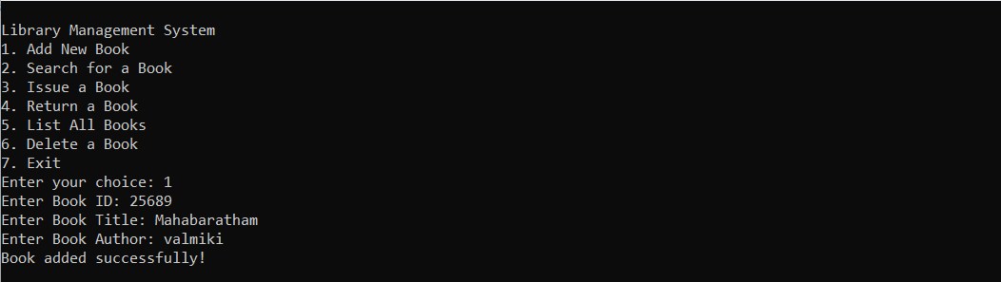

Slide 15
Conclusion
Data Structures and Algorithms (DSA) help in understanding how data is organized, managed, and used efficiently.
Learning about data structures like arrays, linked lists, stacks, and queues, along with algorithms like sorting and searching, shows how to solve complex problems better.
DSA concepts are not just theoretical but are important in software development to create faster and more efficient solutions.
The Simple Library Management System project helps students apply what they've learned in a real-world context, bridging theory and practice.
This project improves understanding of data structures and algorithms and builds essential problem-solving skills needed for software development.

Slide 16
“THANK YOU”

