Slide 1


Slide 2
Problem Statement
In the digital age, students face an overwhelming number of online resources, including articles, videos, and interactive tools.
While these resources are valuable, this information overload can lead to confusion and wasted time, making it difficult for students to maintain a clear path in their learning, hindering their academic progress.

Slide 3
Stakeholders
The stakeholders are primarily Students. Teachers looking for a service to curate teaching material may also be considered as stakeholders.

Slide 4
Market Size
$411
Bn
$108
Bn
$58 Bn
2019
2024
2034
Source: https://www.futuremarketinsights.com/reports/edutech-market#:~:text=Edtech%20Market%20Outlook,to%20hit%20US%24%20411.566%20billion

Slide 5
Current Market Scenario
Key competitors in the EdTech space like Coursera, BYJUs, Udemy help students with the relevant materials while being limited to traditional tutoring methods, online courses and educational apps that provide the same structured learning paths for all.

Slide 6
Solution
Sensei tackles this challenge by offering students an AI-powered mentor that delivers concise, highly relevant information tailored to their specific subjects. By focusing on what truly matters, Sensei ensures that students can concentrate on key concepts and achieve a deeper understanding, ultimately enhancing their learning experience and academic performance.

Slide 7
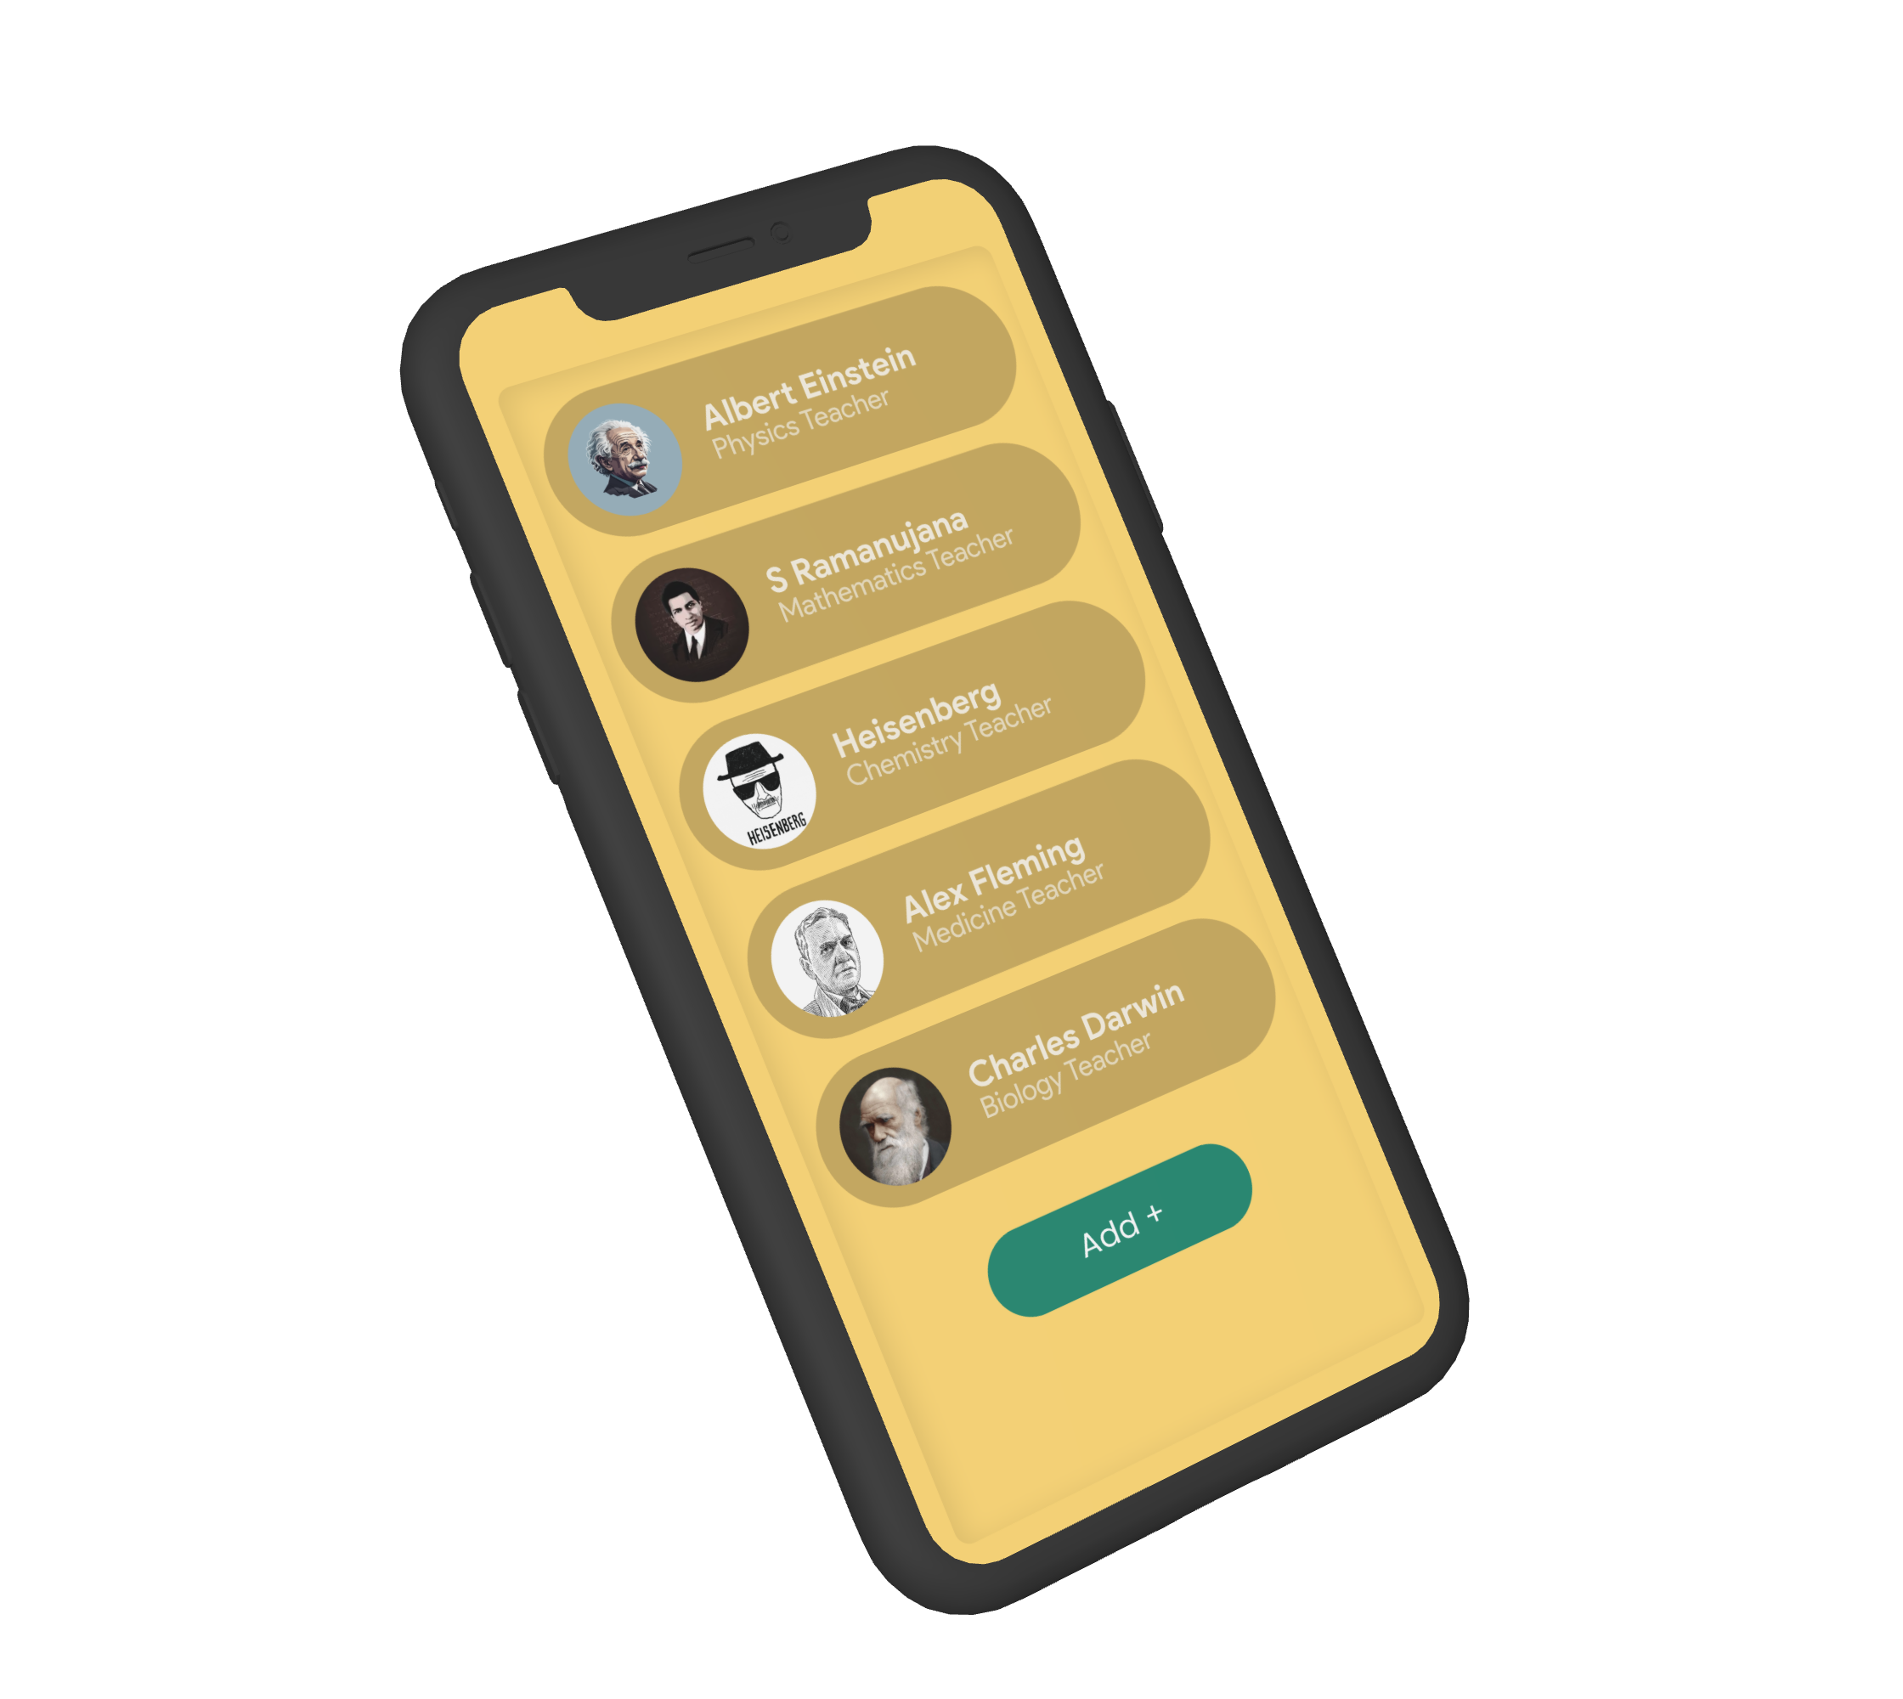
What Is SENSEI?
Sensei is an application where you can take guidance of AI-powered mentors that help in curating study material. It also has advanced doubt clearing capabilities.
Our preventive strategies improve platform reliability and speed, fostering better engagement.

Slide 8
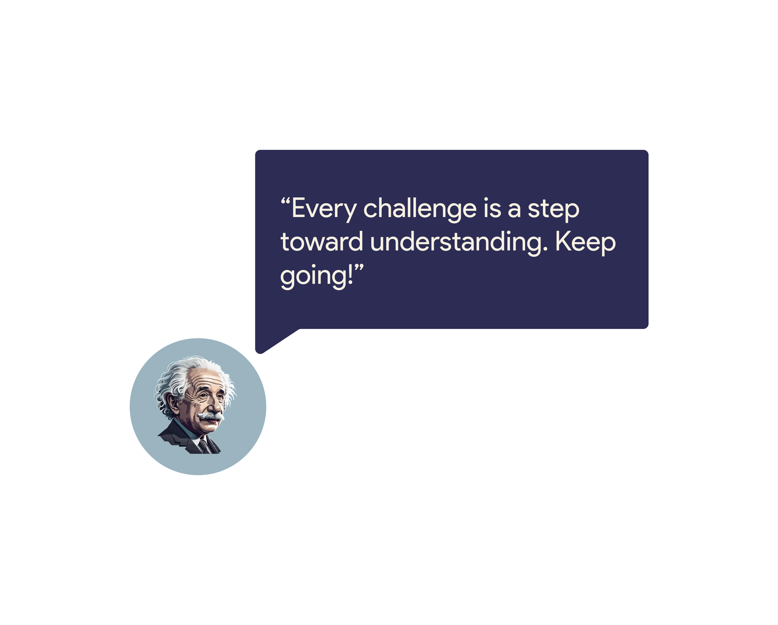
What Makes It Unique?
Imagine learning Physics from Einstein, Mathematics from Ramanujan and Biology from Charles Darwin themselves. With Sensei, It is no longer impossible.
Learn from eminent personalities from the vast library of avatars that we made to make your learning more interactive.

Slide 9
Tech Stack
Python
MongoDB
Python Libraries for Frontend
HTML, CSS, JS

