Slide 1


Domain:

Slide 2
Vinyasa
Sanskrit word for Movement

Slide 3


Slide 4
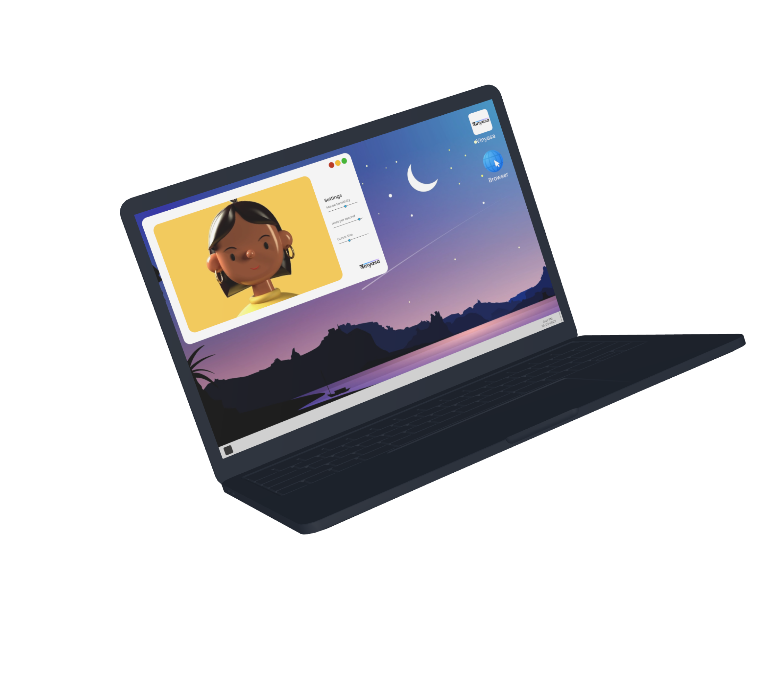
We designed a software to help people with disabilities to navigate through their computer by simple head movements.

Slide 5
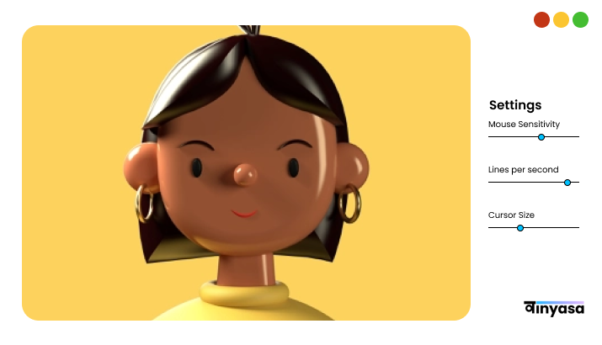
Simple and easy-to-use Interface

Slide 6


Slide 7

Our software is for people who have zero or restricted motor abilities due to chronic illnesses or due to injury.

Slide 8
Our software will also be extremely useful for people who had their forelimbs amputated.

Slide 9


Slide 10
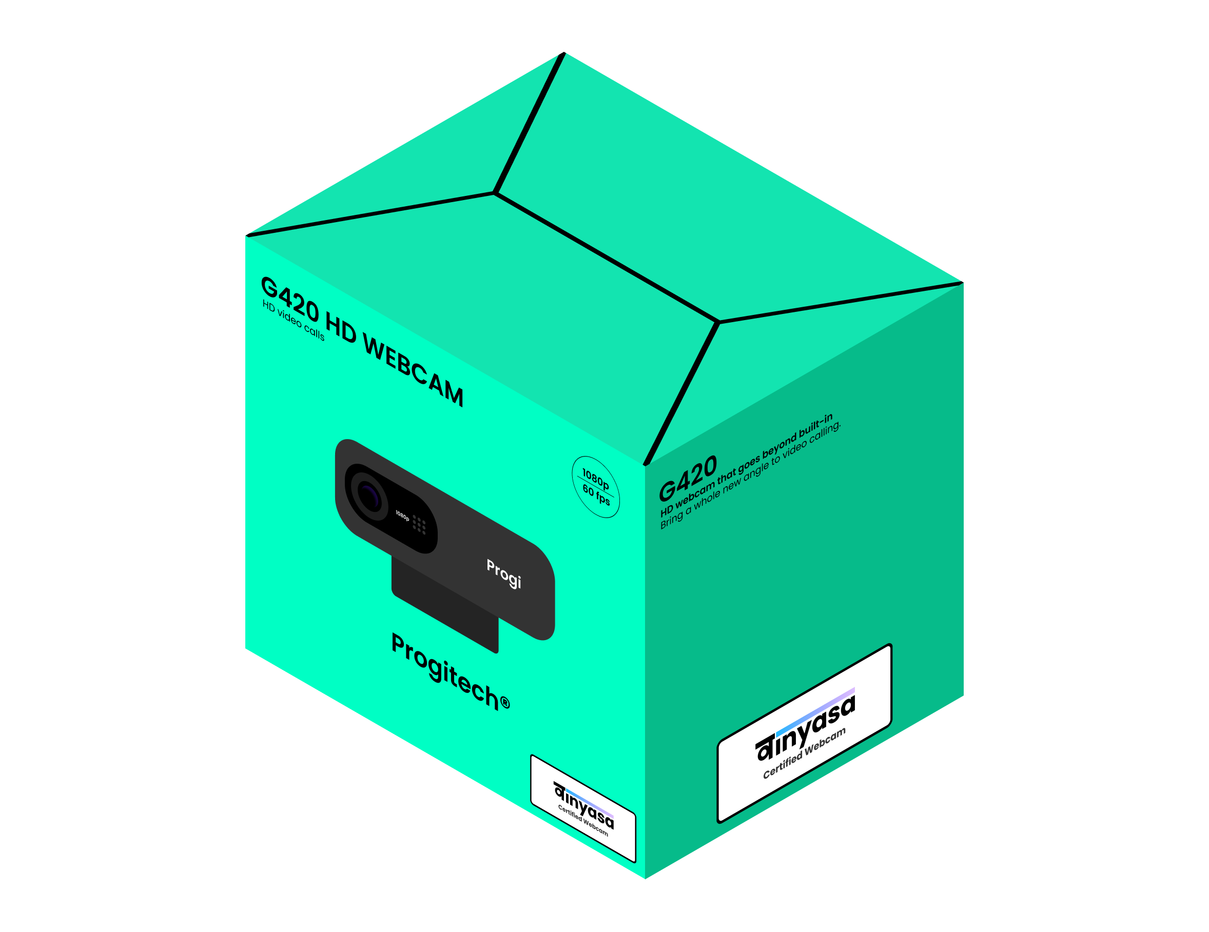
Certifications for products
We will provide webcam manufacturers licenses to use our logo as a mark of trust for the consumers.

Slide 11
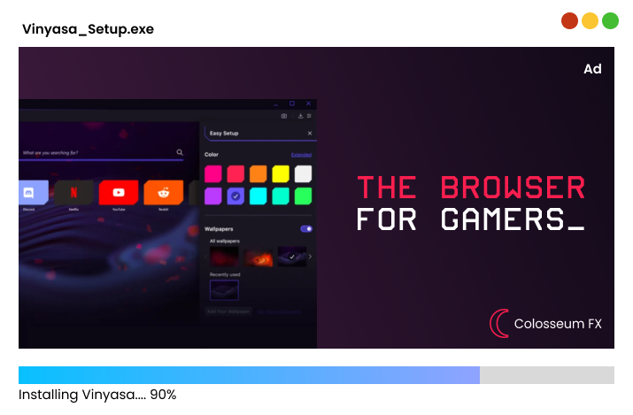
Advertisements in the installer
We will put advertisements of products in the installer of Vinyasa for additional revenue.

Slide 12


