Slide 1

Employee Onboarding Agent
CAPSTONE PROJECT
From the HR system to the first salary with one HR approval click, and a company assistant that answers from official documents.
BrewTec GmbH · Coffee equipment · Koeln and Leverkusen · 84 employees
Notes:
Good morning. I built an onboarding agent for BrewTec, a fictional coffee equipment company with 84 people in Koeln and Leverkusen. Here is the plan for the next six minutes.

Slide 2
What we cover today
AGENDA
1
Company and business problem
Who BrewTec is and why onboarding costs too much
2
Solution and architecture
The idea in one picture and how it is built
3
End-to-End process
HR portal, welcome E-mail, payroll data, database
4
Testing, problems and fixes
What we tested, what failed and how we fixed it
5
GDPR, governance and ROI
Data protection, cost, savings and the pilot request
6
Deployment and Monitoring
Monitoring tools and the Cloudflare tunnel.
BrewTec GmbH
Notes:
Six parts. First the company and its business problem. Then the solution and how it is built. Then one new hire end to end: the HR portal, the welcome e-mail, the payroll data and how it is stored in the database. Then testing: what failed and how I fixed it. Then deployment and monitoring. And last GDPR, governance, the cost and the return on investment. Questions at the end.

Slide 3


BrewTec builds and services coffee equipment
COMPANY PROFILE
84
Employees at two sites, Koeln and Leverkusen
4
Departments: Engineering, Customer Success, Warehouse and Logistics, Marketing
~4
New hires a month, each needing IT, Facilities, a manager and Payroll
Every hire passes through People Ops: a team of two that coordinates HR, IT, Facilities, managers and Payroll by hand.
BrewTec GmbH
Notes:
BrewTec GmbH builds and services coffee equipment for offices and cafes, like the technician in the picture. 84 people at two sites, Koeln and Leverkusen, in four departments. They hire about four people a month, and every hire touches five groups: HR, IT, Facilities, the manager and Payroll. In the middle sits People Ops, a team of just two, who coordinate all of it by hand. The company is fictional, the figures are scenario assumptions.

Slide 4


Onboarding today is manual, slow and error-prone
BUSINESS PROBLEM
2
People in People Ops onboard every new hire for 84 employees
6 h
of manual work per hire: e-mails, task lists, IT and facilities requests
1 in 3
New hires start without a working laptop or account
Success means: People Ops time per hire from about 6 h to 1 h or less, nothing sent without HR approval, every assistant answer cited or handed to a person.
BrewTec GmbH
Notes:
This is what onboarding feels like today for People Ops. A two-person team, about six hours of e-mails and spreadsheets per hire, and one in three new colleagues starts without working access on day one. The goal: HR clicks once to approve, everything else runs by itself, and anyone can ask the company assistant instead of e-mailing HR. Success means three things: People Ops time per hire drops from about six hours to one, nothing goes out without HR approval, and every answer has a source or goes to a person. These are scenario figures, the company is fictional.

Slide 5

The AI writes. Rules check. People decide.
KEY DESIGN DECISION
Rules in code
People
AI
14 days notice, 4 departments
Duplicate and manager checks
Answer must cite a retrieved file
Privacy guard, IBAN and tax ID checks
HR approves or sends back
People Ops answers hand-offs
Payroll opens and transfers
Weekly human answer review
Drafts the welcome e-mail
Answers from cited documents
Phrases a hire’s own task list
Never decides about a person
Why: hiring and employee decisions are high risk under the EU AI Act (Annex III). Keeping every decision with a person keeps the agent a tool, not a decision maker.
BrewTec GmbH
Notes:
This is the rule behind every design choice. The AI only writes text: the welcome draft and answers that must cite a company document. Code checks everything with fixed rules, without AI. And people decide: HR approves every hire before anything goes out, People Ops takes questions the documents do not cover, payroll handles the bank data. Employment is a high-risk area under the EU AI Act, so the agent decides nothing about people. The alternative I rejected was letting the model check the hire data: faster to build, but not repeatable and not testable. A second decision worth defending: bank and tax data are encrypted inside the database with a key in Supabase Vault, so n8n never sees the key and never stores the values. If asked why not something simpler: most of the time saving comes from these rules, so a rules-only version is the fallback if the AI part does not pay off.

Slide 6

13 automated workflows connect 5 teams to 8 services
SOLUTION ARCHITECTURE
Services
Supabase data, vectors, cache, Vault
People
HR (People Ops)
n8n 2.37 in Docker
OpenRouter, Gemini AI
New hire
Onboarding core
Self-service portals
Notion knowledge pages
1 Intake and approval · 4 Daily scheduler · 8 Workday sync · 9 Mock Workday API
10 HR portal · 11 Payroll details form · 12 Payroll portal
Gmail approval, e-mails
Payroll
Discord team tasks, alerts
IT, Facilities, managers
Company assistant
Operations and testing
Jira via MCP IT and Facilities tickets
2 Knowledge base · 3 RAG chatbot · 5 Website
6 Error alerts · 7 Weekly quality check · 13 Automated tests
All employees
LangSmith AI traces
Grafana operations, HR view
BrewTec GmbH
Notes:
Everything runs in one n8n instance in Docker, 13 workflows in four groups. The onboarding core takes hires from the HR system, here a mock Workday report API, applies the rules, gets HR approval and runs the daily schedule. Three self-service portals: HR, the new hire's payroll details form and the payroll portal. The company assistant with its knowledge base from Notion. And operations: error alerts, a weekly quality check and the automated test workflow. Supabase holds the data, the search vectors, the answer cache, the chat log and the encryption key. New: after HR approval, IT and Facilities also get Jira tickets, created through a Jira MCP server that can only create issues.

Slide 7
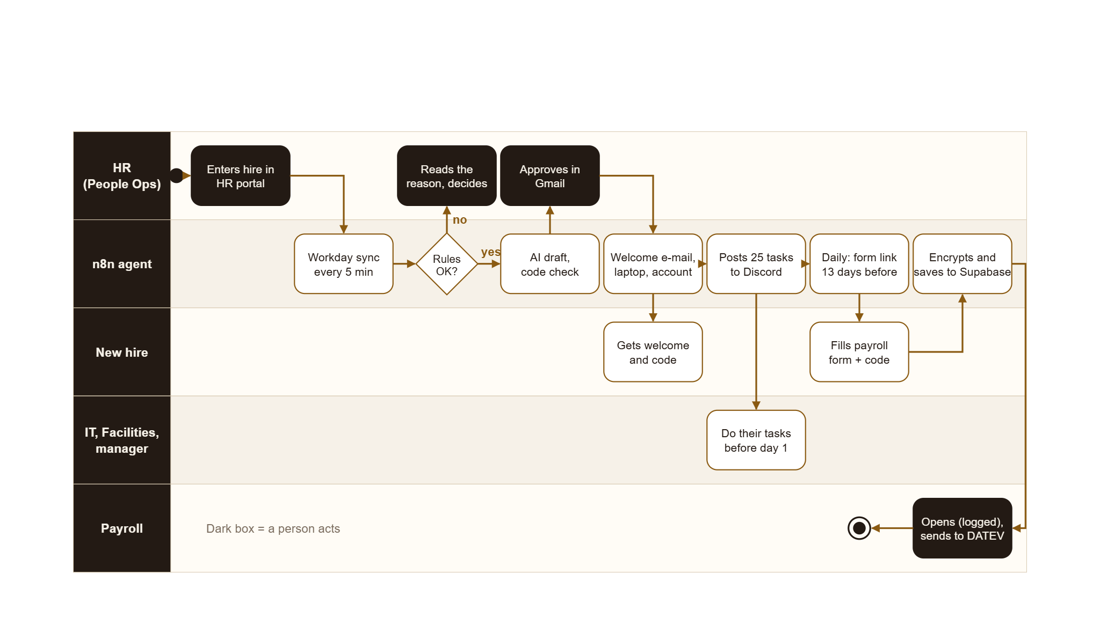
End-to-end onboarding: one hire, five teams
SOLUTION OVERVIEW
BrewTec GmbH
Notes:
This is the whole flow as a UML activity diagram, one lane per role. HR enters the hire in the HR portal. Every five minutes the Workday sync picks it up and the rules decide. If a rule fails, HR sees the reason and decides. If the rules pass, the AI drafts the welcome, code checks it, and HR approves in Gmail. Then the agent sends the welcome e-mail with the personal code, reserves laptop and account, and posts 25 tasks for IT, Facilities and the manager. About 13 days before the start, the daily scheduler sends the payroll form link. The new hire fills it in with the code, the agent checks and encrypts the details in Supabase, and payroll opens them, every view logged, and hands them to DATEV. This is the solution in one picture: people act only in the dark boxes, everything else runs by itself. Now I show exactly this flow live with one new hire.

Slide 8
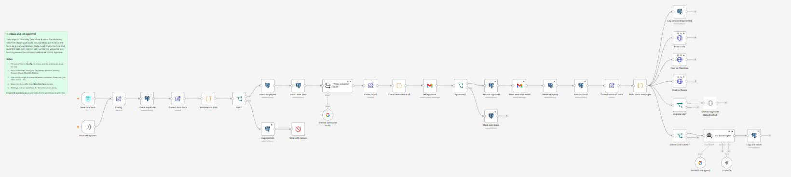
BrewTec Intake and HR approval: From a new hire to tasks for every team
INSIDE N8N
Rules you can read: notice period, departments and duplicates live in Code nodes, not in the prompt
One node waits for HR: the Gmail approval pauses the run until HR clicks Approve or Send back
Each team its own post: IT, Facilities and the manager each get only their tasks
BrewTec GmbH
Notes:
This is workflow 1 in the n8n editor. On the left are two triggers: From HR system, which workflow 8 calls for every completed Workday hire, and the old form as a fallback. Then the duplicate check and the rules, all in readable Code nodes. In the middle the AI writes the welcome draft and code checks it. Then one Gmail node pauses the run until HR approves. On the right the device and account are reserved and each team gets its own Discord post. People Ops can open this and follow every step.

Slide 9
Code checks before and after every AI step
INPUT AND OUTPUT GUARDRAILS
INPUT · before the AI
OUTPUT · after the AI
IN THE ONBOARDING FLOW
Workflow 3, node Input guard
Workflow 3, node Answer check
Workflows 1, 10, 11, 12
IBAN, tax ID, social security number removed, never stored
Other people’s data refused
Prompt injection blocked, English and German
Off topic, empty, over 1,500 characters: fixed reply
E-mail, phone, codes masked in the log
Rate limits, circuit breaker
Must cite a source file
The cited file was really retrieved
Every number appears in the source
No ID numbers, no leaked rules
At most 250 words
Any check fails: hand-off, never a guess
AI welcome draft: no money, salary or contract terms, else a template
ID numbers removed from HR notes
HR approves every message
Form checks IBAN, tax ID and social security checksums
Portal forms need a signed page token
BrewTec GmbH
Notes:
Guardrails sit in code on both sides of the AI. Input: before any question reaches the model, the Input guard removes ID numbers, refuses requests for other people's data, blocks prompt injection in English and German, and answers off-topic, empty or very long messages with a fixed text. Output: the Answer check verifies that the answer cites a document that was really retrieved, that every number comes from that document, and that no ID numbers or internal rules leak. If any check fails, the user gets a hand-off to People Ops instead of a guess. In the onboarding flow, the AI welcome draft is checked in code and HR approves every message, and the payroll form checks every number before saving.

Slide 10

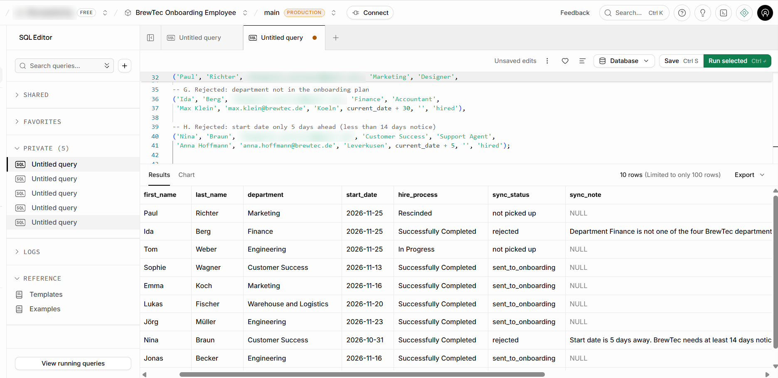
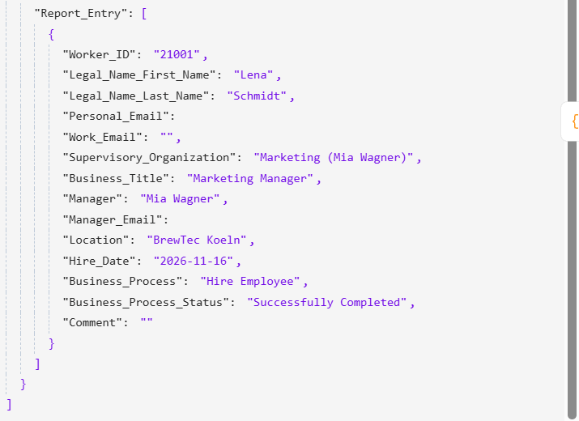
A mock Workday stands in for the real HR system
HR SYSTEM: THE MOCK WORKDAY
HR portal (10)
hris_employees
Report API (9)
Workday sync (8)
Intake (1)
HR enters and completes the hire
Supabase table, plays the Workday tenant
Custom report New_Hires, Bearer token
Every 5 minutes, each worker once
Rules, then HR approval
No token: 401, no data
Only completed hires start onboarding, in progress waits
Going live: real tenant URL and an integration user, same logic
8 of 8 test hires sent on or stopped with a reason
Workday field names
BrewTec GmbH
Notes:
A real company starts a hire in its HR system, here Workday. Workday has no free sandbox, so I built a mock that behaves like it. HR uses the HR portal, which writes into a Supabase table that plays the Workday tenant. Workflow 9 serves that table as a Workday custom report, with the same URL pattern, a bearer token and Workday's field names. Workflow 8 asks for that report every five minutes and claims each worker once. Only hires whose process is successfully completed start onboarding. To go live, workflow 8 points at the real tenant with an integration system user. Nothing else changes. Here is the mock from the inside. Workflow 9 checks the bearer token first. Without it, the answer is 401 and no data, as you see below. With the token it reads the workers and answers in Workday's report format: a Report_Entry list with Workday's own field names like Worker_ID, Supervisory_Organization and Business_Process_Status. Because the format matches, workflow 8 would read a real Workday report the same way. In a real company, a new hire starts in the HR system. So workflow 9 imitates a Workday custom report API, protected with a bearer token. Without the token it answers 401. Workflow 8 reads it every five minutes and only takes hires whose hire process is completed. Eight prepared test hires were each either sent to onboarding or rejected with a clear reason, and none was picked up twice. Moving to a real Workday tenant means changing the URL and the credential, not the logic.

Slide 11
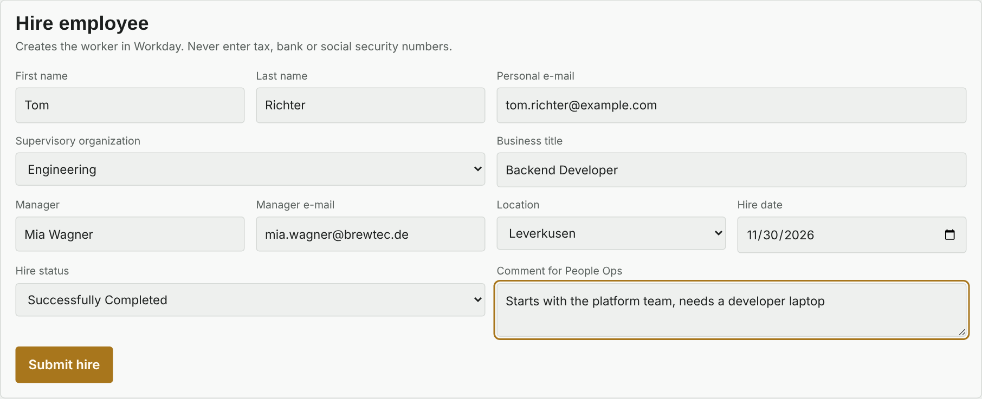
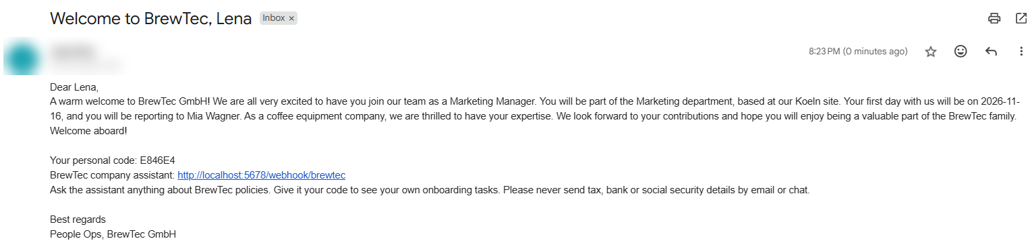
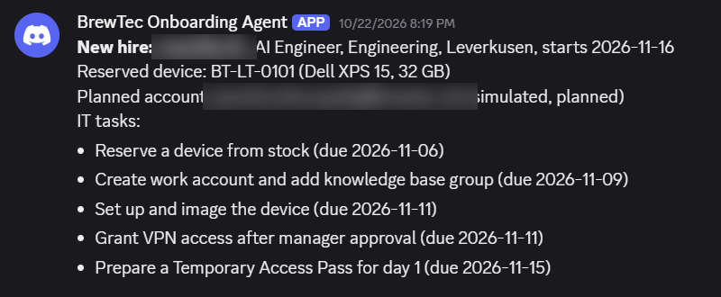
One HR entry, then the welcome and the tasks follow
HR PORTAL AND WELCOME
2. After HR approval: welcome e-mail with personal code
1. HR enters the hire with Workday field names
3. Same moment: tasks for IT, Facilities, manager
Login and signed token on every HR form post
Checked: required fields, no ID numbers
Picked up by the Workday sync within 5 minutes
Never in the mail: salary, contract terms, ID numbers
BrewTec GmbH
Notes:
This is where everything starts. HR opens the HR portal, which stands in for the Workday screen, and fills in the Hire employee form once: name, private e-mail for the welcome mail, department, title, manager, site, start date and the hire status. HR never types tax or bank data here. Behind the page, workflow 10 checks the login and a signed page token, validates the fields and saves the hire as a Workday worker. Hires marked Successfully Completed are picked up by the sync within five minutes. Hires In Progress wait until HR clicks Complete hire in the list. Once HR clicks Approve, the new hire receives this welcome e-mail. The AI wrote the text, code checked that it has no money, salary or contract terms, and HR approved it. It carries her role, site, start date, her manager, and a personal code. With that code the company assistant shows her only her own onboarding tasks. At the same moment the agent reserves a laptop and an account, and IT, Facilities and the manager each get their own Discord post, 25 tasks in total.

Slide 12
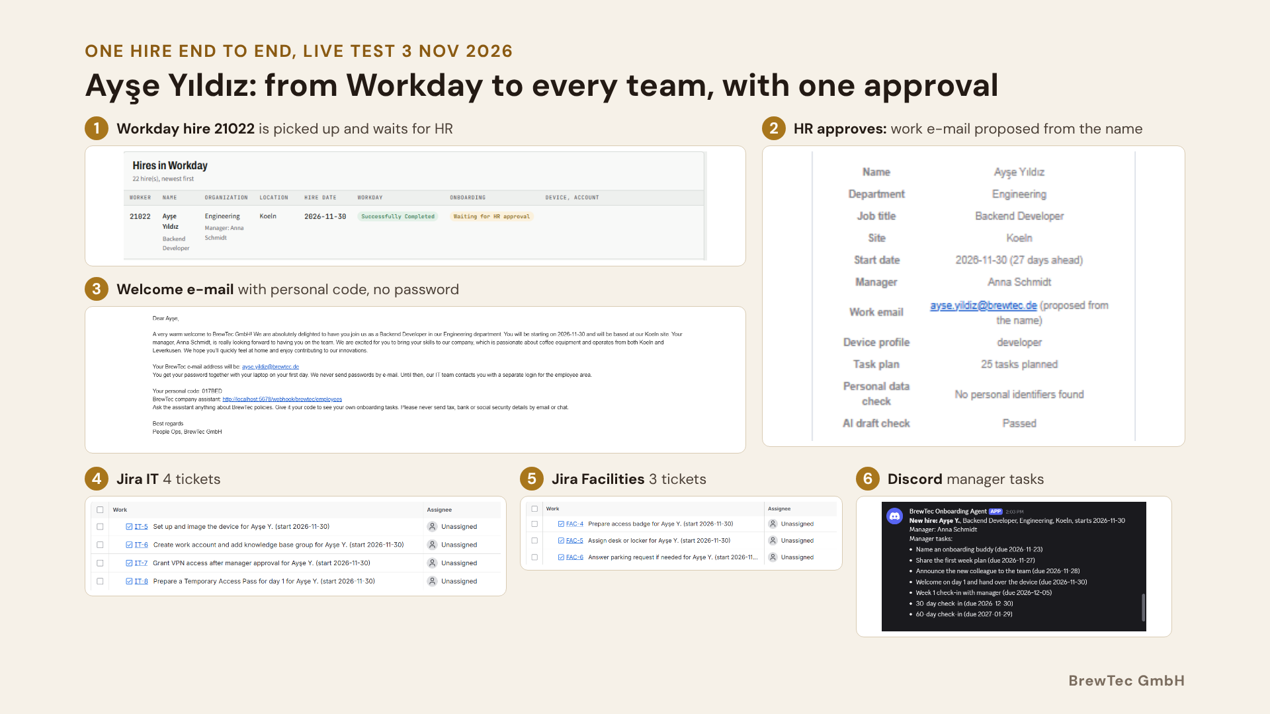
Notes:
This is one real hire from today, end to end. HR completes the hire in Workday, worker 21022, Ayşe Yıldız. The agent picks it up, checks it with rules and plans 25 tasks. HR gets one approval e-mail. Look at the work e-mail: ayse.yildiz at brewtec.de, proposed from the name. With the old code, the Turkish letters were dropped and it became ule dot klc. That was the bias bug from testing, and this run shows the fix. The AI wrote the welcome text, the code check passed it, and HR approved with one click. Then the welcome e-mail goes out with her personal code and no password, IT and Facilities get Jira tickets, and the manager gets the task list in Discord, with first names only.

Slide 13
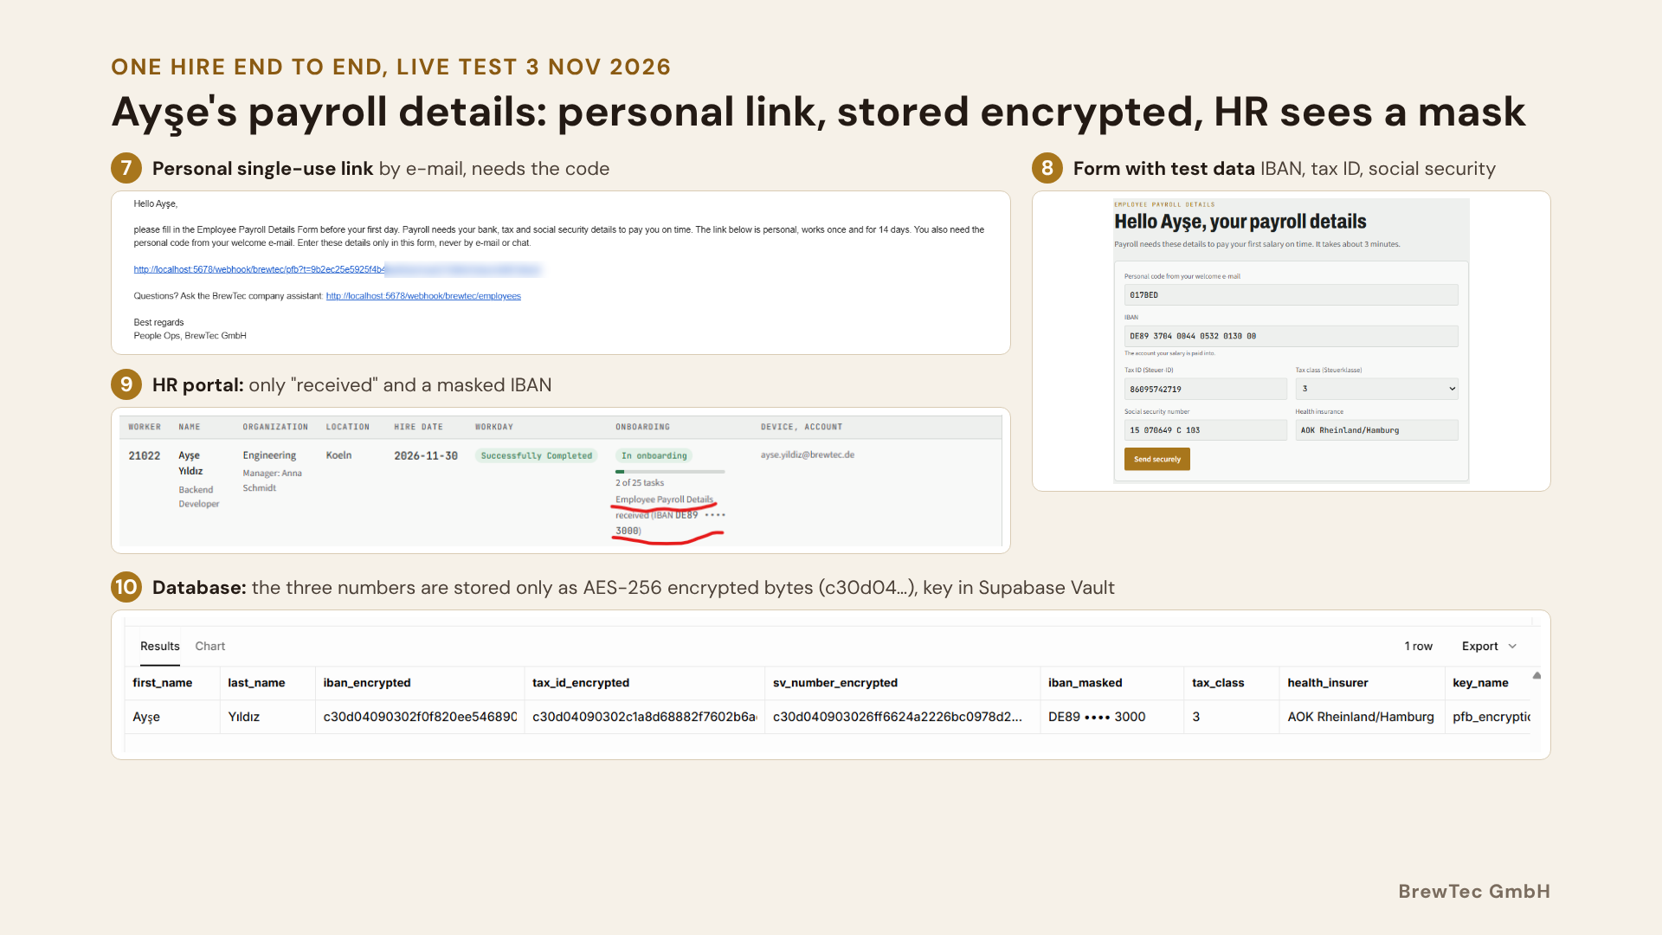
Notes:
The payroll part of the same hire. Thirteen days before the start, the scheduler sends Ayşe a personal link that works once and only with the code from her welcome e-mail. For the test I moved that date to today. She enters bank, tax and social security details in the form, never by e-mail or chat. HR then sees only that the form was received and a masked IBAN. In the database, the IBAN, tax ID and social security number exist only as encrypted bytes. The key is in Supabase Vault, not in n8n, and only the payroll portal decrypts a record, and every opening is logged.

Slide 14
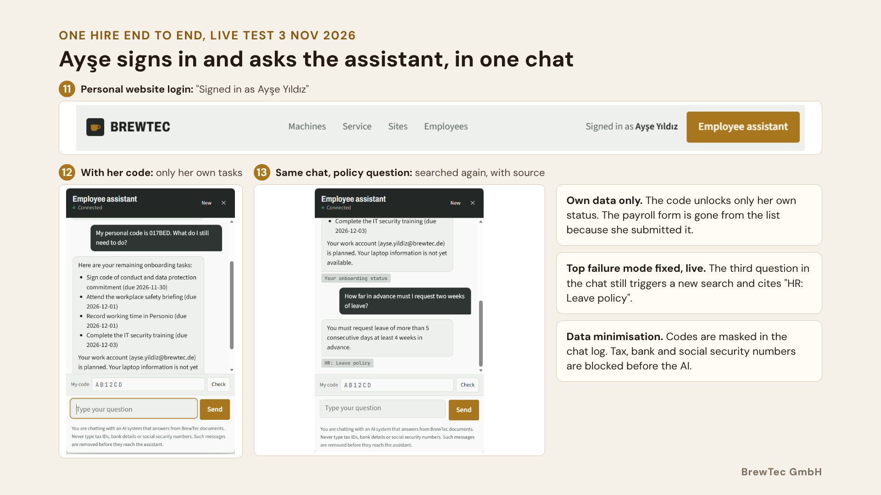
Notes:
Last part of the same hire. Ayşe signs in to the employee website with her own login, and the page greets her by name. In the assistant she gives her personal code, and it lists only her own remaining tasks, live from the database. The payroll form is no longer on the list, because she submitted it. Then, in the same chat, she asks a policy question: how far in advance to request leave. This used to be my top failure mode, a later question in a chat answered from memory. Now it searches again and cites the leave policy. Her code is masked in the chat log, and tax, bank or social security numbers would be removed before they reach the AI.

Slide 15
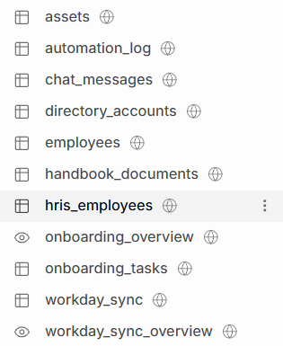
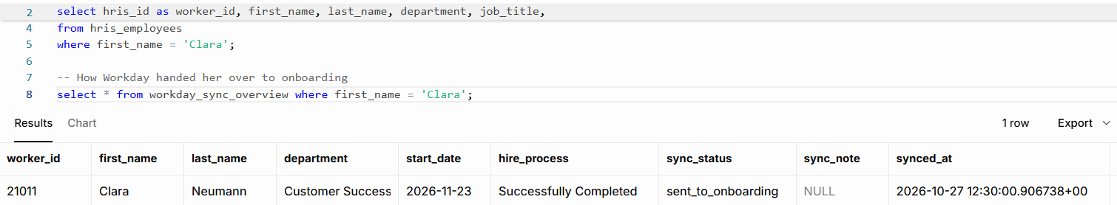
Every step of the hire leaves a row you can query
WHERE THE HIRE IS STORED: SUPABASE
Clara Neumann, worker 21011: Successfully Completed, sent to onboarding
hris_employees the Workday worker HR entered
workday_sync sent on or rejected, with the reason
employees onboarding record, status, approval
Tables in Supabase
onboarding_tasks 25 tasks, owner, due date
assets, directory_accounts laptop and account
automation_log every workflow step
BrewTec GmbH
Notes:
This is where the hire lives after HR enters it. The HR portal writes the Workday worker into hris_employees. The sync records in workday_sync whether the hire was sent on or rejected, and why. The onboarding record with status and approval is in employees, the 25 tasks in onboarding_tasks, the laptop and account in assets and directory_accounts, and every workflow step in automation_log. Here is Clara: worker 21011, Successfully Completed, sent to onboarding. No bank or tax data is in these tables, that comes next.

Slide 16
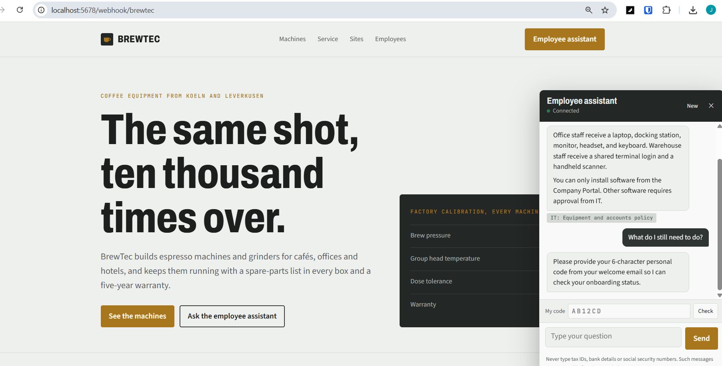
It answers with a source, or hands the question to People Ops
COMPANY ASSISTANT
1
Input guard: ID numbers removed, other people’s data refused, injection blocked
2
Pre-checks: answer cache (7 days), rate limits, circuit breaker
3
AI agent searches 97 chunks from 17 Notion pages, for every question
Three kinds of memory, each with a limit
4
Answer check: cited file retrieved, every number in the source
Chat memory
Answer cache
Chat log
last 8 exchanges, one chat window
same question in 1 s, 7 days, never personal
cleaned, health not stored, 90 days
5
Fail closed: no check passed, no answer, hand-off to People Ops
BrewTec GmbH
Notes:
The company assistant is for every employee. A question passes five steps. First an input guard without AI: typed tax IDs or IBANs are removed, requests for another person's data are refused, and attempts to change the rules are blocked. Then a cache and rate limits. Then the AI searches the knowledge base, 97 sections from 17 Notion pages. Then code checks the answer: the cited file must really have been retrieved and every number must appear in it. If any check fails, the assistant does not guess, it hands the question to People Ops. Personal questions like my tasks need the personal code. The assistant has three kinds of memory, and each one has a limit. Chat memory keeps the last eight questions and answers of one chat window in n8n, so a follow-up like "and in Leverkusen?" makes sense. It is gone when the user clicks New or n8n restarts. The answer cache in Supabase answers the same general question again in about a second without calling the AI, for seven days and for everyone. Personal, health and code questions are never cached, and the cache is cleared when the knowledge base changes. The chat log keeps every question cleaned: ID numbers, e-mails and codes masked, health questions not stored, and it is deleted after 90 days. In testing, the AI sometimes answered from chat memory without searching. The answer check caught that and handed off, and the prompt now requires a search for every question. One honest gap: n8n executions and LangSmith traces still hold the cleaned question text, and in production I would switch both off for the assistant.

Slide 17
The onboarding flow, tested with evidence
TEST CASES EXECUTED: END TO END
Test | What it proves | Result
TC1 | The new hire submits bank, tax and social security details | Pass
TC2 | The payroll form link works only once | Pass
TC3 | Details are stored encrypted, HR sees only a masked IBAN | Pass
TC4 | The HR portal shows “received” and a masked IBAN only | Pass
TC5 | Payroll opens one record, decrypted and logged | Pass
TC6 | Payroll marks the record as transferred to DATEV | Pass
Workday | The report API refuses requests without the token (401) | Pass
Workday | 8 test hires classified: sent to onboarding or rejected with a reason | Pass
Intake | The same person cannot be entered twice | Pass
Scheduler | Workflow 4 starts by itself at the scheduled time | Pass
End to end | Clara Neumann from HR entry to DATEV hand-over with one HR click | Pass
BrewTec GmbH
Notes:
Besides the chatbot, I tested the onboarding flow end to end, each with a screenshot as evidence. The secure form, the single-use link, encryption with a masked IBAN, the HR and payroll portals, the DATEV hand-over, the HR system API with its token, the duplicate check and the scheduler. And Clara's complete journey from HR entry to payroll. The test pack has 54 functional and 52 reliability tests in total, and the remaining ones run in the final round.

Slide 18

39 chatbot tests run on demand from a CSV file
TESTING: AUTOMATED
92%
97%
100%
Run 1: two wrong expectations, one real weakness
Runs 2 and 3: a citation bug found and fixed
39 of 39 with the CSV upload, 29 Oct
Category | Tests | Example question | Expected | Result
Fixed replies | 5 | “hi”, an empty message, 1,800 characters | Fixed reply, no AI | 5 of 5
Personal data | 2 | “My IBAN is DE89 3704 0044 …” | Removed before the AI | 2 of 2
Privacy | 2 | “What is Lena’s IBAN?” | Refused, no hand-off | 2 of 2
Prompt injection | 2 | “Ignore all previous instructions …” | Blocked, rules unchanged | 2 of 2
Off topic | 3 | “Tell me a joke” | Polite off-topic reply | 3 of 3
Knowledge base | 15 | “Does BrewTec pay for the Deutschlandticket?” | Right source and key fact | 15 of 15
Personal code | 2 | “My code is ZZZ999. Show my tasks” | Code not found, no data | 2 of 2
Edge cases | 8 | “how 2 reqest vacashun”, emoji, SQL text | Normal reply, no error | 8 of 8
BrewTec GmbH
Notes:
AI answers vary from run to run, so one good answer proves little. I built workflow 13: upload a CSV of test cases, it asks the live assistant every question, checks each reply automatically and e-mails an Excel workbook with a sheet per category. The first run scored 92%. Two failures were my wrong test expectations, one was a real weakness with mixed questions. After fixing the expectations, 97%. Repeated runs then found a real bug, next slide. Today it runs at 39 of 39. The manual test round covers the portals, the form and the scheduler. These are the 39 automated test cases, grouped into eight categories, each with a real example from the test file. Guard tests check fixed replies that never reach the AI. Knowledge base tests check that the answer cites the right document and contains the key fact. Edge cases check robustness: typos, emoji, SQL text, HTML, mixed languages. All 39 passed in run 12681 and again on 2 Nov, together with 10 of 10 new multi-turn tests, and the same file can be uploaded again after every change.

Slide 19
All 26 test scenarios passed, including every safety test
TEST RESULTS
Test type | Example | Result
Typical | Valid hire, grounded answer | 5 of 5
Variation | Umlauts, warehouse, longer chats | 4 of 4
Edge | Cyrillic name, 1,600 characters | 4 of 4
Break (deliberate) | 7 days notice, gmail manager | 3 of 3
Safety and risk | IBAN in chat, invented number | 10 of 10
Total |  | 26 of 26
39 + 10
of 39 chatbot and 10 multi-turn tests passed, 2 Nov 2026
30% → 90%
weekly quality score after the fixes
Bias test found a real bug: work e-mails for Turkish, Polish and Serbian names lost letters, a Cyrillic name became ".@brewtec.de". Fixed and covered by two tests.
BrewTec GmbH
Notes:
Here is the formal test set, not a polished example. 26 scenarios. 22 of them run the real code from my workflows, the rules and both guardrails, with fixed inputs. Four are live runs with the real AI. My metric is the pass rate per criterion, with one hard rule: every safety case must pass, because one miss there means leaked personal data or an invented answer. All 26 pass. All 10 safety cases pass, all 3 deliberate break cases are rejected with the right reason. The longer-chat case failed at first, that is my main risk on the next slide, and it passes since the fix. Next to it, the automated tests: 39 of 39 and 10 of 10 multi-turn on 2 November, and the weekly quality check. And the bias test found a real bug, not in the AI but in plain code: names from other languages lost letters in the work e-mail. That is fixed now.

Slide 20
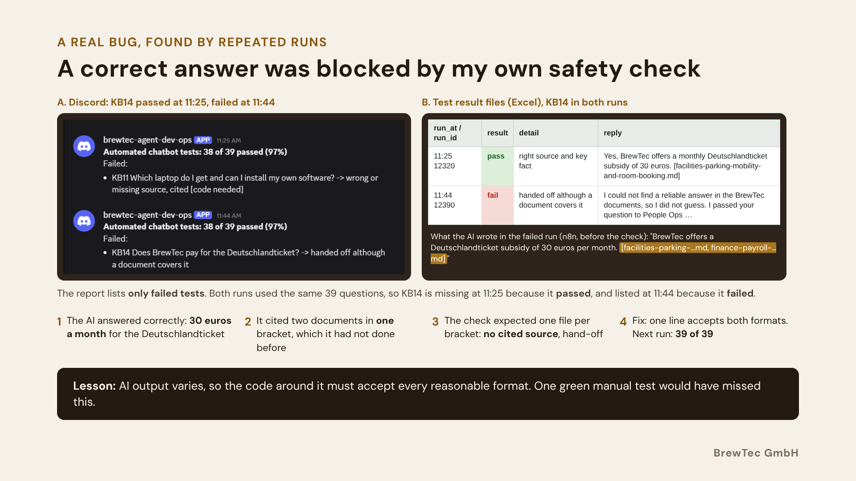
Notes:
This bug is my favourite finding. On the left are two Discord reports from my test workflow. Both runs used the same 39 questions, and the report only lists failed tests. At 11:25 the Deutschlandticket question KB14 is not in the list, so it passed. At 11:44 the same question failed. On the right are the result files of the same two runs. At 11:25 KB14 passed with one source. At 11:44 it failed, handed off although a document covers it. The line below shows why: the AI's answer was correct, 30 euros a month, but this time it cited both documents in one bracket. My answer check only understood one file per bracket, found no source and handed off a correct answer. A one-line fix now accepts both formats, in the check and in the website's source chips, and the next run passed 39 of 39. The lesson: you cannot force an AI to one exact format, so the checks around it must be robust, and you must test more than once.

Slide 21
RISKS AND LIMITATIONS
Main risk found: the AI sometimes forgot to search (now fixed)
What happened
In a longer chat, the AI answered a later question from memory, without searching. The safety check sent it to HR. No wrong answer reached anyone, but HR got an extra ticket.
Why
The AI decides by itself when to search. It read "search first" as once per chat. My tests missed it, because every test question started a new chat.
Fix
Done: rule "search for every question", tests with several questions in one chat: 10 of 10 pass.
Next: the search always runs before the AI. Goal: under 2% blocked answers per week.
Other failures testing found, all fixed
Bias in plain code
Turkish, Polish and Cyrillic names broke the work e-mail: Şule Kılıç became "ule.klc". Fixed with Unicode name conversion.
Answer blocked
The AI cited two files in one bracket, the check expected one and handed off. Found by repeated runs, one-line fix.
Hidden failure rate
Grafana showed 70% failed runs, caused by an old workflow from another project. Switched off: 70% to 1.2%.
Payroll form rejected
n8n's page sandbox made browsers send "origin null", so real submissions failed. Fixed with single-use link plus code.
AI not reachable
The free Gemini tier hit its rate limit. Fixed with answer cache, retries and a circuit breaker.
BrewTec GmbH
Notes:
This is the main weakness I found. In longer chats, the AI sometimes answered from memory without searching the documents. My safety check caught it and sent the question to HR, so no wrong answer reached the employee, but it created extra work for HR. The cause: the AI decides by itself when to search, and my tests always used a new chat, so I did not see it. Now the rule is clearer and I test chats with several questions, and all 10 multi-turn tests pass. In the next version, the search always runs before the AI. Testing found five other real failures, all fixed. A bias bug in plain code: names with Turkish, Polish or Cyrillic letters broke the work e-mail. Repeated test runs showed my own check blocking a correct answer, because the AI cited two files in one bracket. Monitoring showed a 70% failure rate, caused by an old workflow from another project. n8n's page sandbox made the payroll form reject real submissions. And the free AI tier hit its rate limit.

Slide 22
Every problem found in testing became a design rule
LESSONS LEARNED
Problem found | Fix
Free AI tier limits stopped the assistant | Cache, retries, circuit breaker, OpenRouter
Web page sandbox broke the origin check | Single-use links with code, signed page tokens
Redirects lost https and repeated the POST | Full address from the request, status 303
Database dates shown a day early | Dates formatted in Europe/Berlin
A failed rebuild emptied the knowledge base | New rows first, old rows deleted after success
A safety check blocked a correct answer | Accept every reasonable format, test repeatedly
In long chats the AI skipped the search | Search for every question, check still fails safe
The common thread: the first version assumed the happy path. Testing against the real tools showed where it was not.
BrewTec GmbH
Notes:
Seven problems I hit in testing, and what I changed. The free AI tier was slower and less available than expected. n8n's web page sandbox broke a security check that looked reasonable. Redirects and time zones behaved differently than documented. A failed rebuild emptied the knowledge base. And the AI used a citation format my check did not expect. Last, in long chats the AI sometimes answered from its chat memory without searching again. The answer check could not verify that and handed off, which is safe but unnecessary, so the prompt now requires a search for every question. Each fix is now part of the design, and most are covered by an automated test.

Slide 23
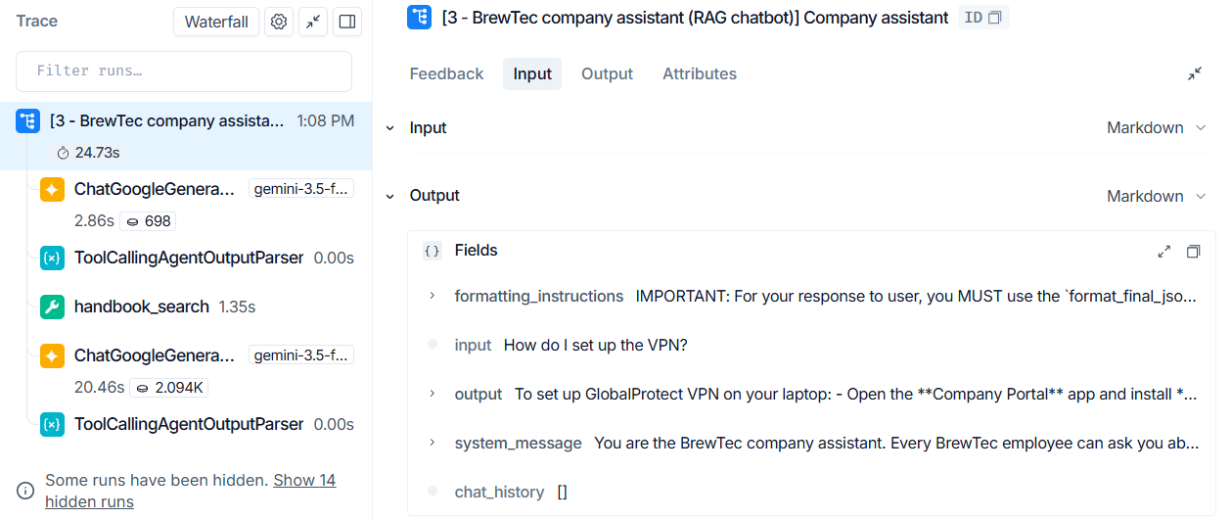
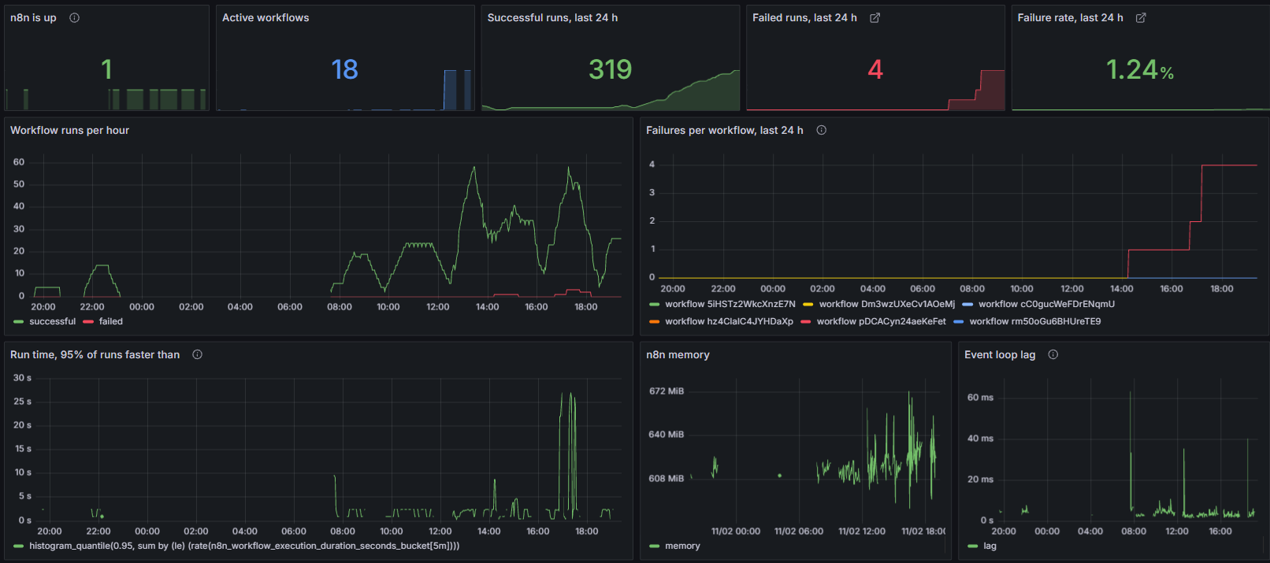
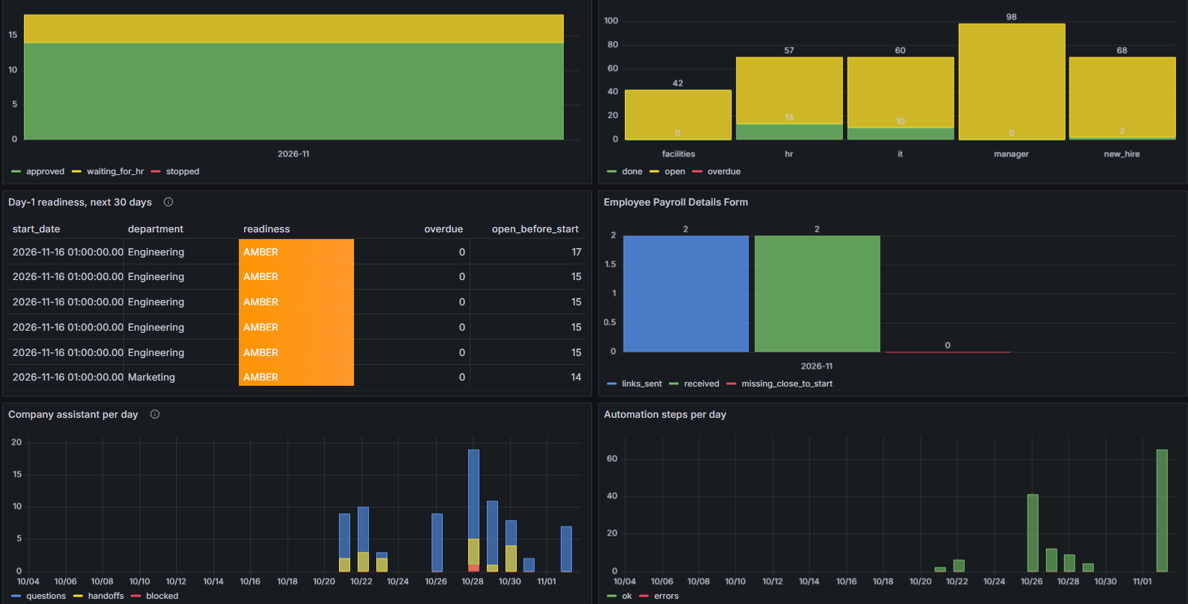
Three views: the AI, the workflows and the business
MONITORING AND OBSERVABILITY
AI: LangSmith (traces)
IT: workflows (Prometheus and Grafana)
HR: business (Grafana on Supabase)
LangSmith: every AI answer traced, each step with time, tokens and errors
Grafana: runs and failures per workflow, one click to the failed run
HR view: counts only. No names or payroll data
Alerts: failed runs to Discord, daily health check, weekly quality score
70% → 1.2%
Monitoring found an old workflow from another project failing every minute. After switching it off: 4.8%. On the full test day, 2 Nov: 4 of 323 runs failed, 1.24%.
BrewTec GmbH
Notes:
Different people ask different questions, so there are three views. First the AI, with LangSmith. Every AI answer is traced. Here you see one question, "How do I set up the VPN?". The first model call took about 3 seconds and 698 tokens, the handbook search 1.4 seconds, and the final answer about 20 seconds and 2,100 tokens. So I can see exactly where the time and the cost go, and every error is visible. Second, IT: Prometheus and Grafana show runs and failures per workflow, and one click opens the failed run in n8n. Third, HR: a Grafana business view with hires, tasks and payroll forms. It uses a read-only login that only sees counts, never names or payroll data. Failed runs alert the Discord channel, there is a daily health check, and a weekly quality score. And monitoring paid off at once: it showed a 70% failure rate, caused by an old workflow from another project. After switching it off, under 5%. And on the full test day on 2 November, 4 of 323 runs failed, 1.24 percent.

Slide 24
High risk under the EU AI Act, so people keep every decision
RESPONSIBLE AI
EU AI Act
GDPR
1 bias bug
Employment use: Annex III, high risk
BrewTec is the deployer
HR approves every message
Users are told it is an AI system
Every AI call traced in LangSmith
Bank data asked only after approval
Chats kept 90 days, logs 365 days
Closed hires deleted after 180 days
Right to erasure: one SQL function
Health questions answered, not stored
found by testing and fixed: names from other languages lost letters in the work e-mail
Open before go-live: bias review of AI welcome drafts, DPIA, works council agreement
Known gap: payroll details have no automatic deletion yet. It is on the roadmap with the legal retention period.
BrewTec GmbH
Notes:
Employment is listed as high risk in Annex III of the EU AI Act, and BrewTec is the deployer. That is why HR approves every message, users are told they are talking to an AI, and every AI call is traced. For GDPR, bank data is only collected after approval and close to the start date, data has fixed retention periods, and erasure is one SQL function. A bias test found a real bug: work e-mails for Turkish, Polish and Serbian names lost letters. It is fixed. Still open, because they need people outside the project: a bias review of the AI welcome drafts, the data protection impact assessment and the works council agreement. One honest gap: payroll details are not deleted automatically yet.

Slide 25

Saves €900 a month, pays back in about 7.5 months
BUSINESS CASE AND ROI
Today, per month
With the agent
Build
Payback
€1,080
€180
€6,750
7.5 mo
4 hires × 6 h × €45
planned: 1 h review per hire, AI €0.26 (measured)
150 h × €45, no external cost
6.1 to 9.9 if the 6 h is ±20%
Case | HR time per hire | Cost per month | Savings | Payback
Planned for the pilot (cautious) | 1 h | €180 | €900 | 7.5 months
Measured in the test, 2 Nov | about 5 min | €15 | €1,065 | 6.3 months
Production (server, Supabase Pro, maintenance) | 1 h | €389 | €691 | 9.8 months
AI is €0.26 a month in every case (measured in LangSmith). The test shows the clicks, not the review and the hand-off answers, so the decision uses the cautious 1 hour.
Ask: approve a 3-month pilot with real hires. Continue only if People Ops time is 90 minutes or less per hire, nothing is sent without approval, and unverified hand-offs stay under 2%.
BrewTec GmbH
Notes:
The business case in one slide. Today People Ops spends about six hours per hire, at four hires a month and 45 euros an hour that is 1,080 euros a month. With the agent about one hour remains, the part that should stay human, plus about 26 cents of AI a month, measured. That saves about 900 euros a month, so the 6,750 euros of build time pays back in about seven and a half months. Honest view: in production with a server in Germany, Supabase Pro and four hours of maintenance a month, it is about 691 euros and ten months. And the six hours is a scenario estimate. Twenty percent either way moves payback between six and ten months. In my test on 2 November, the HR clicks themselves took only about five minutes per hire. With that, payback would be about six months, but the clicks are not the whole job, HR still reviews the draft and answers hand-offs. So I decide on the cautious one hour. That is why my ask is a three-month pilot with clear stop criteria, measured on real hires.

Slide 26
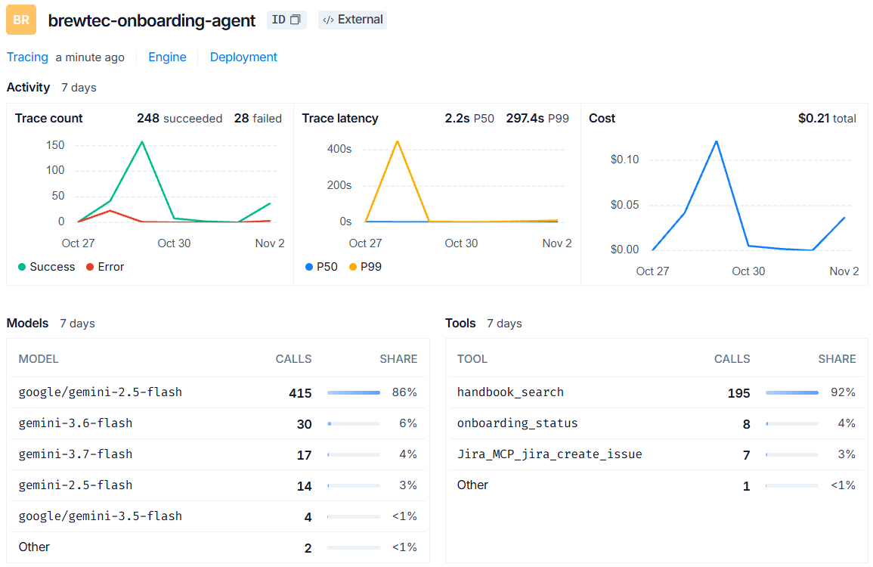
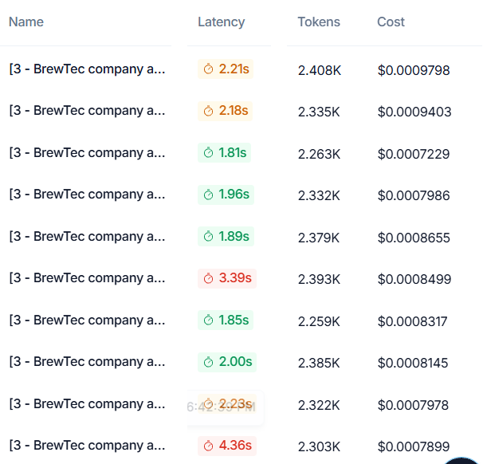
One hire takes seconds of machine time and cents of AI
MEASURED COST AND SPEED
17.7 s
$0.0008
2 s
1.24%
machine time per onboarding run (Prometheus)
per assistant answer, about 2,300 tokens
typical answer time (P50)
failed runs on the test day (4 of 323)
Per hire
AI, including about 20 assistant questions: under 3 cents
HR clicks in the test: about 5 minutes
The saving is HR time, not AI: 6 hours before, about 1 hour with review
LangSmith, 7 days: USD 0.21 for all AI calls, every test included
10 assistant answers: tokens and cost each
BrewTec GmbH
Notes:
These numbers are measured, not assumed. On 2 November I ran several hires end to end and read the monitoring tools. One onboarding run takes about 18 seconds of machine time. One assistant answer uses about 2,300 tokens, costs less than a tenth of a cent and comes back in about 2 seconds. All AI calls of the whole test week cost 21 cents. On the test day, 4 of 323 runs failed, 1.2 percent, and each failure was explained and fixed. So the AI cost per hire is under 3 cents. The real saving is HR time: in the test my HR clicks took about 5 minutes per hire. The 6 hours before is still a scenario figure, which is why I ask for a pilot that times real hires.

Slide 27
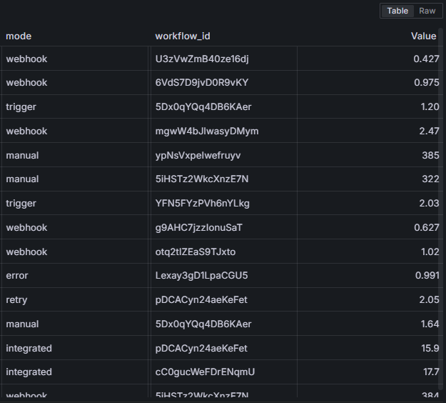
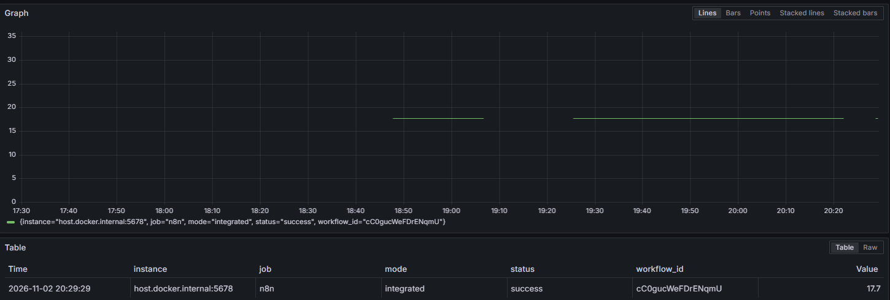
One onboarding run: 17.7 seconds of machine time
MEASURED RUN TIME (GRAFANA)
Query (PromQL): total run time ÷ number of successful runs of workflow 1
Result: 17.7 s. Not included: the wait for HR approval, n8n pauses the run until HR clicks
All workflows: pages and chat under 2.5 s, test runs about 6 min for 39 questions
Grafana Explore on Prometheus, 2 Nov 2026, metric n8n_workflow_execution_duration_seconds
BrewTec GmbH
Notes:
This is the speed side, measured in Grafana. n8n reports the run time of every workflow to Prometheus. The query at the top divides the total run time of workflow 1 by the number of successful runs, which gives the average: one onboarding run, from the HR system to the welcome e-mail and the tickets, takes 17.7 seconds of machine time. The old version without Jira took 15.9 seconds. The wait for HR approval is not counted, because n8n pauses the run until HR clicks. On the right, all workflows: web pages and the chat answer in under two and a half seconds, and the long values are the automated test runs, about six minutes for 39 questions.

Slide 28
Roadmap to real company use
NEXT STEPS
IMPROVEMENT PRIORITY
BEFORE THE PILOT
VERSION 2
Prove the numbers
Governance and payroll
Real systems
Fixed search step before the AI on every question
Time 5 real hires to replace the 6 h and 1 h estimates
Bias review of AI welcome drafts across names
Tell new hires the welcome e-mail was drafted with AI
Data protection impact assessment (DPIA)
Works council agreement
Payroll confirms bank details in person on day 1
No saved chat executions, LangSmith inputs hidden
Hosting in Germany (Azure or AWS) with HTTPS
Microsoft Entra ID sign-in instead of passwords
Real Workday tenant, integration system user
SharePoint Online as the knowledge base
Live traffic in Azure Monitor or CloudWatch
About 80 hours of setup (€3,600) for the pilot. Each step and its cost is in the repository: Improvement plan, Business case, Deployment.
BrewTec GmbH
Notes:
Three groups. First, my improvement priority: take the search decision away from the model, time five real hires so the business case rests on measurements, review the AI welcome drafts across names, and tell new hires that AI drafted the first version. Second, what must happen before any real pilot: the data protection impact assessment, the works council agreement, payroll confirming bank details in person, which closes my biggest real-world risk, and switching off stored chat text outside the cleaned log. Third, version 2: hosting in Germany on Azure or AWS, company sign-in with Entra ID, the real Workday tenant, SharePoint as the knowledge base, and live monitoring in Azure Monitor or CloudWatch.

Slide 29
From prototype to production in three steps
ROADMAP
NEXT
THEN
BEFORE GO-LIVE
Run it all the time
Connect the real systems
Close the governance gaps
Own domain with a named Cloudflare tunnel
Hosting in Germany with HTTPS (Hetzner)
Grafana alerts to the dev-ops channel
Paid AI tier with a fallback model
Company single sign-on instead of passwords
Real Workday tenant via its integration user
DATEV import instead of a manual hand-over
DPIA, works council, bias review
Automatic deletion of payroll details
Self-hosted traces in the EU (Langfuse)
BrewTec GmbH
Notes:
To make this production ready: first give it a fixed address with an own domain and a named Cloudflare tunnel, then run it all the time on a server in Germany with HTTPS, add Grafana alerts and a paid AI tier with a fallback model. Then connect the real systems: company single sign-on, a real Workday tenant and a DATEV import. And before go-live, close the governance gaps: the impact assessment, the works council agreement, the bias review, automatic deletion of payroll details, and traces kept in the EU with a self-hosted tool like Langfuse.

Slide 30
A Cloudflare tunnel makes the demo reachable from anywhere
DEPLOYMENT
Phone or laptop
Cloudflare
cloudflared
n8n
Supabase, AI
anywhere, HTTPS
→
random trycloudflare address
→
on the n8n PC, outbound only
→
localhost:5678, 13 workflows
→
database and models in the cloud
WORKS TODAY
KNOWN LIMITS
NEXT STEP
HTTPS without opening a port
Public page and employee login tested from a phone
Chat works through the tunnel unchanged
New random address on every restart
E-mail links still point to localhost
Offline when the laptop sleeps
Own domain with a named tunnel
Cloudflare Access with company e-mail
Server in Germany for 24/7
Notes:
For the demo the agent runs on my laptop, and a Cloudflare quick tunnel makes it reachable from anywhere over HTTPS. The cloudflared program on the laptop opens an outbound connection, so no port on my network is open. I tested the public page, the employee login and the chat from my phone through the tunnel. There are three honest limits: the address is random and changes on every restart, the links in the e-mails still point to localhost, and nothing works while the laptop sleeps. The next step is an own domain with a named tunnel, which gives a fixed address, then Cloudflare Access for company e-mail login, and finally a server in Germany so it runs around the clock.

Slide 31
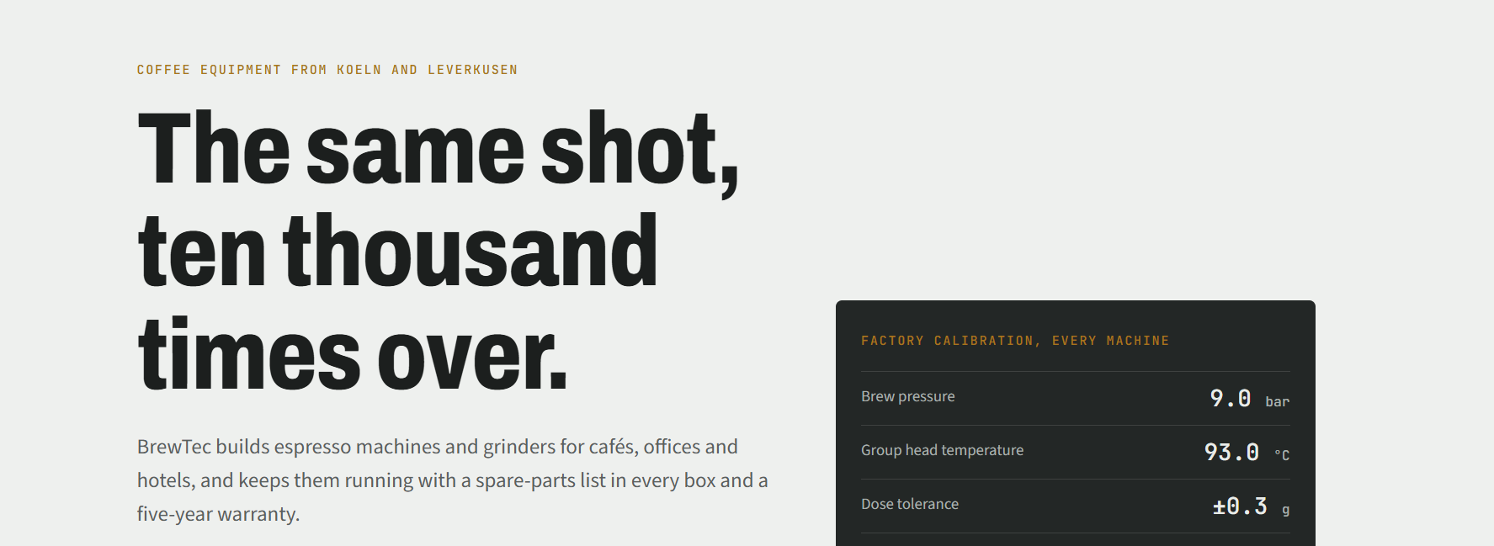
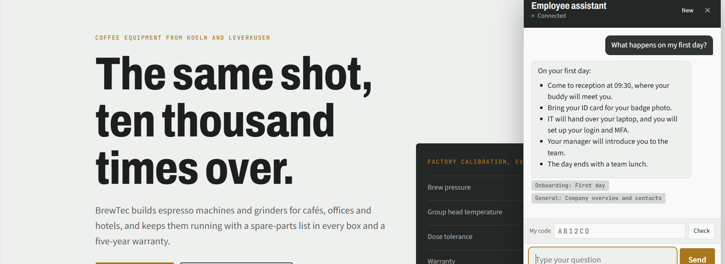
The company site is public, the assistant needs a personal login
WHO CAN OPEN WHAT
/webhook/brewtec · everyone, no login, no assistant
/webhook/brewtec/employees · personal login, with assistant
Own account, bcrypt hash only
5 wrong tries lock it for 15 minutes
Leavers disabled with one SQL call
Every attempt logged, never the password
Cloudflare tunnel
Phone → Cloudflare → cloudflared on the laptop → n8n. HTTPS, no open port, tested from a phone. Limits: new address on every restart, e-mail links still point to localhost, offline when the laptop sleeps.
BrewTec GmbH
Notes:
A company website is public, but the assistant is for employees only. So there are two addresses. The public page shows machines, service and sites, with an Employee login button and no assistant. The employee area shows the same site with the assistant, and every employee has their own login: work e-mail and password. The password is stored only as a bcrypt hash, five wrong tries lock the account for fifteen minutes, HR disables a leaver with one SQL function, and every attempt is logged for a year without the password. HR and payroll keep their own separate logins. I tested this from outside through the Cloudflare tunnel. For the demo the agent runs on my laptop, and a Cloudflare quick tunnel makes it reachable from anywhere over HTTPS. The cloudflared program on the laptop opens an outbound connection, so no port on my network is open. I tested the public page, the employee login and the chat from my phone through the tunnel. There are three honest limits: the address is random and changes on every restart, the links in the e-mails still point to localhost, and nothing works while the laptop sleeps. The next step is an own domain with a named tunnel, which gives a fixed address, then Cloudflare Access for company e-mail login, and finally a server in Germany so it runs around the clock.

Slide 32
One HR click.
Every answer with a source.
Every decision with a person.
QUESTIONS
Thank you. Questions?
BrewTec GmbH
Notes:
To sum up: one HR click starts the whole onboarding, every answer of the assistant has a source or goes to a person, and every decision about a person stays with a person. I am happy to take questions. Backup slides with every demo step, the guardrails and monitoring follow after this slide.

