Slide 1

Migration Strategy Cloud Spanner
By Deval Bhungaliya

Slide 2
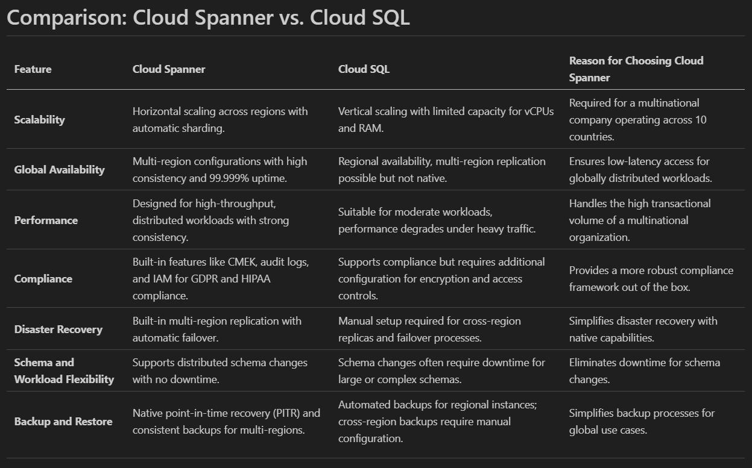
Comparison

Slide 3
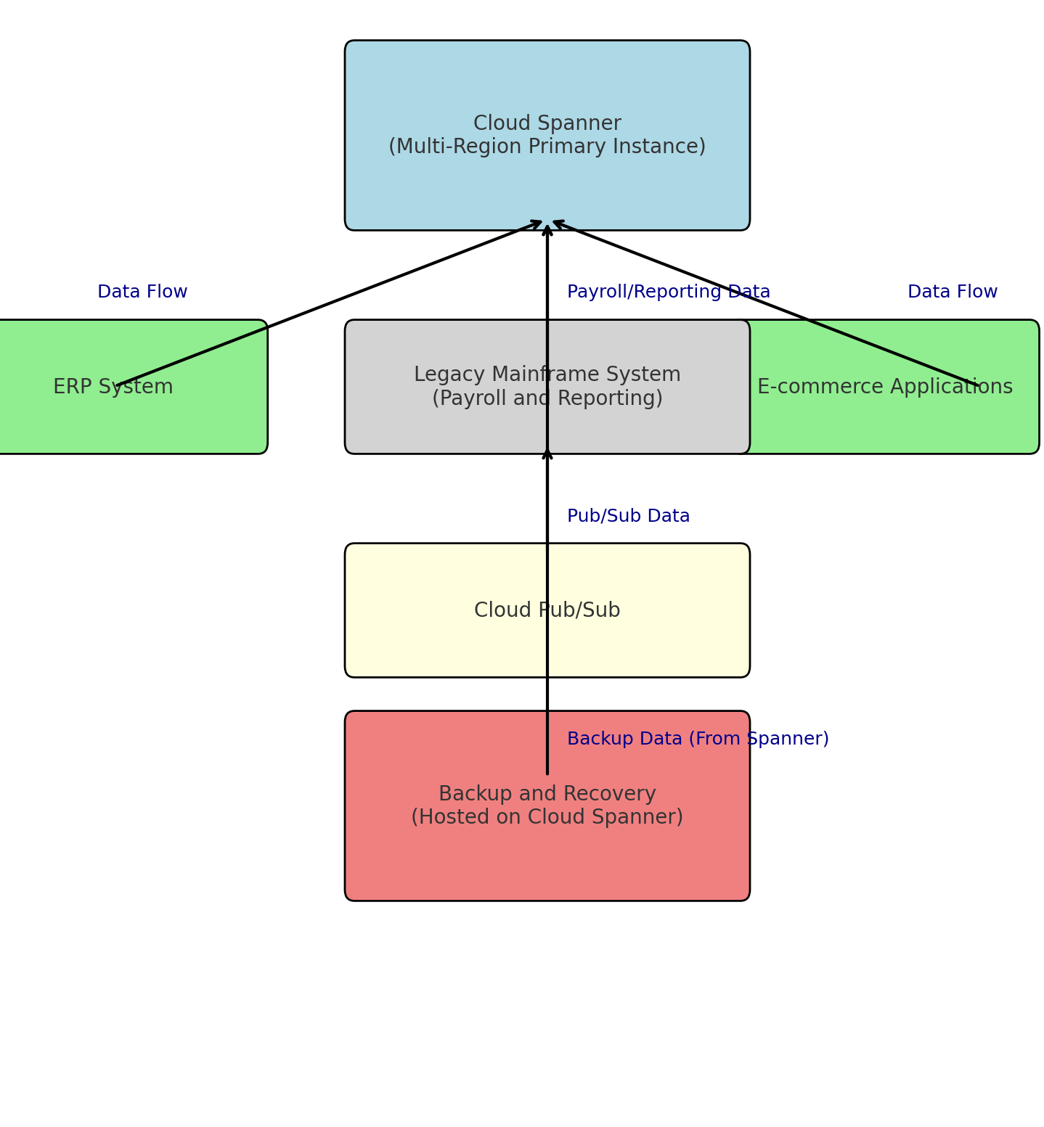
High-Level Architecture
Migration Strategy for SQL Database Cluster to Google Cloud Spanner
Primary Instance: Cloud Spanner multi-region configuration to handle distributed workloads and global user access.
Backup and Recovery: Continuous backups and point-in-time recovery for operational resilience.
Integration: Integration with other systems, such as ERP, Legacy Mainframe System (Payroll and Reporting) and public-facing e-commerce applications, using APIs and Cloud Pub/Sub for real-time data flow.

Slide 4
Migration Strategy for SQL Database Cluster to Google Cloud Spanner
Assessment Phase
Identify dependencies with applications (ERP, e-commerce) and other databases.
Preparation Phase : Set Up Cloud Spanner
Create a multi-region Spanner instance to handle global workloads.
Execution Phase
Perform the migration with minimal disruption to ongoing operations:
Evaluate existing compliance requirements for GDPR, HIPAA, and other relevant regulations.
Define a phased migration approach, starting with less critical workloads.
Create a rollback plan to mitigate issues during migration.
Configure instance settings for high availability and performance.
Configure firewall rules to allow only authorized traffic between Spanner and dependent applications.
Use Database Migration Service (DMS) to establish a replication pipeline for real-time data sync during migration.
Set up automated backups in the source database for safety before initiating migration.
Enable continuous data replication from the source database to Cloud Spanner using DMS.
Monitor replication to ensure consistency between source and target databases.
Test connectivity between applications (ERP, e-commerce) and Cloud Spanner.
Implement API or Pub/Sub connections for real-time data flow.

Slide 5
Migration Strategy for SQL Database Cluster to Google Cloud Spanner
Validation and Go-Live
Ensure the migrated database is fully functional and ready for production
Final Cutover
Schedule the cutover during off-peak hours.
Post-Migration Validation
Verify all data is accessible and applications are functioning as expected.
Conduct end-to-end testing of database operations, queries, and transactions.
Test application interactions with Cloud Spanner to ensure no functionality is broken.
Perform compliance checks to verify adherence to GDPR and HIPAA standards.
Halt writes on the source database, perform a final sync, and redirect applications to Cloud Spanner.
Ensure downtime does not exceed the 4-hour limit.
Conduct a final compliance audit.

Slide 6
Cost Estimation
Assumptions
Compute Capacity: 10 nodes in a multi-region configuration.
Estimated Monthly Costs
Compute Capacity: 10 nodes × $3.00/node/hour × 730 hours ≈ $21,900.
Cost Optimization
Committed Use Discounts: Consider one-year or three-year commitments to receive discounts of up to 40% on compute capacity. Google Cloud
Storage: 500 GB of data.
Network Egress: 200 GB per month.
Storage: 500 GB × $0.30/GB ≈ $150.
Network Egress: 200 GB × $0.12/GB ≈ $24.
Total Estimated Monthly Cost: Approximately $22,074.
Granular Instance Sizing: Utilize granular instance sizing to align resources with workload demands, potentially reducing costs. Google Cloud

Slide 7
Benefits
Global Performance
Ensures low-latency access for users across 10 countries.
High Availability
Multi-region réplication provides 99.999% uptime.
Regulatory Compliance
Comprehensive tools for GDPR and HIPAA compliance.
Operational Simplicity
Fully managed service eliminates hardware and maintenance overhead.
Future-Ready
Seamlessly handles growing workloads and evolving business needs.

