Slide 1
Empower Ability Labs
Accessible Single-Page Application (SPA)

Slide 2
Project Overview
Empower Ability Labs is a Single-Page Application designed to promote accessibility and inclusivity.
Built with WCAG 2.1 AA compliance and ARIA practices for interactive components.
Focused on fostering empathy and creating accessible digital experiences.
Published live for demonstration and practical use.

Slide 3
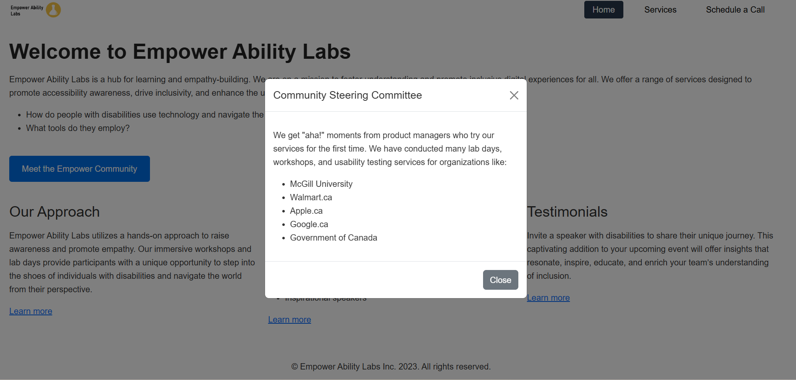
Interactive Components
Tab Navigation: Navigate between Home, Services, and Schedule a Call sections.
Lightbox/Modal: Displays community insights.

Slide 4
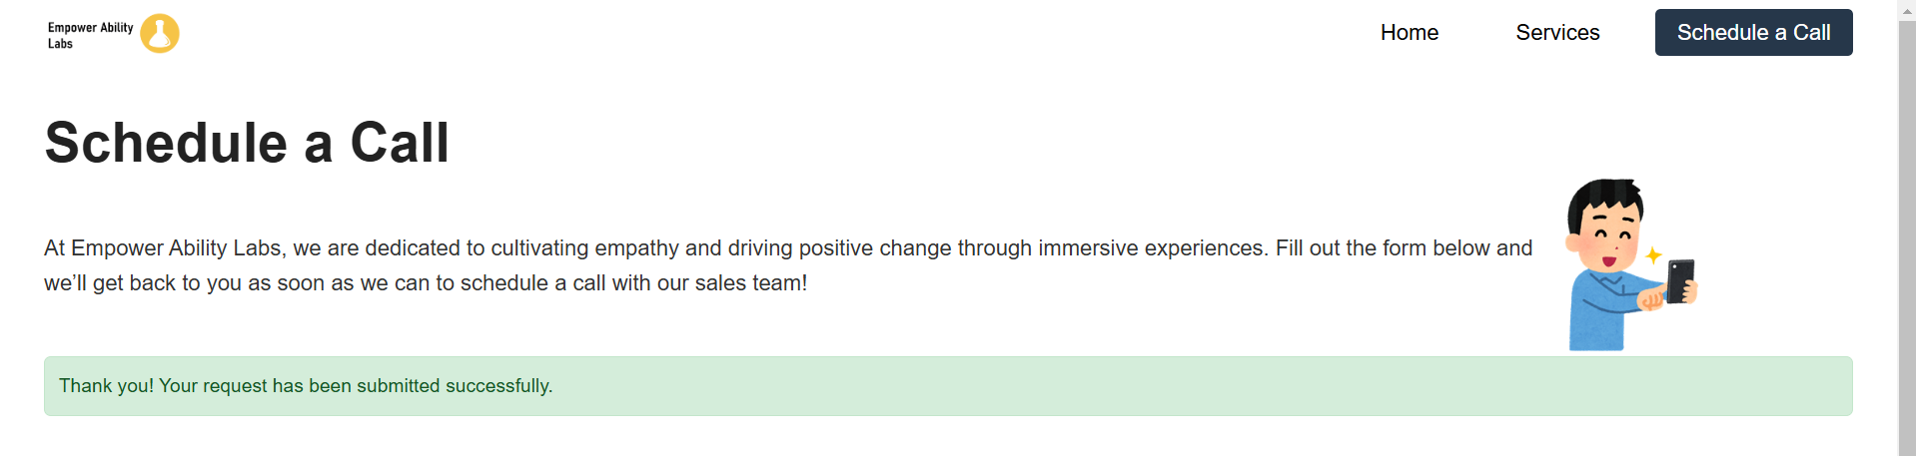
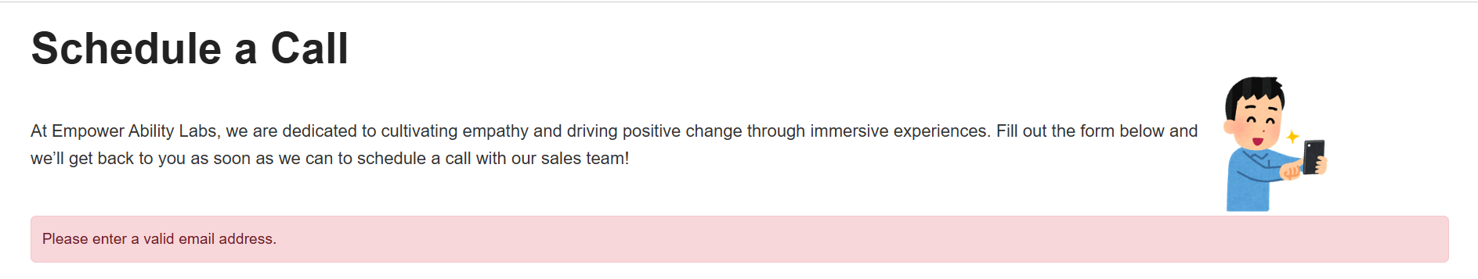
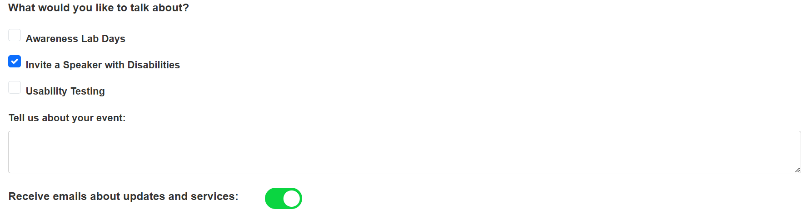
Interactive Components
Dynamic Form: "Tell us about your event" field toggles based on user input.
Toggle Switch: Subscribes users to updates and services.
Integrated error and success messages for form interactions.

Slide 5
Design and Layout
Responsive design ensuring usability across devices.
Proper contrast for readability and WCAG compliance.
Semantic HTML for proper structure and accessibility.
Uniform branding with consistent colors, fonts, and spacing.

Slide 6
Challenges and Solutions
Focus Management:
Implemented JavaScript to shift focus dynamically between sections.
Screen Reader Compatibility:
Added ARIA attributes for better announcements.
Form Validation:
Built custom validation logic for errors and success messages.
Responsive Design Adjustments:
Ensured elements adapt smoothly to different screen sizes.

Slide 7
Team Contributions
Deval Bhungaliya(041107272): Development of interactive components and focus management.
Bhavika Pathria(041096986): Accessibility testing and ARIA enhancements.
Parth Patel(040751954): Form validation logic and screen reader testing.
Neetika Prashar(041167124): Documentation and responsive design optimization.
Collaboratively tested across browsers to ensure compatibility.
Links:
GitHub Repository: https://github.com/bhun0002/CST8914_GRP_SPA
Live SPA: https://bhun0002.github.io/CST8914_GRP_SPA/EmpowerAbilityLab.html

Slide 8
Demo

Slide 9
Questions?

