Slide 1

Trash bins – The ideal route CAS Machine Intelligence
January 2021
Bruno Hunkeler

Slide 2

Content Overview and Structure
0
Introduction / Motivation
1
Results
2
Context Diagram
3
Application Demo
4
Project Insights / Issues
5
Conclusion
6
Q&A

Slide 3




Trash bins – The ideal route Introduction / Motivation
Motivation
Every morning 5:15am a garbageman passes by and empties Trash bins (if full or empty)
Create a product if a trash bin requires maintenance (filling level, HW Issue)
Find an optimal route for a garbage man
Situation is applicable to any city in the world
Challenge
No data source available (simulation of interactive data exchange required)
Equip IoT Component with every trash bin which indicates filling level and IoT Component state
Approach should work for every city in the world
IoT
IoT
Server
Analytics
IoT

Slide 4
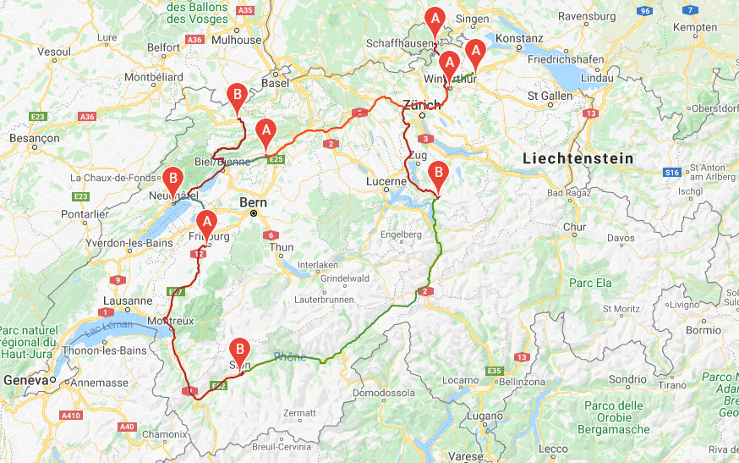
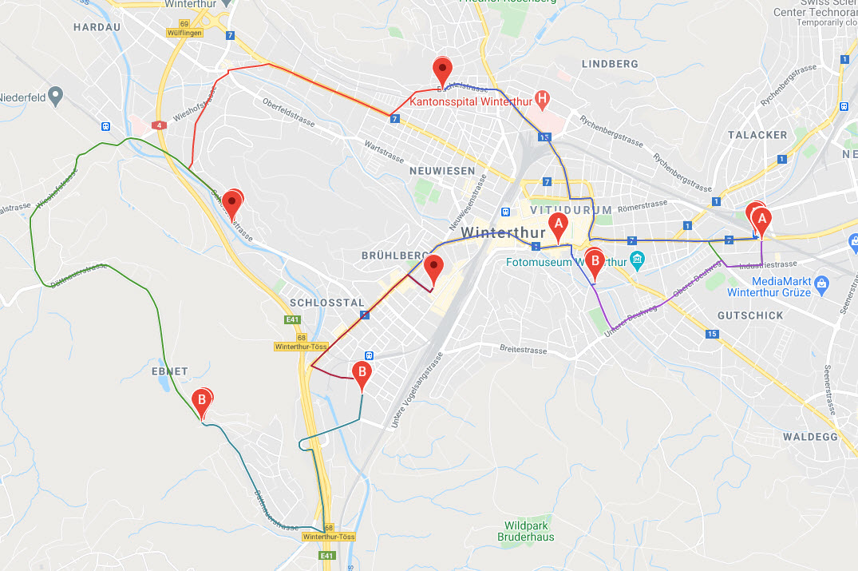
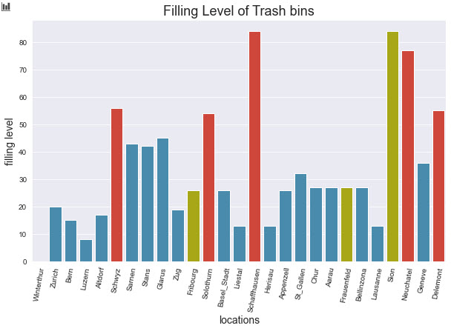
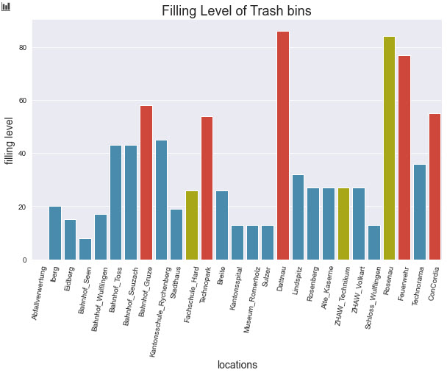
Trash bins – The ideal route Result for Switzerland and Winterthur
Origin: Winterthur
Trash bins: Capital Cities
Origin: Verbrennungsanlage
Trash bins: Random locations

Slide 5

Trash bins – The ideal route Context diagram
Trash bin - Application
Sensor Data (JSON)
Filling level / IoT Component State
TCP Client
TCP Server
24h Sensor Data Stream (JSON)
Distance Matrix
Pre-calcultion
Filling level / IoT Component State
TCP Stream
Consumer
TCP Stream
Producer
Reset
- Filling level - IoT Comp. State
Sensor data Analytics
Sensor data Stream Analytics
Analytics
Dashboard
Geo Coordinates
Evaluation
Optimal Route
Calculate
Visualize optimal Route in Map
Distance
Calculation
Directions
Calculation
Google - Directions \ Distance API

Slide 6
Trash bins – The ideal route Application Demo
Application Demo

Slide 7
Trash bins – The ideal route Project Insights / Issues
Local infrastructure setup - Spark / Hadoop
Data source - 26 locations + Origin (Switzerland / Winterthur) - Manual creation of data source 24h
Optimizer algorithms - Optimal Route Algorithm - Simulated Annealing Algorithm
Google map integration - Directions-, Distance Matrix API Connection - Map Integration
TCP Client / Server - For Data exchange and simulation of real behaviour
Streaming - Dashboard - Producer / Consumer
Issues - Databricks migration not possible due to Infrastructure unavailability) -> Community Edition a wreck - Code bundling (building Python package) - Installation of Geospatial Data Abstraction Library (GDAL) - None I couldn’t manage (just lots of effort)

Slide 8
Trash bins – The ideal route Conclusion
The final Big Data Project has been a challenge overall.
Since no streaming service exists, all data needed to be created synthetically.
Creating synthetic data to simulate a data stream is tedious and time consuming.
But creating the foundations for a new Product and finding out that it generally works, was a delight.
There are now various additional aspects, which could be considered when continuing with the given project as follows:
Apply Machine learning to analyze historic data and predict the future
Estimating the time consumption for a route considering the traffic by using further google API’s
Consider the use of multiple routes and therefore additional Vehicles
Prepare a decent interactive Web Front End

Slide 9

Trash bins – The ideal route Questions

Slide 10
Archive Further Information and Screenshots

Slide 11
Trash bin - Application
Sensor Data (JSON)
Filling level / IoT Component State
TCP Client
TCP Server
24h Sensor Data Stream (JSON)
Distance Matrix
Pre-calcultion
Filling level / IoT Component State
TCP Stream
Consumer
TCP Stream
Producer
Reset
- Filling level - IoT Comp. State
Sensor data Analytics
Sensor data Stream Analytics
Analytics
Dashboard
Geo Coordinates
Evaluation
Optimal Route
Calculate
Visualize optimal Route in Map
Distance
Calculation
Directions
Calculation
Google - Directions \ Distance API

Slide 12
Trash bin - Application
Sensor Data (JSON)
Filling level / IoT Component State
TCP Client
TCP Server
24h Sensor Data Stream (JSON)
Distance Matrix
Pre-calcultion
Filling level / IoT Component State
TCP Stream
Consumer
TCP Stream
Producer
Reset
- Filling level - IoT Comp. State
Sensor data Analytics
Sensor data Stream Analytics
Analytics
Dashboard
Geo Coordinates
Evaluation
Optimal Route
Calculate
Visualize optimal Route in Map
Distance
Calculation
Directions
Calculation
Google - Directions \ Distance API

Slide 13
Trash bin - Application
Sensor Data (JSON)
Filling level / IoT Component State
TCP Client
TCP Server
24h Sensor Data Stream (JSON)
Distance Matrix
Pre-calcultion
Filling level / IoT Component State
TCP Stream
Consumer
TCP Stream
Producer
Reset
- Filling level - IoT Comp. State
Sensor data Analytics
Sensor data Stream Analytics
Analytics
Dashboard
Geo Coordinates
Evaluation
Optimal Route
Calculate
Visualize optimal Route in Map
Distance
Calculation
Directions
Calculation
Google - Directions \ Distance API

Slide 14
Trash bin - Application
Sensor Data (JSON)
Filling level / IoT Component State
TCP Client
TCP Server
24h Sensor Data Stream (JSON)
Distance Matrix
Pre-calcultion
Filling level / IoT Component State
TCP Stream
Consumer
TCP Stream
Producer
Reset
- Filling level - IoT Comp. State
Sensor data Analytics
Sensor data Stream Analytics
Analytics
Dashboard
Geo Coordinates
Evaluation
Optimal Route
Calculate
Visualize optimal Route in Map
Distance
Calculation
Directions
Calculation
Google - Directions \ Distance API

Slide 15
Trash bin - Application
Sensor Data (JSON)
Filling level / IoT Component State
TCP Client
TCP Server
24h Sensor Data Stream (JSON)
Distance Matrix
Pre-calcultion
Filling level / IoT Component State
TCP Stream
Consumer
TCP Stream
Producer
Reset
- Filling level - IoT Comp. State
Sensor data Analytics
Sensor data Stream Analytics
Analytics
Dashboard
Geo Coordinates
Evaluation
Optimal Route
Calculate
Visualize optimal Route in Map
Distance
Calculation
Directions
Calculation
Google - Directions \ Distance API

