Slide 1
Human Guided Machine Vision for Road Detection
Team Turnpike: Kelsey DiPietro, Richard Frnka, Brian Hunter, Shaked Koplewitz, Khanh Nguyen, Scott Spencer
Advisor: Alfonso Limon, Oneirix Labs

Slide 2
Problem Statement
Given a satellite image, create an interface that allows the user to select roads from the image.
3 different components to find the road paths:
Image Segmentation (Pre-Processing)
Road Detection (Pre-Processing)
User interfacing (Post-Processing)

Slide 3
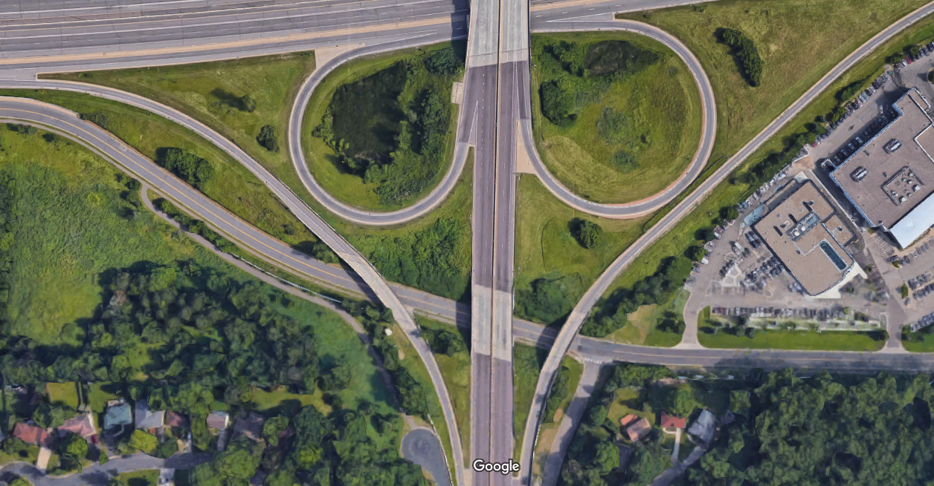
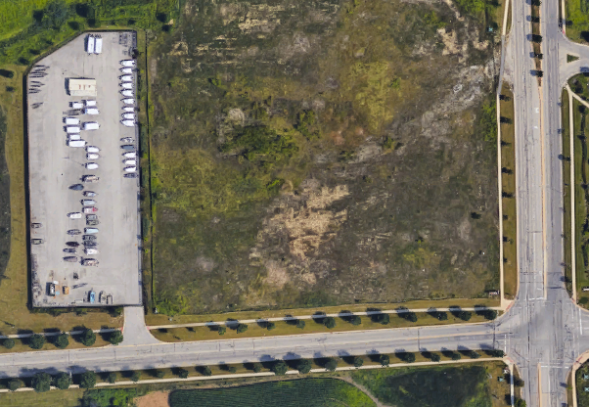
Sample Images
Take a variety of satellite images from Google Earth
All of our examples are zoomed in at a similar level.
Examples include curved and straight roads, roads with cars, intersecting roads.

Slide 4
Image Segmentation
Read the image
Convert the image into pixel intensity value
Detect Edges and Filter the Image
Segment the Image based on connectivity

Slide 5
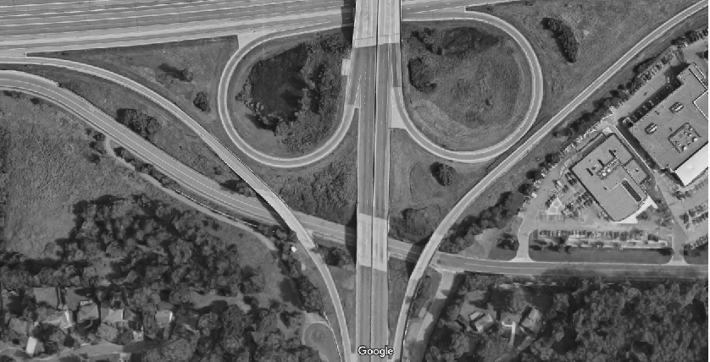
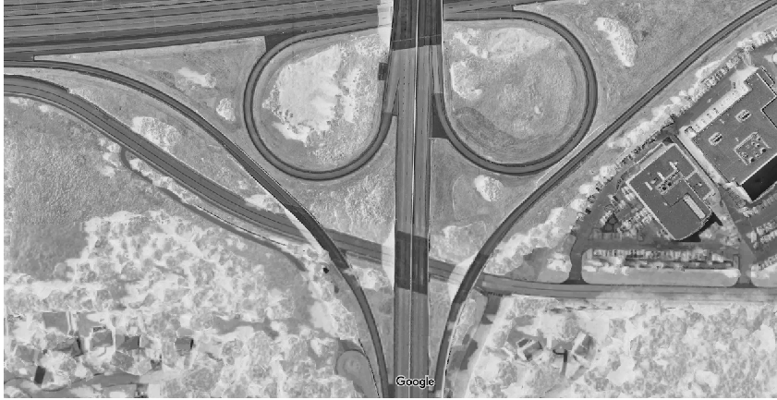
Color Image to Gray Scale

Slide 6
Edge Detection and Filtering
General steps for road detection filtering:
Use edge detection to find road edges
Use additional filters to clean up noise

Slide 7
Edge Detection
Edge detectors look for large changes in the intensity of the image
Large change in intensity → edge within the image
Different types of edge detection methods
Sobel
Canny
Laplacian of a Gaussian
Prewitt
Want: Good detection of the roads with minimal noise.

Slide 8
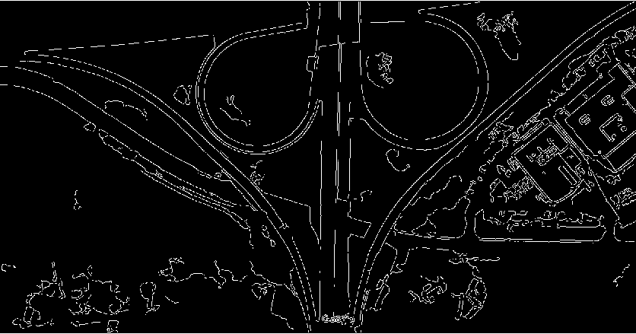
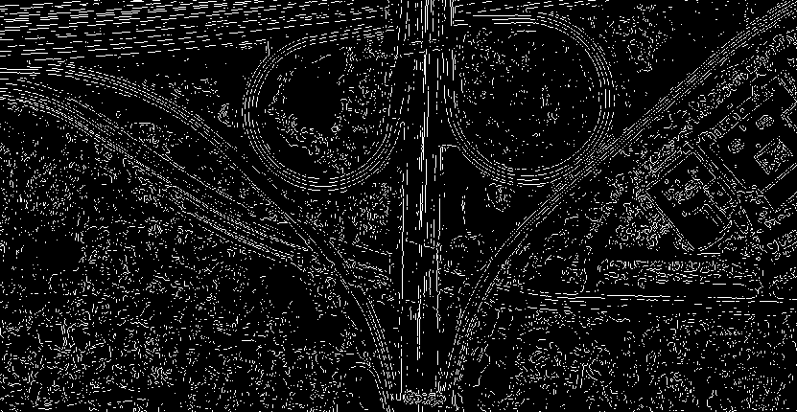
Canny-Edge Detection
Laplacian of a Gaussian (Log) edge detection

Slide 9
Filtering
Add filtering to:
Clean up noise by eliminating stray pixels
Connect small gaps that could have been caused by noise, shadows, or cars.
Eliminate smaller components that do not resemble roads.
Final return gives the original image segmented into different connected components.

Slide 10
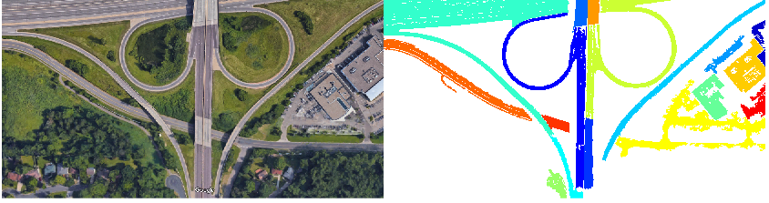
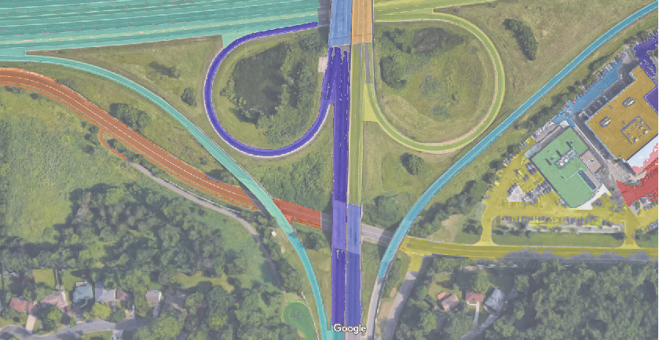

Slide 11
Road Detection
Looks at connected components and determines the probability that the component is a road
Connected components come from the image segmentation and shadow detection algorithms.
Based on the shape of the road (narrowness,curves)
Helps eliminate processing time in the interface if the user clicks a non-road component.

Slide 12
Integrating Human Interaction
Create an app that allows a user to click on a loaded image
If a user clicks the road – the road is highlighted
If the user clicks something other than the road – a pop up box appears informing them it’s not a road
Allows the user to chose different parameters within the algorithms (segmentation methods, shadow detection).

Slide 13
GUI DEMO

Slide 14
Conclusion
Using a combination of edge detection and filtering, our algorithm worked well for simple highway connections and isolated roads.
Road detection algorithms and image segmentation allow us to speed up the processing time, especially when interacting with the GUI
Using a local filtering and tracking system could improve our results for more difficult images, such as roads with heavy traffic and shadows obscuring the entire road.

Slide 15
Thank you
Questions?

