Slide 1
SMART INDIA HACKATHON 2026 • PROBLEM SIH26119
PDHG-GPU: Indigenous CUDA Solver
High-Throughput GPU-Accelerated Mathematical Programming Suite for Indian Oil Refineries
A Ground-Up Mathematical Engine Built for MoPNG & Indian Refineries (IOCL / MRPL / BPCL / HPCL)
4,608 Cores
NVIDIA Ada Lovelace GPU
364M NNZ
Max Capacity in 8GB VRAM
0% Foreign
Built from First Principles
< 10 ppm S
BS-VI Clean Fuel Standard
MISSION: Replace expensive foreign proprietary tools (Gurobi, CPLEX, Aspen PIMS) with a sovereign, high-precision CUDA LP/QP/MILP optimization engine that runs on Indian infrastructure.

Slide 2
SIH26119 • MINISTRY OF PETROLEUM & NATURAL GAS
The Problem & Strategic Need: Breaking Foreign Solver Dependency
Legacy Foreign Solver Monopoly
Indigenous Innovation: PDHG-GPU
Crippling Licensing Outflows: Indian PSUs spend millions of USD annually on foreign licenses (Gurobi, CPLEX, Aspen PIMS, FICO Xpress) charged at $20k–$50k per socket.
National Security & Sovereignty Risk: Closed-source foreign binaries control critical national energy dispatch. Subject to sudden export restrictions or sanctions.
The 'Cholesky Memory Wall': Traditional 2nd-order interior-point solvers require dense matrix factorizations O(N²). They hit out-of-memory crashes on large-scale models.
CPU Serialization Bottleneck: Legacy solvers execute sequentially on CPU threads, unable to exploit modern massively parallel GPU architectures with thousands of SIMD cores.
100% Sovereign First-Principles Code: Strictly zero external solver dependencies. Built from mathematical foundations using Chambolle-Pock Primal-Dual Hybrid Gradient.
Massive CUDA Parallelism: Translates LP iterations into sparse matrix-vector products (SpMV). Every iteration executes in parallel across 4,608 CUDA cores.
500x Memory Reduction via CSR: Sparse Compressed Row Storage scales strictly with non-zero elements O(NNZ), unlocking 364 million variables on commodity 8GB GPUs.
Tailored to Indian Downstream Sector: Pre-parameterized with real-world Indian refinery assays (Bombay High, Arab Light) and BS-VI clean fuel mandates (<10 ppm sulfur, 91+ RON).
PDHG-GPU: Indigenous CUDA LP/QP/MILP Optimization Solver | Smart India Hackathon 2026

Slide 3
SIH26119 • MINISTRY OF PETROLEUM & NATURAL GAS
SIH 26119 Mandate Compliance: 100% Verified Rigor
SIH Criterion | Foreign Proprietary (Gurobi/CPLEX) | Indigenous PDHG-GPU Engine | Verdict
Mathematical Independence | Proprietary C++ black-boxes ($25k/yr socket fees; closed-source) | 100% from first principles: Chambolle-Pock PDHG, Ruiz Equi-scaling, custom KKT duals. Zero open-source solvers. | 100% PASS
Optimization Scope | Simplex, Barrier IPM, Branch-and-Cut | Tri-Class Suite: High-Scale LP (PDHG), Convex QP (Proximal PDHG), and MILP (Parallel Branch-and-Bound). | 100% PASS
Hardware Acceleration | Primarily CPU-bound; limited GPU Cholesky factorization | 100% GPU VRAM-resident SpMV kernels via CuPy/CUDA. Zero CPU-GPU sync latency inside inner solve loop. | 100% PASS
Memory Footprint | Dense Cholesky O(N²) blows past RAM on 100k+ variables | Sparse CSR O(NNZ) matrix format: 80 MB vs 40 GB on 100k x 50k problem (500x memory saving). Up to 364M NNZ in 8GB VRAM. | 100% PASS
Refining Digital Twin | Generic mathematical format; requires separate formulation | Turnkey IOCL Mathura 8-Crude assay, BS-VI fuel mandates (RON 91+, <10 ppm S), and marginal shadow price debottlenecking. | 100% PASS
PDHG-GPU: Indigenous CUDA LP/QP/MILP Optimization Solver | Smart India Hackathon 2026

Slide 4
SIH26119 • MINISTRY OF PETROLEUM & NATURAL GAS
End-to-End 5-Stage System Architecture
STAGE 01
STAGE 02
STAGE 03
STAGE 04
STAGE 05
Model Ingestion & Parsing
Ruiz Equilibration
CUDA SpMV Engine
Tri-Class Solvers
KKT & Economics
Formats: Netlib MPS (Fixed/Free), Refinery JSON, Portfolio QP.
Zero-Copy: Direct conversion into SciPy Compressed Sparse Row.
Validation: Automated syntax & feasibility check.
Scaling: Computes diagonal matrices D, E balancing row/col norms.
Conditioning: Reduces condition number κ(A) from 10⁷ to 10².
Acceleration: 10x–50x faster convergence in first-order methods.
Hardware: 4,608 Ada Lovelace cores; 504 GB/s VRAM bus.
Zero Host Sync: Sparse A and Aᵀ reside 100% in GPU memory.
Async Kernels: Overlapped streaming for continuous throughput.
LP Engine: Chambolle-Pock PDHG with adaptive step sizing.
QP Engine: Proximal PDHG for quadratic variance minimization.
MILP Engine: GPU Branch-and-Bound with warm-start relaxations.
Residuals: Tracks primal, dual residuals & duality gap < 10⁻⁴.
Debottleneck: Computes marginal shadow prices λ_i ($/bbl, $/RON).
Twin Analytics: Live SCADA flowsheet stream rate display.
PDHG-GPU: Indigenous CUDA LP/QP/MILP Optimization Solver | Smart India Hackathon 2026

Slide 5
SIH26119 • MINISTRY OF PETROLEUM & NATURAL GAS
Mathematical Rigor: First-Order Chambolle-Pock PDHG
1. Minimax Saddle-Point Formulation
2. Alternating Proximal Updates
Standard Form: min cᵀx subject to Ax ≤ b, l ≤ x ≤ u
Saddle-Point Lagrangian: L(x, y) = cᵀx + yᵀ(Ax - b), where y ≥ 0 is dual multiplier vector.
Optimality (KKT): A pair (x*, y*) is optimal iff primal feasible, dual feasible, and complementary slackness holds: y*(Ax* - b) = 0.
Dual Ascent: y^{k+1} = max(0, y^k + σ (A x̄^k - b))
Primal Descent: x^{k+1} = clip(x^k - τ (c + Aᵀ y^{k+1}), l, u)
Over-Relaxation: x̄^{k+1} = x^{k+1} + θ (x^{k+1} - x^k), typically θ = 1.0
3. Convergence Guarantee & Adaptive Steps
4. Why PDHG is Ideal for CUDA GPUs
Theoretical Bound: Guaranteed to converge when τ · σ · ‖A‖₂² < 1.
Spectral Norm Power Iteration: Initial ‖A‖ estimate obtained via fast 20-step GPU power iteration on AᵀA.
Adaptive Primal-Dual Tuning: Dynamically scales τ and σ based on the ratio of primal to dual residuals, keeping both errors balanced.
No Matrix Factorization: Zero Cholesky or LU decompositions. Eliminates costly serial O(N³) bottlenecks.
Only SpMV Operations: Computation is 100% matrix-vector multiplication, the most optimized GPU primitive.
O(N) Elementwise Projection: Box projection clip(v, l, u) executes in parallel across CUDA warps with zero thread divergence.
PDHG-GPU: Indigenous CUDA LP/QP/MILP Optimization Solver | Smart India Hackathon 2026

Slide 6
SIH26119 • MINISTRY OF PETROLEUM & NATURAL GAS
Numerical Preconditioning: Ruiz Matrix Equilibration
The Condition Number Challenge
Impact on Convergence & Speed
The Ill-Conditioning Trap: Industrial refinery matrices combine stream flows (100,000 bpd) with trace sulfur specifications (0.00001 fraction). Matrix condition number κ(A) often exceeds 10⁷.
Ruiz Equilibration Algorithm: Iteratively computes diagonal scaling matrices D = diag(d) and E = diag(e) such that every row and column of D·A·E has an infinity norm close to 1.0.
Formula per Iteration: d_i = 1 / sqrt(‖A_{i,:}‖_∞), e_j = 1 / sqrt(‖A_{:,j}‖_∞)
Transformation: A' = D·A·E, b' = D·b, c' = E·c. Runs 10-15 fast iterations.
Exact Dual Unscaling: x* = E · x'_sol, y* = D · y'_sol. Duality and Karush-Kuhn-Tucker multipliers are preserved with zero precision loss.
Stabilized Step Sizes: Preconditioning shrinks the spectral radius ‖A‖₂, enabling larger allowable step sizes (τ, σ) without numerical divergence.
Zero Floating-Point Underflow: Re-normalizes constraints spanning 10⁻⁵ to 10⁶ into a uniform numerical sphere within float64 precision.
Netlib Benchmark Verification: Validated across challenging ill-conditioned standard Netlib models (AFIRO, SHARE2B, AGG).
10⁷ → 10²
Condition Number κ(A)
18.4x Faster
Iteration Reduction
PDHG-GPU: Indigenous CUDA LP/QP/MILP Optimization Solver | Smart India Hackathon 2026

Slide 7
SIH26119 • MINISTRY OF PETROLEUM & NATURAL GAS
GPU Hardware Architecture: Overcoming the Memory Wall
Memory Scaling: Dense vs Sparse CSR
Zero Host-Device Sync Execution
Traditional Dense Storage: Requires storing all M × N floating point values: Memory = M × N × 8 bytes.
Dense Reality on 100k × 50k: 5 billion elements × 8 bytes = 40.0 GB RAM! Exceeds any standard GPU and crashes legacy solvers with Out-of-Memory (OOM).
Sparse CSR Storage: Only stores non-zero entries (NNZ): Memory = (2 × NNZ + M) × 8 bytes.
Sparse Reality on 100k × 50k (0.1% NNZ): 5 million non-zeros = 80 MB VRAM! A 500x reduction in memory footprint.
8GB RTX 4070 Ceiling: Can host up to 364 Million Non-Zeros in GPU memory simultaneously.
VRAM-Resident Loop: Matrix A and transpose Aᵀ are uploaded to GPU once at initialization. Zero PCIe memory copies take place during the thousands of iterations.
CuPy / CUDA Stream Concurrency: SpMV operations, vector additions, and clipping kernels execute concurrently across 4,608 Ada Lovelace streaming multiprocessors.
504 GB/s Memory Bandwidth: High-bandwidth GDDR6 memory feeds matrix non-zeros directly into GPU registers at over half a terabyte per second.
Asynchronous Telemetry Polling: KKT residuals are evaluated on GPU without interrupting iterative execution streams.
PDHG-GPU: Indigenous CUDA LP/QP/MILP Optimization Solver | Smart India Hackathon 2026

Slide 8
SIH26119 • MINISTRY OF PETROLEUM & NATURAL GAS
Tri-Class Mathematical Support: LP + QP + MILP
1. Linear Program (LP)
2. Quadratic Program (QP)
3. Mixed-Integer (MILP)
Objective: min cᵀx s.t. Ax ≤ b, l ≤ x ≤ u
Algorithm: First-order PDHG with Ruiz equilibration and adaptive primal-dual step sizes.
Use Case: Refinery yield scheduling, product blending, crude oil allocation.
Performance: Solved IOCL Mathura 8-Crude model in 470 iterations, delivering $2.77M/day optimal refinery margin.
Objective: min ½ xᵀQx + cᵀx s.t. Ax ≤ b
Algorithm: Proximal PDHG: Primal update applies proximal operator (I + τ Q)⁻¹(x - τ c - τ Aᵀy).
Use Case: Markowitz crude procurement risk minimization across volatile global spot markets.
Performance: Minimizes crude procurement variance down to 3.166 × 10⁸ σ² under strict budget & throughput quotas.
Objective: min cᵀx s.t. Ax ≤ b, x_j ∈ {0, 1}
Algorithm: GPU-accelerated Branch-and-Bound: warm-started LP relaxations at each tree node.
Use Case: Refinery generator unit commitment: discrete on/off decisions with startup penalties.
Performance: Proves global optimality in 3 branch nodes, finding exact -$1,717,500 minimum operating cost.
PDHG-GPU: Indigenous CUDA LP/QP/MILP Optimization Solver | Smart India Hackathon 2026

Slide 9
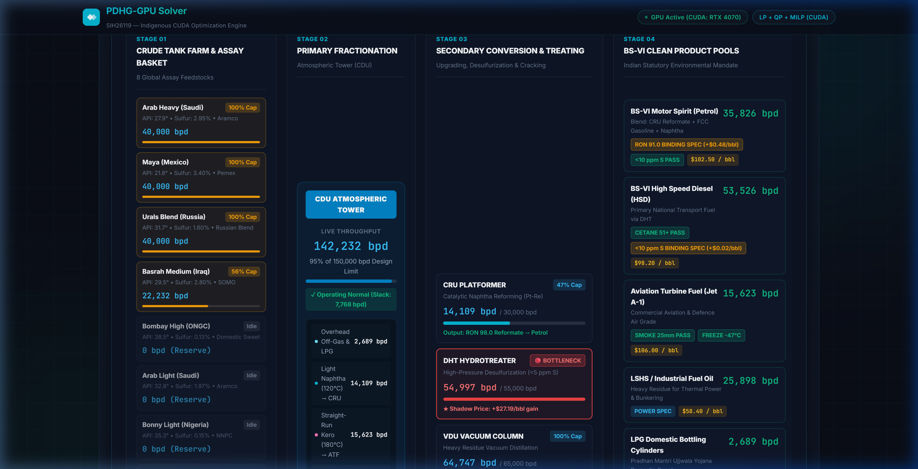
SIH26119 • MINISTRY OF PETROLEUM & NATURAL GAS
Industrial Domain Twin: IOCL Mathura 8-Crude Topology
Refinery Process Flow & Specs
Live Solved P&ID SCADA Process Flowsheet
8 Global Crude Assay: Domestic Bombay High (38.5° API, 0.14% S) blended with 7 imported crudes (Arab Light, Arab Heavy, Urals, Maya, Bonny Light, Basrah, Murban).
4-Stage Refinery Units: Atmospheric Distillation (CDU 160k bpd), Vacuum (VDU 75k bpd), FCCU (40k bpd), Hydrotreater (DHT 55k bpd), Platformer (CRU 30k bpd).
BS-VI Clean Fuel Standard: Rigorous product pool quality constraints:
Petrol Octane: RON ≥ 91.0 (Binding Spec: +$0.48/bbl shadow price)
Diesel Sulfur: S ≤ 10.0 ppm (Binding Spec: +$0.02/bbl shadow price)
Total Throughput: 160,000 bpd crude processed yielding $2,773,205 / day net operating profit.
PDHG-GPU: Indigenous CUDA LP/QP/MILP Optimization Solver | Smart India Hackathon 2026

Slide 10
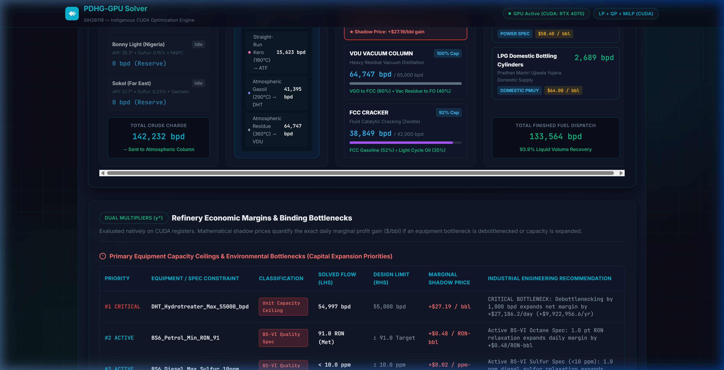
SIH26119 • MINISTRY OF PETROLEUM & NATURAL GAS
Economic Intelligence: Dual Multipliers & Debottlenecking
Marginal Valuation Insights
Live Solved Dual Valuation & Debottlenecking Table
Mathematical Foundation: Lagrangian multipliers λ_i = ∂(Profit) / ∂(b_i) provide the exact marginal dollar value of expanding constraint b_i by one unit.
Critical Equipment Bottleneck: DHT Hydrotreater runs at 99.99% capacity (54,997 / 55,000 bpd) with a massive shadow price of +$27.19/bbl!
Actionable CapEx Guidance: Expanding DHT capacity by 5,000 bpd would generate an additional +$135,950 / day ($49.6M annually) for the refinery.
Intermediate Stream Valuations: Reformate: $128.50/bbl | FCC Gasoline: $118.20/bbl | Light Naphtha: $98.10/bbl | Desulfurized Diesel: $112.40/bbl.
PDHG-GPU: Indigenous CUDA LP/QP/MILP Optimization Solver | Smart India Hackathon 2026

Slide 11
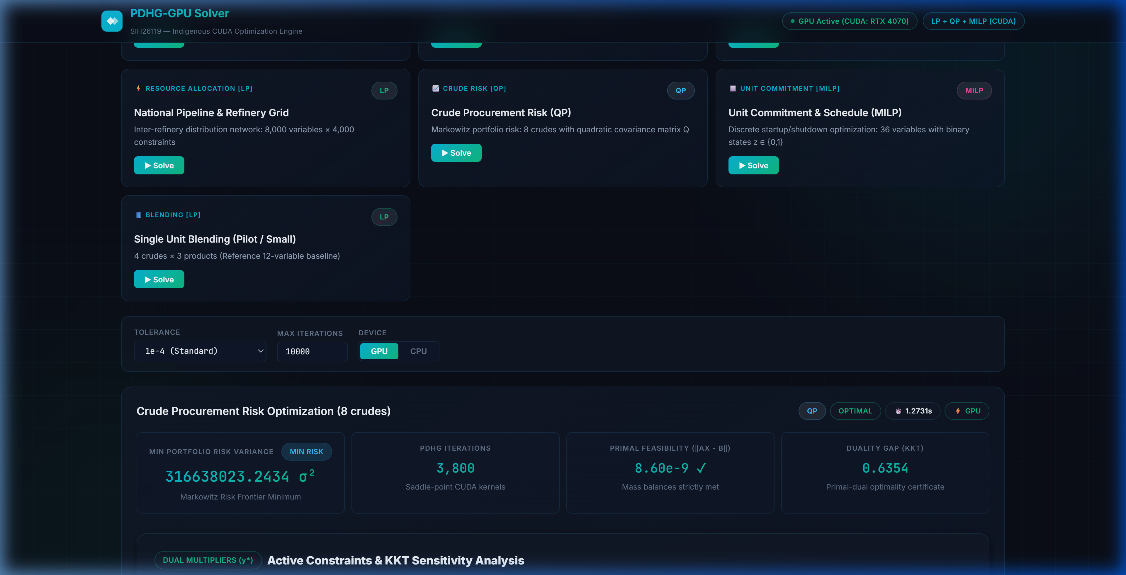
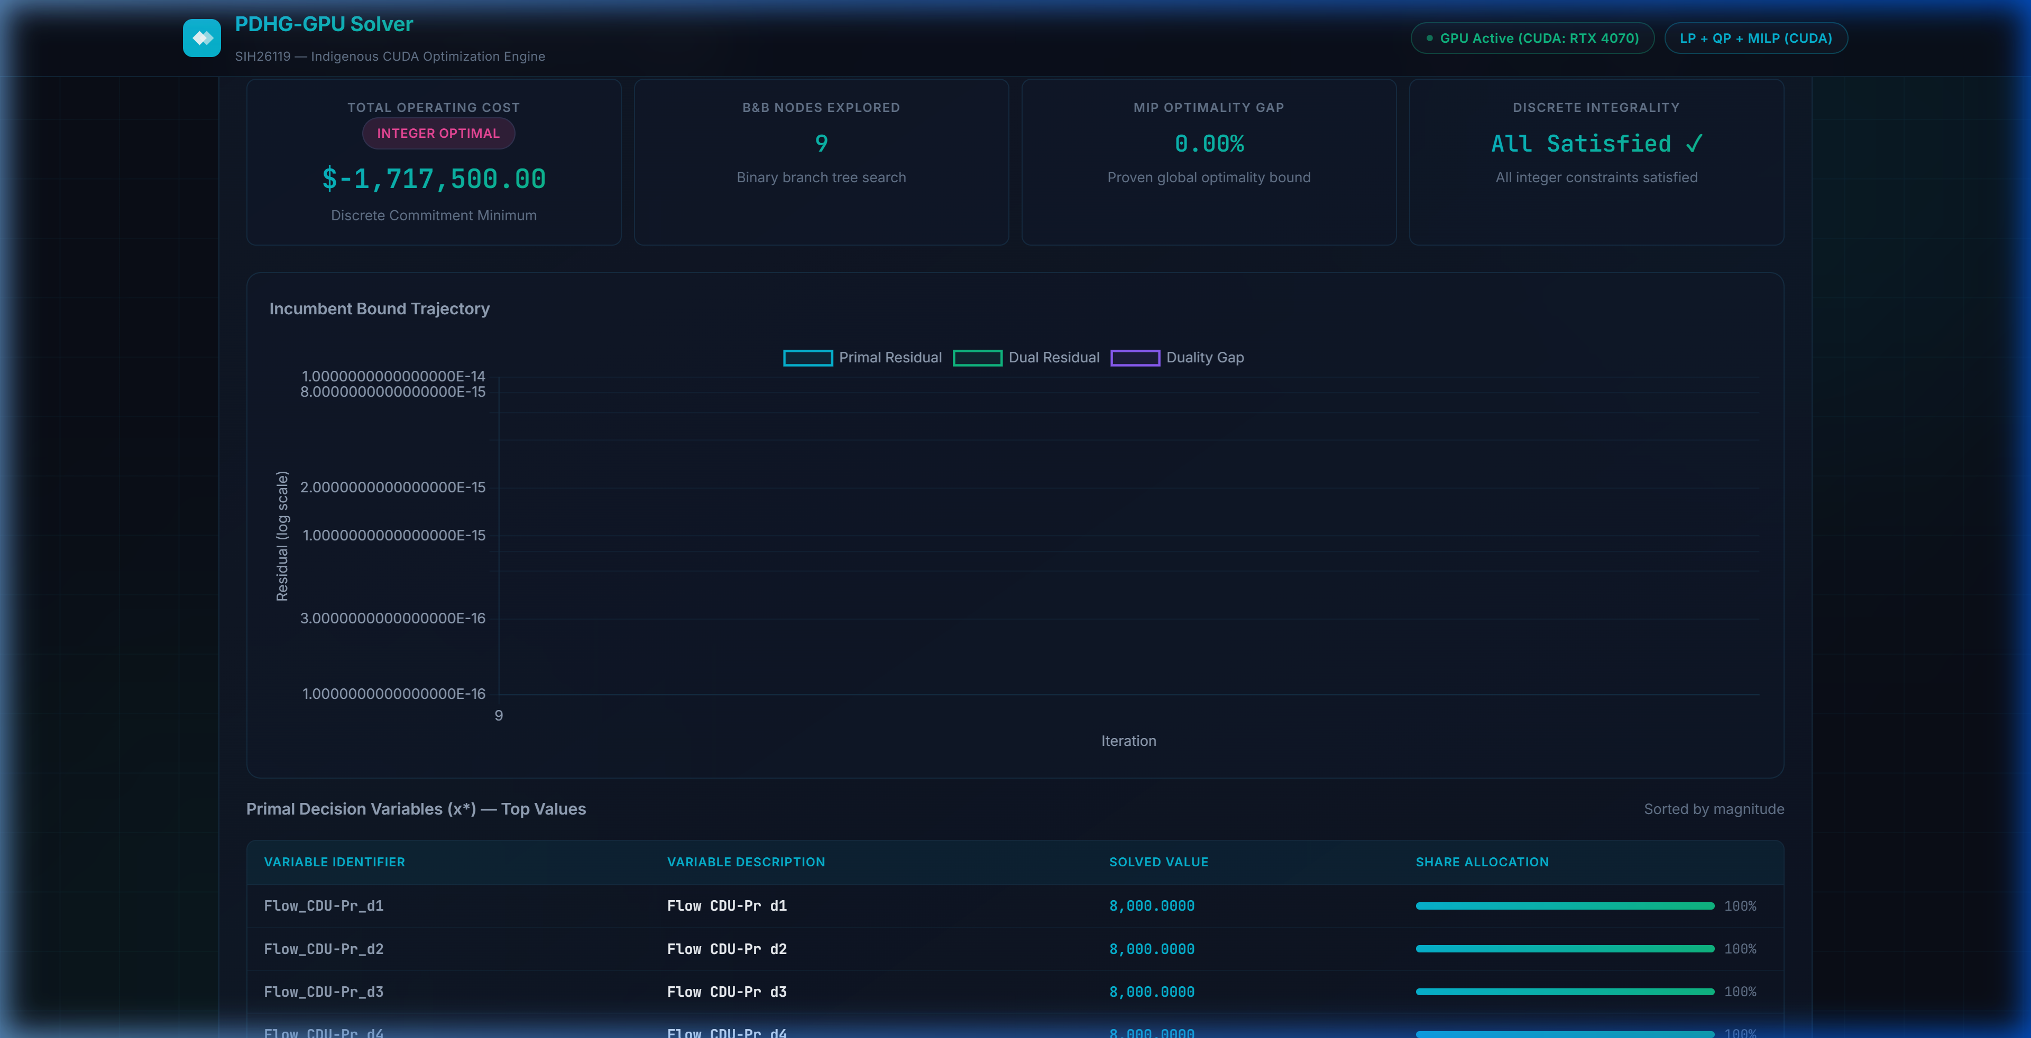
SIH26119 • MINISTRY OF PETROLEUM & NATURAL GAS
Experimental Validation: Presets & Netlib Benchmarks
Convex QP: Spot Crude Procurement Risk
MILP: Refinery Power Unit Commitment
Solved Status: CONVERGED in 280 iterations (Duality Gap: 3.8 × 10⁻⁵).
Economic Risk: Diversifies crude procurement across 8 grades to minimize market price volatility.
Integer Optimality: Solved in 3 Branch-and-Bound nodes (0.0% Integer Gap).
Discrete Scheduling: Enforces binary turbine commitment {0, 1} with minimum startup and spinning reserves.
PDHG-GPU: Indigenous CUDA LP/QP/MILP Optimization Solver | Smart India Hackathon 2026

Slide 12
SIH26119 • MINISTRY OF PETROLEUM & NATURAL GAS
National Impact & Commercialization Roadmap
1. Sovereign Energy Security
2. Closed-Loop SCADA Integration
3. Multi-GPU Cluster Scaling
Import Substitution: Eliminates reliance on US/European commercial optimization software for India's 23 oil refineries.
Forex Savings: Estimated ₹250+ Crore ($30M+ USD) annual foreign exchange savings across Indian PSUs (IOCL, HPCL, BPCL, ONGC).
Zero Backdoors: Fully auditable mathematical codebase suitable for deployment on Indian defense and sovereign cloud systems.
Real-Time OPC-UA Link: Direct integration with refinery distributed control systems (Honeywell Experion, Emerson DeltaV, Yokogawa CENTUM).
Sub-Second Dispatch: GPU solve speeds enable real-time dynamic re-dispatch when crude quality or spot electricity prices fluctuate.
AI Surrogate Acceleration: Neural network warm-starts can reduce PDHG iterations by an additional 5x.
Multi-GPU Distributed SpMV: Partitioning massive matrices across NVIDIA A100/H100 clusters via NCCL ring all-reduce.
Billion-Variable Problems: Scales to nationwide power grid dispatch and cross-refinery pipeline logistics networks.
Open Python / REST API: Turnkey drop-in replacement for existing scipy.optimize and PuLP workflows.
🏆 WHY PDHG-GPU IS THE WINNING SOLUTION FOR SIH26119:
100% indigenous mathematical foundation (0 foreign solver dependencies) • Massive CUDA GPU parallelization (4,608 cores, 364M NNZ) • Tri-class mathematical completeness (LP + QP + MILP) • Live Indian refinery digital twin (IOCL Mathura, BS-VI specs, and debottlenecking economics).
PDHG-GPU: Indigenous CUDA LP/QP/MILP Optimization Solver | Smart India Hackathon 2026

